Slide 1




Marketing Planning 312
Chapter 3 Part 1
MaRketing analysis overview
By Ajarn Suwalya K.

Slide 2
Chapter 3
Collecting and Analyzing Marketing Information

Slide 3
Chapter Outline
Introduction
Conducting a situation analysis
The internal environment
The customer environment
The external environment
Collecting marketing data and information

Slide 4

Issues to Be Considered in a Situation Analysis
The internal environment
  Review of current objectives, strategy, and performance
  Availability of resources
  Organizational culture and structure

Slide 5

Issues to Be Considered in a Situation Analysis (Continued 1)
The customer environment
  Who are our current and potential customers?
  What do customers do with our products?
  When do customers select our products?
  Why (and how) do customers select our products?
  Why do potential customers not purchase our products?

Slide 6

Issues to Be Considered in a Situation Analysis (Continued 2)
The external environment
  Competition
  Economic growth and stability
  Political trends
  Legal and regulatory issues
  Technological advancements

Slide 7
Conducting a Situation Analysis
Analysis alone is not a solution
  Should be combined with intuition and judgement to yield useful results for planning
Data is not the same as information
  Data - Collection of numbers or facts that have the potential to provide information
  Information - Data transformed or combined with other data in a manner that makes them useful to decision makers

Slide 8
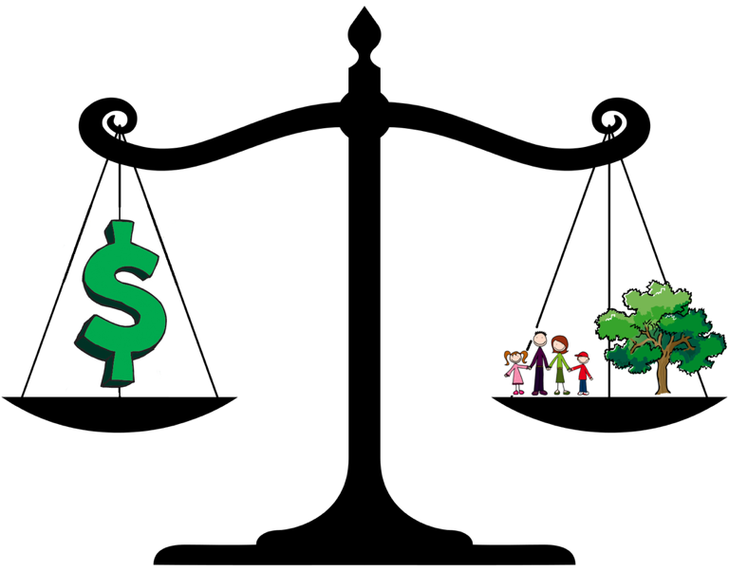
Conducting a Situation Analysis (Continued 1)
Benefits of analysis must outweigh costs
  Value of analysis depends on the quality of resulting marketing plans
  Cost of acquiring data is easily determined
  Benefit of improved decision is harder to estimate

Slide 9

Conducting a Situation Analysis (Continued 2)
Conducting a situation analysis is a challenging exercise
  Analysis should be organized, systematic, supported by sufficient resources, and an ongoing effort
  It is necessary to simultaneously track internal, customer, and external environments

Slide 10
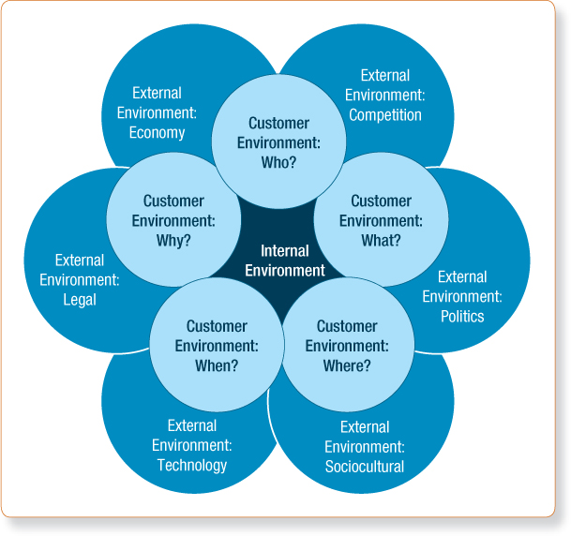
Exhibit 3.2 -The Relationship Among the Internal, Customer, and External Environments

Slide 11
Analyzing the Internal Environment
Involves a review of:
  Current marketing objectives, strategy, and performance
    Consistency of marketing goals with corporate goals
    Reasons behind improving or declining performance
  Current and anticipated organizational resources
    Current state of organizational resources
    Measures required to use resources more effectively

Slide 12

Analyzing the Internal Environment (Continued)
  Current and anticipated cultural and structural issues
    Positive and negative aspects of current and anticipated organizational structure
    Internal politics or management challenges that may affect marketing activities

Slide 13
Analyzing the Customer Environment
Involves examining:
  Firm's current and potential customers
  Prevailing needs of current and potential customers
  Basic features of the firm’s and competitor’s products that meets customers’ needs
  Anticipated changes in customer-needs
Analysis method
  5W model - Who, what, where, when, and why

Slide 14
Exhibit 3.2 -The Relationship Among the Internal, Customer, and External Environments

Slide 15
Discussion Question 1
Discussion Questions
Choose a specific product that you use on a daily basis (such as food items, toiletries, or your car) and apply the 5W model to yourself. Assume your responses are similar to millions of other consumers. Given this profile, how would you approach the marketing strategy for this particular product?

Slide 16

Analyzing the External Environment
Involves examining:
  Competitors
  Economic growth and stability
  Political trends
  Legal and regulatory issues
  Technological advancements

Slide 17
Basic Types of Competition
Brand competitors
  Market products with similar features and benefits to the same customers at similar prices
Product competitors
  Compete in the same product class, but with products that are different in features, benefits, and price
Generic competitors
  Market very different products that solve the same problem or satisfy the same basic customer need
Total budget competitors
  Compete for the limited financial resources of the same customers

Slide 18
Discussion Question 2
Discussion Questions
Consider the last purchase you made (maybe it was lunch or a soft drink). List all the brands, products, generics, and total budget competitors for that product. In a general sense, what would it take for you to switch to another type of competitor? Would any situation encourage you to switch to a generic competitor? When would total budget competitors become more relevant to your decision-making process?

Slide 19
Stages of Competitive Analysis
Identification
  Identify all current and potential competitors
Characteristics
  Assess key competitors’ size, strategy, profitability, and target markets
Assessment
  Assess key competitors’ strengths and weaknesses
Capabilities
  Focus the analysis on competitors’ marketing capabilities
Response
  Estimate competitors’ most likely strategies and responses under different environmental situations

Slide 20
Economic Growth and Stability
Economic change is inevitable and has a profound impact on marketing strategy
General economic conditions
  Inflation, employment and income levels, interest rates, taxes, trade restrictions, tariffs, and changes in the business cycle
Consumer issues
  Willingness to spend, confidence, and spending patterns

Slide 21

Economic Growth and Stability (Continued)
Underreported nature of the U.S. economy
  Shift from tangible- to intangible-dominant society
  Innovation, creativity, and human assets are not counted in yearly GDP statistics

Slide 22
Political, Legal, and Regulatory Issues
Views of elected officials can affect marketing strategy
  Some firms publicly protest legislative actions while others are more discreet
  Examples - Anti-tobacco trend and status of illegal immigration
Firms must abide by the law, but many laws are vague and difficult to enforce
  Examples - Court decisions, corporate governance, and trade agreements

Slide 23
Technological Advancements
Frontstage technology
  Advances that are most noticeable to customers
  Examples - Smartphones, GPS, and microwave ovens
Backstage technology
  Advantages that are not noticeable to customers
  Improves efficiency and effectiveness of marketing activities
  Examples - Computer technology, RFID, and near-field communication

Slide 24

Sociocultural Factors
Social and cultural influences that cause changes in attitudes, beliefs, norms, customs, and lifestyles
Help determine what, where, how, and when purchases are made
Sociocultural trends
  Change in demographics
  Change in customer values

Slide 25
Trends in the U.S. Sociocultural Environment
Demographic trends
  Decline in the teen population
  Increasing number of single-parent families
Lifestyle trends
  Increase in the number of American citizens postponing retirement
  Increase in vacationing at home (staycation)
Value trends
  Growing disconnect with government

Slide 26
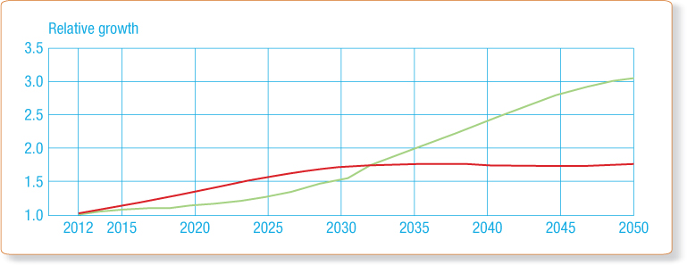
Exhibit 3.8 - Relative Growth in the Number of Older Americans: 2012-2050
Source: Jennifer M. Ortman, Victoria A. Velkoff, and Howard Hogan, “An Aging Nation: The Older Population in the United States,” Current Population Reports. May 2014 (Washington, DC: U. S. Census Bureau), p. 8.

Slide 27
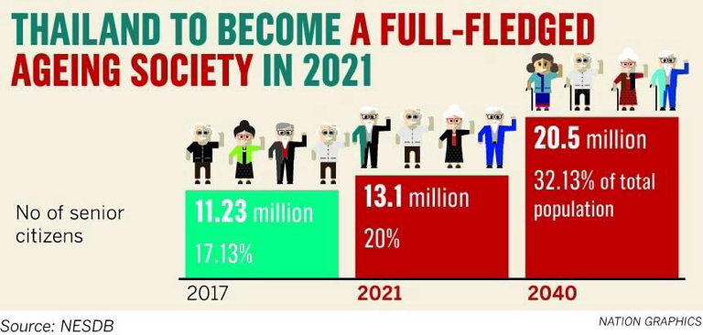

Slide 28
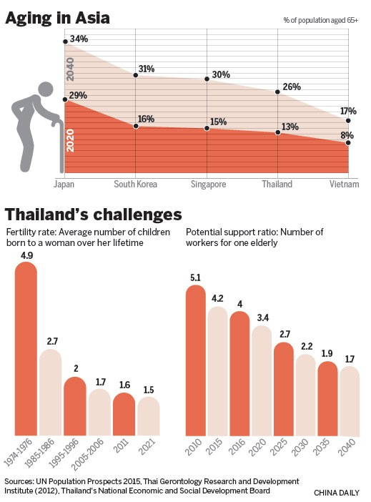

Slide 29

Corporate Affairs
Collection of strategic activities that are aimed at marketing a firm, its issues, and its ideals to stakeholders
Key corporate affairs strategic activities
  Corporate communication
  Government relations
  Investor relations
  Corporate philanthropy
  Corporate sustainability

Slide 30

Collecting Marketing Data and Information
Secondary information sources
  Internal data sources
  Government sources
  Book and periodical sources
  Commercial data sources
Primary data collection
  Direct observation, focus groups, surveys, and experiments

Slide 31
Problems in Data Collection
Incomplete or inaccurate assessment of the situation that the data should address
Severe information overload
Time and expense of collecting environmental data
Organizing vast amount of data and information collected during the situation analysis

Slide 32


