Slide 1
Introduction to Thai Economy:
The Dutch Disease
Joko Leliveld

Slide 2
The Netherlands
1960s- Discovery of large natural gas deposits in the North Sea
Subsequent shift in resources and decline in manufacturing sector
Export of natural gas let to appreciation of currency
Other exports less competitive and exports decreased

Slide 3
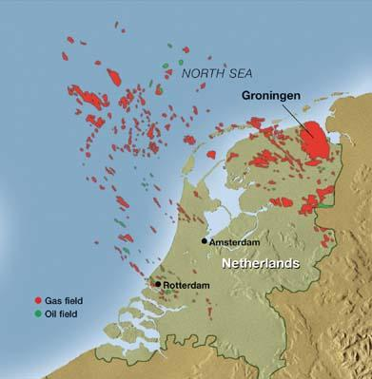
The Dutch kept interest rates low to stop the guilder from appreciating to fast
Investment rushed out of the
country
Crimping future economic
potential

Slide 4
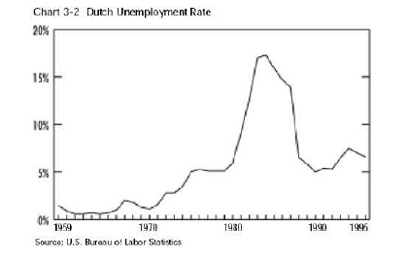
“Crowding out” of manufacturing led to lost jobs
Creation of “safety net” social programs resulted in high levels of unemployment

Slide 5
Definition
The Dutch Disease is the deindustrialization of a nation’s economy that occurs when the discovery of a natural resource raises the value of that nation’s currency making manufactured goods less competitive with other nations, increasing imports and decreasing exports.

Slide 6
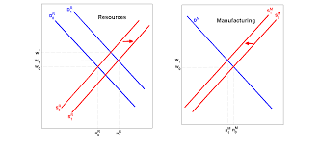
The negative consequences arising from large increases in the value of a country’s currency
The apparent causal relationship between the increase in the economic development of a specific sector and a decline in other sectors

Slide 7
Effects
A decrease in the price competitiveness for exports of the affected country’s manufactured goods
An increase in the quantity of imports
Non- resource industries are hurt by the increase in wealth generated by resource-based industries

Slide 8
Example
1970s Great Britain
Price of oil quadrupled, drill for North Sea Oil
Britain net exporter of oil
Fell into recession because workers demanded higher wages

Slide 9
https://www.youtube.com/watch?v=4z79ZoOrmKw

