Slide 1
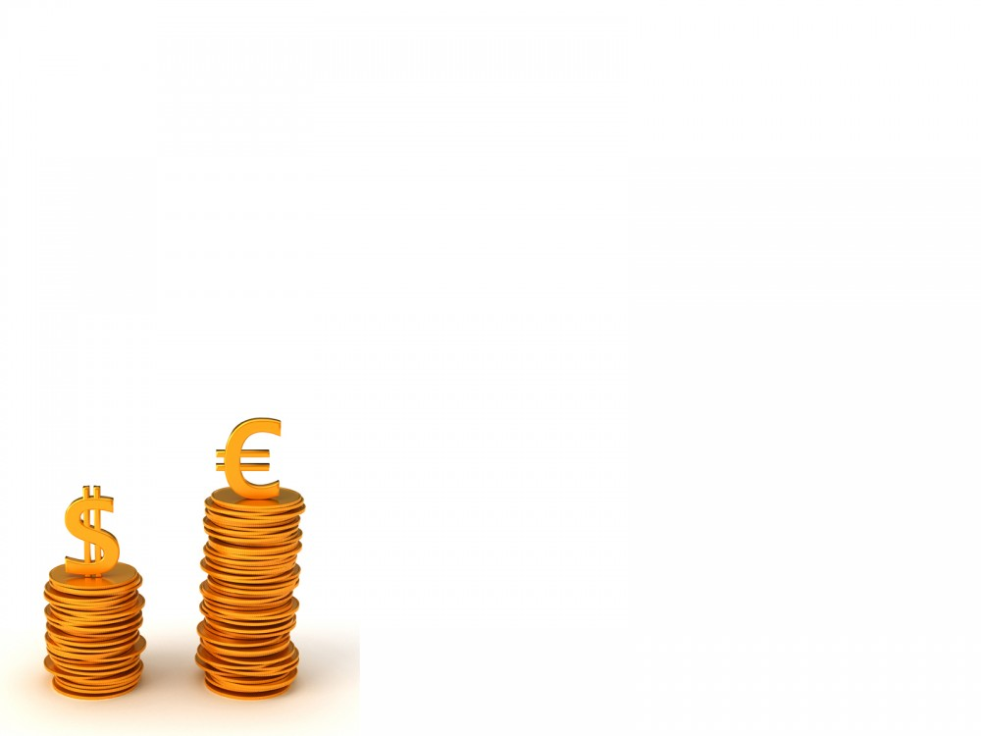

Billionaire
Members
Teekatas Sivakua 5402641442
Chayanee Toungchareontip 5404640145
Ekasit Kunadirekwong 5404640251
Siwakorn Paiboonrattanakorn 5404641101
Tassamon Bessuwat 5404641291

Slide 2
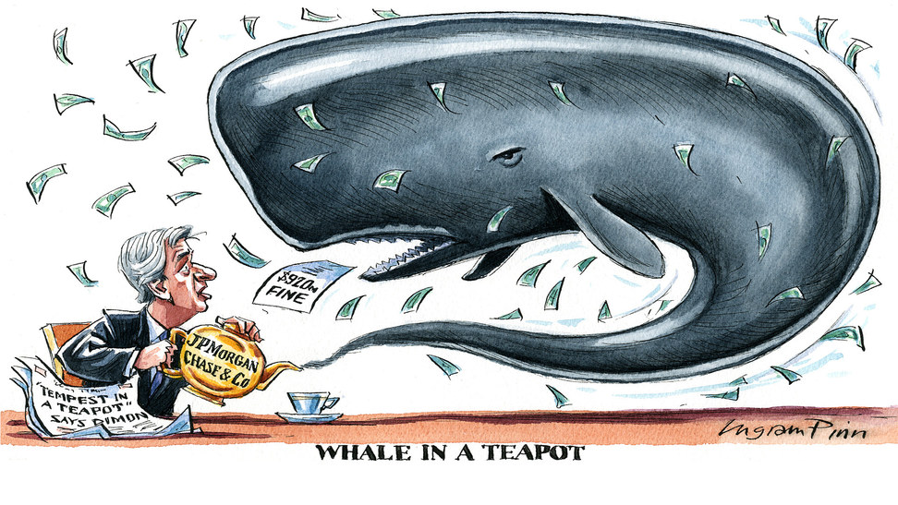
London Whale

Slide 3
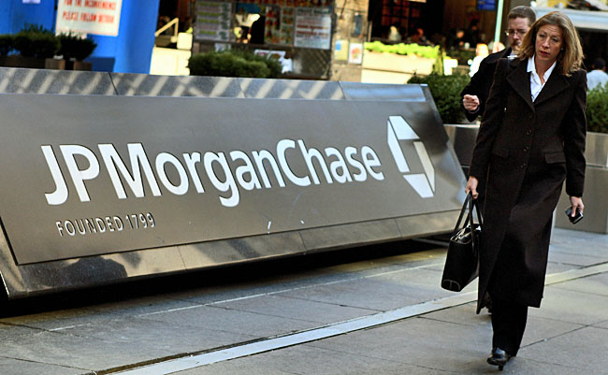

JPMorgan
Notes:
JPMorgan is a global financial services firm and one of the largest banking institutions in the United States
Its businesses include financial services for consumers and small businesses.

Slide 4
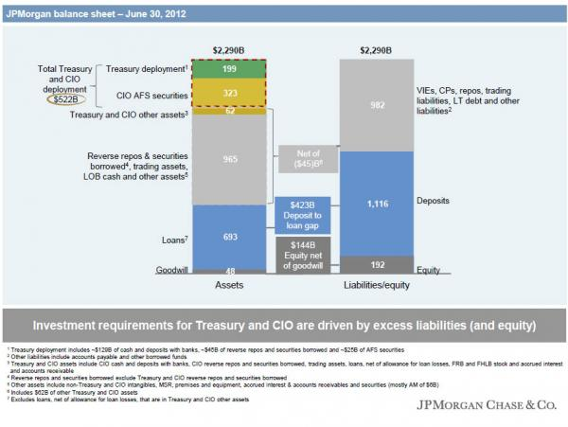
JPMorgan
Notes:
JPMorgan’s businesses take in more in deposits than they make in loans and, as a result, the Firm has excess cash that must be invested to meet future liquidity needs and provide a reasonable return. Which it is a CIO task to manage this amount of asset
Since investments in the asset basically can be seen as a “long” position on that particular asset.
In the unforeseen event, the bank may face losses when those assets gone bad.
CIO invests the bulk of JPMorgan’s excess cash in high credit quality, fixed-income securities (Bonds) and asset-backed securities (Mortgage-back Security)

Slide 5
The role of Chief Investment Office
CIO then initiate the synthetic credit portfolio. Which are the CDO that invest in CDS and other derivatives.
The Synthetic Credit Portfolio provide the exposure that is in the short position which meet the hedging intention to the CIO portfolio.
Notes:
The intention is to hedge against the “long” position of the firm’s portfolio

Slide 6
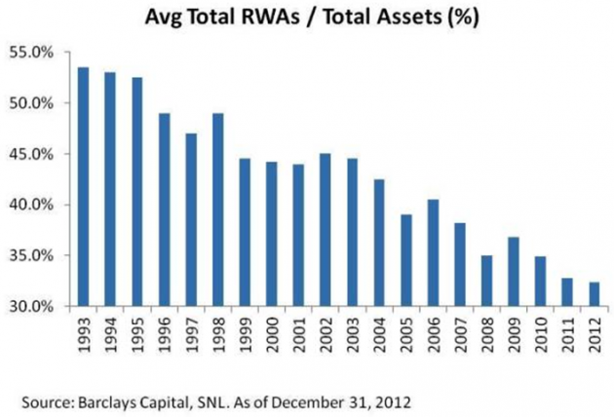

Effect of Preparation of Basel III
Since the CIO portfolio present huge amount of derivatives which contribute to the RWA of overall firm RWA.

Slide 7
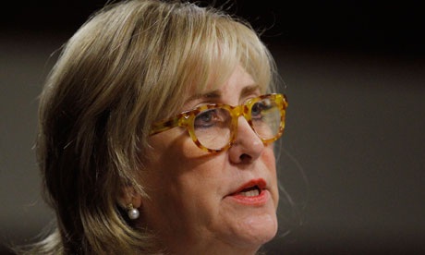
Chief Investment Officer Ina Drew
“She has direct the traders to reduce the portfolio to reduce RWA.
Thus, she tell the traders to “Do the adjustment of portfolio”.
Notes:
The senior management inform CIO to reduce the sizes of portfolio to lessen the RWA accordance to Basel III.
And senior management being optimistic about the Europe economy, thus decided that credit protection is unnecessary.

Slide 8

The Adjustment
The trader ,Bruno Iksil (a.k.a. London Whale) has made the trade for adjustment on the Markit CDX North America Investment Grade Index series 9.

Slide 9
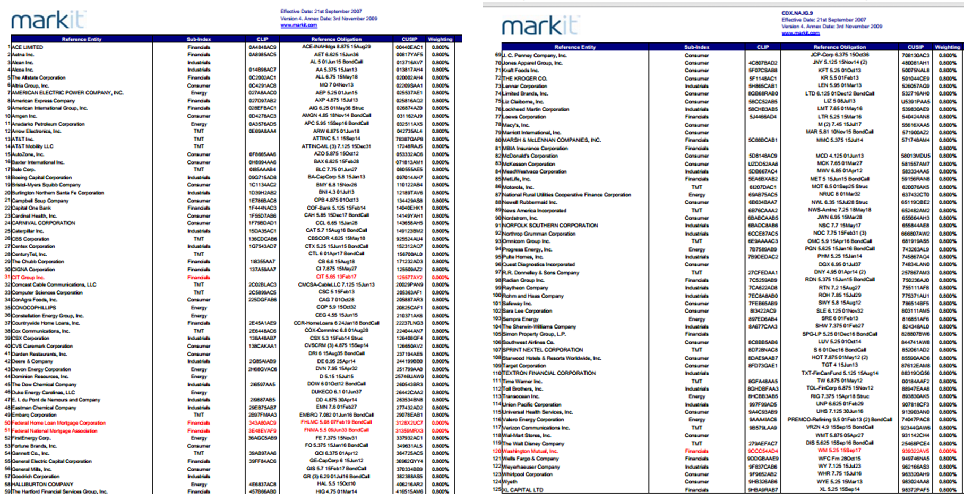
The Adjustment
Notes:
It’s simply an Credit Default Swap (CDS) index that tracks the corporate bonds of 125 high-quality companies in North America.

Slide 10
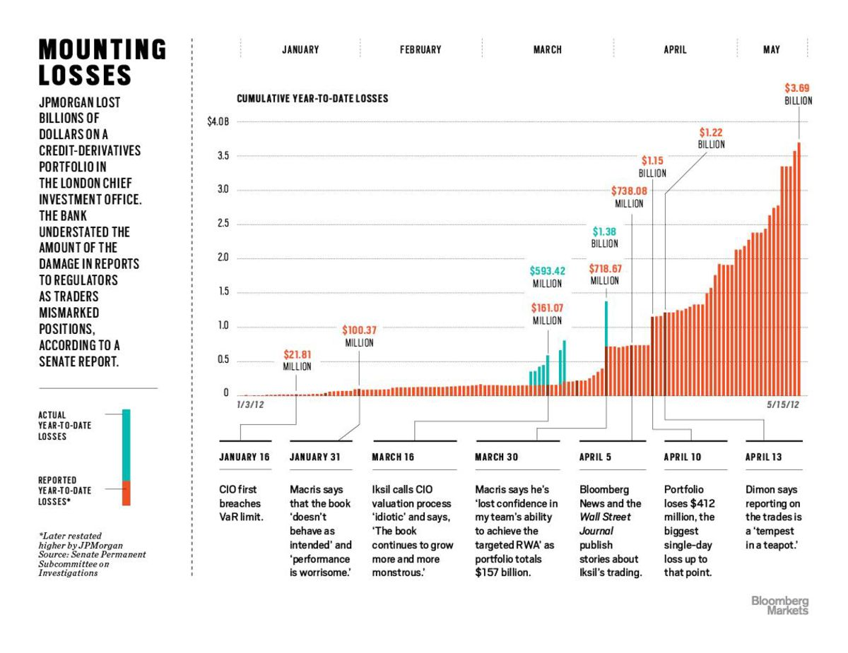
Outcome
Notes:
It turned out that Iksil was not reducing the size of portfolio but increasing it.

Slide 11
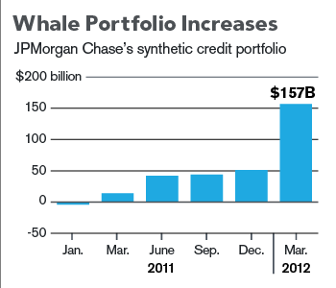
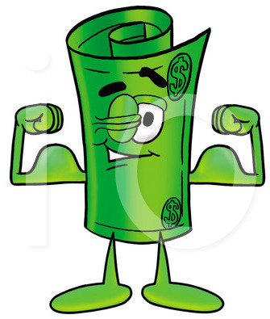

Sizes
SOURCE: JPMORGAN CHASE & CO.

Slide 12
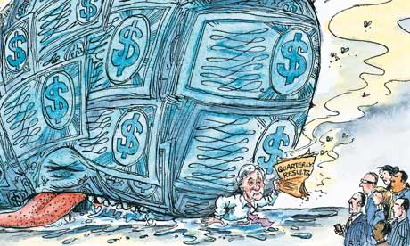
Outcome
CDO Port no longer has a short position but a long exposure.
NO longer hedging of a long position for original assets.
Notes:
1 He was shorting the CDS index to the extend that the
2 Thus result in

Slide 13
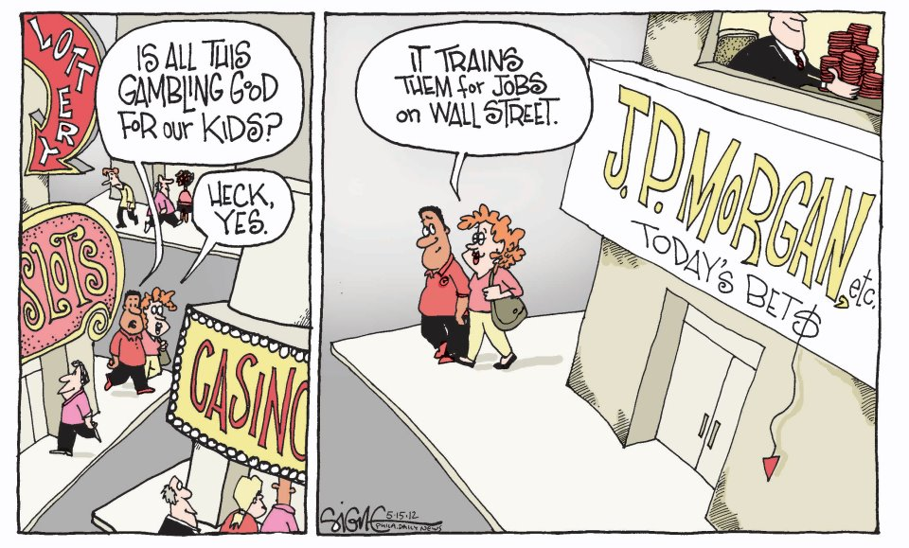
Outcome
And during that period the European Crisis is imminent and causes the market to go against JP Morgan bet.
At the end of 2012, lost are amount up to at least $6.2 billion

Slide 14
Identify Key Issues
The oversize positions have no longer doing the hedging purposes but became a speculative position.
To make the further worse, the top executives have done nothing in preventing or reducing the downside risk of the bet.
Notes:
1 The so call “hedging” position by the firm is out of reasonable proportion.

Slide 15
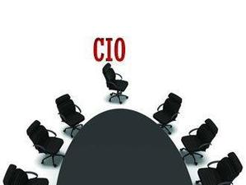
Origin of Problem
CIO’s judgment, execution and escalation of issues in the first quarter of 2012 were poor.
Firm did not ensure that the controls and oversight of CIO evolved commensurately with the increased complexity and risks of CIO’s activities.
Notes:
1. It maybe that of principle-agent problem that they may gain huge from the bet due to compensation.
2. As a result,
significant risk management weaknesses developed within CIO that allowed the traders to pursue
their flawed and risky trading strategies.
3. There were no
limits by size, asset type or risk factor specific to the Synthetic Credit Portfolio. There can arise concentration risk in certain asset.

Slide 16
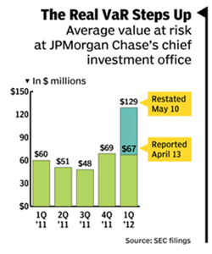
Origin of Problem
Risk limits applicable to CIO were not sufficiently specified.
4. Approval and implementation of CIO Synthetic Credit VaR Model were inadequate.

Slide 17
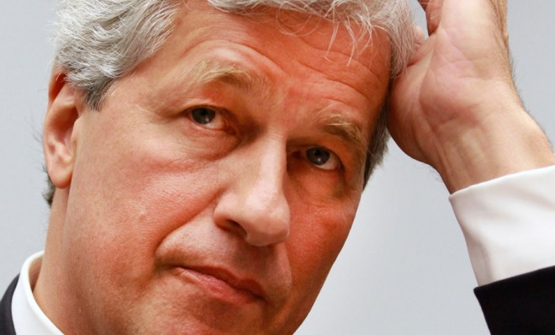
Ineffective Internal Control
Risk management department and the CEO Jamie Dimon, have been notified and acknowledge the position taken by his trader. But dismiss the notice by naming the situation as “tempest in a teapot.”
Notes:
It is clear that all financial institutions will have a risk management department to provide effective monitoring upon all transactions in the bank. Which in this London whale case, Risk department will surely noticed about the huge position taken by the trader and notify the top executives.
“tempest in a teapot.”
Which mean a small event that has been exaggerated out of proportion. And let the situation continue and result in huge loss.

Slide 18
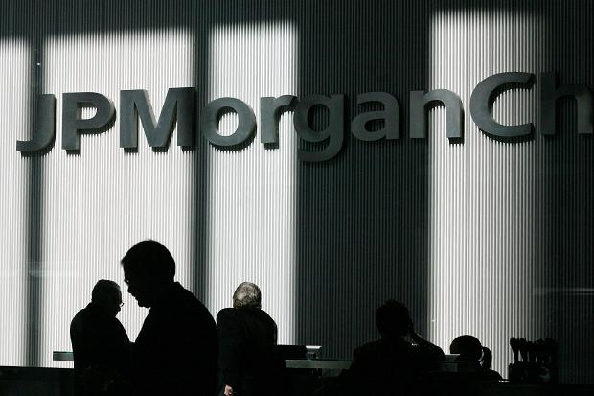
What have been done so far?
After the trade had been settled, the loss to JP Morgan is amounted to more than 8 billion us dollar.

Slide 19
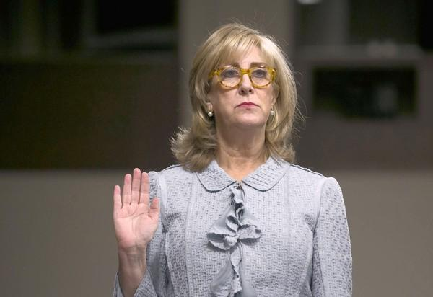
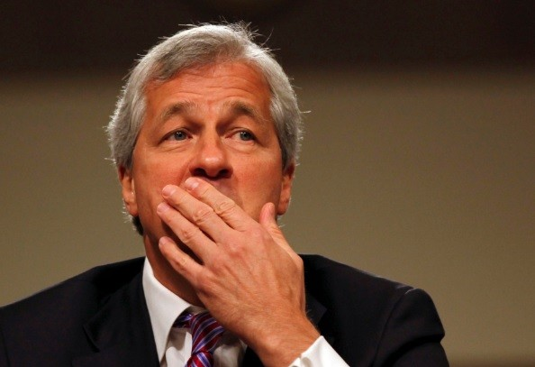
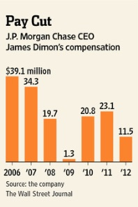
What have been done so far?
On Key Figures
Bruno Ilksil has been set free and not prosecuted
CIO Ina Drew resign in May 2012 after the loss been publicized.
CEO Jamie Dimon got salary cut of 50% in 2012.
Notes:
1due to cooperation in investigation, even though he is the main player to set everything in motion.

Slide 20
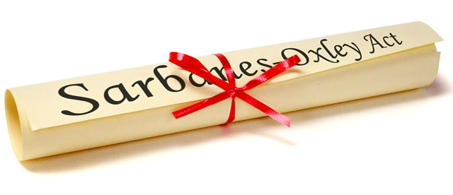
What have been done so far?
On the Company
JP Morgan has violate Sarbanes-Oxley Act
“Section 404: A requirement that management and auditors establish internal controls and reporting methods on the adequacy of those controls.”
The result of such dubious action by the bank in speculating huge position have been seen as a violation to many regulations by many regulator such as SEC.
Notes:
CIO , Ina Drew has misstated the financial result of 1st quarter. And JP Morgan need to republish the numbers. Causing lost in confidence of investors.

Slide 21
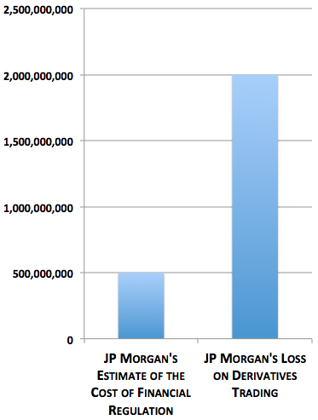
JP Morgan Response
JP Morgan has accepted that their action is reckless
and strategy is flawed. So, they has settled many
allegations with various regulator with huge fines
which amount to more than 1 billion us dollar.
Notes:
Graph: JP Morgan's $2 Billion Loss Was 4X the Alleged Cost of Financial Regulation

Slide 22
Recommendations

Slide 23

Solution To Turnaround
Who is to save the situation ?
Board
Executive Management
Internal Audit
Accounting Firms
Rating Agencies
Regulators

Slide 24
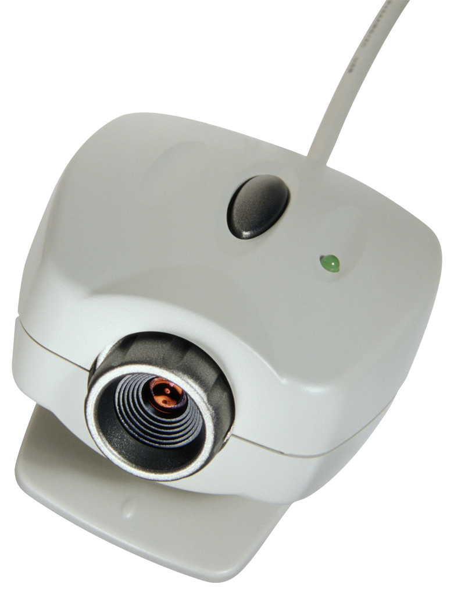
Solution To Turnaround
Increase effectiveness of Risk Management and Internal Control
First priority goes to public interest :
Those with responsibilities must act with ethics, consider long-term sustainable performance, and be transparent.
Segregations of duties :
The same person does NOT approve and do what ever he/she wishes under his/her own consideration.
Monitoring
Deficiencies, frauds, or scandal detected should be reported and corrective action must be taken.
Notes:
Increase effectiveness of Risk Management and Internal Control
First priority goes to public interest :
Those with responsibilities must act with ethics, consider long-term sustainable performance, and be transparent.
Segregations of duties :
So that the same person does NOT approve and do what ever he/she wishes under his/her own consideration.
Monitoring:
Deficiencies, frauds, or scandal detected should be reported and corrective action must be taken.
2424

Slide 25
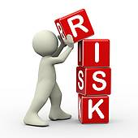
Solution To Turnaround
Effective Risk Assessment
Objectives at Strategic Level must be aligned with Risk Appetite
New model to evaluate risk that covers
all breaches
Notes:
Objectives at Strategic Level must be aligned with Risk Appetite amount of risk it’s willing to accept
New model (other than VaR) to evaluate risk that covers all breaches Assess risks from 2 perspectives, Likelihood and Impact

Slide 26
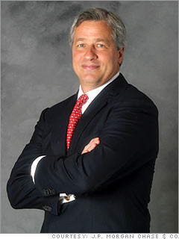
Solution To Turnaround
Remove Conflict of Interest
Such example , James "Jamie" Dimon are
currently held position as both CEO and Chairman
for Board of Director. This may cause complications
for compliances and internal controls to work.
Notes:
Implement Volcker Rule early
So that banks are prohibited from conducting certain investment activities with their excess cash from deposits and from making certain types of speculative investment like in this JPMorgan’s bet case.
2626

Slide 27
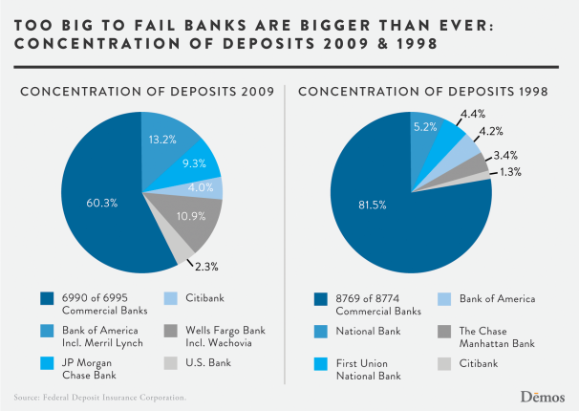
Solution To Turnaround
Separate Business Unit
Separate Depository Unit from
Investing unit to prevent “Too big to fail”
when firm accumulate loss. And
prevent depositor to conduct bank run.

Slide 28
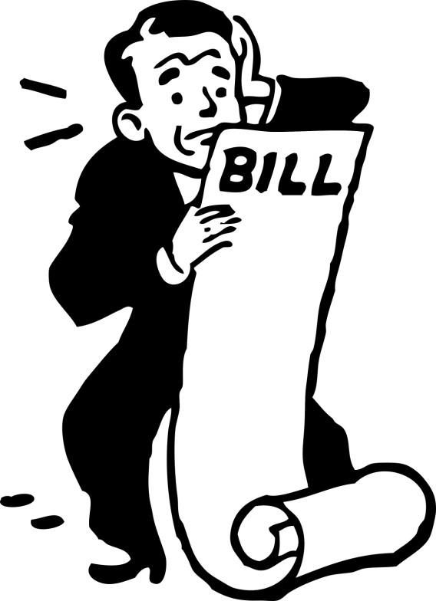
Solution To Turnaround
Specify the Risk Limits
Specify the limitation of size, type , complexity of the assets to limit risks.
Notes:
Specify the risk limits
Specified the limitation of size, type , complexity of the assets to limit risks.

Slide 29
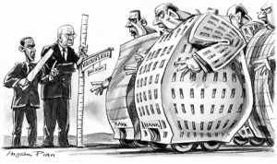
Solution To Turnaround
Impose Severe Penalty
Wrong doer need to be severe punish and be made examples. So, this kind of incident will not happen again. (Not just resign, or fine)
Notes:
Wrong doer need to be severe punish and be made examples. So, this kind of incident will not happen again. (Not just resign, or fine)

Slide 30
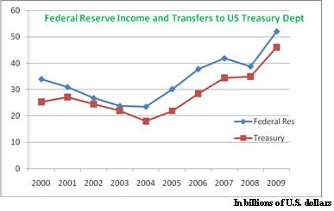
Solution To Turnaround
Implement Volcker Rule earlier
Banks are prohibited from conducting certain investment activities with their excess cash from deposits and from making certain types of speculative investment.
Notes:
Implement Volcker Rule early
So that banks are prohibited from conducting certain investment activities with their excess cash from deposits and from making certain types of speculative investment like in this JPMorgan’s bet case.
3030

Slide 31
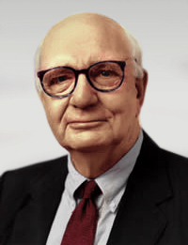
Volcker Rule Implementation
Volcker Rule disallows short-term proprietary trading of securities, derivatives, for banks’ own accounts under the circumstances that these activities do not benefit banks’ customers.
This proposed by Paul Volcker, American economist and former United States Federal Reserve Chairman.

Slide 32
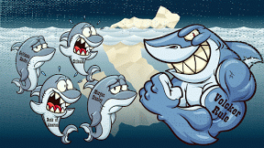
Volcker Rule Delayed
Volcker Rule was meant to be implemented during 2012,
but was delay due to Central Bank and other regulators.
Approved on January 14, 2014.
Wall Street lobbyists are requesting for
deadline extension
Notes:
Volcker Rule was meant to be implemented during 2012,
but was delay due to Central Bank and other regulators
have suggested that they are not able to meet the deadline and will be extended.
It was finally being approved for implement on January 14, 2014.
But still Wall Street lobbyists are requesting for deadline extension

Slide 33
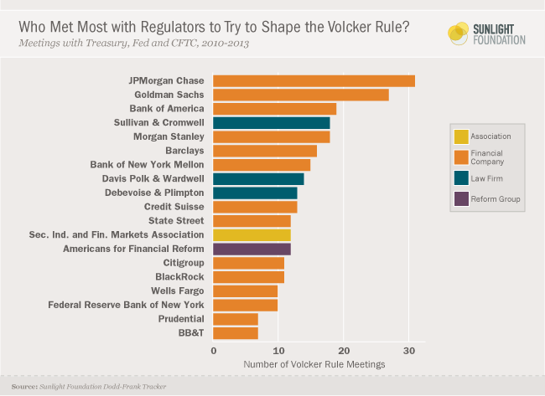
Volcker Rule

Slide 34
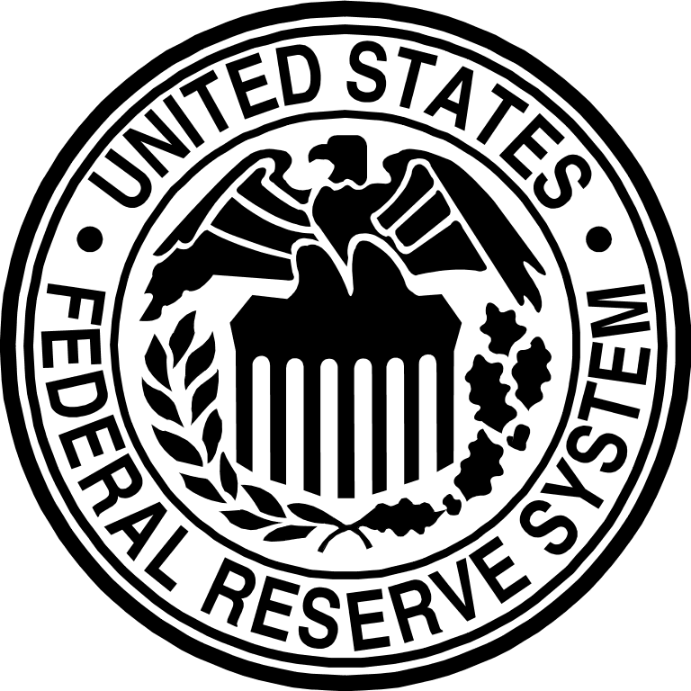

Solution To Turnaround
FED, as a regulator, could have examined
the situation to prevent this case from
happening.
They PLANNED to do
1. Review CIO’s proprietary trading activities
2. Examine governance framework
BUT NEVER DID
Notes:
FED only PLANNED to do, but never did.
Federal Reserve Inspector General Review
FED, as a regulator, could have examined the situation to prevent this.
They did Identifiy risks related to the CIO trading activities and did plan two examinations of the CIO including
Review of the CIO’s proprietary trading activities (2008)
Examination of the CIO’s governance framework (risk appetite, risk management practices) (2010)
FED, at that time, were not able to choose every bank to examine. It had to make a trade-off.
Why FED didn’t act ?
Lack of resources
Weak supervisory plan
Personnel shuffle
Each regulators, stand by in FN Institutes, should talk to each other (COORPORATION)
http://www.bloomberg.com/video/jpmorgan-s-london-whale-could-the-fed-have-prevented-it-HXWKbF1cRfi6F_dmWm0q5A.html
3434

Slide 35
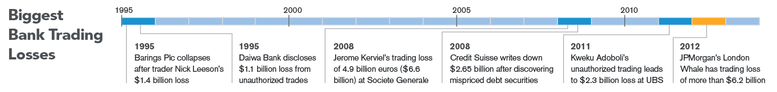

History repeating itself
History big trading losses
Capital and Leverage Requirements
Notes:
Because it seem in the past penalty is not severe enough for bankers to refrain from betting and violating regulation. They keep doing it again and again and again and again.
3535

Slide 36
“The world has enough for everyone's need, but not enough for everyone's greed.”
-Mahatma Gandhi

Slide 37

THANK YOU :)

