Slide 1

Overview of the Lao People’s Democratic Republic
(The Lao PDR)
By NESSARA SUKPANICH
nessara@econ.tu.ac.th

Slide 2
Lao PDR at a glance
Political system: Socialist republic
Head of state: Gen Choummali Saignasone
Prime minister: Bouasone Bouphavanh
Political Parties: Lao People’s Revolutionary Party or LPRP

Slide 3
Basic information of the Lao PDR (2013)
Population | 6.770 million
GDP | $11.14 billion
GDP growth | 8.1%
GNI per capita | $1,460
Inflation | 6.4%
Source: World Bank

Slide 4
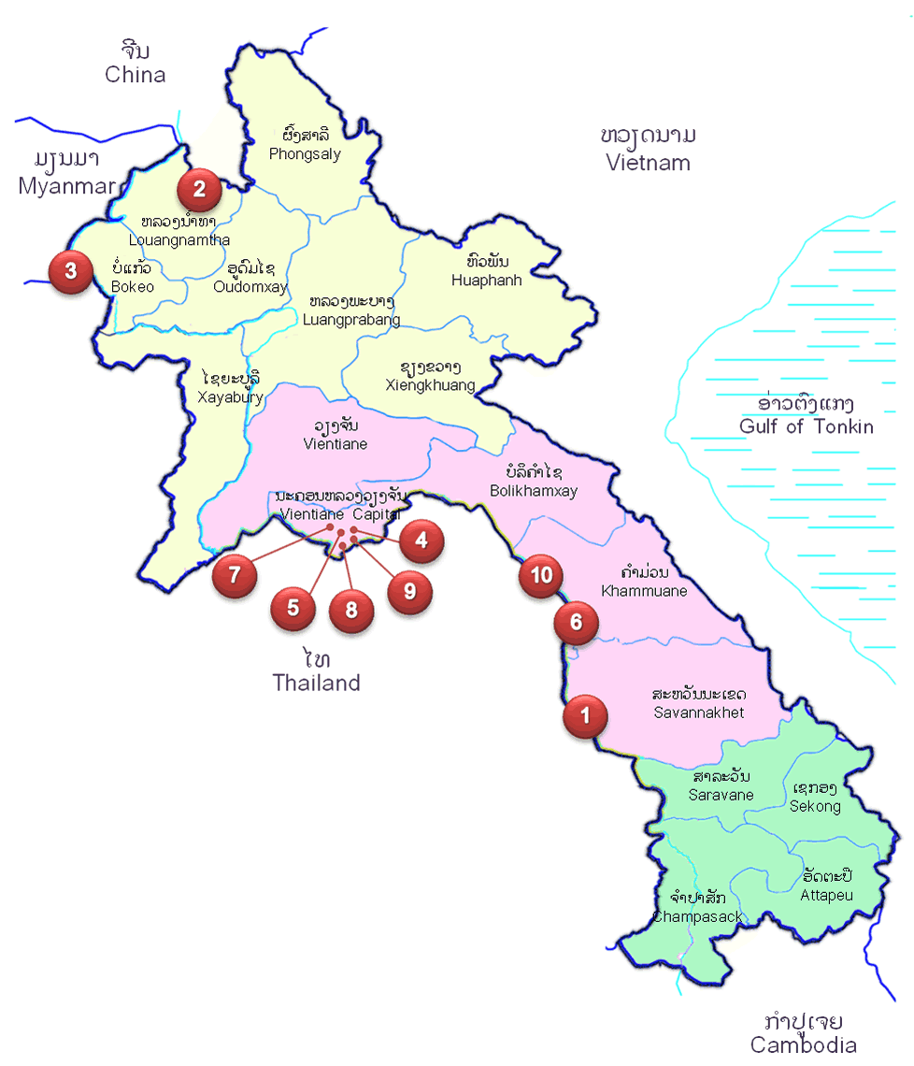
Geography
Administration
16 Provinces
1 Capital City
ที่มา: Ministry of Planning and Investment (Lao PDR)

Slide 5
A bit of History
14th century: Kingdom of Lan Xang (Land of a million elephants) --- King Fa Ngum
Late 18th century: Lan Xang Kingdom was divided into three principalities under Siamese rule
19th Century: Laos was incorporated into French Indochina and a brief Japanese occupation during World War II
1954: Laos gained full independence as a constitutional monarchy

Slide 6
A bit of history
1959: War between US and Vietnam spilled to Lao territory
1975: Lao monarchy ended with the foundation of the Lao PDR
1986: The ruling Lao People’s Revolutionary Party introduced comprehensive economic liberalization policies (New Economic Mechanism: NEM)
1997: Admission to ASEAN

Slide 7
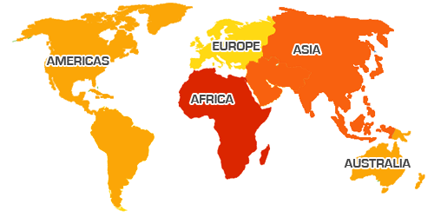
Unilateral Trade Agreements with 39 nations
Bilateral Investment Treaties with 27 nations
ที่มา: Ministry of Planning and Investment (Lao PDR)

Slide 8

Laos: Unique Development Path and Way Ahead
Non-natural resource,
Sustainable manufacturing
and service sector
Natural Resource and
Manufacturing sector
Agriculture sector
Source: Ministry of Planning and Investment (Lao PDR)

Slide 9
Lao PDR GDP Growth
GDP Growth | 2009 | 2010 | 2011 | 2012 | 2013
 | 7.5 | 8.5 | 8.0 | 8.2 | 8.1
Source: World Bank

Slide 10
Lao PDR Real GDP (2013), by industrial of origin
 | Billion Kips | (% of total)
GDP by industrial origin at 1990 | 2002 market prices | 39652.7 | 100
Agriculture | 10163.3 | 25.6
Mining | 2634.1 | 6.6
Manufacturing | 4021.5 | 10.1
Electricity, gas, and water | 1977.9 | 5.0
Construction | 2706.0 | 6.8
Trade | 7639.7 | 19.3
Transport and communications | 1944.1 | 4.9
Finance | 1480.2 | 3.7
Public administration^{b} | 1798.6 | 4.5
Others^{c} | 2363.8 | 6.0
Taxes on imports | 2923.7 | 7.4
Source: Asian Development Bank

Slide 11
Lao PDR export (2013), by country of destination
 | billion Kips | % of total
Exports, total | 3697.9 | 100
1. Thailand | 1231.0 | 33.3
2. China, People's Republic of | 927.9 | 25.1
3. Viet Nam | 425.7 | 11.5
4. United Kingdom | 71.6 | 1.9
5. Japan | 97.8 | 2.6
6. Germany | 83.4 | 2.3
7. India | 101.6 | 2.7
8. United States | 28.3 | 0.8
9. Netherlands | 45.4 | 1.2
10. Australia | 50.9 | 1.4
Source: Asian Development Bank

Slide 12
Lao PDR import (2013), by country of origin
 | billion Kips | % of total
Imports, total | 7,265 | 100
1. Thailand | 4,069 | 56.0
2. China, People's Republic of | 1,893 | 26.1
3. Viet Nam | 488 | 6.7
4. Korea, Republic of | 206 | 2.8
5. Japan | 134 | 1.8
6. Germany | 46 | 0.6
7. France | 15 | 0.2
8. Singapore | 29 | 0.4
9. Belgium | 32 | 0.4
10. Australia | 42 | 0.6
Source: Asian Development Bank

Slide 13
Infrastructure Development

Slide 14
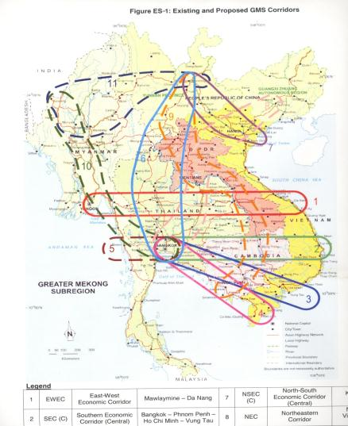
Regional Road Network
1 | East-West Economic Corridor ( EWEC) | Da Nang (VN) passing across Savannakhet (Laos) to Myanmar
2 | North-South Economic Corridor (West) NSEC(W) | Kunming-Bangkok Via Northern Lao PDR/Myanmar
3 | Northeastern Corridor( NEC) | Nanning-Hanoi (VN) Vientiane (Laos) -Bangkok/Laem Chabang
4 | North South Corridor via Laos to Cambodia | Kunming-Mohan-Luang Prabang-Vientiane-Pakse-Phnom Penh/ Sihanoukville
Source: Ministry of Planning and Investment (Lao PDR)

Slide 15
Regional Transportation Routes
Vientiane-Singapore | Total cost (US$)* | Distance (km) | Transit time (days)
Via Bangkok | 1,617 | 2,198 | 6-7
Via Danang | 2,150 | 2,801 | 9-10
Vientiane-Hongkong | Total cost (US$)* | Distance (km) | Transit time (days)
Via Bangkok | 2,006 | 3,398 | 8- 9
Via Danang | 2,150 | 1,330 | 7- 8
*Per one 20 foot container
Source: Development Reviews, July 2012
Source: Ministry of Planning and Investment (Lao PDR)

Slide 16
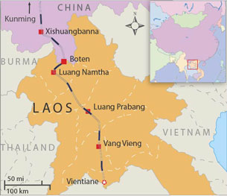
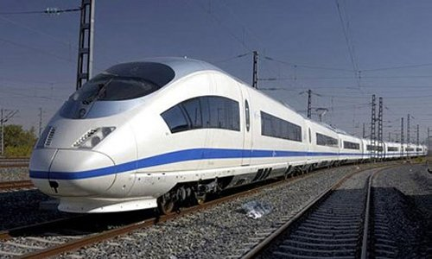
High Speed Railway
421km: connecting Southern China-Vientiane Capital (complete in 2018)
Source: Ministry of Planning and Investment (Lao PDR)

Slide 17
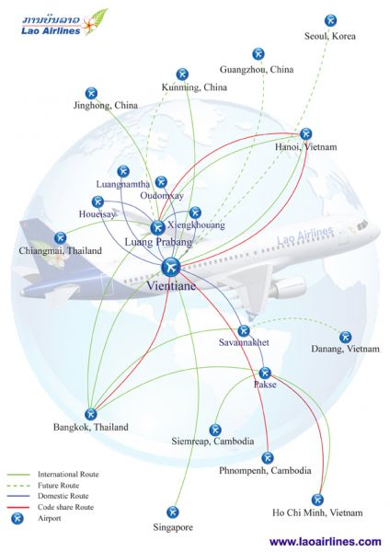






Direct flights to Asian major cities
ที่มา: Ministry of Planning and Investment (Lao PDR)

Slide 18
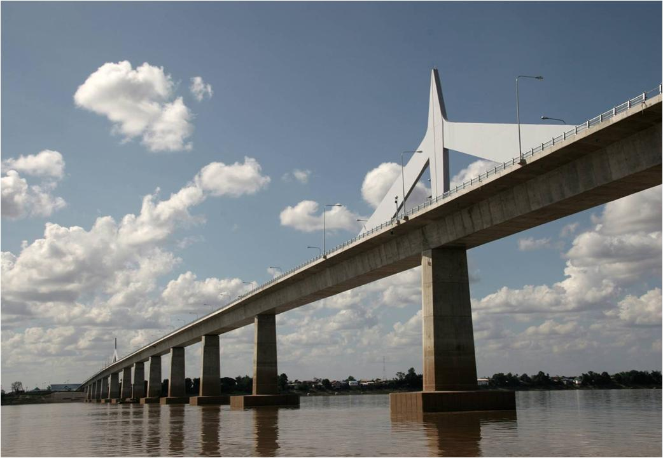

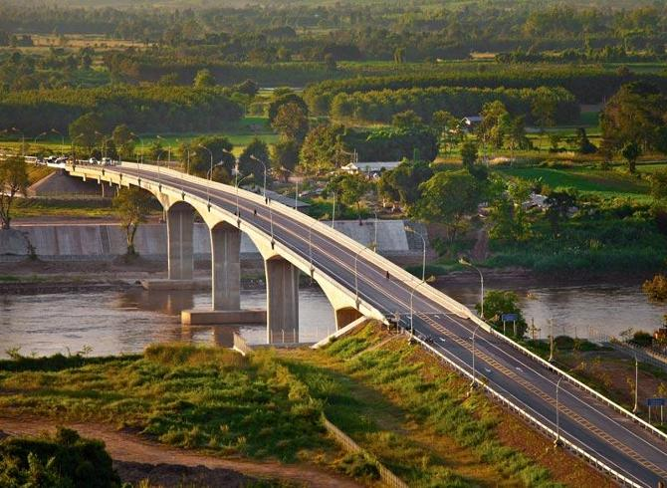

Thai-Lao Friendship Bridges
2nd: Mukdahan – Savannakhet (9 Jan 2007)
1st: Nong Khai – Viantiane (8 April 1994)
4th:Chiang Khong (Chiangrai)-Houayxay (Bokeo) (11 Dec 2013)
3rd: Nakhon Phanom - Khammouane (11 Nov 2011)

Slide 19
Thai-Lao Friendship Bridges
5th: Bueng Kan – Pak Sane (Bolikhamxay)
(not yet under construction)
6th: Na Tan (Ubon Ratchatani) – Lakhonepheng (Saravane)
(not yet under construction)

Slide 20
Labor Market

Slide 21
Labor Force)
YEAR | 2005 | 2010
LABOR FORCEª thousand; calendar year | 2,777 | 3,020
Employed | 2,739 | 2,023
Agriculture | 2,091 | 1,461
Industry | ... | 164
Services | ... | 399
Unemployed | 38 | ...
Unemployment rate, percent | 1.4 | 1.9
Labor force annual change, percent | ... | ...
Labor force participation rate percent | 66.6 | ...
Male | 66.8 | ...
Female | 66.3 | ...
Source: Asian Development Bank

Slide 22
One of the lowest labor cost in Asia
Source: http://www.nwpc.dole.gov.ph/p
ที่มา: Ministry of Planning and Investment (Lao PDR)

Slide 23
Capital Market

Slide 24
Lao Securities Exchange (LSX)
Officially opened: 10 October 2010
Start operation: January 2011
Listed companies when first operate
  Banque Pour Le Commerce Exterieur (BCEL)
  EDL Generation Public Company (EDL-GEN)
Currently more companies have been listed
  Lao World Public Company (LWPC)
  Petroleum Trading Lao Public Company (PTL)

Slide 25
Foreign Direct Investment in the Lao PDR

Slide 26
Investment Laws and regulations in the Lao PDR
Year | Event
1986 | New Economic Mechanism (NEM)
1988 | Foreign Investment Code Privatization program
1989 | Agreement with World Bank and IMF on additional reforms
1990 | Bank of the Lao PDR (the Lao PDR central bank)
1992 | Joined Greater Mekong Sub-region (GMS) Granted observer status in ASEAN
1994 | Law on Foreign Investment Promotion and Management Business Law
1995 | Law on the Bank of the Lao PDR
1997 | A full member of ASEAN Application for the WTO membership
1998 | Participate in AFTA Adopt AIA
2000 | Decree on Commercial Bank
Source: Sukpanich (2014)

Slide 27
Investment Laws and regulations in the Lao PDR
Year | Event
2004 | Major revision of the Law on Foreign Investment Promotion and Management (1994) Law on the Promotion of Domestic Investment
2005 | Enterprise Law 2005 Tax Law 2005
2006 | Enterprise Law 2005 came into effect
2007 | Law on Commercial Bank
2009 | Law on the Investment Promotion in the Lao PDR
2010 | Lao Securities Exchange (LSX)
2011 | Decree on the Implementation of the Investment Promotion Law Law on the Promotion of Small and Medium Enterprises Revision of the Tax Law (2005)
2012 | Adopt ACIA
2013 | A full membership of WTO
Source: Sukpanich (2014)

Slide 28
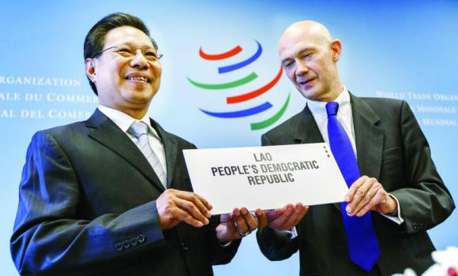
No.158th WTO member in Feb. 2013
Source: Ministry of Planning and Investment (Lao PDR)

Slide 29
Other rules and regulations adjustment
Recently revised law on Investment Promotion 2009, and it’s implemented decree in 2011
Law on Minerals (2008), revised Law on Minerals (2011)
Environmental and Social Impact Assessment Decree (2010)
Land Law (2003), Decree on Implementation of the Land Law (2008) and Decree on Land Concessions (2009)
National Land Policy, currently under revision
National Policy on Environmental and Social Sustainability of the Hydropower Sector
Law on Forestry (2007)
Agricultural Law (1998), revised 2012
Law on Electricity (2011)
ที่มา: Ministry of Planning and Investment (Lao PDR)

Slide 30
Investment laws and regulations in the Lao PDR
Law on the Investment Promotion in the Lao PDR (2009)
    Merging the law governing domestic and foreign investments
    Same tax exemptions for local and foreign business
    access to strengthened and more effective one-stop service for local and foreign investors to hopefully reduce the total business registration period
    Providing the right to foreign investors to purchase land in Lao PDR

Slide 31


One Stop Services
MOIC
Ministry of Industry and Commerce
Enterprise Registration License for General Business
www.moic.gov.la
Ministry of Planning and Investment Concession License & Representative Office License www.investlaos.gov.la
Government’s Office Lao National Committee for Special Economic Zone Investment in Specific Economic Zone Enterprise Registration License www.sncsez.gov.la
ที่มา: Ministry of Planning and Investment

Slide 32
Law on the Investment Promotion (2009)
Promoted sectors
  Agriculture
  Industry
  Manufacturing
  Service
ที่มา: Sukpanich (2014)

Slide 33
Law on the Investment Promotion (2009)
Promoted activities
  Poverty reduction
  People welfare development
  Infrastructure development
  Human capital development
  Jobs creation
  Etc
Promoted zones (3 level)
ที่มา: Sukpanich (2014)

Slide 34
Law on the Investment Promotion (2009)
Promoted Zone (3 level)
  Zone 1: Zones having least socio-economic infrastructure development in facilitating investments. The zones are mainly mountainous remote areas.
  Zone 2: Zones having moderate socio-economic infrastructure development, enabling partial facilitation to the investments, and having less difficult geographical situation compared to Zone 1
  Zone 3: Zones having good socio-economic infrastructure development in supporting investments
ที่มา: Sukpanich (2014)

Slide 35
Special Economic Zones (existing)
Savan-Seno Special Economic Zone 2003
Boten Beautiful Land Specific Economic Zone 2003
Golden Triangle Special Economic Zone2007
Vientiane Industrial and Trade Area 2011
Saysetha Development Zone 2010
Phoukhyo Specific Economic Zone 2010
Thatluang Lake Specific Economic Zone 2011
Longthanh- Vientiane Specific Economic Zone 2012
Dongposy Specific Economic Zone 2012
Thakhek Specific Economic Zone 2012
Source: Ministry of Planning and Investment (Lao PDR)

Slide 36
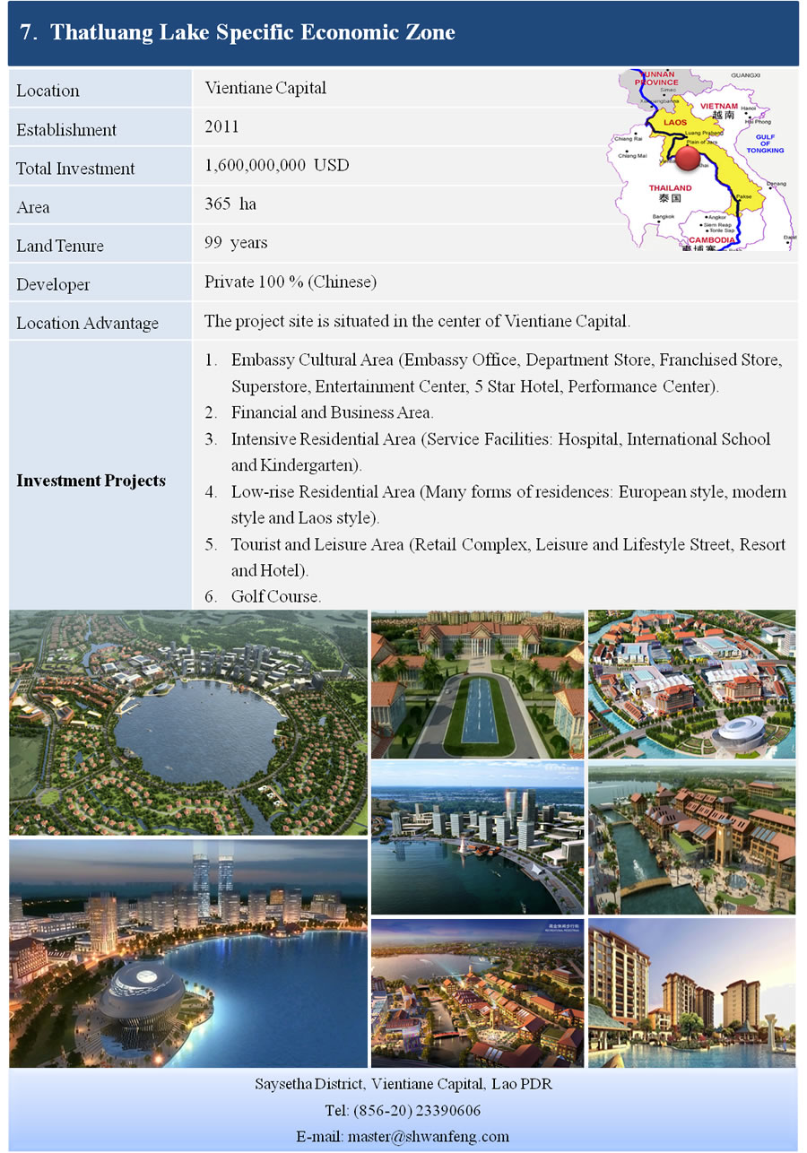
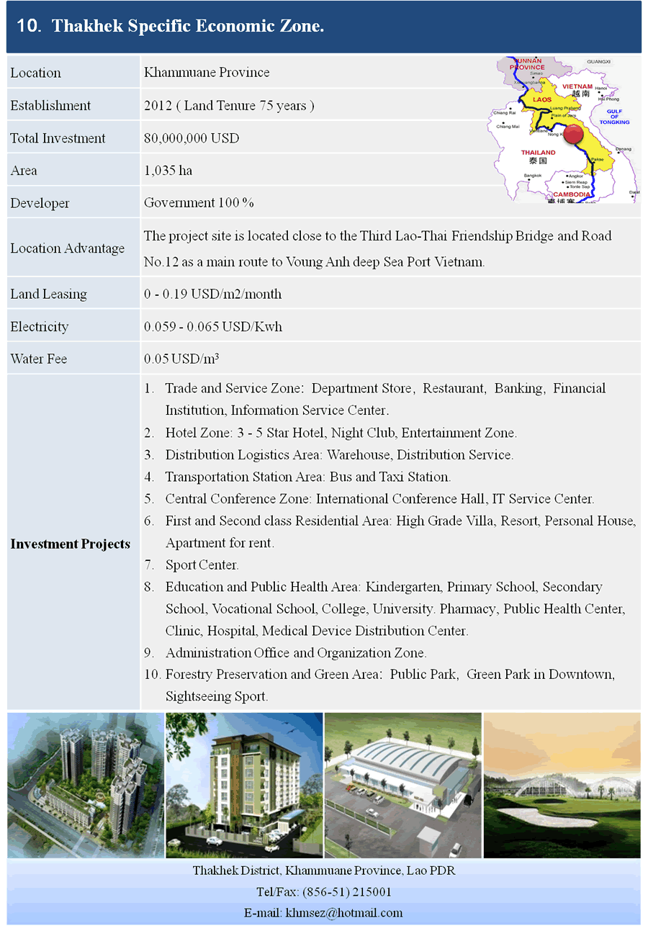
ที่มา: Ministry of Planning and Investment (Lao PDR)

Slide 37
Source: http://www.kpmg.com
ที่มา: Ministry of Planning and Investment (Lao PDR)

Slide 38
Personal Income Tax
Level | Monthly Income (Kips) | PIT rate effective 1 January 2012 | PIT rate effective 1 October 2012
1 | 1,000,000 and below | 0 | 0
2 | 1,000,001 - 3,000,000 | 5 | 5
3 | 3,000,001 - 6,000,000 | 10 | 10
4 | 6,000,001 - 12,000,000 | 15 | 12
5 | 12,000,001 - 24,000,000 | 20 | 15
6 | 24,000,001 - 40,000,000 | 25 | 20
7 | Above 40,000,000 | 28 | 24
Source: summarize based on information from DFDL (2012) and Price Waterhouse and Coopers (2012)
Source: Sukpanich (2014)

Slide 39
Foreign Direct Investment in the Lao PDR

Slide 40
FDI Inflows to Lao, PDR
Source: Ministry of Planning and Investment (2012)
Source: Sukpanich (2014)

Slide 41
Data Source: 1988-2000 data are from Sisombat (2007). Original data are from Department of Domestic and Foreign Investment of Lao PDR (2004)
: 2001-2010 data are from Ministry of Planning and Investment in Laos (2010)
Source: Sukpanich (2014)

Slide 42
Top 10 FDI Countries (1989-2012)
No. | Country | Projects | Value (US$million)
1 | Vietnam | 429 | 4913
2 | Thailand | 743 | 4082
3 | China | 802 | 3952
4 | R.Korea | 288 | 748
5 | France | 224 | 490
6 | Malaysia | 99 | 430
7 | Japan | 103 | 428
8 | Norway | 6 | 358
9 | India | 21 | 161
10 | USA | 113 | 150
Source: Ministry of Planning and Investment (Lao PDR)

Slide 43
FDI By Sectors (1989-2012)
Source: Ministry of Planning and Investment (Lao PDR)

Slide 44
The Lao PDR and Thailand Global Competitive Index
 | The Lao PDR |  | Thailand |  | Lao PDR – Thailand
 | Rank (out of 148) | Score (1–7) | Rank (out of 148) | Score (1–7) | Different rank | Different score
GCI 2013–2014 | 81 | 4.1 | 37 | 4.5 | 44 | -0.4
GCI 2012–2013 (out of 144) | n/a | n/a
GCI 2011–2012 (out of 142) | n/a | n/a
Basic requirements (60.0%) | 83 | 4.4 | 49 | 4.9 | 34 | -0.5
Pillar 1: Institutions | 63 | 4 | 78 | 3.8 | -15 | 0.2
Pillar 2: Infrastructure | 84 | 3.7 | 47 | 4.5 | 37 | -0.8
Pillar 3: Macroeconomic environment | 93 | 4.4 | 31 | 5.6 | 62 | -1.2
Pillar 4: Health and primary education | 80 | 5.6 | 81 | 5.5 | -1 | 0.1
Efficiency enhancers (35.0%) | 107 | 3.6 | 40 | 4.4 | 67 | -0.8
Pillar 5: Higher education and training | 111 | 3.3 | 66 | 4.3 | 45 | -1
Pillar 6: Goods market efficiency | 54 | 4.4 | 34 | 4.7 | 20 | -0.3
Pillar 7: Labor market efficiency | 44 | 4.6 | 62 | 4.3 | -18 | 0.3
Pillar 8: Financial market development | 91 | 3.8 | 32 | 4.6 | 59 | -0.8
Pillar 9: Technological readiness | 113 | 3 | 78 | 3.6 | 35 | -0.6
Pillar 10: Market size | 122 | 2.6 | 22 | 5.1 | 100 | -2.5
Innovation and sophistication factors (5.0%) | 74 | 3.5 | 52 | 3.8 | 22 | -0.3
Pillar 11: Business sophistication | 78 | 3.9 | 40 | 4.4 | 38 | -0.5
Pillar 12: Innovation | 68 | 3.2 | 66 | 3.2 | 2 | 0
Source: provided based on information in World Economic Forum (2013)
Source: Sukpanich (2014)

Slide 45
Foreign Direct Investment of Thai MNEs in the Lao PDR

Slide 46
Thai (actual) direct investment outflow to Laos classified by business sector, 2005-2011 (million US dollars)
Business | 2005 | 2006 | 2007 | 2008 | 2009 | 2010 | 2011P
A Agriculture, forestry and fishing | - | - | - | - | - | - | 0.5
B Mining and quarrying | 0.1 | 0.1 | - | - | - | - | 1.0
C Manufacturing | 0.4 | 5.3 | 19.8 | 6.8 | 5.3 | 12.7 | 120.7
D Electricity, gas, steam and air conditioning supply | - | 7.3 | - | 159.9 | 47.5 | 92.7 | 12.3
F Construction | 1.1 | 8.8 | 28.2 | 38.1 | 36.4 | 32.1 | 63.9
G Wholesale and retail trade; repair of motor vehicles and motorcycles | 0.1 | 6.7 | 0.5 | - | 2.1 | 0.6 | 3.9
H Transportation and storage | 0.0 | - | - | - | - | - | 0.2
I Accommodation and food service activities | 0.1 | - | - | - | - | - | -
K Financial and insurance activities | - | - | 0.4 | - | 56.0 | 9.5 | 14.4
L Real estate activities | - | - | 1.8 | 1.8 | - | - | 0.2
Others | 0.4 | 0.1 | - | 0.2 | 49.8 | 25.5 | 0.9
Total | 2.1 | 28.2 | 50.7 | 206.7 | 197.2 | 173.1 | 217.9
Source: Bank of Thailand
Source: Sukpanich (2014)

Slide 47
Proportion of total value of investment of Thai MNEs approved to invest in the Lao PDR during 1990-2012: shareholders, type and form of investment
 | 1990-1995 | 1996-2000 | 2001-2005 | 2006-2010 | 1990-2000 | 2001-2010 | 1990-2010 | 2011 | 2012
Total capital | 100.00 | 100.00 | 100.00 | 100.00 | 100.00 | 100.00 | 100.00 | 100.00 | 100.00
Domestic share | 18.02 | 24.66 | 23.76 | 23.54 | 21.18 | 23.59 | 23.13 | 4.81 | 25.41
Thai investment share | 81.83 | 75.02 | 45.16 | 52.05 | 78.59 | 50.47 | 55.83 | 86.02 | 25.52
Type of investment
Wholly foreign investment | 51.74 | 3.82 | 13.64 | 26.59 | 29.98 | 23.93 | 25.55 | 88.08 | 1.84
Joint venture | 48.26 | 96.18 | 86.36 | 73.41 | 70.02 | 76.07 | 74.45 | 11.92 | 98.16
Total | 100.00 | 100.00 | 100.00 | 100.00 | 100.00 | 100.00 | 100.00 | 100.00 | 100.00
Form of investment
Concession business | 36.71 | 12.66 | 78.58 | 76.02 | 25.26 | 76.56 | 63.06 | 74.73 | 100.00
General business | 63.29 | 87.34 | 21.42 | 23.98 | 74.74 | 23.44 | 36.94 | 25.27 | 0.00
Total | 100.00 | 100.00 | 100.00 | 100.00 | 100.00 | 100.00 | 100.00 | 100.00 | 100.00
Source: Calculated by the author based on data from Ministry of Planning and Investment (Lao PDR)
Source: Sukpanich (2014)

Slide 48
Proportion of total value of investment of Thai MNEs approved to invest in the Lao PDR during 1990-2012: investment sector
Investment sector | 1990-1995 | 1996-2000 | 2001-2005 | 2006-2010 | 1990-2000 | 2001-2010 | 1990-2010 | 2011 | 2012
Agriculture | 2.75 | 0.95 | 6.69 | 12.76 | 1.93 | 11.51 | 8.94 | 14.52 | 0.86
Banking | 5.46 | 0.00 | 0.00 | 0.72 | 2.98 | 0.57 | 1.22 | 0.00 | 0.00
Construction | 3.12 | 0.00 | 1.13 | 0.48 | 1.70 | 0.62 | 0.91 | 2.37 | 0.00
Consultances | 0.01 | 0.00 | 0.00 | 0.15 | 0.00 | 0.12 | 0.09 | 0.37 | 0.00
Education | 0.00 | 0.03 | 0.02 | 0.01 | 0.02 | 0.01 | 0.01 | 0.00 | 0.00
Electricity Generation | 0.00 | 0.00 | 78.00 | 33.17 | 0.00 | 42.39 | 31.00 | 5.22 | 94.27
Garment | 3.74 | 0.61 | 0.34 | 0.28 | 2.32 | 0.30 | 0.84 | 0.00 | 0.00
Hotel & Restaurant | 35.19 | 0.31 | 1.61 | 1.95 | 19.35 | 1.88 | 6.57 | 1.65 | 0.00
Industry & Handicraft | 5.42 | 3.80 | 3.23 | 14.14 | 4.69 | 11.90 | 9.96 | 67.56 | 0.00
Mining | 33.21 | 1.00 | 0.17 | 31.83 | 18.58 | 25.32 | 23.51 | 0.00 | 4.86
Public Health | 0.00 | 0.00 | 0.00 | 0.00 | 0.00 | 0.00 | 0.00 | 0.00 | 0.00
Service | 0.76 | 12.69 | 3.71 | 2.14 | 6.18 | 2.46 | 3.46 | 3.17 | 0.00
Telecom | 7.77 | 79.78 | 0.87 | 0.00 | 40.47 | 0.18 | 11.00 | 0.00 | 0.00
Trading | 2.07 | 0.19 | 3.78 | 1.29 | 1.22 | 1.80 | 1.64 | 5.06 | 0.00
Wood Industry | 0.51 | 0.63 | 0.45 | 1.07 | 0.57 | 0.94 | 0.84 | 0.08 | 0.00
Source: Calculated by the author based on data from Ministry of Planning and Investment (Lao PDR)
Source: Sukpanich (2014)

Slide 49
Proportion of total value of investment of Thai MNEs approved to invest in the Lao PDR during 1990-2012: investment area (province)
 |  | 1990-1995 | 1996-2000 | 2001-2005 | 2006-2010 | 1990-2000 | 2001-2010 | 1990-2010 | 2011 | 2012
 | Total | 100.00 | 100.00 | 100.00 | 100.00 | 100.00 | 100.00 | 100.00 | 100.00 | 100.00
Province
1 | Attapeu | 0.00 | 0.00 | 0.00 | 0.16 | 0.00 | 0.13 | 0.09 | 0.97 | 0.00
2 | Bokeo | 0.00 | 0.00 | 0.01 | 0.15 | 0.00 | 0.12 | 0.09 | 0.00 | 0.00
3 | Bolikhamxai | 0.04 | 0.00 | 0.99 | 5.28 | 0.02 | 4.40 | 3.22 | 0.00 | 0.00
4 | Champasak | 37.03 | 1.27 | 3.15 | 35.95 | 20.79 | 29.21 | 26.95 | 9.74 | 95.14
5 | Houaphan | 0.00 | 0.00 | 0.00 | 0.00 | 0.00 | 0.00 | 0.00 | 0.00 | 0.00
6 | Khammouan | 0.35 | 0.15 | 78.58 | 1.05 | 0.26 | 16.99 | 12.49 | 0.68 | 0.00
7 | Louangnamtha | 31.82 | 0.00 | 0.00 | 0.00 | 17.37 | 0.00 | 4.66 | 0.00 | 0.00
8 | Louangphabang | 1.31 | 0.00 | 0.38 | 0.22 | 0.72 | 0.25 | 0.38 | 0.00 | 0.00
9 | Oudomxai | 0.00 | 0.00 | 0.00 | 0.00 | 0.00 | 0.00 | 0.00 | 0.00 | 0.00
10 | Phongsaly | 0.00 | 0.00 | 0.00 | 0.00 | 0.00 | 0.00 | 0.00 | 0.00 | 0.00
11 | Salavan | 0.00 | 0.00 | 0.10 | 0.20 | 0.00 | 0.18 | 0.13 | 0.00 | 0.00
12 | Savannakhet | 0.04 | 0.10 | 0.32 | 10.95 | 0.07 | 8.76 | 6.43 | 61.59 | 0.00
13 | Vientiane | 0.05 | 0.00 | 0.65 | 0.62 | 0.03 | 0.62 | 0.46 | 2.34 | 4.86
14 | Vientiane Capital | 29.36 | 98.11 | 15.73 | 42.04 | 60.58 | 36.63 | 43.06 | 22.88 | 0.00
15 | Xaignabouly | 0.00 | 0.00 | 0.09 | 3.10 | 0.00 | 2.48 | 1.82 | 1.80 | 0.00
16 | Xekong | 0.00 | 0.00 | 0.00 | 0.13 | 0.00 | 0.10 | 0.07 | 0.00 | 0.00
17 | Xiangkhouang | 0.00 | 0.36 | 0.00 | 0.15 | 0.17 | 0.12 | 0.13 | 0.00 | 0.00
 | Total | 100.00 | 100.00 | 100.00 | 100.00 | 100.00 | 100.00 | 100.00 | 100.00 | 100.00
Source: Calculated by the author based on data from Ministry of Planning and Investment (Lao PDR)
Source: Sukpanich (2014)

Slide 50
The Lao PDR and Thailand Global Competitive Index
 | The Lao PDR |  | Thailand |  | Lao PDR – Thailand
 | Rank (out of 148) | Score (1–7) | Rank (out of 148) | Score (1–7) | Different rank | Different score
GCI 2013–2014 | 81 | 4.1 | 37 | 4.5 | 44 | -0.4
GCI 2012–2013 (out of 144) | n/a | n/a
GCI 2011–2012 (out of 142) | n/a | n/a
Basic requirements (60.0%) | 83 | 4.4 | 49 | 4.9 | 34 | -0.5
Pillar 1: Institutions | 63 | 4 | 78 | 3.8 | -15 | 0.2
Pillar 2: Infrastructure | 84 | 3.7 | 47 | 4.5 | 37 | -0.8
Pillar 3: Macroeconomic environment | 93 | 4.4 | 31 | 5.6 | 62 | -1.2
Pillar 4: Health and primary education | 80 | 5.6 | 81 | 5.5 | -1 | 0.1
Efficiency enhancers (35.0%) | 107 | 3.6 | 40 | 4.4 | 67 | -0.8
Pillar 5: Higher education and training | 111 | 3.3 | 66 | 4.3 | 45 | -1
Pillar 6: Goods market efficiency | 54 | 4.4 | 34 | 4.7 | 20 | -0.3
Pillar 7: Labor market efficiency | 44 | 4.6 | 62 | 4.3 | -18 | 0.3
Pillar 8: Financial market development | 91 | 3.8 | 32 | 4.6 | 59 | -0.8
Pillar 9: Technological readiness | 113 | 3 | 78 | 3.6 | 35 | -0.6
Pillar 10: Market size | 122 | 2.6 | 22 | 5.1 | 100 | -2.5
Innovation and sophistication factors (5.0%) | 74 | 3.5 | 52 | 3.8 | 22 | -0.3
Pillar 11: Business sophistication | 78 | 3.9 | 40 | 4.4 | 38 | -0.5
Pillar 12: Innovation | 68 | 3.2 | 66 | 3.2 | 2 | 0
Source: provided based on information in World Economic Forum (2013)

Slide 51

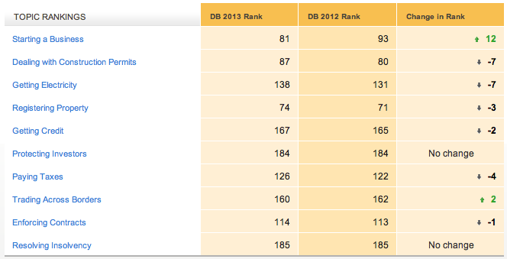
“81 out of 185 countries…
easy to Start Business”
Source: Ministry of Planning and Investment (Lao PDR)

Slide 52
THANK YOU
Q & A

