Slide 1

Chapter 1
Chapter 3
Assessing the External Marketing Situation
Introduction
MK 312 Marketing Management
By
Aj.Suwalya Khemvaraporn

Slide 2

Ch. 3 - Learning objectives
After studying this chapter you should be able to:
■ explain the elements in the PEST analysis
■ discuss the focal company’s relationships to the different actors in the value net
■ understand how the company can establish relationships to competitors
■ discuss how B2B customers make purchase decisions.

Slide 3
The marketing system at three levels
The whole marketing system can be divided into three levels, as follows (see Fig. 3.1 – next slide):
1 The focal company: understanding and analysing the internal situation was dealt with in Chapter 2.
2 Industry level/value net: the focal company’s most important actors/stakeholders at this level are suppliers, partners / complementors, competitors and, of course, the customers.
3 Macro level: the most important changes taking place in the macro environment can be summarized in the so-called PEST analysis: P Political and legal factors, E Economic factors, S Socio-cultural factors, T Technological factors.

Slide 4
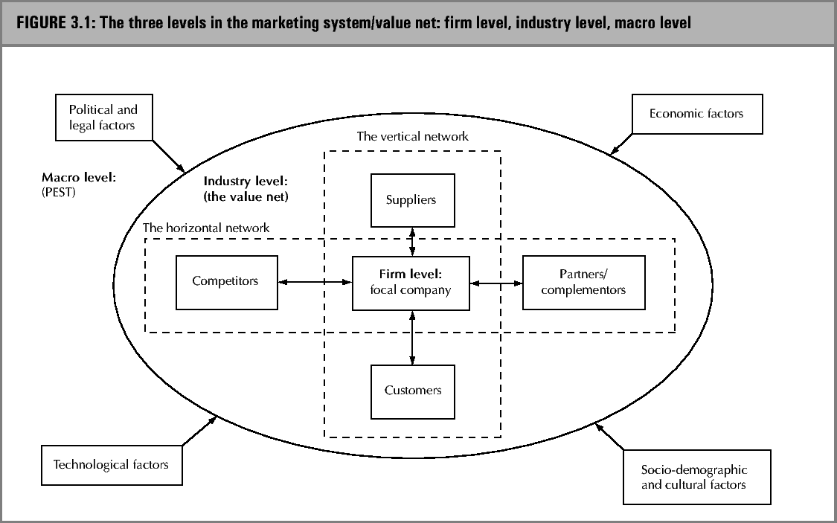
The marketing system / value net

Slide 5

European Union
By January 2002 a single European currency, the euro (€), had been introduced into all but a handful of the EU member states, further facilitating trade and exchange across the old political borders.

Slide 6

European Union
On 1 May 2004, ten new states became members of the EU: the three Baltic States, Hungary, Poland, the Czech Republic, Slovakia, Cyprus, Malta and Slovenia.
This enlargement will have significant implications for many organizations, both commercial and non-commercial, as Europe expands.
The population of the European Union will rise by around 20 per cent, while GDP will rise by only 5 per cent.

Slide 7


PEST Analysis
POLITICAL, LEGAL and ECONOMICAL factors
Socio-demographic and cultural environment
  Social Factors: a number of significant pressures on organization can be identified.
  Customers are becoming increasingly demanding of the products and services they buy.
  Customers demand, and expect, reliable products with quick, efficient service at reasonable prices.
  Furthermore there is little long-term stability in customer demand

Slide 8
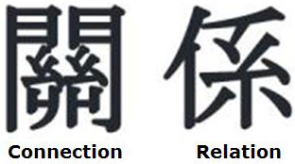

PEST Analysis
CULTURAL FACTORS
  American communicates in a low-context nature, which means that messages are explicit.
  Words carry most of the information in communication and one gets down to business quickly
  In high text , such as France,Japan, and most of the Middle East, less information is contained in the verbal part of the message.
  Much more information resides in the context of communication including background associations, and basic values of communicators (Hall, 1976)
  Thus making longer to conduct business because you need to know more about the business person before a relationship develops

Slide 9

Hofstede’s cultural dimensions
Descriptions of Hofstede’s five dimensions:
Power distance is the extent to which the less powerful members of society accept that power is, and should be, distributed unequally.
Uncertainty avoidance is the extent to which people try to avoid situations where expectations and outcomes are not clear.

Slide 10

Hofstede’s cultural dimensions
Descriptions of Hofstede’s five dimensions (cont.):
Individualism describes the relationship between an individual and the groups to which he/she belongs.
Masculinity is aggressive and materialistic behaviour. Hofstede described this dimension as masculinity vs. femininity
Long-term orientation is the extent to which people within a culture have a long-term vs. a short-term outlook on work, life and other aspects of society

Slide 11


Exhibit 3.1 McDonald’s France: a faster penetration of the French market than expected

Slide 12

PEST analysis
Technological factors:
  Newer technology has had a major impact on particular aspects of marketing.
  Computers, and their wide availability to management, have let to increased interest in sophisticated market modelling and decision support systems.

Slide 13
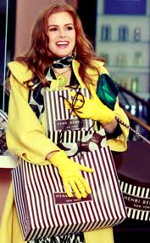

Exhibit 3.2 Cross-cultural ‘gift giving’ behavior and Masterfoods’ introduction of the Celebrations brand

Slide 14
Relations to actors in the industry value net
This task environment refers to the immediate external market where interactions which have a direct effect on our company take place.
Since the firm has relationships with different types of interdependencies, with different objectives for the development of the relationship, and so on, it is important organizationally to differentiate between how different relationships are handled.

Slide 15
The marketing system / value net

Slide 16

Relationships with suppliers
There seem to be three major strategic issues related to purchasing management:
1. The decision of whether to make an item in-house or to buy from external suppliers
2. The development of appropriate relationships with suppliers
3. The managing of the supplier base in terms of size and relationships between suppliers

Slide 17

Exhibit 3.3 Dell faces different buying behavior in different countries

Slide 18

Relationships with customers
In the relationship approach, a specific transaction between the focal company and a customer is not an isolated event, but takes place within an exchange relationship characterized by mutual dependency and interaction over time between the two parties.
An exchange relationship implies that there is an individual specific dependency between seller and the customer. The relationship develops through interaction over time and signifies a mutual orientation of two parties towards each other.

Slide 19



Relationships with partners/ complementors
This kind of relationship is based on collaboration between manufactures of complementary functions and/or products/services.
Each partner has a strategic resource that the other needs –exchange supplier& customer.
Value chain activities developed: One manufacture – other market ei. Diethelm

Slide 20
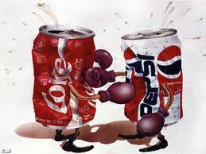
Relationships with competitors
Before entering any relationship with competitors, it is important to analyze the competition in so far as it will affect ease of market entry and potential profitability.
Factors to consider from competitors: number of size of competitors, capabilities (S&W), international marketing strategies, sales volume and relative market share, type of competitor (multinational – Microsoft, Unilever) vs. local

Slide 21

Exhibit 3.4 The nature of fashion markets

Slide 22

B2B markets
It could be relevant to look at the buying processes in both the B2B and B2C markets.
Organizational purchasing decisions are made to meet the objectives of the organization rather than the needs of an individual buyer.

Slide 23
Buying processes in the B2B markets (1)
The actors in the buying centre can be categorized as follows:
■ Initiator: the person who first suggests making a purchase.
■ Influencers/evaluators: people who influence the buying decision. Technical personnel are especially important as influencers.
■ Gatekeepers: group members who regulate the flow of information. A secretary may act as a gatekeeper by determining which vendors get an appointment with a buyer.

Slide 24
Buying processes in the B2B markets (2)
Buying centre (cont.) …
■ Decider: the person who has the formal or informal power to choose or approve the selection of the supplier or brand.
■ Purchaser: the person who actually negotiates the purchase. This could be anyone from the president of the company to a purchasing agent, depending on the importance of the decision.
■ Users: members of the organization who will actually use the product. Users often initiate the buying process and help define product specifications.

Slide 25
‘Buy classes’ in B2B buying
In terms of B2B buying complexity – the buying decisions can be categorized into three buy classes:
1 Straight re-buys: these occur often, are relatively cheap and are usually a matter of routine.
2 Modified re-buy: this situation requires some additional information about, or evaluation of, suppliers.
3 New task: a new task, or new buy, situation (i.e. when the company has not bought the product before) is the most complex purchase decision.

Slide 26

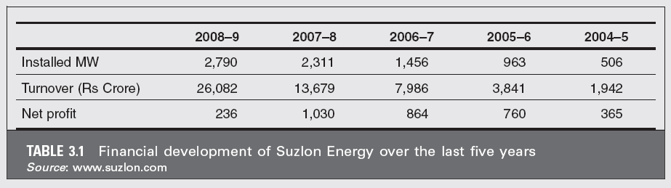

Slide 27
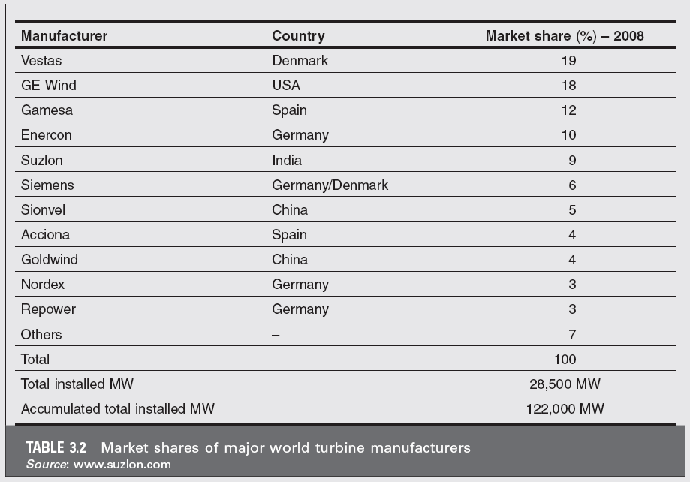

Slide 28
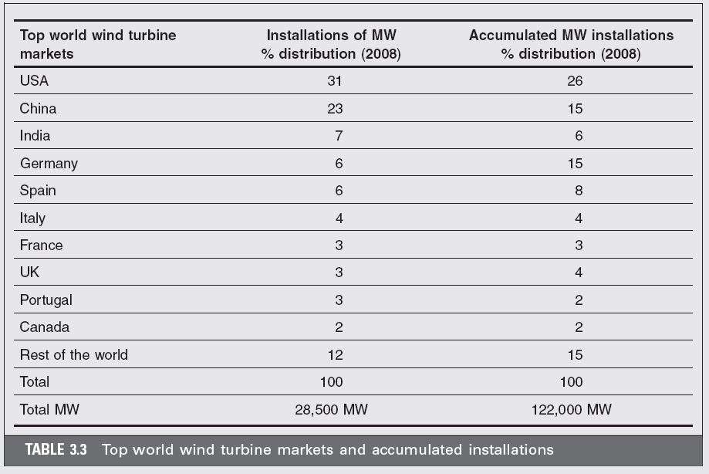

Slide 29
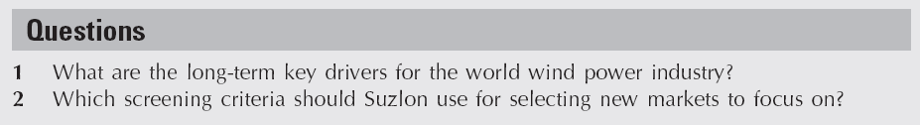

Slide 30

Group Homework
Case study: suzlon energy
Group presentation on value net: 10 mins max

