Slide 1
EE401 Political Economy
Transition II: Political Revolutions
in America and France
Ploy Thammapiranon 2/2017
BE, Thammasat University

Slide 2
Transition II: Political Revolutions in America and France
American Democratic Revolution
  1.1 Brief History
  1.2 New Form of Government
Democratic Revolution in France
  2.1 Brief History
  2.2 The French Revolution
  2.3 Export of the Revolution

Slide 3
Spread of pluralist political institutions
The 1688 Glorious Revolution
established the world’s first pluralist political institutions.
The American Revolutionary War (1776)
created a new form of pluralist political institutions in the US.
The French revolution (1789)
spreads inclusive economic institutions to much of Europe.

Slide 4
1. American democratic revolution
1.1 Brief history
American colonies had developed early forms of pluralist political institutions.
But they were under extractive economic institutions imposed by the UK.
  The Navigation Act monopolized trade with the colonies.
  Exports of agricultural products and imports of manufactured goods.
  Tax collecting without representation.

Slide 5
1. American democratic revolution
1776
the ‘Declaration of Independence’
1783
the second Paris Treaty
No true central government
1787
the Constitution Convention in Philadelphia
1788
1789
Colonies ratified the Constitution
George Washington elected President.

Slide 6
1. American democratic revolution
1.2 New form of government
  Britain had constitutional monarchy and was the wealthiest nation in the world.
  USA was the first ‘modern republic’.
  How can USA achieve the ‘wealth of the nation’ without a monarchy?

Slide 7
1. American democratic revolution
1.2 New form of government
  The US Constitution and markets
State must protect private property
Free trade to create ‘the wealth of nations’.
Federal government collects taxes and spends by approval from Congress.
Separation of legislative, executive and judiciary powers to prevent government-created monopoly.
Resource allocation by competitive private enterprises

Slide 8
1. American democratic revolution
1.2 New form of government
  Economic institutions in the US
The first modern democratic republic.
Full form of pluralist political institutions.
  Popular sovereignty, separation of power, checks and balances.
  1820-70 The Industrial Revolution in Northern US.
The South still under extractive economic institutions until the Civil War.

Slide 9

2. Democratic revolution in France
2.1 Brief history
The absolute monarchy before 1789.
The three estates:
First Estate: nobility
Second Estate: clergy
Third Estate: merchants, professionals, artisans, farmers
  Different rights and laws

Slide 10
2. Democratic revolution in France
2.1 Brief history
French mercantilism was the worst in Europe.
  Heavy taxes on farmers and products.
  Forced labor.
  Restrictions on agricultural trade.
  Strict control of domestic and foreign trade.
  Guild monopolies.
  Poverty.
  Stagnated economy and no innovation.
Absolutist political institutions + extractive economic institutions.

Slide 11
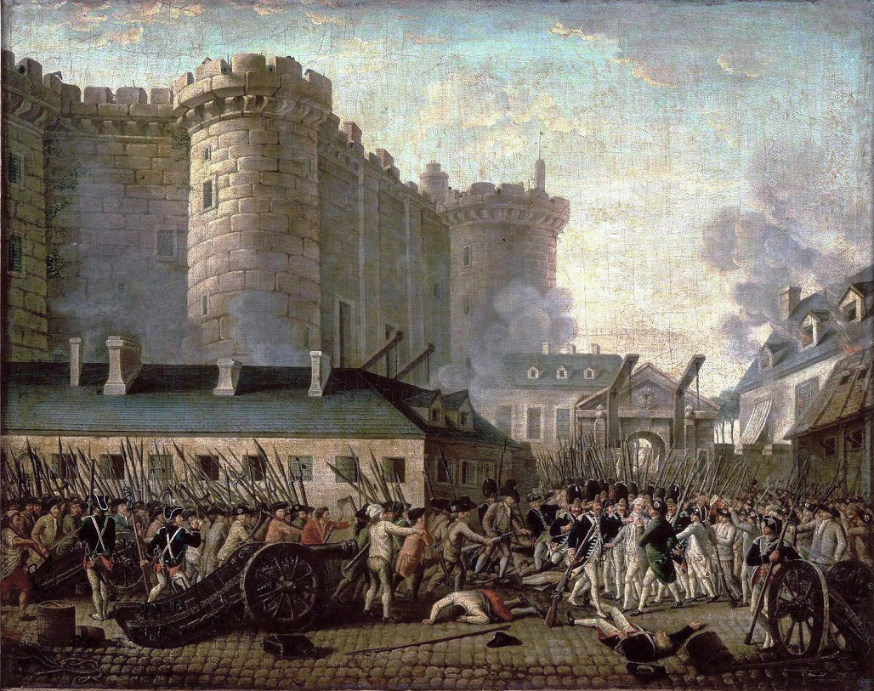
2. Democratic revolution in France
2.2 The French Revolution
King Louis XVI: A fiscal crisis by wars and palace spending.
Physiocrat reforms by Turgot were opposed and abandoned.
Resistance to more tax burden by the Third Estate.
1789, 14 July: the storming of
the Bastille.

Slide 12
2. Democratic revolution in France
2.2 The French Revolution
1789
The National Constituent Assembly proposed a Constitution.
1791
A new Constitution made France a constitutional monarchy.
1792
the First Republic.

Slide 13
2. Democratic revolution in France
2.2 The French Revolution
1792-95
War with Austria, Prussia, Britain and Spain.
1793-94
The Reign of Terror: the Jacobin Club seized power
1794
The Thermidorian Reaction and the White Terror
1795
A new Constitution --- the Directoire.

Slide 14
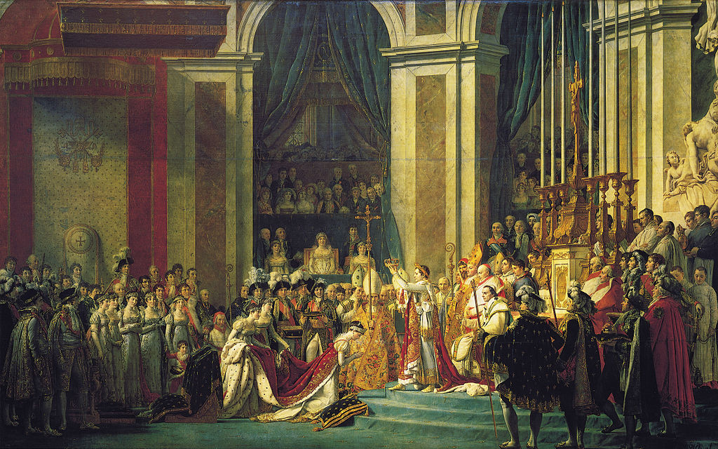
2. Democratic revolution in France
2.2 The French Revolution
1799: Napoléon Bonaparte staged a coup --- the Consulate.
1804: Napoléon crowned Emperor.
1815: Napoleon’s final defeat; restoration of Louis XVII as constitutional monarchy.
The Coronation of Napoleon I, 2 December 1804.

Slide 15
2. Democratic revolution in France
1816-60
1848
1870
1852
1958
1946
2.2 The French Revolution
Revolution to establish Second Republic.
Loss in war with Prussia, Third Republic.
Fifth Republic.
The Industrial Revolution
Emperor Louis-Napoléon Bonaparte.
Fourth Republic.
Conflict between monarchy and National Assembly continued →

Slide 16
2. Democratic revolution in France
2.3 Export of the Revolution
Napoleon spread the French revolution to the rest of Europe.
  Abolition of feudal land relations.
  Guild monopolies were abolished.
  Destruction of the Church’s privileges.
  Equality before the law.
Some of these measures remained despite Napoleon’s defeat.
  Preparation for market development in Eastern Europe.

Slide 17
2. Democratic revolution in France
2.3 Export of the Revolution
Absolute monarchies were restored in most of Eastern Europe.
  Labor mobility and market development.
  Limited industrialization with big capitals-cartels.
  Militarization and royalist nationalism.
  Obstructed technological progress and backward economies.
Absolute monarchies collapsed after losing WWI.

