Slide 1
ASEAN & Environment
In the perception of TEEB:
The Economics of Ecosystems and Biodiversity
Piyathip Eawpanich
GIZ Co-director, ECO-BEST Project
Faculty of Economics
Thammasat University
30 June 2015

Slide 2


Slide 3

From: ASEAN Center for Biodiversity, 2001

Slide 4
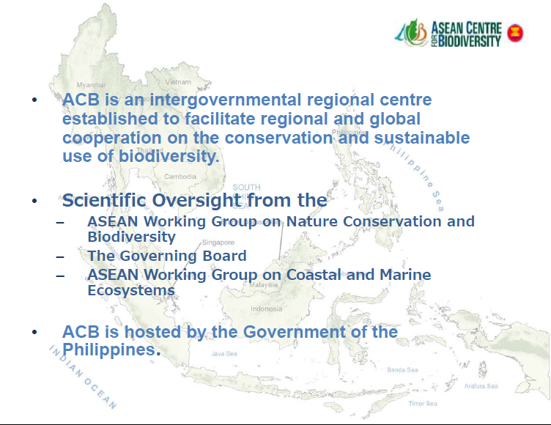
From: ASEAN Center for Biodiversity, 2001

Slide 5
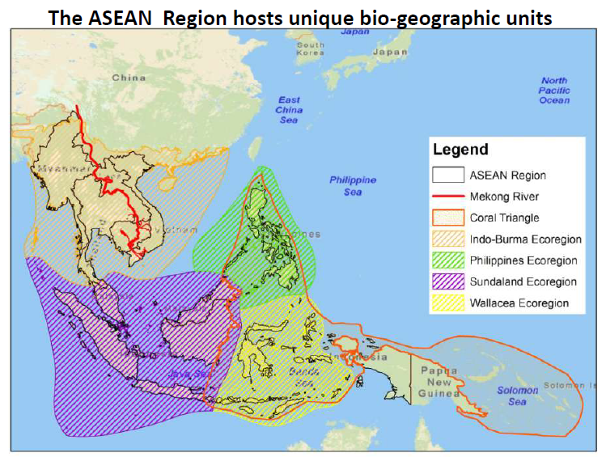
From: ASEAN Center for Biodiversity, 2001

Slide 6
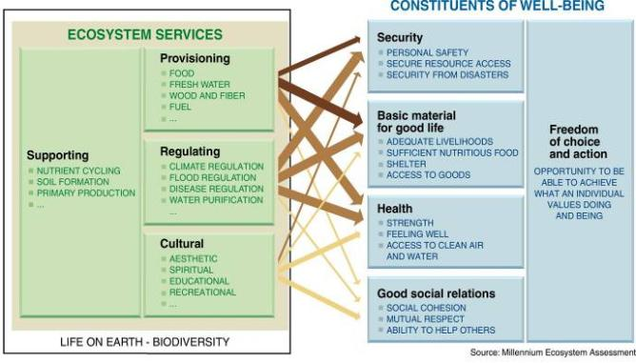
Ecosystem Services and Human Well-being
Source: Pauly und Watson 2005, MA

Slide 7
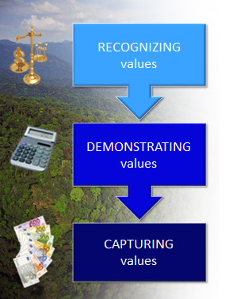
TEEB’s Approach
A feature of all human societies and communities
In economic terms, to support decision making
Introduce mechanisms that incorporate the values of ecosystems into decision making
Notes:
Especially for cultural services,
Usually for regulating services
Easiest for provisioning services, but possible for some regulating services in some circumstances.
7

Slide 8

















Ecosystem Services
Provisioning services
Regulating Services
Cultural and social Services
Habitat or Supporting Services
From: TEEB for Local and Regional Policy Makers (2010)

Slide 9
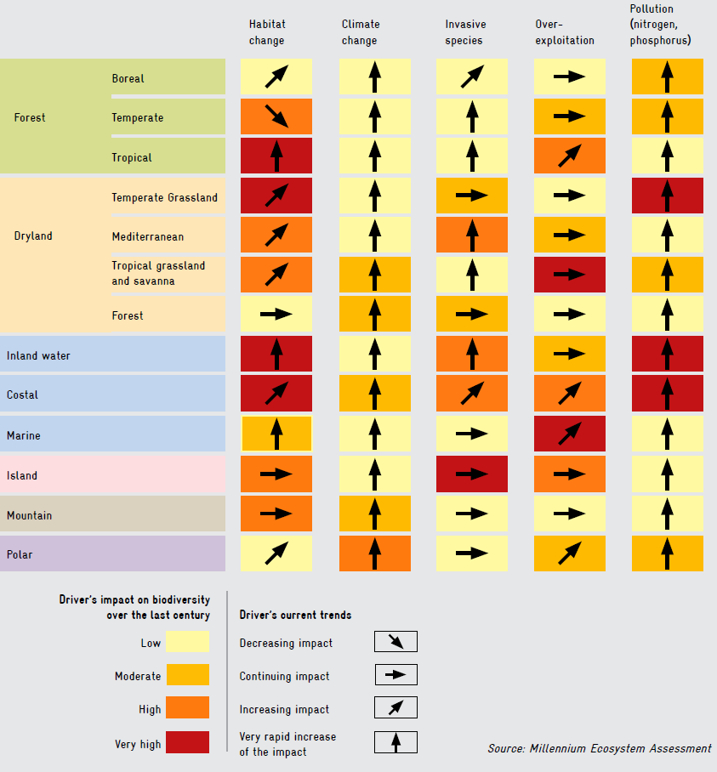
Major Threats to biodiversity Loss (MA, 2005)
Habitat Change
Climate Change
Invasive Species
Over exploitation
Pollution
Tundra
Temperate
Tropical
Forest
Temperate
Mediterranean
Tropical Savanna
Forest
Dry land/
Grassland
Inland water
Coastal
Marine
Island
Mountain
Polar
Driver’s impact on biodiversity
over the last century
Driver’s current trends
Low
Moderate
High
Very high
Decreasing impact
Continuing impact
Increasing impact
Very rapid increase of the impact

Slide 10
Biodiversity: Forest and Wildlife Resources
Lost of Biodiversity is the greatest economic problems of this century
Biodiversity definition is not easy to define. Number of species per area of habitat is normally referred but it ignores the ecosystem properties.
In economist perspective, biodiversity lost problem is one of market failure and, in particular, of externalities and public goods.
Biodiversity provide positive externality at no price. It is as public goods (non rival and non excludable) at all level (local, national, and global)
(2014, Helm & Hepburn, Nature in the Balance)

Slide 11

Type of goods and services
Excludable
Non-excludable
Private Goods | Common Goods
Club Goods | Public Goods
Rival
Non-rival

Slide 12
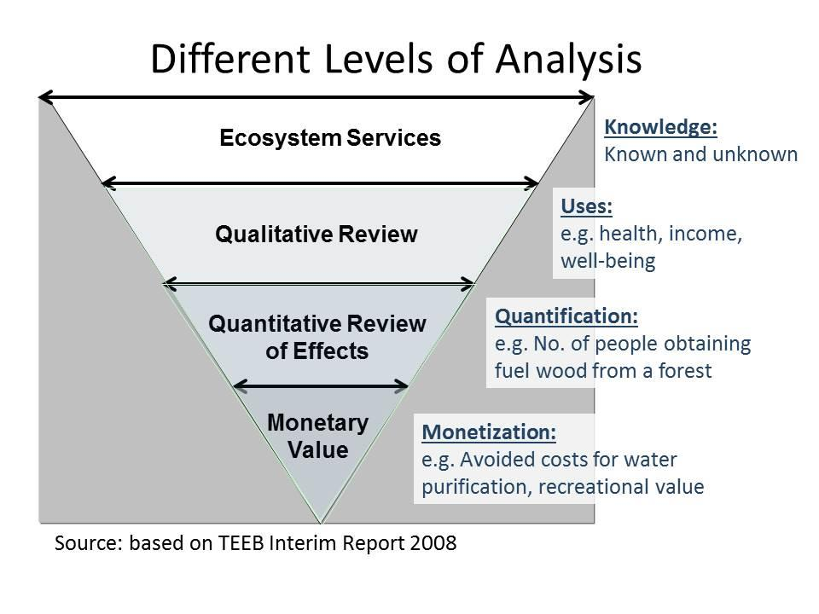
Questions from a park manager
Why monetary value?
How an economist conduct valuation
Can one define the Total Economic Value (TEV) of a nature?
What does TEEB really mean to a protected area manager?
How to apply TEEB in their current work and responsibilities.

Slide 13
Economic Valuation
help determine how best to design policy instruments appropriate for public goods (either at local, national, global level). (Helm & Hepburn, 2014)
Hon Mun Marine PA:
With the valuation of ecosystem services information, the user fee is earmarked for use by the PA and it is now partially self-financed.

Slide 14
Economic Valuation
Try to place monetary value so that species/ecosystem can be included in resources allocation and their conservation can be traded off against other uses of scarce resources. (how much should be spent on species/habitat conservation). (Helm & Hepburn, 2014)
Leuser Forest Ecosystem, Sumatra, Indonesia
Credit:
The ASEAN TEEB Scoping Study, 2014, Valuing ecosystem services in Southeast Asia

Slide 15




Economic Valuation
Not estimates the fundamental ethical value or of ecological importance,
Serves as snapshots from different angles,
Is very much as a case study,
To give information to formulate
policies to limit the decline of
biodiversity and then reverse for
restoration.
(Helm & Hepburn, 2014)

Slide 16
Overview of National and International Policy Options
Providing Information
Setting Incentives
Regulating Use
Indicators & Accounting system for natural capital | Integrating ecosystem & Biodiversity value into policy assessment | Rewarding benefits through payments and markets | Reforming subsidies | Addressing losses through regulation and pricing | Recognizing the value of protected areas | Investing in ecological infrastructure
TEEB for Policy Makers 2009

Slide 17
Overview of Local and Regional Policy Options
Management &
Regulation
Planning &
Regulation
Market Based
Instruments
Ecosystem
Ecosystem
Spatial
Ecosystem
Payments for
Certification
Services in
Services in
Planning &
Services &
Ecosystem
& Labeling
Cities &
Rural Areas
Environmental
Protected
Services &
Public
& Natural
Assessment
Areas
Conservation
Management
Resource
Banking
Management
TEEB for Local & Regional Policy Makers, 2010
Notes:
In comparison:
Emission reductions in Energy and Industry 10 Mio. t CO2 and Households and Traffic 22 Mt CO2 per year until 2012

Slide 18
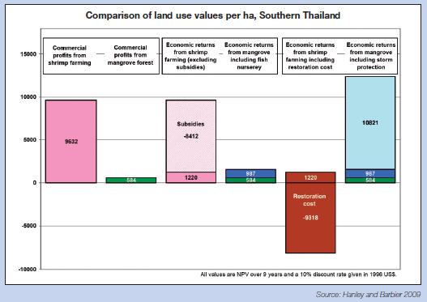

Slide 19
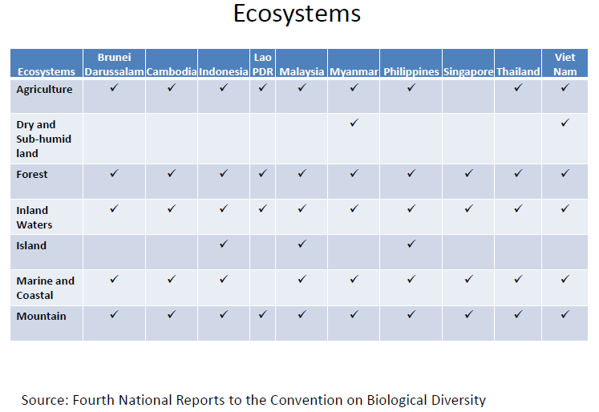
From: ASEAN Biodiversity Outlook, ASEAN Center for Biodiversity, 2001

Slide 20
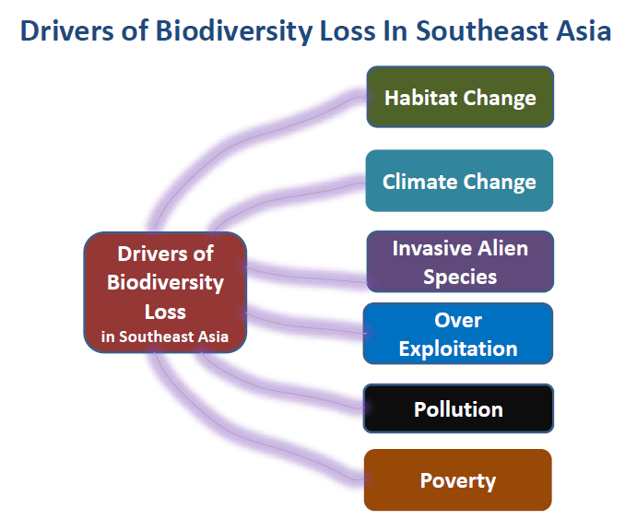
From: ASEAN Biodiversity Outlook, ASEAN Center for Biodiversity, 2001

Slide 21
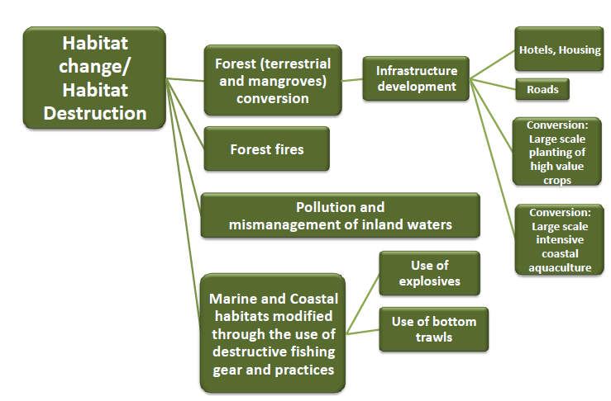
Root Causes of Habitat Change/Destruction Drivers
From: ASEAN Biodiversity Outlook, ASEAN Center for Biodiversity, 2001

Slide 22
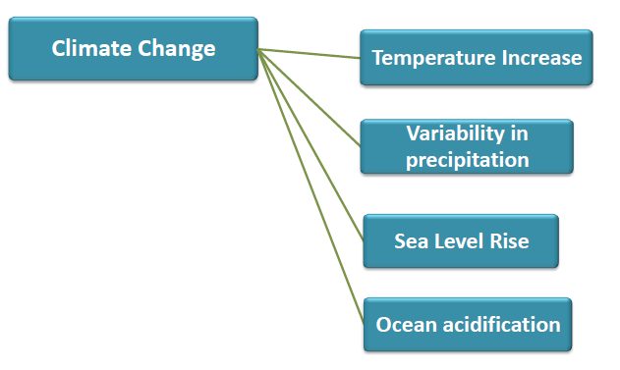
Root Causes of Climate Change
From: ASEAN Biodiversity Outlook, ASEAN Center for Biodiversity, 2001

Slide 23
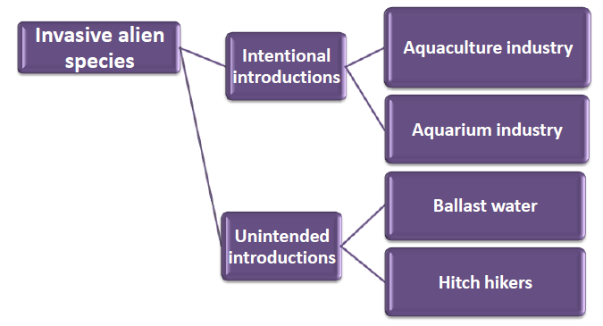
Root Causes of Invasive Alien Species
From: ASEAN Biodiversity Outlook, ASEAN Center for Biodiversity, 2001

Slide 24
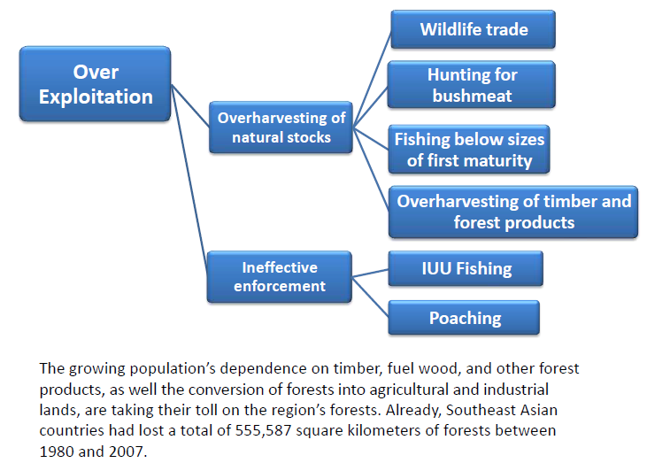
Root Causes of Over Exploitation
From: ASEAN Biodiversity Outlook, ASEAN Center for Biodiversity, 2001

Slide 25
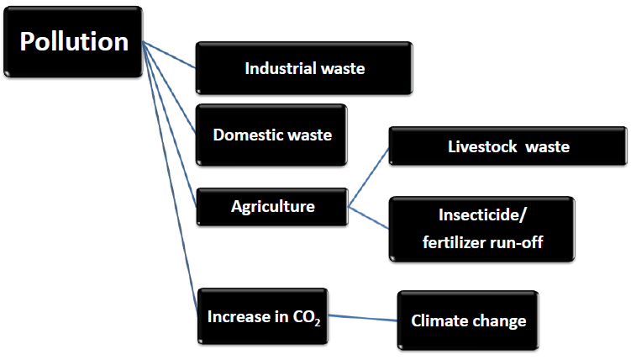
Root Causes of Pollution
From: ASEAN Biodiversity Outlook, ASEAN Center for Biodiversity, 2001

Slide 26
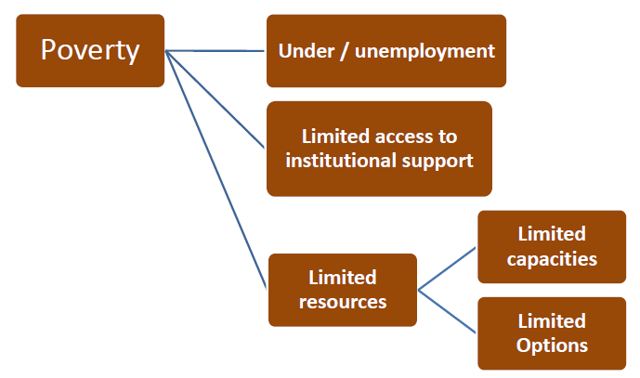
Root Causes of Poverty
From: ASEAN Biodiversity Outlook, ASEAN Center for Biodiversity, 2001

Slide 27
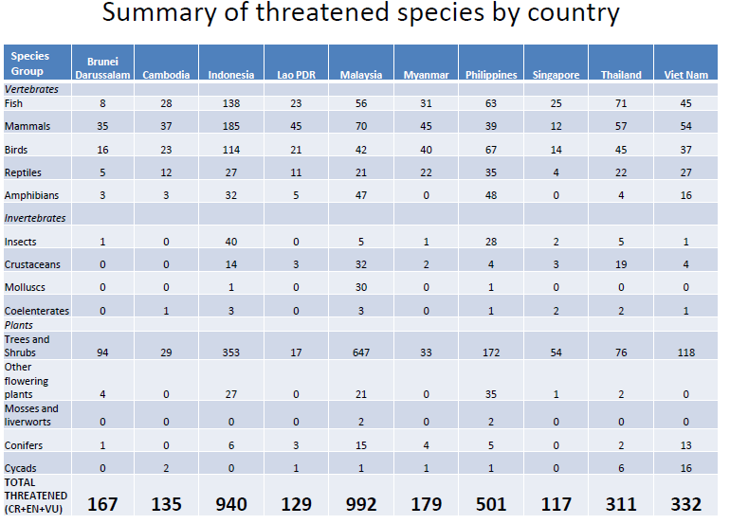
From: ASEAN Biodiversity Outlook, ASEAN Center for Biodiversity, 2001

Slide 28
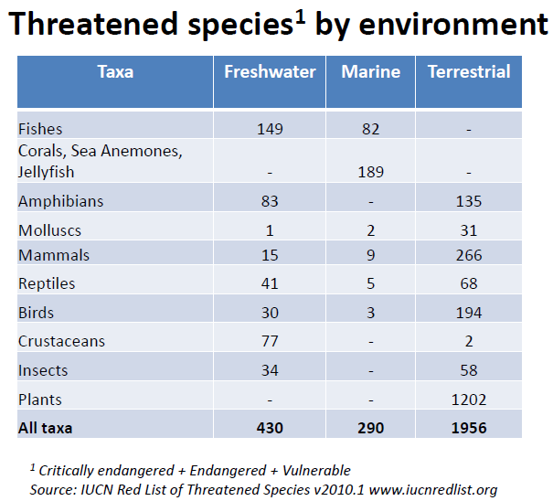
From: ASEAN Biodiversity Outlook, ASEAN Center for Biodiversity, 2001

Slide 29
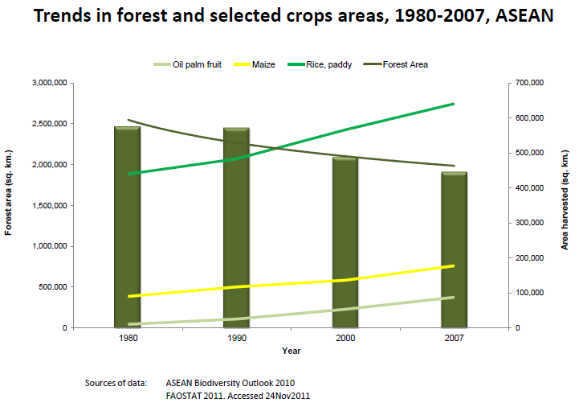
From: ASEAN Biodiversity Outlook, ASEAN Center for Biodiversity, 2001

Slide 30
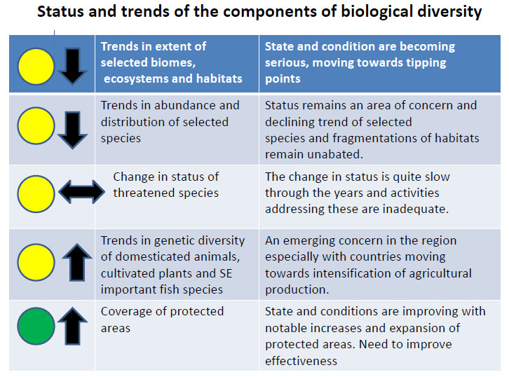
From: ASEAN Biodiversity Outlook, ASEAN Center for Biodiversity, 2001

Slide 31
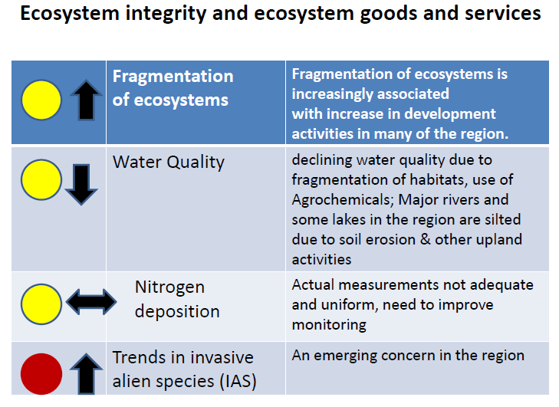
From: ASEAN Biodiversity Outlook, ASEAN Center for Biodiversity, 2001

Slide 32
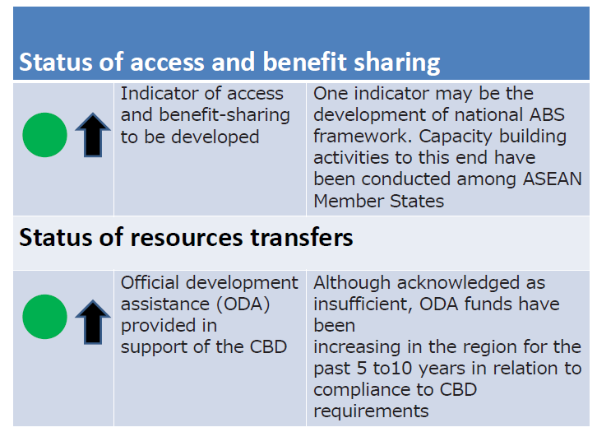
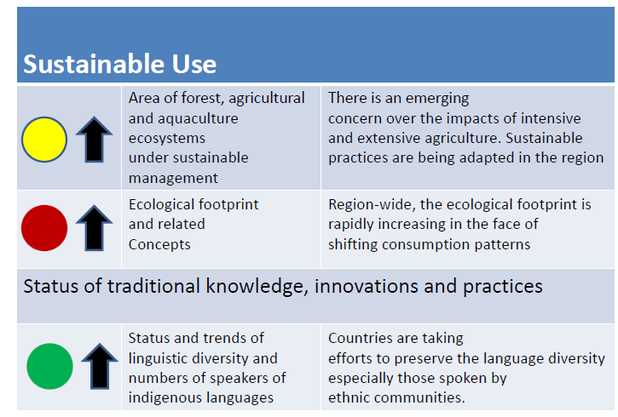
From: ASEAN Biodiversity Outlook, ASEAN Center for Biodiversity, 2001

Slide 33
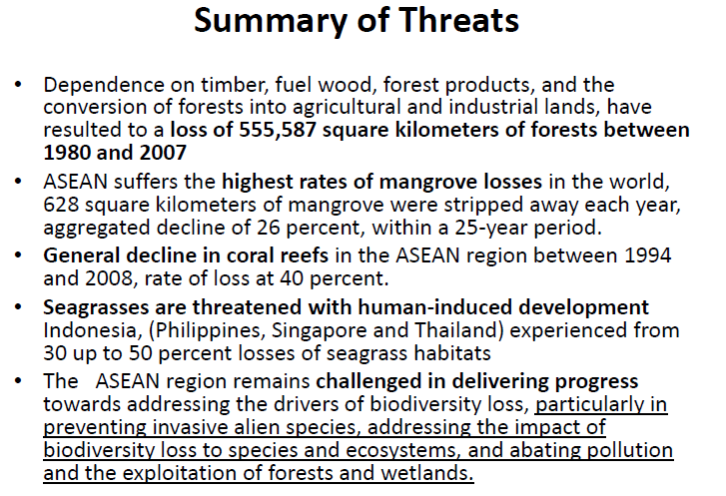
From: ASEAN Biodiversity Outlook, ASEAN Center for Biodiversity, 2001

Slide 34
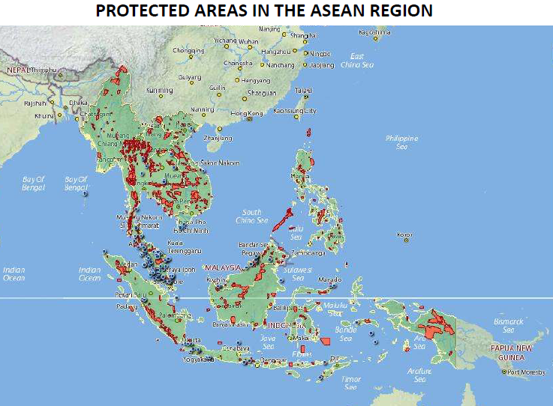
From: ASEAN Biodiversity Outlook, ASEAN Center for Biodiversity, 2001

Slide 35
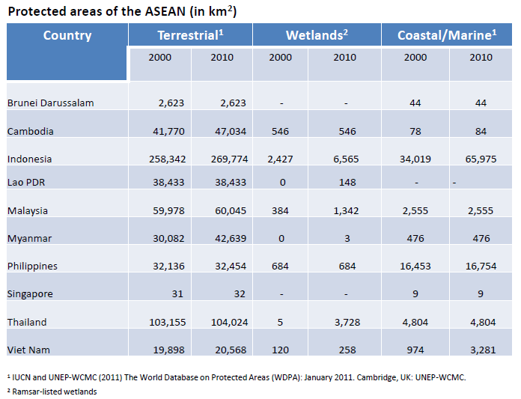
From: ASEAN Biodiversity Outlook, ASEAN Center for Biodiversity, 2001

Slide 36
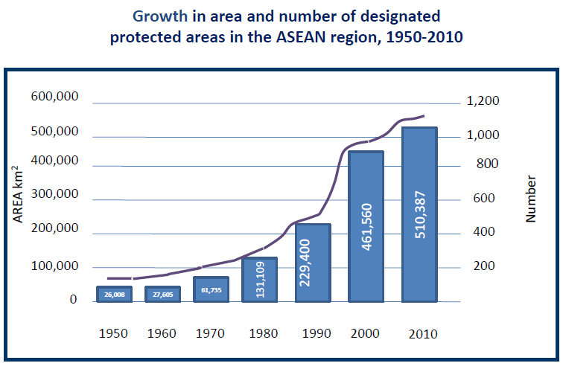
From: ASEAN Biodiversity Outlook, ASEAN Center for Biodiversity, 2001

Slide 37
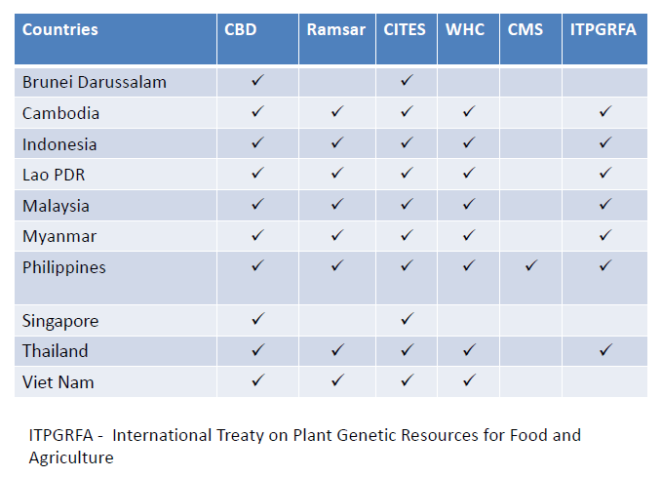
ASEAN member and the Multilateral Environmental Agreement (MEA)
Remarks:
CBD Convention of Biological Diversity
Ramsar Convention on Wetlands of International Importance or RAMSAR Convention
CITES Convention on International Trade in Endangered Wild Fauna and Flora
WHC Convention Concerning the Protection of the World Cultural and Natural Heritage
or World Heritage Convention
CMS Convention on Migratory Species
ITPGRFA International Treaty on Plant Genetic Resources for Food and Agriculture
From: ASEAN Biodiversity Outlook, ASEAN Center for Biodiversity, 2001

Slide 38
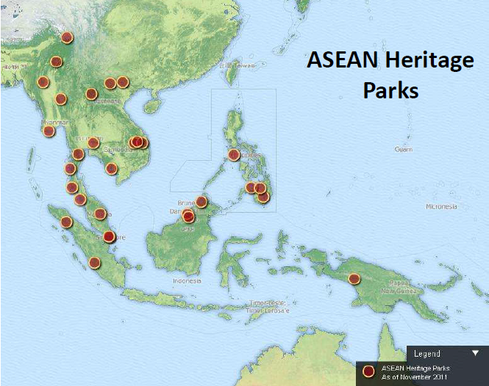
ASEAN Heritage Parks
From: ASEAN Biodiversity Outlook, ASEAN Center for Biodiversity, 2001

Slide 39
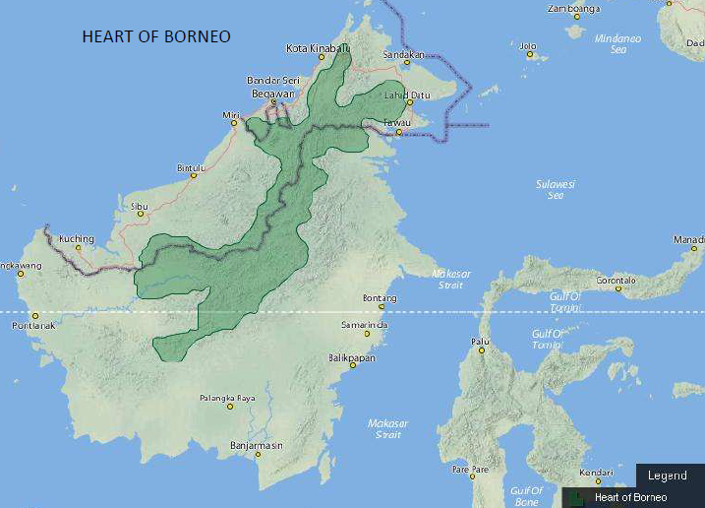
From: ASEAN Biodiversity Outlook, ASEAN Center for Biodiversity, 2001

Slide 40
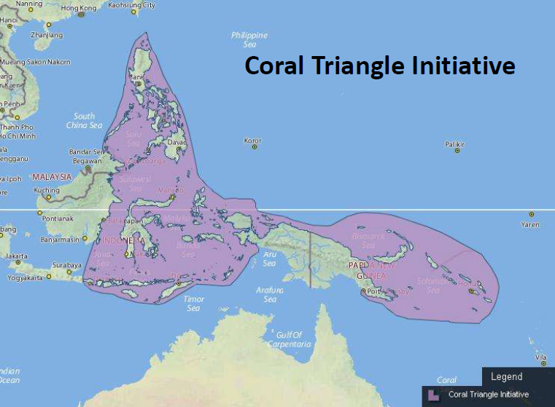
From: ASEAN Biodiversity Outlook, ASEAN Center for Biodiversity, 2001

Slide 41
Khob-khun-kha
www.teeb-sea.info

