Slide 1
Sampling Methods in Research Methodology; How to Choose a Sampling Technique for Research

Slide 2
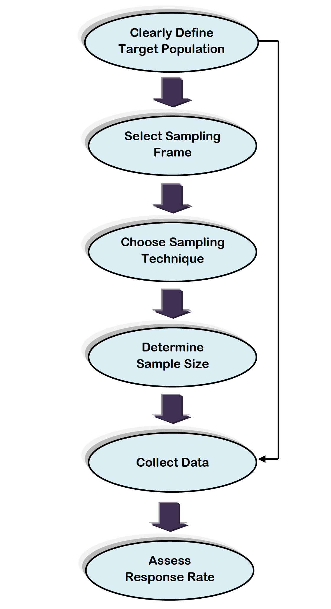
Steps of Research

Slide 3
Steps
A.1: Defining the Population of Interest
A.2: Creating the Sample Frame
A.3: Designing the Survey Questionnaire
A.4: Survey Implementation
A.5: Weighting System for Data Aggregation (Ignored, best for bigger research)

Slide 4
Defining Population of Interests
As it is in history, literature, criminology and many other areas, context is important in statistics. Knowing from where your data comes gives clues about what you can do with that data and what inferences you can make from it.
In survey samples context is critical because it informs you about how the sample was selected and from what population it was selected.
Not every sample selected is a simple random sample so knowing information about the sampling design provides necessary context that allows researchers to create proper estimates and generate correct and projectable inferences.
One of the very first steps, then, in working with survey data is to understand the sampling design. There are a few key concepts that you not only need to understand in general, but define in your sample in order to provide the proper context for computing estimates and drawing inferences.

Slide 5
Sampling Frame
The first is the Sampling Unit.
This is the actual unit that we include in our sample. Usually this unit refers to an individual person, but it could be a company, a school, or a neighborhood, depending on what you’re measuring and how you’re measuring it.
Now put Sampling Units into their proper context and you have the Sample Frame which consists of a listing of all possible Sampling Units.
The target population provides the overall context and represents the collection of people, housing units, schools etc. about which inferences and estimates are desired.

Slide 6
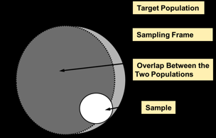
Sampling Frame

Slide 7
Sampling Frame
Ideally, the sampling frame perfectly coincides with the target population. Of course, the ideal is not always possible. Sometimes the frame will be larger or smaller, depending on practical ways of getting in touch with each member of the sample.

Slide 8
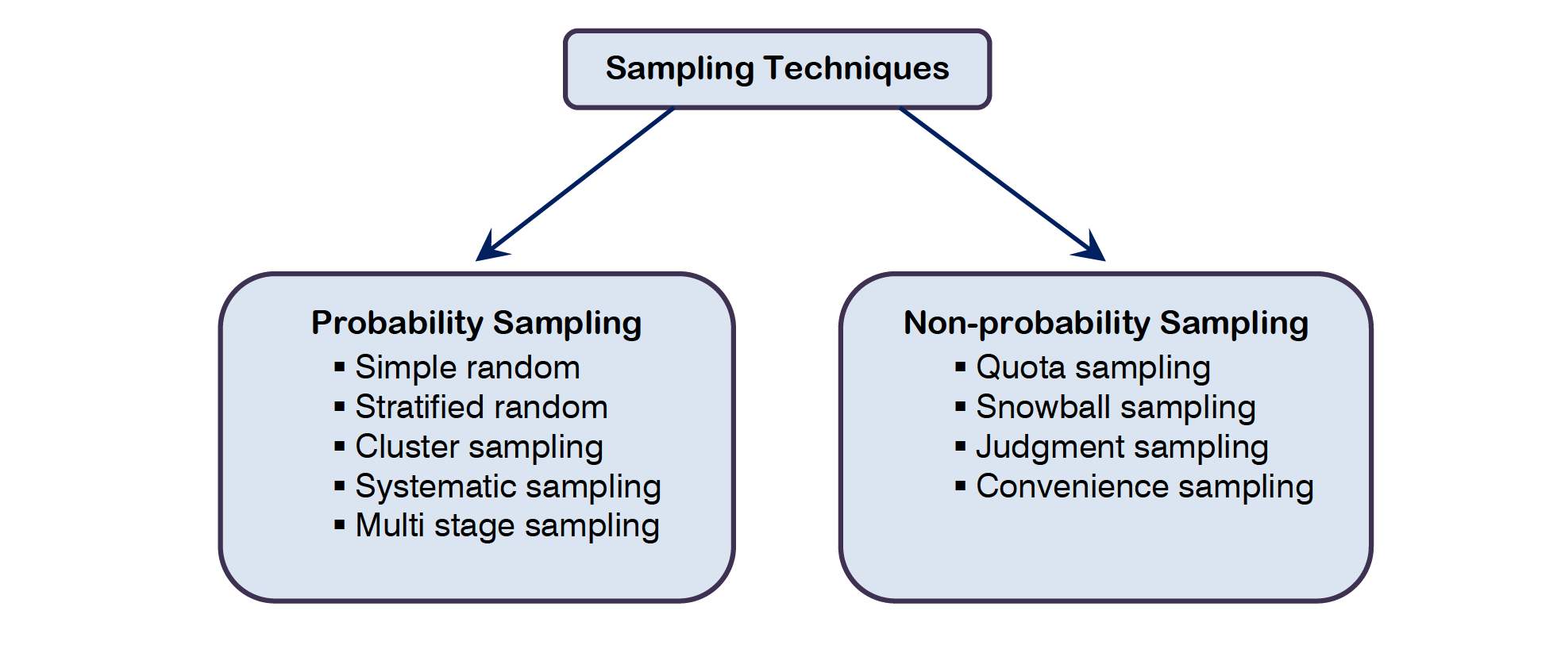
Sampling Technique

Slide 9
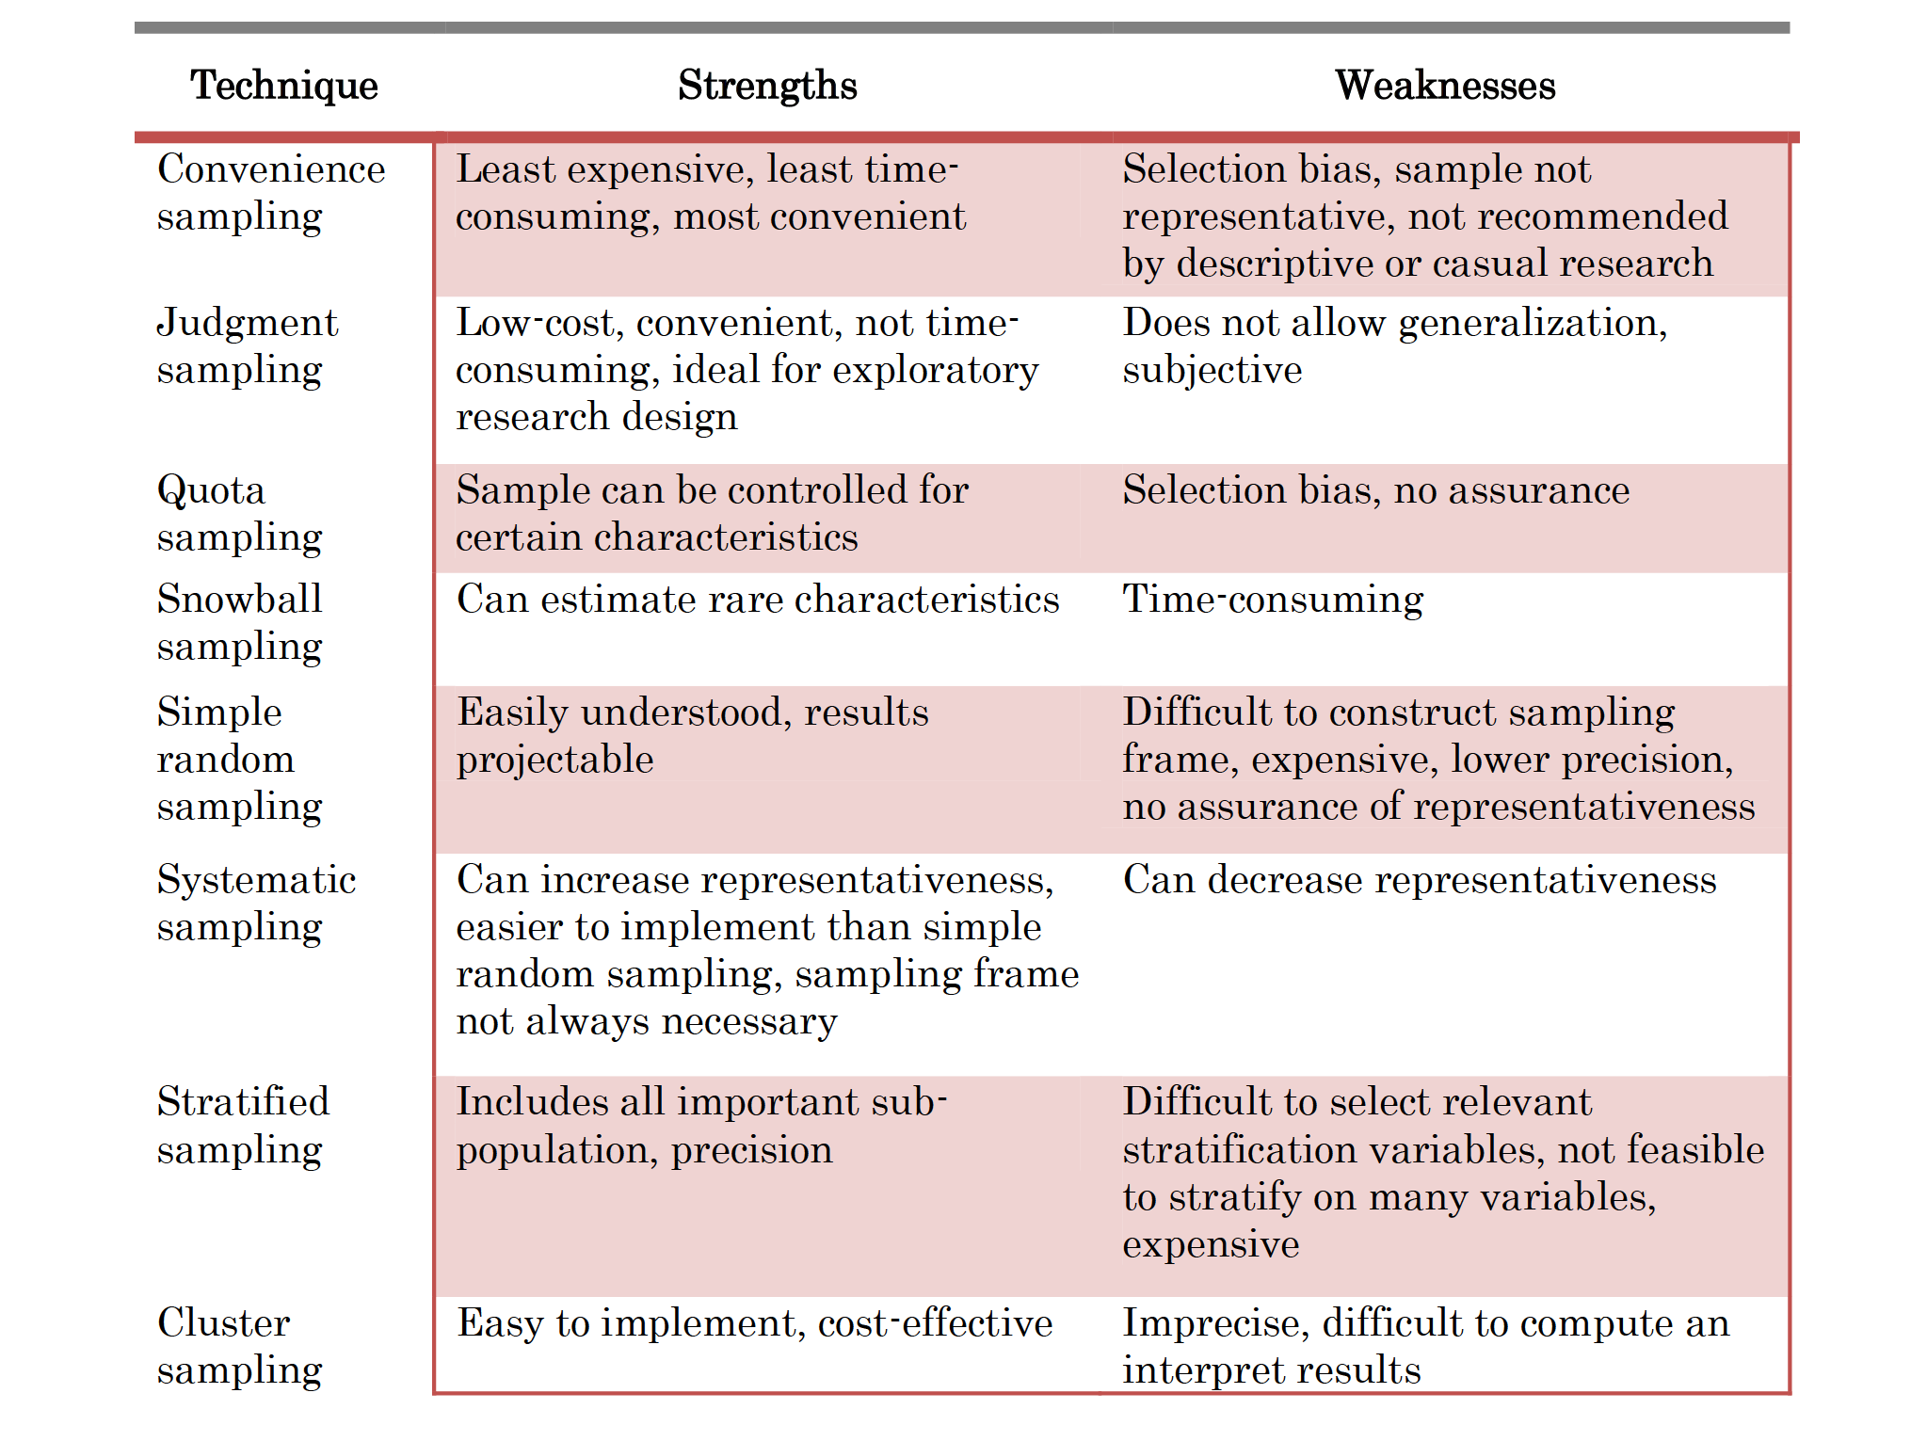

Slide 10
Sample related issues
Determining sample size
Collect Data
Assessing response rate

