Slide 1


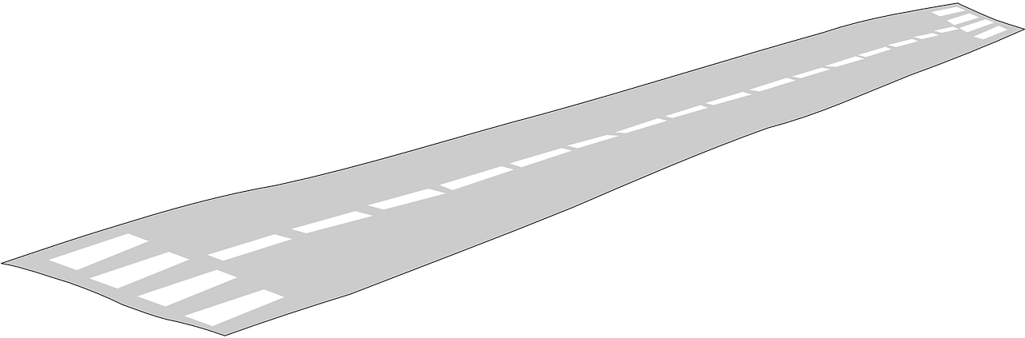
The Factors that affect the growth of Low Cost Airline in South East Asia

Slide 2


Agenda
Introduction
Literature Review
Pros and Cons
Methodology
Framework

Slide 3

Introduction
Southeast Asia has been a market of rapid growth but low profits over the past few years and tend to be the same in 2019.
Of 20 publicly traded airlines based in Southeast Asia, only six were in the black for 3Q2018 and 19 recorded a decline in profitability compared to 3Q2017. Intense competition and a generally price sensitive population made it difficult for airlines to pass on higher fuel costs.
While fuel prices have again been on the decline in 4Q2018, there can be no predicting where fuel costs will be in 2019.
Notes:
Southeast Asia has been a market of rapid growth but meagre profits over the past few years and the outlook for 2019 is more of the same. In fact, profitability will likely slip further following a deterioration in market conditions in 2H2018.
Of 20 publicly traded airlines or affiliates based in Southeast Asia, only six were in the black for 3Q2018 and 19 recorded a decline in profitability compared to 3Q2017. Intense competition and a generally price sensitive population made it difficult for airlines to pass on higher fuel costs.
While fuel prices have again been on the decline in 4Q2018, there can be no predicting where fuel costs will trend in 2019. What is certain is that competition will remain fierce in Southeast Asia, pressuring yields as airlines struggle to find profitable markets for deploying additional aircraft. In this environment, fuel prices are pivotal and the lowest cost operators prevail.

Slide 4
Literature Review

Slide 5


Seat capacity
Southeast Asia Airline 2019 Outlook: In this fast growth market low costs are essential
LCCs have captured most of the attention, due to their rapid expansion and massive aircraft orders. LCCs have added nearly 200 million seats this decade, resulting in Southeast Asia’s LCC penetration rate increasing from less than 30% in 2008 to nearly 50% in 2018.
Domestic growth in Southeast Asia has slowed significantly as the markets have started approaching saturation after several years of rapid growth
1. domestic market
2. international market
Now experiencing faster international than domestic growth. international seat capacity is one of the highest international penetration rates in the world
Notes:
domestic: However, domestic growth in Southeast Asia has slowed significantly as the markets have started approaching saturation after several years of rapid growth driven by LCC stimulation. Fares are already very low, and with a large portion of the population having already started to fly in recent years the opportunity for more rapid domestic growth is limited.

Slide 6



2. Economic factors affecting aviation demand
- Liberalization policy
The lessening of government regulations and restrictions in an economy in exchange for greater participation by private entities
- Intense competition in Aviation industry
New entrants are an issue for many of the established players
more fierce competition as regional airlines struggle to return to profitability.
lower in ticket prices
increase in demand
Government policy and Deregulation
Notes:
file:///C:/Users/user/Downloads/ECONOMICFACTORSAFFECTINGAVIATIONDEMANDPRACTICEOFEUCOUNTRIES.pdf

Slide 7


2. Economic factors affecting aviation demand
2 major groups Business
Leisure travel
-Good Economic performance VS Weak Economic performance
Good economic but population could be affected negatively if demand is insufficient.
Weak economic , airline demand will be affected negatively.
2. The Size of Population
Notes:
Demographic factors also have significant role for aviation demand. The size or distribution of population is one of potential determinants of demand. Even if a country or a region has good economic performance, population will be affected negatively if demand is insufficient. On the contrary, if a region or a country with a very large population is weak in terms of economic performance, the airline demand will also be affected negatively.

Slide 8


3. Aircraft evolution and airline growth
The air transport industry participated in two innovations in 1966
Both resulted from a collaboration of the manufacturer and user.
Coupled with rapid technical evolution, have resulted in the fast and almost continuous growth of the airlines
1. Technology and innovation
the initiation of large-capacity aircraft
2. the introduction into service of the quick change airplane.
Notes:
3. Technology and innovation
this can changes in our social environment and achieved through innovation and evolution
the air transport industry participated in two innvations in 1966 are
the initiation of large-capacity aircraft
which has advantage to the airlines in terms of economies of scales which lead to lower fares and improved level of passenger convenience
the introduction into service of the quick change airplane
which result in terms of more reliable, safe and economical transportation
both resulted from a collaboration of the manufacturer and user caused the fast and continuous growth of the airlines since the first beginnings.
therefore, the efficient airline operation and the incorporation of improved technology increased the demand of low cost airline

Slide 9



3. Aircraft evolution and airline growth
2. Perspective of people toward the air transportation
Education level
greater Income
Lifestyle
Notes:
4. perspective of people toward the air transportation
This factor have a positive correlation with the magnitude of air travel lead to the growth of airline industry
education level related to income
As the higher level of education, people tends to get more income which caused the incentive to travel through airplane and have a financial supports.
lifestyle or travel habit pattern changes
Increase in income can also change in habit pattern on traveling abroad or choosing more convenience trough flying
in addition, young people grown up in an environment of safe and reliable air travel as a normal means of extending their social

Slide 10


pros and cons
pros
improved the transportation system
safer and more reliable
reduced transportation cost
more consumer choices
cons
the operation cost is high
air pollution and environmental problems
compettiveness between the industry
Notes:
pros and cons of the growth of low cost airline
pros
improved the transportation system in terms of more convenience
safe are more reliable due to the change of technology and innovation of aircraft and airline service
reduced transportation cost due to the economies of scale the benefit to customer and the competiness in the airline industry
more consumer choices which customer can choose depends on their preference and value of airline service
cons
The cost of operation is high because the airline transportation rates are higher than other types of transportation and depends on the climate. if the climate is not favorable, there will cause the problems
air pollution and environmental problems such as noise that may affect the people around airport
compettiveness between the industry affect train and bus demand to decreased

Slide 11

Methodology
Secondary research
Gathers existing information through available sources online
get an initial understanding of the collected data that related to the topic
analyze the data

Slide 12
Framework
Low cost airline demand
Improved technology
Seat capacity
The size of population
Perspective of people toward the air transportation
Government policy
Price
Number of firms in airline sector

Slide 13
Conclusion
The emerge of Low Cost Airlines Industry in South East Asia in recent year affected by the factors as the following ; seat capacity , size of population , government policy , technology and perspective of people toward the air transportation
Even though there are many newcomers in this industry we could state that South East Asia is a rapid growth , but meagre profits which lead to the slipping in the profitability in the future.

