Slide 1
Topic 12 Part 2
Factor Markets
(FRANK, Chapter 14)

Slide 2
How the Two Markets Interact
We have derived an individual firm’s demand for labor:
VMPL = w for a competitive firm in the product market
MRPL = w for a monopolist in the product market
Market demand for labor = Sum of individual firms’ demand.
An individual worker’s supply of labor comes from his/her optimal choice between leisure and wage.
The individual labor supply curve can be backward-bending.
Market supply of labor = Sum of individual workers’ supply.
The market labor supply curve is upward-sloping.

Slide 3
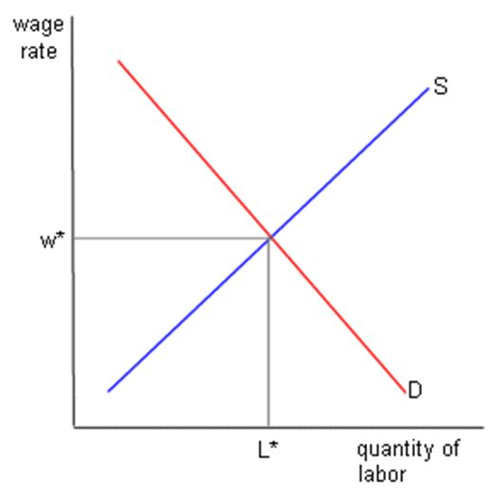
How the Two Markets Interact
In the competitive factor market, Market Demand for Labor and Market Supply of Labor determine the equilibrium wage W*.
An individual firm then takes W* as given, and decides how many workers to hire.

Slide 4
Monopsony
A monopsonist is the “sole buyer” in the factor market.
A classical example is one company in the town where workers cannot or will not leave the area.
In the competitive factor market, firms takes W* as given and face a horizontal labor supply curve at W*. (See Page 3)
In the monopsonist factor market, the monopsonist faces the upward-sloping market labor supply curve.
Here, the monopsonist no longer takes W* as given.
How many workers it hire will affect the wage it faces.

Slide 5
Monopsony
Monopsonist faces the market supply of labor. (BLUE S)
Competitive firms face the horizontal supply at W*. (RED Dotted)

Slide 6
Monopsony
In factor markets,
Average Factor Cost (AFC) is another name for the supply curve for an input.
AFC represents the average payment per worker to achieve any given level of employment.
Total Factor Cost (TFC) = AFC x L
Marginal Factor Cost (MFC) = ∆TFC/∆L

Slide 7
Monopsony
Labor Supply in the monopsonistic market is upward-sloping.
To hire 100 workers, the firm has to pay wage of $4 per worker.
TFC = 4 x 100 = 400
To hire 101 workers, the firm has to increase wage to $4.04 per worker.
However, the firm has to pay this high wage to everyone else.
TFC = 4.04 x 101 = 408.04
MFC is the addition cost from this additional (101ST) worker, equal to $8.04.
MFC = (408.04 – 400)/(101 – 100) = 8.04

Slide 8
Monopsony
AFC and MFC
In the monopsonistic market, the labor supply is upward-sloping.
Suppose AFC is linear, i.e. AFC = a + bL.
We have TFC = aL + bL²
MFC = a + 2bL
The slope of MFC is twice as much as that of AFC.

Slide 9
Monopsony
Monopsonist’s Profit Maximization
Firms in the competitive factor market will hire the workers at the point where VMPL = w or MRPL = w.
But for a monopsonist, w is NO LONGER constant.
To hire more workers, it has to pay higher wage.
The monopsonist will hire the workers at the point where
VMPL = MFC or MRPL = MFC.
That is, the extra gain from hiring extra worker equals the extra cost from hiring extra worker.

Slide 10
Monopsony
The monopsonist will hire the workers at the point where
VMPL = MFC or MRPL = MFC. This will be at L*.
At L*, the market supply indicates that the wage will be W*.
This will be the wage that the monopsonist pays their workers.

Slide 11
Example

Slide 12
Monopsony
Comparison b/w Monopsony and Competitive Factor Market
In the competitive factor market, wage is determined by market demand (D) and market supply (S).
The competitive equilibrium is therefore at (L**, w**).
The monopsonist equilibrium is (L*, w*).
Workers are paid lower wage, and fewer workers are hired.

Slide 13
Monopsony
Comparison b/w Monopsony and Competitive Factor Market

Slide 14
Monopsony
Comparison b/w Monopsony and Competitive Factor Market
This shows exploitation of workers and inefficiency.
The main cause is that if the monopsonist wants to hire more workers, it has to increase wage, but it also has to pay this high wage for all other workers. This causes it to hire less workers.
In the competitive factor markets, one firm hiring more workers does not raise the market wage, so all firms can hire more.

Slide 15
Monopsony – Minimum Wage
Standard Model for Minimum Wage Law

Slide 16
Monopsony – Minimum Wage
Monopsonist Model for Minimum Wage Law

