Slide 1

"Marketing/Branding Strategies in CLMV "
Part II
By Ajarn Suwalya

Slide 2
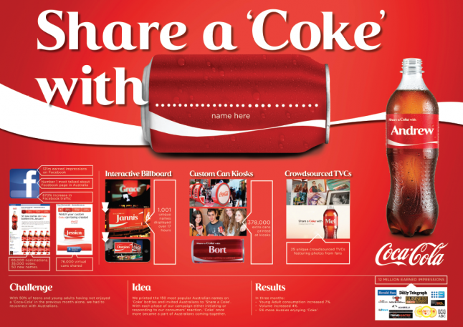
Coke: Share a Coke Campaign
Global initiative into South East Asia

Slide 3
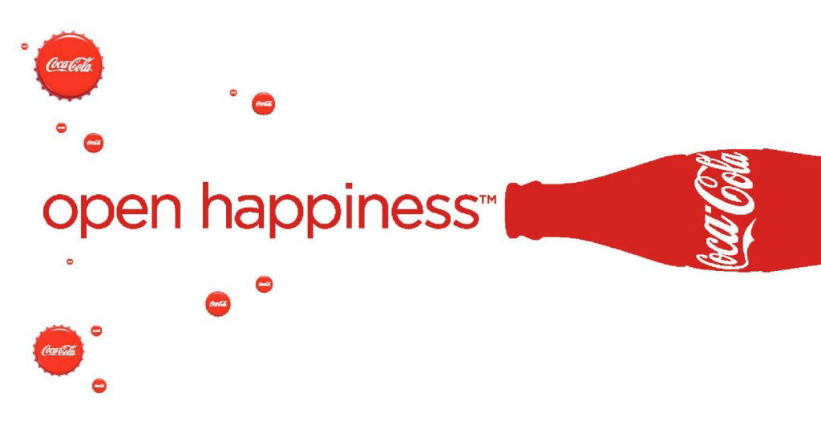

"Share A Coke" Campaign Success

Slide 4
Share a Coke
Coca Cola is all set to spread the message of happiness in the tropical contours of the coconut country Thailand. This time, the leading cola brand is asking you to "Be Fizzy, Be Bold, Share a Coke".
Investing an outstanding 140 million Baht, the entire Thailand will be flooded with 250 million Coke cans, having people's nicknames and their expressions printed on them.
"We know that Thai people are positive and happy … But they are also very reserved about expressing how they feel about other people, especially when those feelings are mixed with special emotions or are particularly complimentary,” Konstantinos Delialis, marketing director of Coca-Cola (Thailand), said in his first interview with local media.
‘Share a Coke’ campaign is a marketing initiative by Coca Cola that started from Australia, and then went on to the UK, Italy, France, Brazil, Austria, Germany, Greece and Israel.
The summer campaign invited consumers to share a moment of happiness with friends, family and loved ones by swapping the iconic logo on the Coke bottles with personalized names. From user generated print names to social media sharing, the campaign has it all.
Source: Sulfiqar Ali Sajwani

Slide 5
YES, IT’S A HIT!
With the outstanding results on board, it would not be wrong to say that Coca Cola’s ‘Share a Coke’ campaign is one of the most successful global campaigns by the company till date.
Australian statistics of the campaign reveal that Young adult consumption increased significantly by 7%. The campaign also earned a total of 18,300,000-plus media impressions, and traffic on the Coke Facebook site increased by 870%, with page likes growing by 39%.
Source: Sulfiqar Ali Sajwani

Slide 6
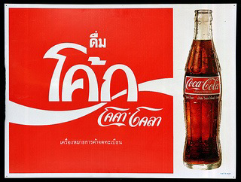
What about the Thai Market?
Coca cola launched a campaign to collect 1 million reasons why Thai people believe in a better future for their country. These reasons will all be compiled into a book called the One Million Reasons, Believe in Thailand.
Users can send their message through many media platforms such as Facebook, Twitter, YouTube and Instagram. You can use the hashtag #COKE1M. This is a great way to get the people of Thailand inspired to live a better life and make a better future for their country(Palsingh, 2012).
In Thailand the soft drink market is very competitive, with Coke coming in at 24% and Pepsi at 40%. Coke’s sales have been affected dramatically due to Thailand’s heavy rainfall and monsoons that have isolated two-thirds of the population.
After the country had been in critical condition from the floods, social media sites were spread with many depressing messages of the state that the country was in. Coke, seeing this advantage to start a new campaign that would benefit the morale of the country and Coca Cola(Cream,n.d).
Source: Lindsayaustin worldpress.com

Slide 7
What about the Thai Market?
People were encouraged to write in their stories of hope and this received attention from people all over the world. 137 million messages made it on Coke’s Facebook page and this brought happiness to Thailand(Facebook, 2013).
The campaign also brought awareness to 92% of Thai people, coke sales went up to 29 million unit cases and market share increased from 24% to 30%.
This was a win win campaign for Coke and Thailand. This campaign was really inspirational, in that it showed a country that had nothing and was depressed to reaching out and helping many Thai people achieve happiness for their country.
Source: Lindsayaustin worldpress.com

Slide 8

What about the Vietnam Market?
Over the last two years, Vietnam has been one of the world's fastest-growing markets for brand Coca-Cola across. Coke’s brand love scores are also growing fast in Vietnam. The country’s first "Share a Coke" campaign in 2014 helped drive a lot of that success. This year, there was a new challenge: Maintain strong momentum for the brand, especially with teens, where the market competition is intense.
To take "Share a Coke" to the next level, the Vietnam team looked to the now-universal language of emoticons. In Vietnam – as in much of the world – young people use emoticons to share how they feel. Coca-Cola Vietnam introduced 41 emoticons. “Emoticons have become a perfect sharing platform, a sharing of human feelings,” said Pratik Thakar, integrated marketing communications director for Coca-Cola’s ASEAN business unit, which includes Vietnam. “It transcends language barriers and has pretty much become a part of popular culture across most ASEAN markets.”
Vietnam kicked off the first phase of the campaign to build awareness. Beyond traditional media, a “social invasion” entailed bloggers and local celebrities introducing Coke’s new emoticons. Special partnerships with Facebook and the country's largest local messaging platform, Zalo, helped spread the word.
Source: www.coca-cola.com

Slide 9
What about the Vietnam Market?
In the second phase, the team is focused on inspiring teens to share their own stories. Consumers will be able to personalize cans at retail outlets and customize stickers on Zalo. Within four days of the phase two launch, consumers had downloaded 1.3 million stickers.
"Share a Coke emoticons are, once again, proving our way of doing marketing with the consumer at heart,” said Uyen Pham Na, marketing director, Coca-Cola Vietnam. “I believe Coke emoticons will be a new way for Vietnamese teens to communicate their feelings. This campaign not only brings Coca-Cola closer to our consumer but also benefits our business with promising volume increase."
Basil Sidky, general manager for Coca-Cola in Indochina, added, “I am very excited about the Coke emoticon campaign. It’s smart to leverage the youth’s social currency to boost the brand’s relevance in this mobile and digital era, giving us a much richer ground to engage with our consumers.”
The campaign is scheduled to roll out across Thailand later this year and in the Philippines in the summer of 2016.
Source: www.coca-cola.com

Slide 10
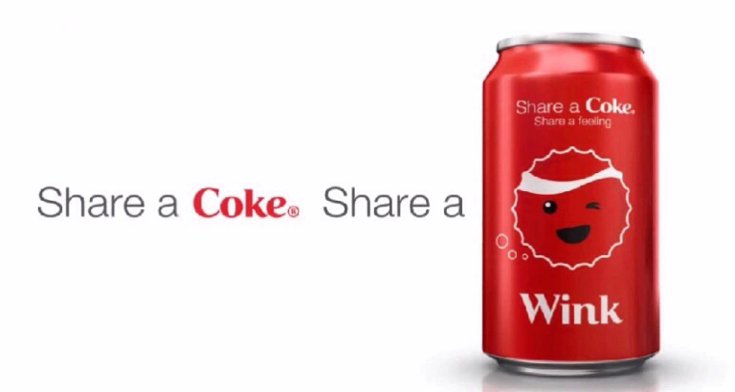
What about the Vietnam Market?

Slide 11

TVC : Coca Cola: The Happiest Thank You
Malaysia

Slide 12
TVC : Coca Cola: Share A Coke
Vietnam

Slide 13
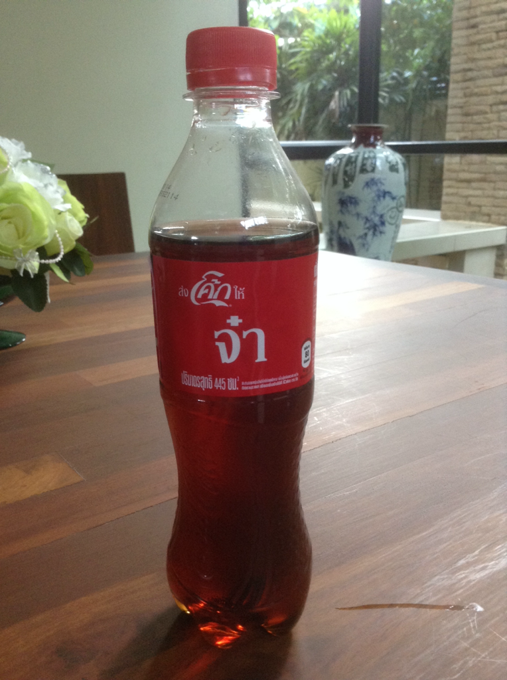

Slide 14

Life at Unilever Vietnam
Unilever Cambodia

Slide 15

Unilever : Axe Excite Brand Activation

Slide 16
Unilever : Axe Excite
Launched in Europe
How suitable is this for the Asian Market?
How can you localize this brand activation campaign to fit the Asian Market?

Slide 17
The Brand Essence
Four Steps of Brand Building

Slide 18
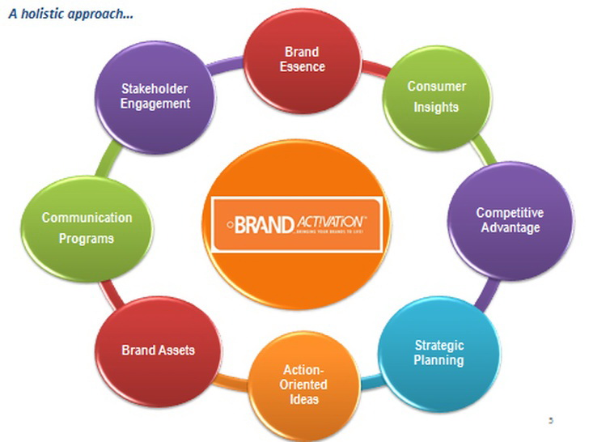
Holistic Approach to Brand Activation
Brand Activation
Activating your brand for the strongest results requires consistency with brand strategy and finding the correct communication and marketing mix to carry that message. This holistic approach is what Brand Activation uses to get extraordinary results by implementing game changing programs.

Slide 19
The Four Steps of Brand Building
Ensure identification of the brand with customers and an association of the brand in customers’ minds
TARGET GROUP
Establish the totality of brand meaning in the minds of consumers
Position
Elicit the proper customer responses to the brand identification and brand meaning
Communicate
Convert brand response to create an intense, active loyalty relationship between customers and the brand Customer Relations

Slide 20
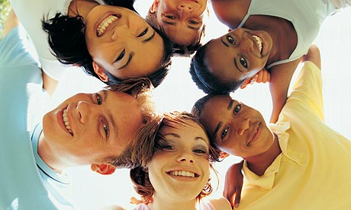
Step 1: Segmenting & Targeting

Slide 21
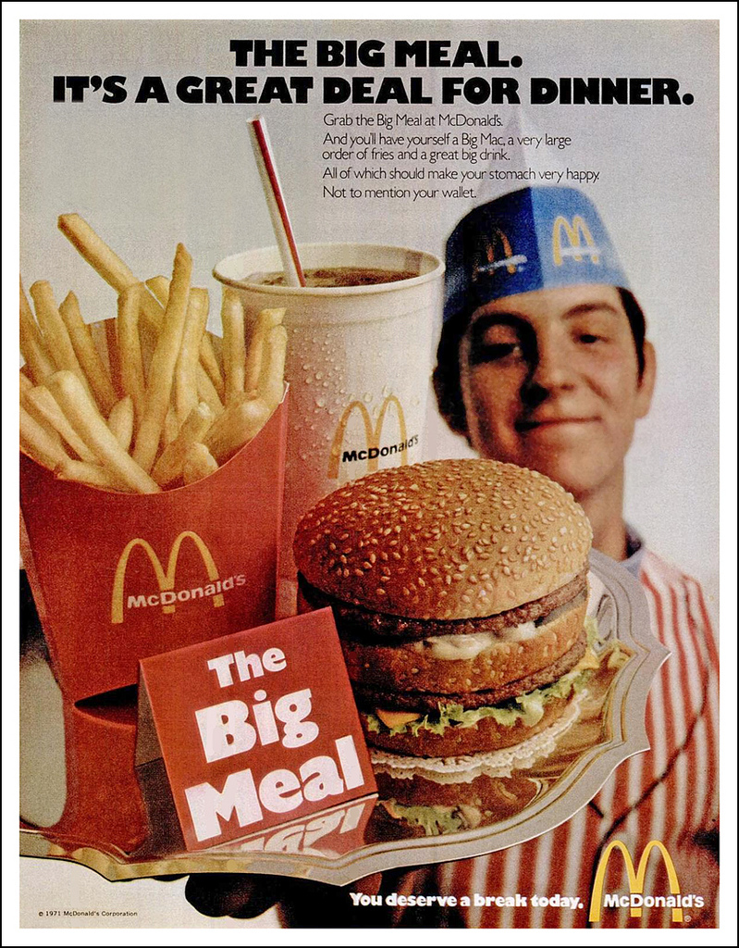

Slide 22
Step 2: Brand Positioning
Is at the heart of the marketing strategy
“. . . the act of designing the company’s offer and image so that it occupies a distinct and valued place in the target customer’s minds.”
Philip Kotler

Slide 23
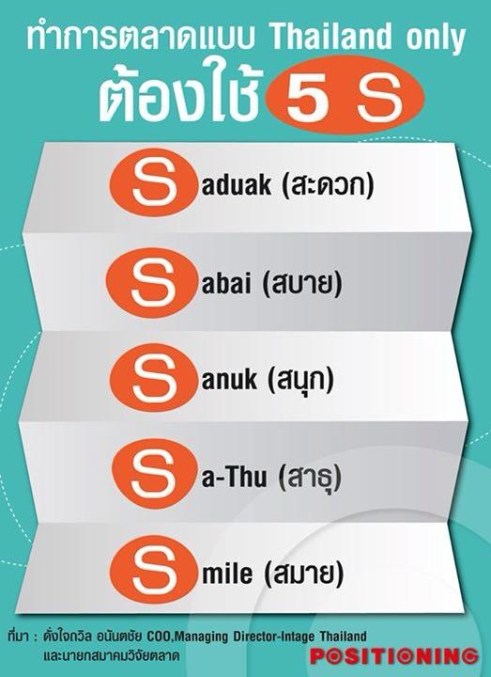
Convenience
Relaxed
Fun
Blessed
Smile

Slide 24
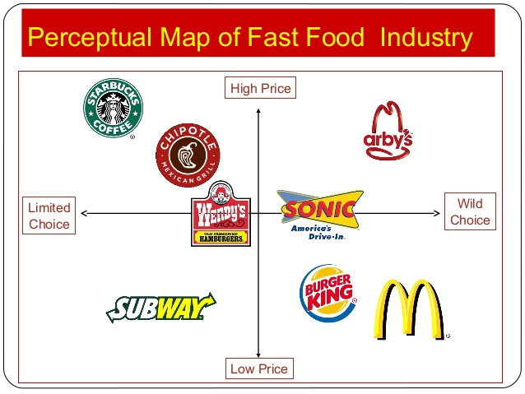
Brand Positioning: Perceptual Map
A perceptual map provides a visual picture of how customers see different competitors.

Slide 25
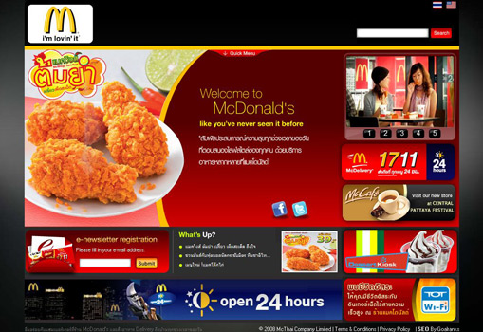
McDonald’s Menu in Thailand

Slide 26
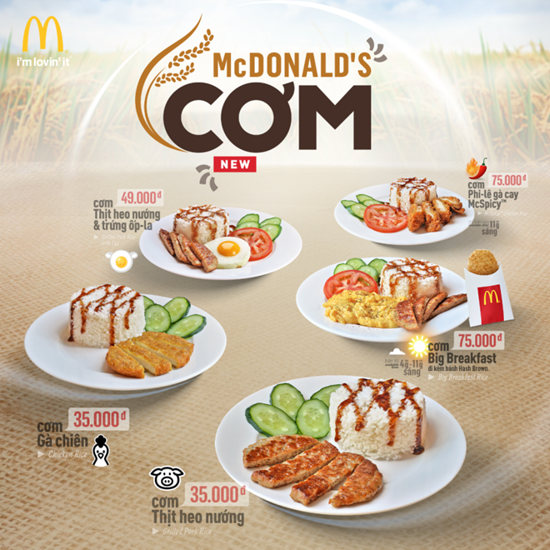
McDonald’s Menu in Vietnam

Slide 27
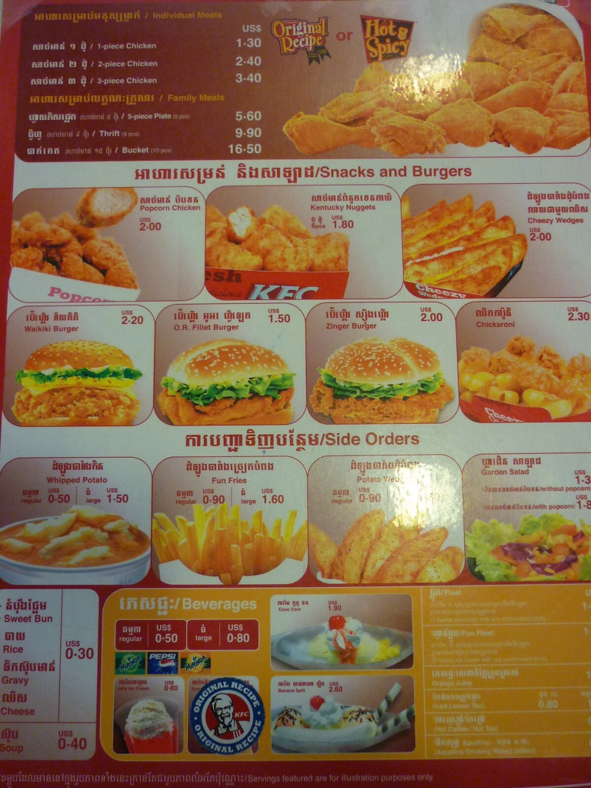
KFC's Menu in Cambodia

Slide 28
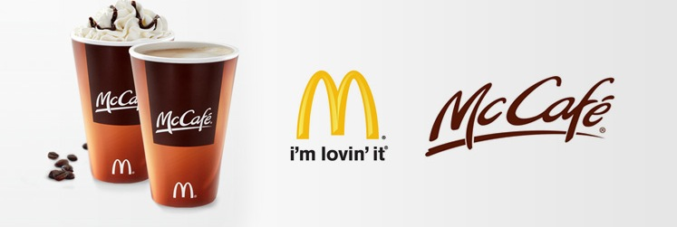
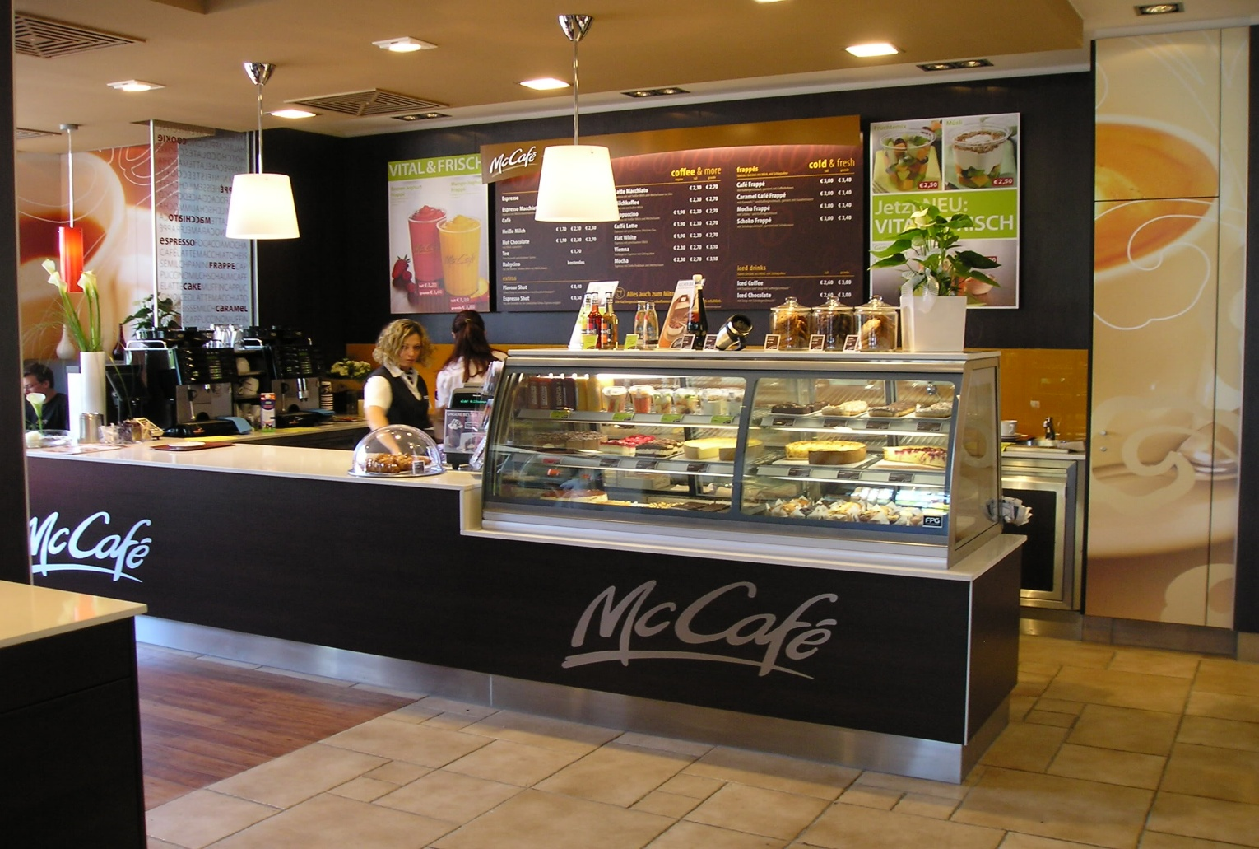
McDonald’s adding more Variety

Slide 29
Step 3: Communications via
Brand Elements
A variety of brand elements can be chosen that inherently enhance brand awareness or facilitate the formation of strong, favorable, and unique brand associations.
Brand Names
URLs
Logos and Symbols
Characters
Slogans
Packaging
Notes:
20

Slide 30
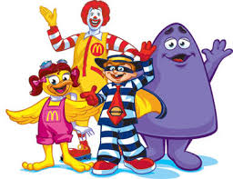
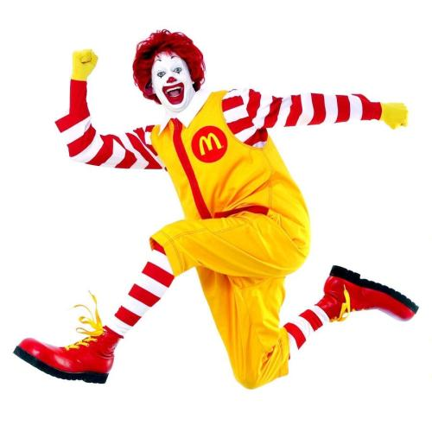
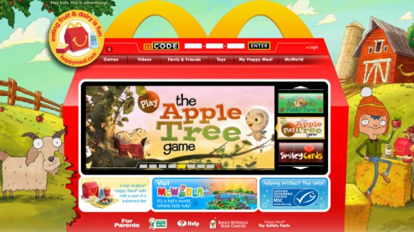

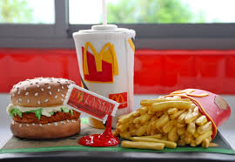
Example: McDonald’s
Brand Names
URLs
Logos and Symbols
Characters
Slogans
Packaging

Slide 31
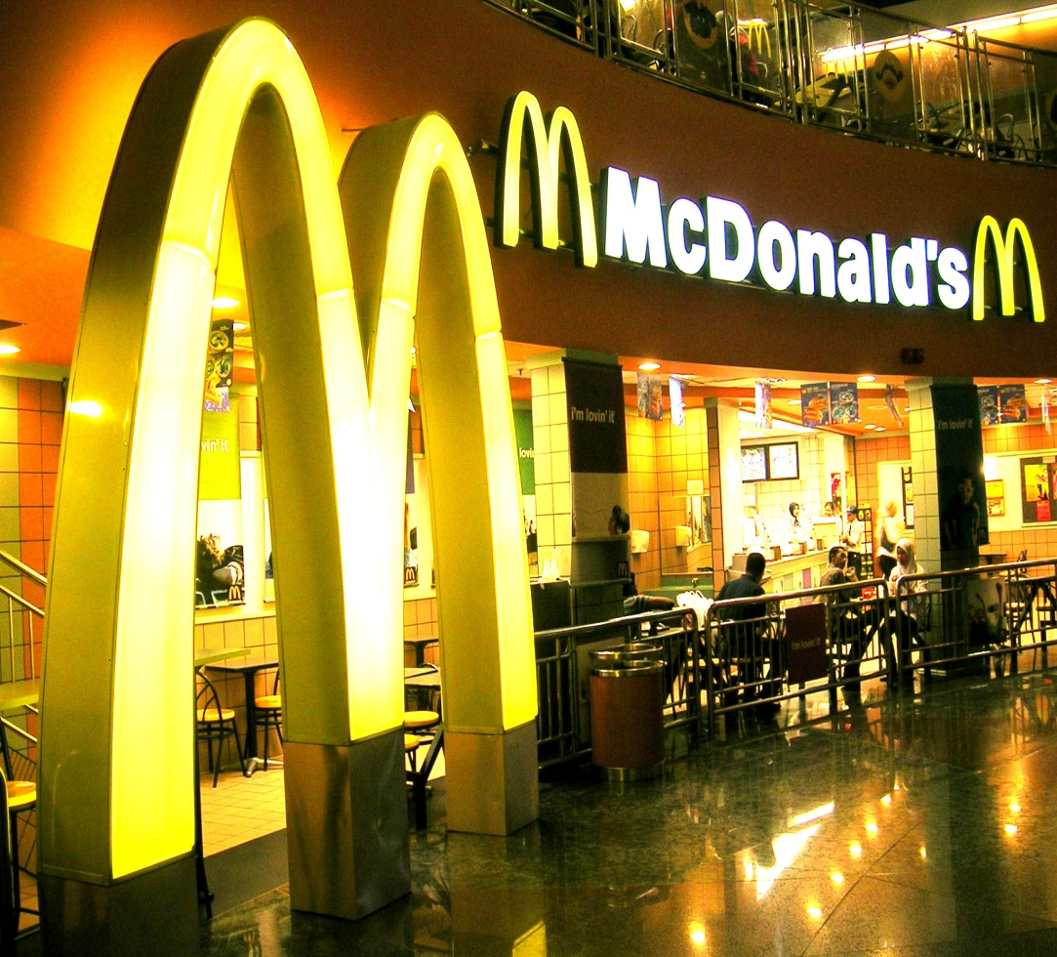
Putting It All Together
The entire set of brand elements makes up the brand identity, the contribution of all brand elements to awareness and image.
The cohesiveness of the brand identity depends on the extent to which the brand elements are consistent.

Slide 32

Brand Personality
Brand Personality: is the set of human characteristics that become associated to the brand….

Slide 33

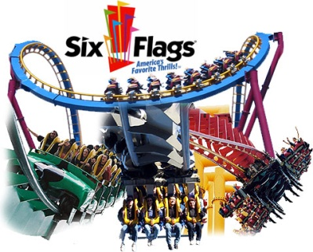


Dimensions of Brand Personality
Brand personality
Sincerity
Down to Earth
Honest
Wholesome
Cheerful
Excitement
Daring
Spirited
Imaginative
Up to Date
Competence
Reliable
Intelligent
Successful
Sophistication
Upper class
Charming
Ruggedness
Outdoorsy
Tough

Slide 34
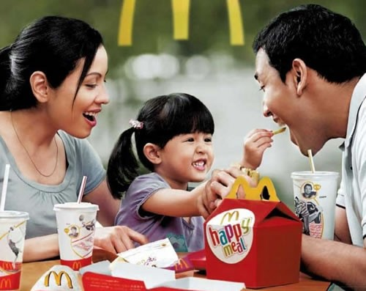
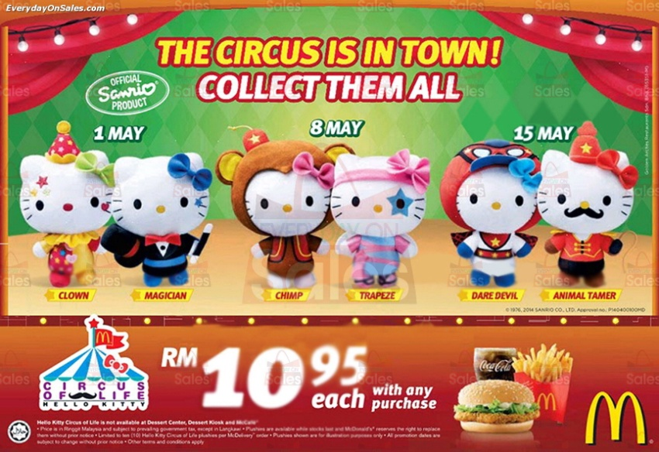
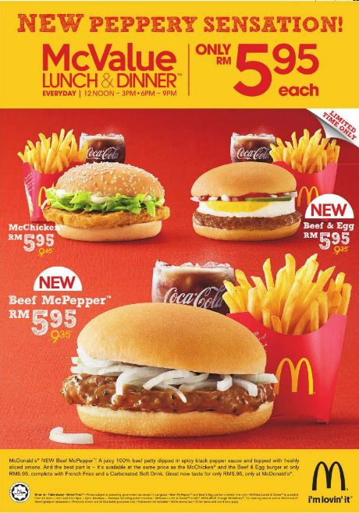
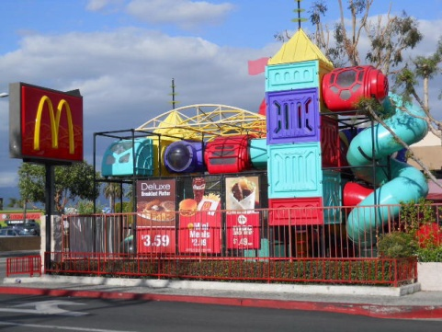
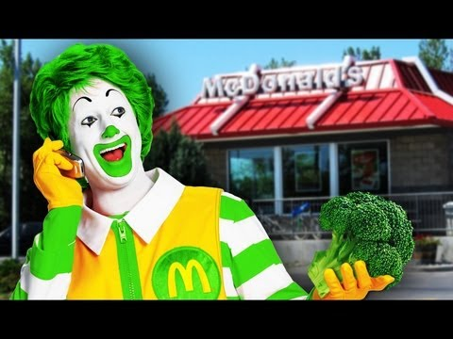
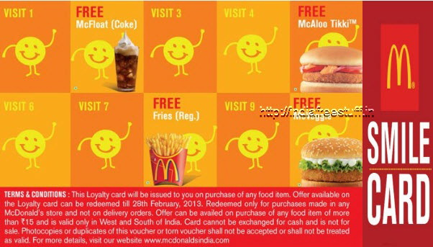
Step 4: Customer Loyalty – Brand Activation

Slide 35
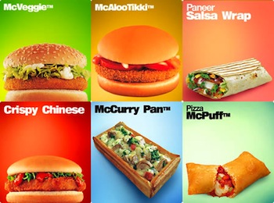
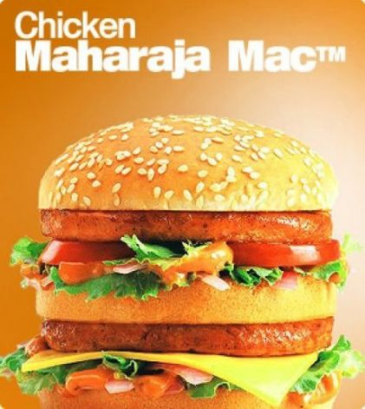
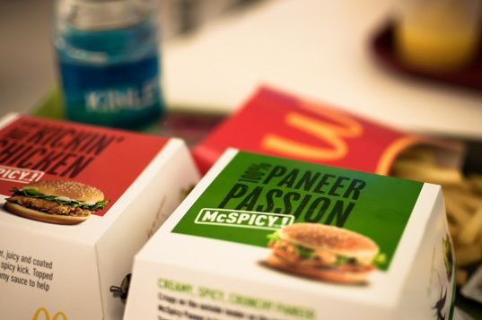
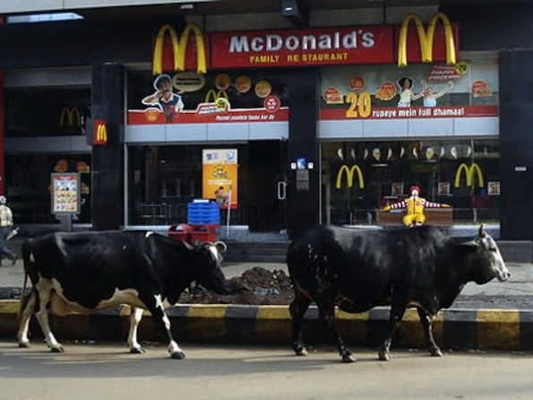
Vegetarian McDonald’s Opening in India vdo from SourceFed ( (Opened 2 restaurants in 2013)

Slide 36
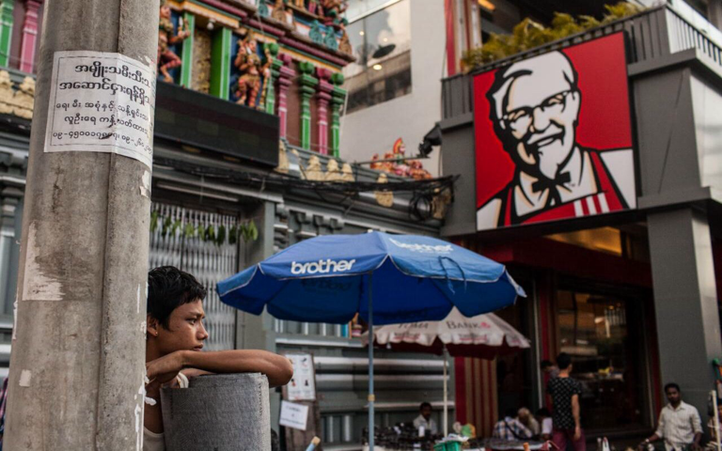
McDonald's Vietnam
Myanmar's First KFC

Slide 37

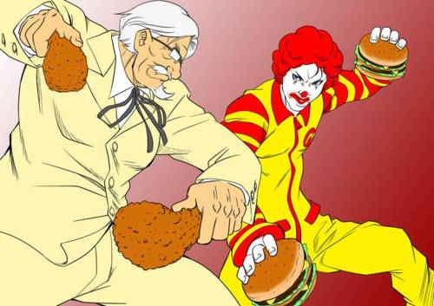
The Brand Challenge

Slide 38
Your Challenge
Please form teams of 7-8 students
1.You will have 20 minutes to do the following:
Create a new brand for your new product. You are to use the lessons learned from the handouts especially the major brand elements.
Create one brand activation activity that could engage your target audience.
  Note: You will have to create your team name and everyone has to come up in front, but does not have to present.
  2.Each team will then have 5 minutes to present
Introduce your team and your new brand
Criteria for judgment for winning team includes creativity, differentiation, and purchase intent.

Slide 39
Your Challenge
Topics for brand building:
Lipstick for Men (Metro-sexual Market)
Shampoo for Teenagers
Soft Drink for Pregnant Women
Sports Wear for Old Age (Age 60 up)
Ice Cream for people with sensitive teeth and gums

Slide 40
Today’s takeaways…
The meaning of brands
  Getting Started
The Brand Essence
  The importance of Culture and Technology
  Brand Activation in Thailand
Brand Building
  The 4 steps
The Brand Challenge- mini simulation

Slide 41

Questions Anyone?

Slide 42
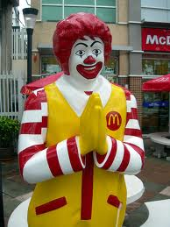
Kob Kun Krub…Ka
Thank you

