Slide 1
Instruments to Alleviate Poverty
EE463 Globalization and international development
Faculty of economics
Thammasat university

Slide 2
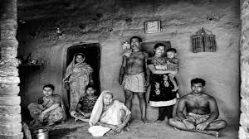
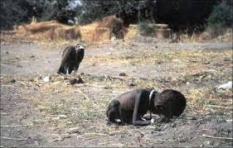
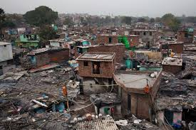
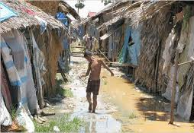
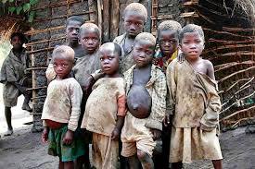
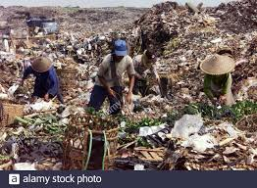
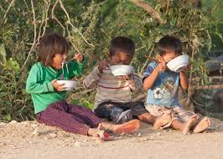
Snapshots of poverty

Slide 3
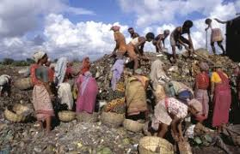
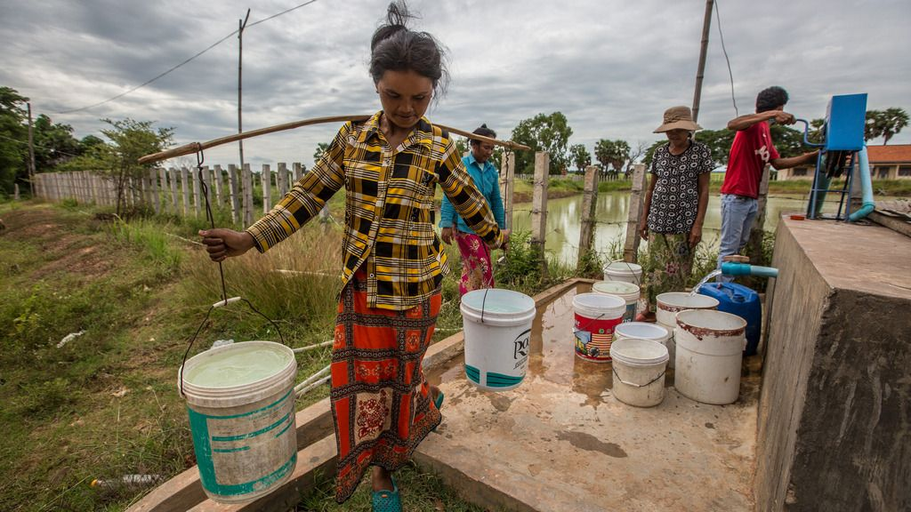
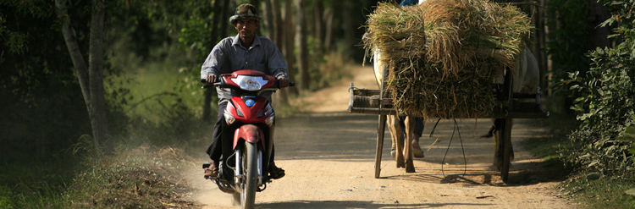
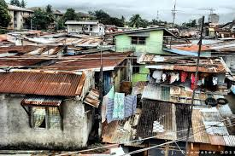

Slide 4
Instruments to alleviate poverty
Strategies
Policies
Poverty assessments
Programs
Projects

Slide 5
Poverty alleviation strategy
Poverty alleviation strategy: a broad direction (usually at the national level) containing economic and humanitarian measures intended to permanently lift people out of poverty
Several types of poverty alleviation strategies:
community organizations based micro-financing,
capability and social security
market-based measures
good governance

Slide 6
Policy and the policy cycle
A policy is a set of principles to guide decisions and achieve rational outcomes. A policy is a statement of intent, and is adopted and implemented by a mandated authority (e.g., government agency)
A policy cycle is a process that explains how policy should be drafted, implemented and assessed; and translate public demands into government action. It involves 6 steps:

Slide 7
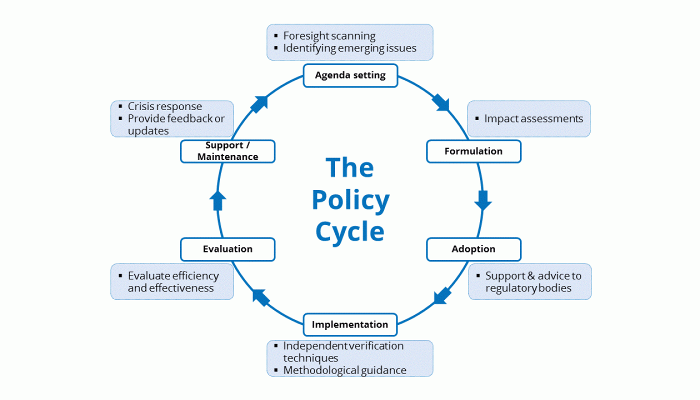
The Policy Cycle

Slide 8
The policy cycle
Agenda setting: Identifying problems that require government attention and defining the nature of the problem
Policy formulation: setting objectives, identifying costs and estimating the effect of solutions
Adoption: Ensuring that the chosen policy has support of various stakeholders
Implementation: making sure that policy decisions are carried out as planned
Evaluation: Assessing the extent to which the policy was successful or the policy decision was the correct one
Support and maintenance: Considering if the policy should be continued, modified or discontinued

Slide 9
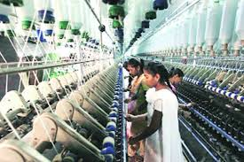

Examples of policies to alleviate poverty
Create jobs
Raise the minimum wage
Support pay equity
Provide paid leave and paid sick days
Establish flexible work schedules
Invest in affordable, high-quality child
care and early education
Expand medical coverage to the poor
Conditional cash transfer to the poor
Provide basic infrastructure
Provide social protection (food subsidies, grants, in-kind)

Slide 10
Case study: setting the minimum wage
Agenda setting: Debates over minimum wages relate not only to the impact on profits, but to the unintended consequence for the workers: the possibility that employers would react by cutting hiring, leaving fewer jobs for workers at the low end of the employment ladder.
Policy formulation: A new minimum wage should be set based on a thorough review of the advantages and disadvantages of the policy
Adoption: the draft policy was discussed and agreed upon by the Ministry of Labor, National Assembly members and the National Federation of Laborers
Implementation: raising the minimum wage did cause a decrease in overall employment as some employers laid off some of their workers
Evaluation: Although there occurred layoffs, minimum wages are a promising route to raising living standards of the working poor
Support and maintenance: The policy of raising minimum wages should be continued and reviewed every 5 years

Slide 11
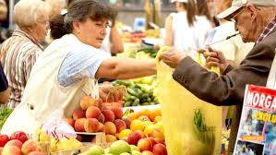
Poverty and social impact analysis
Poverty and Social Impact Analysis: an approach to assess the distributional and social impacts of policy reforms on the well-being of different groups of the population, particularly on the poor and most vulnerable
Evidence-based analyses of the potential poverty and social impacts of reforms offer insights into different policy options and support the decision making process; such analyses can help mitigate potential negative impacts and identify pathways to more inclusive reforms.

Slide 12
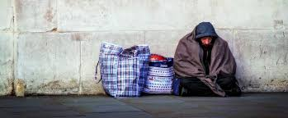
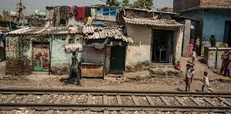
Rationale For psia
Policy makers are constantly trying to find better solutions to development problems and this involves analyzing and considering different policy options.
All reforms have costs and benefits which are usually distributed unequally across different groups of the population.
Even the best planned reforms may have unintended impacts on the poor and vulnerable groups

Slide 13
Benefits of PSIA
Poverty and Social Impact Analysis informs the design of policies and programs by:
Providing evidence on the poverty, social, and distributional effects of reforms;
Proposing changes and course corrections to a policy or program, and identifying measures to mitigate any adverse impacts;
Identifying alternative options to enhance poverty reduction and positive outcomes; and
Creating space for public dialogue around reforms through engaging stakeholders

Slide 14
PSIA FRAMEWORK
Asking the right questions
Analyzing stakeholders, institutions, impacts and risks
Understanding transmission channels
Gathering data and information to fill gaps
Enhancing positive and address negative impacts
Establishing monitoring and evaluation systems
Fostering policy debate and feedback for policy adjustment

Slide 15
Programs and projects
A project represents a single, focused set of activities with a goal, objectives, means and expected outcome and outputs within specific time and budget
A program is a collection of projects – together all the projects form a connected package of work. The different projects complement each other to assist the program in achieving its overall objectives

Slide 16

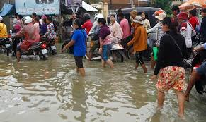
Programs and projects
Example 1:
A food assistance program to assist communities devasted by floods
Projects under the program:
Rehabilitation of damaged community infrastructure
Cash-for-work schemes for vulnerable groups
Micro-credit lending to communities

Slide 17
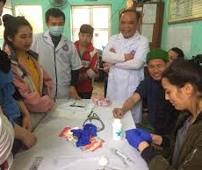
Programs and projects
Example 2:
Program to improve health in rural areas
Projects under the program:
Nutrition for elementary school children
Immunization for mothers and children
Awareness campaign for health and hygiene

Slide 18
Targeted interventions
Although the there is wide consensus on the role of economic growth as a means of long-term alleviation of poverty, most governments and donors continue to fund measures to target the poor directly and to provide a social safety net to protect against adverse shocks, through programs and projects
Such schemes can range from the provision of infrastructure, subsidized food, employment creation, access to health and other social facilities, microfinance and occasionally cash grants

