Slide 1
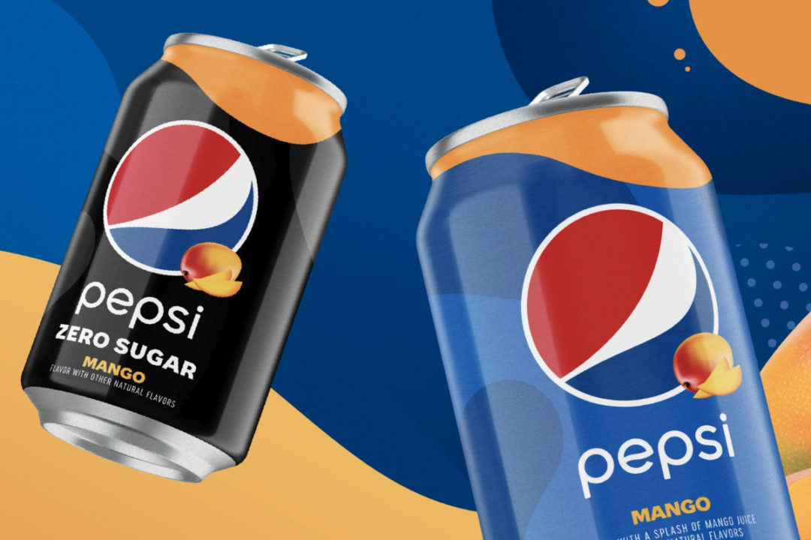
Pepsi introduces first permanent flavored cola in five years
Photo: PepsiCo, Inc.
PURCHASE, NY. — PepsiCo, Inc. is rolling out Pepsi Mango and Pepsi Mango Zero Sugar nationwide,
marking the brand’s first new permanent flavored cola in five years and the brand’s first permanent
release of a zero sugar and regular variety at the same time, the company said.
Featuring a blend of mango juice, cola and natural flavors, Pepsi Mango contains 150 calories,
\41 grams of sugar and 34 mg of caffeine per 12-oz can. Pepsi Mango Zero Sugar has 0 calories and 0 grams of sugar.
Pepsi introduces first permanent flavored cola in five years
PEPSI MANGO
CREDIT:
Thank you very much
James Nattaporn for sharing
PURCHASE, NY. — PepsiCo, Inc. is rolling out Pepsi Mango and Pepsi Mango Zero Sugar nationwide, marking the brand’s first new permanent flavored cola in five years and the brand’s first permanent release of a zero sugar and regular variety at the same time, the company said.
Featuring a blend of mango juice, cola and natural flavors, Pepsi Mango contains 150 calories, 41 grams of sugar and 34 mg of caffeine per 12-oz can. Pepsi Mango Zero Sugar has 0 calories and 0 grams of sugar.
ADAPTATION

Slide 2
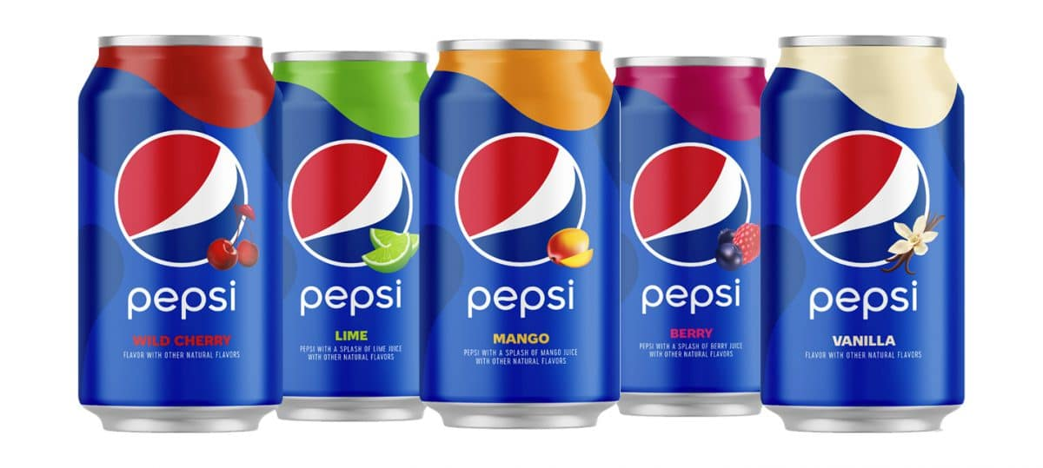
"Our consumers are always looking for new and exciting flavors, so we couldn't be more excited to introduce them to Pepsi Mango,” said Todd Kaplan, vice president of marketing for Pepsi. “Our team has created a surprisingly perfect match with Pepsi Mango, combining the delicious taste of Pepsi cola with the flavor of a sweet, juicy mango. Mango is one of the most popular fruits in the world, and it serves as the perfect complement to Pepsi, creating an irresistible combination that our fans can enjoy everywhere throughout the year."
03.18.2021
By Rebekah Schouten

