Slide 1
STATA
TA Section

Slide 2
Content
-Why stata?
-Do-file
-Import Data From Excel
-Window Interface
-Rename and Label
-Basic Statistic
-Graph(Scatter) and Line Fit Gen.
-Regression
-Variable Gen.
-HAM(Heteroscedasticity, Auto Correlation, Multi collinearity)

Slide 3
Why Stata ?
-Easy to use
-Have many advanced function
-Widely used in many research organization
-But still hard for newcomer

Slide 4
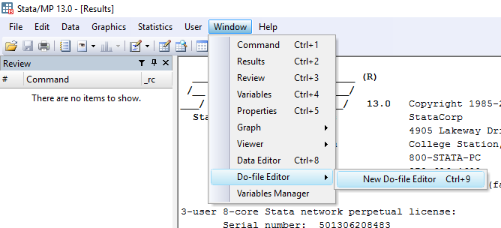
Do-file

Slide 5
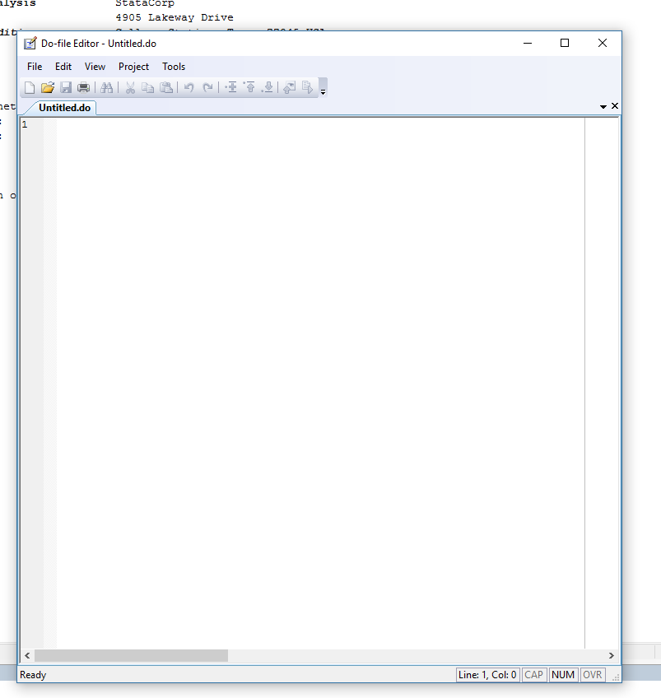
Do-file

Slide 6
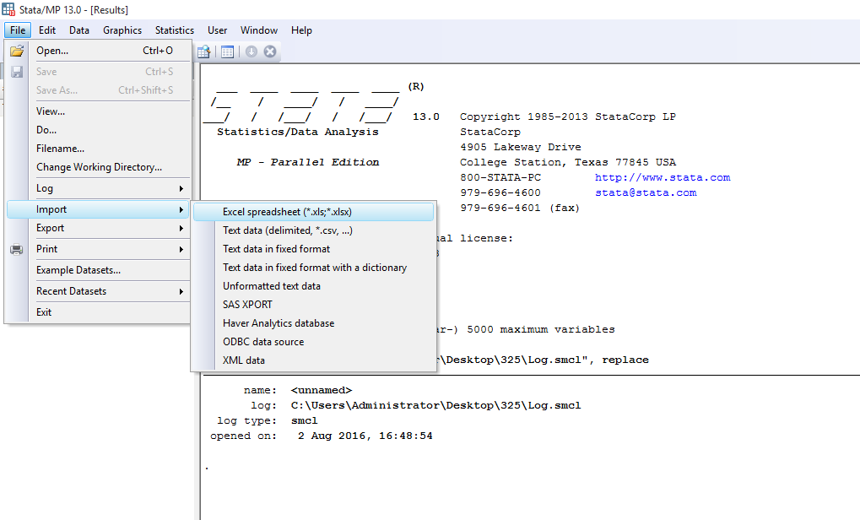
Import Data From Excel

Slide 7
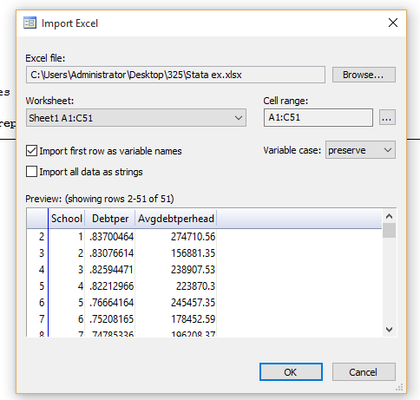
Import Data From Excel
Don’t forget

Slide 8
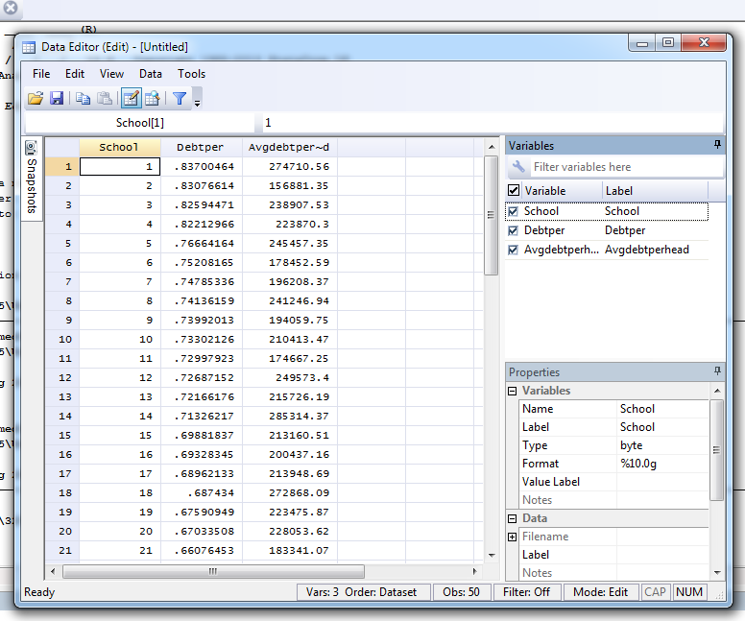
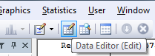
Import Data From Excel

Slide 9
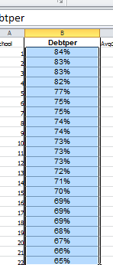
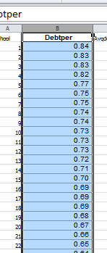
Import Data From Excel
-Before import the data from excel make sure that the data is suitable for our work.
-For example, make sure that the data is numerical for quantitative analysis.
-Not that we cant do it in Stata, but it is sometimes easier in excel.

Slide 10
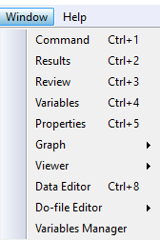
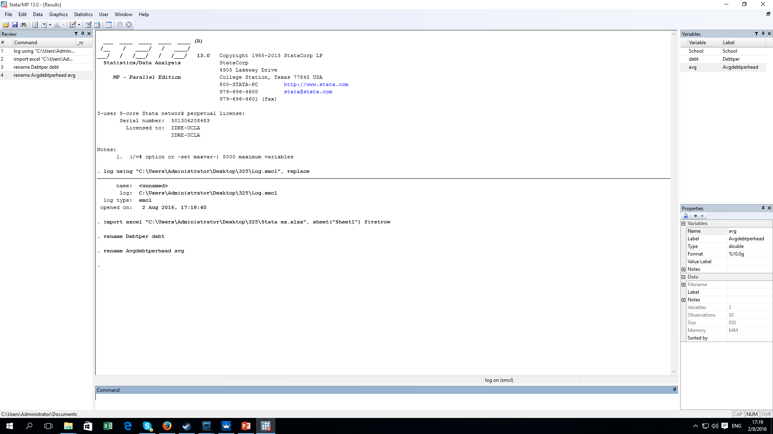
Window interface

Slide 11
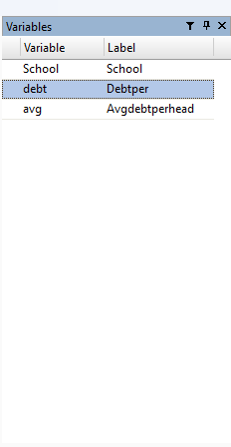
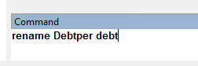
Rename
New name
Old name

Slide 12
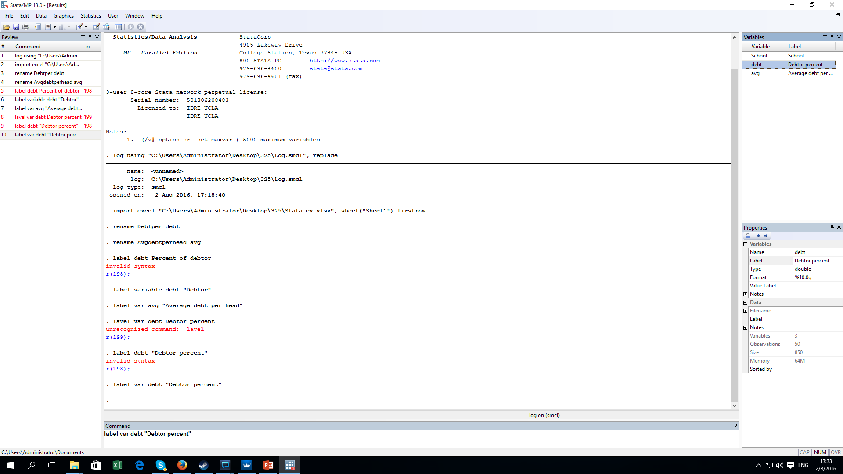
Label
Don’t forget
variable
New Label

Slide 13
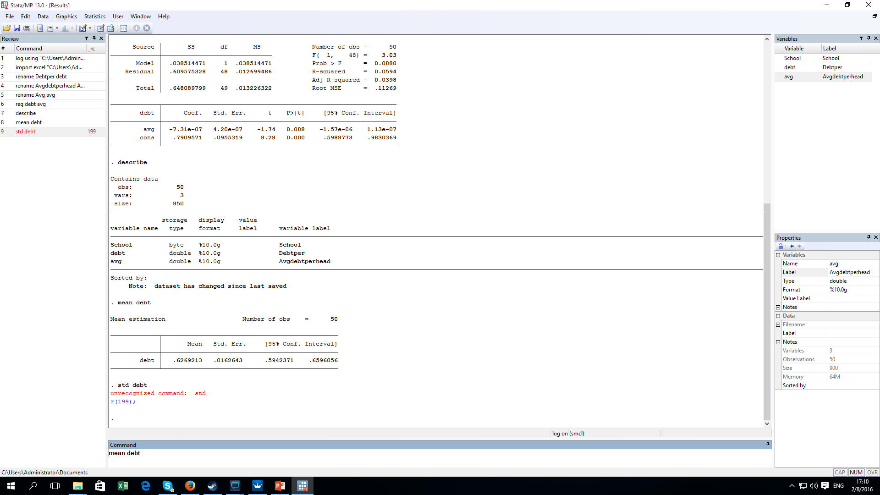
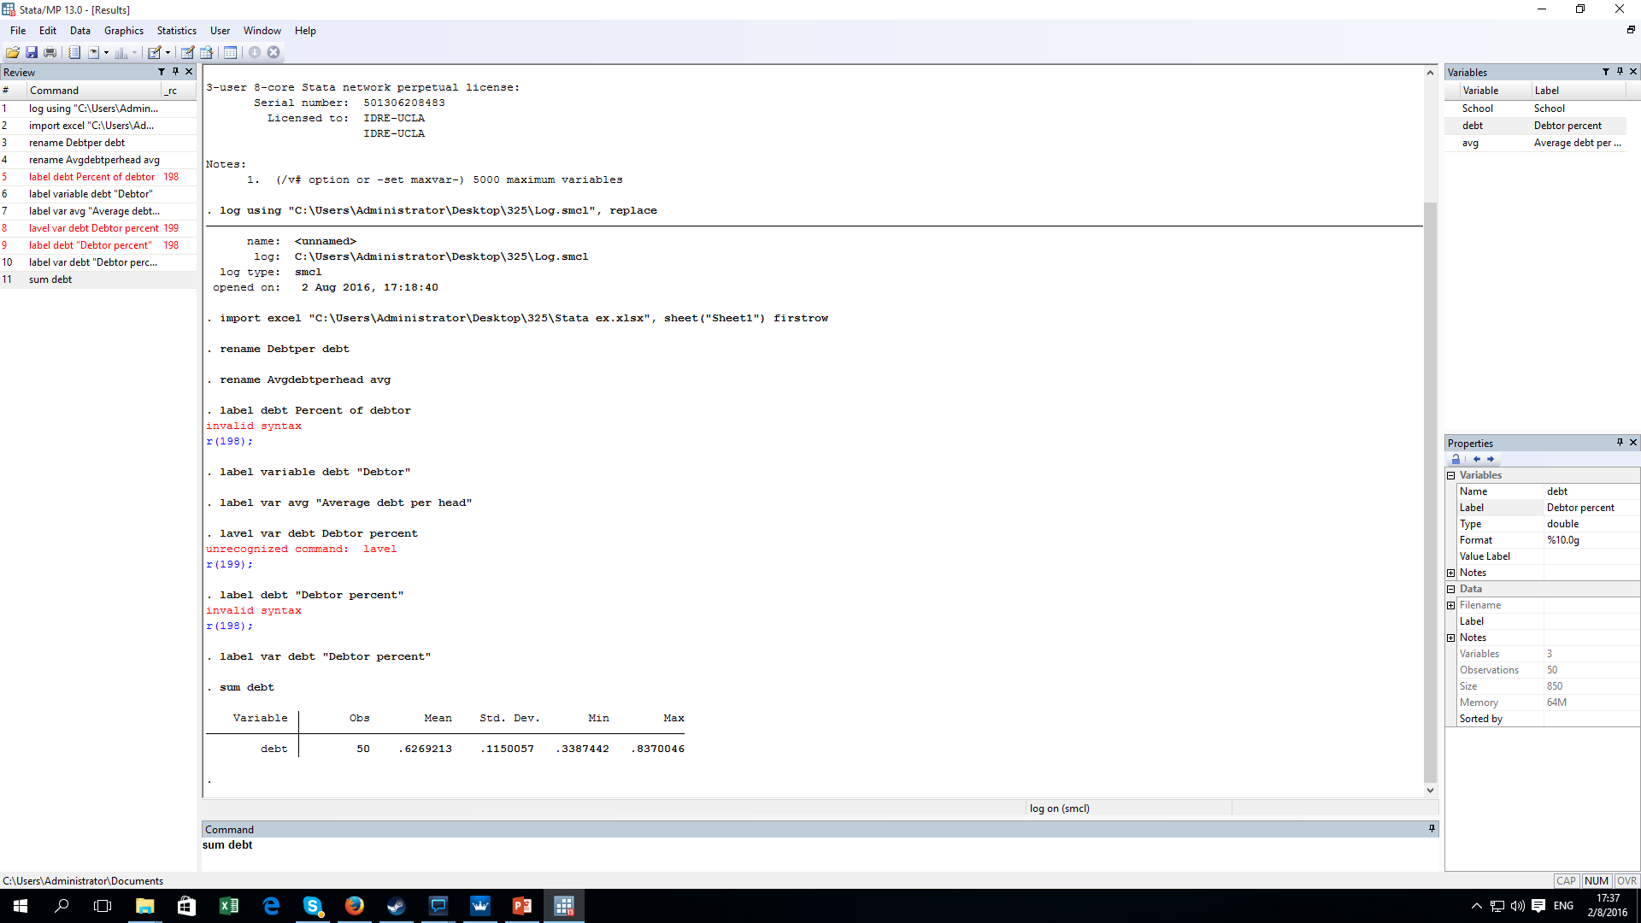
Basic statistic

Slide 14
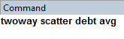
Graph and Line Gen.
Scatter/Dot
X axis
Types of twoway graph
Y axis

Slide 15

Graph and Line Gen.
Line
1.Linear Fit (lfit)

Slide 16
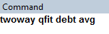
Graph and Line Gen.
2. Quadratic fit (qfit)

Slide 17
Graph and Line Gen.
y
y
x
x

Slide 18
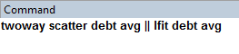
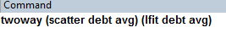
Graph and Line Gen.
Both ?
OR

Slide 19
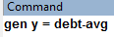
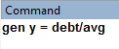
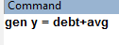
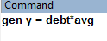
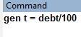
Variable gen.
+ = plus
= minus
/ = divide
* = multiply
Newvar name
Constant is also fine

Slide 20
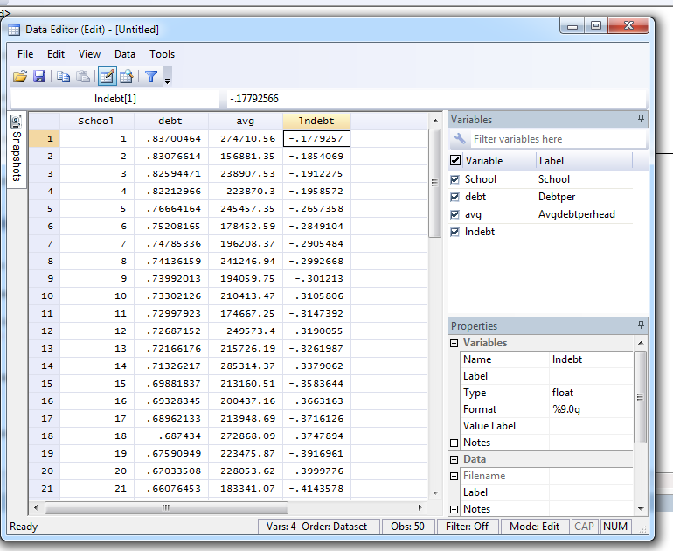
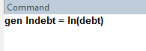
Variable gen.
ln

Slide 21
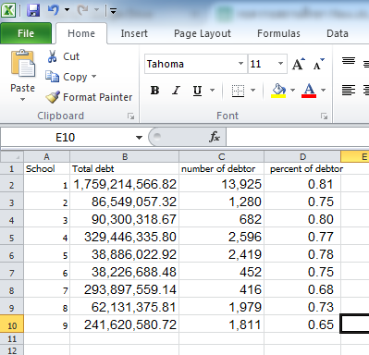
Variable gen.
-It makes more sense to use mean of debts of each school, to compare with the percent of debtor, but there is no data.
What can we do ?
-Also, some of the reasons for using “ln” and ratio(debt/avg) are to deal with growth and heteroscedastic.

Slide 22
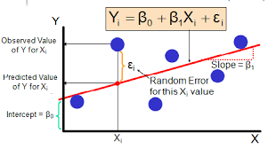
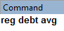
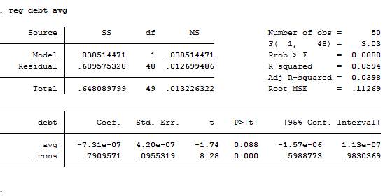
Regression
Y axis
X axis

Slide 23
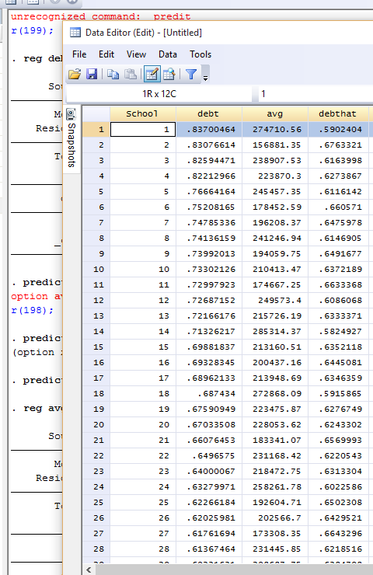
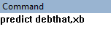

Regression
These next two commands will be applied for the latest regression.
Name of predicted var
xb means linear prediction

Slide 24
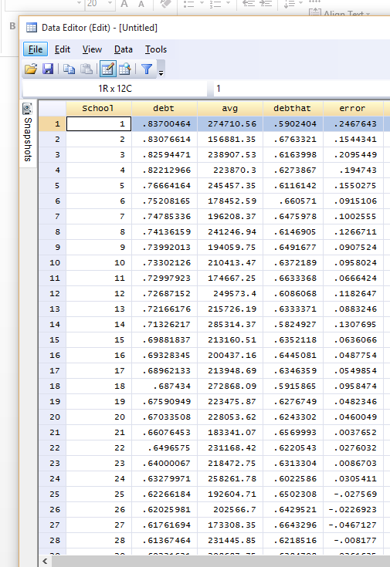
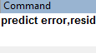
Regression
Name of predicted var
resid means residual or error term

Slide 25
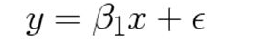
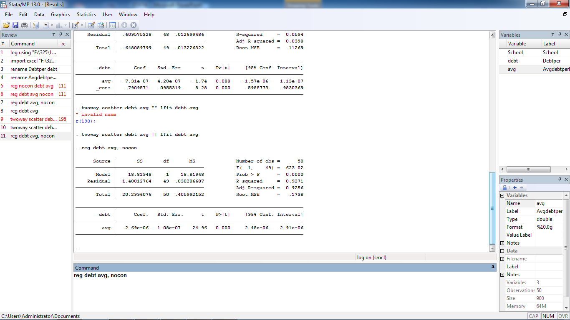
Regression
No intercept model

Slide 26
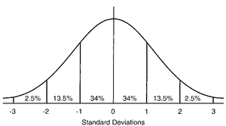
Regression
There are two variables that are not statistically significant.
What should we do about it ? Cut one of them or both ?
debt | Coef. | Std. error | t | P > |t|
y | 210704 | 136820 | 1.54 | .88
avg | 2.58e-06 | 2.07e-07 | 12.46 | 0.00
_cons | -0.56 | 17.5 | 0.032 | .975

Slide 27
Regression
r^2
Beta1
Beta0
2 tailed P-Value

Slide 28
Regression
F Cal
ESS
RSS
Root MSE = Avg amount of different in estimated and actual Y

Slide 29
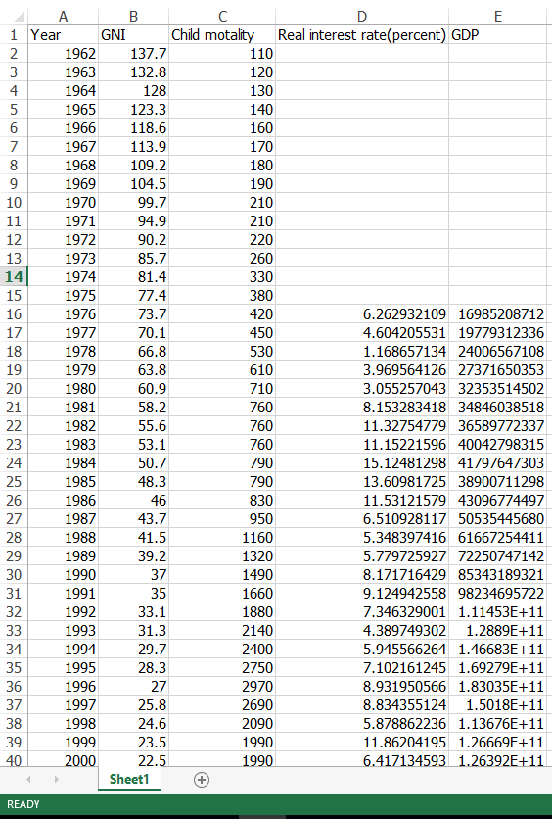
Application : Reciprocal and Log-lin
Use file “stata ex 2”

Slide 30
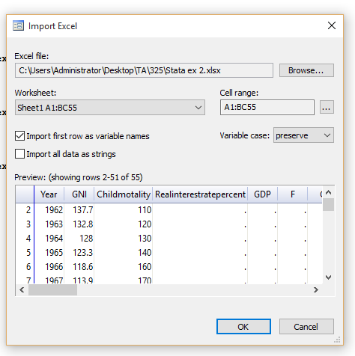
Application : Reciprocal
-Begin log
-Import file
-rename and labor
Don’t forget

Slide 31
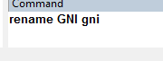
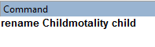
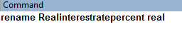
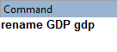
Application : Reciprocal

Slide 32
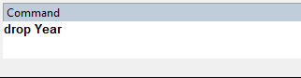
Application : Reciprocal
2 more commands
Drop variable
Name of variable(s)
Command

Slide 33
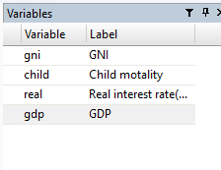
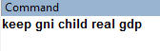
Application : Reciprocal
2. Keep variables
Name of variable(s)
Command

Slide 34
Application : Reciprocal
twoway scatter gni child
GNI and child mortality have other
relationship apart from linear.

Slide 35
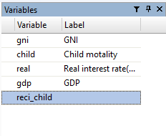
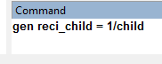
Application : Reciprocal

Slide 36
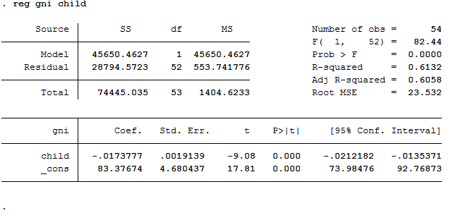
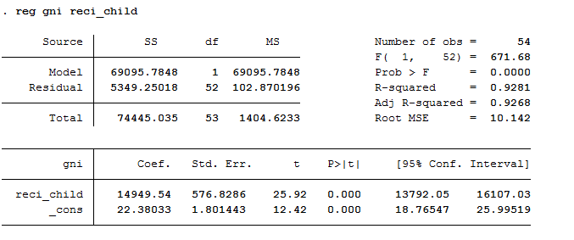
Application : Reciprocal
Which one is better ?

Slide 37
Application : Reciprocal

Slide 38
Application : Reciprocal
Interpreting reciprocal model
  Beta is not practically meaningful so look at the plot instead

Slide 39


Application : Log-Lin model
In macroeconomic, a reduction in real interest rate will increase a rate of investment leading to a increase in GDP.
We would like to know that if real interest rate changes by 1 percent what will be a percentage change in GDP.
We use model

Slide 40

Application : Log-Lin model
generate ln(gdp)

Slide 41
Application : Log-Lin model
twoway (scatter ln_gdp real)(lfit ln_gdp real)
Hetero ?

Slide 42

Application : Log-Lin model
Robust

Slide 43


Application : Log-Lin model

Slide 44

Multi Variables regression
Clear all data

Slide 45

Multi Variables regression
Use file “stata ex 3”

Slide 46


Multi Variables regression
-Import file
-rename and labor

Slide 47

Multi Variables regression
Dependent variable
Independent variables

Slide 48

Multi Variables regression

Slide 49

Hypothesis Testing
- It will use the latest regression as a tested data.
Command
variables

Slide 50


Hypothesis Testing
Ho

