Slide 1
Climate change
EE463 Globalization and international development
Faculty of economics
Thammasat university

Slide 2
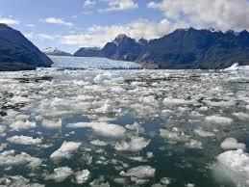
overview
Mean global surface temperature has risen by approximately 1.1°C since the beginning of the industrial revolution
16 of the 17 warmest years in modern times have occurred since 2001, largely resulting from greenhouse gas emissions from human activities into the atmosphere
Ice caps are melting, oceans are acidifying, and the steadily rising sea level together with ever stronger typhoons and occurrence of natural disasters

Slide 3
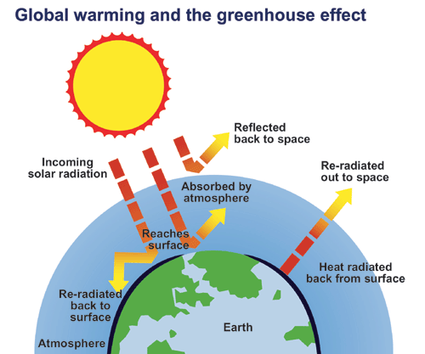
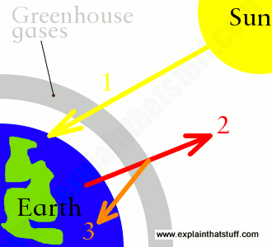
Global warming
Destruction of the world’s forests and gas emissions from industries and cars contribute to climate change caused by global warming through the greenhouse effect
Simplified explanation of global warming
incoming solar radiation
re-radiation to outer space
with accumulation of greenhouse gasses, sun’s rays are blocked and cannot be re-radiated to outer space, thereby causing global warming
Global warming: one of the main causes of climate change

Slide 4
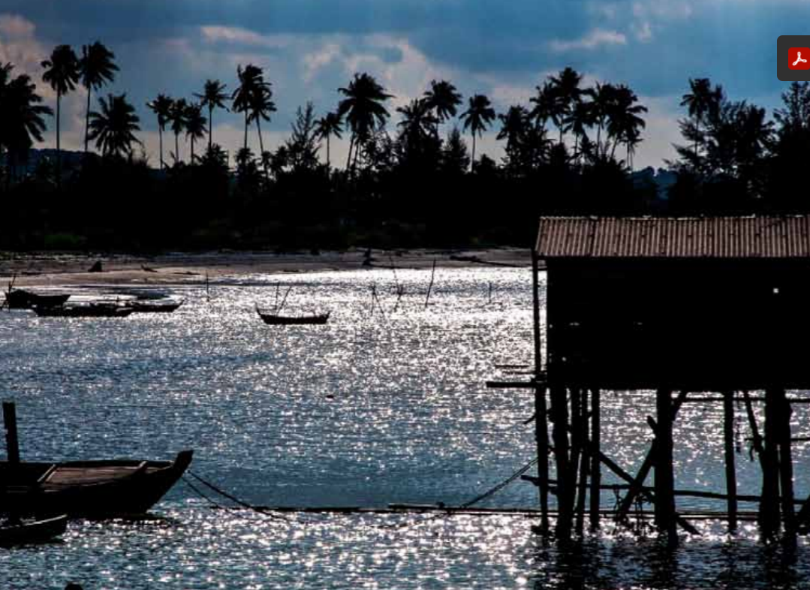
Climate change
Without urgent action to address climate change, the world population will experience declining freshwater and crop yields, increasing loss of forests and farmlands, rising sea levels threatening coastal communities, and a surge in infectious diseases such as dengue and malaria
At the 2015 United Nations Climate Change Conference in Paris, leaders from 195 nations committed to limit global warming to well below 2.0°C

Slide 5
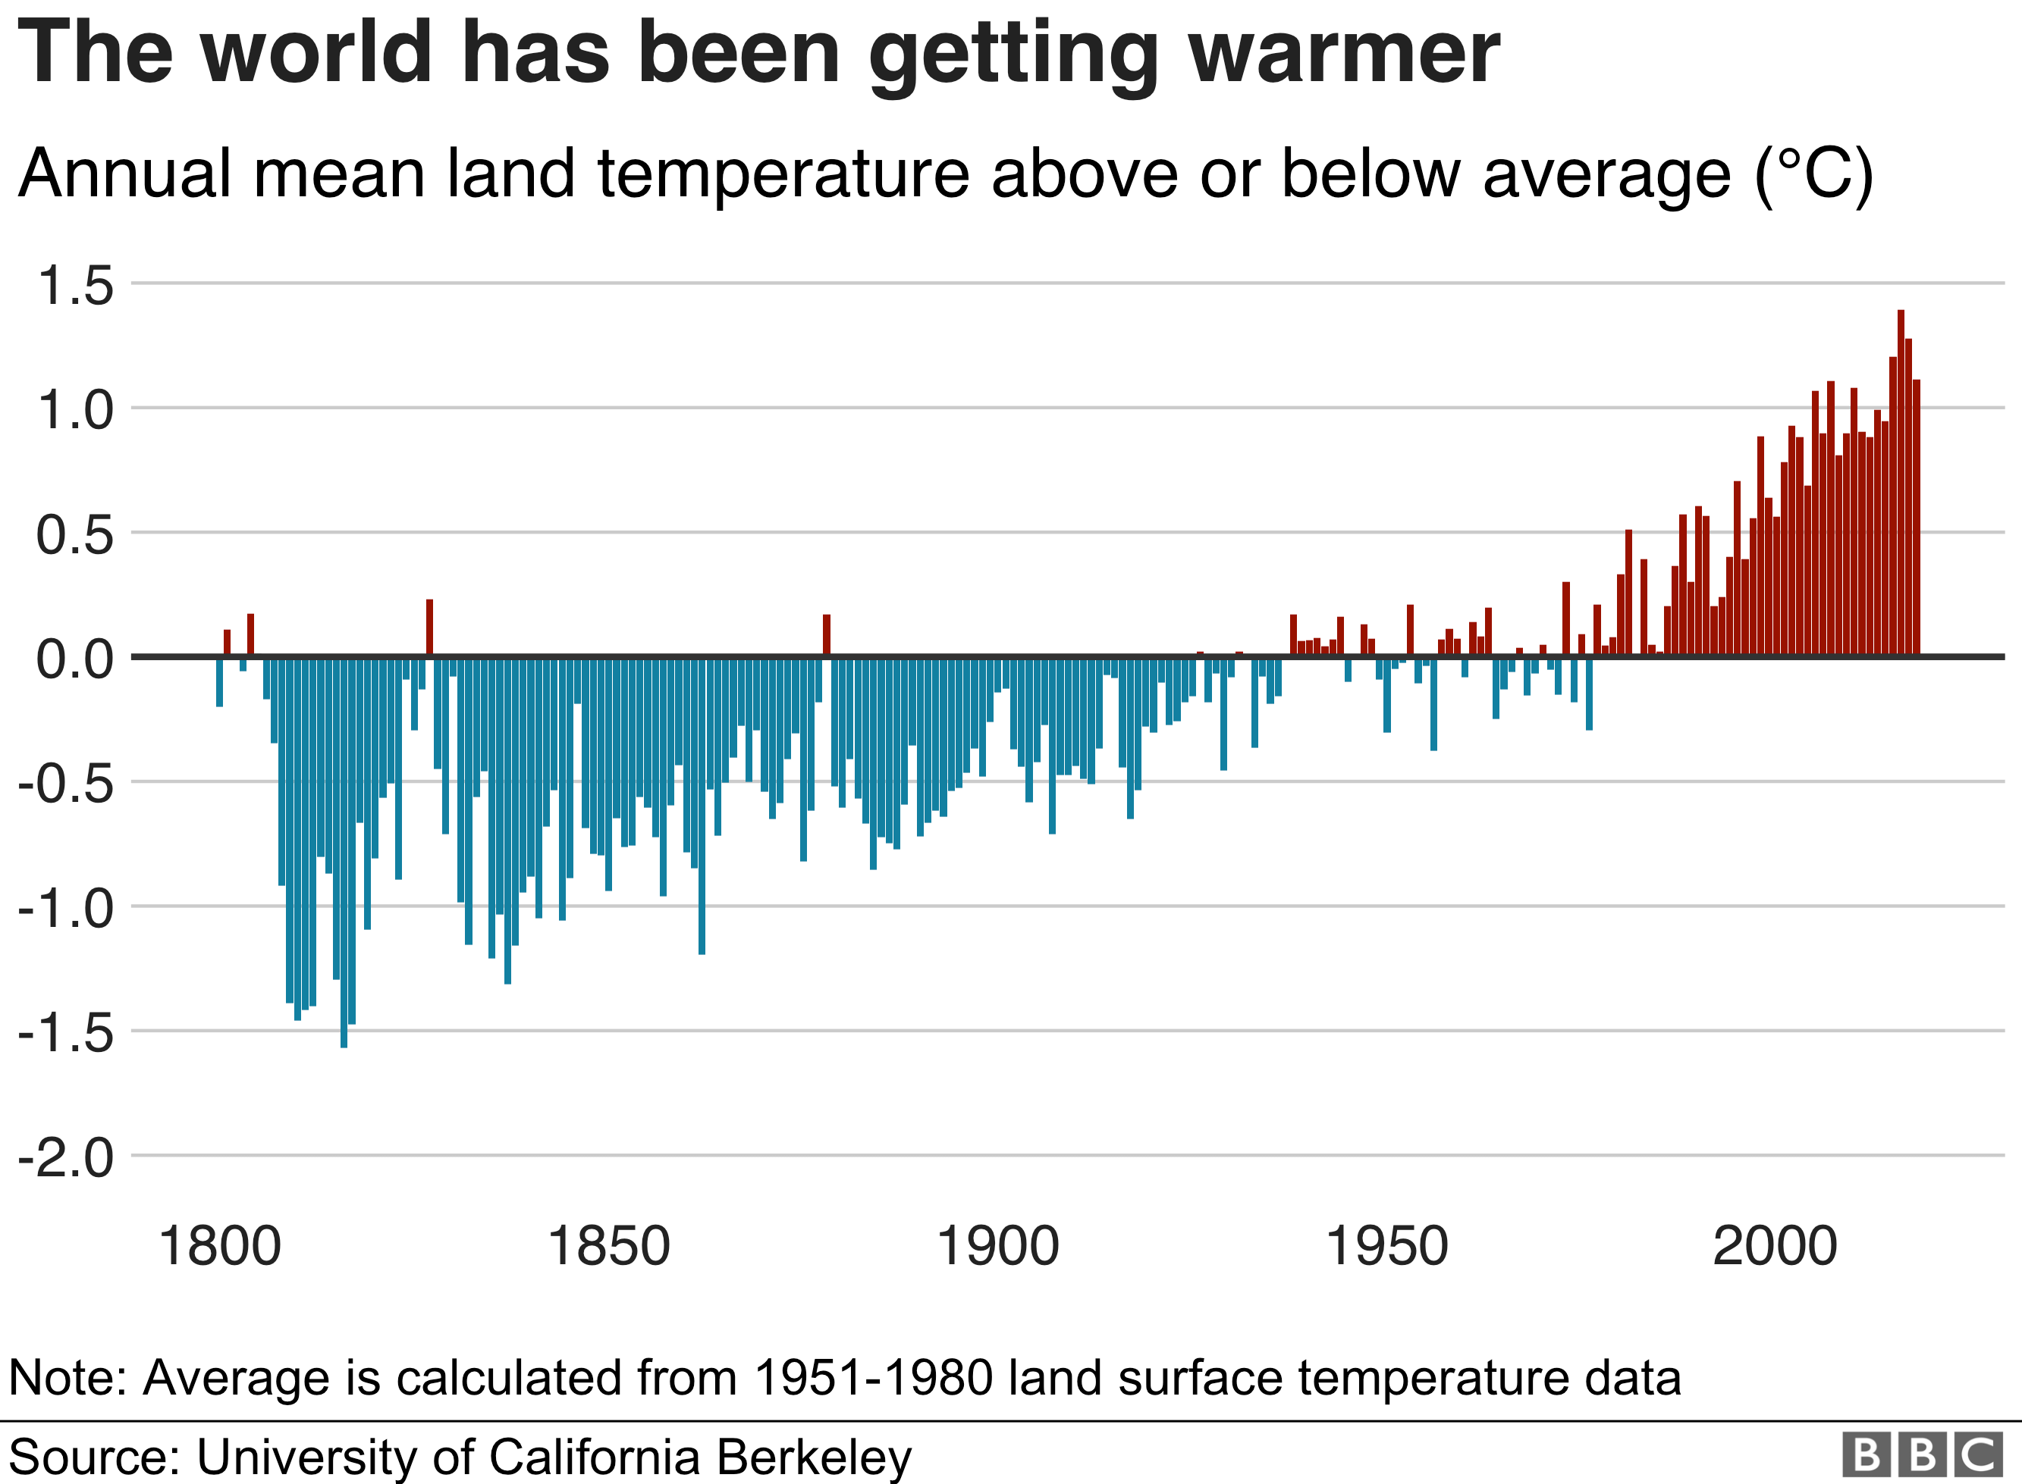
definitions
Global warming: increasing average temperatures attributed to human activities that emit greenhouse gases (CO2, CO)
Climate change: changes in climate that alter underlying probabilities of weather outcomes
Sustainability: meeting the demands of the present generation without compromising the needs of future generations

Slide 6
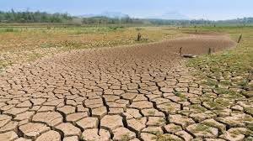
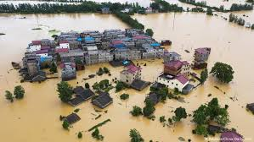
Impacts of climate change
Temperature Change average temperatures could increase by more than 6°C above preindustrial levels by the end of the 21st century
Heat Extremes Heat extremes may spread over the world’s land mass. If no actions are taken, the world could enter into entirely new climate patterns due to frequent occurrence of heat extremes
Precipitation an upward trend in annual mean precipitation, along with frequent and intense rainfall will thereby cause more severe flooding

Slide 7
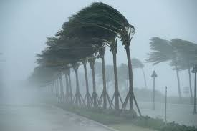
Impacts of climate change
Sea-Level Rise sea-level could rise to 1.4m and even more in the future. For every degree of global warming, sea-level rise will be at least 2.3m
Tropical Cyclones rising global average temperature could cause upward trend in damages due to increasing cyclone frequency and strength
Agriculture food security threats through higher temperatures, drier conditions, sea-level rise, and flooding and relates to the potential effects carbon monoxide from fertilization

Slide 8
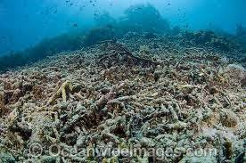
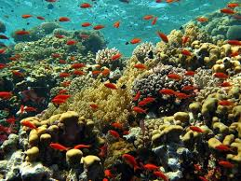
Impacts of climate change
Fisheries and Reef Ecosystems coral reef systems are projected to collapse due to mass bleaching with global warming up to 2°C; causing severe consequences for coastal livelihoods such as reduced fish stocks and tourism
Energy Security increasing unavailability of water will cause intermittent performance of hydropower plants and potential grid infrastructure failure; and continued reliance on unsustainable fossil fuels and energy imports

Slide 9
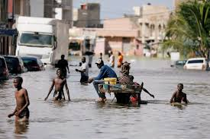
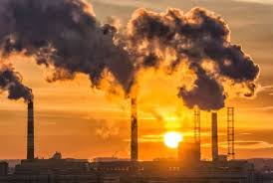
Impacts of climate change
Migration degradation of natural resources through climate change will increase rural poverty and migration to cities, which will in turn add to the growth of informal settlements
Cities emit large amounts of greenhouse gases due to concentrated activities; and will be vulnerable due to their reliance on global supply chains, and occurrence of local disasters

Slide 10
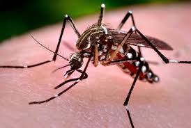
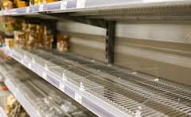
Impacts of climate change
Health more cases of heat-related deaths, particularly among the elderly, increase in the number cases of vector-borne diseases due to global warming
Supply Chains disruption in supply chains caused by extreme weather events can affect the highly interlinked global trade network; production and consumption can therefore suffer from events outside the region

Slide 11
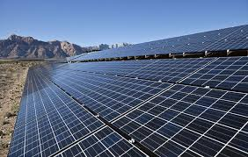
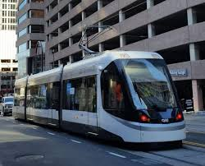
Climate Change mitigation
Climate change mitigation: any actions or efforts taken to reduce or prevent the long-term risks of climate change on human life and property by reducing the sources or enhancing the sinks of greenhouse gases emissions
Examples of mitigation strategies:
adopting renewable energy sources like solar, wind and small hydro;
developing sustainable transport (bus rapid transit, electric vehicles, and biofuels)
promoting more sustainable uses of land

Slide 12
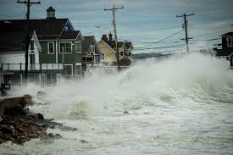
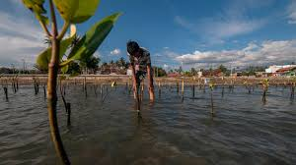
Climate change adaptation
Climate change adaptation: adjustments in ecological, social or economic systems in response to actual or expected climatic effects. This requires changes in processes and practices to lessen the impacts of climate change
Examples of adaptation measures:
Inventorying and tracking of ecological resources
implementing early warning systems to anticipate natural disasters
Restoring and expanding natural ecosystem barriers (mangroves, reforestation)

Slide 13
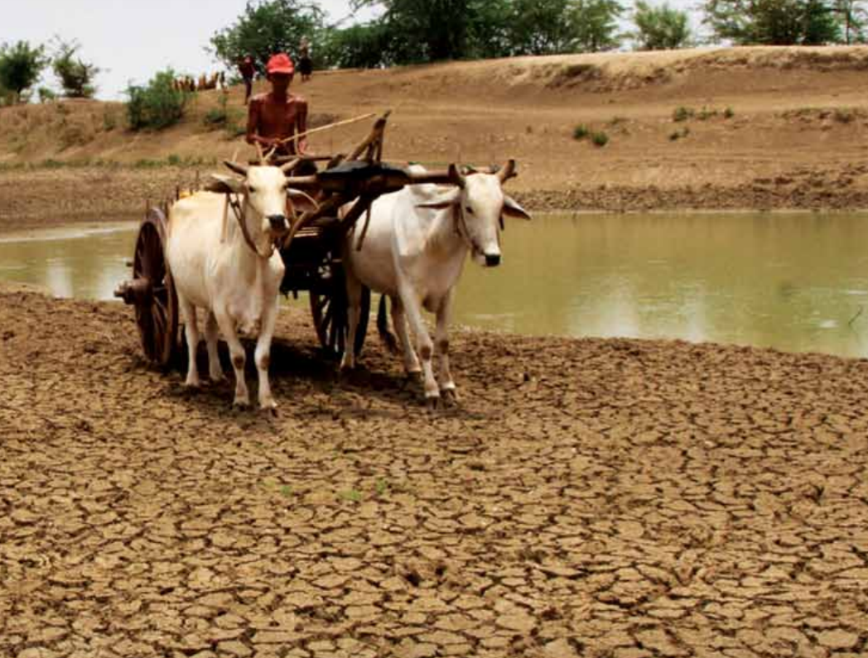
Policy implications
Mainstreaming climate change actions in development planning is crucial for cost-effective and sustainable development
Climate mainstreaming requires harmonization of climate change agendas into existing national programs and policies; it also requires financial and technical support to address issues of climate change while ensuring economic growth

Slide 14
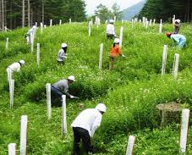
Policy implications
Programs to improve the economic alternatives of the poor: irrigation, sustainable farming and use of alternative fuels provide incentives to increase farmers’ productivity
Industrial emissions abatement practice: regulations to limit industrial pollution, including taxation on emissions, tradeable emission permits, quotas and standards
Proactive stance toward climate change and environmental degradation through public policies

Slide 15
reference
https://www.adb.org/sites/default/files/publication/325251/region-risk-climate-change.pdf

