Slide 1

The Bankruptcy of Baring Bank
GROUP3
CHUTIKARN KANTHIDA VANVISA CHAWISA SASITHORN

Slide 2
Outline
Background of the Barings Bank
Who is Nick Leeson
The Collapse
Recommendation
Risk Analysis

Slide 3
“He lost so much money speculating
in yen that he brought down the whole bank before the top command even
knew what was happening.”
William Mcdonald Wallace, 1998

Slide 4

Background
British bank
founded in 1762.
The oldest merchant bank in Britain.
For centuries, it was considered the largest and most stable bank in the world
The bank collapsed in 1995 after suffering losses of £827 million ($1.3 billion).
BACKGROUND
NICK LESSONS
THE COLLAPSE
RISK ANALYSIS
RECOMMENDATION

Slide 5
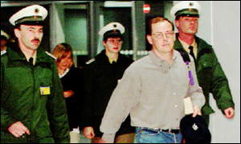
In 1995, the bank collapsed by one of the employee “Nick Leeson”.
Total loss of £827 million ($1.3 billion) was due to speculative investing, primarily in futures contracts, at the bank's Singapore office.
BACKGROUND
NICK LESSONS
THE COLLAPSE
RISK ANALYSIS
RECOMMENDATION
Notes:
On February 26th 1995

Slide 6
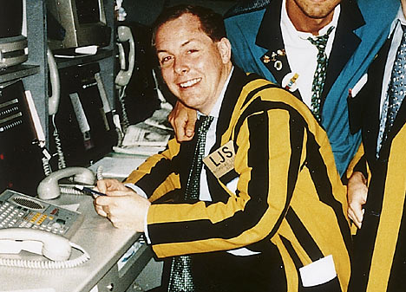
Who is Nick Leeson?
Rogue Trader
Notes:
A rogue trader is an authorized employee making unauthorized trades on behalf of their employer. It is most often applicable to financial trading, where professional traders make unapproved financial transactions.

Slide 7
Nicholas (“Nick”) Leeson
Mr. Nicholas Leeson was an employee working at Barings Future Singapore.
Barings Futures Singapore (BFS) traded on the Singapore International Monetary Exchange (SIMEX).
His responsibilities are for
Trading
Accounting
Settlements activities
BACKGROUND
NICK LESSONS
THE COLLAPSE
RISK ANALYSIS
RECOMMENDATION
Notes:
Mr. Nicholas Leeson was an employee who was put in charge of operations for Barings Future Singapore.
On July 1, 1992, Barings Futures Singapore (BFS) started trading on the Singapore International Monetary Exchange (SIMEX).

Slide 8
Barings Bank
London
Unauthorized Trades
Branch
Used error account to hide loss
Trader
Barings Future Singapore
Nick Leeson
Accounting
created
Settlement
Error Account
employee
BACKGROUND
NICK LESSONS
THE COLLAPSE
RISK ANALYSIS
RECOMMENDATION
Notes:
Settlement of securities is a business process whereby securities or interests in securities are delivered, usually against (in simultaneous exchange for) payment of money, to fulfill contractual obligations, such as those arising under securities trades.

Slide 9
What was Nick Leeson Supposed to Do ?

Slide 10
Leeson's trading activities mainly involved three futures markets:
Futures on the Japanese Nikkei 225 stock index.
Futures on 10-year Japanese Government bonds (JGB futures).
Euroyen futures dealt in SIMEX and TIFFE (Tokyo Financial Futures Exchange) in Japan.
BACKGROUND
NICK LESSONS
THE COLLAPSE
RISK ANALYSIS
RECOMMENDATION

Slide 11
Nick Leeson’s Activities
Authorized
Arbitraging
  On exchanges with the Nikkei 225 in SIMEX and OSE
  Try to capitalize on small price differences between the futures contracts.
Switching:
  Select the cheapest market to execute a client’s order
Trading on futures contracts on behalf of Barings Group Clients’
Accumulated a Japanese port. In stock index futures on Nikkei 225
BACKGROUND
NICK LESSONS
THE COLLAPSE
RISK ANALYSIS
RECOMMENDATION
Notes:
Apparently, large price differences existed between the two contracts that were very similar in design. The profits from exploiting such price differences between exchanges are small and therefore trading volumes tend to be large.
The risks are low, because every long position on one exchange is offset by a short position on the other.
Leeson developed an even more lucrative activity, namely ‘switching’. As Barings was able to trade in Japan as well as in Singapore, it could select the cheapest market to execute a client’s order. For example, it could tell a client it would buy 1000 Nikkei futures contracts in Osaka, while in reality it made the purchase on SIMEX, where at that moment the price was lower. Barings would charge the client the price quoted on the OSE or slightly better, which was still worse than the price in Singapore.
The difference meant extra profit for Barings (SR3.9). This selection of the more profitable location of the two to do business, was referred to as ‘switching’ .

Slide 12

Account 88888, Lucky Number?
Error account was first used to hide the error
The purpose is netting minor trading mistakes.
A mistake was first made by his colleagues
  rather than buy 20 contracts, she had sold them, costing Barings £20,000.
But then, he began his unauthorized trading from that day
BACKGROUND
NICK LESSONS
THE COLLAPSE
RISK ANALYSIS
RECOMMENDATION
Notes:
Leeson claims that this account was first used to hide an error made by one of his colleagues; rather than buy 20 contracts as the customer had ordered, she had sold them, costing Barings £20,000.
Everything began with an error account “88888” created by a new phone clerk who made a loss of 20,000 pounds with this mistake.
Since Leeson tried to cover up this and other losses from his team, he began his unauthorized trading from that day

Slide 13
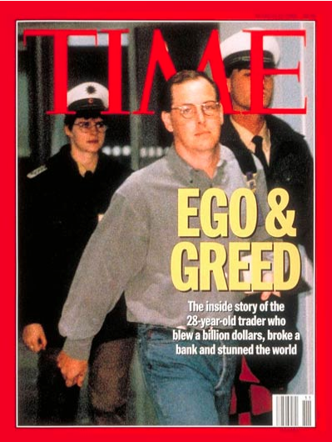
How Leeson Broke Barings?

Slide 14

Unauthorized Activities
He secretlysold options and took positions on SIMEX on both futures and options contracts.
Financing futures’ margin requirements by;
    Earn premium by selling options.
    Borrowing huge amounts of money from Barings’ head office in London.
Any loss from unauthorized trading activities was hidden in Account 88888
BACKGROUND
NICK LESSONS
THE COLLAPSE
RISK ANALYSIS
RECOMMENDATION
Notes:
With the error account, he secretly sell options and took positions on SIMEX on both futures and options contracts.
People in London thought he was a smart trader who created half of Barings Singapore’s 1993 profits and half of the entire Barings’ 1994 profits.
But in fact, in 1994 alone, Leeson lost Barings $296 million while his boss in London thought he made them $46 million, so Leeson was offered a bonus of $720,000.
As a matter of fact, Leeson lost money for Barings almost from day one.

Slide 15
Derivative Trading Strategy
Inter-Exchange Arbitrage:
Strategy that takes advantage of the price differential between the futures in one exchange and cash in another exchange.
Straddle Strategy:
Strategy that is accomplished by holding an equal number of puts and calls with the same strike price and expiration dates.
BACKGROUND
NICK LESSONS
THE COLLAPSE
RISK ANALYSIS
RECOMMENDATION

Slide 16
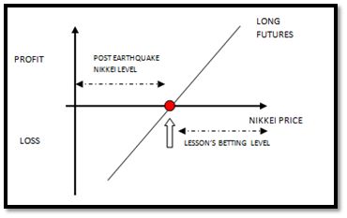
Loss From Long Futures
Before the earthquake Nikkei was trading in a range between 19.000 – 19.500
But the post-earthquake levels where 18.950 declining up to 17.950 on 23/01 and so on…
BACKGROUND
NICK LESSONS
THE COLLAPSE
RISK ANALYSIS
RECOMMENDATION

Slide 17
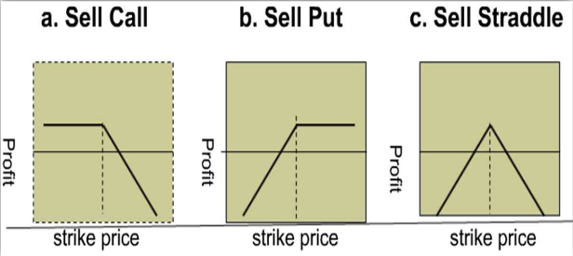
Straddle Strategy
Profit
Profit
Strike Price
Strike Price
a. Sell Call Option
b. Sell Put Option
BACKGROUND
NICK LESSONS
THE COLLAPSE
RISK ANALYSIS
RECOMMENDATION

Slide 18
Straddle Strategy
C. Sell Straddle
Profit
Profit
Profit
Strike Price
Strike Price
a. Sell Call Option
a. Sell Put Option
Strike Price
BACKGROUND
NICK LESSONS
THE COLLAPSE
RISK ANALYSIS
RECOMMENDATION

Slide 19
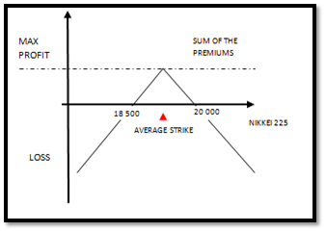
Loss from straddles
Straddles caused further losses since after just 2 days, as consequence of the earthquake…
BACKGROUND
NICK LESSONS
THE COLLAPSE
RISK ANALYSIS
RECOMMENDATION

Slide 20
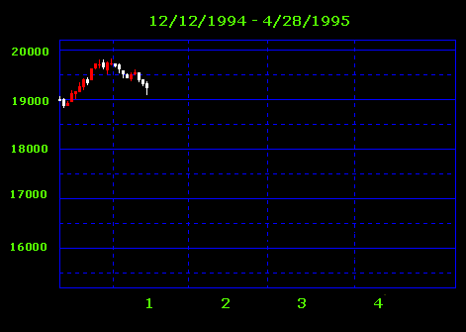

How Leeson Broke Barings?
BUY
Nikkei 225日経平均株価
4Q 1994 - January 1995
  Nikkei in a range of 19,000 – 19,500
  Leeson held long futures of 3,000 Nikkei 225 equity contracts
BACKGROUND
NICK LESSONS
THE COLLAPSE
RISK ANALYSIS
RECOMMENDATION
Notes:
In December 1994 and January 1995, Nikkei was trading in a range of 19,000 to 19,500, and Leeson was holding long futures positions of Nikkei 225 equity contracts on the OSE.
In Leeson’s case, he needs the Nikkei to be traded within or near strikes between 18,500 and 20,000.

Slide 21
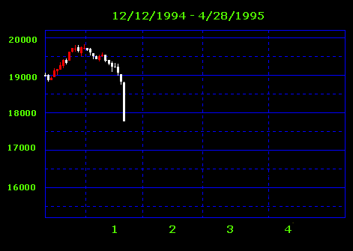
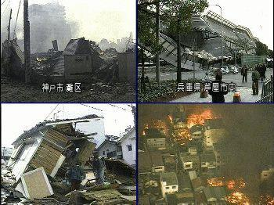
How Leeson Broke Barings?
Nikkei 225日経平均株価
  January 17, 1995
    Kobe Earthquake
    Nikkei dropped sharply as people took cash out
BACKGROUND
NICK LESSONS
THE COLLAPSE
RISK ANALYSIS
RECOMMENDATION
Notes:
The Nikkei dropped significantly after the Kobe earthquake on January 17th as people took money out from the market.

Slide 22
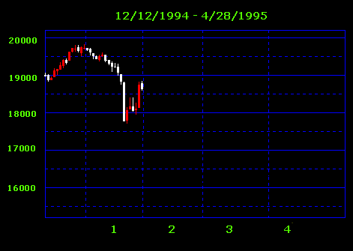
How Leeson Broke Barings?
Nikkei 225日経平均株価
BUY
January 20 – February, 1995
  Leeson launched aggressive buying program: (3,000) 55,206 March contracts and 5,650 June contracts
BACKGROUND
NICK LESSONS
THE COLLAPSE
RISK ANALYSIS
RECOMMENDATION
Notes:
There was a bounce two weeks after the crisis, and Leeson hoped for a strong short-term v-shaped rebound.
By using his error account, Leeson launched an aggressive buying program, which summed up to 55,000 March 1995 contracts and 5,000 June 1995 contracts over the next three weeks.

Slide 23
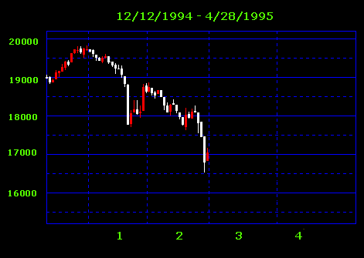
How Leeson Broke Barings?
  Barings collapsed – could not meet huge trading obligations
  Outstanding futures positions of $27 billion (Barings’ capital was $615 million)
Nikkei 225日経平均株価
BACKGROUND
NICK LESSONS
THE COLLAPSE
RISK ANALYSIS
RECOMMENDATION
Notes:
Unfortunately, it was a bull trap. The market dropped further in February. In the end, Barings collapsed as it couldn’t meet the huge trading obligations for the positions that Leeson established.
As a whole, on February 27th, 1995, Barings had outstanding notional futures positions on Japanese equities and interest rates of $2 billion, including $7 billion on Nikkei 225 equity contracts and $20 billion on Japanese government bond and Euroyen contracts.

Slide 24
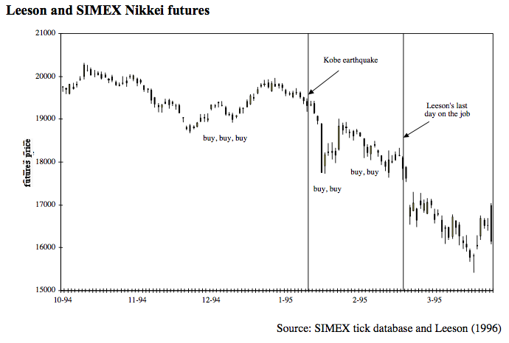
BACKGROUND
NICK LESSONS
THE COLLAPSE
RISK ANALYSIS
RECOMMENDATION

Slide 25
The largest part of Barings’ losses came from a massive long position in Nikkei futures.
In January 1995, the total was 90,000 contracts or about 7.5% of total trading volume.
BACKGROUND
NICK LESSONS
THE COLLAPSE
RISK ANALYSIS
RECOMMENDATION

Slide 26
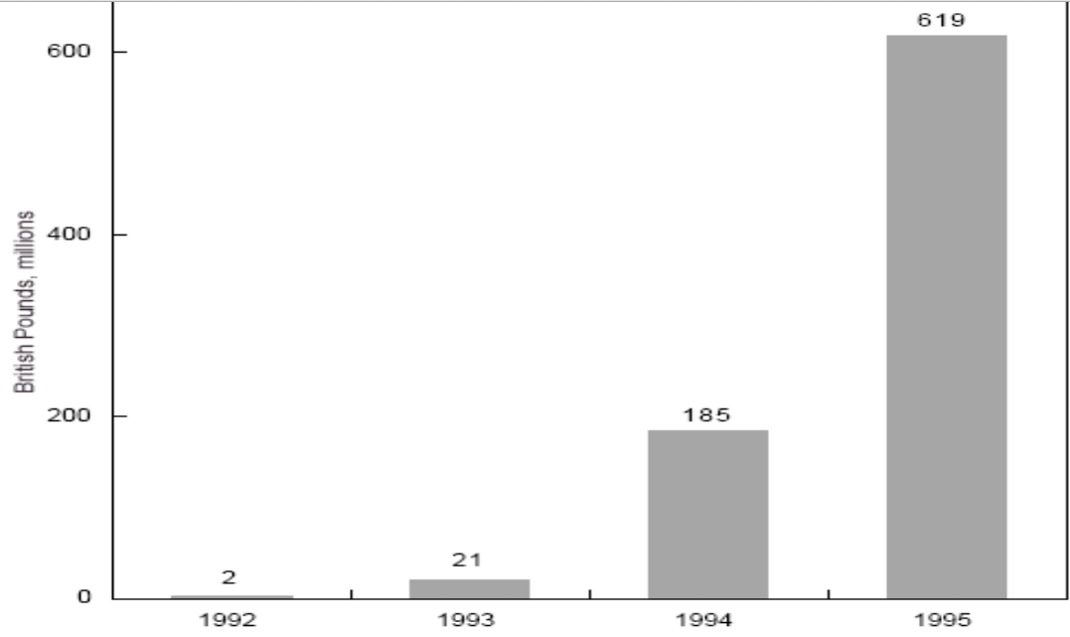
Summary of Total Loss in 88888 Account
BACKGROUND
NICK LESSONS
THE COLLAPSE
RISK ANALYSIS
RECOMMENDATION
Notes:
The total monthly trading volume through Account 88888 increased from 2,051 in July 1992 to a peak of 96,121 in September 1994. In January 1995, the total was 90,000 contracts (SR3.14) or about 7.5% of total trading volume.

Slide 27
Manipulating the Trading and Accounting Record
1. Avoided disclosure of unhedged positions in the reports to Baring Securities Japan Limited(BSJ) and Baring Securities Limited (BSL).
2. Record fictitious trades between the accounts of BSL and BSJ and Account 88888.
3. Leeson often instructed his settlements staff to record fictitious trades in the accounting system.
-The effect was that unhedged positions were transferred from the BSJ or BSL accounts to Account 88888, so that no unhedged positions were reported at the end of the day.
-This practice effectively reduced margin calls from SIMEX
BACKGROUND
NICK LESSONS
THE COLLAPSE
RISK ANALYSIS
RECOMMENDATION

Slide 28
Summary of Nick Leeson’s Activities
Authorized
Unauthorized
Arbitraging
On exchanges with the Nikkei 225 in SIMEX and OSE
Switching: try to capitalize on small price differences between the futures contracts.
Trading on futures on behalf of Barings Group Clients’
Contracts in SIMEX on long futures linked to Nikkei 225
Short on futures written
  on the JGB
  on the Euroyen exchange rates
Sold straddles: same maturity based on a stable market expectation
Accumulated a Japanese port. In stock index futures on Nikkei 225
Huge losses after the market fall
(due to the earthquake)
BACKGROUND
NICK LESSONS
THE COLLAPSE
RISK ANALYSIS
RECOMMENDATION
Notes:
Apparently, large price differences existed between the two contracts that were very similar in design. The profits from exploiting such price differences between exchanges are small and therefore trading volumes tend to be large.
The risks are low, because every long position on one exchange is offset by a short position on the other.
Leeson developed an even more lucrative activity, namely ‘switching’. As Barings was able to trade in Japan as well as in Singapore, it could select the cheapest market to execute a client’s order. For example, it could tell a client it would buy 1000 Nikkei futures contracts in Osaka, while in reality it made the purchase on SIMEX, where at that moment the price was lower. Barings would charge the client the price quoted on the OSE or slightly better, which was still worse than the price in Singapore. The difference meant extra profit for Barings (SR3.9). This selection of the more profitable location of the two to do business, was referred to as ‘switching’ .

Slide 29

After the Bankruptcy
ING, a Dutch bank, purchased Barings Bank in 1995 for the nominal sum of £1 and assumed all of Barings' liabilities, forming the subsidiary ING Barings.
Today no longer exists as a corporate entity.
BACKGROUND
NICK LESSONS
THE COLLAPSE
RISK ANALYSIS
RECOMMENDATION

Slide 30
Risk Analysis of the Collapse of Barings Bank

Slide 31
Market risk or Operational risk?
Operational risk
The bank had completely failed to institute a proper managerial, financial and operational control system.
Market risk
The drop in index price resulting from earthquake affected Leeson's straddle positions.
BACKGROUND
NICK LESSONS
THE COLLAPSE
RISK ANALYSIS
RECOMMENDATION
Notes:
Although the losses that caused the bank’s collapse by speculative unhedged derivatives trades were expressions of market risk, the true problem revealed by the scandal was a failure of adequate operational risk management. Leeson’s unauthorized trading was made possible by his having had effective control over both the front and back offices thereby enabling him to hide his improper trades and the losses he was actually making.
Ultimately, senior management bore responsibility for the collapse as they had failed to ensure that there were adequate controls over the trading operations and risk exposures. Worse, it later became apparent that senior management lacked sufficient understanding of the bank’s critical businesses, notably that of its options and derivatives trading in Singapore.
As a result of an operational risk, Nick Leeson had an opportunity to conduct unauthorised activity by taking proprietary position on SIMEX on both futures and options contract.
The Kobe earthquake shattered Leeson's options strategy. Leeson's straddle positions started to look shaky. The call options Leeson sold looked worthless but the put options became very valuable to their buyers if the Nikkei continued to decline. Leeson's losses on these puts were unlimited and totally dependent on the level of the Nikkei at expiry, while the profits on the calls were limited to the premium earned.

Slide 32
Recommendation and What should have been done ?

Slide 33
Operational Risk
Segregation of duty.
Trading activities, accounting, and settlements should be operated by different independent person in order to prevent and detect frauds and unauthorized activities.
Clear determination of responsibilities for each bussiness and specification of the limits of each operator.
Each department to accept the information should build a fully communication to avoid fragmented and abuse of power.
BACKGROUND
NICK LESSONS
THE COLLAPSE
RISK ANALYSIS
RECOMMENDATION

Slide 34
Operational Risk
Supervision from management.
Management should have full knowledge of the bussiness in which the firm operates and understand the risks involved. Therefore, they can review and monitor the subordinate’s activities. Reporting line should be clear as well.
Separation of proprietary trading from agency trading.
The two activities should have been separated clearly for transparency purpose.
BACKGROUND
NICK LESSONS
THE COLLAPSE
RISK ANALYSIS
RECOMMENDATION

Slide 35
Operational Risk
Independentinternalaudit.
Effective internal auditing would help improving organization’s governance, risk management and management control by providing insight and recommendation. Upon informing of significant weakness, top management must take an action to resolve such problem quickly and appropriately.
BACKGROUND
NICK LESSONS
THE COLLAPSE
RISK ANALYSIS
RECOMMENDATION

Slide 36
Bankruptcy Risk
Adequate capital.
The firm should have retained more capital to be able to support the risk incurred due to such investment.
Matching of investment plan and the company risk appetite.
Before formulating any investment strategies, the finance manager must first assess the risk appetite. The extent to which the firm can expose themselves to risk must be discussed.
VAR analysis
BACKGROUND
NICK LESSONS
THE COLLAPSE
RISK ANALYSIS
RECOMMENDATION

Slide 37
What should have been done ?
Rely less on margin finance (hold less risky position)
Increase offset position as an insurance (by short position)
Less on speculative trading
  Maybe increase position on volatile trading
  This will make return to decrease but risk also decrease (good for volatile situation)

Slide 39
Q&A

Slide 40
Group 3
5304640161 ChutikarnPayungsak
5304640245 KanthidaSripakpraek
5304641326 VanvisaAroomchootee
5302640239 Chwisa Kanchanatawan
5302641112 SisithornJirajaroenying

