Slide 1
Revision Slide 1
Demand & Supply

Slide 2
Outline
Introduction
Demand
Consumer Surplus
Supply
Producer Surplus

Slide 3
Introduction
Market is a place where buyers and sellers engage in exchange of a good or service.
Standard Assumptions of Demand & Supply Model
Many “Atomistic or Small” Sellers and Buyers
Identical Products among Sellers
No Barriers to Entry/Exit
Perfect Information
Because of these assumptions, sellers and buyers are “PRICE TAKERS”.
The “Price” is determined by the market forces (demand & supply).
BUT the government may influence price through intervention.

Slide 4
Demand
Individual Demand is the amount of a good or service that an individual consumer is willing and able to buy at a given price.
Market Demand is the sum of all individual demand at a given price.
Derived Demand is the demand for a good that is derived from the production and sale of other goods, e.g. demand for labor is derived from demand for the product.
The demand curve we usually draw is the Market Demand.

Slide 5
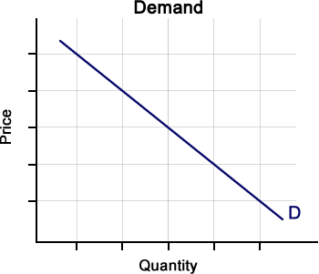
Demand Curve
The demand curve shows a negative relationship between price (P) and quantity demanded (Qd).
Law of Demand: Ceteris Paribus, as P rises, Qd falls, and vice versa.

Slide 6
Linear Demand Equation
Demand Equation is expressed as Qd as a function of P: Qd = f(P)
e.g. Qd = 10 – 2P
However, what we usually draw is the “Inverse Demand Curve”.
Inverse Demand is expressed as P as a function of Qd: P = f(Qd)
e.g. From Qd = 10 – 2P
2P = 10 – Qd
we get P = 5 – (½)Qd as the inverse demand equation.

Slide 7
Determinants of Demand
Price Determinant:
Price
Non-Price Determinants:
Income: Normal Good or Inferior Good
Price of Related Products: Prices of Substitutes or Complements
Taste, Preference, Advertising
Demographic Factors: Population Size and Age Groups
Government Policies, e.g. income tax

Slide 8
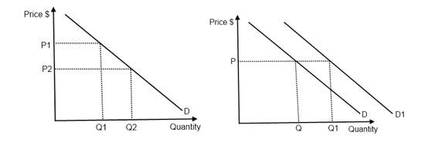
Change In Demand Curve
Movement along the demand curve is caused by a change in the PRICE Determinant of demand.
i.e. when P falls, Qd rises.
Shift of the demand curve is caused by a change in the NON-PRICE Determinant of demand.
i.e. when income rises, Qd rises at ALL prices.

Slide 9
Types of Goods
Categorized based on a change in income:
Normal Good: a good that is demanded more as income rises
  e.g. most goods are normal, as we buy more when we are richer
Inferior Good: a good that is demanded less as income rises
  e.g. own-brand products
Categorized based on how goods are related:
Substitutes: a good that can replace another good
  e.g. Coke and Pepsi
Complements: a good to be used together with another good
  e.g. gasoline and car toothbrush and toothpaste

Slide 10
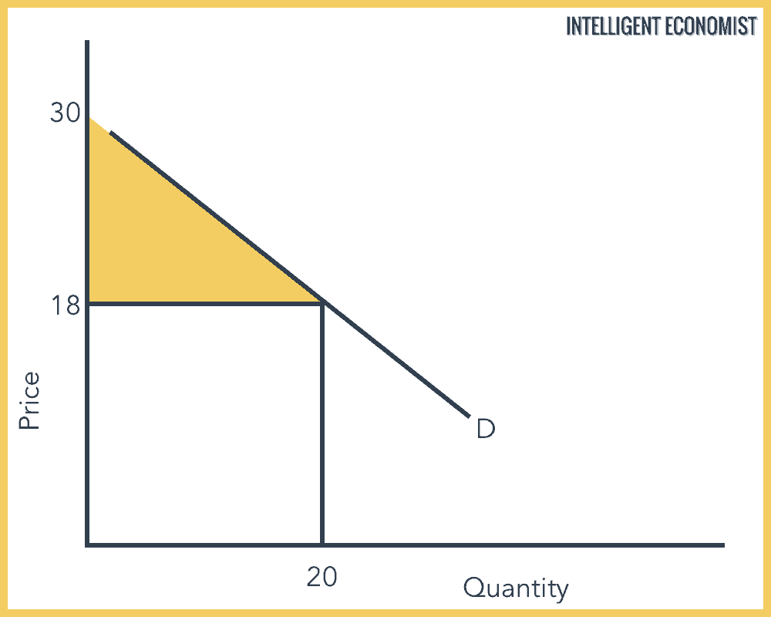
Consumer Surplus
Consumer Surplus is a measure of consumer welfare, expressed in monetary terms.
It is the difference between the price consumers are willing to pay (indicated by the demand curve) and the price they are actually paying (indicated by the MARKET price, not necessarily the equilibrium price).
CS = Area below demand curve and above the mkt price
= (½)(30-18)(20) = 120 $

Slide 11
Supply
Individual Supply is the amount of a good or service that an individual producer is willing and able to sell at a given price.
Market Supply is the sum of all individual supply at a given price.
The supply curve we usually draw is the Market Supply.

Slide 12
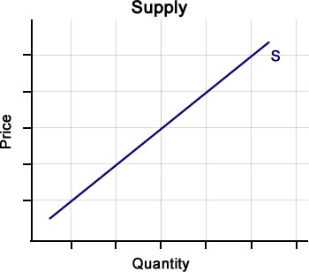
Supply Curve
The supply curve shows a positive relationship between price (P) and quantity supplied (Qs).
Law of Supply: Ceteris Paribus, as P rises, Qs rises, and vice versa.

Slide 13
Linear Supply Equation
Supply Equation is expressed as Qs as a function of P: Qs = f(P)
e.g. Qs = 10 + 2P
However, what we usually draw is the “Inverse Supply Curve”.
Inverse Supply is expressed as P as a function of Qs: P = f(Qs)
e.g. From Qs = 10 + 2P
2P = Qd – 10
we get P = (½)Qd – 5 as the inverse supply equation.

Slide 14
Determinants of Supply
Price Determinant:
Price
Non-Price Determinants:
Cost of Production, e.g. wage and material cost
Price of Related Products: joint supply and competitive supply
  Joint supply: goods that are produced together, e.g. meat and leather
  Competitive supply: goods that compete each other for the same factors of production, e.g. iPhone and iPad
Technology
Supply Shocks, e.g. bad weather or discovery of new resources
Government Policies, e.g. output tax and subsidy

Slide 15
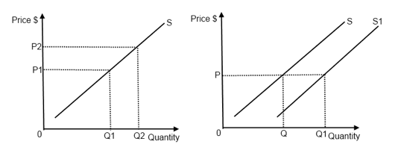
Change In supply Curve
Movement along the supply curve is caused by a change in the PRICE Determinant of supply.
i.e. when P rises, Qs rises.
Shift of the supply curve is caused by a change in the NON-PRICE Determinant of supply.
i.e. when cost of production falls, Qs rises at ALL prices.

Slide 16
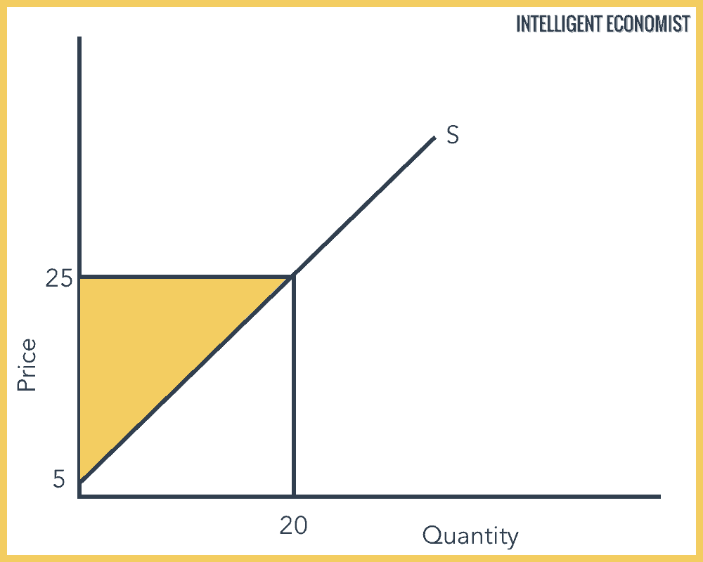
Producer Surplus
Producer Surplus is a measure of producer welfare, expressed in monetary terms.
It is the difference between the price producers are willing to sell (indicated by the supply curve) and the price they are actually selling (indicated by the MARKET price, not necessarily the equilibrium price).
PS = Area above supply curve and below the mkt price
= (½)(25-5)(20) = 200 $

