Slide 1
Methods of Therapy
General Psychology

Slide 2
Agendas
Psychotherapy
Insight Therapies
Behaviour Therapies
Biomedical Therapies

Slide 3
Psychotherapy
A systematic interaction between a therapist and a client
that uses psychological principles to influence the client’s thoughts, feelings, or behavior
to help them overcome psychological disorders, adjust to problems in living, or develop as an individual

Slide 4
History
Asylums
  Warehouse not a treatment
Mental Hospitals
  Get treatment
Community Health Care Movement
  Patients live in the community

Slide 5
Three Major Approaches to Therapy:
  Insight (personal understanding)
  Behavior (maladaptive behaviors)
  Biomedical (mental illness and medical treatments, such as drugs)
Eclectic Approach
  an approach to psychotherapy that, depending on the client’s problems, uses techniques from various forms of therapy

Slide 6
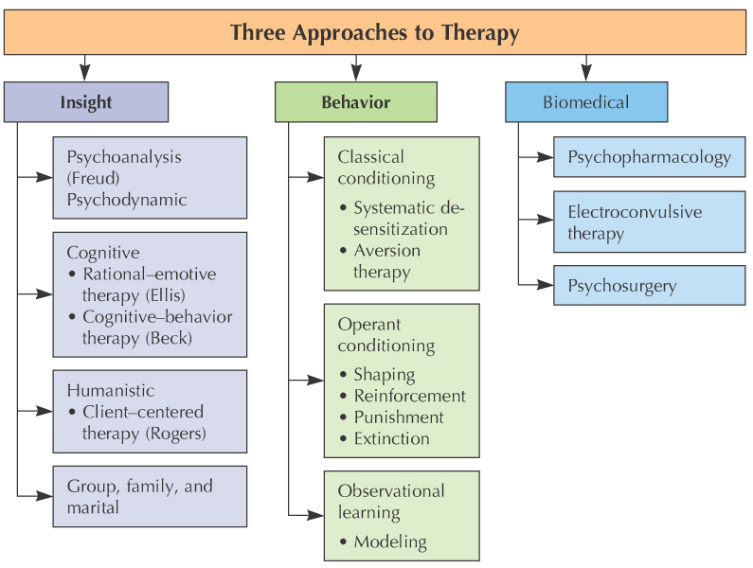

Slide 7
Psychoanalytical Perspective
Psychoanalysis

Slide 8
Insight Therapies: Psychoanalysis/Psychodynamic
Psychoanalysis: Freudian therapy designed to bring unconscious conflicts into consciousness

Slide 9
Psychoanalytic Therapy
Psychoanalysis - Freud’s method of psychotherapy
  Catharsis- release of emotional tension (psychic energy) by expressing repressed feelings and impulses.
  Free Association – talk about any topic that comes to mind.
  Resistance- the tendency to block free expression of impulses and primitive ideas- a reflection of the defense mechanism ‘repression’

Slide 10
Psychoanalytic Therapy
Transference- responding to one person in a way that is similar to the way one responded to another person.
  E.g. a young woman client may seek affection and approval from the therapist because she wants these things from her father.
Wish fulfillment- in dreams, acting out repressed impulses, ideas.

Slide 11
Psychoanalytic Therapy
Modern psychodynamic approaches differ:
  face to face interaction (no lying on a couch)
  therapist is directive in suggesting helpful behavior (not only focused on insight)
  more focus on ego than id (so, many are considered ego-analysts)
  less emphasis on sex and aggression.

Slide 12
Insight Therapies: Psychoanalysis/Psychodynamic
Evaluation of psychoanalysis: Limited applicability and lack of scientific credibility
Psychodynamic Therapy: briefer, more directive, and more modern form of psychoanalysis that focuses on conscious processes and current problems

Slide 13
Cognitive Perspectives
Rational-Emotive Behavioural Therapy (REBT)
Cognitive Therapy (CT)

Slide 14
Insight Therapies: Cognitive
Cognitive Therapy: focuses on faulty thinking and beliefs
  Improvement comes from insight into negative self-talk (unrealistic things a person has been telling himself or herself)
  Cognitive Restructuring (process of changing destructive thoughts or inappropriate interpretations)

Slide 15
Insight Therapies: Cognitive (Continued)
Two Major Cognitive Therapies:
Albert Ellis’s Rational-Emotive Behavior Therapy (REBT)
Aaron Beck’s Cognitive Therapy

Slide 16
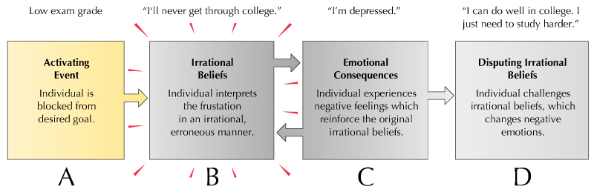
Ellis’s Rational-Emotive Behavior Therapy (REBT): eliminates self-defeating beliefs through rational examination

Slide 17
Cognitive Therapy
Focus on client cognition (expectations, attitudes, beliefs) to relieve distress and promote adaptive behavior
Beck’s Cognitive Therapy: confronts and changes behaviors associated with destructive cognitions
Depressive Thinking Patterns:
  selective perception
  overgeneralization
  magnification
  all-or-nothing thinking
  (Absolutist thinking)
Notes:
Aaron Beck’s Cognitive Therapy
A focus on client cognition (expectations, attitudes, beliefs) to relieve distress and promote adaptive behavior
Selective perception
Overgeneralizing
Magnifying
Absolutist thinking
*focus on cognitive errors and changing them.

Slide 18
Evaluation of cognitive therapy:
Pro: Considerable success with a range of problems
Con: Criticized for overemphasizing rationality, ignoring unconscious dynamics, minimizing importance of the past, etc.

Slide 19
Cognitive Behaviour Therapy
Combines the techniques of behavior therapy and cognitive therapy.
Effective with anxiety, depression, personality disorders, anorexia.

Slide 20
Humanistic Perspectives
Client-centred Therapy

Slide 21
Insight Therapies: Humanistic
Humanistic therapy: Maximizes personal growth through affective restructuring (emotional readjustment)
Focuses on the client’s subjective, conscious experience ‘here and now.
Key assumption: People with problems are suffering from a blockage or disruption of their normal growth potential, which leads to a defective self-concept.

Slide 22
Client-Centered Therapy
Rogers’s Client-Centered Therapy: emphasizes client’s natural tendency to become healthy and productive
A warm therapeutic atmosphere that frees clients to engage in self-exploration and expression
Techniques include:
  Empathy Recognize client’s feelings, experiences from their point of view
  Unconditional positive regard Accepting the value of another person, but not everything they do.
  Genuineness Openness and honesty in responding to the client.
  Active listening -empathic listening in which the listener echoes, restates, and clarifies
Notes:
the creation of a warm therapeutic atmosphere that frees clients to engage in self-exploration and expression.
Assumes people disown parts of themselves that weren’t accepted:
Conditions of worth

Slide 23
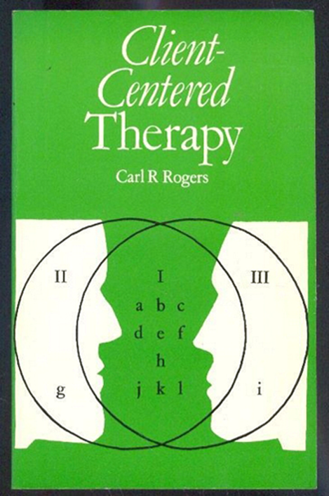
Client-Centered Therapy
Practiced widely in university counseling centers.
  Helps with anxiety, depression, making decisions
  Helps clients reach their own decisions.

Slide 24
Evaluation of humanistic therapy:
Pro: Evidence for success
Con: Basic tenets, such as self-actualization, difficult to test scientifically

Slide 25
Behavioural/ Learning Perspectives
Behaviour Therapy

Slide 26
Behaviour Therapy
Behaviour Therapy: group of techniques based on learning principles used to change maladaptive behaviors
Three foundations of behavior therapy:
  Classical conditioning
  Operant conditioning
  Observational learning

Slide 27
Classical Conditioning
Systematic Desensitization: gradual process of extinguishing a learned fear (or phobia) by working through a hierarchy of fearful stimuli while remaining relaxed
Flooding

Slide 28
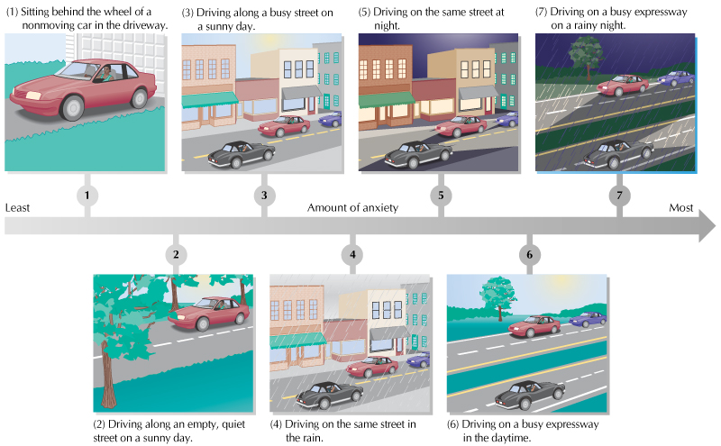

Slide 29
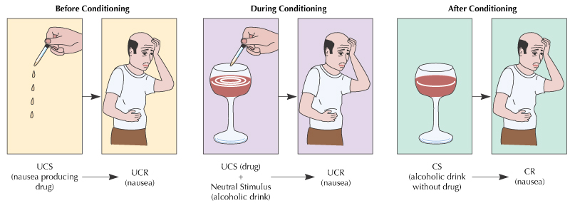
Classical Conditioning
  Aversion Therapy: pairing an aversive (unpleasant) stimulus with a maladaptive behavior
Notes:
Smoking and nausea

Slide 30
Operant Conditioning
Operant Conditioning Techniques Used to INCREASE Adaptive Behaviors:
Shaping--successive approximations of target behavior are rewarded (includes role-playing, behavior rehearsal, assertiveness training)
Tokens: symbolic rewards used to immediately reinforce desired behavior

Slide 31
Operant Conditioning
Operant Conditioning Techniques Used to DECREASE Maladaptive Behaviors:
Extinction: withdrawal of attention
Punishment: adding or taking away something (e.g., time-out)
Begins with functional analysis.
  Trigger, reinforcers

Slide 32
Observational Learning
Modeling: watching and imitating models that demonstrate desirable behaviors
Participant Modeling: combining live modeling with direct and gradual practice
Social skills training
  Self-monitoring
  Behavior rehearsal
  Feedback

Slide 33
Evaluation of behavior therapies:
Pro: Strong evidence for success with a wide range of problems
Con: Questioned and criticized for generalizability and ethics

Slide 34
Group, Family, and Marital Therapies
Group Therapy: a number of people meet together to work toward therapeutic goals
Family and Marital Therapies: work to change maladaptive family and couple interaction patterns

Slide 35
Biological Perspectives

Slide 36
Biomedical Therapies
Biomedical Therapy: uses physiological interventions, such as drugs, to reduce or alleviate symptoms of psychological disorders
Three forms of biomedical therapy:
  Psychopharmacology
  Electroconvulsive therapy (ECT)
  Psychosurgery

Slide 37
Psychopharmacology
Four major categories of drugs:
Antianxiety (increases relaxation, reduces anxiety and muscle tension)
Antipsychotic (treats hallucinations and other symptoms of psychosis)
Mood Stabilizer (treats manic episodes and depression)
Antidepressant (treats symptoms of depression)

Slide 38
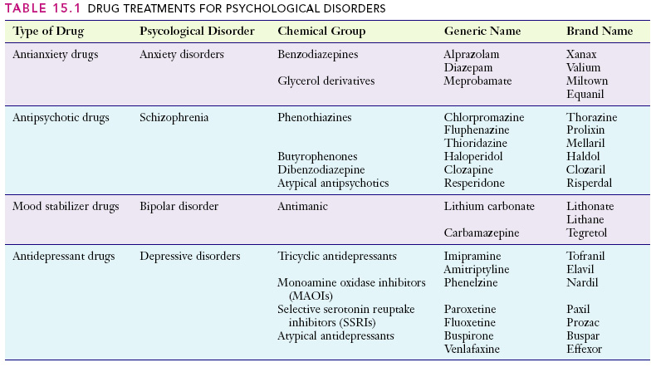

Slide 39
Biomedical Therapies (Continued)
Electroconvulsive Therapy (ECT): based on passing electrical current through the brain and used when other methods have not been successful
Psychosurgery: operative procedures on the brain designed to relieve severe mental symptoms that have not responded to other forms of treatment

