Slide 1
What is Economics All About ?
EE 211

Slide 2
A set of principles for understanding the economics of how individuals make choices
A set of principles for understanding how individual choices interact
A set of principles for understanding economy-wide interactions
Explain the importance of scarcity, choice, and opportunity cost, and they are illustrated by the production possibilities boundary
Explain that all economies are mixed economies, having elements of free markets, tradition, and government intervention

Slide 3
Distinguish between positive and normative statements in economics.
Explain how economists use models to help them think about the economy.
Describe the interaction between economic theories and empirical observation.
Describe several types of economic data, including time-series and cross-sectional data, and scatter diagrams.
Explain how the slope of a relation between two variables, X and Y, is interpreted as the marginal response in Y to a unit change in X.

Slide 4
Individual Choice
is the decision by an individual of what to do, which necessarily involves a decision of what not to do
Basic principles behind the individual choices:
  Resources are scarce
  The real cost of something is what you must give up to get it
  “How much?” is a decision at the margin
  People usually take advantage of opportunities to make themselves better off

Slide 5
Scarcity, Choice, and Opportunity Cost
Economics is the study of the use of scarce resources to satisfy unlimited human wants
Resources
A society’s resources are divided into land, labor, and capital
Economists refer to resources as factors of production
Outputs are goods (tangibles) or services (intangibles)

Slide 6
Resources are scarce
A resource is anything that can be used to produce something else
  Example Land, labor, capital
Resources are scarce – the quantity available isn’t large enough to satisfy all productive uses
  Example Petroleum, lumber, intelligence, …

Slide 7
The real cost of something is what you must give up to get it
The real cost of an item is its opportunity cost: what you must give up in order to get it
Opportunity cost is crucial to understanding individual choice:
  Example The cost of attending the economics class is what you must give up to be in the classroom during the lecture
Sleep? Watching TV? Rock climbing? Work?
All costs are ultimately opportunity costs

Slide 8
“How much?” is a decision at the margin
You make a trade-off when you compare the costs with the benefits of doing something
Decisions about whether to do a bit more or a bit less of an activity are marginal decisions

Slide 9
Marginal Analysis
Making trade-offs at the margin: comparing the costs and benefits of doing a little bit more of an activity versus doing a little bit less
The study of such decisions is known as marginal analysis
  Example Hiring one more worker, studying one more hour, eating one more cookie, buying one more CD…

Slide 10
People usually take advantage of opportunities to make themselves better off
An incentive is anything that offers rewards to people who change their behavior
  Example Price of gasoline rises → people buy more fuel-efficient cars
There are more well-paid jobs available for college graduates with economics degrees →more students major in economics
People respond to these incentives

Slide 11
Interaction: How Economies Work
Interaction of choices—my choices affect your choices, and vice versa
Principles that underlie the interaction of individual choices:
There are gains from trade
Markets move toward equilibrium
Resources should be used as efficiently as possible to achieve society’s goals
Markets usually lead to efficiency
When markets don’t achieve efficiency, government intervention can improve society’s welfare

Slide 12
There are gains from trade
In a market economy, individuals engage in trade: They provide goods and services to others and receive goods and services in return
There are gains from trade: people can get more of what they want through trade than they could if they tried to be self-sufficient

Slide 13
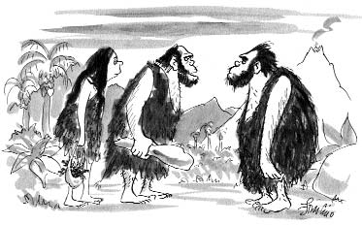
This increase in output is due to specialization: each person specializes in the task that he or she is good at performing.
©The New Yorker Collection 1991
Ed Frascino from cartoonbank.com.
All Rights Reserved.
“I hunt and she gathers – otherwise we couldn’t make ends meet.”
The economy, as a whole, can produce more when each person specializes in a task and trades with others

Slide 14
Markets move toward equilibrium
An economic situation is in equilibrium when no individual would be better off doing something different
Any time there is a change, the economy will move to a new equilibrium
  Example what happens when a new checkout line opens at a busy supermarket?

Slide 15
Resources should be used as efficiently as possible to achieve society’s goals
An economy is efficient if it takes all opportunities to make some people better off without making other people worse off
Should economic policy makers always strive to achieve economic efficiency?
Equity
everyone gets his or her fair share
Since people can disagree about what’s “fair,” equity isn’t as well-defined a concept as efficiency

Slide 16
Efficiency
the resources are organized so as to produce the largest possible amount of the goods and services that people want to purchase

Slide 17
Efficiency vs. Equity
Example Handicapped-designated parking spaces in a busy parking lot
A conflict between:
equity, making life “fairer” for handicapped people, and
efficiency, making sure that all opportunities to make people better off have been fully exploited by never letting parking spaces go unused
How far policy makers should go in promoting equity over efficiency?

Slide 18
Markets usually lead to efficiency
The incentives built into a market economy already ensure that resources are usually put to good use
Opportunities to make people better off are not wasted
Exceptions: market failure, the individual pursuit of self-interest found in markets makes society worse off
→ the market outcome is inefficient

Slide 19
When markets don’t achieve efficiency
Why do markets fail?
Individual actions have side effects not taken into account by the market (externalities)
One party prevents mutually beneficial trades from occurring in the attempt to capture a greater share of resources for itself
Some goods cannot be efficiently management by markets

Slide 20
Trade-offs: The Production Possibility Frontier
illustrates the trade-offs facing an economy that produces only two goods
shows the maximum quantity of one good that can be produced for any given production of the other
improves our understanding of trade-offs by considering a simplified economy that produces only two goods by showing this trade-off graphically

Slide 21
The Production Possibility Frontier
Quantity of coconuts
30
D
Feasible and
efficient
in production
Not
feasible
A
15
Feasible but
not efficient
B
9
C
Production possibility frontier
PPF
0
20
28
40
Quantity of fish
Notes:
Figure 2.1 - The Production Possibility Frontier
The production possibility frontier illustrates the trade-offs facing an economy that produces two goods. It shows the maximum quantity of one good that can be produced given the quantity of the other good produced. Here, the maximum quantity of coconuts that Tom can gather depends on the quantity of fish he catches, and vice versa. His feasible production is shown by the area inside or on the curve. Production at point C is feasible but not efficient. Points A and B are feasible and efficient in production, but point D is not feasible.

Slide 22
Increasing Opportunity Cost
Quantity of coconuts
Producing the first
. . .
requires giving
35
20 fish . . .
up 5 coconuts
30
But producing 20
more fish . . .
A
25
20
. . .
requires
15
giving up 25
more coconuts…
10
5
PPF
0
10
20
30
40
50
Quantity of fish
Notes:
Figure 2.2 - Increasing Opportunity Cost
The bowed-out shape of the production possibility frontier reflects increasing opportunity cost. In
this example, to produce the first 20 fish, Tom must give up 5 coconuts. But to produce an additional 20 fish, he must give up 25 more coconuts.

Slide 23
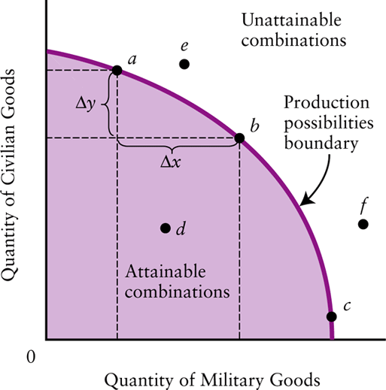
A Production Possibilities Boundary

Slide 24
Economic Growth
Quantity of coconuts
Production is initially at point A (20 fish and 25 coconuts), → it can move to point E (25 fish and 30 coconuts).
35
E
30
The economy can now produce more of everything.
A
25
20
15
Economic growth results in an outward shift of the PPF because production possibilities are expanded.
10
5
Original
New
PPF
PPF
0
10
20
25
30
40
50
Quantity of fish
Notes:
Figure 2.3 - Economic Growth
Economic growth results in an outward shift of the production possibility frontier because production possibilities are expanded. The economy can now produce more of everything. For example, if production
is initially at point A (20 fish and 25 coconuts), it could move to point E (25 fish and 30 coconuts).

Slide 25
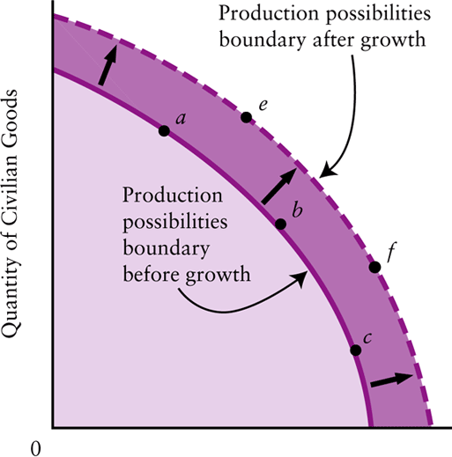
The Effect of Economic Growth on the Production Possibilities Boundary

Slide 26
Production Possibilities for Two Castaways
(a) Tom’s Production Possibilities
Quantity of coconuts
30
Tom’s consumption
without trade
9
Tom’s
PPF
0
28
40
Quantity of fish
Notes:
Figure 2.4 - Production Possibilities for Two Castaways
Here, each of the two castaways has a constant opportunity cost of fish and a straight-line production possibility frontier. In Tom’s case, each fish always has an opportunity cost of 3⁄4 of a coconut.

Slide 27
Production Possibilities for Two Castaways
(a) Hank’s Production Possibilities
Quantity of coconuts
20
Hank’s consumption
without trade
8
Hank’s
PPF
0
6
10
Quantity of fish
Notes:
Figure 2.4 - Production Possibilities for Two Castaways
Here, each of the two castaways has a constant opportunity cost of fish and a straight-line production possibility frontier. In Hank’s case, each fish always has an opportunity cost of 2 coconuts.

Slide 28
Tom and Hank’s Opportunity Costs
 | Tom’s Opportunity Cost | Hank’s Opportunity Cost
One fish | 3/4 coconut | 2 coconuts
One coconut | 4/3 fish | 1/2 fish

Slide 29
Specialize and Trade
Both castaways are better off when they each specialize in what they are good at and trade
It’s a good idea for Tom to catch the fish for both of them, because his opportunity cost of a fish in terms of coconuts not gathered is only 3⁄4 of a coconut, versus 2 coconuts for Hank
Correspondingly, it’s a good idea for Hank to gather coconuts for the both of them

Slide 30
Comparative Advantage and Gains from Trade
(a) Tom’s Production and Consumption
(b) Hank’s Production and Consumption
Quantity of coconuts
Quantity of coconuts
30
Tom’s consumption without trade
Hank’s production with trade
Tom’s consumption with trade
20
Hank’s consumption with trade
10
Tom’s production with trade
10
Hank’s consumption without trade
9
8
T
o
m
's
Hank's
PPF
PPF
0
28
30
40
Quantity of fish
0
6
10
Quantity of fish
Notes:
Figure 2-5: Comparative Advantage and Gains from Trade By specializing and trading, the two castaways can produce
By specializing and trading, the two castaways can produce and consume more of both goods. Tom specializes in
catching fish, his comparative advantage, and Hank— who has an absolute disadvantage in both goods but a comparative advantage in coconuts—specializes in gathering coconuts. The result is that each castaway can consume more of both goods than either could without trade.

Slide 31
How the Castaways Gain from Trade
Both Tom and Hank experience gains from trade:
  Tom’s consumption of fish increases by two, and his consumption of coconuts increases by one.
  Hank’s consumption of fish increases by four, and his consumption of coconuts increases by two.

Slide 32
Comparative vs. absolute advantage
An individual has a comparative advantage in producing a good or service if the opportunity cost of producing the good is lower for that individual than for other people
An individual has an absolute advantage in an activity if he or she can do it better than other people. Having an absolute advantage is not the same thing as having a comparative advantage

Slide 33
Tom vs. Hank – Absolute vs. Comparative
Tom has an absolute advantage in both activities: he can produce more output with a given amount of input (in this case, his time) than Hank
But we’ve just seen that Tom can indeed benefit from a deal with Hank because comparative, not absolute, advantage is the basis for mutual gain
So Hank, despite his absolute disadvantage, even in coconuts, has a comparative advantage in coconut gathering
Meanwhile Tom, who can use his time better by catching fish, has a comparative disadvantage in coconut-gathering

Slide 34
Comparative Advantage and International Trade
(a) The U.S. Production Possibilities Frontier
(b) Canadian Production Possibilities Frontier
Quantity of aircraft
Quantity of aircraft
3,000
Canadian production with trade
U.S. consumption without trade
U.S. consumption with trade
Canadian consumption without trade
2,000
1,500
1,500
U.S. production with trade
Canadian consumption with trade
1,000
U
.S.
Canadian
PPF
PPF
0
1
2
3
0
0.5
1
1.5
Quantity of pork (millions of tons)
Quantity of pork (millions of tons)
Notes:
Figure 2.6: Comparative Advantage and International Trade
In this hypothetical example, Canada and the United States produce only two goods: pork and aircraft. Aircraft are measured on the vertical axis and pork on the horizontal axis. Panel (a) shows the U.S. production possibility frontier. It is relatively flat, implying that the United States has a comparative advantage in pork production. Panel (b) shows the Canadian production possibility frontier. It is relatively steep, implying that Canada has a comparative advantage in aircraft production. Just like two individuals, both countries gain from specialization and trade.

Slide 35
Comparative Advantage and International Trade
The US and Canada can both achieve mutual gains from trade
If the US concentrates on producing pork and ships some of its output to Canada, while Canada concentrates on aircraft and ships some of its output to the US, both countries can consume more than if they insisted on being self-sufficient

Slide 36
Transactions: The Circular-Flow Diagram
Trade takes the form of barter when people directly exchange goods or services that they have for goods or services that they want
The circular-flow diagram is a model that represents the transactions in an economy by flows around a circle

Slide 37
The Circular-Flow Diagram
Money
Households
Money
Goods
F
a
c
t
ors
and
services
Markets for goods and services
Factor Markets
Goods
and
services
F
a
c
t
ors
Money
Firms
Money
Notes:
Figure 2.7: The Circular-Flow Diagram
This diagram represents the flows of money and goods and services in the economy. In the markets for goods and services, households purchase goods and services from firms, generating a flow of money to the firms and a flow of goods and services to the households. The money flows back to households as firms purchase factors of production from the households in factor markets.

Slide 38
Circular-Flow of Economic Activities
A household is a person or a group of people that share their income
A firm is an organization that produces goods and services for sale
Firms sell goods and services that they produce to households in markets for goods and services
Firms buy the resources they need to produce—factors of production—in factor markets

Slide 39
The Circular Flow
Individuals own factors of production. They sell the services of these factors to producers in factor markets and receive payment in return
  The payment becomes their (factor) incomes
Producers transform factor services into goods and services, which they then sell to individuals in goods markets, receiving payment in return
  The payment becomes the incomes of producers

Slide 40
How are Decisions Made?
Maximizing Decisions
People are maximizers
Consumers maximize utility, producers maximize profits
Marginal Decisions
All decisions are based on weighing marginal cost against marginal benefit

Slide 41
The Complexity of Production
Production usually displays two characteristics noted long ago by Adam Smith: specialization and the division of labor
Specialization is the allocation of different jobs to different people. It is more efficient than self-sufficiency because:
  Individual abilities differ -- comparative advantage
  Focusing on one activity leads to improvements -- learning by doing
Division of labor extends the idea of specialization for the production of a single good or service

Slide 42
Markets and Money
Specialization must be accompanied by trade
Money eliminates the cumbersome system of barter by separating the transactions involved in the exchange of products, thereby facilitating specialization and trade

Slide 43
Is There an Alternative to the Market Economy?
Types of Economic Systems
  Traditional
  Command
  Free-Market
In practice, every economy is a mixed economy, in the sense some decisions are made by firms and households and some by the government

Slide 44
Government in the Modern Mixed Economy
Key government-provided institutions in market economies are private property and freedom of contract
Governments also intervene to:
  correct market failures
  provide public goods
  offset the effects of externalities
Markets often work well, but sometimes government policy can improve the outcome for society as a whole

Slide 45
Positive and Normative Advice
Normative statements depend on value judgments and opinions -- cannot be settled by recourse to facts
Positive statements do not involve value judgements. They are statements about what is, was, or will be

Slide 46
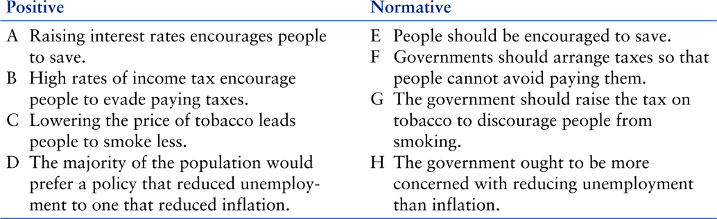
Positive and Normative Statements

Slide 47
Economic theories
A theory consists of:
  a set of definitions about variables
    endogenous and exogenous variables
  a set of assumptions
    motives, physical relations, direction of causation, conditions of application
  a set of predictions (or hypotheses)

Slide 48
Endogenous variable
A variable that is explained within a theory
Dependent variable
Exogenous variable
A variable that is determined outside the theory
Independent variable

Slide 49
Models
  as a synonym for a theory
  as a specific quantitative formulation of a theory
  as a specific application of a general theory
  as an illustrative abstraction which helps to understand key features of a complex world

Slide 50
Testing theories
Rejection Versus Confirmation
A hypothesis can be tested and may be rejected by the data. This rejection brings the value of the theory into question
An alternative is to search for confirming evidence for a theory
But no matter how unlikely the theory is, some confirming evidence can generally be found

Slide 51
Statistical Analysis
Statistical analysis is used to test a hypothesis such as “if X increases, then Y will also increase”
Economists are compelled to use millions of “uncontrolled” experiments that are going on every day in the economy
These activities can be observed and recorded continuously, producing a mass of data
The analysis of such data requires the use of appropriate -- and often quite complex -- statistical techniques

Slide 52
Correlation Versus Causation
Positive correlation means only that X and Y move together
Negative correlation means that X and Y move in opposite directions
But X and Y may not be causally related. Or they may be related in the opposite way to what is expected -- reverse causality
Most economic predictions attempt to establish causality
Statistical tests often attempt to distinguish between correlation and causality

Slide 53
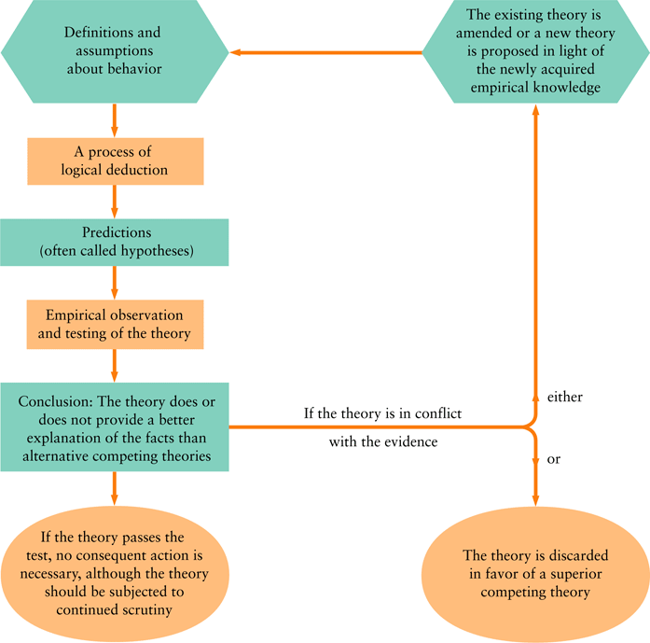
The Interaction Between Theory and Empirical Observation

Slide 54
Graphing economic theories
A functional relation can be expressed:
  in a verbal statement
  in a numerical schedule (a table)
  in a mathematical equation
  in a graph

Slide 55
Functions
Consider a relationship between a household’s annual income, Y, and its total consumption, C.
We use a symbol to express the dependence of one variable on another.
C = f(Y)
“C is a function of Y” -- we also say “the amount of consumption expenditure depends upon the household’s income.”

Slide 56
Graphing Functional Relations
The relationship between two variables may be positive or negative.
If the graphs of these relationships are straight lines, the variables are linearly related to each other.
Otherwise, variables are said to be non-linearly related.

Slide 57
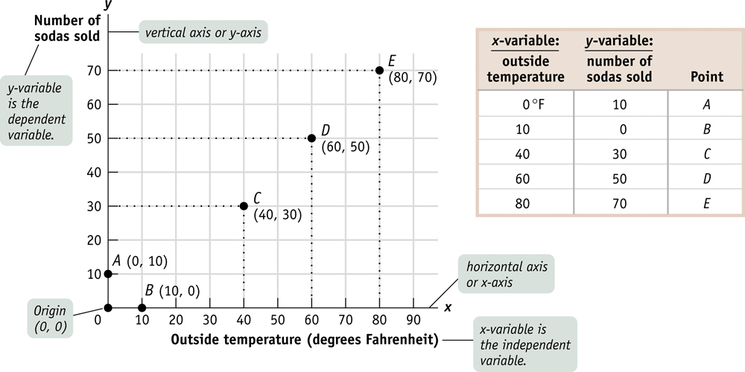
Two variable graphs

Slide 58
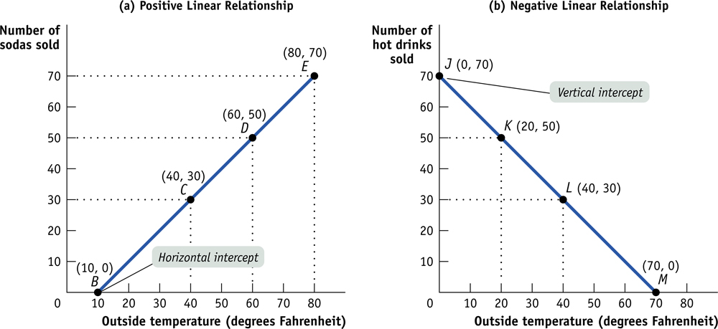

Slide 59
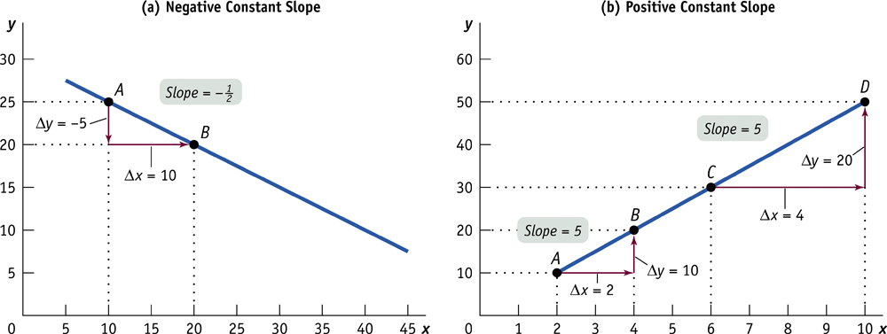
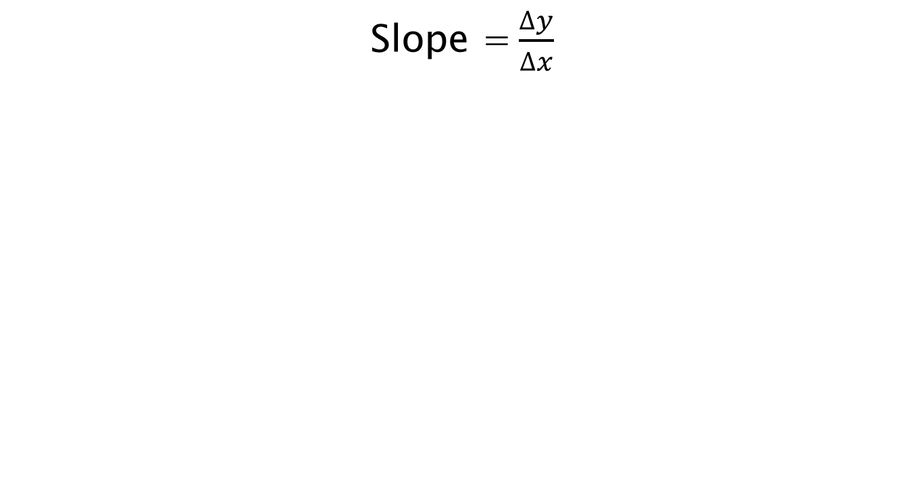
The slope of a Linear Curve
Slope = $\frac{∆y}{∆x}$

Slide 60
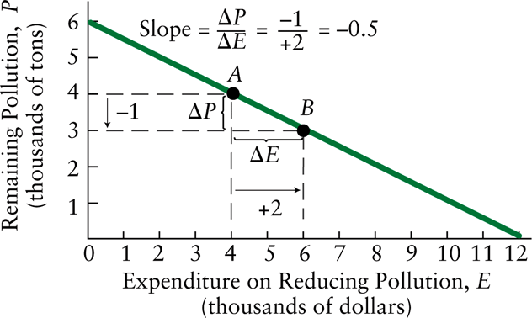
Example
Linear Pollution Reduction
Let X be the variable measured on the horizontal axis and Y be the variable measured on the vertical axis.
The slope of a straight line is then ΔY/ΔX.

Slide 61
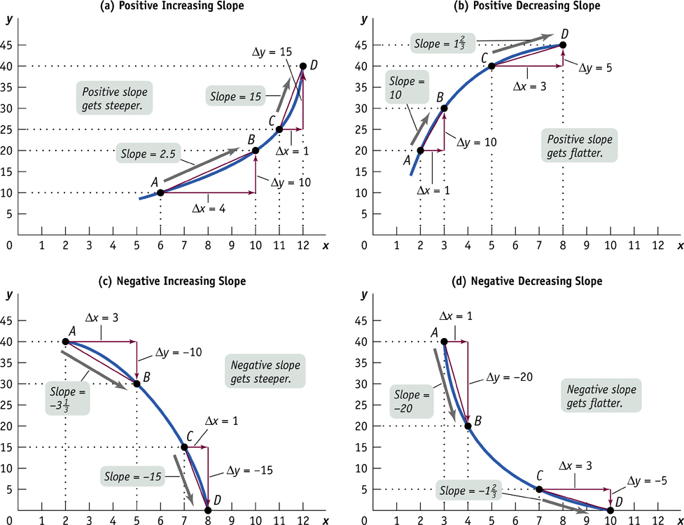
The Slope of a nonlinear curve

Slide 62
Calculating the slope along a nonlinear curve
The Arc Method of calculating the slope
The Point Method of calculating the slope

Slide 63
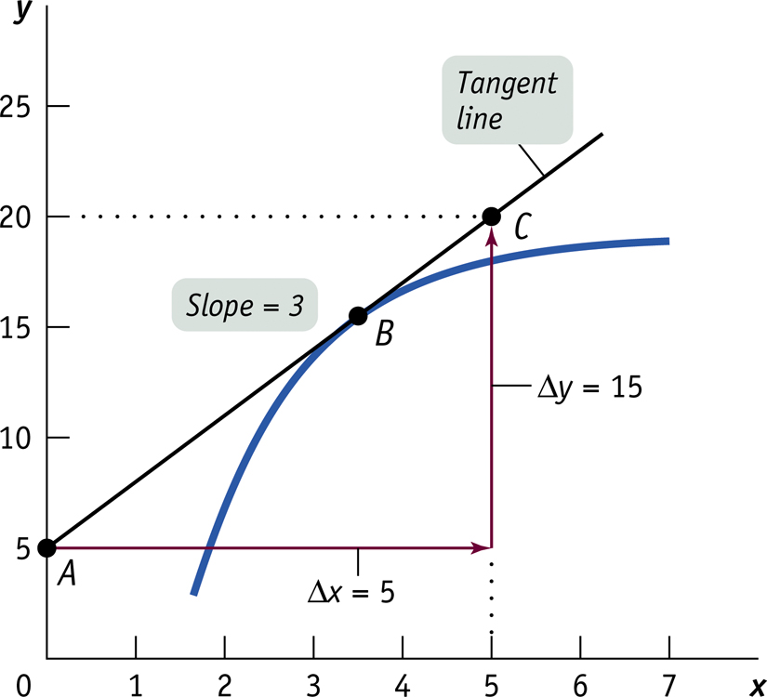
The Point Method of calculating the slope

Slide 64
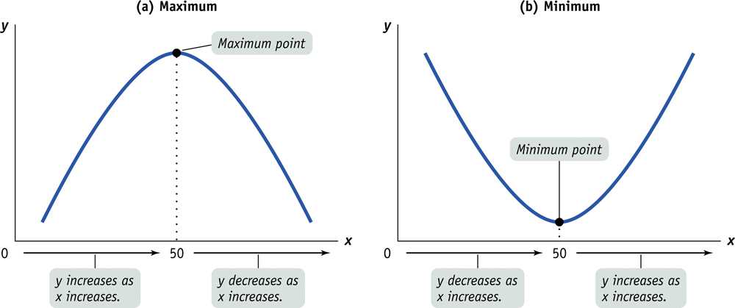
Maximum and Minimum points

Slide 65
Economic data
Graphing Economic Data
Economic variables usually come in two basic forms:
  Cross-sectional data
  Time-series data
A scatter diagram is a useful and common way of looking at the relationship between two variables

Slide 66
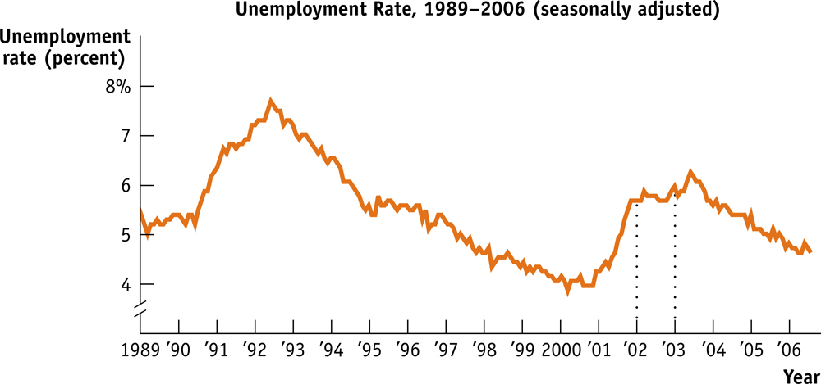

Slide 67
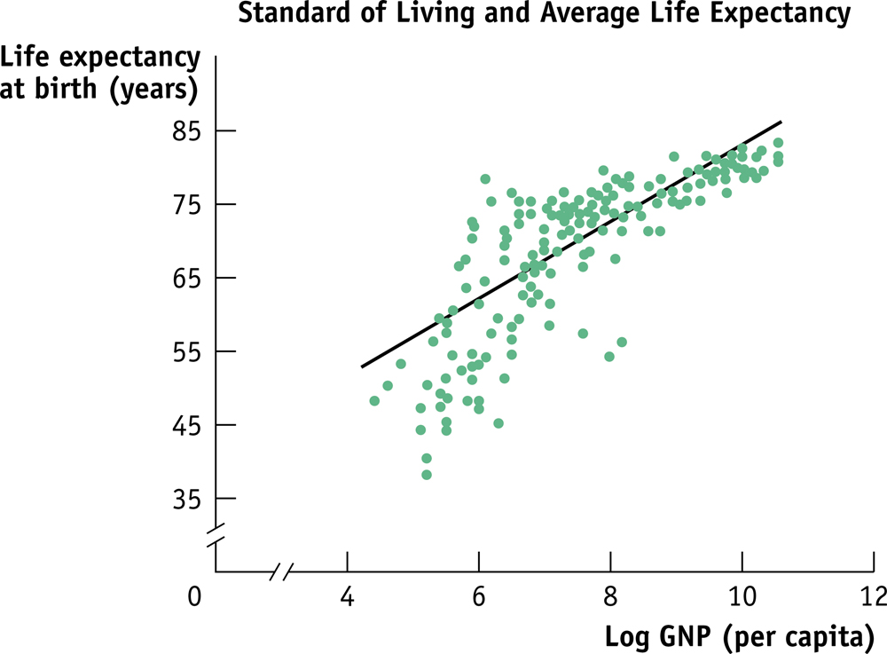

Slide 68
Source:
Lipsey, Regan, and Storer (2008)
Krugman and Wells (2008)

