Slide 1
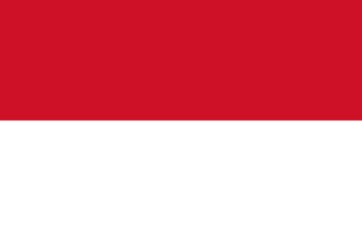
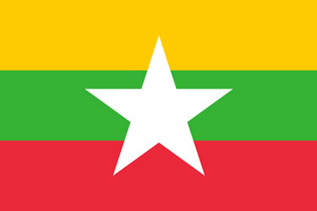
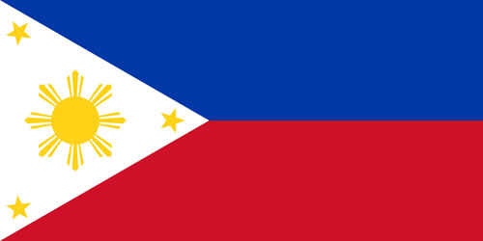
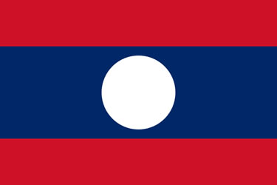
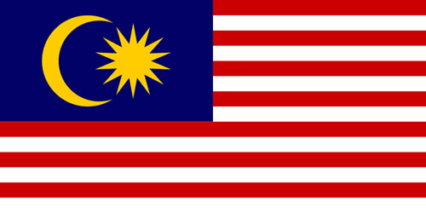
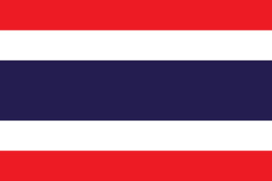
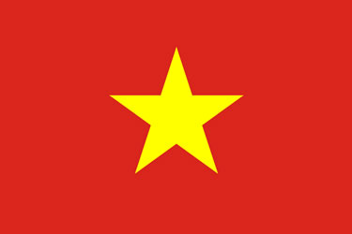
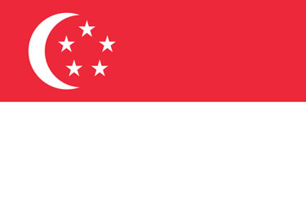
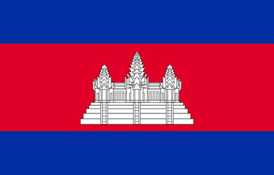

Indonesia Malaysia
Philippines Myanmar
Thailand Singapore
Laos Brunei
Cambodia Vietnam
Notes:
Thai flag – red white and blue with biggest stipe blue in center
Plain red and white – Indonesia
Red and white with stars and moon – Singapore
Yellow green red with white star – Myanmar
Like usa but with star and moon – malayisa
Red with yellow star – Vietnam
Red white and blue with yellow snowflake type things – Philippines
Central red stripe with castle – Cambodia
Yellow with black and white diagonal – brunei
White circle on blue with red outsides - laos

Slide 2
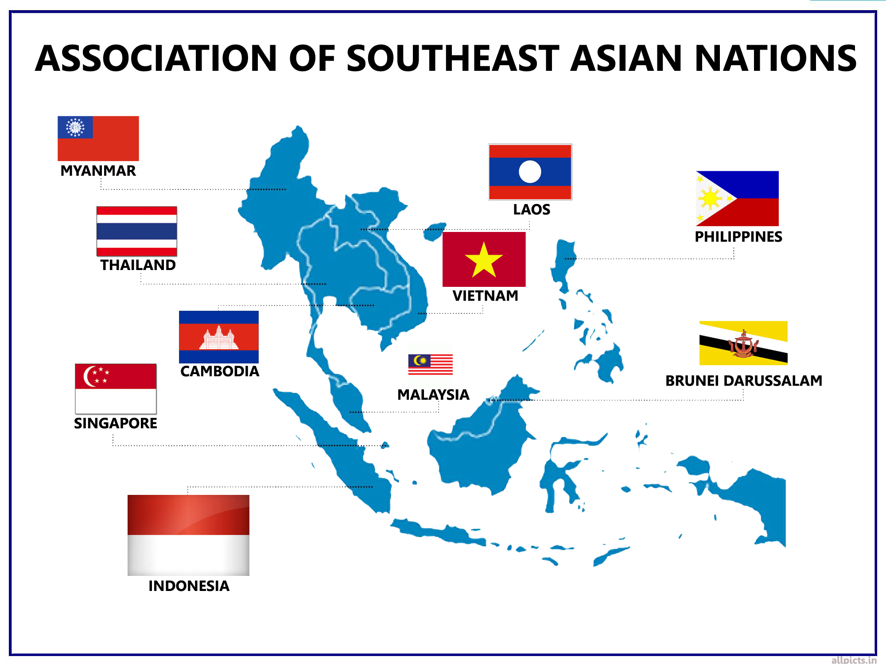
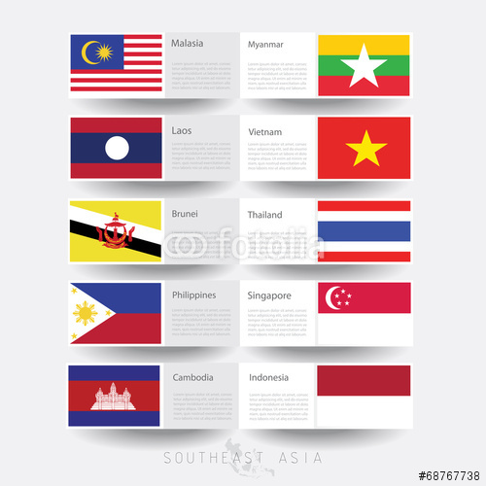
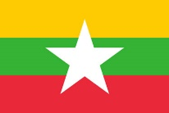

Slide 3
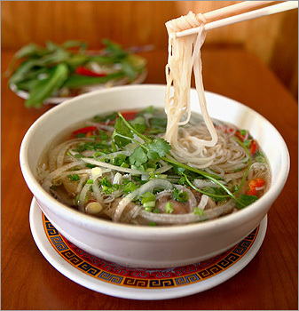

Slide 4
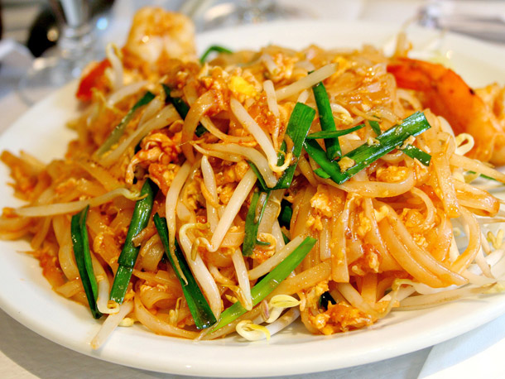

Slide 5
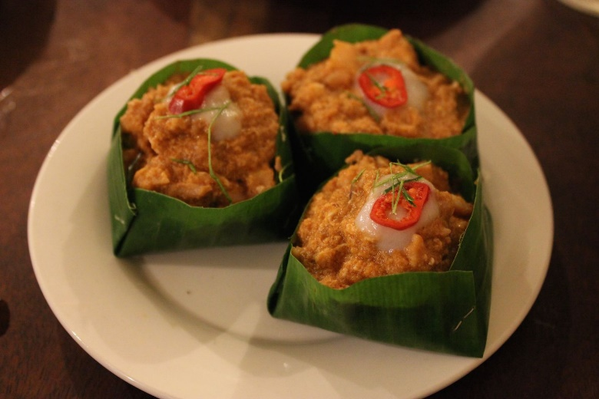

Slide 6
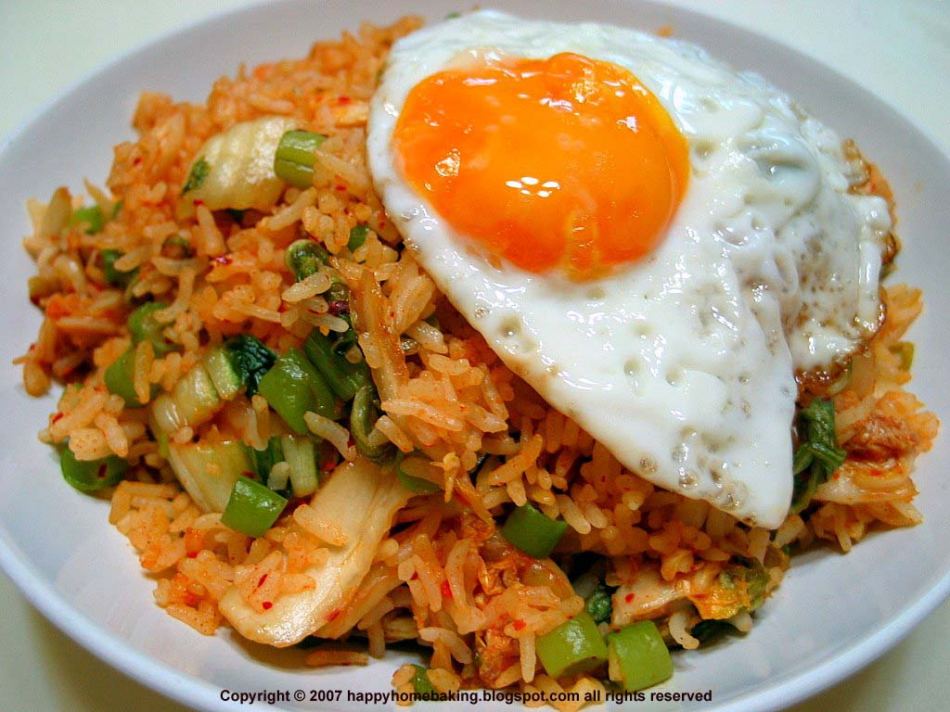

Slide 7
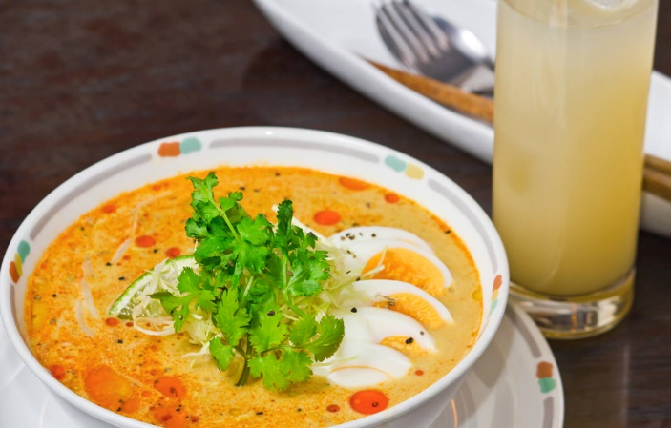

Slide 9
Amok
Pho
Pad Thai
Mohinga
Nasi Goreng
Notes:
. Mohinga -
No conversation about Myanmar food is complete without a mention of mohinga. This tempting dish is made from round rice noodles served in a hearty, herbal-based broth, often supplemented with the crunchy pith of the banana tree. It is a favorite breakfast dish, but also a common snack at any time of day or night.
The popular Khmer dish called amok uses a kind of catfish steamed in a savoury coconut-based curry. The small fish known as Trey Dang Dau are very common and are often eaten deep-fried. While freshwater fish is the most commonly used meat in the Cambodian diet, porkand chicken are also popular.
Nasi goreng, literally meaning "fried rice" in Indonesian and Malay, can refer simply to fried pre-cooked rice, a meal including stir fried rice in small amount of cooking oil or margarine, typically spiced with kecap manis (sweet soy sauce), shallot, garlic, ground shrimp paste, tamarind and chilli and accompanied by ...
Phở or pho (pronounced variously as /fʌ/, /fə/, /fər/, or /foʊ/; Vietnamese: [fəː˧˩˧] ( listen)) is a Vietnamese noodle soup consisting of broth, linguine-shaped rice noodles called bánh phở, a few herbs, and meat, primarily served with either beef or chicken.
pho, a dish that is served primarily at breakfast time and remains a staple of the early-rising Vietnamese population. Pho is like cereal, Pop Tarts, oatmeal and scrambled egg. It’s how you start the day. In the mercilessly crowded cities, pho is typically taken at street stalls, where Vietnamese park their motorbikes before diving into a bowl. The term pho actually refers to the noodles, not the soup. There are hundreds of different soups found around Vietnam. But pho is made with pristine white rice flour noodles that are made daily and sold in markets. To me, the most stunning part about slurping pho in the motherland was the quality of the noodles. They were always tender with a nice body. They were like nothing I had ever had before.
3. But, really, everybody in Vietnam judges the pho by its broth. The herb and vegetables garnishes, which I will get to later, are available everywhere and always exceptionally fresh. The noodles are the bomb, which is also the norm.
Sip the broth first (I stress this because it’s important) while you work the noodles with your chopsticks. It’s OK, even preferred, that you stick your face into the bowl while slurping. You get a hit of those aromatics while avoiding a messy splatter. Once the noodles are gone (they usually go first), raise the bowl to your lips with both hands and polish it off. This is not impolite. This is how you finish a bowl of pho

Slide 10



What language is each written in?
ဟလို
Halo
xin chào
สวัสดี
你好
ສະບາຍດີ
Notes:
สวัสดี sawatdii (Thai)
ສະບາຍດີ - sabaay dii (Laos)
xin chào – sin jao - Vietnam
Halo – haaalo - Indonesian
ဟလို Burmese
你好 - Chinese – for singapore

Slide 11

What countries in ASEAN are Monarchies?

Slide 12
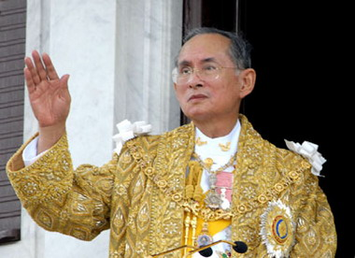
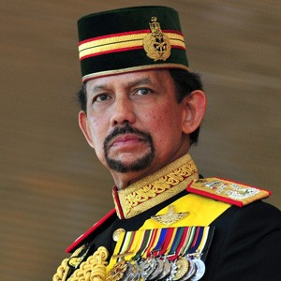
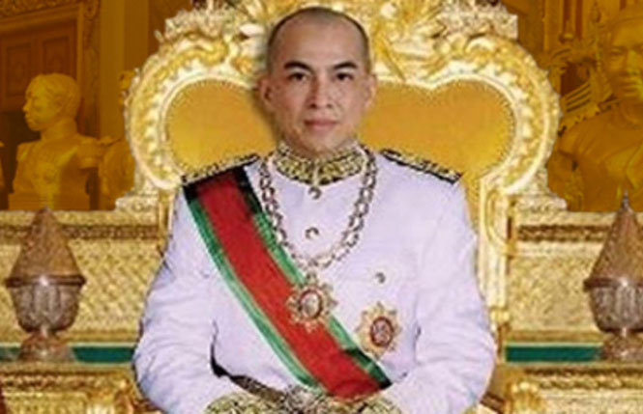
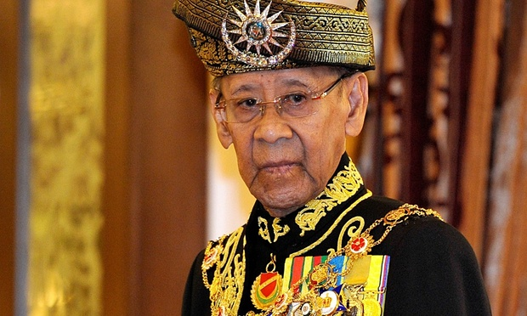
Monarchies in ASEAN
Bhumibol Adulyadej
King of Thailand
Hassanal Bolkiah
Sultan of Brunei
Abdul Halim
Monarch of
Malaysia
Norodom Sihamoni
King of Cambodia

Slide 13
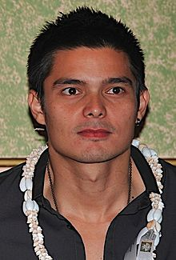


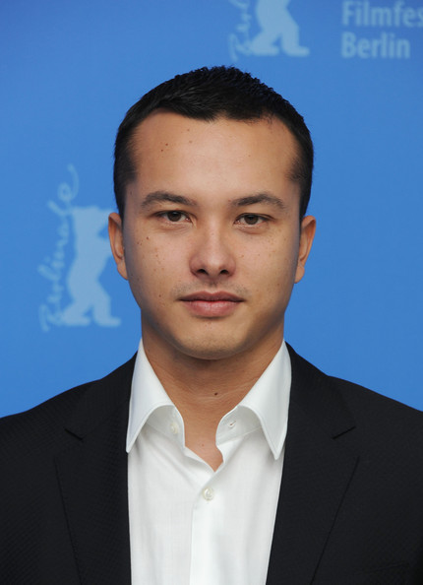
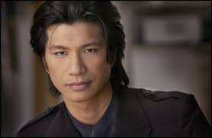



Dingdong Dantes
Maja Salvador
Tania Gunadi
Nicholas Saputra
What ASEAN Country has the Most Beautiful Actors and Actresses?
Michelle Yeoh
Farid Kamil
Dustin Nguyen
Ngô Thanh Vân
Notes:
Top left – Philippines top right – Indonesia bottom left – Malaysia bottom right - vietnam

Slide 14

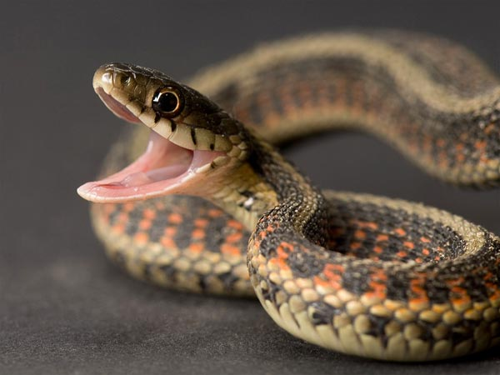
In which Countries of ASEAN are Schools often Taught in English?
S-nake s-nake Fich fich
Notes:
Philippines – half of subjects especially science and math
Malaysia – was science and math until 2012 – phased out and going back to malay
Brunei – most subjects after elementary grade 3
Singapore – all subjects
In many countries, local language is used for k-3
Germans in southeast asia? – very few. Most maybe Philippines with 6,400

Slide 15
Top 5 Southeast Asian Sports
1
2
3
4
5

Slide 16
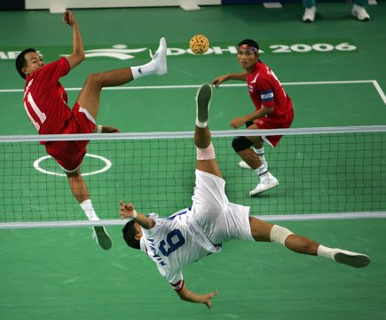
Top 5 Southeast Asian Sports
1 Football
2 Badminton
3 Boxing
4 Rugby
5 Cricket
Honorable Mention - Takraw

Slide 17
Best Pop Music
PH
ID
VN
MY
TH

