Slide 1
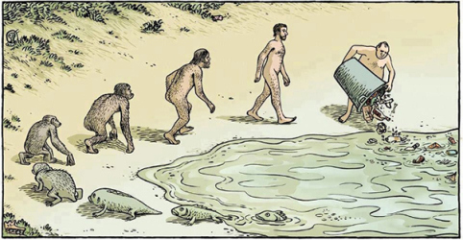
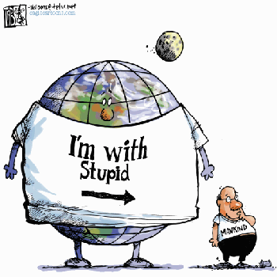
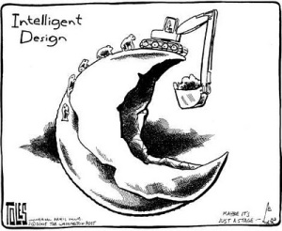
International trade & investment VS environment

Slide 2
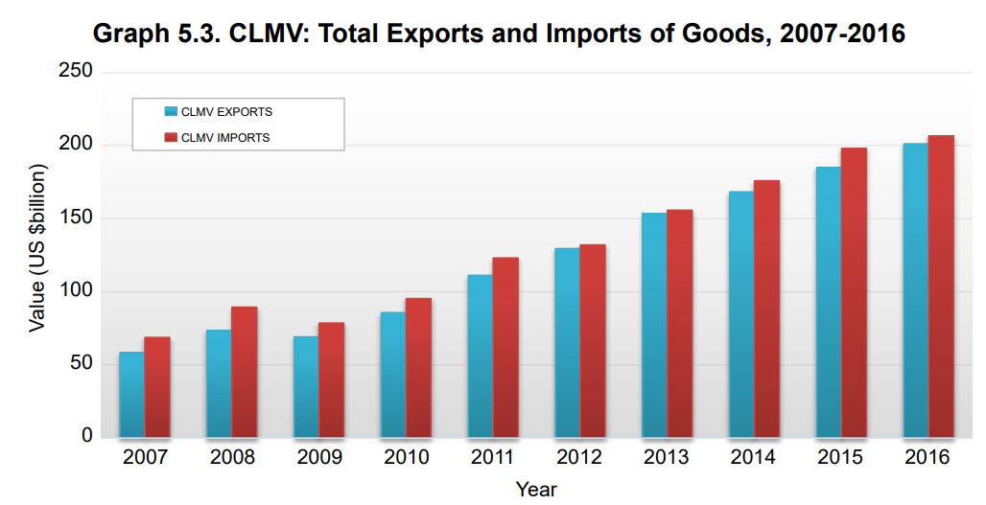


Slide 3
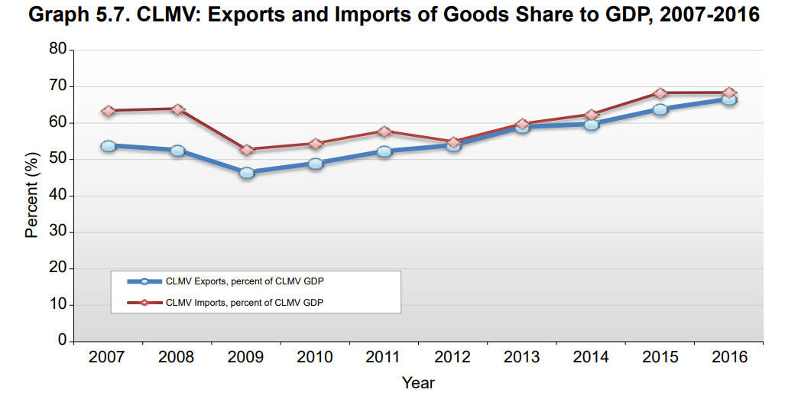

Slide 4
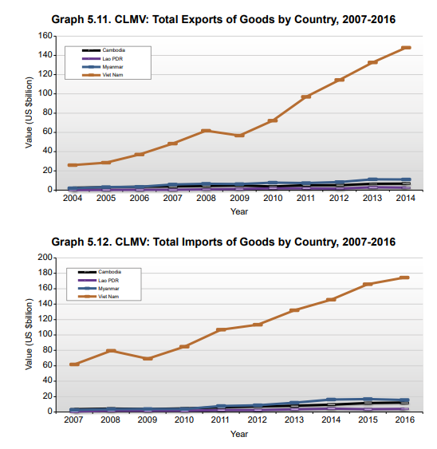

Slide 5
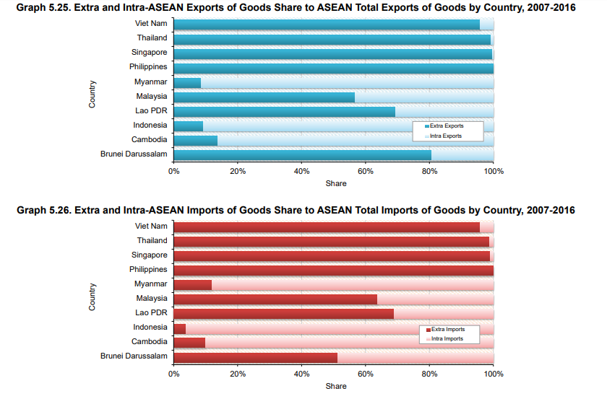

Slide 6
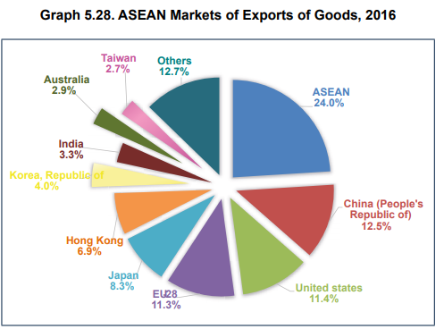
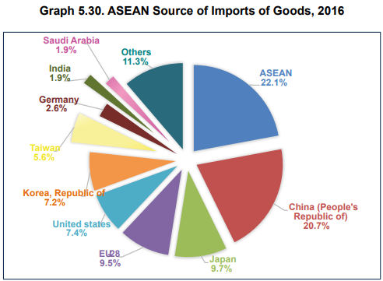

Slide 7
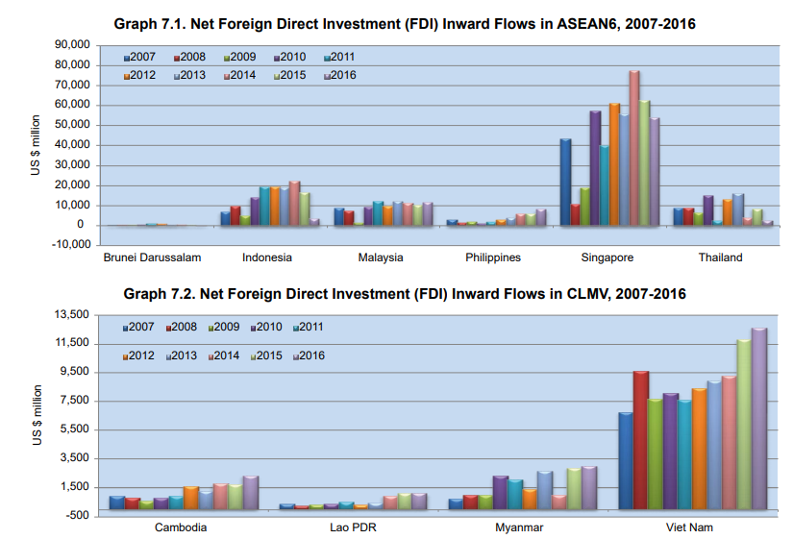

Slide 8
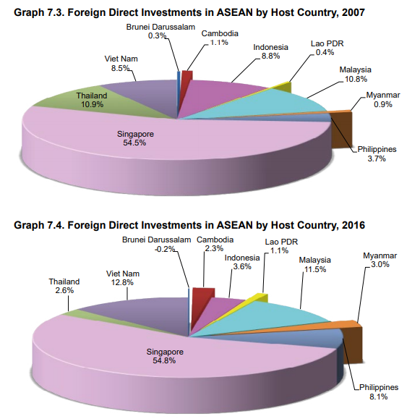

Slide 9
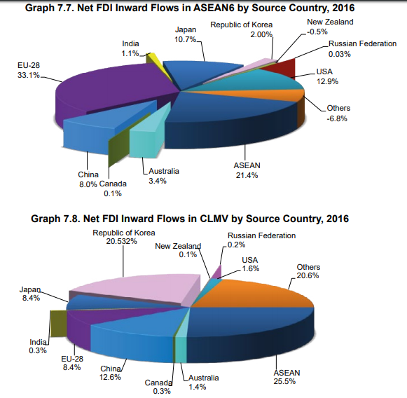

Slide 10
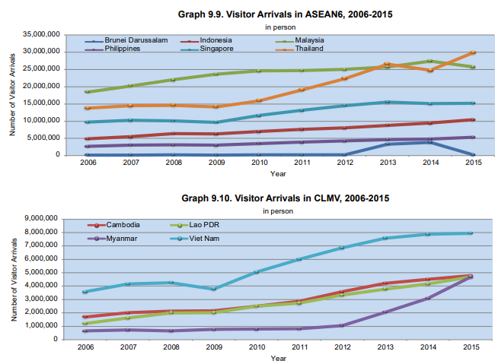

Slide 11
Group discussion: (30 mins)
PROs of free trade
CONs of free trade
PROs of FDI
CONs of FDI

Slide 12
Is trade good or bad for the environment?

Slide 13
Is trade good or bad for the environment?
• Does globalization help or hurt, in achieving the tradeoff between environmental and economic goals?
– Do international trade & investment allow countries to achieve more economic growth for any given level of environmental quality?
– Or do they damage environmental quality for any given rate of economic growth?

Slide 14
Introduction
Free trade proponents argue that FTAs have a positive impact on the environment because after liberalization countries will
  have access to environmentally friendly technologies,
  produce goods in which they have a competitive advantage and
  have greater income due to trade liberalization.
On the other hand, environmentalists argue that trade liberalization is detrimental for the environment because it will
  expand more polluting industries
  encourage more polluting industries to locate in countries with lax environmental regulations.

Slide 15
Some of the common concerns…
  Reducing barriers to trade will reinforce the tendency
  for countries to export commodities that make use of
  resource-intensive production factors (“pollution havens”).
  Trade liberalization may directly affect environmental
  standards (“race to the bottom”).
  “Environmental tariffs” may be employed against trading
  partners deemed to have inadequate environmental
  standards.

Slide 16
But, evidence seems to suggest otherwise…
Countries that are more open to trade adopt cleaner technologies more quickly.
Increased real income is often associated with increased demand for environmental quality .
Greater openness to trade also encourages cleaner manufacturing

Slide 17
International trade theory (basic)
Economists believe that free trade improves economic welfare. (assume no externalities)
Each country can produce A and B at the different cost.
  Relatively low production cost of A in country 1 ➔ 1 has comparative advantage in producing A➔ 1 should produce/export A and import B
  Relatively low production cost of B in country 2 ➔ 2 has comparative advantage in producing B➔ 2 should produce/export B and import A

Slide 18
International trade theory (basic)
The Heckscher-Ohlin theorem
A fundamental proposition regarding the pattern of trade between two economies.
The Heckscher-Ohlin theorem suggests that trade is determined by differences in factor endowments.
  A country will
    export those goods relatively intensive in its abundant factor of production and
    import those goods relatively intensive in its scarce factor of production.

Slide 19
The Heckscher-Ohlin theorem
For example, a country having an abundant supply of capital will find it cheaper to manufacture goods whose production is capital intensive.
    The country is said to have a ‘comparative advantage’ in the production of such goods.
HO theorem implies that countries well endowed with environmental resources should specialise on the production of environmentally damaging goods.

Slide 20
Growth and the Environment
Environmental Kuznets Curve (EKC)
Research has examined whether a relationship exists between economic growth and pollution
A model of this relationship is the environmental Kuznets curve (EKC), an inverted U shape, implying that:
  Early stages of industrialization are linked to relatively high pollution levels when growth is a priority
  environmental controls are lenient or nonexistent
  More advanced economic development ➔ greater concern for environmental quality and a strengthening of environmental regulation
A consensus is forming that this tradeoff is not as severe as once believed

Slide 21
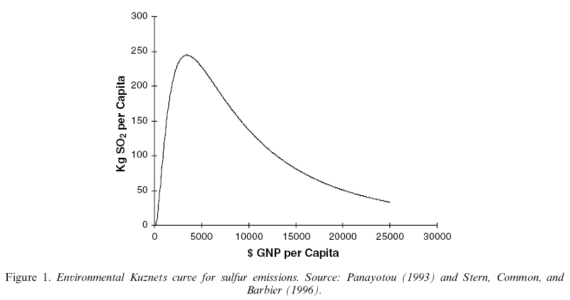
Environmental Kuznets Curve
Early stages of industrial development
Pollution
More advanced stages of development
EKC
Income per capita

Slide 22
The Environmental Kuznets Curve
Why does the curve rise at low levels of development?
Why does pollution tend to fall at higher levels of development?

Slide 23
Why does the curve rise at low levels of development?
  Pollution heaven and race to the bottom
  Reducing barriers to trade and investment will reinforce the tendency for countries to export commodities that make use of resource-intensive production factors OR move production bases to the countries with less environmental regulations (“pollution havens”).
  This may directly affect environmental standards (“race to the bottom”).

Slide 24
Why does pollution tend to fall at higher levels of development?
The stringency of environmental regulation reflect the population’s preference for environmental quality.
The stringency of environmental policy is endogenous so the growth in income that accompanies trade liberalisation might increase the stringency of environmental policy

Slide 25
Scale, composition and technique effects: Grossman and Krueger (1993)
G & K give a useful decomposition for thinking about the reasons underlying changes in emissions.
Emissions are by definition equal to the overall scale of activity S, multiplied by the share of dirty goods in total output σ, multiplied by the emissions per unit of the dirty good, e.
This says that the percentage change in emissions is equal to
the percentage change in the scale of output plus the percentage change in the share of the dirty commodity plus the percentage change in emissions intensity of the dirty commodity.

Slide 26
Scale effects:
Trade liberalisation boosts market access which will generate economic growth, so likely to lead to an increase in the scale of economic activity.
Other things being equal the scale effect will be environmentally damaging.

Slide 27
Composition effects:
Trade liberalisation is also likely to alter the composition of output.
  If a country enjoys a relative abundance of the environmental factor of production then that country will increasingly specialise in the production of environmentally intensive ‘dirty’ commodities.
  Similarly, if a country possesses a relative abundance of capital then that country will specialise in the production of capital intensive commodities. In fact many goods are both capital intensive and environmentally intensive.
The overall effect of the composition effect on the environment is therefore ambiguous.

Slide 28
Technique effects:
technological dissemination through trade liberalization
through the importation of innovations embodied in both intermediate goods and capital goods (e.g. machinery or equipment used in the production of other goods and services) which a country could not have produced on its own.
the transfer of knowledge about new production methods and design from developed countries.

Slide 29
Technique effects:
As trade liberalisation increases per capita income levels the public will call for greater environmental quality.
  Assuming that the Government is responsive to such demands it will tighten environmental regulations.
  compelling producers to adopt different production techniques and new technology.
  This is the technique effect of trade liberalisation.
the overall impact of trade liberalisation is an empirical question.

Slide 30
Impact of trade liberalization
The expectation is that the scale effect will increase emissions and technique effect will decrease emissions.
The composition effect will increase or decrease emissions depending on the production mix of goods after trade liberalization.
  If production of dirty goods increases in the economy, then pollution will increase and
  if the economy produces cleaner goods after trade liberalization it will lead to decreases in emission level.
the overall impact of trade liberalization is an empirical question.

Slide 31
Resource Curse

Slide 32
Resource Curse
There are evidences that many oil-, gas- and mineral-rich countries have failed to reach their full potential as a result of their natural resource wealth.
“The resource curse, also known as the paradox of plenty, refers to the paradox that countries with an abundance of natural resources (like fossil fuels and minerals), tend to have less economic growth, less democracy, and worse development outcomes than countries with fewer natural resources.”
Oil, mineral and gas wealth is distinct from other types of wealth because
  its large upfront costs, long production timeline, site-specific nature, price and production volatility and non-renewable nature.

Slide 33
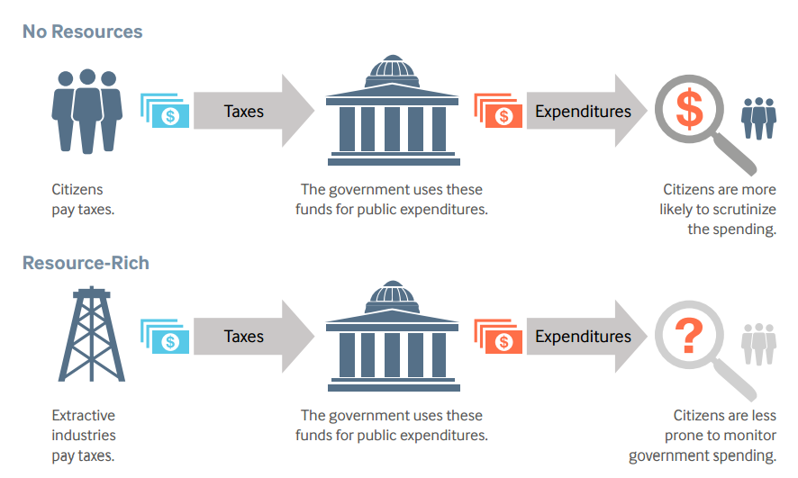
Cause of resources curse
The lack of Democracy
  Natural resource wealth has made it more likely for governments to become or remain authoritarian.
  large revenues from natural resources ➔ less dependent on levying taxes on citizens ➔ Politicians and government officers are less directly tied to citizen requests or demands.
  when resource revenues are secret, citizens do not have a clear sense of whether the resource revenues are being spent well or not.

Slide 34
Cause of resources curse
Conflict: natural resources can provoke and sustain internal conflicts as different groups fight for control of the resources or use natural resources to finance their fighting.
Inefficient spending and borrowing: The amount that governments collect in resource revenues can change drastically from year to year because of changes in commodities prices and production.

Slide 35
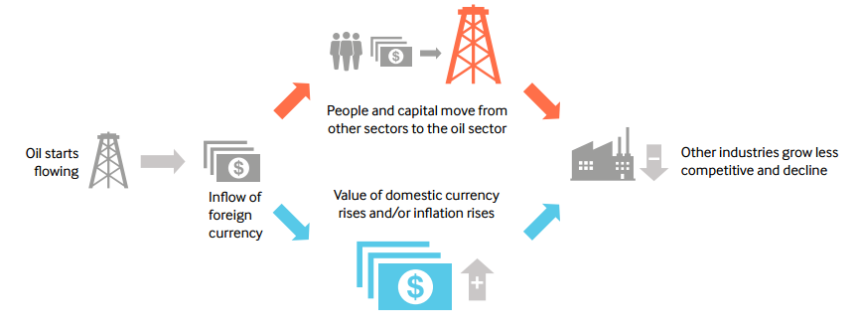
Cause of resources curse
Dutch disease: A large increase in natural resource revenues can hurt other sectors of the economy, particularly export-based manufacturing, by causing inflation or exchange rate appreciation and shifting labor and capital from the non-resource sector to the resource sector

Slide 36
Cause of resources curse
• Limited government capture of benefits:
  In some cases, only a small share of the production value of the resource stays in the country
  fail to compensate the state and communities for depleting their resources and related environmental damage or loss of livelihood.
  The point-source nature of extractive industries often creates challenges when trying to balance the needs of the people and environments that surround the mining area.

Slide 37
Jade industry in Myammar
https://thediplomat.com/2017/05/smuggling-away-myanmars-chance-for-peace/
https://www.globalwitness.org/en/campaigns/myanmar/cursed-treasure-report/#chapter-5/section-4
https://time.com/battling-for-blood-jade/

Slide 38
Environmental problem : Negative Externalities
By-products of consumption and production may harm others.
  Driving releases GHGs to the atmosphere
  Air pollution from power plants cause respiratory diseases.
Consumers and producers only take into account of private cost when they decide how much to consume and how much to produce.
Social cost = Private cost + Externality cost.
With externalities, consumers and producers tend to consume and produce too much.
  Think about gasoline consumption. from the social planner’s perspective, you consume too much?

Slide 39
How to solve environmental problem?
Command-and-Control
Tax
Information

Slide 40
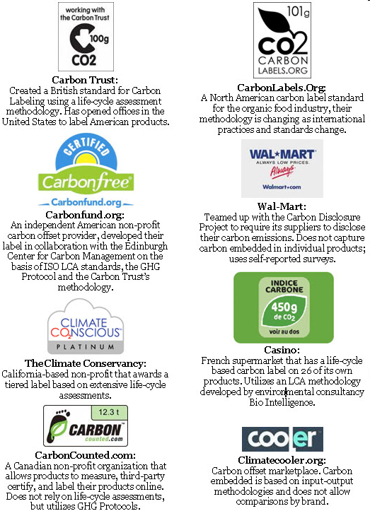

Slide 41
Environmental problem
  Local problem
  Regional problem
  Global problem

Slide 42
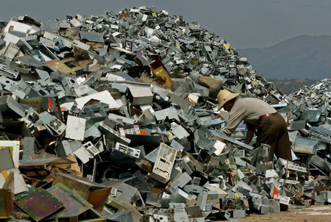
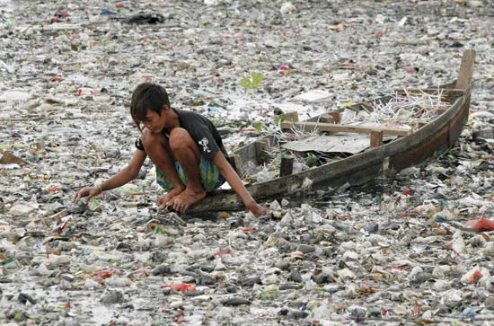
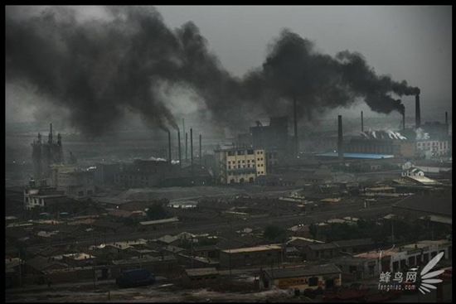
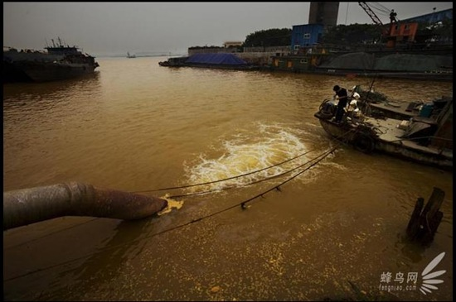
Environmental problem

Slide 43

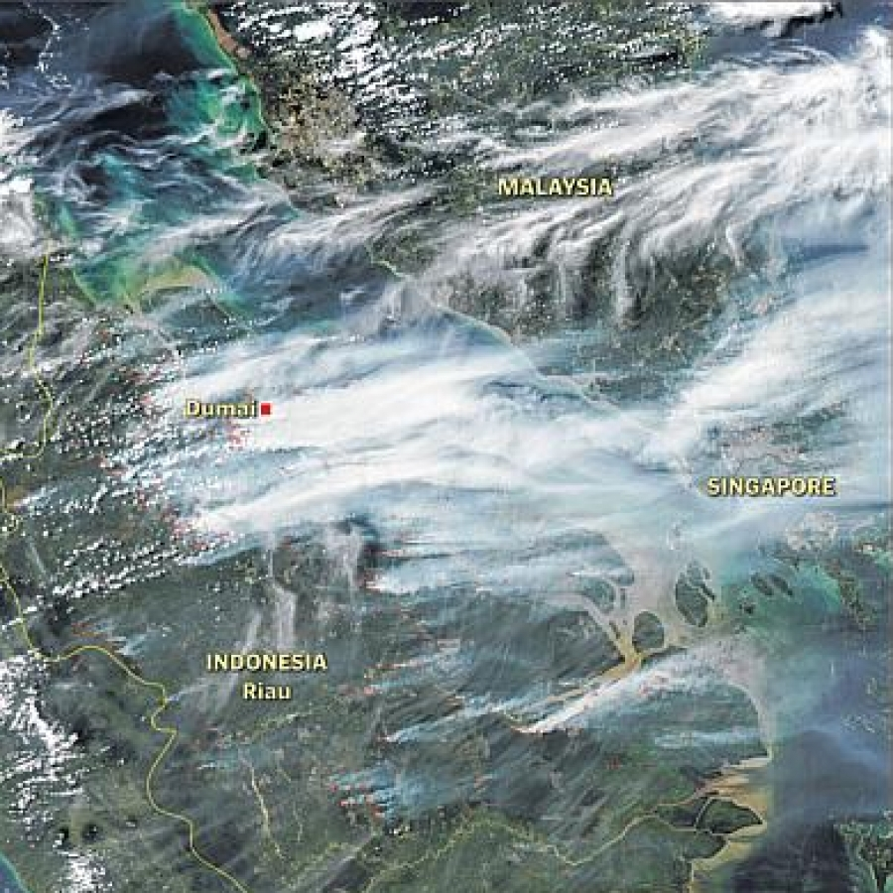
Regional environmental problem
https://www.nationalgeographic.com/magazine/2018/06/the-journey-of-plastic-around-the-globe/

Slide 44
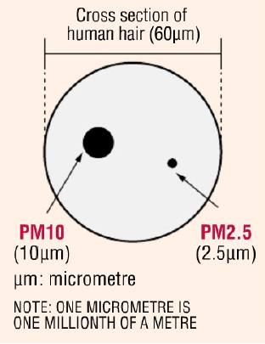
Transboundary pollution problem in ASEAN: HAZE
HAZE : Atmospheric moisture, dust, smoke and vapor suspended in the air to form a partially opaque condition and impair visibility.

Slide 45
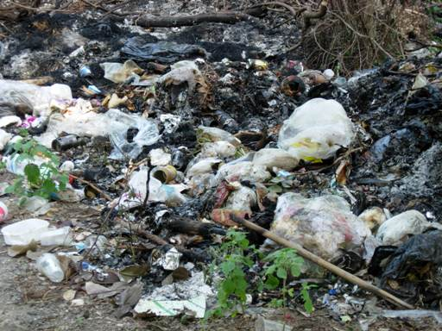
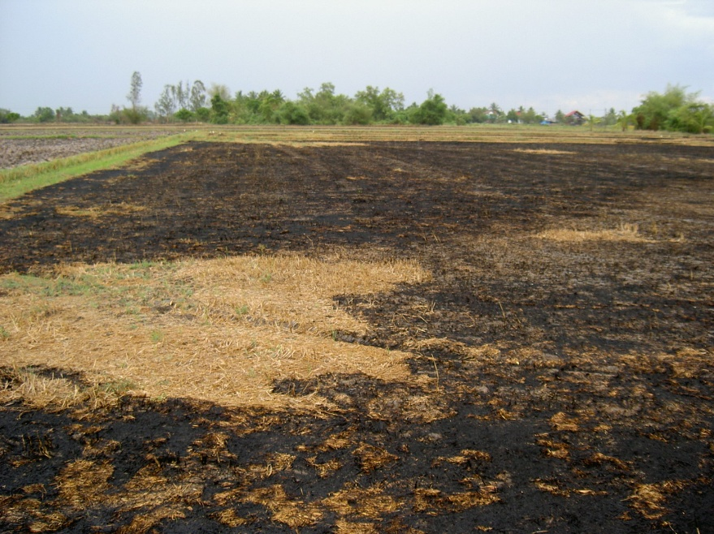
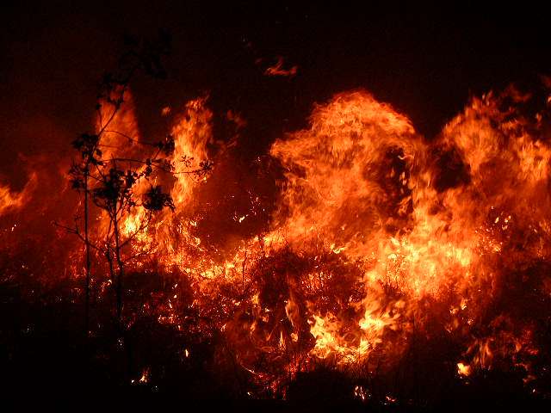
Haze resulted from 3 main activities;
Solid Waste Burning
Agricultural Waste Burning
Forest Fire

Slide 46
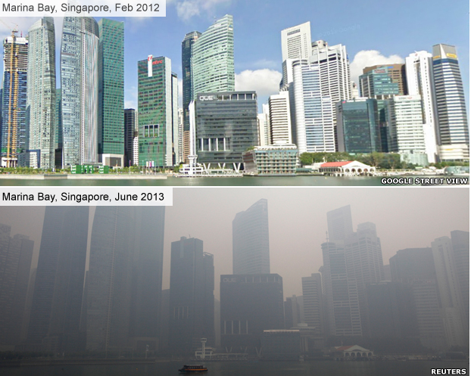

Slide 47
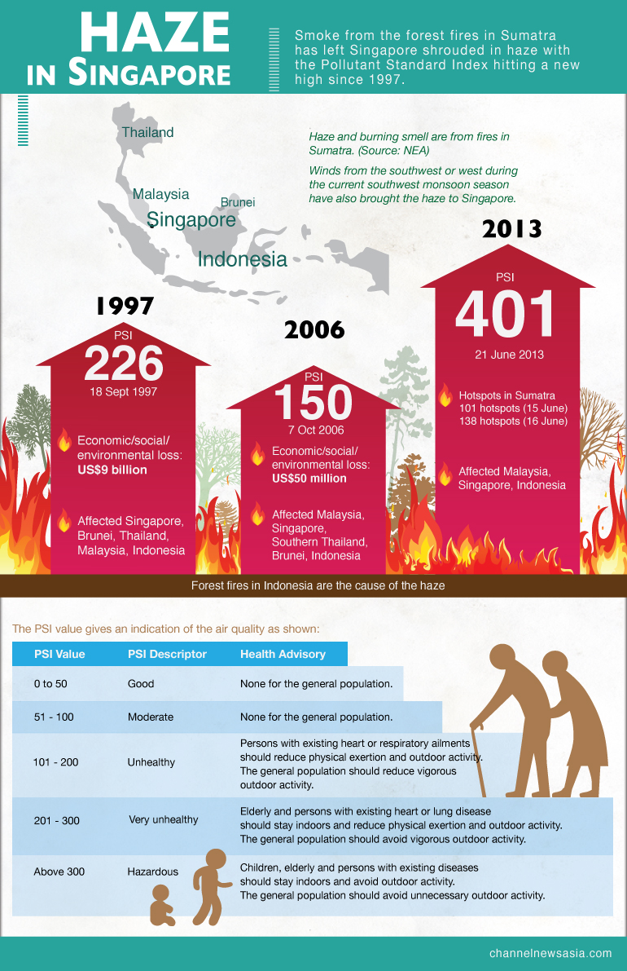

Slide 48
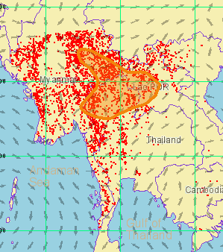
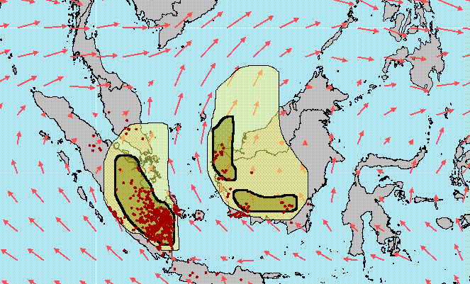
Haze Situation in Southeast Asia
During dry season in the Northern Hemisphere (January - April), hotspot in Mekong Sub-Region was found to increase. These burning activities result in transboundary haze pollution which can be seen clearly in the satellite images
On the other hand, fire in the Southern Part of the Region is found to be more intense during June – September particularly in Sumatra and Borneo.

Slide 49
Southern Smoke Haze Episode in 1997
The economic loss suffered by countries during this environmental disaster was enormous. Several economic sectors, including air, water and land transport, tourism and agriculture have been severely affected
Poor visibility making airlines canceling flights to several airports in the region
Implicated as a factor in the crash of a commercial aircraft in Sumatra on 26 September 1997, that killed all 243 people abroad

Slide 50
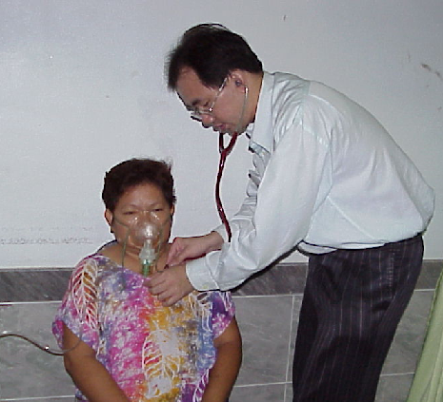
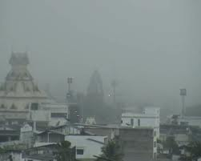
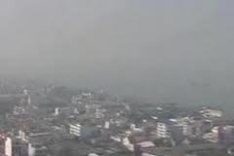
Haze pollution has also resulted in considerable health impact on the people of the countries affected. An increase in number of sick people who required clinic visits or hospital admission was reported from Malaysia, Singapore and Thailand.
More than 20,000 and 4,000 cases were reported in Malaysia and Singapore, respectively, and several thousands cases in Thailand.

Slide 51
ASEAN Agreement on
Transboundary Haze Pollution
Objective:
The Agreement aims to prevent and monitor transboundary haze pollution as a result of land and/or forest fires which should be mitigated, through concerted national efforts and intensified regional and international co-operation.

Slide 52
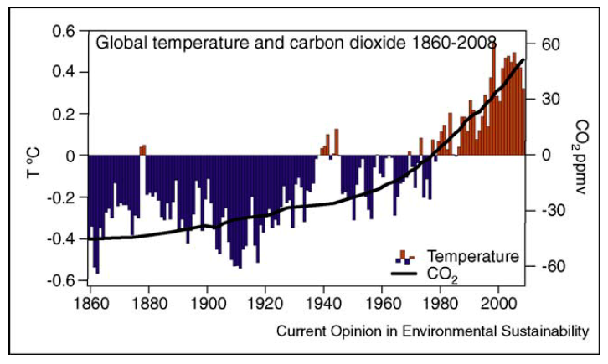
Global Environmental Problem
Stock vs Flow of “pollution”
Public good and free rider
Inter-generation problem
Far distant future
High uncertainty
Notes:
http://www.cgd.ucar.edu/cas/Trenberth/trenberth.papers/EnergyDiagnostics09final2.pdf
See http://www.economist.com/node/21533360 for a comparison of HadCru to Nasa, Noaa, Berkeley Earth….same.

Slide 53
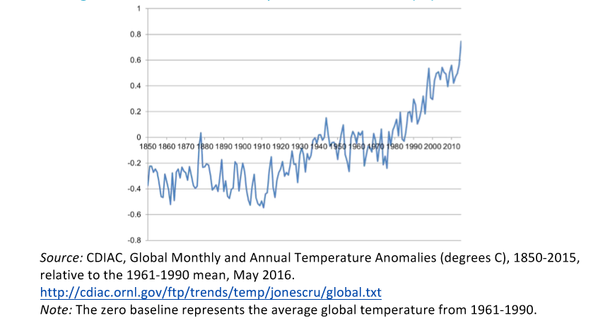
Global Annual Temperature Anomalies (°C), 1850–2015

Slide 54
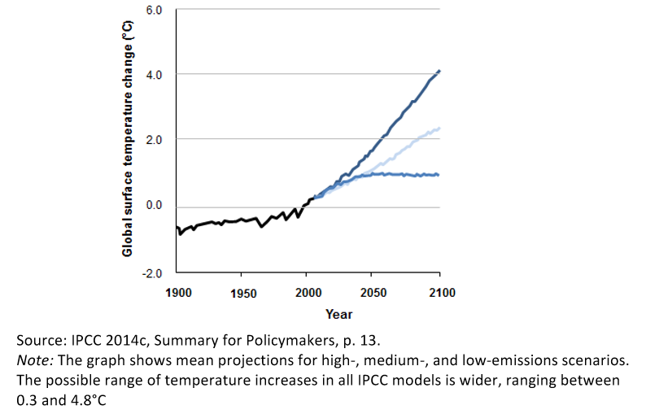
Global temperature trend 1900 - 2100
https://climate.nasa.gov/interactives/climate-time-machine

Slide 55
Will trade opening lead to more pollution (GHGs)?
Trade opening can affect the amount of emissions in three principal ways
The scale effect : increased level of economic activity will require greater energy use and will therefore lead to higher levels of greenhouse gas emissions.

Slide 56
Will trade opening lead to more pollution (GHGs)?
The composition effect : opening changes the structure of a country’s production in response to changes in relative prices. The effect on a country’s greenhouse gas emissions will depend on whether a country has a comparative advantage in emission-intensive sectors and whether these sectors are expanding or contracting.
differences in environmental regulations between countries “pollution haven hypothesis”

Slide 57
Will trade opening lead to more pollution (GHGs)?
Finally, the technique effect refers to improvements in the methods by which goods and services are produced, so that the emission intensity of output is reduced.
  more open trade can increase the availability, and lower the cost of, climate-friendly goods and services. ➔ help meet the demand in countries whose domestic industries do not produce these climate-friendly goods and services in sufficient quantities or at affordable prices.
  WTO’s trade negotiations under the Doha Round, which aim to open markets for environmental goods and services

Slide 58
Border measures to prevent carbon leakage
absence of an internationally agreed price on carbon and since emission reduction policies, such as taxes and/or trading schemes, are not applied universally, the implementation of emission reduction policies has given rise to concerns about competitiveness as well as about environmental efficiency, i.e. “carbon leakage”
if environmental policies in different countries impose different levels of costs on competing firms, thus creating a price advantage for firms located in countries with less stringent environmental policies ➔ pollution heaven

Slide 59
Discussion
In your opinion, which environmental problem should be addressed immediately? Why?
How can we reduce the conflict of economic growth and environment?

