Slide 1
Agricultural transformation and rural development
EE361/363 Economic Development of CLMV
Faculty of economics,
Thammasat university
5 February 2021

Slide 2
The agriculture Sector
Two thirds of the world population are poor; most live in rural areas. Their basic concern is survival
For many developing countries, although employment in the agriculture is around 50%-70% of the total workforce, the share GDP (total income/economic output) is around 30%-40%. This means the sector has low productivity
Many rural farmers live on subsistence. It means they produce for their own consumption, no surpluses to sell to the market. Or they are laborers on other people’s land. In either case, their productivity is low
Productivity can be increased, but will require investments, i.e., improved technical know-how, access to capital and access to farm inputs and access to markets

Slide 3
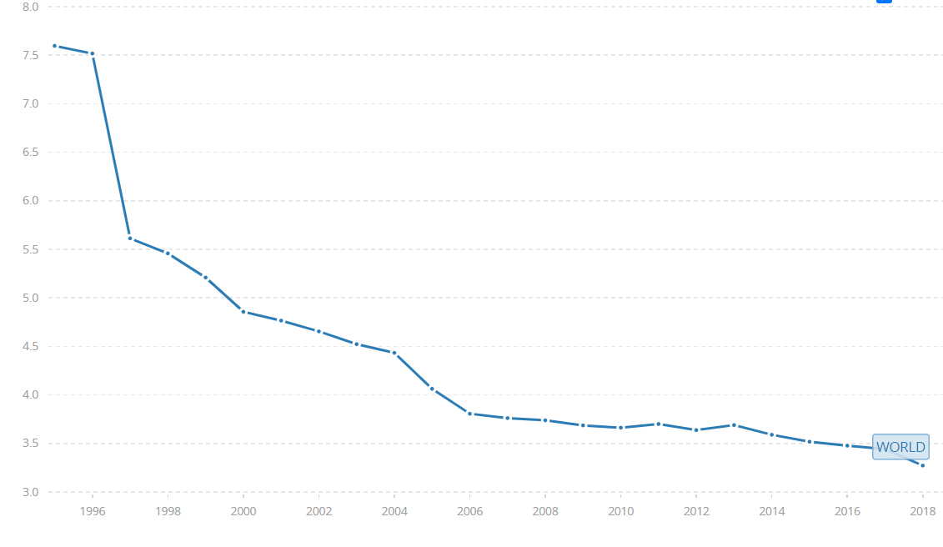
AGRICULTURE ShARE OF GDP IS DECLINING
The share of agriculture sector to total GDP worldwide has declined for 7.5% in 1985 to less than 3.5% in 2018

Slide 4
Share of key economic sectors in selected countries
Country | Agriculture | Manufacturing | Services
United States | 0.9 | 19.1 | 80.0
China | 7.9 | 40.5 | 51.6
Japan | 1.1 | 30.1 | 68.7
South Korea | 2.2 | 39.3 | 58.3
Indonesia | 13.7 | 41.0 | 45.4
Thailand | 8.2 | 36.2 | 55.6
Vietnam | 15.3 | 33.3 | 51.3

Slide 5
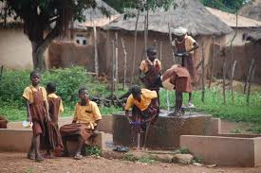
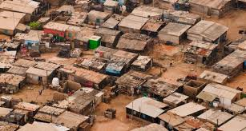
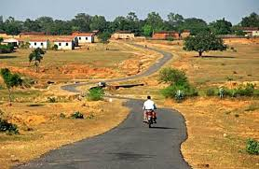
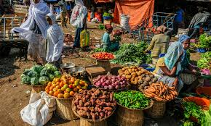
The agriculture sector
Health
and
hygiene
In many parts of the world, poverty is associated with rural areas. While this is not always the case, if development is to take place and become self sustaining, it will need to address the issues of rural areas and agriculture
Shelter
Transportation
Markets

Slide 6
PREVIOUS And current thinking on agriculture
PAST: Agriculture plays supporting role in the economy
Provides sufficient cheap food and labor to expand the industrial sector
Generates revenues/foreign exchange from agricultural exports
Provides rising incomes to create farmer demand for consumer products
Agriculture labor as factor market contribution
NOW: Agriculture is key element in any economic development strategy
Accelerates output growth and increase farmer productivity
Meets rising demand for agricultural output due to rapid urbanization
Meets the demand of diversified, non-agricultural labor intensive rural development

Slide 7
Some common terms

Slide 8
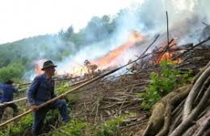
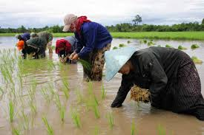
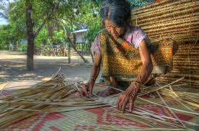
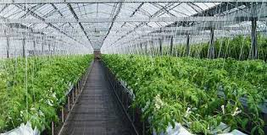
Farming methods and income generation
Clockwise from top left:
1. Slash and burn
2. Subsistence farming
3. Commercial farming
4. Non-farm employment

Slide 9
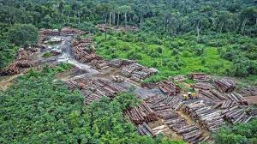
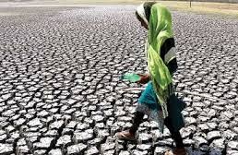
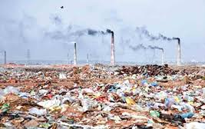
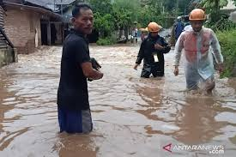
Impacts on farm land due to human activities and natural occurrences
Clockwise from top left:
1. Deforestation
2. Drought
3. Floods
4. Environmental pollution

Slide 10
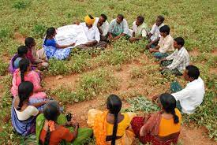
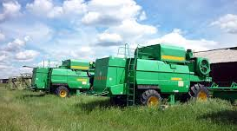
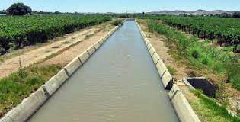
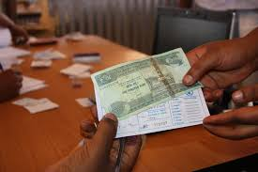
Improving productivity
Clockwise from top left:
1. Extension services
2. Mechanization
3. Access to credit
4. Agriculture infrastructure

Slide 11
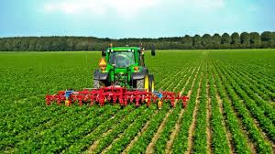
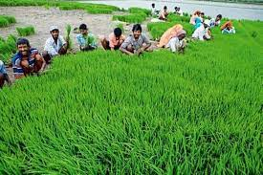
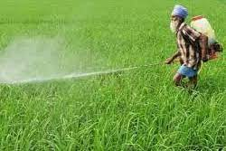
The green revolution
Green Revolution: The boost in grain production associated with the discovery of new hybrid seed varieties of rice, wheat, and corn, resulting in high farm yields
The strategy to “feed the world” was pursued in the context of the Cold War; the West hoped that by having sufficient food, countries will not be swayed to follow the footsteps of socialism
Increased food production from 1970-2010 enabled developing countries to increase the national outputs and significantly reduce poverty

Slide 12
Trends in agricultural productivity - 1
Ability of agricultural production to keep up with population growth: due to a wide range of successful programs to reduce hunger and raise productivity over several decades (roughly 1970 to 2010). However success in uneven:
Slash and burn had reached a limit where soil in not able to revitalize nutrients
Subsistence farmers are unable to purchase seeds, fertilizer and limited in their agricultural know-how
Food shortages due to flood, drought and other natural disasters
In some countries the share of labor in the agriculture sector decreases even when GDP does not increase.

Slide 13
Trends in agricultural productivity - 2
The food shortage that occurred worldwide (2008) highlighted the continuing vulnerabilities in the agricultural sector, such as:
Diversion of food production to the production of biofuels
Increasing demand for meat* particularly from China
Variability in weather patterns because of climate change
Rising energy costs which affect agricultural input costs
Unfavorable government policies such as interference in food prices**
Neglect of the agriculture sector in favor of the manufacturing and services sectors, which are urban-based
* (raising cattle requires more land than grain)
** such as requirement to farmers to sell their goods at a low price

Slide 14
Government role in agricultural sector
Address externalities (positive and negative) through appropriate policies. Positive externalities (e.g., windfall in crop harvest) could be addressed through subsidies (providing storage, maintaining fair prices); negative externalities (agricultural waste) could be addressed through taxes or penalties
Improve efficiency and reduce poverty, particularly in rural areas by providing infrastructure (irrigation, rural roads), provide farmer access to credits and markets, and needed skills (agriculture extension activities)
Stabilize food prices by guaranteeing farm gate prices for farmers and ensuring adequate supply for consumers

Slide 15
Agricultural-based strategy for economic development
Any agricultural-based strategy for economic development requires the following components:
Accelerated output growth through technological, institutional and price incentive changes to raise farmer productivity
Rising domestic demand for agricultural output derived from employment-oriented urban development strategy
Diversified nonagricultural labor intensive rural development activities that directly and indirectly support and are supported by the farming community

Slide 16
Agricultural systems
Agricultural-based countries
Agriculture still a major source of economic growth, comprising one-third of country’s economic output
Roughly two thirds of the population are employed in the agricultural sector
Examples: Cambodia, Laos, Zambia, most countries in Africa and South Asia
Transforming countries
A majority of the poor live in rural areas (around 80%), but agriculture contributes only a small share to GDP growth (7%)
Examples: Indonesia, Philippines, Sri Lanka
Urbanized countries
Rural-urban migration reaches a point where around one half of the poor live in cities
Examples: Brazil, Argentina, countries in Europe and North America

Slide 17
Issues and challenges in Agriculture
Agriculture-based countries
Existence of agriculture dualism, comprising huge landholdings employing tens to hundreds of people, and small farms with barely enough income to support the farmer owners
Inefficient farming as wealthy land owners do not utilize the full potential of huge land areas for agriculture, but instead leave the land idle
Unequal land distribution: to much land in the hands of a few; hardly enough land for too many people

Slide 18
Issues and challenges in Agriculture
Transforming countries
High densities in agriculture land: too many people crowding on too little land; relatively small farm size (> 4 hectare)
Introduction of monetized transactions vis-a-vis collective land; and rise of moneylenders
Transformation of subsistence to commercial farming, causing farmers to become poorer
Cycle: subsistence farmer – tenant farmer – landless laborer – jobless vagrant – migrant dweller in cities

Slide 20
Towards an Integrated agricultural and rural development strategy
Aim: improve rural level of living through increased small farm income, output and productivity
Improve small-scale agriculture; use new technologies and innovations in farm practices for sustained improvements in output and productivity. However the technologies and innovation s should be appropriate to the local context
Provide economic incentives through institutional and pricing policies. Low farm gate prices for farmers’ goods creates disincentives to produce. Access to credit and farm inputs will also require government intervention
Support conditions for rural development; land reform (redistribution of rights of ownership or use of land), support programs, development of rural infrastructure

Slide 21
conclusion
Half of the of the world’s population live in rural areas, most are in less developed and developing countries and a majority are poor. Therefore the agricultural sector is often associated with poverty
Agricultural productivity is low in most countries, as the share of employment exceeds agricultural share of GDP
The share of agricultural sector to GDP is declining worldwide; however the sector has strategic importance, namely for food security, poverty alleviation, and generating income and revenues

Slide 22
conclusion
The Green Revolution has benefitted the world population due to increases in food production, keeping up with population growth, agricultural know-how and alleviating hunger; however challenges remain as many remain poor
Government plays an important role in addressing issues facing the agricultural sector, such as addressing negative externalities, improving efficiency and productivity, setting appropriate policies and introducing reforms, and stabilizing prices for agricultural products

