Slide 1
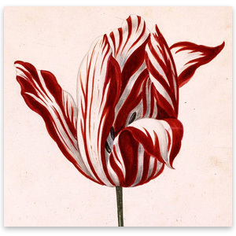
The Tulip Mania

Slide 2
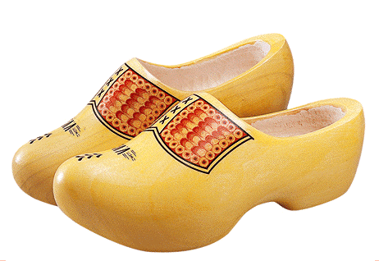

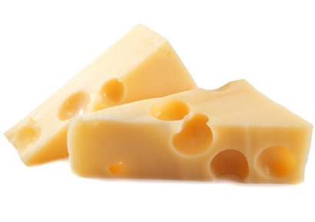
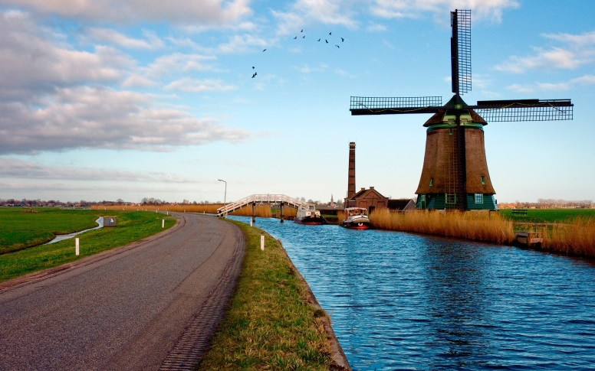
Country Symbols

Slide 3
Index:
The history of the tulip
The rise of the Tulip Mania
The economic bubble
The collapse of the Tulip Mania
The effect of the collapse

Slide 4
History of the Tulip
The origin of the Tulip: Turkey
1593 → Tulips were imported in the Netherlands
The tulip was the only flower in Europe with a saturated intense petal color, which made it popular.

Slide 5
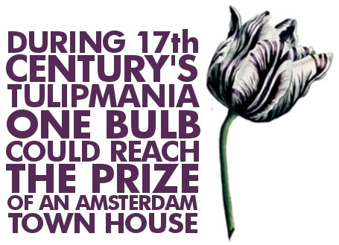
The rise of the Tulip Mania
First only artificial and scientifical level, later also on financial level.
1637 → Trade wind: speculated trading only driven by the goal of earning profits without rational reasoning.
Prices increased very quick, very high → higher than 10 times the income of a skilled craftsman

Slide 6
The economic bubble
Economic bubble: the price of an asset which strongly deviates from the intrinsic value
The Tulip Mania is recorded as the first economic bubble

Slide 7
Collapse of the Tulip Mania
End of 1637 → buyers refused to show up at the tulip bulb auction.
Reason: prices where not an accurate reflection of the value of the bulb
Domino effect: everybody starts to sell → prices become lower and lower → huge losses

Slide 8
Effect of the collapse
Governmental solution: offered to pay 10% of the face value of the contracts
Result: market plunged even lower, even government was nog able anymore to help
Conclusion: lots of people had to live with huge losses because of the beautiful tulips

