Slide 1

D
BI 201/ BA 291 Business Law & Options for starting up a business
by Parichat Jantori

Slide 2
Group activities:
If you're managing the following companies, what are the laws you think specifically apply to your business?

Slide 3


Case: Liebeck v. McDonald's Restaurants (McDonald's coffee case and the hot coffee lawsuit)
a woman who was heavily burned by hot coffee purchased from fast food restaurant McDonald's was rewarded $2.86 million.
Her attorneys argued that McDonald's coffee was "defective," claiming it was too hot and more likely to cause serious injury than coffee served at any other establishment

Slide 4
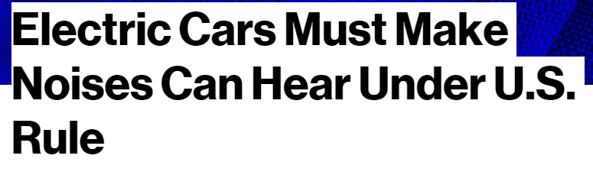


Case:

Slide 5
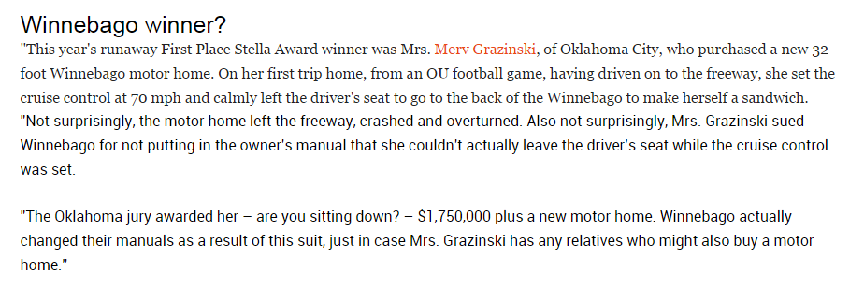
Case:

Slide 6
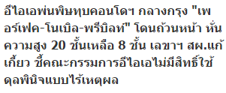

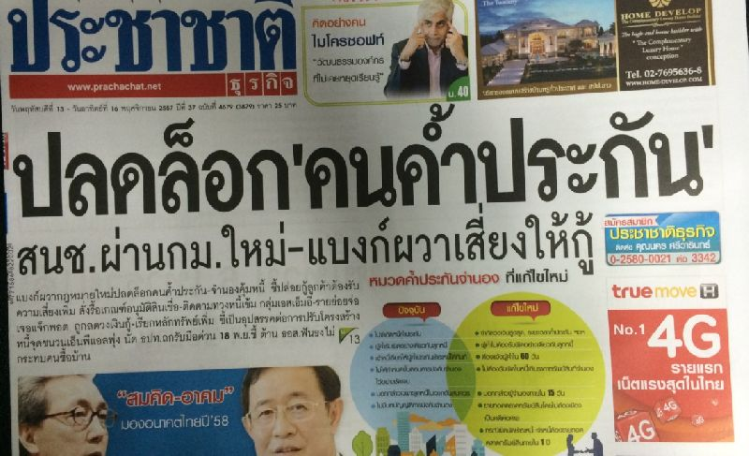
Cases:

Slide 7
Key Takeaway
Law and regulations affect your business in many ways:
Permission to operate
Rights to sue or to be sued, Right to hold asset or land
Business conducts e.g. opening hours, labor regulation, consumer right, product liability, competition, technological requirement, keeping record of business transaction etc.
Cost of business e.g. tax, minimum wage requirement, employee rights and benefits, environmental requirements
Business protection e.g. intellectual property (trademark, patent, copy right)

Slide 8
Key Takeaway
Some laws apply to businesses in general
Business organization
Contract law
Bankruptcy and reorganization
Tax law
Labor law
Intellectual property
Consumer protection
Trade competition law (or anti-monopoly law)
Exchange control
Dispute resolution (Litigation or arbitration)

Slide 9
Group think:
If you look at companies doing a business, some of them define themselves as Partnership, PLC, co. Ltd.?
Why is so?
How does this different form impact your business?
If you have to choose a legal form of business, how would you make your decision?

Slide 10
Key Takeaway
There are different legal form of business in Thailand.
Each form provides some advantages and disadvantages for business.
There is no one size fits all answer, which form is the best.
Depends on type and size of business, preference for liability, management duties, funding options, flexibility, tax duty etc.

Slide 11
Sole proprietorship
Characteristics:
unincorporated business owned by individual, that is not incorporated
no legal distinction between the owner and the business
the owner receives all profits (subject to taxation specific to the business) and has unlimited responsibility for all losses and debts
Sole owner of the business is fully liable for any liabilities of the business (unlimited liability)
pay personal income tax
typically small business with less than 50 employees

Slide 12
Sole proprietorship
A sole proprietor has capacity to conduct any business which does not require a specific form of business organization
If business has a sales volume from 20 baht per day or the total of goods from 500 baht, it must be registered “Commercial registration ”.
More information about Commercial registration http://www.dbd.go.th
Note: Capacity of types of individuals may be limited, e.g. minor, incompetent person, semi-incompetent person, person of unsoundmind.

Slide 13
Sole proprietorship
Advantages of a Sole Proprietorship
Ease and cost of formation
Secrecy
Distribution and use of profits
Flexibility and control of the business
Government regulation
Taxation (pay income tax)
Disadvantages of a Sole Proprietorship
Unlimited liability
Limited sources of funds
Limited skills
Lack of continuity
Lack of qualified employees
Taxation (deduction max. 60,000 Baht)

Slide 14
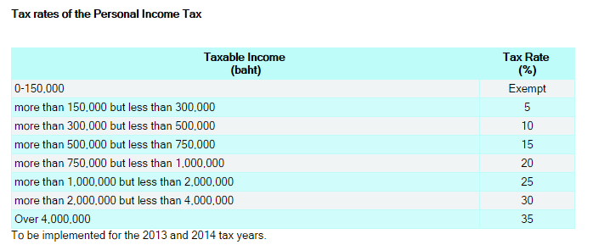
Personal Income Tax
Personal income tax: a tax levied on the total income of individuals (with some deductions/ allowances exemption permitted)
See the form: http://www.rd.go.th/publish/fileadmin/tax_pdf/pit/PIT91_070158.pdf

Slide 15
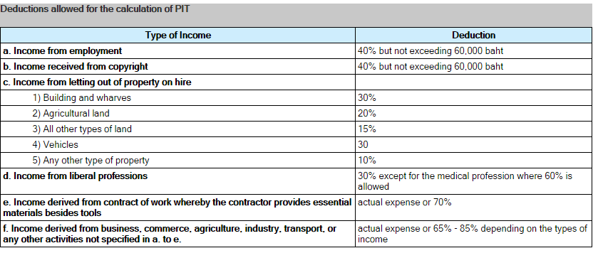
Personal Income Tax

Slide 16
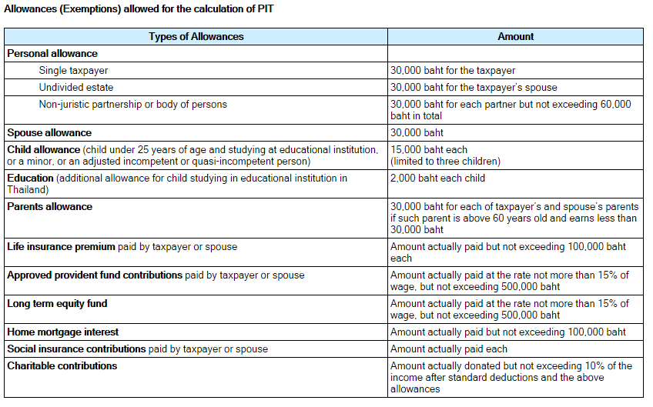
Personal Income Tax

Slide 17
Partnership
A form of business organization defined by the Uniform Partnership Act as “an association of two or more persons who carry on as co-owners of a business for profit”
3 Forms of partnership
Unregistered ordinary partnership (ห้างหุ้นส่วนสามัญไม่จดทะเบียน)
Ordinary partnership (ห้างหุ้นส่วนสามัญ)
Limited partnership (ห้างหุ้นส่วนจำกัด)

Slide 18
Partnership
 | Unregistered Ordinary Partnership | Registered Ordinary Partnership | Limited Partnership
Nature of Organization | No separate entity Partnership has no legal entity | Separate entity from the partners Partnership has legal entity | Separate entity from the partners Partnership has legal entity
Number of owners | 2 or more | 2 or more | 2 or more
Taxation | PIT | CIT | CIT
Liability | All partners are jointly and unlimitedly liable for all the obligations of the partnership. | All partners are jointly and unlimitedly liable for all the obligations of the partnership. A partner may make a claim on behalf of the partnership against third parties. Creditors must exhaust all assets of the partnership before they can pursue claims against the individual partners. | All partners are jointly and unlimitedly liable for all the obligations of the partnership. A partner may make a claim on behalf of the partnership against third parties. Creditors must exhaust all assets of the partnership before they can pursue claims against the individual partners.

Slide 19
 | Unregistered Ordinary | Registered Ordinary | Limited Partnership
Scope of activities | All partners are bound by the acts done by any of them in the ordinary course of the business of the partnership. | A registered ordinary partnership is able to engage in any of the activities within the scope of the objects registered. | A limited partnership is able to engage in any of the activities within the scope of the objects registered.
Procedure of establishment | No establishment is required. Normally, partners enter into a Partnership agreement with each other | Registration with the MOC is required. | Registration with the MOC is required.

Slide 20
Corporate Income Tax
The corporate income tax rate in Thailand is 20 % on net profit. However, the rates vary depending on types of taxpayers.
In calculating CIT, deductible expenses are as follows:
1. Ordinary and necessary expenses. However, the deductible amount of the following expenses is allowed at a special rate:
- 200% deduction of Research and Development expense,
- 200% deduction of job training expense,
- 200% deduction of expenditure on the provision of equipment for the disabled;
2. Interest, except interest on capital reserves or funds of the company;
3. Taxes, except for Corporate Income Tax and Value Added Tax paid to the Thai government;
4. Net losses carried forward from the last five accounting periods;
5. Bad debts;
6. Wear and tear;
7. Donations of up to 2% of net profits;
8. Provident fund contributions;
9. Entertainment expenses up to 0.3% of gross receipt but not exceeding 10 million baht;
10. Further tax deduction for donations made to public education institutions, and also for any expenses used for the maintenance of public parks, public playgrounds, and/or sports grounds;
11. Depreciation

Slide 21
Articles of Partnership
Articles of partnership (หนังสือบริคณสนธิ): Legal documents (required for registration of limited partnership and registered ordinary partnership) that set forth the basic agreement between partners which contains
Name, purpose, location of the partnership
Duration of the agreement
Authority and responsibility of each partner
Character of partners (i.e., general or limited, active or silent)
Amount of contribution from each partner
Division of profits or losses
Salaries of each partner
How much each partner is allowed to withdraw
Death of partner
Sale of partnership interest
Arbitration of disputes
Required and prohibited actions
Absence and disability
Restrictive covenants
Buying and selling agreements

Slide 22
Advantages and Disadvantages of Partnership
Disadvantages
Unlimited liability (for general partner)
Business responsibility – all partners are responsible for business actions of all others
Life of the partnership (= life of the general partnership, 2-persons partnership terminated when partner dies or withdraws)
Distribution of profits – profits are distribute to partners by share or as specified in article of partnership
Limited sources of funds – shares are not sold to public
Taxation of partnerships (income + corporate)
Advantages
Ease of organization- requires articles of partnership
Availability of capital & credit- greater earning power and credit rating
combined knowledge & skills
Decision making
Regulatory controls – few regulations controls affecting its activities
May convert into private limited company

Slide 23
Dissolution of Partnership
Terms of contract of partnership provide for it.
A definite period of time descried in the terms of partnership has expired.
The partnership was formed for a single undertaking, which has been completed.
Any of the partners gives due notice to the others (withdrawal)
Upon death, bankruptcy or incapacity of a partner (general partner)
exception: the partnership can continue to exist if the remaining partners buy the shares of the withdrawing partner.

Slide 24
Private Company Limited
Characteristics:
the most common structure for conduction business in Thailand
established by at least 3 people (Private company), 15 people (Public company)
Separate entity from its shareholders
has legal entity
able to own property and carry on the business under its name
stockholders can buy, sell, give or receive share as gifts or inherit them
Stockholders are entitled to all profits may be distributed (dividends)
liability to the third parties is separate from individual liability of its shareholders
liability of the shareholders is limited to the value of an individual shareholder‘s unpaid share capital
Private companies limited have fewer company management duties than public companies limited.
Can be converted to Public company

Slide 25
Private Company Limited
A private company limited is able to engage in any of the activities within the scope of the objects set forth in its MOA (Memorandum of Association).
Registration with the MOC is required.
Corporate tax, distribution of dividend is subject to 10% withholding tax
Notes:
http://www.set.or.th/th/regulations/tax/tax_p1.html

Slide 26
Public Company Limited
Characteristics:
a minimum of 15 promoters is required registration of a public limited company
separate entity from its shareholders
legal entity
Pay corporate tax, distribution of dividend is subject to 10% withholding tax
The shareholders will not be liable for any liabilities caused by the public company limited (limited liability/ limited to the share)
no restriction on the transfer of shares
can offer its shares to public - the stock of public company can be sold, bought and traded to anyone
at least 50% of the directors must reside in Thailand; and board meetings must be held at least once every three months.

Slide 27
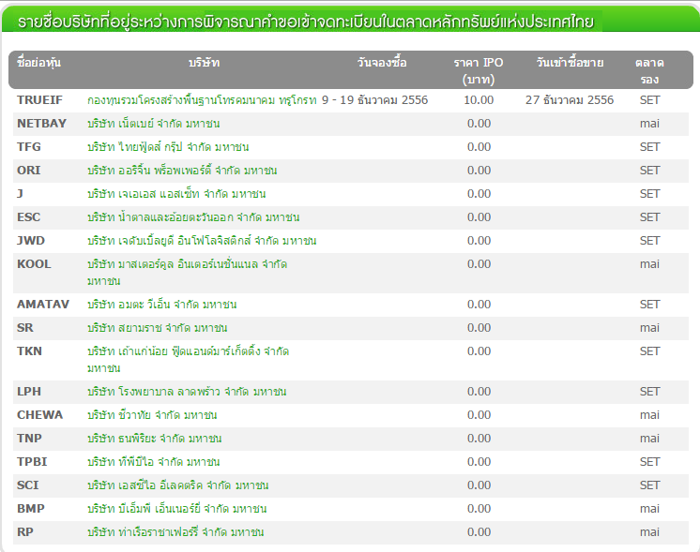
IPO (Initial Public Offering)
The IPO is selling a corporation’s stock on public markets for the first time. Because going public raises cash, and usually a lot of it.

Slide 28
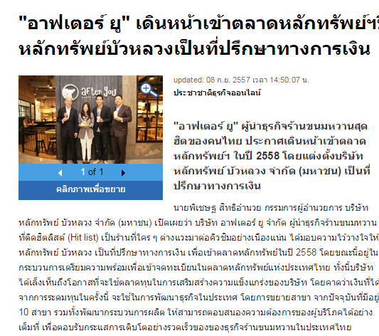
IPO of After you
http://www.prachachat.net/news_detail.php?newsid=1410162700

Slide 29
Difference between SET and mai
SET provides a market for large companies with more than THB 300 million in paid-up capital after IPO to raise long- term funds.
mai, on the other hand, is a source of funding for small and medium-sized enterprises, having over THB 200 million in paid-up capital after IPO.
However, from the viewpoint of firms applying to the Securities Exchange Commission (SEC) for an IPO, there are no regulatory differences.

Slide 30
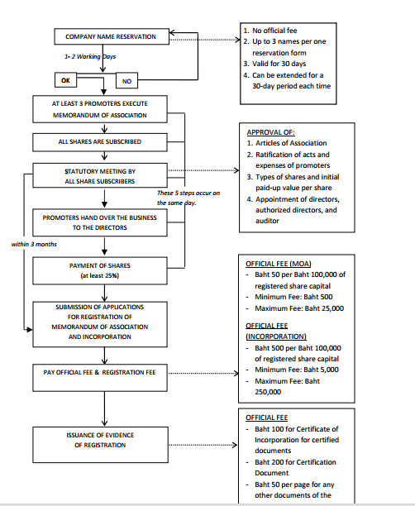
Registration of a Company

Slide 31
Management of Limited Company
The company’s business is to be managed by the directors of the company as appointed at the meeting of the shareholders
Inside Directors – individuals who serve on the board and are employed by the corporation (usually executives of the corporation).
Outside Directors – individuals who serve on the board who are not directly affiliated with the corporation (usually Executives of other corporations).
A supervisory board is a group of individuals chosen by the stockholders of a company to promote their interests through the governance of the company and to hire and supervise the executive directors and CEO (two-tier board system e.g. Germany)

Slide 32
Duties of Limited Company
prepare their financial statement at least once in every 12 months and has at least one auditor and present it to the general meeting of the shareholder for the approval
hold a general meeting within 6 months from the date it is registered as a juristic person and hold this meeting as least once in every 12 month
give its share certificates to the shareholders and arrange shareholder registration book
In case that there is any change in the registered items, the company has to register the new information to the registrar at the partnership/company registration office where the head office is situated

Slide 33
Dissolution of a Company
The company shall be dissolved in any of cases as follows:
(1) when the meeting of shareholders resolved to dissolve the company with votes not less than three-fourths of the total number of votes of the shareholders attending the meeting and having the right to vote;
(2) when the company becomes bankrupt;
(3) when the court orders dissolution of the company under Section 155 and the order is final.

Slide 34
Advantages and Disadvantages of Company
Advantages:
  Limited liability
  Transfer of ownership
  Perpetual life
  External sources of funds
  Expansion potential
Disadvantages:
  Double taxation
  Forming a corporation
  Disclosure of information
  Employee-owner separation

Slide 35
Small business and SMEs
Definition:
Small business is any independently owned and operated business, not dominant in its competitive area, employing less than 500 people.
Definition from EU
An enterprise which employs fewer than 250 persons and has an annual turnover not exceeding EUR 50 million and/or an annual balance sheet total not exceeding EUR 43 million

Slide 36
SME
According to Thai Law, SME is…
Type of business | Number of employees |  | Asset in million baht
 | Small | Middle | Small | medium
Production | Less than 50 | 51-200 | Less than 50 | 51-200
Wholsalers Retailers | Less than 25 Less than 15 | 26-50 16-30 | Less than 50 Less than 30 | 51-100 31-60
Service | Less than 50 | 51-200 | Less than 50 | 51-200

Slide 37
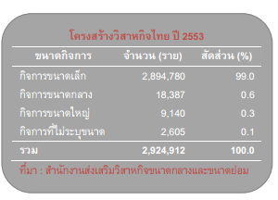
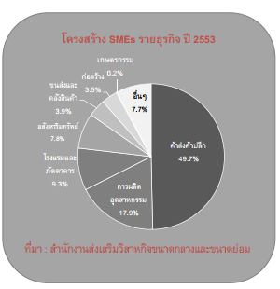
SME in Thailand

Slide 38
Impact of Small Business
80% of all new jobs, annually, created by small business in the last 10 years
boost domestic consume, reduce export
Small businesses responsible for 37% of GDP
Account for 44% of all sales in the country
Initial of potential business
Create value for domestic product and resources
provide wide variety of quality products

Slide 39
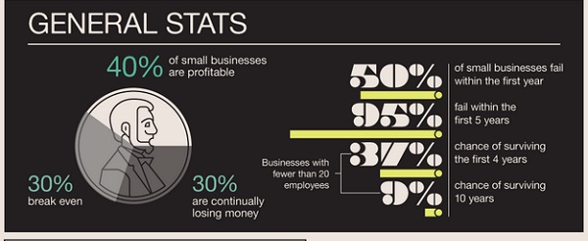
SME in Trouble

Slide 40
Group Discussion: Why SMEs fail?
Provide suggestions on how to reduce failure rate?
Notes:
http://business-easy-easy.blogspot.com/2010/11/blog-post_08.html

Slide 41
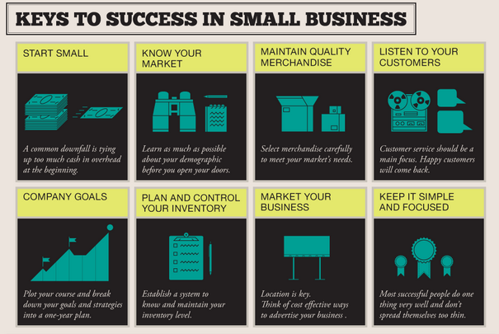
Notes:
http://thumbsup.in.th/2013/03/most-tried-and-failed-sme/

Slide 42
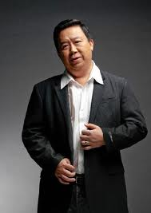

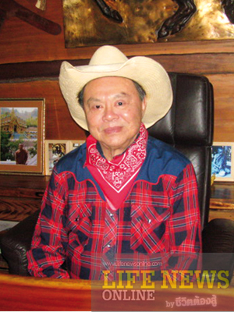
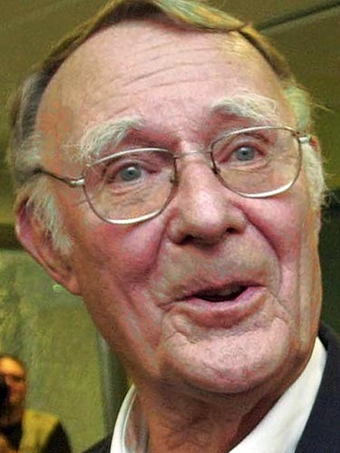

Entrepreneurship
Initiative Risk taking Persisting

Slide 43


