Slide 1
Economics of Multinational Enterprises
Nessara Sukpanich

Slide 2
Definition of Multinational Enterprises (MNEs)
According to OECD Guidelines of Multinational Enterprises (2008)
A precise definition of multinational enterprises is not required for the purposes of the Guidelines.
These usually comprise companies or other entities established in more than one country and so linked that they may co-ordinate their operations in various ways.
While one or more of these entities may be able to exercise a significant influence over the activities of others, their degree of autonomy within the enterprise may vary widely from one MNE to another.
Ownership may be private, state or mixed.

Slide 3
Definition of Foreign Direct Investment (FDI)
According to OECD Benchmark Definition of Foreign Direct Investment Fourth Edition (2008)
Direct investment is a category of cross-border investment made by a resident in one economy (the direct investor) with the objective of establishing a lasting interest in an enterprise (the direct investment enterprise) that is resident in an economy other than that of the direct investor.
The motivation of the direct investor is a strategic long-term relationship with the direct investment enterprise to ensure a significant degree of influence by the direct investor in the management of the direct investment enterprise.
The “lasting interest” is evidenced when the direct investor owns at least 10% of the voting power of the direct investment enterprise. Direct investment may also allow the direct investor to gain access to the economy of the direct investment enterprise which it might otherwise be unable to do.
The objectives of direct investment are different from those of portfolio investment whereby investors do not generally expect to influence the management of the enterprise.

Slide 4
Types of FDI
Based on direction of investment
  Inward FDI
  Outward FDI
Based on types of activity
  Horizontal FDI
  Vertical FDI: Backward vertical FDI vs Forward vertical FDI
Based on modes of entry
  Owned subsidiaries
  Merger & Acquisition
  Joint Venture
Based on nationality of investors
  Wholly foreign owned
  Joint venture between foreign firm and local firm

Slide 5
Types of FDI
Based on motives of FDI (Dunning 1980, 1981)
  Natural resource-seeking FDI: MNEs choose a specific host country based on sources of natural resources at the lowest relative cost. This type of MNE is normally associated with the export of resource-based products from the host country.
  Market-seeking FDI: MNEs expand their production abroad to new customers in new markets or by extending and preserving their existing markets. In terms of trade, this type of FDI can sometimes generate an import substitution effect, but often also leads to trade creation.
  Efficiency-seeking FDI: This type of FDI reflects a rationalization of the MNE’s operations and normally is related to a specialization of various affiliates in its internal network. This can increase both intra-firm knowledge and goods flows. However, Hiratsuka (2006) suggests that indeed efficiency-seeking motive of FDI can be regarded as one type of resource seeking FDI
  Strategic asset-seeking FDI: In this case, assets of foreign firms are utilized to create synergies with the existing FSAs through common ownership. This could be done by modes of entry such as joint venture or acquisition.

Slide 6
Determinants of FDI
Dunning’s OLI framework (Dunning 1977, 1981)
Ownership advantages (O advantages): A firm’s ownership advantage can come in many possible forms. According to Dunning (1983a and 1983b), these advantages may relate to assets (Oa advantages) and transaction skills (Ot advantages).
  The former advantages arise from the ownership of assets which are specific to the firm and to which other firms do not have access (unique assets), such as firm-specific knowledge, managing capability, marketing capability, etc.
  The latter advantages relate to the capabilities of MNEs to capture transactional benefit (or economizing transaction costs) through the coordination of assets located in different countries.
  For a firm to engage in FDI, the benefit from these ownership advantages should outweigh the cost of doing business abroad.
Location Advantages (L advantages): These advantages can be related to government controls and regulations, such as tariffs and quotas, political risk, and cultural values. It can also come from the foreign market’s cheap factor prices, and can be related to transportation costs. Factors such as access to customers and local opportunities are also important sources of location advantages.
Internalization advantages (I advantages): A firm may decide to engage in FDI rather than exporting or licensing to overcome market imperfection problems. According to Rugman (1982), the imperfections of the market can be both natural market imperfections (e.g. the public good characteristic of knowledge) and structural market imperfections (e.g. government controls and regulations)

Slide 7
Determinants of FDI
FSAs/CSAs framework (static and dynamic)
Firm-specific advantages (FSAs): a firm’s unique resources and heterogeneous capabilities can generate competitive advantages, which can lead to sustainable superior returns (Rugman and Verbeke, 2002; Barney, 1991). For example firms’ knowledge, managing capability, managerial capability
Country-specific advantages (FSAs): These advantages arise from the environment of the country.
  These CSAs may include natural market factor endowments, factor prices, government regulations, and market access (Sukpanich and Rugman, 2010).
  Asian Development Bank (2006) describes that a country attractiveness as a host of FDI depends on
      (1) Comparative advantage in international production
      (2) Investment climate: Foreign investment regime and general investment
      environment

Slide 8
Impact of FDI to host and home country

Slide 9
Case study: FDI in the Lao PDR

Slide 10
FDI flows to the Lao PDR (1988 - 2015)
Million US dollars
Source: World Bank (from CEIC database)
1986: New Economic Mechanism
1994: Law on Foreign Investment Promotion and Management
1997: Asian Financial Crisis/become ASEAN member countries
2004: Adjust Law on Law on Foreign Investment Promotion and Management
2009: Law on Investment Promotion
2013: Full member of WTO

Slide 11
FDI stocks (net inflows) to the Lao PDR (1998 – 2015)
Million US dollars
Source: World Bank (from CEIC database)

Slide 12
Compared FDI flows vs. Approved FDI in the Lao PDR (2000 - 2015)
Million US dollars
Source: FDI flows data in 2000-2015 are from World Bank (from CEIC database)
Approved FDI data 2000-2014 are from Lao Statistics Bureau (from CEIC database) 2015 data are from Ministry of Planning and Investment (2016)

Slide 13
Compared actual FDI vs. Approved FDI in the Lao PDR (2000 - 2015)
Million US dollars
Source: FDI flows data in 2000-2015 are from World Bank (from CEIC database)
Approved FDI data 2000-2014 are from Lao Statistics Bureau (from CEIC database) 2015 data are from Ministry of Planning and Investment (2016)

Slide 14
Approved FDI by sectors (2000 – 2015)
Million US dollars
Source: ข้อมูลปี 2000-2014 มาจาก Lao Statistics Bureau (สืบค้นจากฐานข้อมูล CEIC)
ข้อมูลปี 2015 มาจาก Ministry of Planning and Investment (2016)

Slide 15
Approved FDI by sectors (2000 – 2015)
Million US dollars
Source: Data 2000-2014 are from Lao Statistics Bureau (from CEIC database)
2015 data are from Ministry of Planning and Investment (2016)

Slide 16
Approved FDI by country (2000 – 2015)
Million US dollars
ที่มา: Ministry of Planning and Investment (สืบค้นจากฐานข้อมูล CEIC)

Slide 17
FDI inflows by country
Million US dollars
หมายเหตุ ปี 2012 และ 2013 ไม่มีข้อมูล
ที่มา: ASEAN Statistic Database (2016)

Slide 18
Motives of FDI in the Lao PDR
Natural resource-seeking FDI
E.g. in Mining, electricity generation (especially in hydropower
generation), agriculture.
Market-seeking FDI
  Domestic market: e.g. investment in service sectors, construction
  Regional market: e.g. Most of electricity produced in the Lao PDR have been exported to neighboring countries (such as for Thailand, Vietnam and Cambodia)
  Other regions market: e.g. investment in agricultural sectors in the Lao PDR to gains GSP (generalized systems of preference) from other countries such as the U.S. and countries in Europe

Slide 19
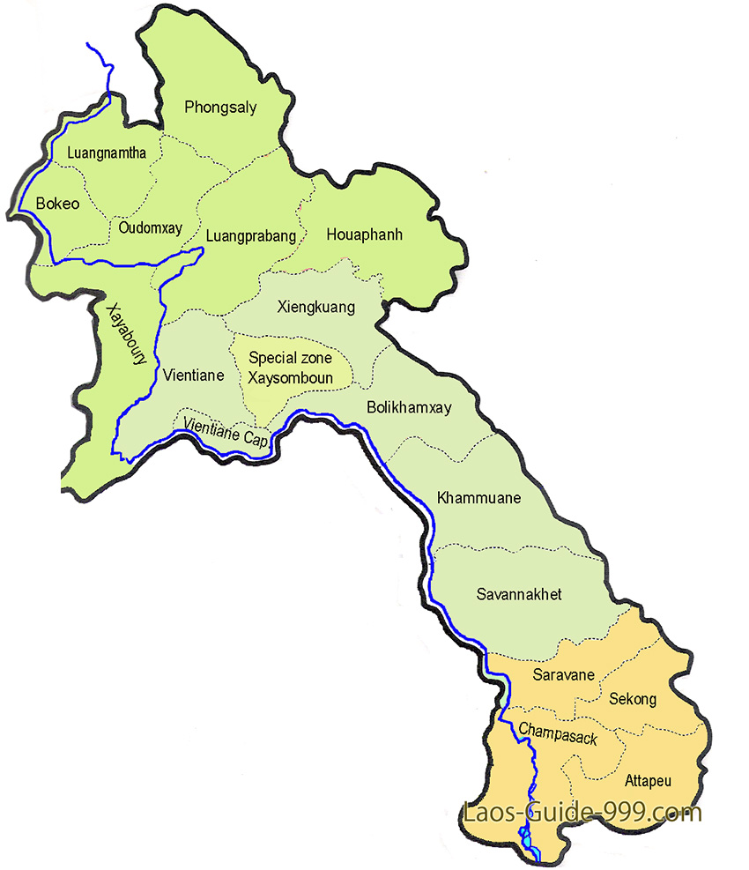
The map of Lao PDR

Slide 20
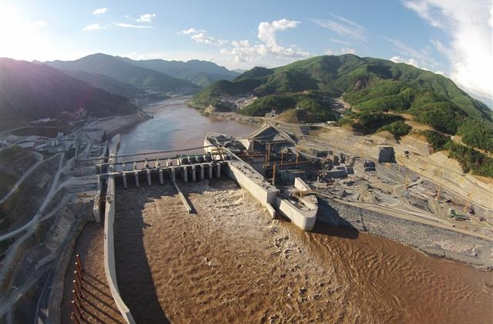
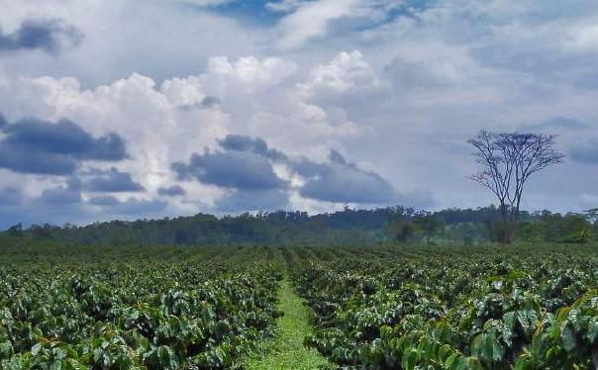
Xyaburi Hydropower Project in the Lao PDR
(Thai SOEs and private sector 80%, the Lao PDR government 20%)
Coffee plantation in the Lao PDR

Slide 21




Northern Laos
Zipline business in the Lao PDR

Slide 22
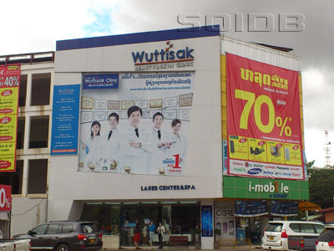

Wuttisak Clinic in Vientiane
Black Canyon in Vientiane

Slide 23
Motives of FDI in the Lao PDR
Efficiency-seeking FDI
  Low labor cost in the Lao PDR
  Labor cost in neighbouring countries (such as Thailand) increase so that Thai MNEs and other country MNEs that used to use Thailand as production base move some of their production (especially, the one with labor intensive production) to the Lao PDR.
  Corporation in the region brings about efficient regional production supply chain.
  E.g. Toyota Boshoku (Japan), Nikon (Japan), Siam Cement Group
  (Thailand), HP (U.S.), Coca-Cola (U.S.)
Strategic-assets seeking FDI
  Many MNEs invested in the Lao PDR joint invest with the Lao PDR government or Laotian private sector to gain access to intangible assets regarding their experience of doing business in the Lao PDR and strategic asset in terms of local networking (for their material sourcing, product distribution, and other business network)

Slide 24
Determinants of FDIs in the Lao PDR
Host country specific advantages
(Host CSAs or Pull Factors)
Home country specific advantages
(Home CSAs or Push Factors)
Firm-specific advantages (FSAs)

Slide 25
Host country specific advantages (pull factors)
Positive factors
  Lao PDR has rich natural resources.
  Political stability in the Lao PDR.
  High level of economic growth, but concentrated in some sectors.
  Low labor cost.
  Exchange rate of the Lao PDR currency is quite stable, especially with US dollars.
  Corporation in the region provide investors to access to larger market and be able to use Lao as one of the production base in the production supply chain.
  Lao has adjusted the country’s trade and investment regulations to be more up to international standard, especially The Law on Investment Promotion (2009) that combines domestic investment law with foreign investment law.

Slide 26
Host country specific advantages (pull factors)
Negative factors
  Small market size.
  Labor: although with low labor cost, Lao has limited amount of labor force, low labor productivity. Shortage of labor in all levels (administrative, professional, skilled and unskilled labor).
  Investment regulations: although adjust laws and regulations regularly, there are still problems when they have been implemented.
  Still lack of some necessary technology and infrastructure.
  Still have problems of corruptions and practices of informal sector
  Institutions, especially justice, have not been developed enough to provide efficient monitoring and control.
  In some occasions, the Lao government cannot fully deliver amount land specified in concession contract with different reasons (such as use of land by local people).

Slide 27
Global Competitive Index (GCI) 2016 by World Economic Forum
Source: World Economic Forum (2016) page 230
GCI of the Lao PDR is lower than the average level of countries in East Asia and Pacific in almost al aspects, especially in terms of market size, technological readiness, infrastructure and higher education and training.

Slide 28
Global Competitive Index (GCI) 2016 by World Economic Forum
Problems of doing business in the Lao PDR (2016 – 2017)
ที่มา: World Economic Forum (2016) หน้าที่ 230
Important problems of doing business in the Lao PDR are inadequate educated workforce, access to financing, poor work ethic in national labor force, tax rate and inadequate supply of infrastructure, respectively.

Slide 29
Ease of Doing Business 2017 by world bank (rank from 190 countries)
Category | Cambodia | Laos | Myanmar | Vietnam
Ease of Doing Business | 131 | 139 | 170 | 82
1. Starting a Business | 180 | 160 | 146 | 121
2. Dealing with Construction Permits | 183 | 47 | 66 | 24
3. Getting Electricity | 136 | 155 | 149 | 96
4. Registering Property | 120 | 65 | 143 | 59
5. Getting Credit | 7 | 75 | 175 | 32
6. Protecting Minority Investors | 114 | 165 | 179 | 87
7. Paying Taxes | 124 | 146 | 119 | 167
8. Trading across Borders | 102 | 120 | 159 | 93
9. Enforcing Contracts | 178 | 88 | 188 | 69
10. Resolving Insolvency | 72 | 169 | 164 | 125
Source: Ease of Doing Business database by world bank
Factors that the Lao PDR has advantage over Cambodia and Myanmar (but still disadvantage to Vietnam) are dealing with construction permits, registering property and enforcing contracts

Slide 30
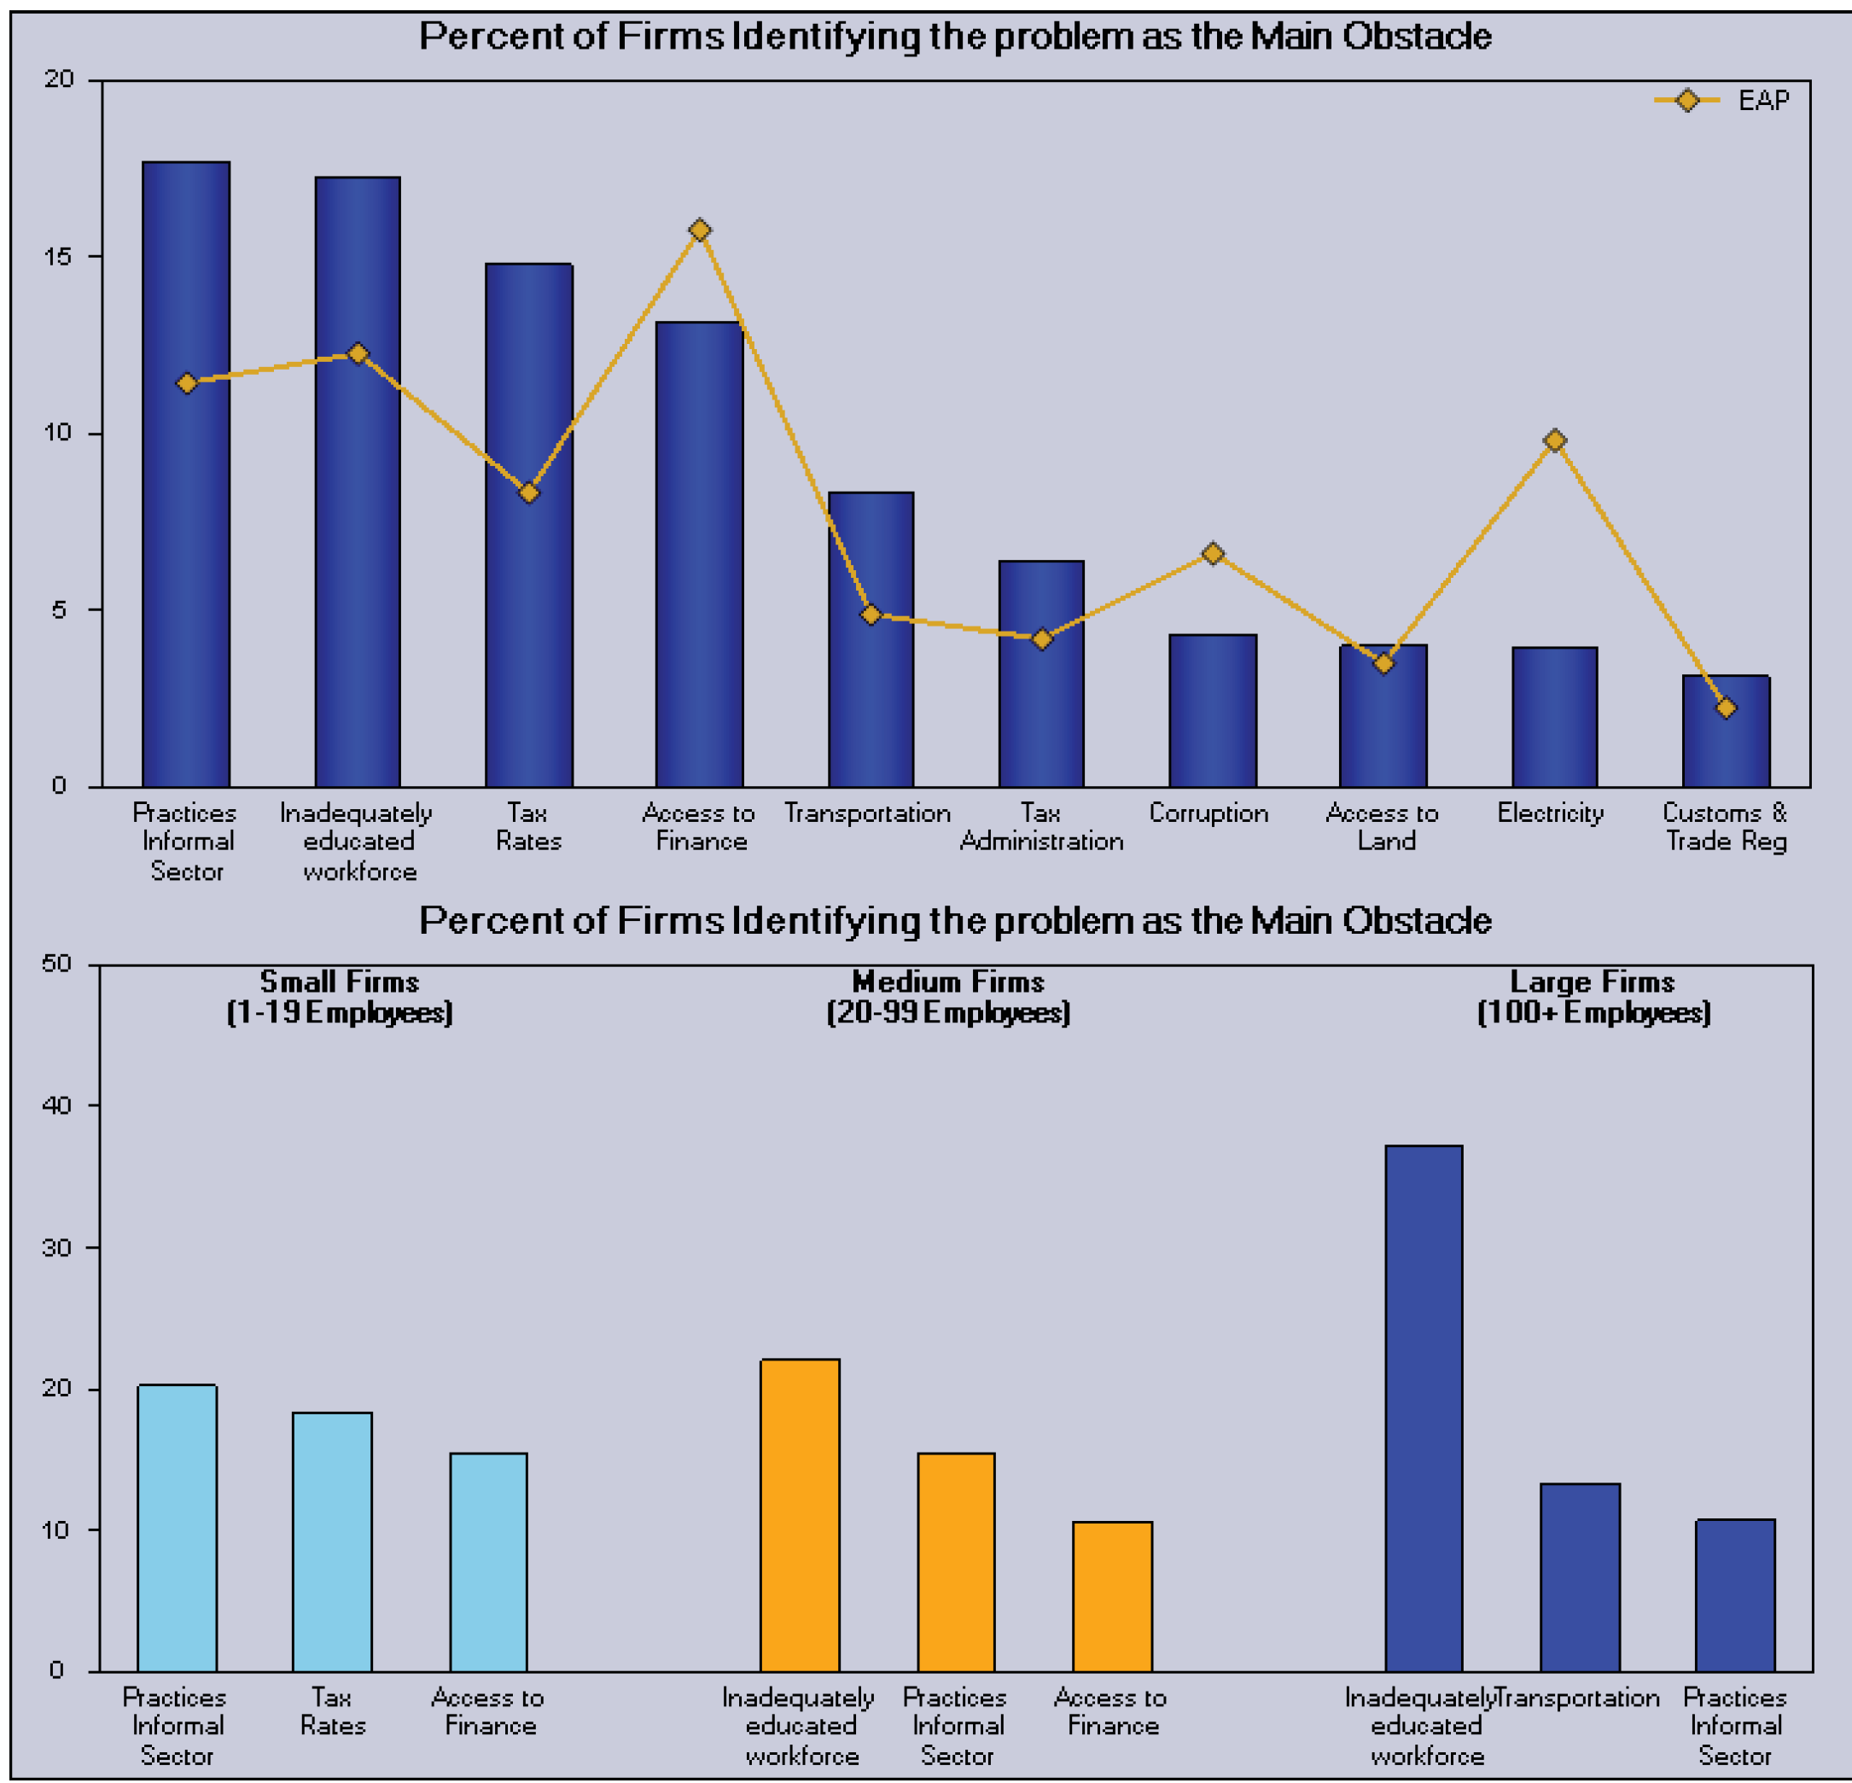
Obstacles of doing business in the Lao PDR (from Enterprise Surveys
Source: World Bank and International Finance Corporation, 2011, page 4

Slide 31
Home country specific advantages (push factors)
China
China is the major investor in the Lao PDR investing in various sectors but important sectors are investment in energy and infrastructure (especially hydropower generation), electricity transmission and trade, road and railway construction projects.
Chinese MNEs plays more roles in investment in ASEAN (including the Lao PDR) partly due to the support from Chinese government and banking sector.
  Chinese government set up various institutions to support foreign investment of Chinese firms. For example, the China-ASEAN Investment Corporation Fund (CAF), the ASEAN-China Centre, the ASEAN-China Business Council, ACFTA portal and Asian Infrastructure Investment Bank (AIIB), China-ASEAN Investment Corporation Fund (CAF), Asian Infrastructure Investment Bank (AIIB), etc.
  Chinese banks support Chinese MNEs investing abroad by being a financial source for those firm.

Slide 32
Home country specific advantages (push factors)
Vietnam
Outward FDI of Vietnam are mostly state-owned enterprises (SOEs) and concentrated in resource incentive countries and in a few industries
  Example of Vietnam SOEs investing in the Lao PDR: Vietnam Rubber Group (VRG), Vietnam Oil and Gas Group (Petrovietnam), Viettel, Songda Group (leading company of construction and industry of Vietnam)
Vietnamese government plays a key role to support outward FDI of Vietnamese MNES such as investment by SOEs and financial support.
More Vietnamese banks have expanded to the Lao PDR. Those banks can support Vietnamese MNEs in terms of financial facilitation.

Slide 33
Home country specific advantages (push factors)
Thailand
In general, investment of Thai MNEs in the Lao PDR normally occurs from host CSAs rather than measures or policy from Thai government to support Thai MNEs outward FDI.
Thai banks play key roles to be financial source for Thai MNEs (especially for large investment projects in the Lao PDR). Besides, Thai banks also expand their branches to the Lao PDR and these bank can help Thai MNEs in terms of financial facilitation
Other push factors
  Large pieces of land in Thailand for agricultural plantation are scarce.
  Wage in Thailand becomes higher.
  Compared to China, Thailand does not have strong and explicit policy to support outward FDI.

Slide 34
Firm Specific Advantages, FSAs
Different FSAs for each MNES in the Lao PDR, e.g.
Some MNEs may have technology advantage or managing capability over other MNEs
MNEs with high investment experience in the region may have advantages over other MNEs in terms of their understanding of system process and limitation of doing business in developing countries in the region
Large Stated-owned MNEs or large private MNEs may have economies of scales advantages in their production and management process.
Well-known MNEs in the region have advantage over other MNEs in terms of their brand recognition in the Lao PDR before they even enter operation in the country.

Slide 35



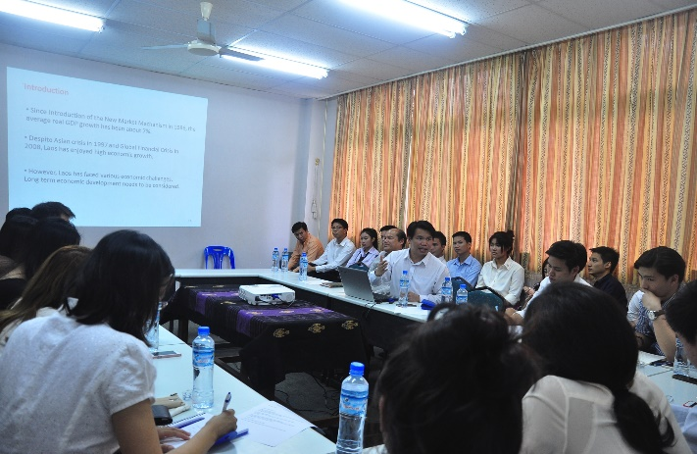





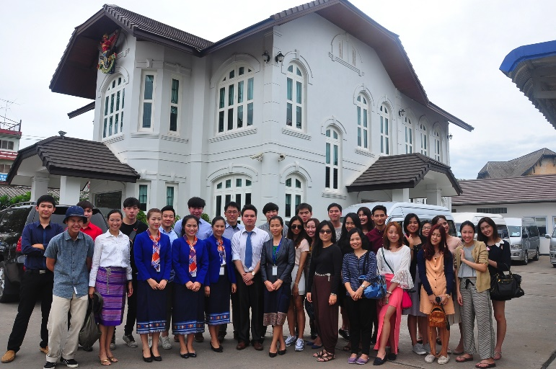
Thai-border & Vientiane

Slide 36
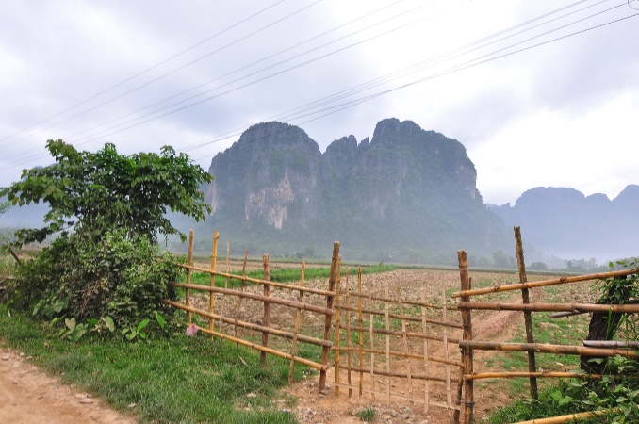
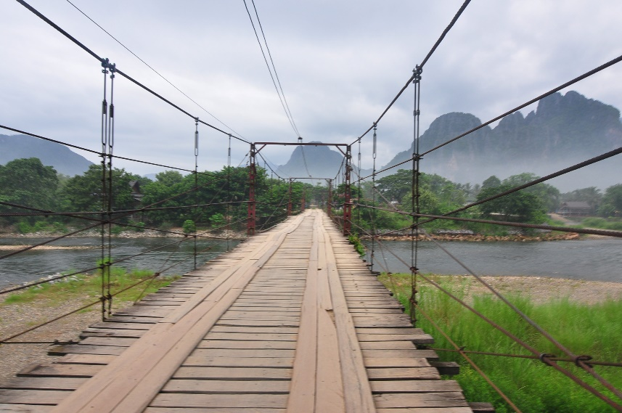



Vang Vieng

Slide 37
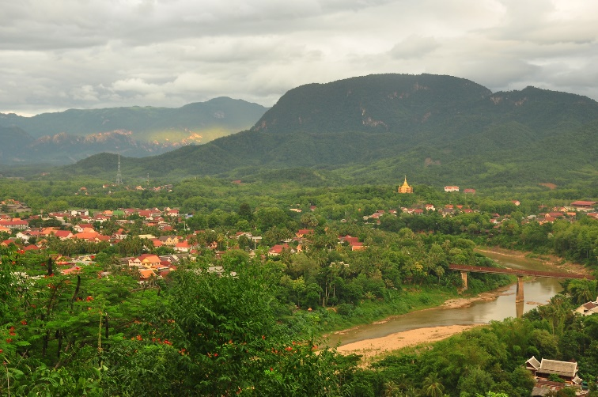


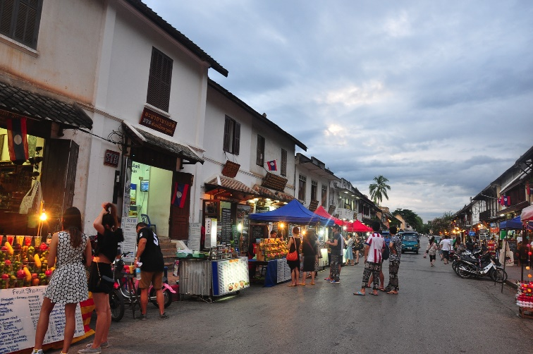



Luang Prabang

Slide 38
Thank you
Q&A

