Slide 1
The Development of Capitalism in Thailand
TU101 BE
Thorn Pitidol

Slide 2
Group Presentation: 10 November 2017
In a group of 7. Choose 1 ASEAN Country (1 group per 1 country).
Make yourself the representatives of that country
Give 7 minutes presentation trying to convince international investors to come and invest. Highlight a crucial aspect and the potential of the country’s economy!
  Submit the print out of your presentation. Your presentation will be evaluated by your friends vote + lecturer.

Slide 3
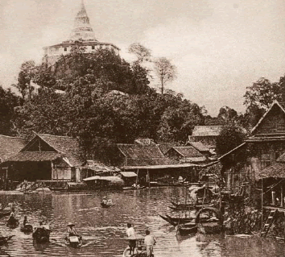
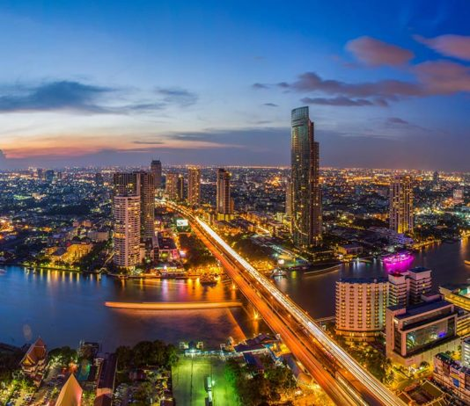
Thai Economy: Then and Now
Early Rattanakosin
2017

Slide 4
How did we get here?

Slide 5
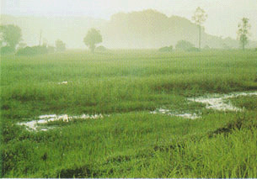

Early Rattanakosin (1782-1850)
Two types of areas facilitated the Kingdom’s two crucial forms of production.
  Rice production
  Collection of forest products

Slide 6
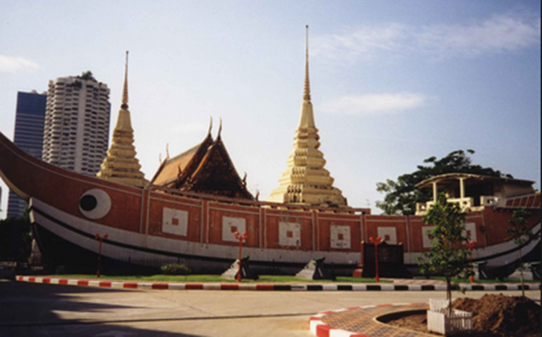
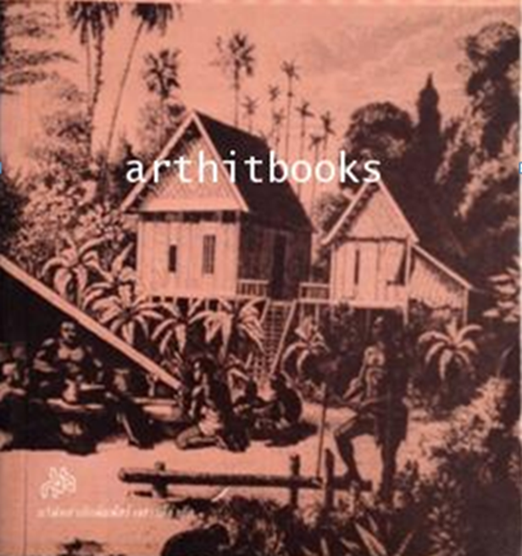
Early Rattanakosin (1782-1850)
Duality of Trade and Subsistence Economy
  Nobles and King actively pursued trade
  Under the Sakdina system, Phrai (peasants) and slave were extracted of labour.
  Other than providing labour, Phrai lived in subsistence.

Slide 7
Chinese in Early Rattanakosin
Catalyst of Change
Protector of Sakdina
Inflow of Chinese led to
  New types and techniques of agricultural production
  Expansion of domestic market
But the Chinese also
  Cooperated with Sakdina by becoming their “tax-collectors”
  Helped sustain Sakdina while limited their own capital accumulation.
Parasitic Capitalism

Slide 8
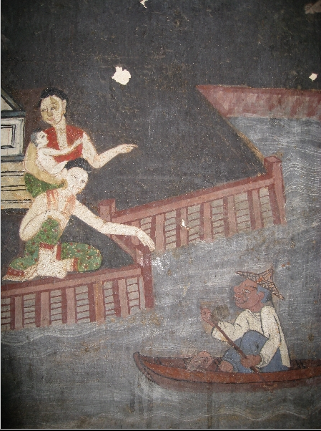
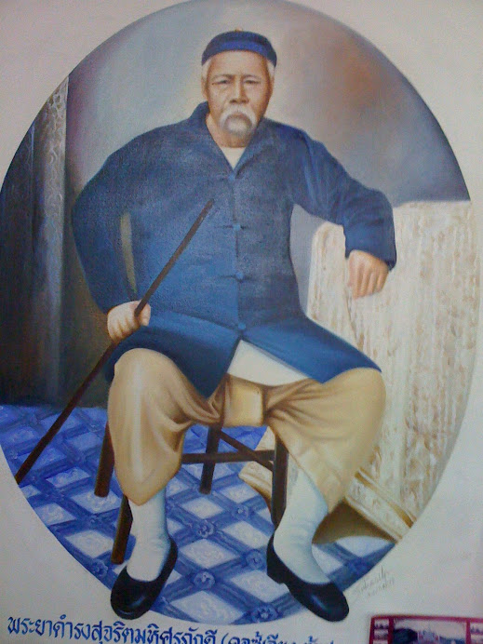
Chinese in Early Rattanakosin
Catalyst of Change
Protector of Sakdina

Slide 9
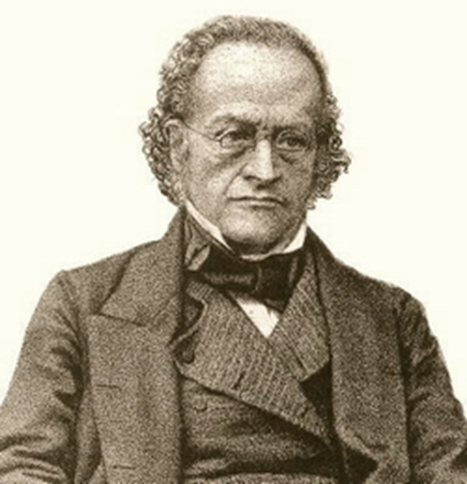
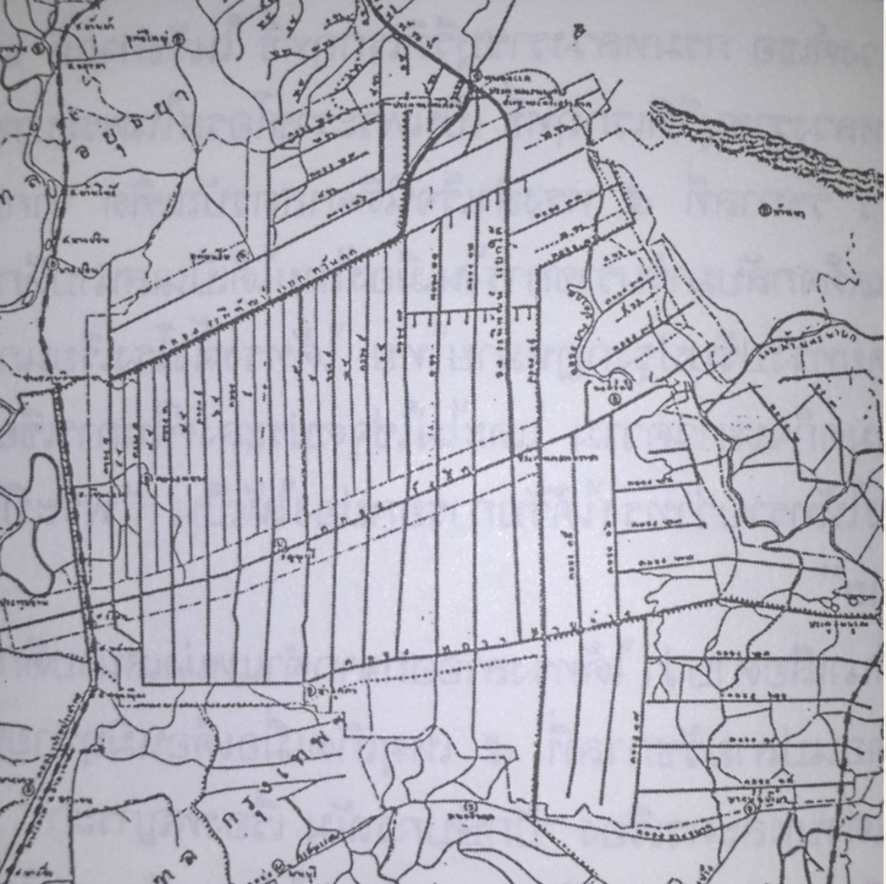
Bowring Treaty (1855)
Granting the ability to trade freely
Extra-territorial rights
3 percent tariff
Impact
  Integration of Siam into World Economy under imperialism
  Rapid expansion of rice production

Slide 10
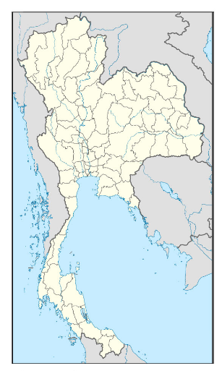
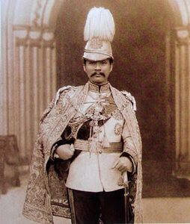
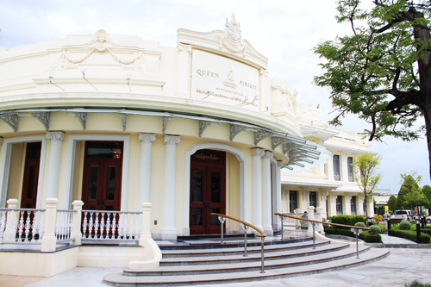
Rise and Fall of Absolutism (1850-1932)
Rama V Reform: the Rise of Absolutism and Siam Nation State
Defining the borders
Building forces
Constructing ideologies
Building bureaucracy

Slide 11
Rise and Fall of Absolutism (1850-1932)
Capitalism under Rama V: Three Capitalists and a Transformed Peasants
  3 groups of capitalists competing
    Chinese controlling rice trade
    Westerners accessing service and serving urban consumers
    The Crown and nobles holding lands
  Big changes to the peasant
    Small farmers cultivating new land or renting
    Shifting between serving market and subsistence

Slide 12
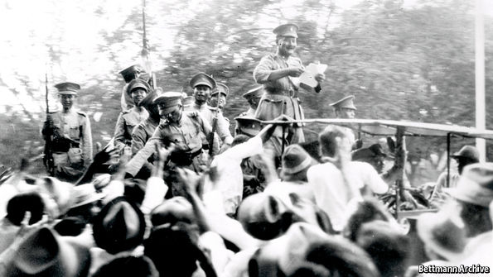
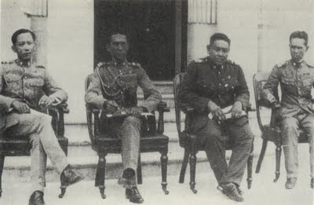
1932 Revolution
The great depression caused the export price for rice to drop 50%
  Chain of consequences: lost in farmers income, gov’t revenue, cuts in budget
  Whose responsibility?

Slide 13
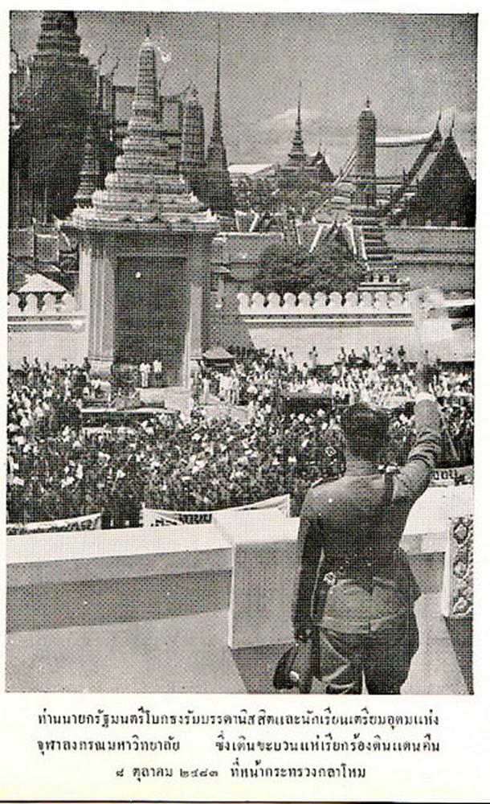
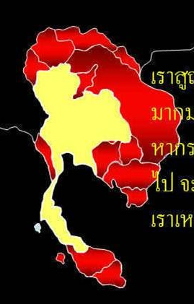
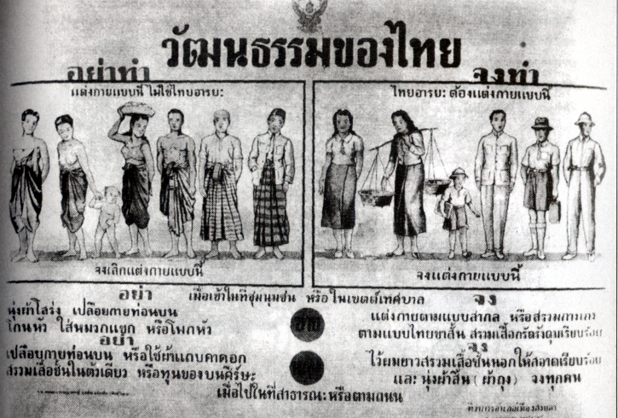
Post 1932 to WWII
The Rise of Military Nationalism under Phibul

Slide 14
Post 1932 to WWII
Economic Nationalism
  Nationalism led to the view that peasants hardship rooted in exploitation by foreigners
  Continuing with the trend from Absolutism, Chinese were identified as the foreigners who caused problem.
  “We now dominate the Chinese, who have to do whatever we want them to"
Bureaucratic Capitalists
  “A Thai economy for the Thai people” promoted state enterprises to replace the Chinese.
  Bureaucrats became a new group of capitalist via control of state enterprises and forming alliance with private sector.

Slide 15
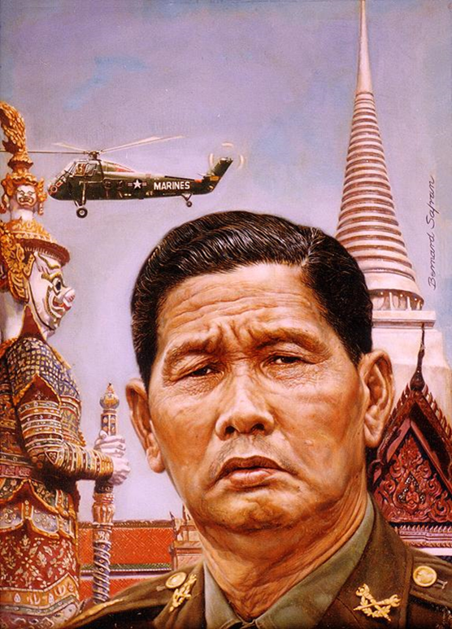
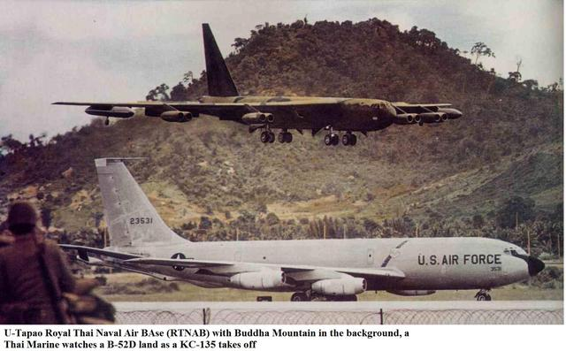
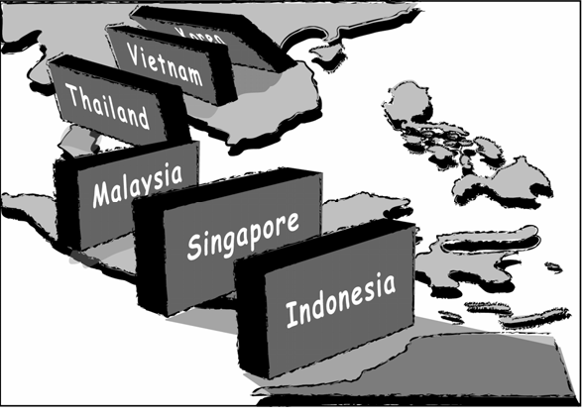
America and The Rise of Sarit Thanarat

Slide 16
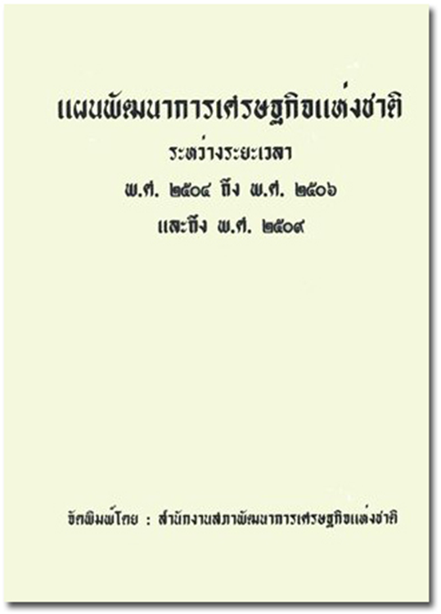
Development Era (1950-1980)
Under US advises, Sarit proclaimed a new economic strategy “development era”
  Growth led by private sector
  Extensive infrastructure investment
  Import-substitution
Bankers capitalism
  Chinese bankers performed a crucial task of allocating funds
  Like other emerging capitals in this period, relied on “reciprocal relations” with the military

Slide 17
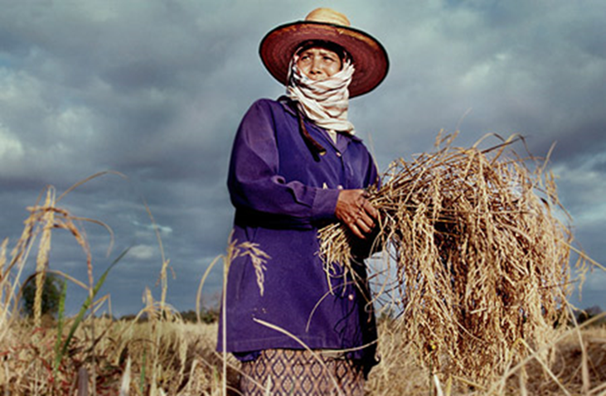

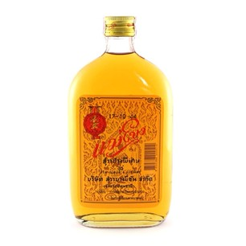

Sarit’s “Imbalanced Development”
Private capitals
  Tariff protection
  Joint investment from foreigners
  Licensing regime
Farmers & workers
  Exploited by tariff
  Low wages, suppression of unions
  Limited land entitlements

Slide 18
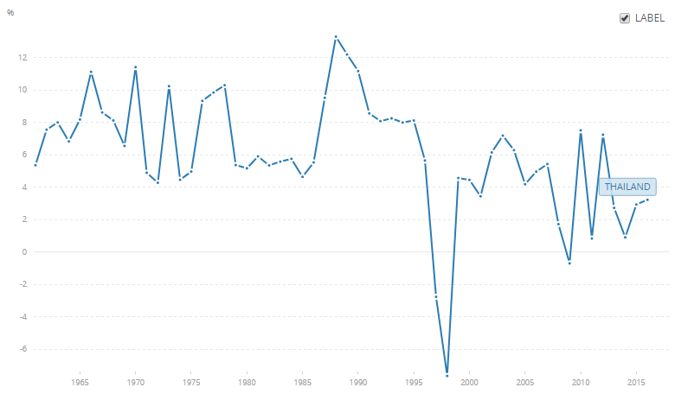
1980-Present
The import-substitution strategy reached limits in late 1970s
Oil shocks and the devaluation of Baht in early 1980s.

Slide 19

1980-Present
The growth strategy was shifted to “export-oriented” in mid 1980s. Thailand converged to full-scale capitalism.
  Removal of tariff-protection
  Foreign direction investment. Integration in East-Asia chain of production
  Financial liberalization

Slide 20
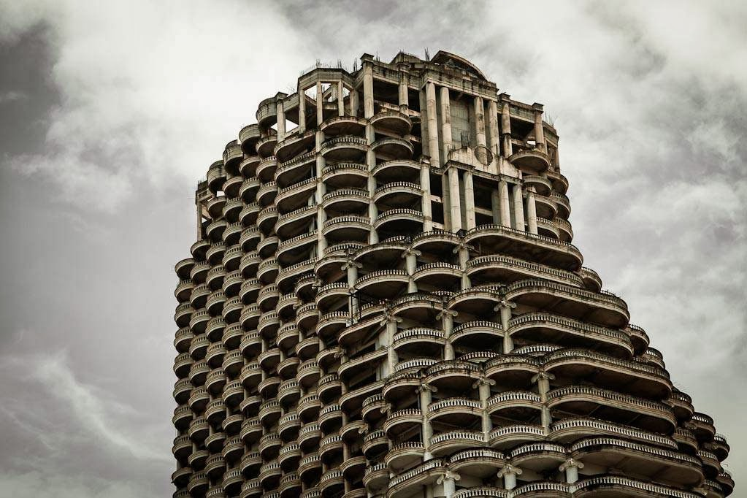
1980-Present
1997 Financial Crisis and the IMF Structural (Neo-liberal) Reform

Slide 21
Phases of Capitalism in Thailand VS World
Thailand
World Captialism
Early Rattanakosin (1782-1850): Parasitic Capitalists
Rise and Fall of Absolutism (1850-1932): Three Capitalists
Military Nationalism (1932-1950): Bureaucratic Capitalists
Development Era (1950-1980): Bankers Capitalism
1980-Now: Full-Scale Capitalism to Neo-liberalism
Dawn of capitalism (1500-1820)
Industrial Revolution (1820-1870)
High noon (1870-1913)
Turmoil (1914-1945)
Golden Age (1945-1973)
Discontinuity (1973-1979)
Rise and Fall of Neo-liberalism (1980-Today)

