Slide 1
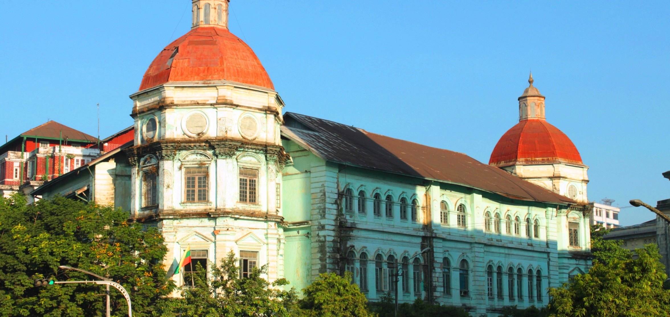
Globalization and development
YOUR LOGO
EE463 Globalization and International Development
Notes:
© Copyright Showeet.com – Free PowerPoint Templates

Slide 2
Module outline
YOUR LOGO
01
What is Globalization?
04
Measuring Growth and Development
02
Economic Growth and Development
05
Conclusion
03
Case Studies
06
Conclusion
Notes:
© Copyright Showeet.com – Free PowerPoint Templates

Slide 3
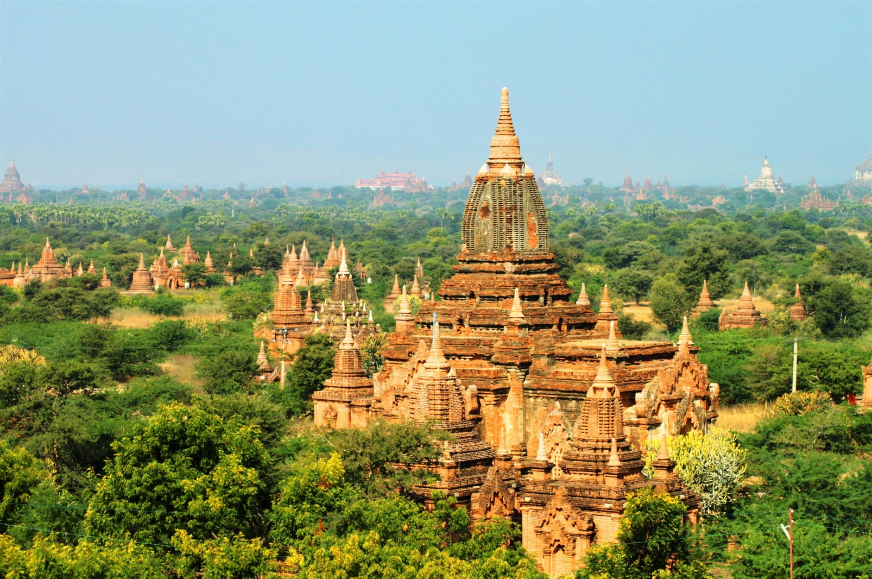
What is Globalization?
Globalization

Slide 4
Globalization is the integration of national economies into the global economy through:
  trade in goods/services,
  direct foreign investment
  movement of people and capital
  technology
Jagdish Bhagwati
Notes:
© Copyright Showeet.com – Free PowerPoint Templates

Slide 5
Globalization is the increasing interdependence of world economies as a result of flows of cross-border trade, international capital and advances in technology and information
Notes:
© Copyright Showeet.com – Free PowerPoint Templates

Slide 6
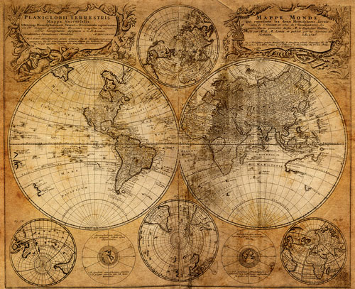
Globalization is not New
Throughout history, civilizations have developed commercial trade routes, pursued military conquests and embarked on exploration expeditions, and experienced cultural exchanges

Slide 7
Modern day globalization
Following World War II, world trade accelerated and resulted in what is now known as “globalization”
The process of modern globalization has sped up with improvements and innovations in information, transportation and communication technology

Slide 8

Growth and Development
Economic Growth and Development

Slide 9
Distinctions
Economic growth: a rise in national or per capita output/income
Economic development is broader and does not only cover output/income, but also improvements human well-being; this requires structural change
Economic growth without structural change: means that wealth is concentrated in the hands of a few
Indicators of human well-being
income distribution
health
education
environment
structure of the economy

Slide 10
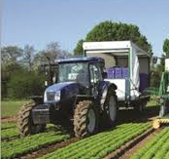
Economic growth and development
Economic growth is a necessary but not sufficient condition for economic development
Development should not only measure income and wealth; it should also focus on people such as: expanding the capabilities of people to live the lives people choose to lead
Implication: economic development encompasses having education, a healthy life, not being poor, being safe from crime, being involved in the community

Slide 11
Development and Growth Indicators
Economic output: Gross Domestic Product (GDP), GDP/capita (or GNP or GNI)
Literacy rate: percent of the population being able to read and write
Infant mortality rate: infant deaths per 1,000 births
Primary and secondary school enrollment
Poverty rate: percentage of population living below the poverty line
Human Development Index (HDI)
Growth and development
Develop-ment

Slide 12

Countries develop and change
Change in political system
Demographic shifts
Spread of endemic disease
Rapid global trade
Movement of capital; (e.g., foreign investments and lending)
Information and technology

Slide 13
Countries develop differently
Development requires growth, but growth in itself does not in itself result in development
Countries which have moved from less developed to developed within 40 years (annual GDP growth of 7%): South Korea, Taiwan, Hong Kong and Singapore
Fast growing economies
India, China, Malaysia, Thailand and Viet Nam; Botswana, Chile, Estonia and Mauritius
Countries that have developed slowly/remained stagnant
Myanmar, North Korea, Papua New Guinea
Countries that have regressed
Ukraine, Argentina

Slide 14
Classification of rich and poor countries
Classification according to World Bank*
High income
Upper middle income
Lower middle income
Low income
During the Cold War (1950-1980)
Recognizing continuum of development stage
First World
Second World
Third World
Developed
Developing
Least developed
* World bank classification is based on a country’s gross national income (GNI) per capita

Slide 15
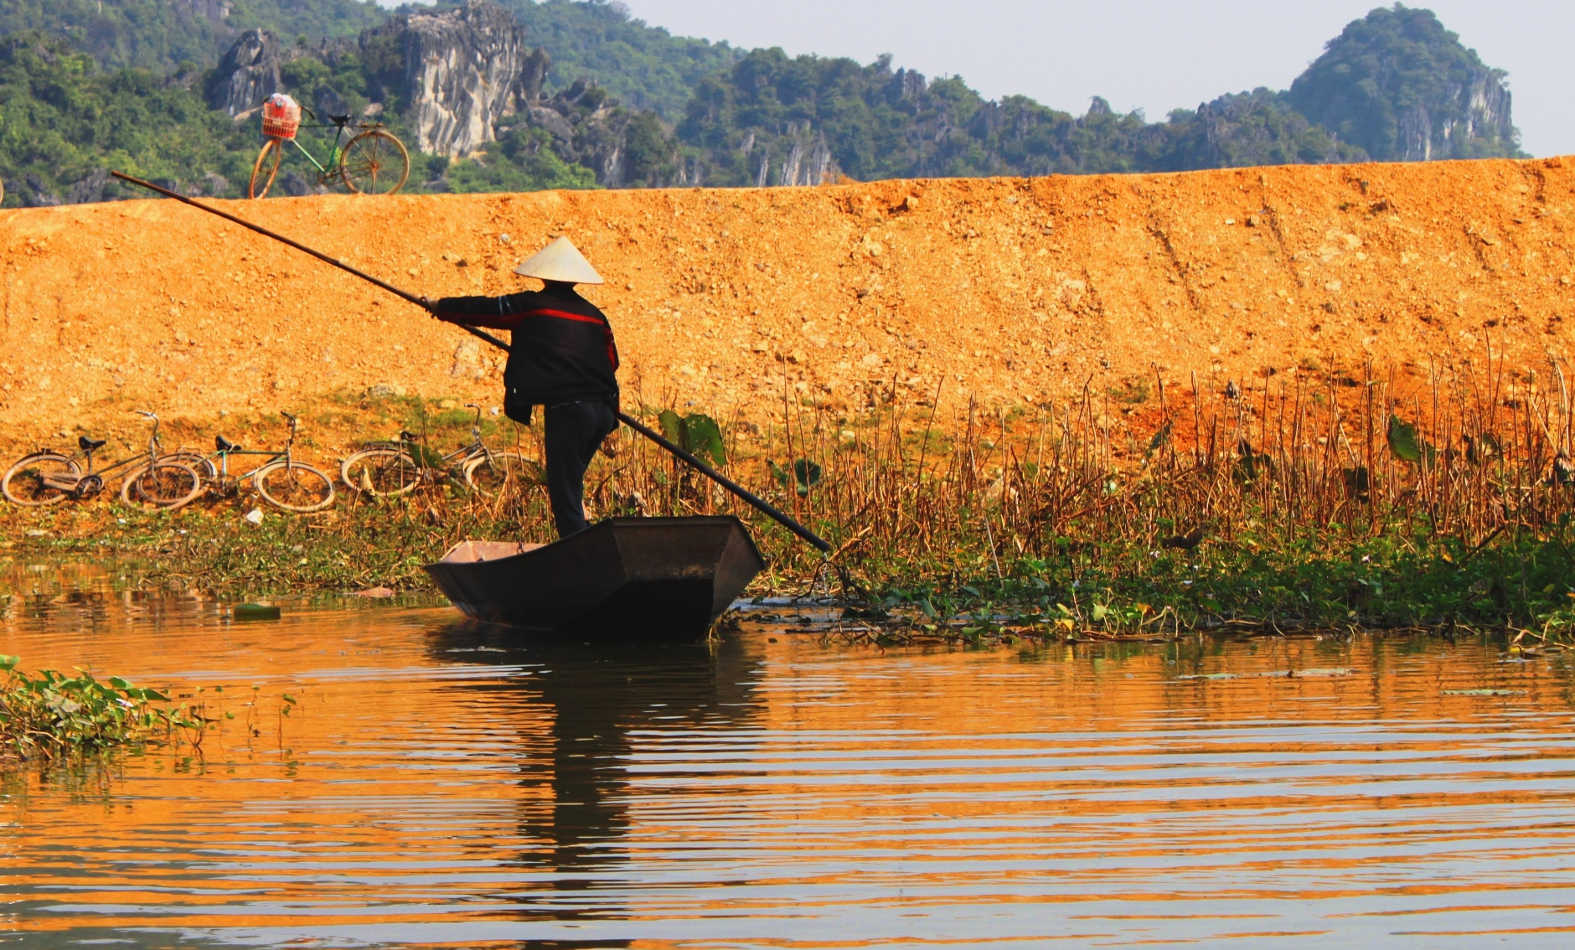
Case studies
Economic Growth and Development

Slide 16
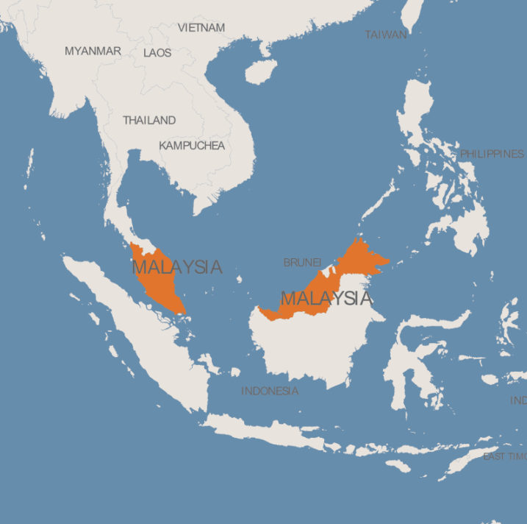
Malaysia
A poor country in the 1970s; benefitted from economic relocation, attracted foreign investment with sound economic polices
Global demand for electronics led to increased exports, more jobs and economic growth
Sustained growth for a long period enabled Malaysia to move from low country to upper middle income status
As Malaysia faces more competition from low wage countries, it must look at developing a knowledge-based economy

Slide 17
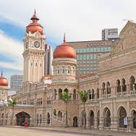
Malaysia, 1970-2010
  GDP per capita: fourfold increase
  Mortality rate: 41 per thousand to 6 per thousand
  Life expectancy: increased from 61 to 75 years
  Adult literacy: increased from 58% to 92%
  Enrollment ratio (girls to boys): increased from 83% to 103%
  Share of agriculture to national output: decreased from 33% to 10%

Slide 18
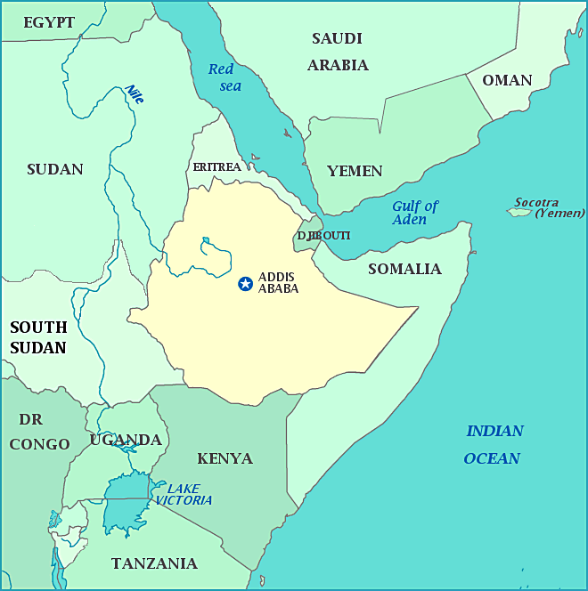
Ethiopia
A low income country, stagnant growth during1970-2000
Most of population live in rural areas, engaged in subsistence farming
Limited water supply, electricity and paved roads; faces perennial drought and epidemic disease
In 2004 policy measures taken by government to liberalize the economy and take policy measures to attract investment
Since 2010 considered an emerging economy due to increasing foreign investment

Slide 19
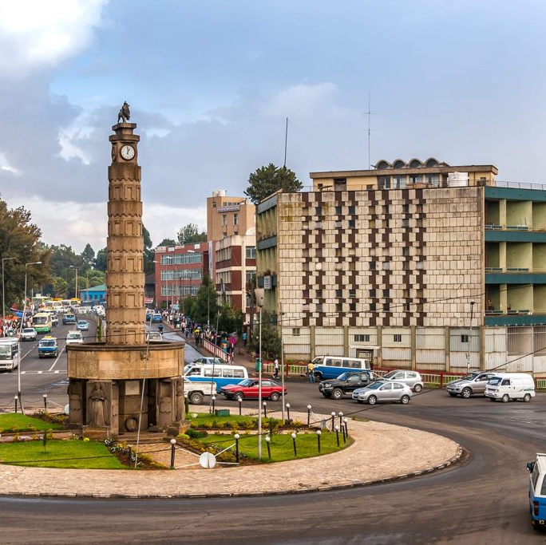
Ethiopia, 1970-2010
  GDP per capita : stagnant until 2000s ; however marked increases from 2004 onwards
  Mortality rate: 136 per thousand to 67 per thousand
  Life expectancy: increased from 43 to 56years
  Adult literacy: around 33%
  Share of agriculture to national output: decreased from 51%

Slide 20
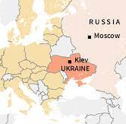
Ukraine
Relatively good standard of living in the 1970s; break-up with the Soviet Union worsened standard of living
Previously dependent on Soviet Union (housing, food, jobs)
Economy was not competitive, not linked to the outside world, little foreign investment
Due to mismanagement, rampant corruption and heavy debt burden, the standard of living declined

Slide 21
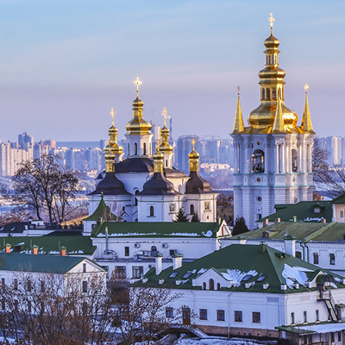
Ukraine, 1970-2010
  GDP per capita : decreased by 15%
  Mortality rate: decreased from19 per thousand to 12 per thousand
  Life expectancy: relatively constant, 72 years
  Adult literacy: stable 90%

Slide 22
Comparisons in GDP per capita, 1960-2020
Malaysia
Ukraine
Ethiopia

Slide 23

Coffee Break
YOUR LOGO
Enjoy your 15’ pause
Photo credit: fernandovillalobos via Pixabay
(Creative Commons Zero license)
Notes:
© Copyright Showeet.com – Free PowerPoint Templates

Slide 24
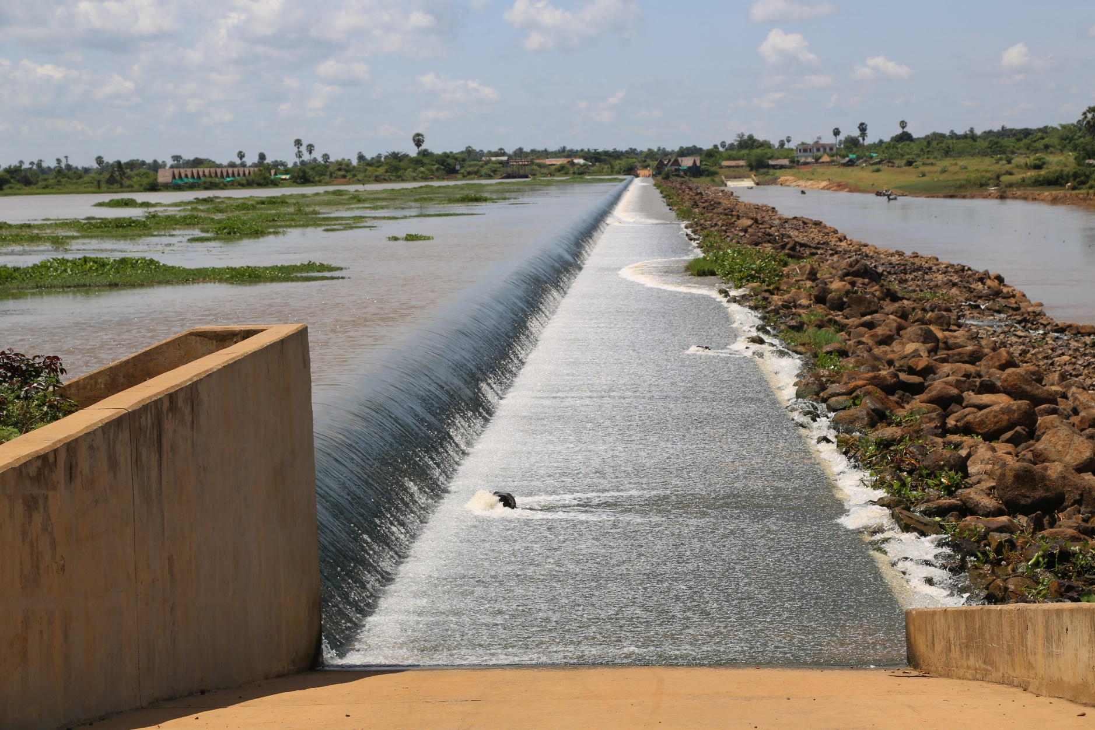
Measuring growth and development
Economic Growth and Development

Slide 25
Key Indicators
Gross National Product (GNP): sum of value of finished goods and services produced by society in a given year
Gross National Income (GN1): similar to GNP but includes product taxes (less subsidies) and net receipts of primary income from abroad
Gross Domestic Product (GDP): output produced within the borders of a country (including those by foreigners) in a given year
GDP per capita: Total output divided by number of population
Real GDP: adjusted for domestic price inflation

Slide 26
Difference between GDP, GNP and GNI
GNP
GDP
GNI
Total value of goods/services produced by society (citizens of a country); includes remittances from abroad; excludes foreign investments
Total value of goods/services produced within the country
(includes foreigners but excludes citizens living abroad)
GNP + product taxes (minus subsidies) not included in the valuation of output + net receipts of primary income from abroad

Slide 27
Human Development Index
Developed by the United Nations to quantify the essential elements of human development, which are not captured in GDP
Some measures: have a healthy life, to acquire knowledge, and have access to resources that are essential to lead a long and healthy life.
Unlike GDP, HDI is difficult to measure and comparisons across country data may be difficult
HDI captures only three 3 dimensions of human development
What HDI measures
Long and healthy life: life expectancy, mortality rate
Acquire knowledge: years of schooling, enrollment rate, literacy rate
Access to resources: transforming GNI per capita values into rankings

Slide 28
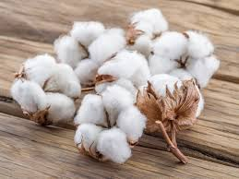
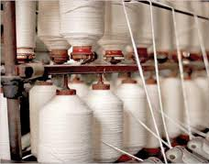


Value added
Incremental gain to the price of a product at a particular stage of production
Cotton balls
Cotton threads
Cotton shirts
Packaged product
tax
tax
tax

Slide 29
How is GDP calculated?
GDP = C + I + G + (X – M)
whereby:
GDP = gross domestic product (national income)
C = consumption
I = investment
G = government spending
X = exports
M = imports
GDP is not a perfect measure of national economic output. Despite its limitations it is still the most widely used measure of economic growth

Slide 30
Limitations of GDP
Does not measure non-market activities: unpaid labor such as housework
Does not measure negative externalities: pollution
Does not take into account the informal economy
Does not measure the quality of life

Slide 31
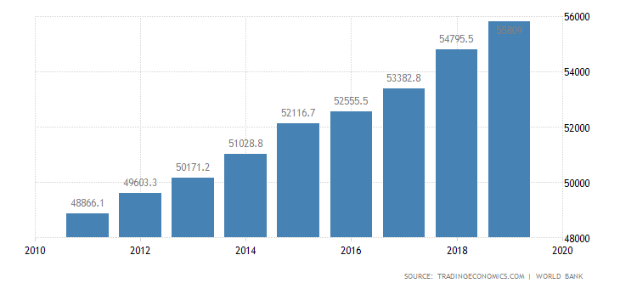
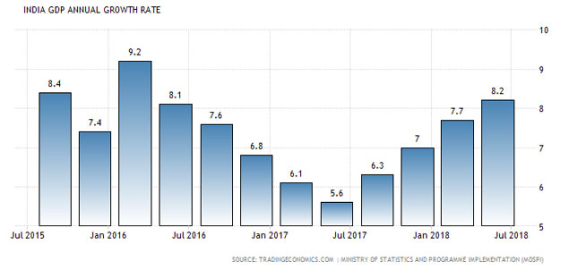
Economic growth: rise of GDP over time
Rising GDP = increasing economic growth
Chart: United States GDP/capita, 2010-2020
Fluctuating GDP = decline and rebound in economic growth
Chart: India GDP annual growth rate 2015-2018

Slide 32
Comparisons of GDP per capita
* in US $
Country
Norway
Japan
South Korea
United Kingdom
United States
China
Botswana
Viet Nam
Ethiopia
India
Year 1970
3,306
3,308
279
2,348
5,234
113
153
231
204
108
Year 2020
67,294
40,113
31,489
40,284
63,543
10,500
6,710
2,785
936
1,900
High GDP per capita during the period
Extraordinary growth
Stagnant growth

Slide 33
GDP per capita over time, 1960-2020
USA
Japan
Rep of Korea
PR China

Slide 34
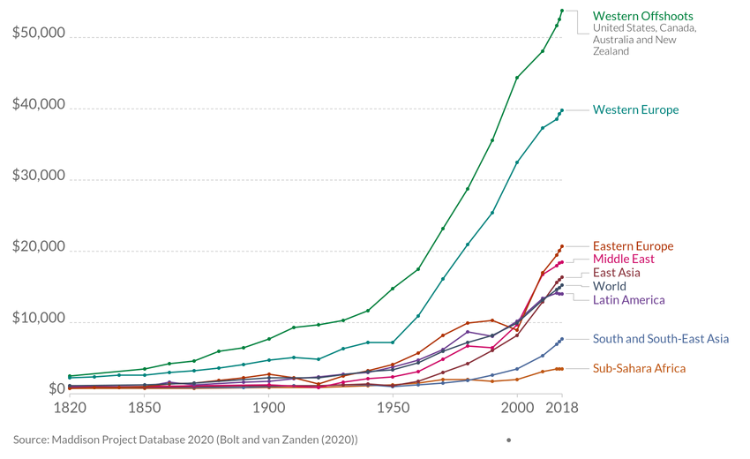
GDP/capita long-term trend, 1820-2018

Slide 35
COnclusion
Economic Growth and Development

Slide 36
Summary of today’s presentation
Globalization is the increasing interdependence of world economies as a result of flows of cross-border trade, international capital and advances in technology and information
Globalization is the integration of national economies to the global economy through trade, direct foreign investments and movement of people, capital and technology

Slide 37
Summary of today’s presentation
Many changes have occurred in the past 40 years. Different countries have different development experiences
The terms “first, second and third world” are no longer relevant; countries are now classified as “least developed”, “ lower middle income”, “upper middle income” and “advanced industrialized” countries
Foreign investment is a driver of economic growth. However to make this happen, government policies and human factors play a large role
To develop from low-income to a high-income status, a country should be able to sustain economic growth for a long period of time, accompanied by structural change

Slide 38
Summary of today’s presentation
Economic growth is measured by increase or decrease in national economic output. Several indicators are GNP, GDP, GNI
Although economic growth is desirable, it alone is not sufficient for economic development; development does not deal only with income; it should also focus on people
Human Development Index is an effort to capture non-monetary aspects of development; however there are difficulties in measurement
Economic growth = increase in per capita income
Economic development = Economic growth + structural change

Slide 39
Notes:
© Copyright Showeet.com – Free PowerPoint Templates

