Slide 1

Communications
MK 341: Special Topics in Marketing 1
Marketing Leadership Development and Cross-cultural Management
By Ajarn Suwalya K.

Slide 2
Today’s Happenings;
What we plan to achieve
Please gather in your groups and share last lesson
Effective Communications
Activities
Why is Communication vital to effective leadership?
Active Listening
Branding Nike and Apple Marketing Strategy
Group Project Update 2

Slide 3


Exercise 1: Telephone

Slide 4
Wny is Communication Vital to Leadership?
"It is crucial to communicate effectively in negotiations to ensure you achieve your goals. Communication is also important within the business. Effective communication can help to foster a good working relationship between you and your staff, which can in turn improve morale and efficiency."
Communicating effectively for business | Business Queensland
https://www.business.qld.gov.au › comm...

Slide 5
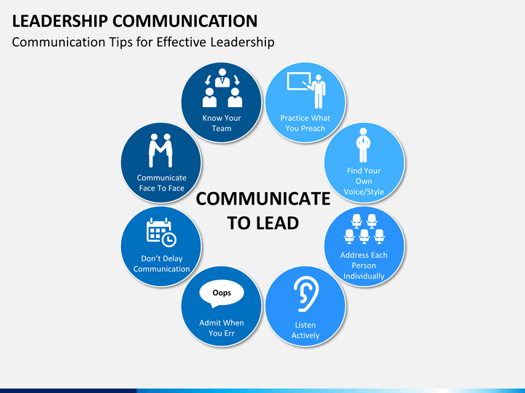

Slide 6
Task- based strengths for Leaders
Able to summarize and clarify.
Actively listen to workers' ideas views and emotions.
Verbalized ideas in a convincing and concise manner.
Interviewing skills.
Allow effective communication within teams.
Courteous in email communication.
Give constructive criticism to staff.
Take time to make personal connection.
Handle bad news sensitively.
Good quality report writing.
Presentation skills.
Ability to network.
Persuasive negotiation.

Slide 7
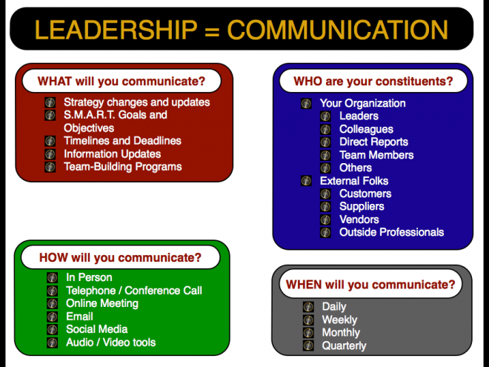

Slide 8
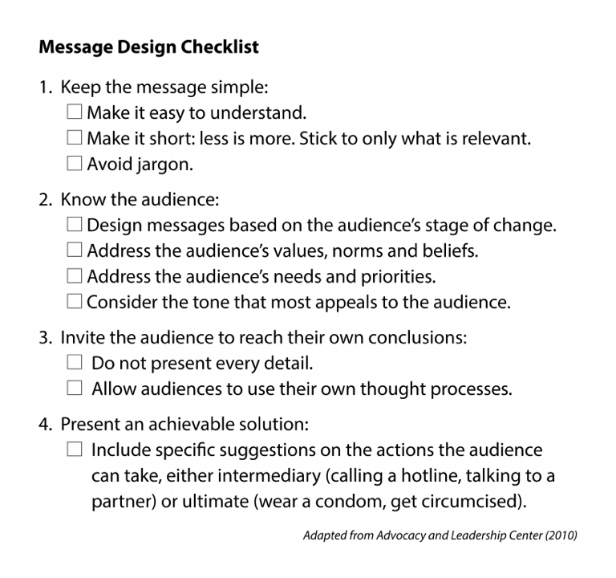


Slide 9

Exercise 2: Drawing

Slide 10
Active Listening

Slide 11
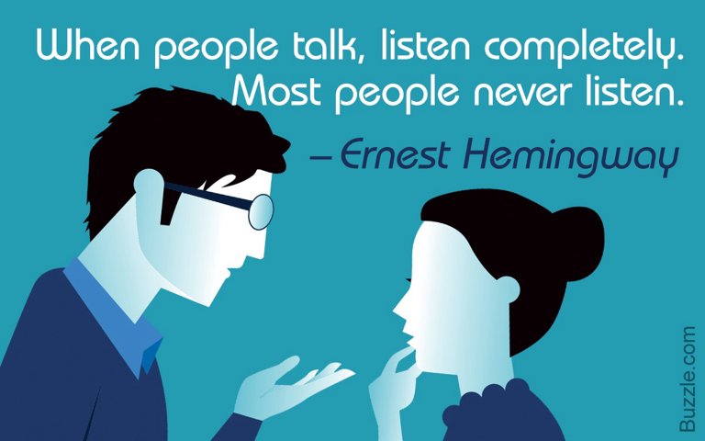
Active Listening

Slide 12
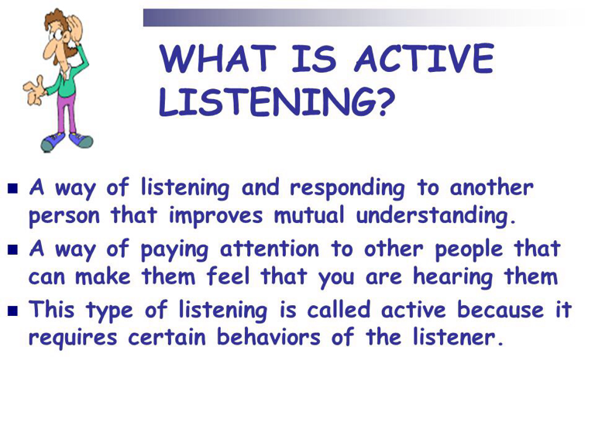
Active Listening

Slide 14
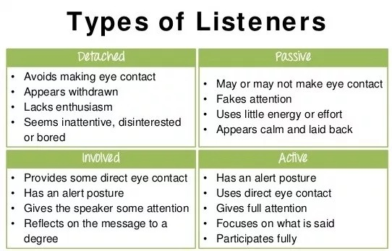

Slide 15
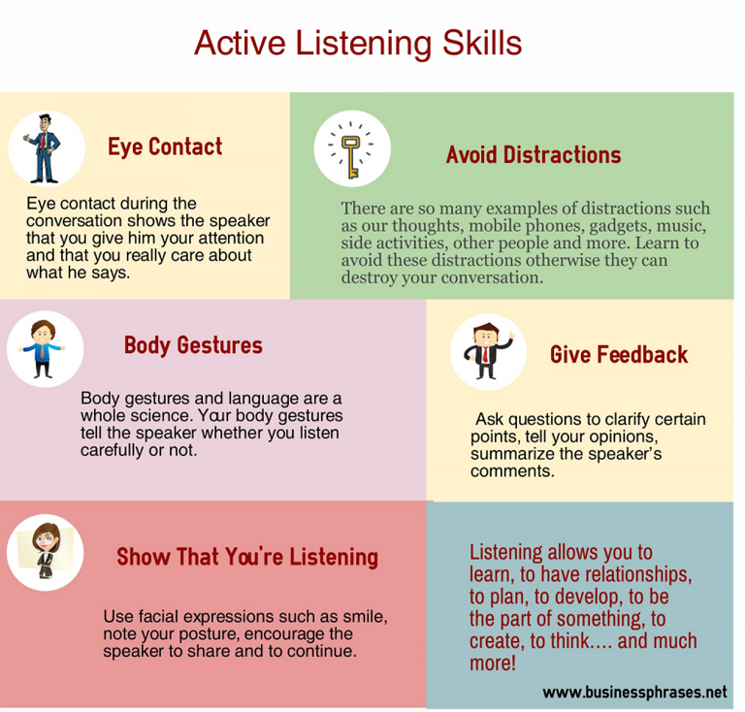

Slide 16



Slide 17
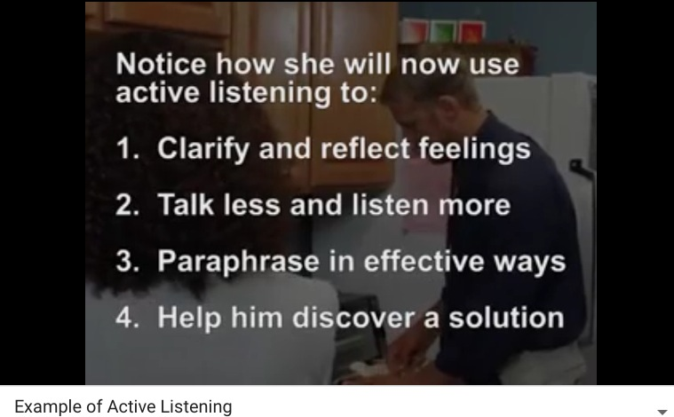
Active Listening

Slide 18
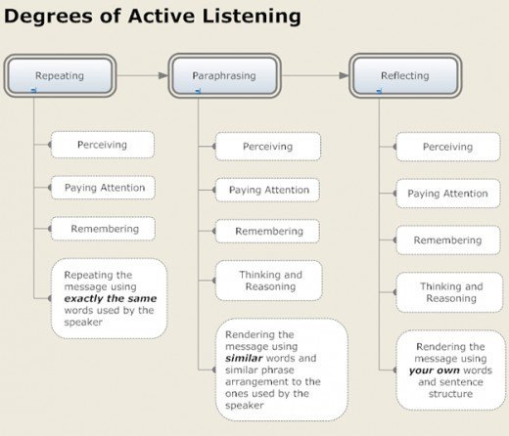

Slide 19
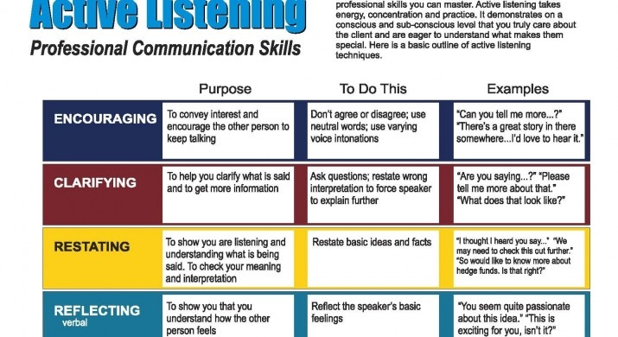

Slide 20
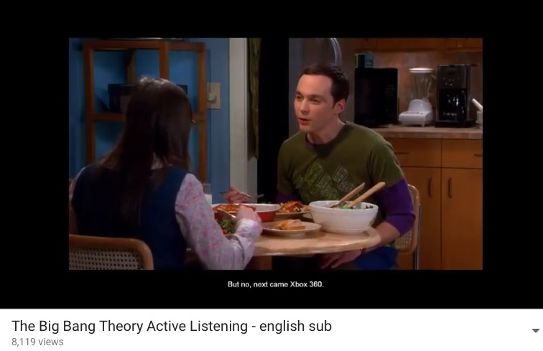
Active Listening

Slide 21
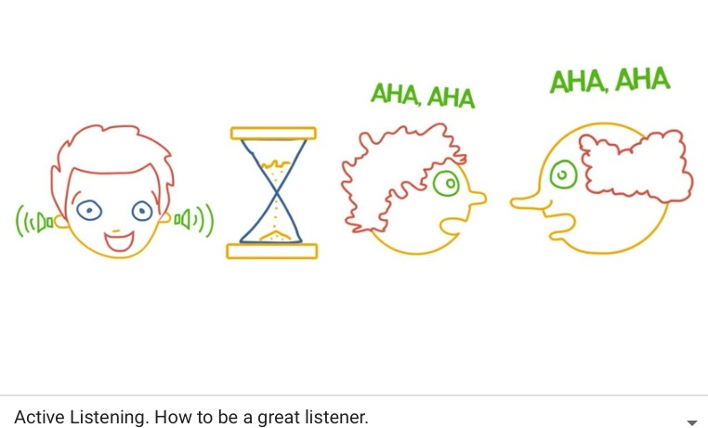
Active Listening

Slide 22


Exercise 3: Active Listening Pair

Slide 23

Exercise 4: Active Listeners!!!

Slide 24
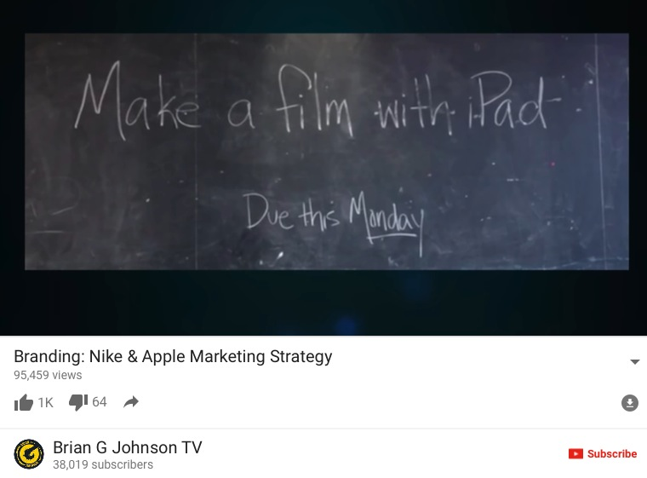

Slide 25
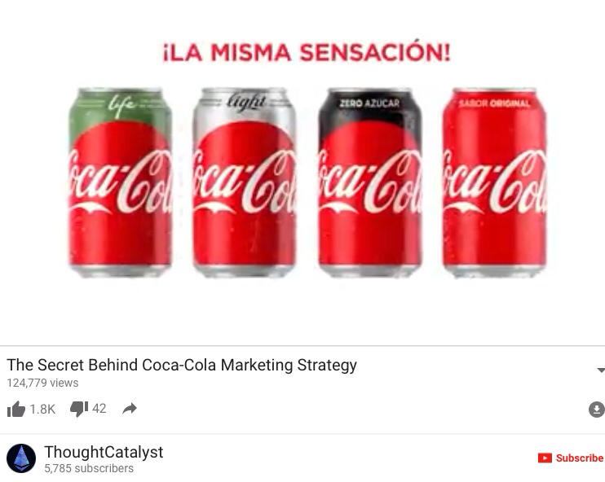

Slide 26
Individual Homework
Please complete the handouts on Active Listening Skills

Slide 27
What we accomplished
Effective Communications
Activities
Why is Communication vital to effective leadership?
Active Listening
Branding Nike and Apple Marketing Strategy
The Secret Behind a Coca-Cola Marketing Strategy
Project Update 2

Slide 28


