Slide 1

INTEGRATED BRAND COMMUNICATION
Massimiliano La Franca
Lesson 3

Slide 2
Recap from last lesson
Marketing process:
  Opportunity
  Target market
  Marketing mix dev
Agencies: who does what

Slide 3
Influencing decisions through communication

Slide 4
The big picture
Communication
Decision process
Behavior
Confirmation

Slide 5
How does it work?
Communication is a tool that attempts to influence people’s behaviors
Behavior:
  is the total collection of actions and reactions exhibited by a person that can be measured objectively (ex. Purchasing, consumption behaviors)
  the consequence of a conscious or unconscious decision (ex. I need to by a new toothbrush)
  Influenced by attitudes but different as it is clearly visible
  Influence the decision process to influence behaviors

Slide 6
Before we go, why so much on behaviors…
Students should read
Homelessness is a problem
I should exercise
I should recycle
I should designate a driver
I should vote
Should change strategy to fight terrorism
There’s a gap between what we say and what we do. What we do is the only thing we can actually see and influence
However in order to influence we need to know what’s the decision process that leads to this behavior and what attitudes influence our behaviors.

Slide 7
The decision-making process
Problem recognition
MOTIVATION
Alternative evaluation
ATTITUDE
Post-purchase evaluation
Information search
PERCEPTION
Purchase decision
AKA: path to purchase
Notes:
A tool to simplfy the decision making process in people mind. Being a mind-process, it involves a series of psychological processes that are behind each stage
Sowe will look at each one of those in details

Slide 8
The decision-making process
Problem recognition
MOTIVATION
Alternative evaluation
ATTITUDE
Post-purchase evaluation
Information search
PERCEPTION
Purchase decision
AKA: path to purchase
Notes:
A tool to simplfy the decision making process in people mind. Being a mind-process, it involves a series of psychological processes that are behind each stage
Sowe will look at each one of those in details

Slide 9
Problem recognition
Problem recognition
Alternative evaluation
Post-purchase evaluation
Information search
Purchase decision
When people realize a need
Different sources:
  Out of stock
  Dissatisfaction
  New needs because of changes in their conditions
  Marketing generated needs
  Curiosity vs new products
Marketing tries to influence this stage; in order to effectively do this, it needs to know people’s motivations.
IMPLICATION: If we know what the underlying reason for a specific purchase we can develop the right tools to influence the decision process

Slide 10
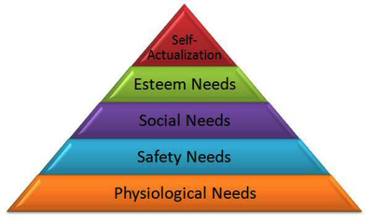
Motivations
Problem recognition
Alternative evaluation
Post-purchase evaluation
Information search
Purchase decision
From Latin “movere” what moves you taking a specific decision
The most famous framework is Maslow’s Hierarchy of needs
We all have different needs according to the situations we live in; until the basic needs are satisfied the others are less relevant
IMPLICATIONS for mktg
  Forces to think of what is the key needstate of a specific target group, this way mktg can be focused on communicating the relevant messages
  What need do we want to satisfy?
  Example: VOLVO - BMW

Slide 11




Slide 12


Different personality, attitude and goals underpinned by different needs
TRANSCENDENCE
Helping others to self-actualise
ORANGE – THIS DEFINES THEM
Want to help their baby grow into their own unique person
Providing the guidance and environment for happy, healthy (mentally and physically) balanced growth
Also a journey of growth for them as individuals
SELF ACTUALISATION
Personal growth, self - fulfillment
AESTHETIC NEEDS
Beauty, balance, form, etc.
COGNITIVE NEEDS
Knowledge, meaning, self-awareness
EGO/ESTEEM NEEDS
Achievement, status, responsibility, reputation
BELONGING NEEDS
Family, affection, relationships, work group etc
SAFETY NEEDS
Protection, security, order, law, limits, stability, etc
YELLOW – THIS DEFINES THEM
All they want is a healthy happy family
Their role in life is to protect and look after their family
About belonging – being a wife, having a family
BIOLOGICAL AND PHYSIOLOGICAL NEEDS
Basic life needs: air, food, drink, warmth, sex, sleep etc

Slide 13





How do we learn about motivations
Problem recognition
Alternative evaluation
Post-purchase evaluation
Information search
Purchase decision
Marketing researches, mainly qualitative
In-depth interviews
Focus groups
Association tests
Projective techniques

Slide 14
A very famous research flop…

Slide 15
The decision-making process
Problem recognition
MOTIVATION
Alternative evaluation
ATTITUDE
Post-purchase evaluation
Information search
PERCEPTION
Purchase decision
AKA: path to purchase

Slide 16
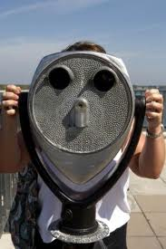
Information search
Problem recognition
Alternative evaluation
Post-purchase evaluation
Information search
Purchase decision
Once realised a need, we start searching for info on how to solve it
  Internal research: what do I know about it? Internal auto-pilot (Pack re-design cases Fruit d’or – Jif)
  External researches: the importance of the “influencers”, peers, public institutions and marketing activities
The psychological process behind information is “perception”.

Slide 17

Selecting marketing information
Problem recognition
Alternative evaluation
Post-purchase evaluation
Information search
Purchase decision
We sense information, select, interpret and retain the relevant ones:
  We process info through sensation first; audio-visual is most important but increasing importance of sense-marketing (think perfumes section in Central)
  Select what we need and what we don’t
  Retain only what we need
IMPLICATION: how do you make yourself visible and relevant – the power of disrupting
Notes:
Exposed to 1500-4000 messages per day but only perceive about 80

Slide 18
Food for thought
The main point is: we are exposed to too much information, our brain tries to defend us from all of this but some information passes without us realising it.
Think how this impact our decision process
See some interesting examples:
  Selective attention
  Submliminal – a tricky example – US elections
  Ads: BMW flash logo

Slide 19
The decision-making process
Problem recognition
MOTIVATION
Alternative evaluation
ATTITUDE
Post-purchase evaluation
Information search
PERCEPTION
Purchase decision
AKA: path to purchase

Slide 20
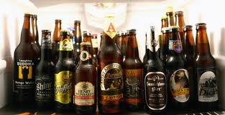
Alternative evaluation
Problem recognition
Alternative evaluation
Post-purchase evaluation
Information search
Purchase decision
Ok, I know what I need and I have gathered some info…what’s available?
  Reduce complexity, remember a small number
  Top-of-mind brands: the set of brands that spontaneously come to mind in a specific category
Ok I know the brands, how do I choose?
  Attitudes towards a brand
  Product benefits (rational – emotional)
  Availability
  Price
Attitude the psychological process
The paradox of choice

Slide 21
The paradox of choice
Suggested book - Berry Schwartz: the paradox of choice

Slide 22
The decision-making process
Problem recognition
MOTIVATION
Alternative evaluation
ATTITUDE
Post-purchase evaluation
Information search
PERCEPTION
Purchase decision
AKA: path to purchase

Slide 23
Purchase decision
Yep, we’re finally there, we have:
  influenced their needstate
  passed through the gates of their selective attention
  influenced their attitudes towards the brand
  Created “purchase intention”
Now it’s time to buy…but things can still go wrong; for purchase to happen there’s a need to match intent with the characteristics of the brand we selected at right time in the right place (i.e. what happens on the point of purchase - supermarket, car salon..?)

Slide 24
The decision-making process
Problem recognition
MOTIVATION
Alternative evaluation
ATTITUDE
Post-purchase evaluation
Information search
PERCEPTION
Purchase decision
AKA: path to purchase

Slide 25
Post-purchase evaluation
learning process which helps people adjusting their behaviors over time
Fundamental to build “loyalty” expressed as both:
  FREQUENCY: How many times consumers choose my brand when they shop the category (ex. Dove – shampoo)
  PRECENTAGE: % of volumes of a specific brand that the same consumer buy in a specific category
This stage is often neglected by FMCG marketers but is getting more and more crucial through of social media (Social search – google plus your world)

Slide 26
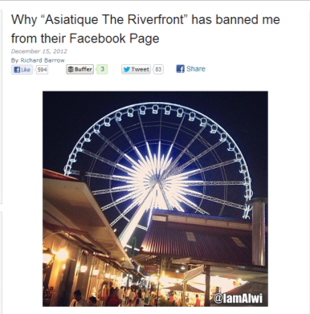
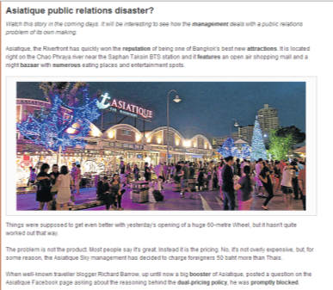
Asiatique PR disaster
Asiqatique launches their new attraction: the wheel. They decide to double price charging farangs 50baht more and announce it on their FB page.
A famous travel blogger, Richard Barrow, posts a question on why they decide to double charge. As response the social media manager (!) deletes the post and bans him from their FB page.
The blogger reports this on his blog, twitter and FB. Thousands of people start posting on Asiatique FB page shouting against the discriminating policy, bombarding with complaints and calls for a boycott.
Asiatique FB page is now active after months of being shot down.
http://www.richardbarrow.com/2012/12/why-asiatique-the-riverfront-has-banned-me-from-their-facebook-page/
http://www.bangkokpost.com/learning/easier-stuff/326441/asiatique-public-relations-disaster

Slide 27
United breaks guitars

Slide 28
Decision process - Path to purchase:
Summary and learning points

Slide 29
Implications for our strategy
1. Realization
I need an hotel
2. Search and confirmation
Ask friends, check offers and compare prices
3. Booking
I’ve decided
4. Experience and Post- experience
1. Improve Awareness
2. Stimulate the need and make clear what is IBIS offer
3. Creative use of channels (integrated communication)
1. Word of Mouth is crucial.
2. Online aggressive comms & price promotions
3. Build on great current IBIS work on customer relation online
Ensure smooth booking process
Careful management of WOM: emphasize positive comments and neutralize negatives
Online: blogs, social network
Data: Quant Research for IBIS Inspire Research
Notes:
- Internet transactions in Thailand: Accommodation was the major source of income through Internet transactions. Flight only was the second most popular reason to go online
- Booking process: The technology of online booking in Thailand is up to date and customers are able to get instant
confirmation after making a room booking. The most important thing for Internet booking services are
accuracy and speed. It is necessary for hotels to check up all inquiries every minute. If they provide
impressive services, hotels establish credibility and create loyalty amongst customers who will reward the
hotels by becoming regular visitors

Slide 30
Problem recognition
Alternative evaluation
Post-purchase evaluation
Information search
Purchase decision
Decision making process – path to purchase: it is fundamental to understand how people take decision in order to develop the best IMC plan to influence them
5 main stages; in each phase consumers are influenced by many factors as their beliefs, friends, opinion leaders, media…in different ways
Each category has a different path. Hence in each category different phases might be more or less important.
Each phase is characterised by different “influencers”
Understanding the path to purchase means to understand:
  What are the critical phases to influence
  Who are the most critical influencers per each phase

Slide 31
Your time to work…EXERCISE
Exercise: divide in group and define the path to purchase for a specific target in a specific category
  GROUP 1: family with 2 kids buying a new car
  GROUP 2: white collar deciding what airline to buy to travel to London
  GROUP 3: college students deciding to buy a new mobile phone
Output: 1 flowchart with examples per each stage
  Think to every stage of the path to purchase, think who and what will influence decision and in what channel
30 mins to discuss in the group – each group presents back to class for discussion 5 min

Slide 32
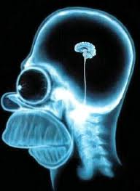
Last, watch out…we’re not rational

Slide 33

How does our brain take decisions?
This tool it is a simplification of reality to help developing strategies, not reality itself
Plato theory: 2 horses, one rational to let run and the other emotional to tame
Neurologists have shown that we need both the left (rational) and right (emotional) side of the brain to take any decision
We feel like a choice is the right one it is because our mind is telling so
A constant battle at emotional level happens between positive and negative emotions in different parts of our brain; the one which wins determines the decision

Slide 34
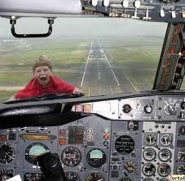
What’s the implication?
There’s no such a thing as rational consumers
People don’t take decisions on the basis of rational information only
That’s why you can’t convince someone who’s scared to flight through data only…

