Slide 1
Industrial Development and Policy in ASEAN
June 15th, 2015

Slide 2
Some Terminology
Industry
  Agriculture
  Industry
  Service
  ISIC
Industrialization
  Manufacturing sector becomes a significant sector
  GDP measures
  Export measures

Slide 3
Some Terminology
Development
  Income, growth, improvement, structural economic change
Developing Countries
  Countries that are going through such process
Newly Industrialized Economies
Emerging Economies
Least developing countries

Slide 4
Some Terminology
Technology
  Way of producing commodities
  Technological capability
Research and Development
Technological Sophistication
Dynamic product
Catch-up and Latecomer

Slide 5
Traditional Industrial Development Rationale
Two possible paths of industrialization
NAIC (Newly Agro-Industrializing Country)
  Gradual steps
Industrial Upgrading Policy
  Heavy intervention

Slide 6
Myint’s Observation
Vicious cycle of poverty
  Low growth is an result of low saving and investment.
The capacity to use resource productively
  Vent for surplus: going beyond subsistent consumption
Three required conditions
  Economic incentives
    Balanced growth relationship between agricultural sector and consumer goods
  Provision of capital goods
    Irrigation
    Power
    Machinery
  Export substitution: Going away from export raw material to semi processed goods

Slide 7
Primary Product Exports, Import Substitutions, and Export Promotion
Why can’t we rely only on export of primary product ?
  Monoculture economy
  Heavy and Light industry in developed country
  Rising share of services
  Income elasticity
  Agricultural protectionism
  Industrial use of natural resources lead to higher growth
  Replacing natural with synthetic
  Tariff structure

Slide 8
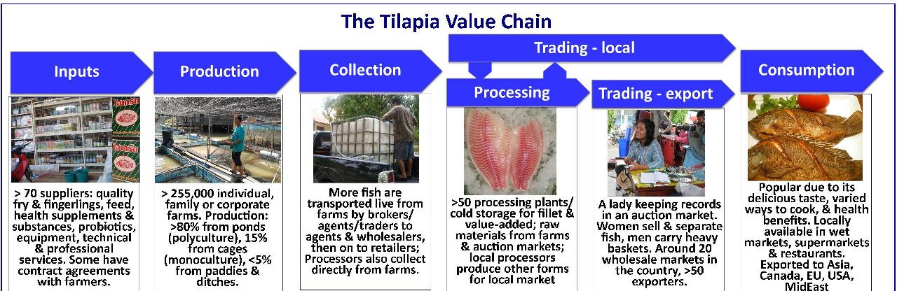
NAIC
Source: SEAT KU
Notes:
Show the Figures 6-1

Slide 9
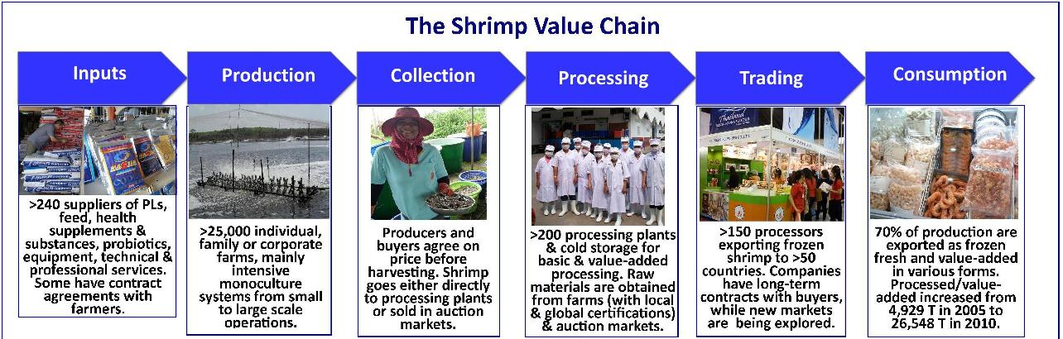
NAIC
Source: SEAT KU

Slide 10
NAIC problems
Monoculture
Environment
Will you upgrade the infrastructure?
And Technology

Slide 11
Raul Prebisch
Manufactured goods
  Labor intensive
Natural Resource intensive
Capital intensive
Technology intensive
Knowledge intensive
Innovation intensive
Characteristics of Market

Slide 12
Import substitution
Planning
Industry to be developed
Strong leadership
Policy
  Trade
  Domestic

Slide 13
Export Promotion
Less centrally planned
More fundamental
Leadership
Policy
  Trade
  Domestic
Notes:
Show Table 6-2 6-3

Slide 14
Upgrading Import substitution and Industrial Policy
Policies aim at alter the industrial structure
  Subsidies
  Taxes
Technological Development
  Market failures
Improve Economic Utility
  Diversification
  Trim of the excess
Miscellaneous Policies
  SMEs
  Rice Pledging Program
  Energy Saving

Slide 15
Tools
New legislation and measures
Administrative guidance
Maintenance of infrastructure
Special taxation measures
Subsidies
Government Finance
Bigness VS. Failure

Slide 16
East Asian Approaches to Industrial Policy
Export promotion after import substitution: incentive taxation and import refunds
Protect and cultivate specified industries: heavy and chemical industries
Promote industry that supports export drive: metal, molds, and machines
Technological development
Protect and cultivate SMEs
Notes:
Show Table 6-5-7

Slide 17
Trade and Foreign Investment
Trade and development
  Early image of colonial
  Absolute advantage
  Comparative advantage
  Dynamics
Term of Trade decline
Structure of Trade Market
  Oligopoly
  Monopoly
  Monopolistic Competition

Slide 18
Trade and Foreign Investment
Import Substitution
Export Promotion
International Production Network or Global protection Networks
Openness and trade reversal
Foreign Direct Investment and Transnational Corporations

Slide 19
Liberalization Policies
How far should we go?
Japan
Korea
Taiwan
Singapore
Thailand
Vietnam
Laos
Cambodia
Myanmar

Slide 20
Market or Planning
Market
  Market structure, conduct, and performance
Planning
  Why plan?
Industrial Policy
  Override the market structure, conduct, and performance.

Slide 21
Latecomer
Dependent
  Dynamics
Independent
  Dynamics

Slide 22
Industrial Adjustment after Crises
Nothing lasts forever
Too big too fail or too fail
Economic crises
Industrial adjustment and policy adjustment
Conductors or Facilitators

Slide 23
Systemic Vulnerability and Sustainable Economic Growth
Skills and Upgrading in Southeast Asia
Monthien Satimanon

Slide 24
Conceptual Framework
Structural Conditions
Coalitional Breadth
Institutionalized public-private linkages
Resolving collective dilemmas
Level of technical intellectual capital

Slide 25
Resource curse
Revenue generation
Inter-Elite Conflict
Technology and Revenue Generation

Slide 26
Domestic Fragmentation
Heterogeneous vs Homogenous
  Thai-Chinese
  Malay-India-Chinese
  Singapore
  South Korea
  Japan

Slide 27
External Threats
Degree of Severity
  Thai
  Japan
  Myanmar
  Laos
  Singapore
  Taiwan
  South Korea

Slide 28
Interaction
 | Low External Threats |  | High External Threats
 | More Fragmented | More Homogenous | More Fragmented | More Homogenous
Few Resource Endowments | Broad Participation From ruling elite and competition | Broad with limited participation from ruling party | Narrow Participation within groups | Broad Participation across groups and classes
More Resource Endowments | Narrow High participation from competing factions | Narrow Low participation from ruling elite | Broad Participation and consultation from ruling party | Narrow Little participation outside ruling party

Slide 29
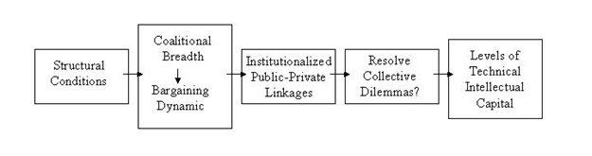
Putting them all together Part 1

Slide 30
Theory of Coalitional origins
“Rational actors form coalitions only as broad as necessary to achieve their ends because payoffs must be shared among the members of the winning coalition. Again, as mentioned in chapter one, these coalitions are made up of actors who vote for, or otherwise provide support to, the ruling elite. They may or may not be formally incorporated into the political system into parties or other political units. Fewer members of a winning coalition mean more rewards per actor”.

Slide 31
Theory of Coalitional origins
“Inter-elite conflict for political power is one reason elites might expand their ruling coalition (Waldner 1999).”
“Important impetus for coalitional breadth is the means by which governments generate wealth necessary to buy political support. Every government must generate revenues to stay in power. When revenues can be generated easily through relationships with a small number of industries or sectors, then Riker’s logic prevails and coalitions are kept narrow and small.”

Slide 32
Theory of Coalitional origins
“On the other hand, when revenues can only be generated by extracting small amounts from numerous people, such as with extensive and comprehensive tax systems, pressure mounts on the government to expand the coalitional size. In return for taxation, the government must reward those that supported them. This is an extension of the argument made in Shafer (1994)”.

Slide 33
Theory of Coalitional origins
If anything about pressures to allow coalitional actors to participate in policy processes.
Upgrading an economy requires massive amounts of technology and information, which must be derived from and shared with as many of the intellectual resources and capital in a society as possible. The more difficult and complex the technological demands of the industries that create a nation’s wealth, the broader and more participative the coalition must be to support the country’s political economy.

Slide 34
Theory of Coalitional origins
In contrast, when societies depend on less technologically demanding industries, such as selling raw materials and natural resources to generate wealth, the processes usually require less participation from a narrower coalition.

Slide 35
Theory of Coalitional origins
Once created, coalitional structure has feedback effects. Narrow coalitions create incentives for elites to implement rents that encourage fragmentation, resulting in further coalitional narrowing. Without broad input, those in power create institutions and policies that benefit themselves and in the process marginalize the rest of society politically, economically, and socially.

Slide 36
Theory of Coalitional origins
Broader coalitions allow more participation. Participants, in turn, push for institutions that benefit themselves. The more people who participate in policy processes, the more likely the outcome will be compensation in the form of public goods (Bueno de Mesquita 2000). The result is reduced income inequality, which facilitates consolidation, rationalization, and cooperation, which also leads to further coalitional expansion.

Slide 37
Theory of Coalitional origins
Resource Curse
Revenue generation
Inter-Elite Conflict
Technology and Revenue Generation

Slide 38
Theory of Coalitional origins
Domestic Fragmentation
External Threat
Interactions with the above factors in coalitional origins.

Slide 40
How Broad and Participative Coalitions Lead to Good Policy
Broad, cross-cutting coalitions, which encourage all actors to be actively engaged in policy making processes, facilitate the intensive cooperation, information sharing, careful monitoring, and appropriate enforcement necessary to overcome collective dilemmas that hinder the formation of institutions necessary for skills development.

Slide 41
How Broad and Participative Coalitions Lead to Good Policy
The important causal mechanism between coalitional breadth and participation on the one hand and institutional linkages within society on the other is side payments. Side payments are those remunerations given by the elite to social actors in return for political support.

Slide 42
How Broad and Participative Coalitions Lead to Good Policy
The type, timing, and duration of side payments create preferences for institutions that will maximize the payoffs to individuals in the coalition. As the size of the coalition increases, ceteris paribus, coalition members’ share of supplied private goods decreases making the utility calculus for cooperation more favorable by lessening the difference between belonging and not belonging to the winning coalition (Bueno de Mesquita, et. al., 1999).

Slide 43
How Broad and Participative Coalitions Lead to Good Policy
When leaders must rely on a broad range of social actors for political support, they tend to provide public goods as the most efficient form of side payments in return for political support. Furthermore, as resource endowments decrease, the likelihood rises that ruling elites will provide public goods as side payments to coalition members (Doner, Ritchie, Slater 2005; Root 1996).

Slide 44
How Broad and Participative Coalitions Lead to Good Policy
But public goods are more difficult to design and implement and require more cooperation and interaction among the coalitional actors than is necessary to provide private goods. The provision of more advanced public goods requires more intensive cooperation to design, implement, monitor, and maintain (enforce).

Slide 45
How Broad and Participative Coalitions Lead to Good Policy
Narrow coalitions have less need for connective public-private linkages and therefore do not create the institutions necessary to facilitate these linkages, or, if they already exist, allow them to weaken and decay.
The provision of public goods is important for several reasons. Most importantly, public goods increase equality. Political processes underlying institutional formation and maintenance reflect power asymmetries among the various parties involved (Knight 1992).

Slide 46
How Broad and Participative Coalitions Lead to Good Policy
Game theoretic, rational choice frameworks assume intentional actors, strategic options, and payoffs associated with certain choices (Scharpf, 1997).
Providing public goods creates an environment where all members of society can gain in influence and power, in turn influencing the institutional structure in ways that pay off for them personally. Since by definition all have access to these goods, income equality is enhanced.

Slide 47
How Broad and Participative Coalitions Lead to Good Policy
Income equality is important because lower inequality increases the purchasing power of low-income families for superior goods, such as education and training (Birdsall, et. al., 1997).
Education and training, in turn, advance an individual’s earning potential, further reducing income inequalities and providing further resources with which to participate in the institutional system. In short, equality puts more people in a position to be linked to the policy process if the political institutional structure allows it.

Slide 48
How Broad and Participative Coalitions Lead to Good Policy
The linkages I speak of are less like the ones theorized by developmental state scholars and more like the “embedded autonomy” envisioned by Peter Evans (1994). Whereas the developmental scholars suggested that the state could control all state-society relationships, scholars such as Richard Doner (1992) and Weiss (1995) recognized that all the players in government-private sector relationships were critical to the interaction.

Slide 49
How Broad and Participative Coalitions Lead to Good Policy
It is true that productive public-private relationships are not possible in an environment of minimalist states or acquiescent societies. Capacity for statecraft remains a necessary ingredient, but in conjunction with an assertive and involved private sector (Doner and Hawes, 1995).

Slide 50
How Broad and Participative Coalitions Lead to Good Policy
The relationship between the state and private sector needs to increasingly function in an integrated, more balanced and interdependent way. More balanced public-private linkages facilitate good economic policy in at least three ways.

Slide 51
How Broad and Participative Coalitions Lead to Good Policy
First, they better balance multiple preferences of both the state and society for resource allocation, including economic growth, domestic stability, and external security. Second, they facilitate balanced negotiation and complex bargaining with a broader range of actors in a more demanding environment.

Slide 52
How Broad and Participative Coalitions Lead to Good Policy
Third, they create autonomy for the state from any single, dominating interest. The state is therefore able to formulate neutral, technocratic policy and to demand help from the private sector to monitor and assist in compliance and enforcement. At the same time, such state-society relationships demand transparency and accountability from the government on policy direction and decisions. Trust and legitimacy come from repeated cooperative interactions, which the state cannot break if it desires continued future cooperation from a naturally skeptical and profit-oriented private sector (Ritchie and Hicken 2002).

Slide 53
Putting them all together Part 2
Systemic vulnerability influences the breadth and participation of political coalitions through the nature, type, and timing of side payments. Coalitional breadth and participation shapes the linkages among economic actors in society. These linkages or the lack thereof, what Evans called “embedded autonomy,” facilitate policy processes and institutional creation in an endogenous fashion that in turn influences skills development and upgrading.

Slide 54
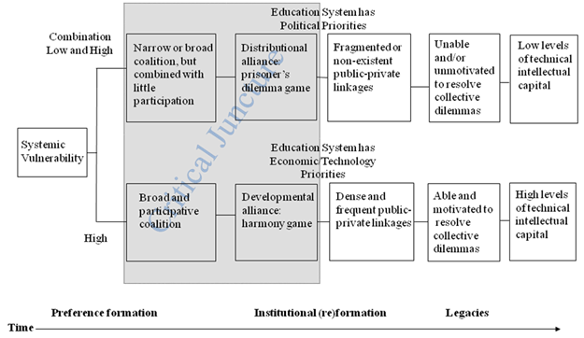
Putting them all together Part 2

Slide 55
Empirical Evidence
Qualitative matching within the countries of Southeast Asia, provides control for regional variation and considers the counterfactuals on several key variables.
This effort is designed to eliminate potential alternative correlative relationships, thereby relieving any worries of omitted variable bias.

Slide 56
Empirical Evidence
Regional comparison between Northeast and Southeast Asia using both qualitative and quantitative data.
Employ three-stage, least-squares analysis on quantitative, world-wide data to explore the potential generalizeability of any discovered correlations.

Slide 57
Empirical Evidence
Variables | Malaysia | Singapore | Thailand
Resource endowments | High | Low | High
Ethnic composition | Fragmented | Homogeneous | Homogeneous
Coalitional structure | Broad, but with little participation | Broad and highly participative | Narrow with little participation

Slide 58
Variables | Malaysia | Singapore | Thailand
Colonialization | British | British | None
State strength | Mid to high | High | Low
Elite conflict | Low to mid | High | Low
Institutional structure | Macro growth with micro distribution | Developmental | Macro growth with micro distribution
Economic strategy | Import substitution and export processing zones. | Integration into the global economy | Import substitution and export processing zones.
Foreign investment | High | High | Mid to High
Tariffs structure | High (except for export processing zones) | Virtually none | Mid to High (but falling in most areas and none in EPZs)

Slide 59
Variables | Malaysia | Singapore | Thailand
Language of education | Malay | English/Chinese | Thai
Bureaucratic fragmentation | High (especially at the line ministry level) | Low | High
Extent to which labor is included in education and training | Low to non-existent | High | Low to non-existent
Early technical focus | Primary commodities | Industrial technologies | Primary commodities

Slide 60
Empirical Evidence
 | Thailand | Singapore | Malaysia
1975 Ethnic Composition (Herfindahl concentration index) | .5942 | .6083 | .5071
2007 Ethnic Composition (Herfindahl concentration index) | .5942 | .6156 | .3273
1975 Commodity Exports (% of GNP) | 20.33 | 0.01 | 58.87
Income Equality (0=complete equality) 1975 1989 | 41.74 (1990) 48.80 | (1973) 41 39 | (1976) 53 48.35
Scientists, Engineers, and Technicians (per 1 million capita) 1995 2000 2002 2004 | 159 (2001) 400 (2003) 494 (2003) 494 | 3081 4478 4733 4997 | 175 319 356 503
R&D Expenditure (% of GDP) 2000 2002 2004 | .252 .244 .255 | 1.91 2.16 2.25 | .49 .69 .60

Slide 61
Empirical Evidence
 | Thailand | Singapore | Malaysia
Tertiary Enrolment (% of gross) 1970 1980 1990 2000 2004 | 13.0 12.7 19.0 35.0 44.0 | 7.8 18.6 … … | 4.0 4.1 7.2 23.0 31.0
Secondary Enrolment (% of gross) 1975 1992 2001 2004 | 26 37 67 72 | 52.0 78.9 … … | 42 60 65 72
Public Education Expenditures (as % of GNP) 1975 2000 2004 | 3.6 5.41 4.23 | 2.9 … … | 6.00 6.20 6.25
Number of Political Parties 1998 | 11 | 5 | 15
Winning Coalition Size 1970 1990 | .50 .75 | .75 .75 | .75 .75
Ministries responsible for technical education and training 2001 | 7 | 3 | 4

Slide 62
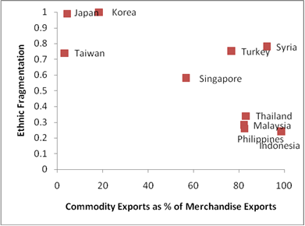
Empirical Evidence

Slide 63
Industry development in Thailand
Electronics and Electrics
Automobile
Food
Notes:
Video of global value chain

Slide 64
Industry Potential in TCLMV
Thailand’s Commercial Sectors
• Aviation
• Broadcast Equipment
• Defense Equipment
• Education Services
• Food Processing and Packaging Equipment
• Medical Devices
• Pollution Control
• Oil and Gas Machinery and Service
• Telecommunication

Slide 65
Industry Potential in TCLMV
Thailand’s Agricultural Sectors
• cotton
• wheat
• Soybeans
• Fresh Fruit
• Wine
• Dried Fruits and Nuts
• Snack Food

Slide 66
Industry development in Cambodia
Garment
Food
Tourism

Slide 67
Industry Potential in TCLMV
Cambodia’s Commercial Sectors
• Agribusiness and Food Processing
• Architecture, Construction, and Engineering Services
• Tourism Infrastructure and Resorts
• Education
• Household Goods and Appliances
• Used Car and Automotive Parts
• Power Generation Equipment
• Fast Food and Beverage Franchises
• Pharmaceuticals, Medical Supplies, and Medical Equipment

Slide 68
Industry development in Laos
Power Generation
Electronics
Tourism

Slide 69
Industry Potential in TCLMV
Laos’s Commercial Sectors
• Tourism Infrastructure and Resorts
• Architecture, Construction and Engineering Services
• Pharmaceuticals, Medical Supplies and Medical Equipment

Slide 70
Industry development in Myanmar
Resource-Based
Agriculture
Tourism

Slide 71
Industry Potential in TCLMV
Myanmar’s Commercial Sectors
• Energy – Oil and Gas
• Power Generation
• Telecommunications
• Mining
• Construction Equipment

Slide 72
Industry development in Vietnam
Electronics and Electrics
Automobile
Food

Slide 73
Industry Potential in TCLMV
Vietnam’s Commercial Sectors
• Power Generation, Transmission and Distribution
• Telecommunications Equipment and Services
• Oil and Gas Machinery and Services
• Information Technology Hardware and Software Services
• Airport and Ground Support
• Environmental and Pollution Control
• Medical Equipment
• Safety and Security
• Education and Training Services
• Franchising
• Architecture, Construction and Engineering

Slide 74
Industry Potential in TCLMV
Vietnam’s Agricultural Sectors
• Cotton
• Wheat
• Soybeans & Soybean Meal
• Hides and Skins
• Corn & Corn By-Products
• Red Meats
• Poultry Meat
• Fresh Fruits
• Wine
• Forest Products

