Slide 1
Aggregate Demand and
Aggregate Supply
Thorn Pitidol
Faculty of Economics, Thammasat University
EE212, Semester 2/2556

Slide 2
Topics
Aggregate Supply Curve (AS)
  Short-run aggregate supply curve (SRAS)
  Long-rum aggregate supply curve (LRAS)
The equilibrium between aggregate demand (AD) and aggregate supply (AS)

Slide 3
Introduction
We have already derived the aggregate demand curve.
Now we want to know what the aggregate supply curve looks like, so that we can find the equilibrium price and output of an economy.
Unlike the aggregate demand curve, there are variations between short-run and long-run aggregate supply curve.

Slide 4
Aggregate Supply
Total supply of goods and services in an economy.
A curve that traces out

Slide 5
Short-Run Aggregate Supply
Short-run aggregate supply curve has the following characteristics

Slide 6
Short-Run Aggregate Supply
The rationale for upward sloping
  In short-run, we assume that wage is the main component of input cost, and that wage is “_________”
  With wage constant (in SR), as price increases, profit margin rises. This means firms will produce more output.

Slide 7
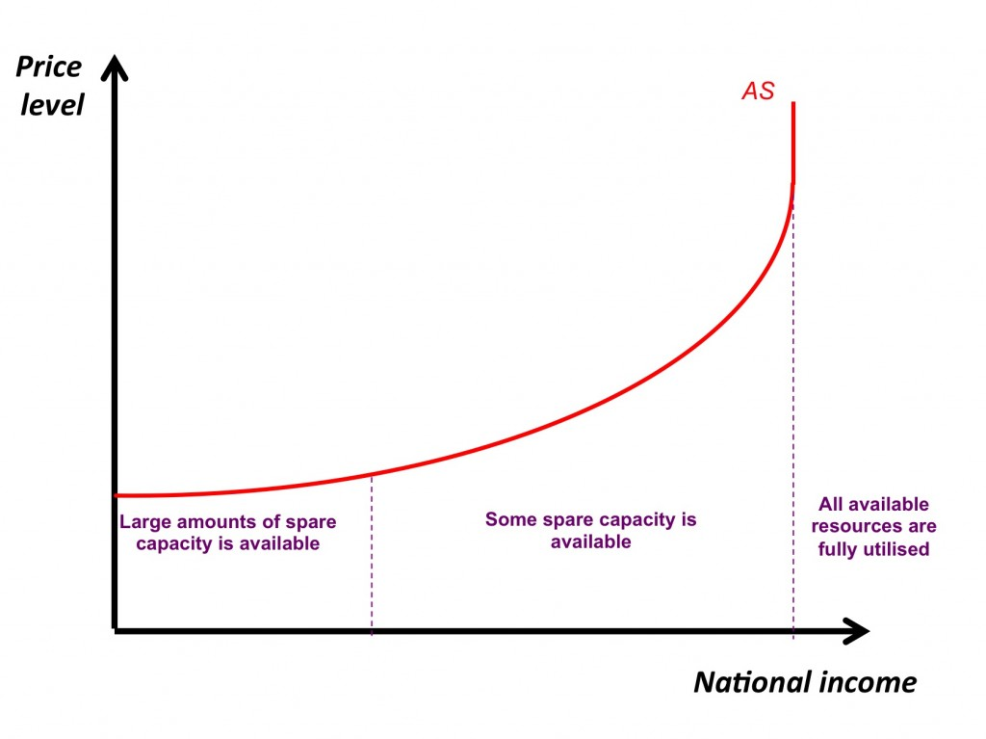
Short-Run Aggregate Supply
The rationale for curving nature of SRAS.
We can also think of the curve as reflecting “___________________________________”

Slide 8
Short-Run Aggregate Supply
Shift in SRAS
  With the rise in input cost
    Such as the rise in wages or energy price
    SRAS shift
  With the rise in capacity to produce output
    Such as the rise in labour force or in technology of production
    SRAS shift

Slide 9
Long-run Aggregate Supply
The long-run aggregate supply curve has the following characteristics

Slide 10
Long-run Aggregate Supply
Rationale for LRAS being vertical
  In the long-run, as wages can fully adjust, the profit margin from rise in prices will disappear.

Slide 11
Long-run Aggregate Supply
Putting SRAS and LRAS together with AD

Slide 12
Long-run Aggregate Supply
Potential GDP
  The point where the LRAS lies signifies the level of output in which, if the actual output rises above there will be inflation.

Slide 13
Long-run Aggregate Supply
Inflationary gap
  When the actual output rises above the potential GDP (as designate by LRAS)
Recessionary gap
  When the actual output falls below the potential GDP

