Slide 1
Geography and Historical Context CLMV
YOUR LOGO
FACULTY OF ECONOMICS
THAMMASAT UNIVERSITY
Notes:
© Copyright Showeet.com – Creative & Free PowerPoint Templates

Slide 2
Outline
01
04
Overview: CLMV within GMS
Trends and Issues
02
05
History, culture and spatial development
Way forward
03
06
Drivers of economic growth
Conclusion
Notes:
© Copyright Showeet.com – Creative & Free PowerPoint Templates

Slide 3
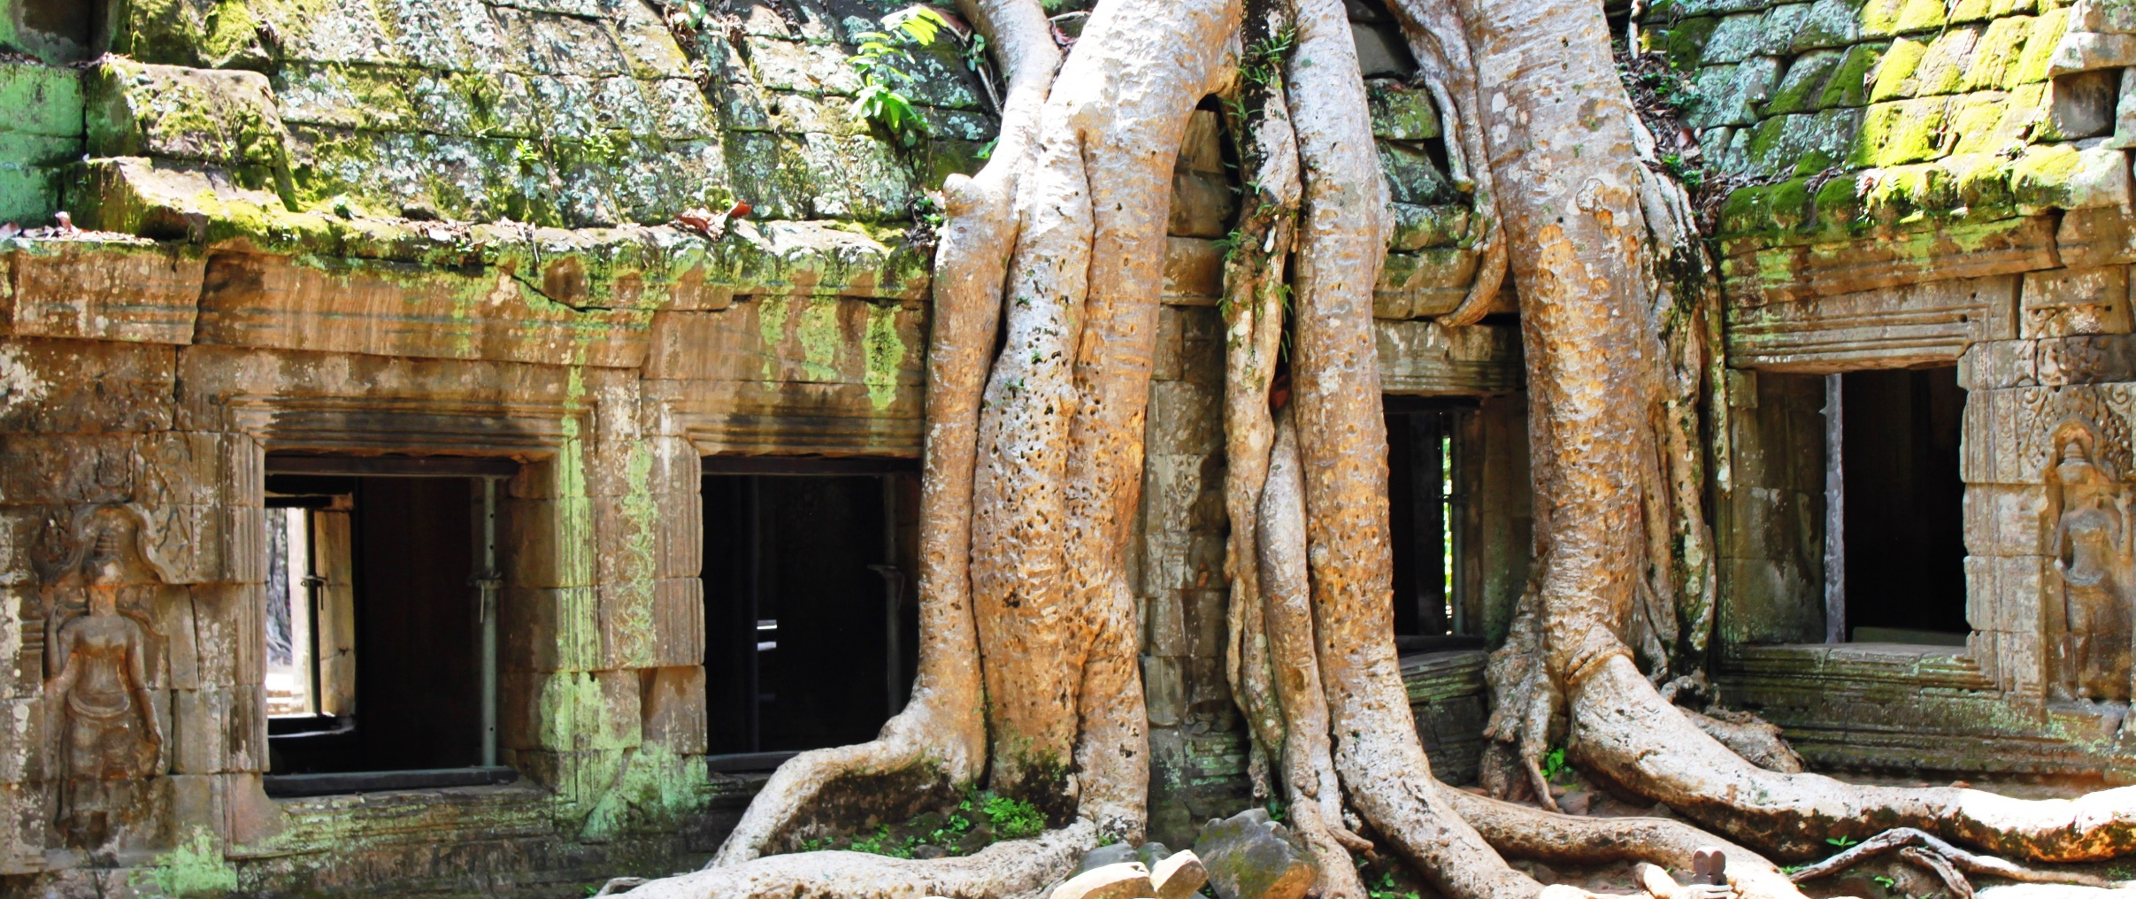
Overview
CLMV within the Greater Mekong Subregion
Photo credit: padrinan via Pixabay (Creative Commons Zero license)
Notes:
© Copyright Showeet.com – Creative & Free PowerPoint Templates

Slide 4
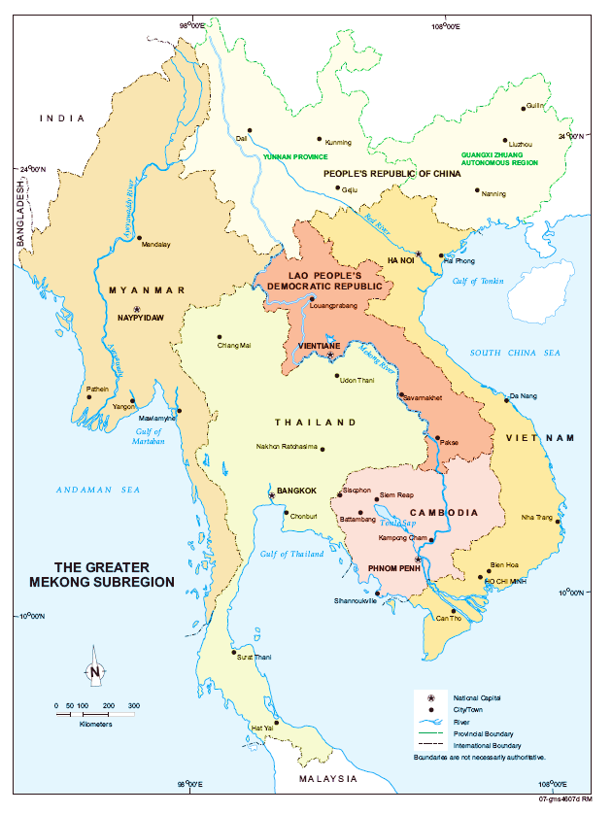
The Greater Mekong Subregion
A geographical entity comprising Cambodia, Lao PDR, Myanmar, Thailand, Vietnam; and Yunnan Province and Guangxi Special Autonomous Region (PR China)
Bound by geography, history, the Mekong river and history; yet diverse in culture, traditions and environment
One of the least urbanized areas in the world; yet rate of urbanization in accelerating
Notes:
© Copyright Showeet.com – Creative & Free PowerPoint Templates

Slide 5
Comparisons
Country | Population (mil) | Area (000 m3) | GNI per capita | % urban population | HDI Rank (UN)
Cambodia | 15.4 | 180 | 1,140 | 25 | 143
Lao PDR | 7.1 | 236 | 2,150 | 37 | 138
Myanmar | 14.5 | 675 | 1,190 | 31 | 145
Thailand | 87 | 513 | 5,640 | 51 | 87
Viet Nam | 115 | 332 | 2,060 | 37 | 115
Notes:
© Copyright Showeet.com – Creative & Free PowerPoint Templates

Slide 6


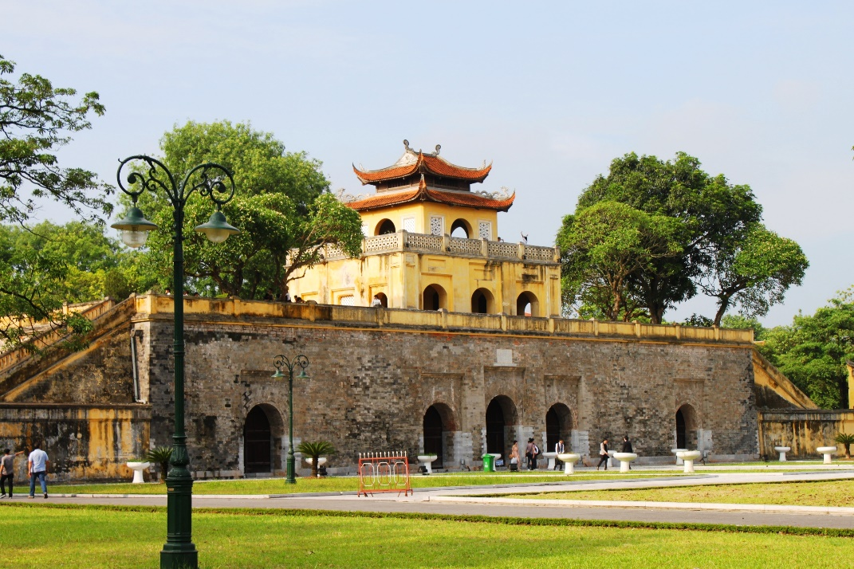
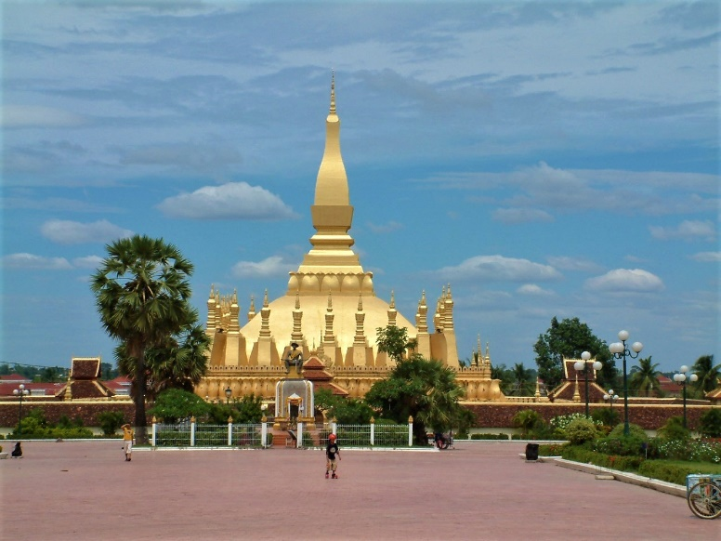
Some impressions of the region

Slide 7
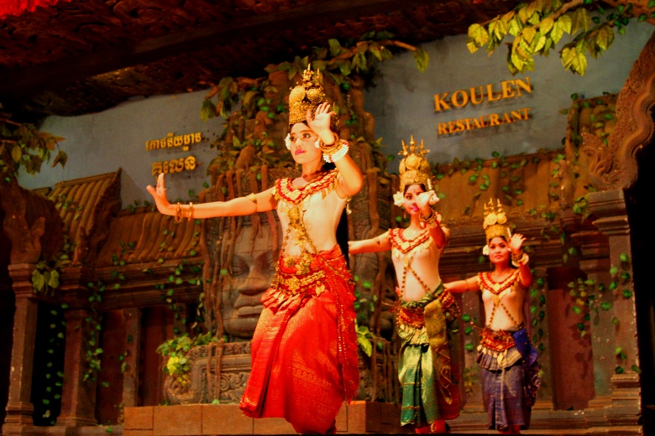



Some impressions of the region

Slide 8
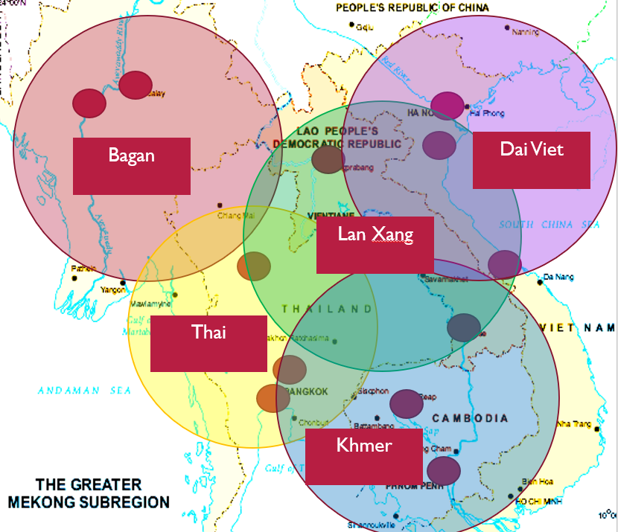
Commonalities across CLMV
Rise and fall of kingdoms: Bagan, Thai, Khmer, Lan Xang and Dai Viet
Ancient capital cities located along waterways and fertile valleys and remain the main urban centers of today
Waterways are used to transport agricultural goods and people
Buddhism as common belief in all CLMV countries

Slide 9
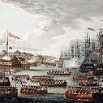
Colonial Exploitation, 1800‒1950
Division and conquest
Resource extraction and exploitation
Rise of port cities
Migration of population to cities

Slide 10
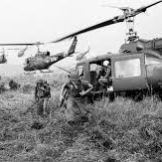
War and Conflict 1950‒1990
Political and economic instability
Stagnant development
De-population of urban areas
De-linking of urban and rural areas

Slide 11
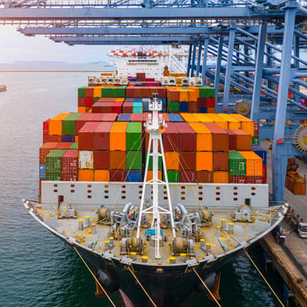
Economic Transformation 1990‒current
Relative political stability
Political and economic reforms
Shift from command- towards market- based economies
Increased cross-border movement
Rapid urbanization and urban growth
Uncontrolled development

Slide 12

CLMV Economies
Drivers of Economic Growth
Photo credit: T0nymix via Pixabay (Creative Commons Zero license)
Notes:
© Copyright Showeet.com – Creative & Free PowerPoint Templates

Slide 13

Global Trends
Division of labor: movement towards higher value products
Global finance: movement of global capital to areas of high returns
Technology: movement towards higher technology and use of information systems
Regional cooperation: ease of cross-border movement of goods and people

Slide 14
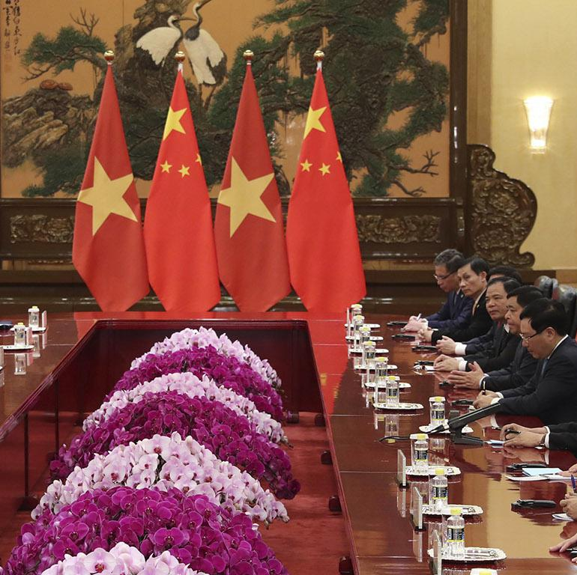
Government Policies and Strategies
Provides strategic policy direction: movement from command- to market based economies; agricultural reforms; decentralization (laws, development plan)
Provides operational guidelines (regulations, instructions)
Provides easement, incentives and constraints on development activities
Sets the enabling environment for business and societal activities

Slide 15
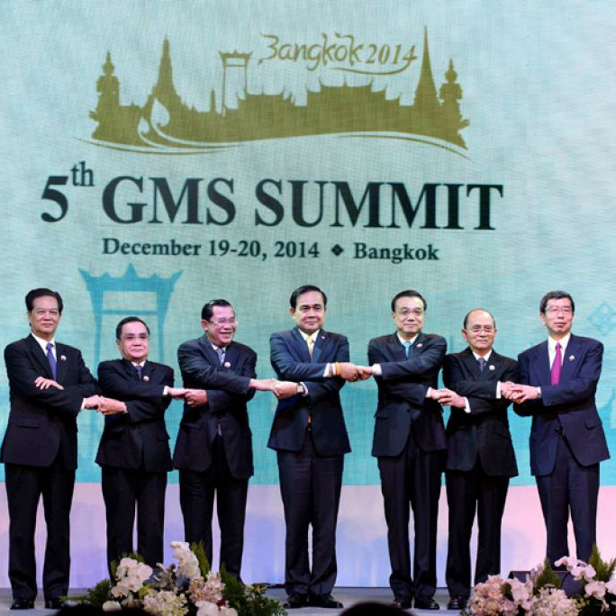
Regional Cooperation
Facilitation of economic exchange: cross-border trade, labor, capital
Human development: training, certification, cultural exchanges, prevention of spread of communicable disease, prevention of human trafficking
Environmental and natural resource management; tourism
Largely facilitated through the GMS Programme, launched in 1992

Slide 16
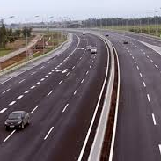
Transport and Trade Facilitation
Improvements in physical connectivity: roads, airports, cross-border facilities, reduces travel time
Enhancements in competitiveness in the production of goods and services
Acceleration of economic growth and productivity through better movement and flow of people, goods and services
Opening up of remote and isolated areas

Slide 17

Foreign Investment
Official Development Assistance
Foreign direct investment
Special Economic Zones
Partnerships: contract farming, public-private partnerships

Slide 18
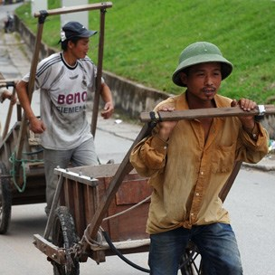
Rural Urban Migration
Push and pull factors: environmental degradation, lack of employment and income, better job prospects in cities
Increased mobility due to decreasing transportation costs
Changes in spatial locations of economic activities
Opening up of remote areas

Slide 19

Trends and Issues
Key Trends and Issues in the Region
Photo credit: Friis-Holst via Pixabay (Creative Commons Zero license)
Notes:
© Copyright Showeet.com – Creative & Free PowerPoint Templates

Slide 20
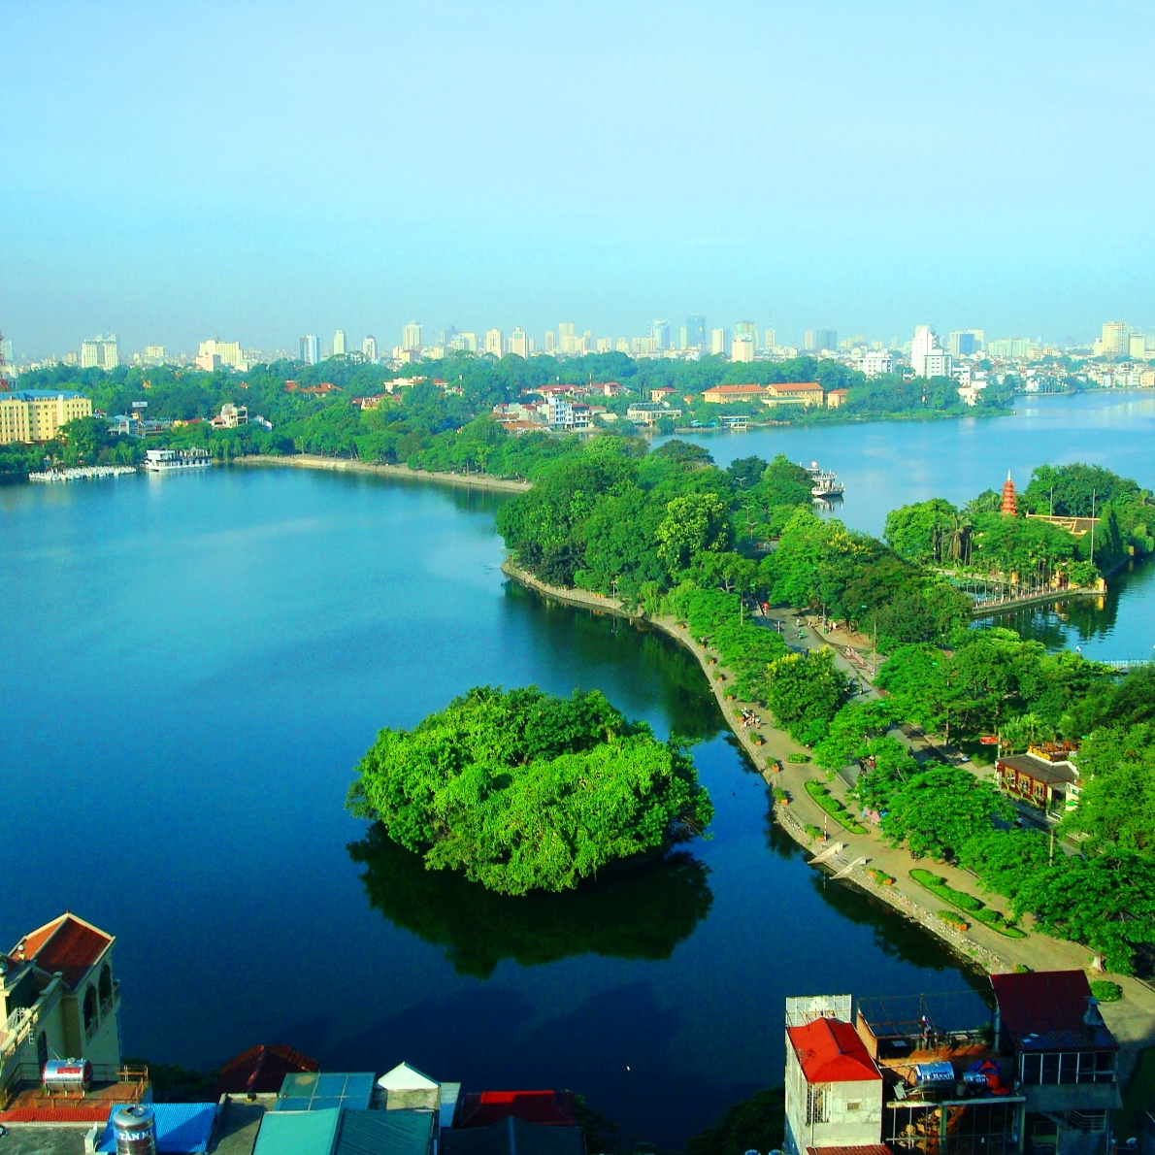
Issues
Reforms and government policies of CMLV countries have greatly contributed to opening up the economy
Although CLMV are experiencing rapid economic growth, there are challenges: widening disparities between the rich and poor; environmental degradation; and infrastructure gaps in urban areas
People are moving to cities because of perception of better living; cities are therefore becoming larger but will need to be better managed

Slide 21
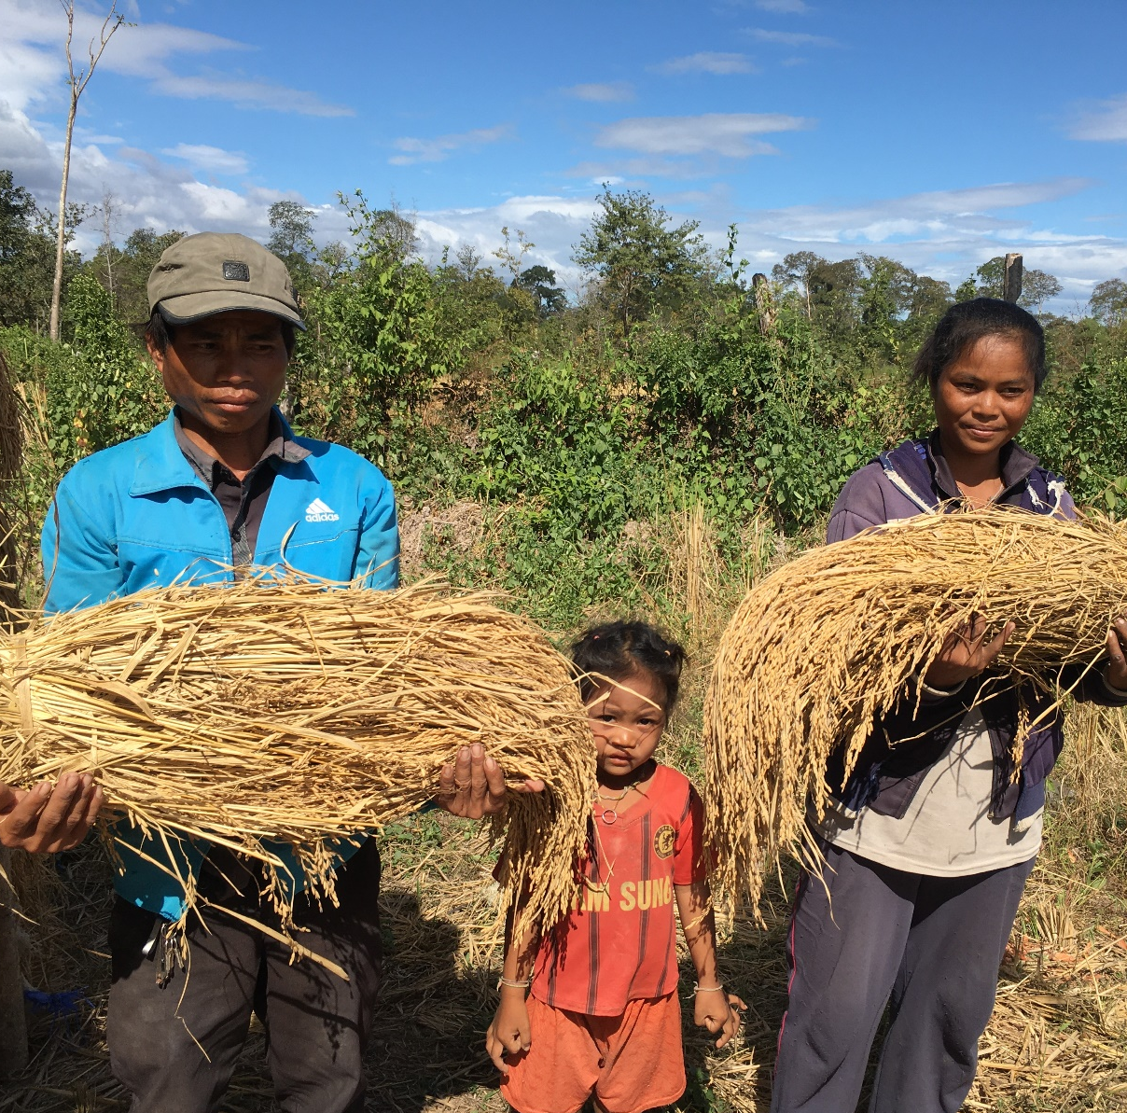
Trends
Agriculture will continue to play a dominant role in the economies of CLMV. However there is a shift towards decreasing share of agriculture and greater share of manufacturing and services.
Greater cooperation among countries in the Greater Mekong Subregion (CLMV + Thailand) presents opportunities for economic growth

Slide 22
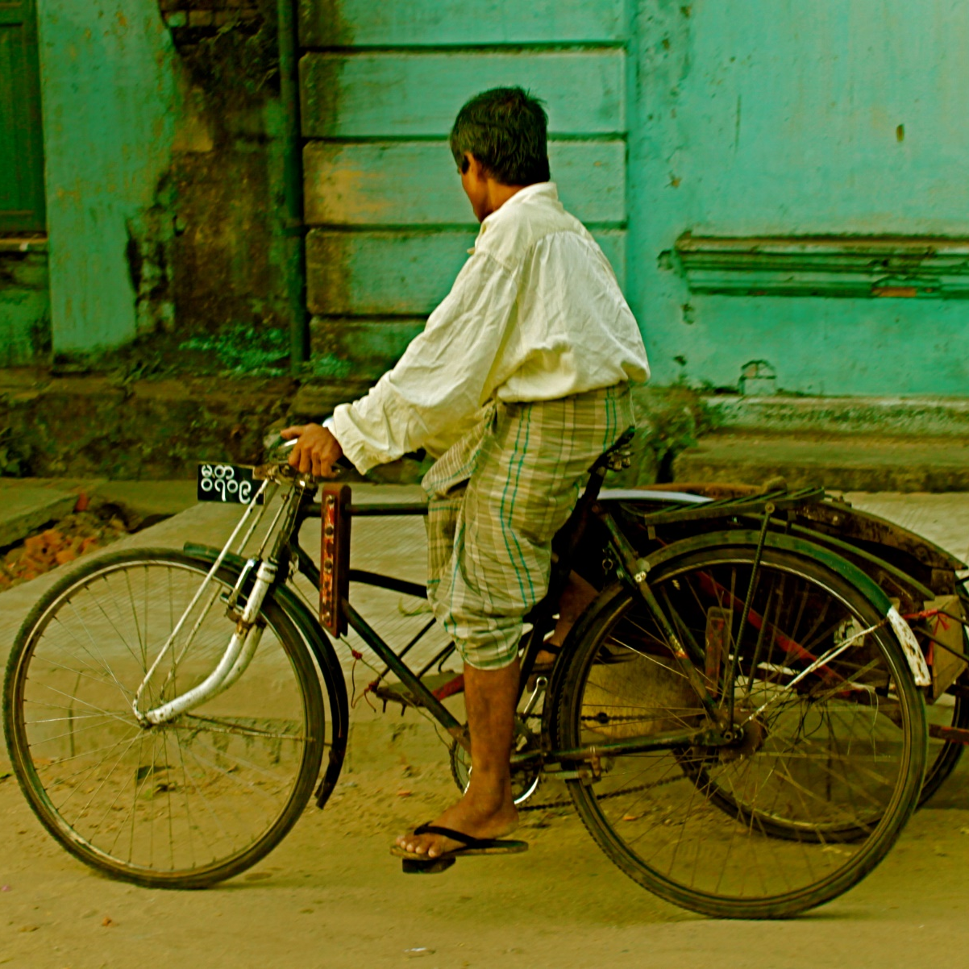
Trends
Social relationships and norms are changing because of increased physical and social mobility
People are moving to cities because of perception of better living; cities are therefore becoming larger

Slide 23
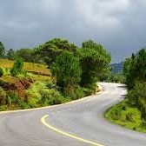
Trends
Previously isolated areas are now more accessible. This provides opportunities for economic activity but at the same time poses environmental and social challenges (environmental degradation, human trafficking, shift in cultural norms).
Emergent spatial trends: development of border towns, areas of tourism and special economic zones

Slide 24

conclusion
Summary of key discussions
Photo credit: Skitterphoto via Pixabay (Creative Commons Zero license)
Notes:
© Copyright Showeet.com – Creative & Free PowerPoint Templates

Slide 25
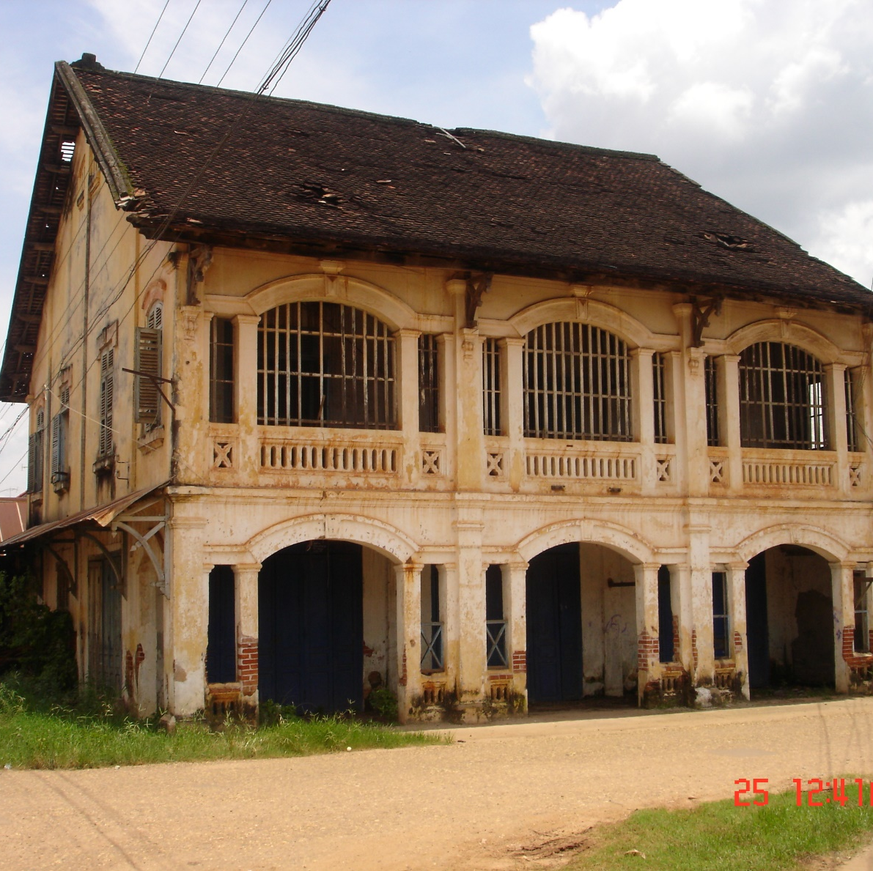
Conclusion
CMLV countries have a shared history of trade, conflict and cooperation, and have had high and low points in history. Yet the countries have marked differences in their geography, culture and development trajectories.
Since the 1990s there has been a realization for the need to work together for mutual benefit. The GMS Programme which was initiated in 1992was instrumental in making this happen.

Slide 26
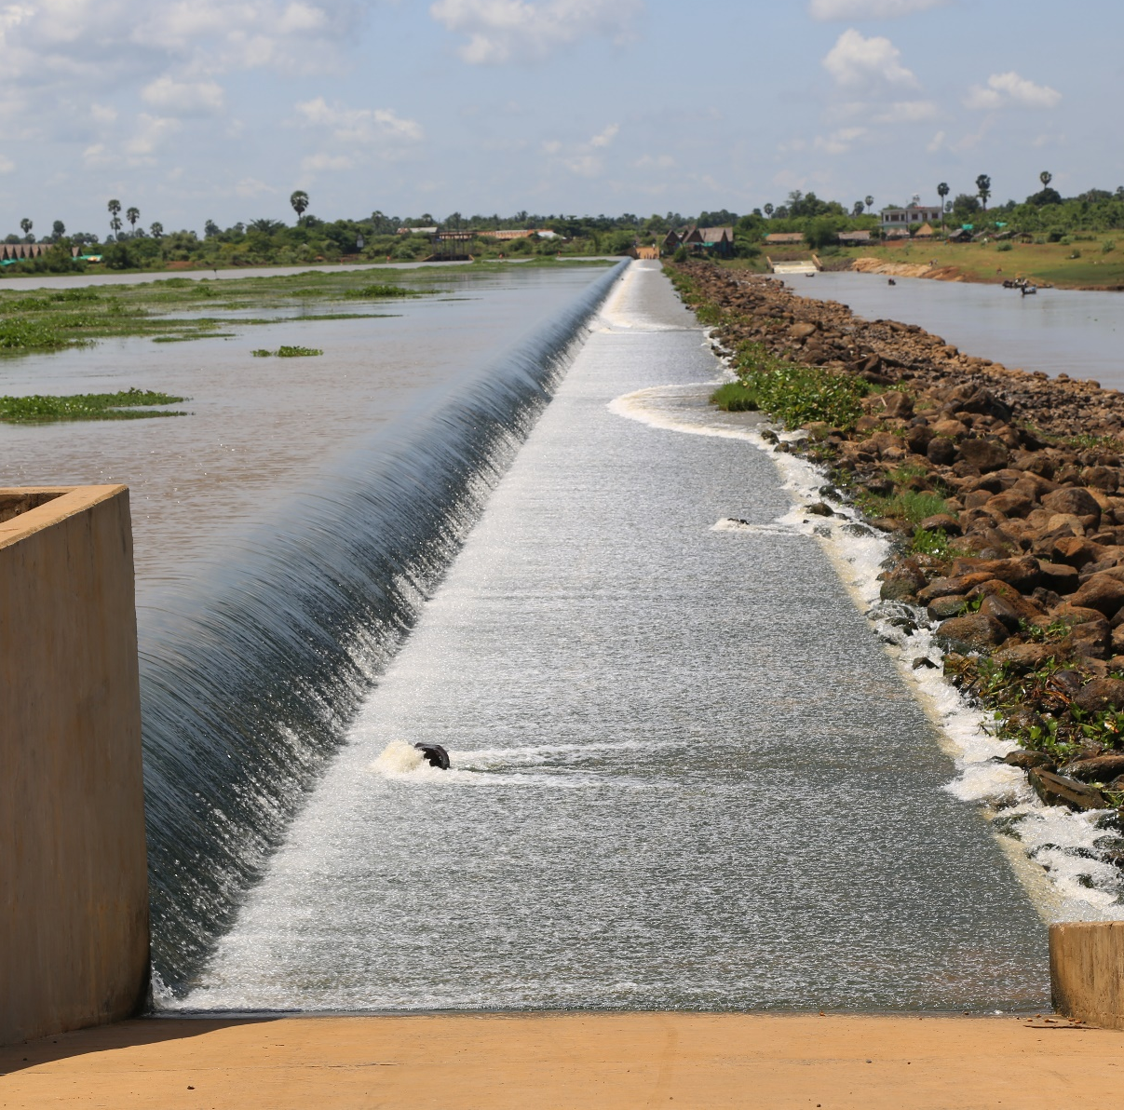
Conclusion
Agriculture has been and will continue to play a dominant role in the economies of CLMV. However there is a shift towards decreasing share of agriculture and greater share of manufacturing and services.
Despite significant progress in terms of economic growth, there are challenges that need to be addressed. Among these are widening disparities between the rich and poor; environmental degradation and pollution; and ensuring sustainable development

Slide 27
Thank You !
Notes:
© Copyright Showeet.com – Creative & Free PowerPoint Templates

