Slide 1

BI 201/BA 291 – Marketing
By Aj. Parichat Jantori

Slide 2
Marketing
Warming up questions:
Name the product that Kong is a presenter?
Why do you think these brands choose him?
How could Magnum increase its sales from 5 million pieces per year to 10 million pieces in 4 years?
Have you seen this advertising? Do you think it works?
https://www.youtube.com/watch?v=kGinQerO2ug
Notes:
http://www.positioningmag.com/content/60770
https://www.google.co.th/url?sa=t&rct=j&q=&esrc=s&source=web&cd=1&cad=rja&uact=8&ved=0CB0QFjAAahUKEwi2voP609XIAhUCUI4KHasmAUg&url=http%3A%2F%2Fsquare.megazy.com%2F%25E0%25B8%25AD%25E0%25B9%2588%25E0%25B8%25B2%25E0%25B8%2599%25E0%25B8%2599%25E0%25B8%25B4%25E0%25B8%2595%25E0%25B8%25A2%25E0%25B8%25AA%25E0%25B8%25B2%25E0%25B8%25A3-%25E0%25B8%25AD%25E0%25B9%2588%25E0%25B8%25B2%25E0%25B8%2599-%25E0%25B8%259F%25E0%25B8%25A3%25E0%25B8%25B5%2Fgm-biz-august-2012-%25E0%25B9%2580%25E0%25B8%25A5%25E0%25B9%2588%25E0%25B8%25A1-32-%25E0%25B8%25AB%25E0%25B8%2599%25E0%25B9%2589%25E0%25B8%25B2-18.htm&usg=AFQjCNEJ2mfxGJY2npiXz_yslLczpMJkoA&sig2=Z_Vmc-wMoVXFXljnQmLq0g&bvm=bv.105814755,d.c2E

Slide 3

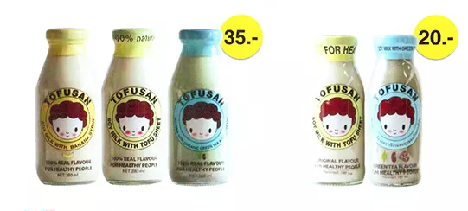
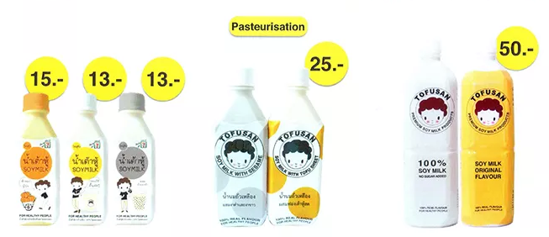
Marketing
Notes:
http://www.marketingoops.com/news/brand-marketing/brand-move/tofusan-brand/

Slide 4
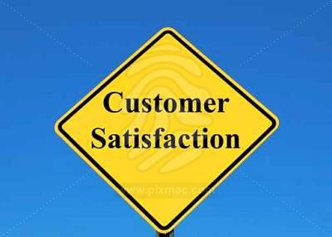

Marketing
Marketing: A process of planning and executing the conception, distribution, promotion, and pricing of ideas, goods, services, organizations, and event to create relationships that satisfy individual and organizational objectives.
Notes:
Marketing is not just selling and advertising, it is a systematic approach to satisfy customes --- repurchase (word of the mouth)

Slide 5
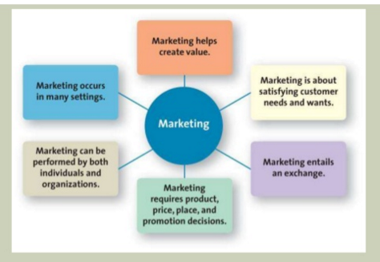
Marketing
Notes:
Marketing is not just selling and advertising, it is a systematic approach to satisfy customes --- repurchase (word of the mouth)

Slide 6
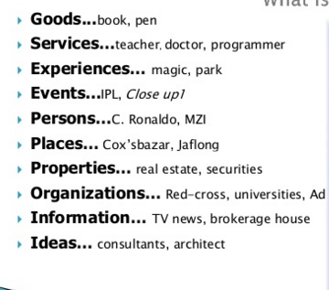
Marketing
Notes:
Marketing is not just selling and advertising, it is a systematic approach to satisfy customes --- repurchase (word of the mouth)

Slide 7
Benefits of marketing
Social & economic
Boost economic
Business organization
raise revenues
Customer
Increase product varieties
Intensiver competition – therefore higher quality goods at lower price
Income distribution and increase employement
Main business task

Slide 8
Evolution of marketing concept
Production Orientation
from industry revolution until early 1920s
a firm should focus on those products that it could produce most efficiently
“Quality product at affordable price sells themselves”
Sales Orientation (selling concept)
early 1930s
companies not only would produce the products, but also would try to convince customers to buy them through advertising and personal selling
„Sell what we can make“
Marketing Orientation
after WWII
focusing on customer needs before developing the product
„Make what we can sell“
Notes:
https://www.youtube.com/watch?v=aZ-4E2OtafY

Slide 9
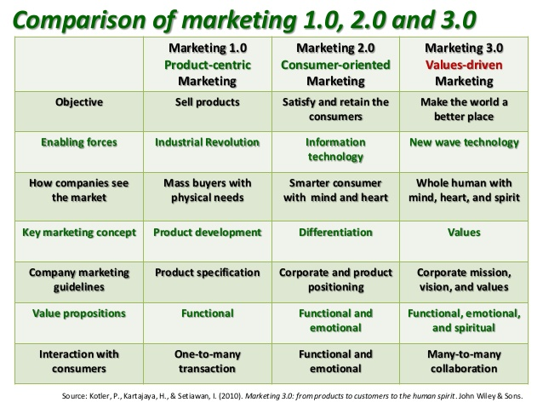
Evolution of marketing concept
Notes:
https://www.youtube.com/watch?v=aZ-4E2OtafY

Slide 10
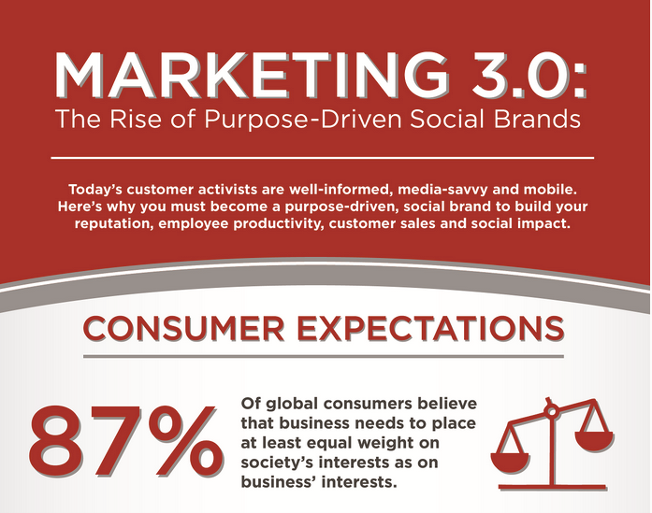
Evolution of marketing concept
Notes:
https://www.youtube.com/watch?v=aZ-4E2OtafY

Slide 11

Functions of marketing
Buying
Selling
Transporting
Storing
Grading
Financing
Marketing research
Risk taking

Slide 12
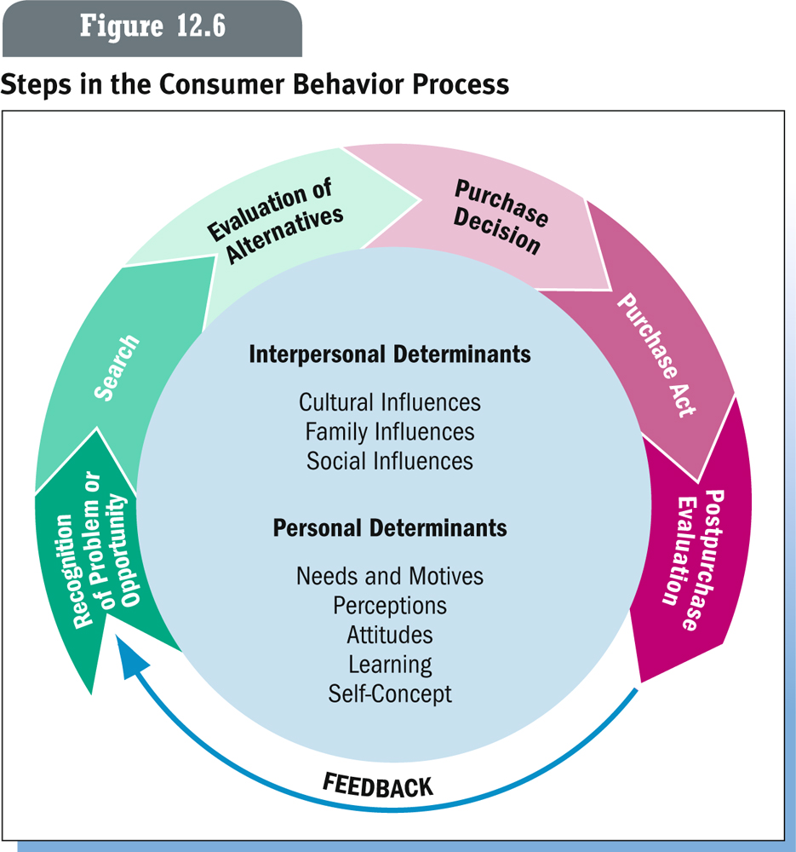
Customer behavior

Slide 13
Need, Want, Demand
Needs are the basic human requirement
People need food, water.
Needs become wants when they are directed to specific objects that might satisfy need.
People want hamburger, noodle, green tea.
Demand are wants for specific product backed by an ability to pay.
“Marketers do not create needs but influence wants”

Slide 14
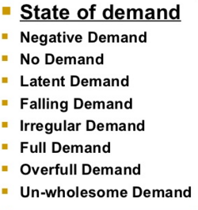
Demand

Slide 15
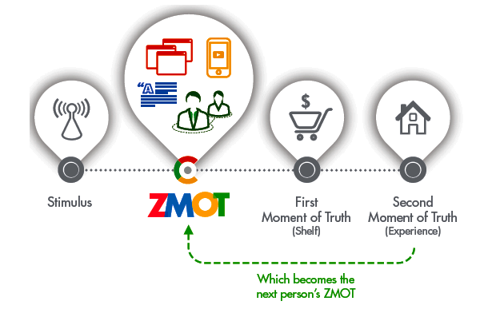
Zero, First, Second Moment of Truth
Notes:
http://www.youtube.com/watch?v=UmM9qfzfzhw

Slide 16
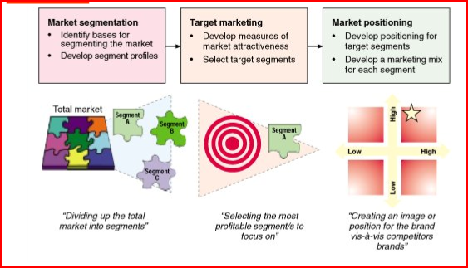
STP marketing

Slide 17
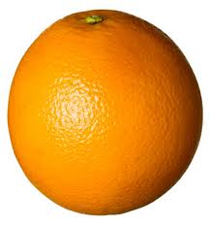
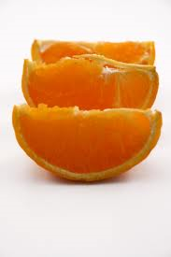
Market Segmentation
Market Segmentation: A strategy whereby a firm divides the total market into groups of people who have relatively similar product needs (homogenous group of consumers)

Slide 18
Market Segmentation
Why segmentation?
Facilitate right choice of target market
Facilitate tapping of the chosen market
Make the marketing effort more efficient and economic
Help identify less satisfied segment

Slide 19
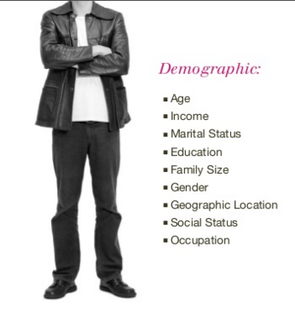
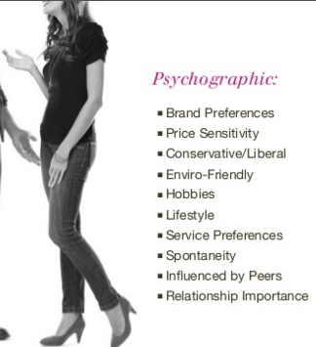
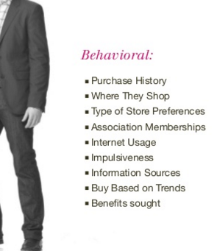

Market Segmentation Methods

Slide 20
Market segmentation
Activity:
Please ideitfy the possible market segments of following firms by using appropriate segmentation based.
Cosmetics
Car manufacturer
Banking
Toothpaste
Champoo
Mobile phones
Hotel
Notes:
http://www.segmentationstudyguide.com/segmentation-bases/segmentation-base-examples/

Slide 21
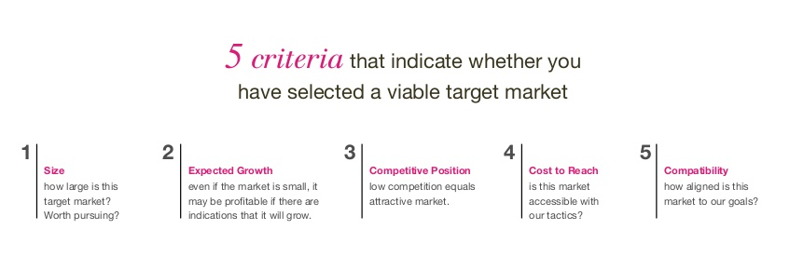
Target market selection
Target Market – very specific group of consumers that a company focuses its marketing efforts to
Notes:
http://www.slideshare.net/akanksha91/market-segmentation

Slide 22
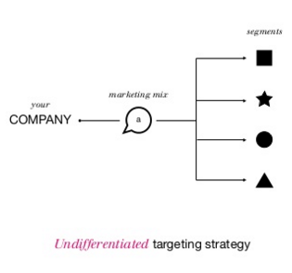
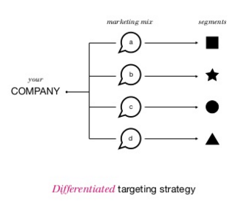
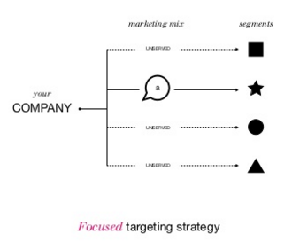
Target market selection

Slide 23
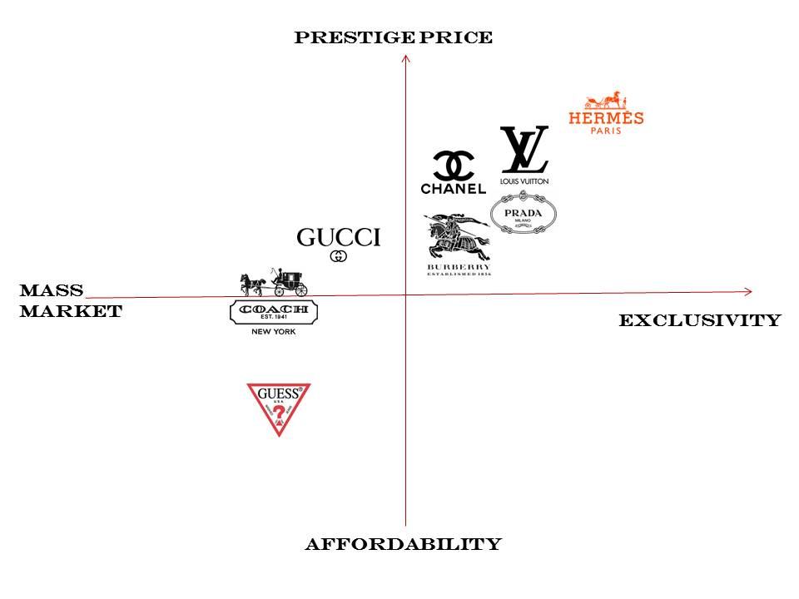
Positioning
How do you want to be perceived?
Positioning is a marketing strategy that aims to make a brand occupy a distinct position, relative to competing brands, in the mind of the customer.
Notes:
http://www.slideshare.net/akanksha91/market-segmentation

Slide 24
Positioning
Activity: Draw a positioning map for following products/ services
Hospital
Condominium
Cars
Mobile phone
Supermarket
Shampoo
Clothes, Fashion brand
Airlines
Notes:
http://www.slideshare.net/akanksha91/market-segmentation

Slide 25
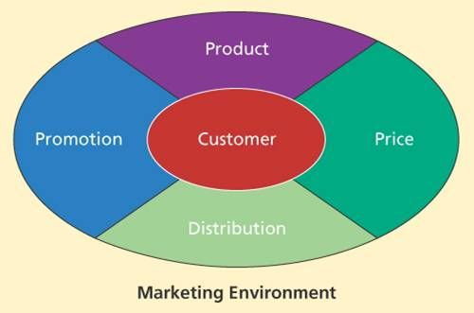
Marketing Mix

Slide 26
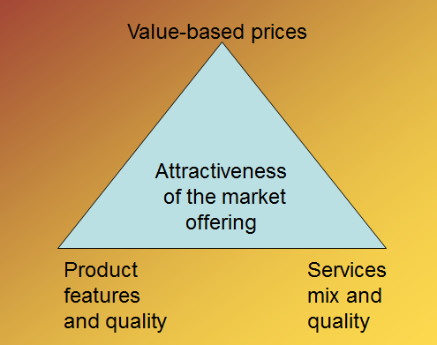
Product
A product is anything that can be offered to a market to satisfy a want or need, including physical goods, services, events, experiences, persons, places, properties, organizations, information and ideas.
Components of market offering

Slide 27
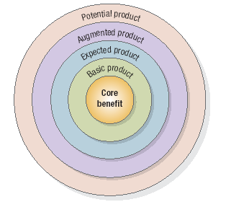
Levels of product
Kotler uses five product levels in which a product is located or seen from the perception of the consumer. These five product levels indicate the value that consumers attach to a product.
Notes:
http://www.toolshero.com/marketing/five-product-levels-kotler/

Slide 28
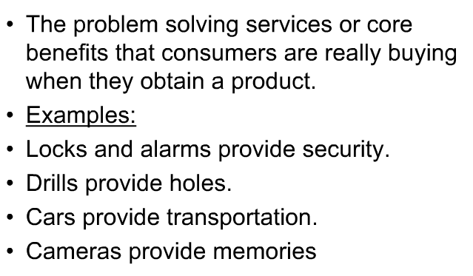
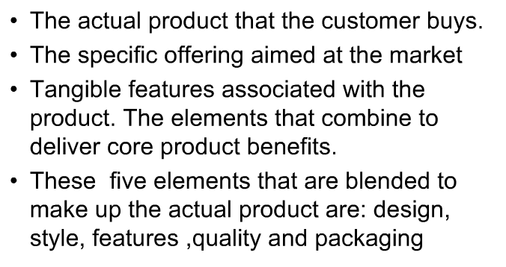
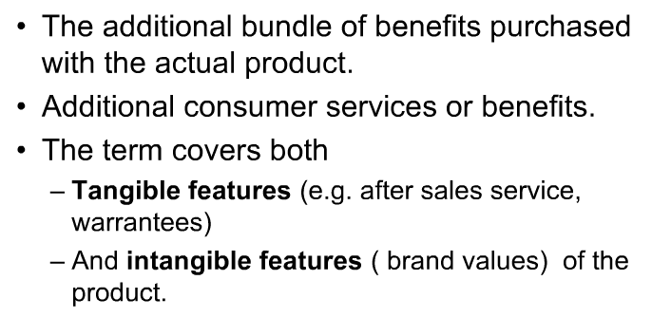
Levels of product
Core Product
Basic/ Generic Product
Augmented Product

Slide 29
Levels of product
Activity:
Please define each level of the following product:
Hotel
Car
Winter Jacket
Mobile phone
Hospital
Paint
Toilet paper

Slide 30
Levels of product
The competition between businesses focuses mainly on the distinctiveness of the Augmented Product according to Philip Kotler.
For production companies it is important to deliver products in an upward trend from ‘Core Product’ to ‘Augmented Product’ and to have the potential to grow into the ‘Potential Product’.
Each level of the five product levels adds value for the customer. The more efforts production companies make at all levels, the more likely they are to stand a chance to be distinctive.
To be able to tower over the competition, production companies focus on factors which consumers attach extra value to such as extreme packaging, surprising advertisements, customer-oriented service and affordable payment terms.
Notes:
http://www.toolshero.com/marketing/five-product-levels-kotler/

Slide 31
Classifications of Products
Consumer products: Merchandise or other item of common or daily use, ordinarily bought by individuals or households for private consumption.
Industrial products: Machinery, manufacturing plants, materials, and other goods or component parts for use or consumption by other industries or firms.
Materials and parts
  Capital items
  Supplies and services

Slide 32
Classifications of consumer products
Convenience Products
Buy frequently & immediately
Low priced
Many purchase locations
Includes:
  Staple goods
  Impulse goods
  Emergency goods
Shopping Products
Buy less frequently
Gather product information
Fewer purchase locations
Compare for:
  Suitability & Quality
  Price & Style
Specialty Products
Special purchase efforts
Unique characteristics
Brand identification
Few purchase locations
Unsought Products
New innovations
Products consumers don’t
want to think about
Require much advertising &
personal selling

Slide 33
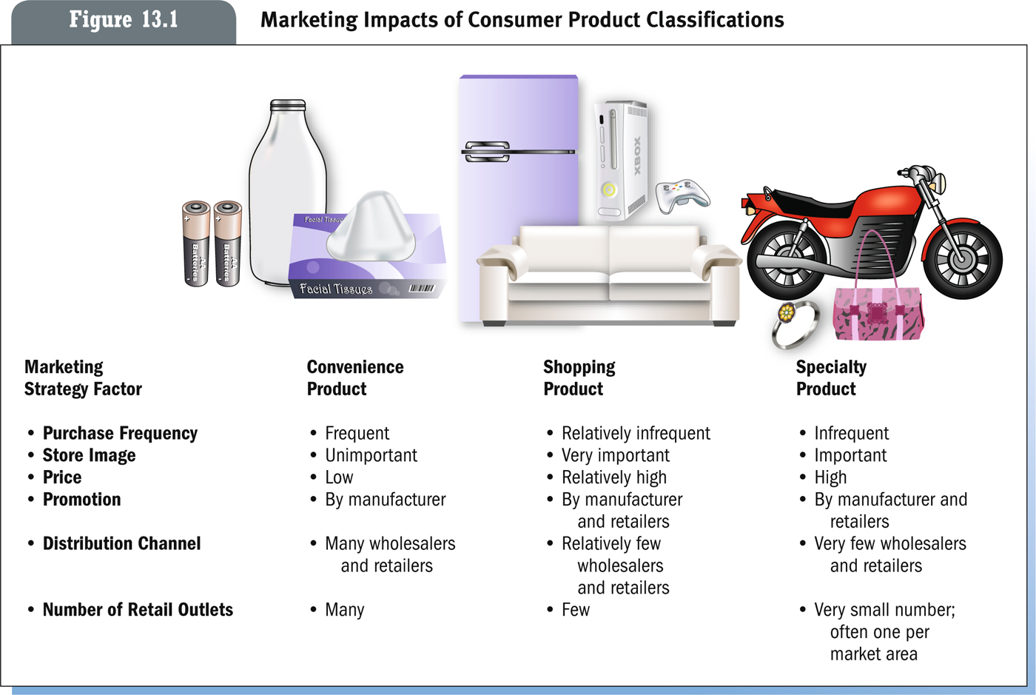
Marketing strategy for each product classification

Slide 34
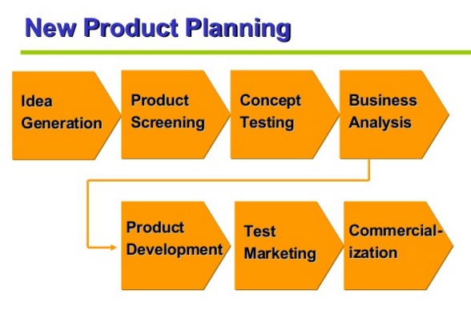
Product Strategies
- Creating New to the world product
Notes:
http://www.cardesignonline.com/design/modelling/clay-modelling.php
http://www.cardesignonline.com/design/modelling/clay-modelling.php
http://www.auto-news.de/erlkoenige/anzeige_BMW-1er-erwischt-Hier-faehrt-der-brandneue-Kompakte-spazieren_id_27683
http://www.motorline.cc/autowelt/index.php/article=149577/=Autowelt_-_ERWISCHT__Der_neue_Mini_Crossman_-

Slide 35

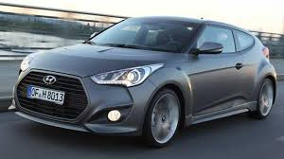
Product Development
Improve, add features & functions
Product & Services Differentiation
Features, Customization, Performance, Conformance, Durability, Reliability, Reparability, Style , Ordering ease, Delivery, Installation, Customer training, Customer consulting, Maintenance and repair, Returns

Slide 36
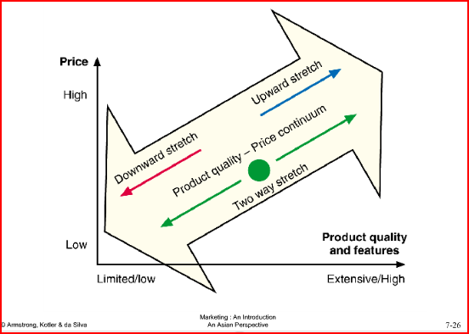
Product Mix
Product mix: the total composite of products offered by a particular organization, consists of both product lines and individual products
Product mix width:
  Number of different product lines
  carried by company
Product mix depth:
  Number of different versions of each
  product in the line
Notes:
The product mix of a company, which is generally defined as the total composite of products offered by a particular organization, consists of both product lines and individual products. A product line is a group of products within the product mix that are closely related, either because they function in a similar manner, are sold to the same customer groups, are marketed through the same types of outlets, or fall within given price ranges. A product is a distinct unit within the product line that is distinguishable by size, price, appearance, or some other attribute. For example, all the courses a university offers constitute its product mix; courses in the marketing department constitute a product line; and the basic marketing course is a product item. Product decisions at these three levels are generally of two types: those that involve width (variety) and depth (assortment) of the product line and those that involve changes in the product mix occur over time.
The depth (assortment) of the product mix refers to the number of product items offered

Slide 37
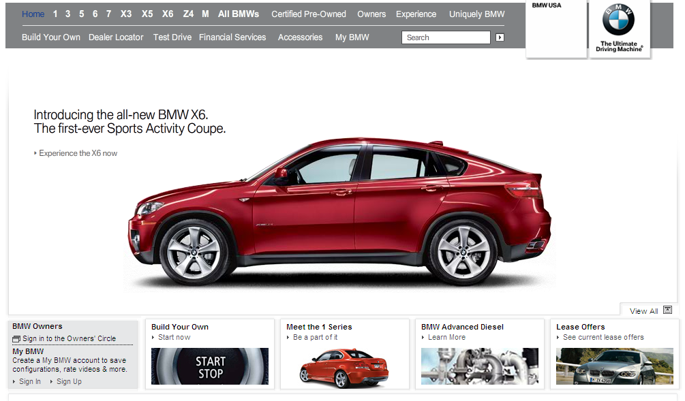
Product Mix
Line Filling
Notes:
The product mix of a company, which is generally defined as the total composite of products offered by a particular organization, consists of both product lines and individual products. A product line is a group of products within the product mix that are closely related, either because they function in a similar manner, are sold to the same customer groups, are marketed through the same types of outlets, or fall within given price ranges. A product is a distinct unit within the product line that is distinguishable by size, price, appearance, or some other attribute. For example, all the courses a university offers constitute its product mix; courses in the marketing department constitute a product line; and the basic marketing course is a product item. Product decisions at these three levels are generally of two types: those that involve width (variety) and depth (assortment) of the product line and those that involve changes in the product mix occur over time.
The depth (assortment) of the product mix refers to the number of product items offered

Slide 38
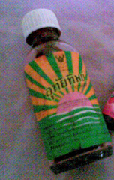
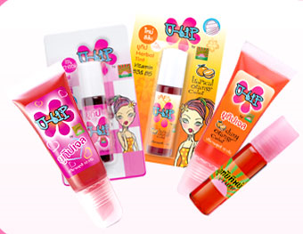
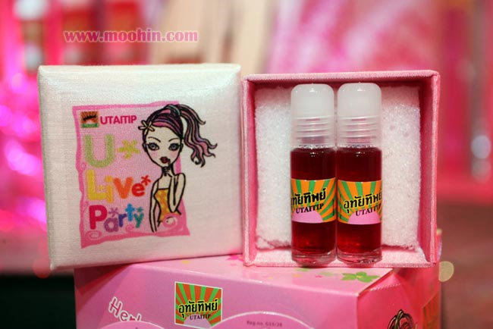
Product repositioning
Arranging for a product or brand to occupy some other clear and distinctive position in the market and in the minds of target consumers than that which it presently occupies.

Slide 39
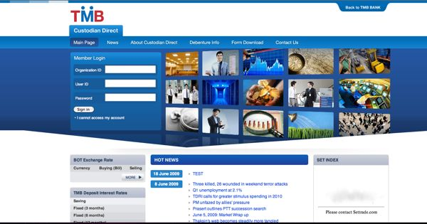

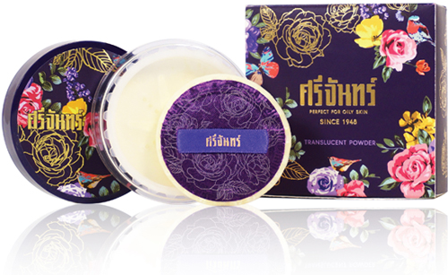
Relaunch/ Rebrand
Includes changes of a company or product, name, culture, values, behaviors, tone, visual collateral
Notes:
https://www.youtube.com/watch?v=-5b9t8hlKDA

Slide 40
Identifying Products
Product Attributes: quality (level of performance, consistency), differentiated features, style, design
Branding: sign, symbol, color, word, logo or a combination of these
Packaging: packaging concept, element, product safety, environment concern
Labeling: identify, describe ingredient, instructions, promote
Product support: services, after sale service

Slide 41
Branding
Branding Strategy
Brands with strong equity have many competitive advantages:
  High consumer awareness
  Strong brand loyalty
  Create barrier to entry
  Helps when introducing new products, Create entry barriers
  Less susceptible to price competition
  Secure price premium

Slide 42
Brand Elements
Brand
names
URLs
Slogans
Elements
Logos
Characters
Symbols
Notes:
Brand element criteria
Memorable
Meaningful
Likeability
Transferable
Adaptable
Protectible

Slide 43

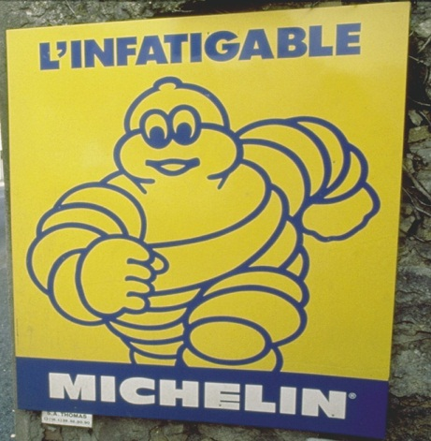

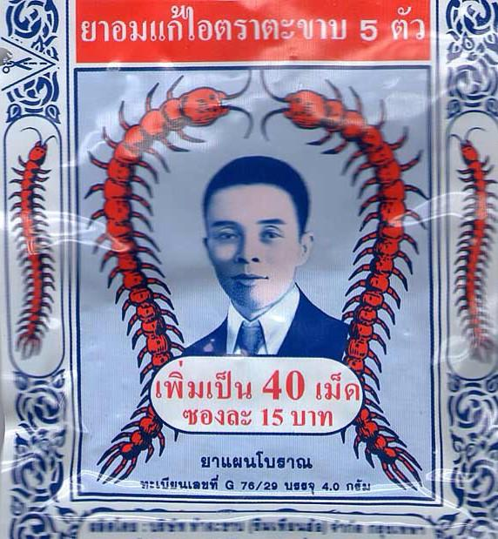
Brand Element Criteria
Desirable qualities for a brand name
Include:
It should be easy to pronounce,
recognize and remember
It should suggest product benefits and qualities
It should distinctive
It should extendable
It should easily translate into foreign languages
It should be capable of registration and legal protection

Slide 44
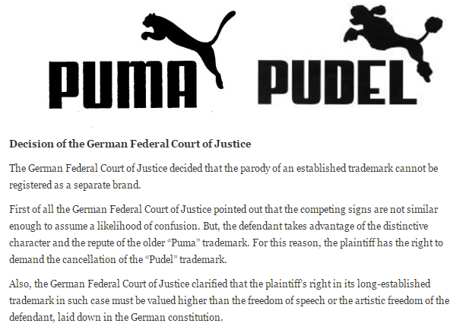
Brand

Slide 45
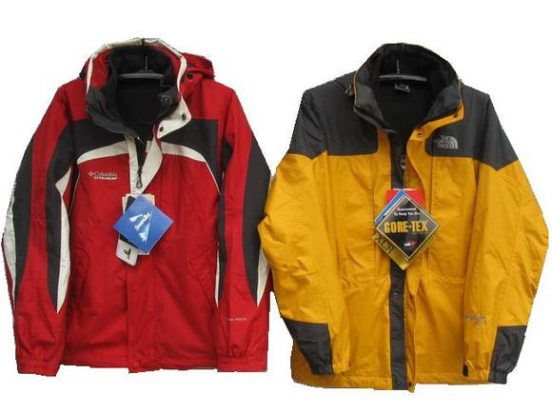

Brand Sponsorship
Manufacturer brands
Private (store) brands
Licensed brands
Co-branding

Slide 46
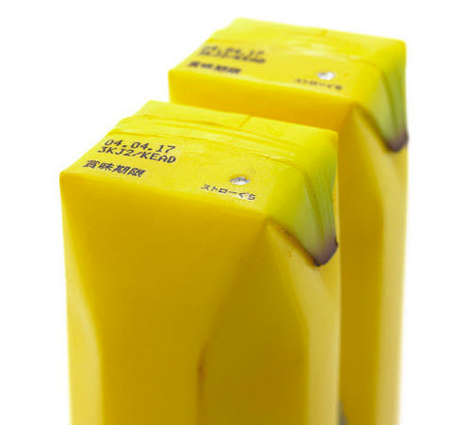
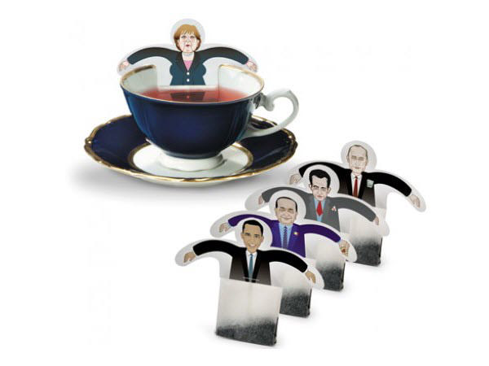
Packaging Objectives
Identify the brand
Convey descriptive and persuasive information
Facilitate product transportation and protection
Assist at-home storage
Aid product consumption
Serve as Brand-touch-point
Notes:
http://www.hongkiat.com/blog/clever-creative-packaging-designs/

Slide 47
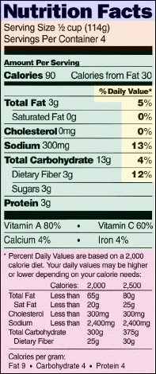
Functions of Labels
Identifies
Grades
Describes
Promotes

Slide 48
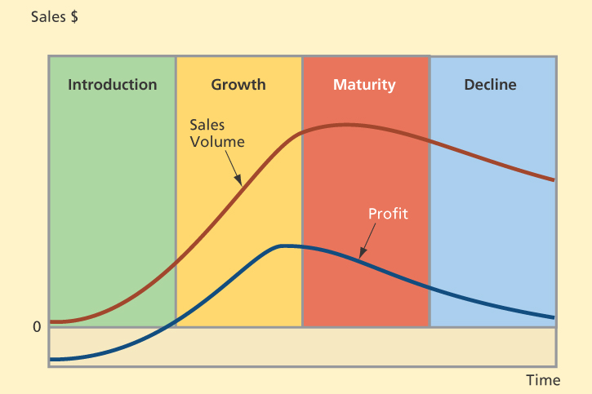
Product Life Cycle

Slide 49
Product Life Cycle
Introduction stage – firm promotes demand for its new offering, informs the market about it, gives free samples to entice consumers to make a trial purchase, and explains its features, uses, and benefits.
Growth stage - sales climb quickly as new customers join early users who are repurchasing the item. Company begins to earn profits on the new product.
Maturity stage - industry sales eventually reach a saturation level at which further expansion is difficult.
Decline stage - sales fall and profits decline.

Slide 50
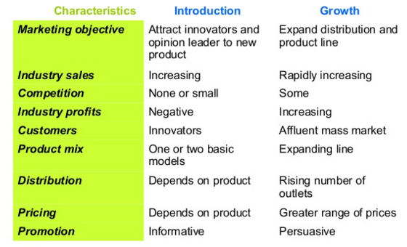
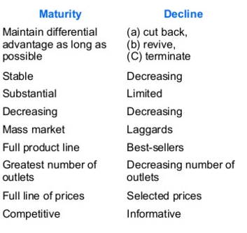
Product Life Cycle

Slide 51
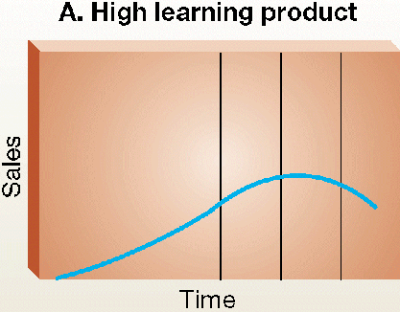
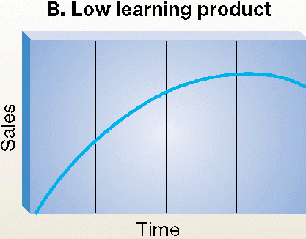
Product life cycle
Significant education of the customer is required.
Extended introductory period
Sales begin immediately
Little learning is required by the consumer
Benefits of purchase are readily understood

Slide 52
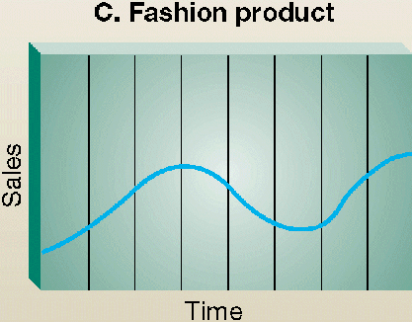

Product life cycle
Most often appear in women’s and men’s clothing styles.
Length of the cycles may be years or decades
Rapid sales on introduction
Equally rapid decline.
Often novelties and have a short life cycle.

Slide 53
Pricing Strategy
Price is the amount of money charged for a product or service
Major consideration in setting price
Customer perceptions of value
Other internal and external considerations
  Nature of the market and demand
  Competitors’ strategies and prices
Product costs

Slide 54

Steps in setting price

Slide 55
Pricing method
Cost-plus pricing
  - Adding a standard markup to the cost of the product
Break-even pricing
- pricing technique use to determine the minimum sales volume of a product must generate at the certain price level to cover the cost
Target-return pricing
- Set the price to achieve a target return-on-investment (ROI)

Slide 56
Setting Price Level (new products)
Skimming Pricing
Setting an intentionally high price relative to the prices of competing products.
Helps marketers set a price that distinguishes a firm’s high-end product from those of competitors.
Helps a firm recover its product development costs before competitors enter the field.
Penetration Pricing
Setting a low price as a major marketing weapon.
Often used with new products.
Notes:
When to Use skimming price:
Product’s quality and image must support its higher price.
Costs of low volume cannot be so high they cancel the advantage of charging more.
Competitors should not be able to enter market easily and undercut the price.
When to Use penetration:
Market is highly price sensitive so a low price produces more growth.
Costs must fall as sales volume increases.
Need to keep competition out or effects are only temporary.

Slide 57
Pricing strategies
Promotional pricing
• Loss-leader pricing
• Special-event pricing
• Cash rebates
• Low-interest financing
• Longer payment terms
• Warranties and service contracts
• Psychological discounting
Geographical Pricing: modifying a basic list price based on the geographical location of the buyer
Differentiation pricing: A pricing strategy that charges different segments of customers altered prices for the same products or services. For example: Airplane ticket

Slide 58

Place (Distribution)

Slide 59

Distribution channels
Notes:
The number of intermediary levels indicates the length of a marketing channel.
Direct Channels
Indirect Channels
Producers lose more control and face greater channel complexity as additional channel levels are added.
Direct Distribution
Direct contact between producer and customer.
Most common in B2B markets.
Often found in the marketing of relatively expensive, complex products that may require demonstrations.
Internet is helping companies distribute directly to consumer market.
Distribution Channels Using Marketing Intermediaries
Producers distribute products through wholesalers and retailers.
Inexpensive products sold to thousands of consumers in widely scattered locations.
Lowers costs of goods to consumers by creating market utility.

Slide 60

Intensity of market coverage

Slide 61

Intensity of market coverage

Slide 62






Distribution channel
Activity: How would you sell following products?

Slide 63

Distribution channel

Slide 64


Modern trade vs. Traditional Channel
Notes:
http://drkunchitsingsuwan.blogspot.com/2008/08/blog-post_4852.html

Slide 65


Modern trade vs. Traditional Channel
Notes:
http://drkunchitsingsuwan.blogspot.com/2008/08/blog-post_4852.html
Aquares modern trade 50% traditional 50%

Slide 66

Promotion strategy
  Integrated marketing communications (IMC)
  The integrating and coordinating the company’s many communication channels to deliver a clear, consistent, and compelling message about the organization and its products.
Marketers must understand each promotion tool when shaping the marketing communications mix.
Notes:
Integrated marketing communication is
the integration by the company of its communication channels to deliver a clear, consistent, and compelling message about the organization and its brands.
Integrated marketing communication calls for recognizing all contact points (brand contact) where the customer may encounter the company and its brands.
Integrated marketing communication calls for recognizing all contact points (brand contact) where the customer may encounter the company and its brands.

Slide 67

Hierarchie of effect model of communication process
Notes:
http://www.youtube.com/watch?v=pD9P2J0E_BU
http://www.youtube.com/watch?v=AlncW35MWSw
http://www.youtube.com/watch?v=vilUhBhNnQc
http://www.youtube.com/watch?v=pB7nDL4TZOk
http://www.youtube.com/watch?v=jrcAuoMNAHY
http://www.youtube.com/watch?v=HLd4jIDagwQ
http://www.youtube.com/watch?v=StCy9p_78Ok&feature=related

Slide 68
7 Ms of Marketing Communication
Market: Target group
Mission: Objectives
Message: Content, Structure, Format, Source
Media: Personal, Non-Personal
Money (Marketing Budget)
Mix (Promotion Mix)
Measurement

Slide 69
Promotion
The promotion mix is the specific blend of advertising, sales promotion, public relations, personal selling, and direct-marketing tools that the company uses to persuasively communicate customer value and build customer relationships.
Major Promotion Tools
  Advertising.
  Sales promotion.
  Public relations.
  Personal selling.
  Direct marketing

Slide 70

Promotion Mix

Slide 71



The Promotion Mix
Advertising is any paid form of non-personal presentation and promotion of ideas, goods, or services by an identified sponsor.
  Broadcast, Print, Internet, Outdoor

Slide 72

The Promotion Mix
Sales promotion is the short-term incentives to encourage the purchase or sale of a product or service.
  Discounts
  Coupons
  Displays
  Demonstrations

Slide 73




The Promotion Mix

Slide 74

The Promotion Mix
Public relations involves building good relations with the company’s various publics by obtaining favorable publicity, building up a good corporate image, and handling or heading off unfavorable rumors, stories, and events.
  Press releases
  Sponsorships
  Special events
  Web pages

Slide 75

The Promotion Mix
Personal selling is the personal presentation by the firm’s sales force for the purpose of making sales and building customer relationships.
  Sales presentations
  Trade shows
  Incentive programs

Slide 76
The Promotion Mix
Direct marketing involves making direct connections with carefully targeted individual consumers to both obtain an immediate response and cultivate lasting customer relationships – by using direct mail, telephone, direct-response television, e-mail, and the Internet to communicate directly with specific consumers.
    Catalog
    Telemarketing
    Kiosks

Slide 77
Setting Promotion Budget
Affordable budget method sets the budget at an affordable level.
  Ignores the effects of promotion on sales
Percentage-of-sales method sets the budget at a certain percentage of current or forecasted sales or unit sales price.
  Easy to use and helps management think about the relationship between promotion, selling price, and profit per unit
  Wrongly views sales as the cause than the result of promotion

Slide 78
Setting Promotion Budget
Competitive-parity method sets the budget to match competitor outlays.
  Represents industry standards
  Avoids promotion wars
Objective-and-task method sets the budget based on what the firm wants to accomplish with promotion and includes
  Defining promotion objectives
  Determining tasks to achieve the objectives
  Estimating costs

Slide 79


Slide 80

Promotion Mix Strategies
Push strategy involves pushing the product to the consumers by inducing channel members to carry the product and promote it to final consumers.
  Used by B2B companies

Slide 81
Promotion Mix Strategies
Pull strategy is when the producer directs its marketing activities toward the final consumers to induce them to buy the product and create demand from channel members.
  Used by B2C companies

Slide 82

Below the line vs. Above the line
Notes:
http://www.positioningmag.com/content/59650
http://www.bangkokbiznews.com/news/detail/530798

Slide 83




Advertising Idea
Notes:
http://www.positioningmag.com/content/59650
http://www.bangkokbiznews.com/news/detail/530798
http://www.adweek.com/adfreak/watch-zappos-hilariously-punk-google-ambushing-its-cupcake-truck-austin-167314

