Slide 1
Factor Endowments and the Heckscher-Olin Model
EE451
Chayun Tantivasadakarn
Faculty of Economics, Thammasat University

Slide 2
Outline
Assumptions
Autarky equilibrium
The Heckscher-Ohlin Theorem
Factor-Price-Equalization Theorem
The Stolper-Samuelson Theorem
The Rybczynski Theorem
Testing the Heckscher-Ohlin Model
Specific-Factor model

Slide 3
Assumptions
2 countries, Home and Foreign
2 homogenous goods, rice (X) and airplanes (Y)
2 homogenous factors, labor (L) and capital (K)
CRTS and identical technology across countries
Each good has different factor intensities and no factor intensity reversal
Capital markets: K = K_{X} + K_{Y} and K* = K*_{X} + K*_{Y}
Labor markets: L = L_{X} + L_{Y} and L* = L*_{X} + L*_{Y}
Countries have different factor abundance
Perfect competition in all markets

Slide 4
Assumptions
Perfectly mobile factors within each country
  Same wage rate earned in both industries of each country
  Same rental rate earned in both industries of each country
Identical and homothetic preferences across countries
  A poorer country will buy less of both rice and airplane, but in the same ratio as a richer country facing the same prices
  Not a realistic assumption, but it allows us to focus attention on the differences in resources as the sole reason for trade
Goods are traded freely without transportation costs, market distortions, and government interventions

Slide 5
No factor intensity reversal
Factor intensity is the relative capital-labor ratio. It refers to the demand for factors of the goods.
K
K_{Y}/L_{Y}
Regardless of the changes in w/r, the factor intensity of one good relative to that of other goods does not change.
Y
K_{Y}
It is assumed here that Y is always capital intensive while X is labor intensive or the capital to labor demand of Y is always greater than those of X.
K_{X}/L_{X}
K_{X}
X
L_{Y}
L_{X}
L

Slide 6
Factor intensity and capital-labor ratio
w₀/r₀
K_{Y}/L_{Y}
K
w/r
(K_{Y}/L_{Y})/
X
Y
Y
w₀/r₀
K_{Y}
K_{X}/L_{X}
(w/r)/
(K_{X}/L_{X})/
K_{X}
X
L_{Y}
L_{X}
L
K_{Y}/L_{Y}
K/L
K_{X}/L_{X}

Slide 7
Factor intensity reversal (FIR)
Factor intensity reversal means that the relative K-L ratio of the good may reverse when w/r is changed enough.
This happens when isoquants of the 2 goods cross more than once.
K_{Y}/L_{Y}
K
X
Y
K_{X}/L_{X}
w/r
(K_{X}/L_{X})/
X/
(K_{Y}/L_{Y})/
Y/
Y is K-intensive at w/r but turns L-intensive at (w/r)/.
L
(w/r)/

Slide 8
Factor intensity and capital-labor ratio
K_{Y}/L_{Y}
K
X
Y
w/r
K_{X}/L_{X}
w/r
w₀/r₀
(K_{X}/L_{X})/
(w/r)/
X/
(K_{Y}/L_{Y})/
Y/
L
K_{X}/L_{X}
K_{Y}/L_{Y}
K/L
(w/r)/

Slide 9
Factor intensity reversal (FIR): Example
Although all countries may have access to the same technologies, the machines used in the U.S. are different from those used in Asia and elsewhere
Shoe production in US uses automated manufacturing machine, while the same production in India uses individual sewing machine
In call centers, technologies are virtually identical and therefore factor intensities are similar across countries
So, shoes in India are labor intensive compared to the call center—the opposite of the U.S.

Slide 10




India USA
L-intensive
K-intensive

Slide 11
Factor Abundance
The two nations are identical in every way except its factor abundance or the ratio between the capital stock and labor force that each country has.
Factor abundance refers to supply of factors of countries
It is assumed here that the supply of factors are fixed and Home is relatively labor abundant and Foreign is relatively capital abundant or the capital to labor supply in F is higher than those in H or

Slide 12
Factor Abundance and PPCs
K
Y*
Y
k = K*/L*
Y
Y*
E*
E
K
Y
Y/
E/
X
X*
L
L
X/
X*
X
X

Slide 13
Factor Abundance and PPCs
Home is L-abundant; its PPC is biased toward the X axis.
Foreign is K-abundant; its PPC is biased toward the Y axis.
This result holds, regardless of the sizes of the two economies as long as the factor proportions are the same.
  Endowment point E* and E/ lie on the same ray k along with which relative endowments are the same.
  Because of CRTS, isoquants for X and Y are both homogeneous of degree one.
  PPC shrinks in or grows out in a parallel fashion.
See 02Neoclassic.xls

Slide 14
Autarky equilibrium
Given identical homothetic preferences, H’s autarky equilibrium is at A while F’s is at A*.
P*_{A}
Y
Y*
A*
H has comp. adv. in X and F has comp. adv. in Y.
Y
CIC*_{A}
A
CIC_{A}
Note this result hold even with the smaller size economy with Y/X/.
P_{A}
X*
X
X
What if preferences are sufficiently biased toward X?

Slide 15
The Heckscher-Ohlin Theorem
Since P*_{A} > P_{A}, X from H is cheaper and Y from F is cheaper.
D_{X} in H rises and P_{X}/P_{Y} rises. D_{Y} in F rises and P*_{X}/P*_{Y} falls until they are equalize at P_{W}.
Y
H’s production point moves to Q and consumes at C.
F’s production point moves to Q* and consumes at C *.
Q*
Y*
A*
C*
B*
C
CIC*_{F}
A
CIC_{H}
F exports B*Q* and imports B*C*.
H exports BQ = B*C* and imports BC = B*Q*.
Both countries gain from trade
B
Q
P_{W}
P_{W}
X*
X
X

Slide 16
Equilibrium relative price: Offer curves
Y
H’s Offer Curve
H’s imports
F’s exports
P_{W}
P*_{A}
B*
C*
C
F’s Offer Curve
P_{A}
Q*
X
Q
B
H’s exports
F’s imports

Slide 17
The Heckscher-Ohlin Theorem
The Heckscher-Ohlin Theorem: Given the assumptions of the model, a country will export the commodity that intensively uses its relatively abundant factor.
It is also referred to as the Factor-Proportions Theory
H is L-abundant, so the relative wage rate is lower and suitable to produce X which is L-intensive.
F is K-abundant, so the relative interest rate is lower and suitable to produce Y which is K-intensive.
H exports the L service which is its abundant factor and imports the K service which is its scarce factor.

Slide 18
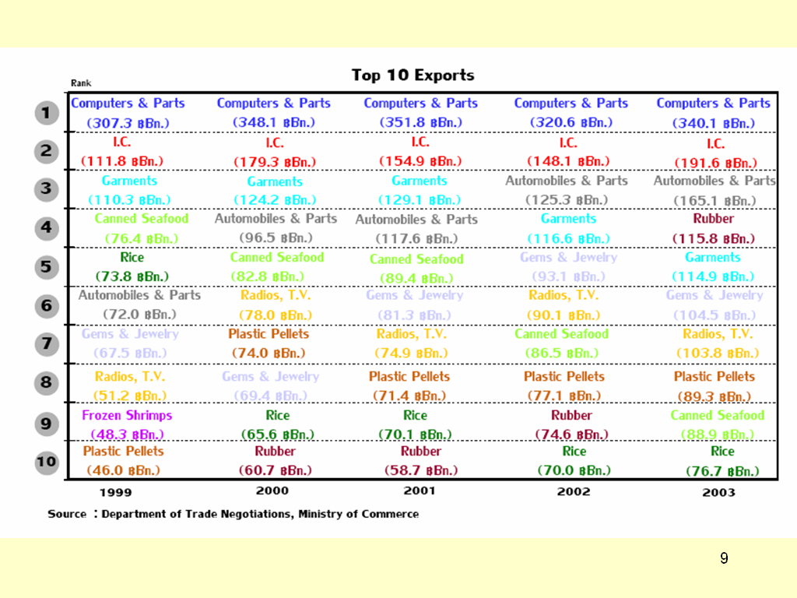

Slide 19
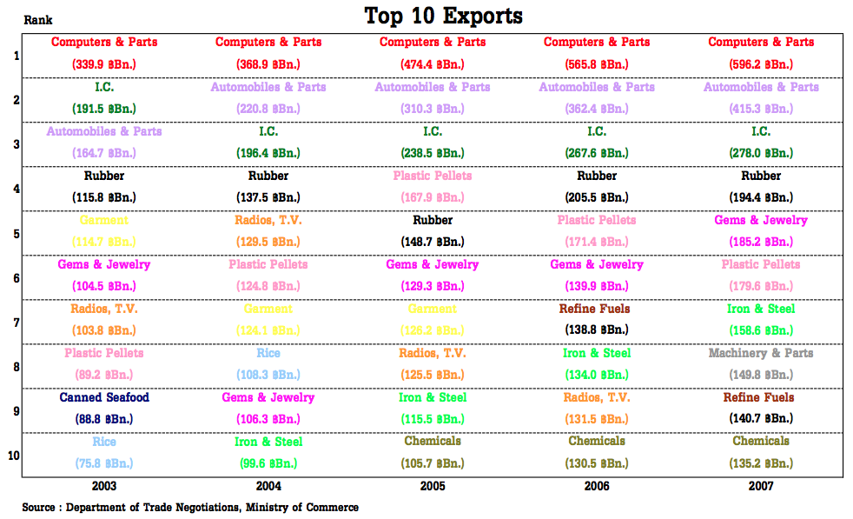

Slide 20
Factor-Price-Equalization Theorem (FPE)
The Heckscher-Ohlin Theorem shows that the differences in endowments lead to different factor prices, different pattern of comparative advantage and trade.
But international trade eventually equalizes the commodity prices and change the production. What impact international trade should have on the factor prices of the trade partners?
FPE Theorem predicts that international trade will equalize the relative factor prices.
To show this we need to find the relationship between the commodity prices and the factor prices.

Slide 21
Commodity prices and factor prices
Y
K_{X}
0_{Y}
L_{Y}
A
(w/r)_{B}
Y_{A}
Y_{B}
X_{B}
P_{A}
X_{A}
(w/r)_{A}
B/
k_{XB}
Y_{B}
B
C
Y_{A}
P_{B}
A/
X_{A}
X_{B}
X
0_{X}
L_{X}
K_{Y}

Slide 22
Commodity prices and factor prices
At an initial price ratio P_{A}, the equilibrium on the PPC is at point A.
This point corresponds to point A/ in the Edgeworth box diagram
Point A/ is the tangency point between the X_{A} and Y_{A} isoquants on the contact curve, the equilibrium factor price ratio is (w/r)_{A}.
Suppose the relative price increases to P_{B}, the equilibrium on the PPC moves to point B. Outputs of X will rise and Y will fall.

Slide 23
Commodity prices and factor prices
This point corresponds to point B/ in the Edgeworth box diagram and the equilibrium factor price ratio is (w/r)_{B}.
Given CRTS technology, the slope of X_{B} at point B/ must be the same as the slope of X_{A} at point C which is higher than the slope of X_{A} at point A or (w/r)_{B} > (w/r)_{A}.
This implies that as the relative commodity prices increases, the relative factor prices also increase.

Slide 24
Commodity prices and factor prices
There is a unique relationship between relative commodity prices and the relative factor prices as long as both goods are produced.
Reason: Since X is labor intensive, as P_{X}/P_{Y} increases, production of X increases. This demands more labor and increases the wage rate.
w/r
(w/r)*_{A}
(w/r)_{W}
(w/r)_{A}
P_{A}
P_{W}
P*_{A}
P_{X}/P_{Y}

Slide 25
Factor-Price-Equalization Theorem (FPE)
Note that this function is the same for both countries by CRTS and identical technology.
Since free trade causing the relative commodity prices to equalize, the relative factor prices must also equalize.
The Factor-Price-Equalization Theorem: Under identical CRTS, free trade in commodities will equalize relative factor prices through the equalization of relative commodity prices, so long as both countries produce both goods.

Slide 26
Why don’t we observe FPE?
Significant transportation costs.
Trade restrictions: tariffs and quotas.
Market distortions: monopolies, labor union
Non CRTS technology
Not identical technology
Factor-intensity reversal
Heterogeneous factor
Even though FPE is unlikely, trade can result in strong tendencies in that direction.

Slide 27
The Stolper-Samuelson Theorem
The theorem intends to show that the change in commodity prices change the distribution of real incomes between capital and labor.
From profit maximization conditions: VMP = factor price,
If the marginal products change, the real returns will change.

Slide 28
The Stolper-Samuelson Theorem
K_{X}
0_{Y}
L_{Y}
(w/r)_{B}
X_{B}
(w/r)_{A}
X_{A}
B/
k_{XB}
E
C
Y_{A}
k_{YB}
D
k_{XA}
A/
k_{YA}
0_{X}
L_{X}
K_{Y}
31
32

Slide 29
The Stolper-Samuelson Theorem
Movement from A/ to D reduces L keeping K constant. Law of Diminishing Returns implies further that MP_{L} at D is higher than that at A/.
By CRTS, the MP_{L} is constant along the ray O_{X}DCB/. So MP_{L} at point D and B/ are the same.
MP_{L} at point B/ is higher than MP_{L} at point A/ and w/P_{X} is higher.
Hence, the increase in commodity prices, movement from A/ to B/, has increased MP_{L} and w/P_{X}.

Slide 30
The Stolper-Samuelson Theorem
K_{X}
K_{X}
MP_{K}
X_{A}
From A/ to B/ real wage increases
B/
E
D
A/
O_{X}
L_{X}
MP_{K}
MP_{L}
From A/ to B/ real interest decreases
MP_{L}
L_{X}

Slide 31
The Stolper-Samuelson Theorem
Movement from A/ to E raises K keeping L constant. Law of Diminishing Returns implies further that MP_{K} at E is lower than that at A/.
By CRTS, the MP_{K} is constant along the ray O_{X}CB/. So MP_{K} at point E and B/ are the same.
MP_{K} at point B/ is lower than MP_{K} at point A/ and r/P_{X} is lower.
Hence, these prove that the increase in commodity prices, movement from A to B, has decreased MP_{K} and r/P_{X}.
28

Slide 32
The Stolper-Samuelson Theorem
Note that the K-L ratios in X at point A/ is lower than those at point B/ because (w/r)_{A}< (w/r)_{B} or k_{XA} < k_{XB} and k_{YA} < k_{YB}
L_{Y}
0_{Y}
(w/r)_{B}
X_{B}
(w/r)_{A}
B/
k_{XB}
k_{YB}
A/
k_{XA}
k_{YA}
L_{X}
0_{X}
K_{Y}
28

Slide 33
The Stolper-Samuelson Theorem
Movement from A/ to B/ increases X but decreases Y --> increases demand for L but decreases demand for K --> increase w/r, causing K/L to rise for both goods.
This implies that any increase in K-L ratios will increase the real wage of L and lower the real returns to K.
Since the movement from point A/ to B/ also increases the K-L ratios in Y, this will also increase the real wage of L and lower the real returns to K in industry Y.
These results hold as long as the economy remains incompletely specialized.
28

Slide 34
The Stolper-Samuelson Theorem
The Stolper-Samuelson Theorem: If there are CRTS and if both goods continue to be produced, a relative increase in the price of a commodity will increase the real return to the factor used intensively in that industry and reduce the real return to the other factor.
A labor abundant country enters free trade. This will increase the relative price of labor intensive goods, make the workers better off and capitalists worse off.
  Workers will support free trade while capitalists will oppose it.
  Not only workers in labor intensive sectors will be better off, but also workers in capital intensive sectors

Slide 35
The Stolper-Samuelson Theorem
Since an increase in the relative price of X causes w/P_{X} to increase and r/P_{X} to decrease, these imply that
These equations are called the “magnification effect.” They show how changes in the prices of goods have magnified effects on the earnings of factors.
  Small fluctuations in the relative prices of goods on world markets can lead to exaggerated changes in the long-run earnings of both factors.

Slide 36
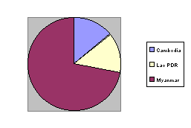

The Rybczynski Theorem
The theorem show the relationship between changes in factor endowments and changes in the outputs of the two commodities when their prices are assumed to be constant.
For instance, a country gains labor endowment through labor immigration.

Slide 37
The Rybczynski Theorem
New equilibrium
K_{X}
0_{Y}
0/_{Y}
L_{Y}
E/
k_{X}
Initial equilibrium
C
E
k_{Y}
k/_{Y}
0_{X}
ΔL
L_{X}
K_{Y}
K/_{Y}
An increase in labor endowment

Slide 38
The Rybczynski Theorem
At the initial equilibrium point E on the contract curve where the isoquants of X and Y tangent, the K-L ratio for X and Y are k_{X} and k_{Y}, respectively.
Suppose L is increased by ΔL, the origin for Y is shifted from O_{Y} to O/_{Y}.
Recall that there is a one-to-one relationship between P_{X}/P_{Y} and w/r. Since P_{X}/P_{Y} is constant, so is w/r. Therefore, the K-L ratios in both goods are not affected.

Slide 39
The Rybczynski Theorem
Even though the endowment L has increased, the ray k_{X} and k_{Y} are not affected.
Hence, the K-L ratio for Y is shifted parallel from k_{Y} to k/_{Y} and point E/ must be the new equilibrium.
Since point E/ is farther from origin O_{X} than is point E, output of X must increase.
Output of Y must decrease since O/_{Y}E/ is shorter than O_{Y}E (O/_{Y}E/ is equal to O_{Y}C < O_{Y}E).

Slide 40
The Rybczynski Theorem
The Rybczynski Theorem: If relative commodity prices are constant and if both commodities continue to be produced, an increase in the supply of a factor will lead to an increase in the output of the commodities using that factor intensively and a decrease in the output of the other commodities.
Reason: The increase in L-intensive good, X, draws both L and K from K-intensive good, Y, causing Y to contract.

Slide 41
The Rybczynski Theorem
An increase in L endowment will shift the PPC biased toward the X (L-intensive good) axis from XY to X/Y/.
Y
Rybczynski Line
Y/
Y
E
Since P is constant, the equilibrium moves from E to E/.
The line joining them is called the Rybczynski line.
Note that X increases while Y decreases.
E/
R
P
P
X
X/
X

Slide 42
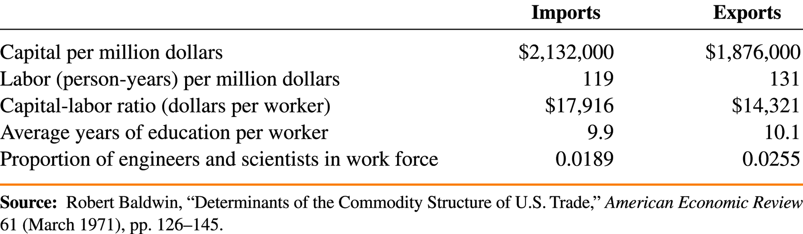
Testing the Heckscher-Ohlin Model
Tests on U.S. Data
  Leontief paradox: Leontief found that U.S. exports were less capital-intensive than U.S. imports, even though the U.S. is the most capital-abundant country in the world.
  Factor Content of U.S. Exports and Imports for 1962

Slide 43
Testing the Heckscher-Ohlin Model
Leontief used labor and capital used directly in the production of final good exports in each industry.
He also measured the labor and capital used indirectly in the industries that produced the intermediate inputs used in making exports.
The capital is high because we are measuring the whole capital stock—not the part actually used to produce exports.
The capital/labor ratio was $14,000: each person employed was working with $14,000 worth of capital.

Slide 44
Testing the Heckscher-Ohlin Model
It was impossible for Leontief to get information on the amount of labor and capital used to produce imports.
He used data on U.S. technology to calculate estimated amounts of labor and capital used in imports from abroad.
  Remember the HO model assume technologies are the same across countries.
This gave a capital/labor ratio of $18,000 per worker.
  This exceeds the ratio for exports.

Slide 45
Heckscher-Ohlin Model
Leontief assumed correctly that in 1947 the U.S. was capital abundant relative to the rest of the world.
  From the HO model, Leontief expected that the U.S. would export capital intensive goods and import labor intensive goods.
Leontief, however, found the opposite.
  The capital labor ratio for U.S. imports was higher than for exports.
This contradiction came to be called Leontief’s paradox.

Slide 46
Testing the Heckscher-Ohlin Model
Tests on Global Data: A study by Bowen, Leamer, and Sveikauskas tested the Heckscher-Ohlin model using data for a large number of countries.
  This study confirms the Leontief paradox on a broader level.
Tests on North-South Trade
  North-South trade in manufactures seems to fit the Heckscher-Ohlin theory much better than the overall pattern of international trade.

Slide 47
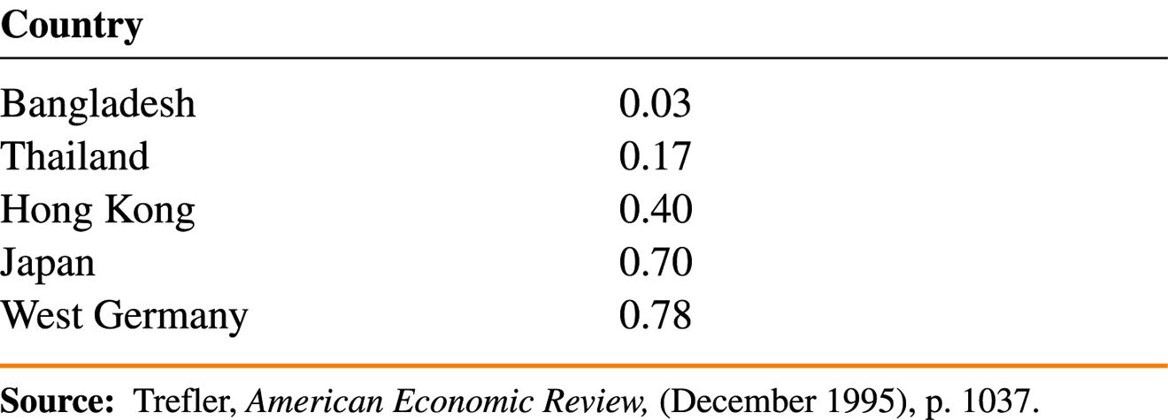
Testing the Heckscher-Ohlin Model
A study by Trefler in 1995 showed that technological differences across a sample of countries are very large.
Estimated Technological Efficiency, 1983 (United States = 1)

Slide 48
Possible explanations for the Leontief paradox
Assumptions of H-O model are too restrictive:
  land and natural resources
  skilled and unskilled labor
Demand biases for goods in which it normally has comparative advantage.
Non-identical technologies.
Factor intensity reversal.

Slide 49
Summary
The Heckscher-Ohlin model, in which two goods are produced using two factors of production, emphasizes the role of resources in trade.
The Heckscher-Ohlin theorem predicts that a country will export the commodity which uses intensively its abundant factor and import the commodity which uses intensively its scarce factor.
International trade tends to equalize factor prices. Complete FPE is not observed due to transportation costs, barriers to trade, distortions, differences in technology and inputs.

Slide 50
Summary
A rise in the relative price of the labor-intensive good will shift the distribution of income in favor of labor:
  The real wage of labor will rise in terms of both goods, while the real income of capitalists will fall in terms of both goods.
For any given commodity prices, an increase in a factor of production increases the supply of the good that uses this factor intensively and reduces the supply of the other good.

Slide 51
Summary
The owners of a country’s abundant factors gain from trade, but the owners of scarce factors lose.
Empirical evidence is mixed on the Heckscher-Ohlin model.
  Most researchers do not believe that differences in resources alone can explain the pattern of world trade or world factor prices.

Slide 52
The Specific-Factor Model
H-O model assume free mobility of factors between sectors which can only happen in the long run.
In the short run, some factors, such as capital take a long time to be converted from one industry to others.
This model assume that capital is fixed and specific to each sector but labor still freely mobile.
It is a short run version of H-O model.

Slide 53
The Specific-Factor Model: Assumptions
2 countries, 2 homogenous goods: X and Y
Perfect competition in all markets. P_{X} and P_{Y} are given.
3 factors: mobile Labor (L), specific capital for X (K_{X}), specific capital for Y (K_{Y}).
X = F(K_{X},L_{X})
Y = G(K_{Y},L_{Y})
Full employment conditions

Slide 54
The Specific-Factor Model: PPC
Production Function for Y
Y
Production Possibility Curve
Y = G(K_{Y},L_{Y})
Y
A
B
X
L_{Y}
L
X
Production Function for X
Full employment condition for labor
L
X = F(K_{X},L_{X})
L_{X}

Slide 55
The Specific-Factor Model: labor allocation
Profit maximization requires that
VMP^{X}_{L} = P_{X}MP^{X}_{L} = w
VMP^{Y}_{L} = P_{Y}MP^{Y}_{L} = w
Since labor is freely mobile, there must be only one wage rate. Hence, labor will move across industries until VMP^{X}_{L} = VMP^{Y}_{L}.
VMP^{X}_{L} is plotted from left to right while VMP^{Y}_{L} is plotted from right to left.
The length of the horizontal axis represents the labor supply:

Slide 56
The Specific-Factor Model: labor allocation
Labor will move from Y to X until wages are equalized at w.
At L₁, w_{X} > w_{Y}.
w_{X}
w_{Y}
N
M
Employment in X = L_{X}.
Employment in Y = L_{Y}.
Labor income = area wO_{X}O_{Y}w.
Capitalist return in X = AwM. Capitalist return in Y = AwN.
w_{X}
A
w
w
w_{Y}
VMP^{Y}_{L}
VMP^{X}_{L}
O_{X}
L₁
L
O_{Y}
L_{X}
L_{Y}
L

Slide 57
The Specific-Factor Model: increase in K_{X}
w_{X}
w_{Y}
MP^{X}_{L} and VMP^{X}_{L} move up.
This increases w, L_{X}, X and decreases L_{Y} and Y.
N
M
r_{X} must fall since K_{X} increases. r_{Y} must also fall since output Y fall.
B
w /
w /
P_{X}MP^{X}_{L}(K₁)
w
w
A
Since good prices are fixed, real wage increases and real returns on both specific factor decreases.
VMP^{Y}_{L}
P_{X}MP^{X}_{L}(K₀)
O_{X}
L
L/
O_{Y}
L_{X}
L_{Y}

Slide 58
The Specific-Factor Model: increase in K_{X}
If technology is constant returns to scale, the marginal product depends on K-L ratio. For instance,
Since w is increasing while r is decreasing, K/L must rise.
From P_{X}MP^{X}_{L} = w and P_{X}MP^{X}_{K} = r_{x}, we know that w/P_{X} = MP^{X}_{L} and r_{x}/P_{X} = MP^{X}_{K}.
When K/L increases, MP^{X}_{L} and w/P_{X} increase; at the same time MP^{X}_{K} and r_{x}/P_{X} decrease.

Slide 59
The Specific-Factor Model: increase in L
w_{X}
w_{Y}
w_{Y}
M/
N
N
VMP^{X}_{L}
VMP^{Y}_{L}
M
A
w
w
B
w /
w /
O_{X}
L
O_{Y}
L/
O_{Y}
L_{X}
L_{Y}
ΔL
L/_{Y}
Chayun Tanti
59
Notes:
59

Slide 60
The Specific-Factor Model: increase in L
w_{X}
w_{Y}
w_{Y}
M/
N
N/
VMP^{X}_{L}
VMP^{Y}_{L}
M
A
w
w
B
w /
w /
O_{X}
L
L/
O_{Y}
O/_{Y}
DL
L_{X}
L_{Y}
L/_{Y}

Slide 61
The Specific-Factor Model: increase in L
The increase in L, will increase the length of the labor axis and carry the VMP^{Y}_{L} with it.
Nominal wage falls due to the increase in labor supply.
Both X and Y increase.
Nominal r_{X} and r_{Y} rise because the increase in outputs increase the demand for their specific factors.
Since good prices are constant, real wage falls, real r_{X} and r_{Y} both rise.

Slide 62
The Specific-Factor Model: increase in endowment
At constant commodity prices, any increase in the endowment of a specific factor will increase the real returns to the mobile factor and lower the real returns to both specific factors.
An increase in the endowment of the mobile factor will reduce its own real income and increase the real income of both specific factors.

Slide 63
The Specific-Factor Model: change in a price
M/
If P_{X} increases by free trade, VMP^{X}_{L} shifts upward.
w_{X}
w_{Y}
N
The w_{X} > w_{Y}, labor will move from Y to X until wages are equalized at w/.
Note that w/ increases less than the increase in P_{X}.
M
C
w_{X}
B
w /
w /
VMP^{X}_{L}/
w
w
A
VMP^{Y}_{L}
VMP^{X}_{L}
O_{X}
L
L/
O_{Y}
L_{X}
L_{Y}

Slide 64
The Specific-Factor Model: change in a price
Employment in X, L_{X} increases. Employment in Y, L_{Y} decreases.
Nominal labor income increases. w/P_{Y} increases while w/P_{X} decreases since w increases less than P_{X}.
Capitalists nominal return in X increases to area Bw/M/. r_{X}/P_{Y} increases. r_{X}/P_{X} increases since MP^{X}_{K} increases by more L_{X}.
Capitalists nominal return in Y decreases to area Bw/N. Both r_{Y}/P_{Y} and r_{Y}/P_{X} decreases.

Slide 65
The Specific-Factor Model: change in a price
A relative price increase of a good increases the real return of the specific factor used in that industry, reduces the real return of the other specific factor, and has an ambiguous effect on the mobile factor.
Free trade affects the real returns in the short run differently from the long run.
Different groups of capitalists may support free trade differently in the short run.

