Slide 1
Macroeconomics:
An Introduction (2)
Thorn Pitidol
Faculty of Economics, Thammasat University
EE212, Semester 1/2557

Slide 2
Topics
Tools for understanding macroeconomic issues
Tradeoff between macroeconomic objectives
Basic concepts in understanding economic activities

Slide 3
Tools for understanding macroeconomic issues
Basic tools for investigating macroeconomic phenomena

Slide 4
Tools for understanding macroeconomic issues
Empirical tools
  Empirical =
  In economics, most empirical analysis are done quantitatively (through analysis of numbers)
    Recording of how quantitative value of a variable change through time
    Also, recording of relationships between variables
      This is about finding correlation between variables
      But needs to be careful that correlation does not imply causation

Slide 5
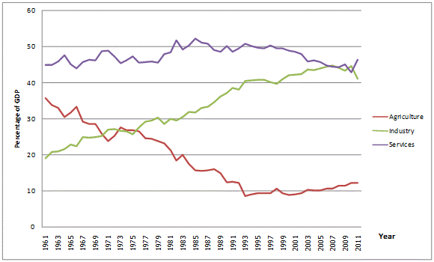
Tools for understanding macroeconomic issues
Empirical tools (time-series)
Share of GDP in Thailand (Percentage) from 1961-2011
Data Source: The World Bank 2013 (http://data.worldbank.org/country/thailand)

Slide 6
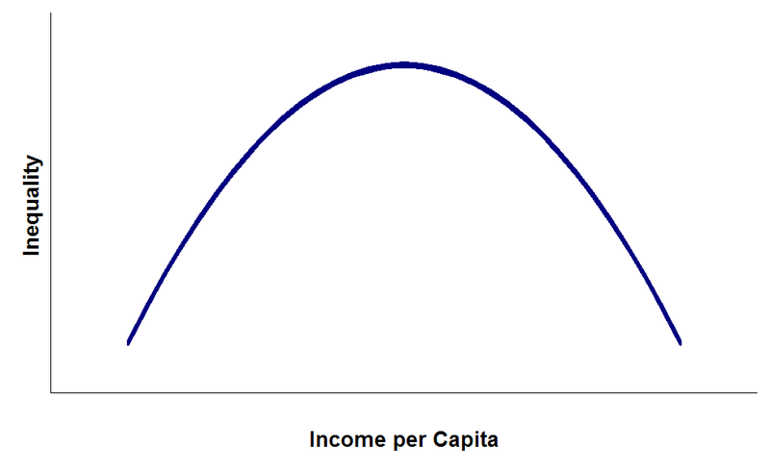
Tools for understanding macroeconomic issues
Empirical tools (regression)
Kuznet Curve

Slide 7
Tools for understanding macroeconomic issues
Theoretical tools
  Quantitative analysis may not produce enough insights on “how things work”
  Economists construct
    A model, proposing the nature of relationships between variables, is based on thought-experiments.
    Assumptions are outlined, and through careful reasoning, a mathematical explanation is built.

Slide 8
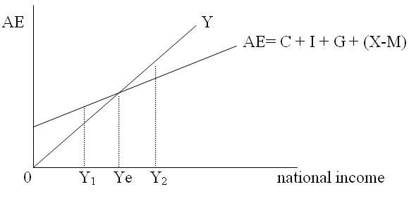
Tools for understanding macroeconomic issues
Theoretical tools
  Economic Model
  Keynesian model of income determination

Slide 9
Tools for understanding macroeconomic issues
Historical tools
  In addition, knowledge of historical events also forms another route in which economic knowledge can be developed.
  This route can be indispensable in giving broader insight on economic phenomena. This is because

Slide 10
Tools for understanding macroeconomic issues
Historical tools
  Example: “Kicking Away the Ladder” (Ha Joon Chang, 2002)
    Historically, the Western developed nations had used trade protections and subsidies to support the growth of their industries. Such policies, in place throughout 18-19th century, contributed to its powerful economic position in the present. It seems, therefore, contradictory that these are the nations that ask developing countries to develop through “trade-liberalisation.

Slide 11
Tradeoff between macroeconomic objectives
The concept of trade-off is central to economics
  Remember the Production Possibility Frontier (PPF)?
What about the trade-off in macroeconomics?

Slide 12
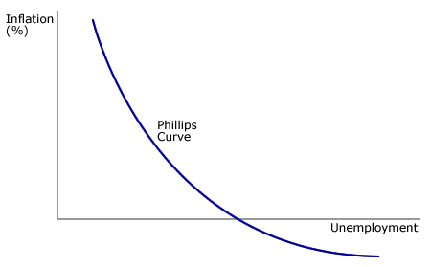
Tradeoff between macroeconomic objectives
Trade off in employment and inflation
  Phillips Curve

Slide 13
Tradeoff between macroeconomic objectives
Trade off in efficiency and equity
  Programs to promote equality comes at the expense of distorting incentives to work and, thus, reduce efficiency in the economy.
    For example: unemployment benefits
But we have to keep in mind that several notions of “trade-off” are contestable.

Slide 14
Finding macroeconomic data online
From the World Bank website, we can check for data for Thailand and other countries
  http://data.worldbank.org/country/thailand
Example:
  We can find data on unemployment and inflation, and plot them as time series.
  We can also observe their relationship overtime.

Slide 15
Basic concepts in understanding economic activities
4 essential macroeconomic activities:

Slide 16
4 essential macroeconomic activities
Resource maintenance=
  Capital stocks = a quantity of any resource that is valued for its potential economic contributions

Slide 17

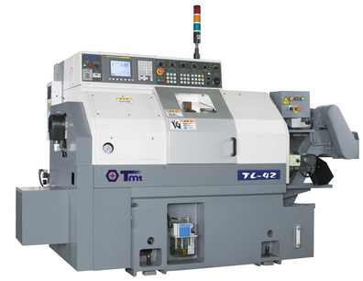



4 essential macroeconomic activities
Types of capital
  Natural capital
  Manufactured capital
  Human capital
  Social capital
  Financial capital

Slide 18
Important concepts on resource maintenance
Stock VS Flow Variables
  Stocks
  Flow
Flows change the level of stocks
Most macroeconomic variables can be categorised into stock or flow variables

Slide 19

Important concepts on resource maintenance
Stock VS Flow
Examples
Income =
Wealth =
Investment =
Capital =

Slide 20
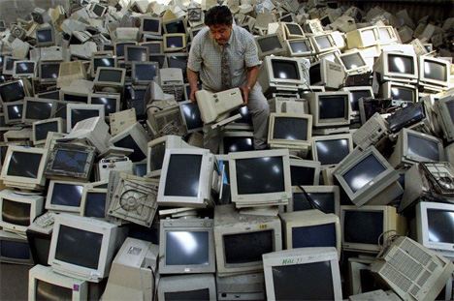
Important concepts on resource maintenance
Investment VS Depreciation
  Investment is primarily the activity of resource maintenance
  Depreciation occurs when
    Manufactured assets, for example, wear out and lost their usefulness overtime.
  Resource maintenance activities help to keep up the quantity and quality of important capital stocks.

Slide 21
4 essential macroeconomic activities
Consumption
  The final use of a good or service
  Consumption is frequently contrasted with

Slide 22
4 essential macroeconomic activities
Production = conversion of resources into goods and services.
Production converts "inputs" into "outputs"
  Inputs include materials that become part of the produced good, supplies that are used up in the production process, and labour time.
  But there are flow of services, arising out of capital stocks, that will not be used up. These include

Slide 23
Important concepts on production
“Nominal VS. Real” Value
  In economics, “nominal” value refers to the value expressed in monetary terms, i.e. in the units of a currency.
  “Real” is a value that is adjusted from the nominal value to remove the effect of a change in price over a period of time.
  For example,

Slide 24
4 essential macroeconomic activities
Distribution
  the allocation of products and resources among people
Macroeconomists are usually particularly interested in

Slide 25
Important concepts on distribution
Who receives income? Labour VS Capital
  Labour income is compensation received by workers in the form of wages, salaries, and fringe benefits
  Capital income include rents, profits, and interest
Questions usually arise

Slide 26

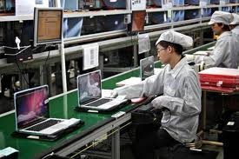
Important concepts on distribution
Tim Cook (Apple CEO) VS A Chinese labour (who produces apple products)
The Apple CEO's pay was $4.2 million in 2012 (Forbes)
A salary for an entry level worker in Foxconn factory is approximately $ 3600 per annual in 2013 (Dailymail, UK)
The difference is just 1,166 times

Slide 27
Important concepts on distribution
Measurement of income distribution
  20:20 Ratio (income of the richest 20% divided by that of the poorest 20%)
  Lorenz curve = a line used to portray an income distribution, drawn on a graph with percentiles of household on the horizontal axis and the cumulative percentage of income on the vertical axis.
  Gini ratio =

Slide 28
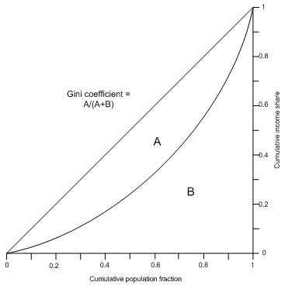
Lorenz Curve
Gini ratio (or coefficient) = a/a+b
If the gini is higher, the economy is more unequal
Thailand Gini Coefficient (world bank)
1990 = 45.27
1996 = 42.9
2000 = 42.84
2006 = 42.35
2009 = 40.0
Other countries
Cambodia 2009 = 36.0
South Korea 2007= 31.3

Slide 29
Important concepts on distribution
Wealth inequality -- the distribution of wealth, i.e. what people own in assets or debt
Example:
  http://business.time.com/2014/01/20/worlds-85-wealthiest-people-as-rich-as-3-5-billion-poorest/

Slide 30
4 essential macroeconomic activities
Important concepts on distribution: taxes VS transfers
  Taxes is the main venue for the government to raise revenue.
  Transfer are flow of money, goods, or service from the government to its people. It forms an important part of the roles of a government in providing welfare.

Slide 31
The Revenue Structure, Thai Government, 2533-2554 BE
Unit: Millions Baht
2,224,377
209,427
(9.4%)
1,123,109
(50.5%)
891,841
(40.1%)
Direct taxes
Indirect taxes
Non-tax revenues
Direct taxes: personal and corportate income taxes
Indirect taxes: VAT and excise taxes
Non-tax revenues : government services fees, and revenue from state-own enterprises

Slide 32
Thailand’s fallen poverty VS persistent inequality
Despite being very successful with the effort to reduce absolute poverty, Thailand has achieve very little success in reducing inequality.
Why do you think this has happened to us?

Slide 33
The 3 spheres of economic activities
Economic activity take place in three major sphere:
  Households: make decisions on consumption and savings, supply of labour, investment in education.
  Firms: makes decisions in production and investment.
    Main motive is assumed to be profit-making.
  Government: makes decisions related to the provision of public goods, and regulation of markets.
    But is generally seen by economists as inefficient.

