Slide 1


EE 366 Economics of Services Sector
Dr. Nessara Sukpanich

Slide 2

Contents
Overview
1
Relevant definitions
2
General characteristics of service
3
Classification of service
4
Measurement of service economy
5
Service sector in Thailand
6

Slide 3












1. Overview
Service Sector Contribution to GDP (%) by 2016
Canada
U.K.
Germany
China
Country
% of World GDP
74.1
51.6
1.U.S.
2.China
3.Japan
4.Germany
5.U.K.
6.France
7.India
8.Italy
9.Brazil
10.Canada
24.5
14.8
6.5
4.6
3.5
3.3
3.0
2.4
2.4
2.0
80.2
68.9
Japan
Italy
France
U.S.
India
71.1*
80.2
73.8
79.2
Brazil
53.8
73.3
Even though the Chinese economy is ranked as the world’s second country in 2016 ,the
services sector’s share of GDP in China (51.6%) is much lower than countries like the U.S.
(80.2%), U.K. (80.2%), France (79.2%), etc.
Source: World Bank
* Denotes estimation

Slide 4





1.Overview (Cont.)
Service Sector Contribution to GDP (%) 2016 compared to 2010
Source: World Bank

Slide 5



1.Overview (Cont.)
Sector Employment in Top Seven Nations by 2010
Nation
% of World Labor
% of Agriculture
% of Manufacturing
% of Service
China
21.0
50
15
35
India
17.0
60
17
23
U.S.
4.8
2
20
78
Indonesia
3.9
45
16
39
Brazil
3.0
23
24
53
Russia
2.5
12
23
65
Japan
2.4
5
26
69
Source: World Bank

Slide 6

1.Overview (Cont.)
Sector Employment in Top Seven Nations by 2016
Nation
% of World Labor
% of Agriculture
% of Manufacturing
% of Service
China
23.6
29
29
42
India
14.7
47*
22*
31*
U.S.
4.7
2
18
80
Indonesia
3.7
33
33
45
Brazil
3.1
1
22
77
Russia
2.2
7
27
66
Bangladesh
2.1
47*
13*
40*
Service sectors become more important in BRIC economies(Brazil, Russia, India and China)
Source: World Bank
* Denotes estimation

Slide 7
1.Overview (Cont.)
Role of Services in an Economy
Financial Services
Infrastructure Services
Financing
Leasing
Insurances
Communication
Transportation
Utilities
Banking
Manufacturing
Services inside company:
Personal Services
Distribution Services
Heath care
Restaurants
Hotels
Finance
Accounting
Legal
R & D and design
Wholesaling
Retailing
Repairing
Consumer Services
Self-service
Business Services
Consulting
Auditing
Advertising
Waste disposal
Government Services
Military
Education
Judicial
Police and fire protection
Source: Service Management

Slide 8



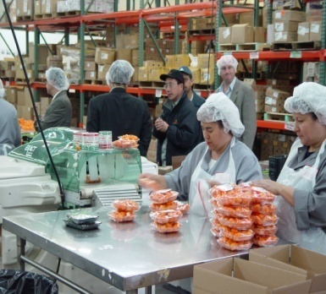

1.Overview (Cont.)
Stages of Economic Evolution
Quinary
(Human Potential)
Quaternary
(Trade and Commerce)
Heath, Education, Arts,
Research, Recreation
Tertiary
(Domestic Service)
Transportation, Communication, Retailing, Finance, Government
Restaurants, Hotels, Laundry, Maintenance
Secondary
(Goods-producing)
Primary
(Extractive)
Manufacturing, Processing
As nations become industrialized, there is an inevitable shift of employment from one sector of the economy to another.
Agriculture, Mining, Fishing, Forestry
Source: Fitzsimmons, Fitzsimmons and Bordoloi (2014)

Slide 9

2. Relevant definitions
Services
D
E
F
I
N
I
T
I
O
N
services are a diverse group of economic activities not directly associated with the manufacture of goods, mining or agriculture
OECD
GATS
Services includes any service in any sector except services supplied in the exercise of governmental authority
Services are all economic activities
except those in Agriculture, Manufacturing, and Mining & Quarrying Sector.

Slide 10
2. Relevant Definitions (Cont.)
D
E
F
IN
I
T
I
O
N
Zhou (2016) explains definition of services (activities), service industry and service economy
Services (Activities)
Two kinds of outcomes of human labor
- the materialization type (good)
- the activated type (services)
They typically involve the provision of human value added in the form of labour, advice, managerial skill, entertainment, training, intermediation and the like (OECD, 2012)
Characteristics of services (explained later): Customer participation, simultaneity, perishability, intangibility, heterogeneity, and nontransferable ownership (Fitzsimmons, Fitzsimmons and Bordoloi, 2014)

Slide 11
2. Relevant Definitions (Cont.)
D
E
F
IN
I
T
I
O
N
Zhou (2016) explain definition of services (activities), service industry and service economy
2. Service industry
  An industry sector which is engaged in various kinds of service activities and has nothing to do with the self-consumption service or built in services, only the services activities which are external, independent and supplied for the consumption of usage of others can be classified to the service industry
  Service industry is not the collection of all kinds of service activities
3. Service economy
A social economic form based on services activities and
dominated by service sectors

Slide 12
3. General Characteristics of Service
Customer
Participation
Simultaneity
Distinctive Characteristics
of Services
Perishability
Intangibility
Heterogeneity
Non-transferable Ownership
Note: Could be some exceptions for each characteristic in some service industry
Source: Fitzsimmons, Fitzsimmons and Bordoloi (2014)

Slide 13
3. General Characteristics of Service (Cont.)
NOTE:
For services,
  Inputs are the customers themselves, and
  resources are the facilitating goods, employee labor, and capital at the command of the service manager.
Thus, to function, the service system must interact with the customers as participants in the service process.
Because customers typically arrive at their own discretion and with unique demands on the service system, matching service capacity with demand is a challenge.
For some services, such as banking, however, the focus of activity is on processing information instead of people. In some cases such as electronic fund transfer, the presence of the customer at the bank is unnecessary
Source: Fitzsimmons, Fitzsimmons and Bordoloi (2014)

Slide 14
3. General Characteristics of Service (Cont.)
Presence of customer as a participant in service process requires attention to facility design, e.g. restaurant
Customer can play an active part in the process, e.g. medical service, education
May take consumer out of process such as internet banking, online-shopping
Customer
Participation
Created and consume simultaneously so cannot be stored
Unlike manufacturing, service cannot relies on inventory strategy as a buffer to absorb fluctuations in demand
Manufacturing problem - inventory control/
Service problem - customer waiting or queuing
Simultaneity characteristic eliminates many opportunities for quality control intervention
Simultaneity
Source: Fitzsimmons, Fitzsimmons and Bordoloi (2014)

Slide 15
3. General Characteristics of Service (Cont.)
Perishability
Cannot be stored so incur opportunity loss of idle capacity (time-perishable capacity), e.g. empty airlines, un occupied hospital and hotel room – full capacity utilization becomes managing challenge
Possible consumer cyclic behavior over short periods of time, e.g. restaurant
Seasonal variation in demand can create surges in activity
With time perishable capacity and variable demand, managers faces three basic options: smooth demand, adjust service capacity, and allow customer to wait
Source: Fitzsimmons, Fitzsimmons and Bordoloi (2014)

Slide 16
3. General Characteristics of Service (Cont.)
Intangibility
Services are ideas and concepts/products are things. So, service innovation are not patentable
Franchising allows the parent firm to sell its ideas to local entrepreneur
Unlike products that customers may see, feel and test its performance before buying, in service customer has to rely on reputation of the service firm
In many service areas, the government has intervened to guarantee acceptable service performances
Source: Fitzsimmons, Fitzsimmons and Bordoloi (2014)

Slide 17
3. General Characteristics of Service (Cont.)
Heterogeneity
Intangibility and customer participation characteristics of service results in variation of service from customer to customer.
Direct customer and employee contact in services creates the possibility of a more satisfying human work experience.
In general, employee is the firm’s sole contact with customers. So, service managers must be concerned about employees’ attitude as well as their performance.
Source: Fitzsimmons, Fitzsimmons and Bordoloi (2014)

Slide 18
3. General Characteristics of Service (Cont.)
Nontransferable ownership
Unlike goods, services do not involve transfer of ownership
Customer may gain access or rental of resources
Customer do not purchase an asset but, instead, have use of the asset for a specific time such as use of human labor (e.g. dentist), technology (e.g. cellular network), or physical asset (e.g. theme park)
Customer often share the service provider’s asset concurrently with other customers
Source: Fitzsimmons, Fitzsimmons and Bordoloi (2014)

Slide 19
4. Classification of service provider (by users)
Service provided for producers (business services): B2B
Service provided for final consumers: B2C

Slide 20
4. Classification of service (by delivery process)
Degree of interaction and customization
Low
High
Service factory:
Airlines
Trucking
Hotels
Resorts and recreation
Service shop:
Hospitals
Auto repair
Other repair services
Low
Degree of labor intensity
Mass factory:
Retailing
Wholesaling
Schools
Retail aspects of commercial
banking
Professional Service:
Physicians
Lawyers
Accountants
Architects
High
Source: Service Management

Slide 21
4. Classification of service (in various organizations)
Scope of the Service Sector
NESDB Concept | GATS Concept
1. Wholesale and retail trade | 1. Business services
2. Transportation and storage | 2. Communication services
3. Accommodation and food service activities | 3. Construction and related engineering services
4. Information and Communication | 4. Distribution services
5. Financial and insurance activities | 5. Educational services
6. Real estate activities | 6. Environmental services
7. Professional, scientific and technical activities | 7. Financial services
8. Administrative and support service activities | 8. Health-related and social services
9. Public Administration and defense | 9. Tourism and travel-related services
10. Education | 10. Recreational, cultural, and sporting services
11.Human heath and social work activities | 11. Transport services
12. Arts, entertainment and recreation | 12. Other services not included elsewhere
13. Other service activities
14. Activities of households as employers
Source: National Economic and Social Development Board & GATT

Slide 22
4. Classification of service (in various organizations)
Scope of the Service Sector
OECD
1. Wholesale and retail trade
2. Transportation and warehousing
3. Information
4. Finance and insurance
5. Real estate, rental and leasing
6. Professional, scientific and technical
7. Administrative and support, and waste management
8. Education
9. Health care and social assistance
10. Arts, entertainment and recreation
11. Accommodation and food services
12. Public administration
Source: National Economic and Social Development Board & GATT

Slide 23
5. Measurement of service economy
Scope of the Service Sector
Categories
Indexes
Formulas
Source: Zhou (2016), p. 48

Slide 24
5. Measurement of service economy
Scope of the Service Sector
Categories
Indexes
Formulas
Source: Zhou (2016), p. 48

Slide 25
5. Measurement of service economy
Scope of the Service Sector
Categories
Indexes
Formulas
Source: Zhou (2016), p. 48

Slide 26

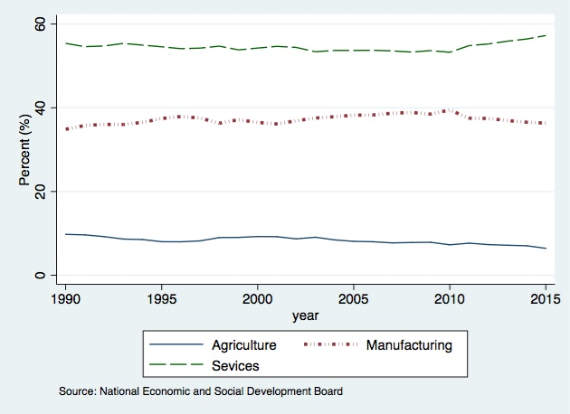

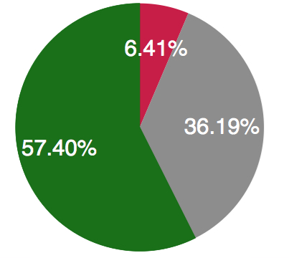


6. Service Sector in Thailand
2015
GDP Contribution by sector
Agriculture
Manufacture
Service
The service sector has contributed the largest percentage
to the country’s GDP since 1990.

Slide 27





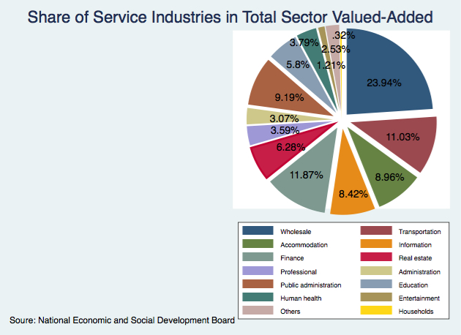









6. Service Sector in Thailand (Cont.)
Share of Service Industries in Total Sector Valued-Added(2015)
Arts
Health
Other services
Households
Education
Wholesale
and retail trade
Public Administration
Administration
Professional
Transportation
Real Estate
Accommodation
Finance
Information and Communication

Slide 28
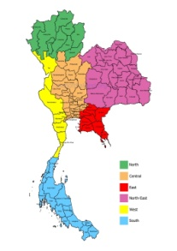
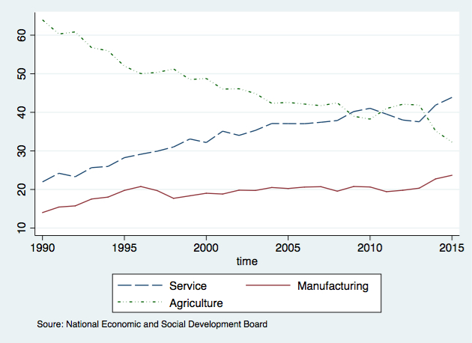

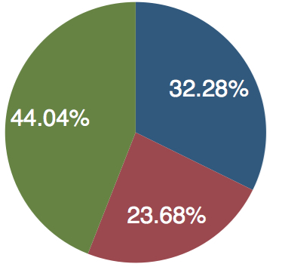


6. Service Sector in Thailand (Cont.)
Labor Employment by sector
2015
Agriculture
Service
Manufacture
The service sector employs as many as 44% of the work force and produces
57% of GDP. In comparison, the manufacturing sector employs only 23 % of
the work force and produces as much as 35% of GDP.

Slide 29

Reference
Fitzsimmons, J. A., Fitzsimmons M. J. and Bordoloi, S., Service
Management Operations, Strategy, Information Technology, 8th
Edition, McGraw-Hill, 2014
Jansson, J. O., The Economics of Service Microfoundations, Development and Policy, 2nd Edition, Edward Elgar, 2013
Zhou, Z., The Development of Service Economy: A General Trend of the Changing Economy in China: Truth & Wisdom Press and Springer Science+Business Media Singapore, 2016

