Slide 1
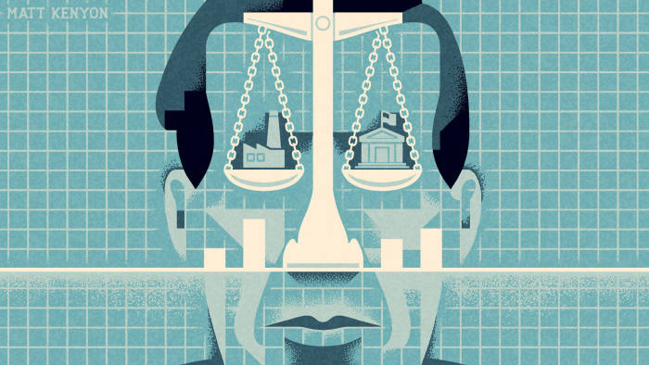

EE 403
Law & Economics
Property Law : 3
Anin Aroonruengsawat, Ph.D
2022/20220

Slide 2
Application of property law to information: Intellectual Property Right
Four principal areas of law create property in information.
  Patent system : ownership rights to inventions, processes, and other technical improvements.
  Copyright system : ownership right to authors, artists and composers
  Trademark system: ownership for distinctive commercial marks or symbols that uniquely identify and individual’s organization’s output
  Trade secrets : deals with business practices in which commercial enterprises have a property interest.

Slide 3
Innovation and information
Innovation ➔ lower cost/new product ➔ higher consumer surplus
A company that innovates gains a competitive advantage, creates extraordinary profits.
When the innovation diffuses fully, the innovator loses its competitive advantage ➔ profits fall.
Without legal intervention, competition can quickly destroy the profits from innovation ➔ too little innovation.

Slide 4
Innovation and information
Information has two characteristics that make transactions in information different from transactions in private goods.
Credibility and
Non-appropriability : producers have difficulty selling information for more than a fraction of its value.
  information is generally costly to produce and cheap to transmit.
  popular music is costly to make and recordings are cheap to copy
  reseller bears only the cost of transmission, not the cost of production ➔ consumers try to “free ride” by paying no more than the cost of transmission.

Slide 5
Information is public good.
information use is nonrivalrous ➔ one person’s use of an idea does not diminish its availability for others to use.
Excluding some people from learning about a new idea can be expensive, because the transmission of ideas is cheap.
➔ nonexcludable.
Non-appropriability of information is essentially the same problem as non-excludability for public goods ➔ private markets often undersupply public goods.

Slide 6
Market undersupplies creative works: Remedies
  Supply or subsidize art and science ➔ basic research funding
  Charitable contributions ➔ tax deduction incentive
  Trade secrets protection ➔ non-disclosure agreement (NDA)➔the employee or contractor promises not to disclose any of the company’s secrets
  Patents
  Copyright
  Trademark

Slide 7
Intellectual Property
Patents and copyright may be temporary monopolies that can vary in breadth and duration.
The owner can disseminate it and charge fees for its use, such as licensing fees for patents
Narrowing the breadth or shortening the duration of intellectual property rights often decreases monopoly profits and increases dissemination.

Slide 8
Patents:
Patent office establishing that the invention is for a “new and useful process, machine, manufacture, or composition of matter or [a] new and useful improvement thereof”.
The innovation must be “non-obvious”, must have “practical utility and must not have been commercialized or known to the public for mare than a year before the date of application”
The successful applicant receives a 20-year monopoly on the use of the invention.
No one can use the invention except by its owner’s consent.
The holder may, at his or her discretion, license the use of the patent in exchange for the licensee’s payment of a fee known as a royalty.

Slide 9
Patents:
The information in the application is accessible to the public.
If the application fails, competitors will be able to freely use the invention described in the application.
If the application succeeds, competitors will have a precise description of the invention, so they can try to emulate it without trespassing on the patent (“engineer around the patent”).
For these reasons, some inventors prefer to rely on trade secrets protection and not apply for a patent.

Slide 10
Patents: Broad or Narrow?
Patents create an exclusive property right in an invention with two dimensions: duration and breadth.
“Duration” refers to the number of years between a patent’s registration and its expiration.
“Breadth” refers to how similar another invention can be without infringing on the patent for the original invention.
.
The Rubik’s Cube is a popular puzzle in which each of the six sides of the cube are divided into a 3 × 3 grid. An American court ruled that the Rubik’s Cube did not infringe an earlier patent by Moleculon for a similar game using a 2 × 2 grid
.
.

Slide 11
Efficient duration: What is the optimal patent life?
patents create a temporary monopoly
balance between encouraging creativity and discouraging dissemination.
the current international default patent term ➔ 20 years
Germany has established a two-tiered patent system. Major inventions in Germany receive full-term patents, while minor inventions and improvements receive petty patents for a term of 3 years.
In addition, must pay an annual fee to continue the patent.

Slide 12
Copyright
Copyright grants writers, composers, and other artists property rights in their creations on demonstration that their works are original expressions.
Copyright law automatically applies to anything you’ve written/created
A broad copyright forbids any unauthorized use, whereas a narrow copyright permits some unauthorized uses. The law handles these uses through so-called fair-use exceptions.
For example, books are quoted in reviews, or photocopied or distributed electronically for educational purposes

Slide 13
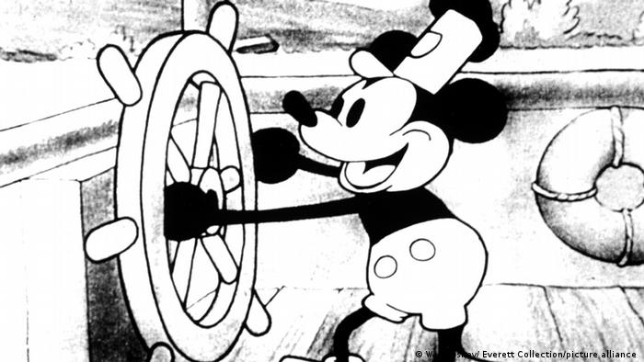
Copyright
the duration of a copyright until it now stands as the creator’s life plus 70 years
tracing costs, the costs of searching among all novels to make sure the idea does not, unintentionally, infringe copyright.
To limit these costs, creators are given limited duration and relatively narrow breadth for their creations.
Cheap encrypting will al- legedly enable producers of digital information to control who uses it without much need for law.

Slide 14
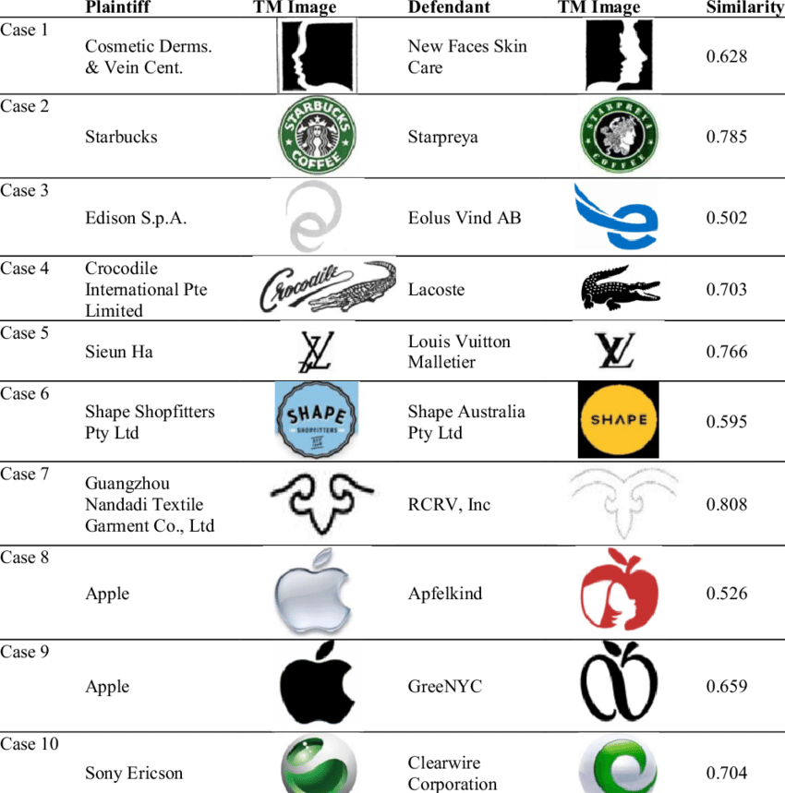
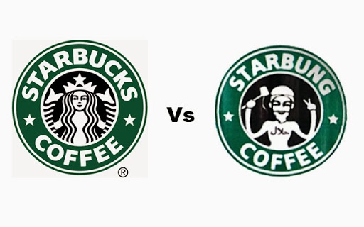
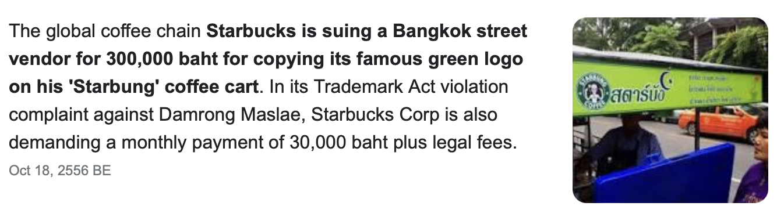
Trademark
recognizable symbols for products , Such symbols are trademarks or service marks
As in the case of patents, the successful applicant must establish that the mark passes certain criteria, the most important of which is distinctiveness

Slide 15
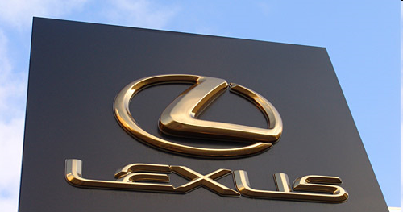
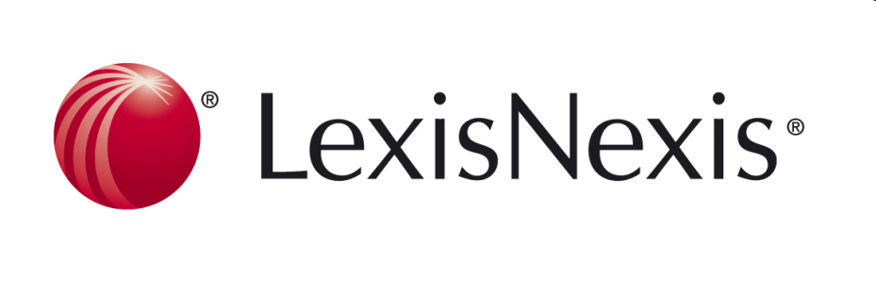
Trademark
In 1989, Toyota introduced the Lexus name (L-E-X-U-S). They were sued by Lexis (L-E-X-I-S), a company that provides searches of legal sources (now Lexis-Nexis, which those of you who go to law school will get to know quite well). The court ruled for the car company, saying they were not infringing.
Notes:
In 1989, Toyota introduced the Lexus name (L-E-X-U-S)
They were sued by Lexis (L-E-X-I-S), a company that provides searches of legal sources (now Lexis-Nexis, which those of you who go to law school will get to know quite well)
The court ruled for the car company, saying they were not infringing.
The first time I taught this class, I stumbled on an article that for the second time in a year, Toyota was suing a porn star who’s adopted the stage name “Lexus”
Taken together, these seem to suggest that Toyota believes that:
you are unlikely to mistake a luxury car for an online legal search
but you might mistake a luxury car for gay porn
(The CEO of EBoys Studios claims the actor took the name “in honor of the Greek god Lexus”, which would be a better story if there had been a Greek god Lexus.)
Of course, Lexus isn’t really claiming that people will be confused about whether they’re getting a car or gay porn
Obviously, trademark law prohibits someone else from selling a soft drink called Coca-Cola
Less obviously, it also prohibits someone else from selling, say, a clothing line or a sandwich meat called Coca-Cola
The legal doctrine here is “dilution of the distinctive quality of a mark or trade name,” which can be claimed even in “the absence of competition between the parties or the absence of confusion as to the source of goods or services.”
That is, once you’ve established a brand name, people can’t use it in a way that hurts its image, even if it doesn’t create genuine confusion about whose products are whose.
The economic argument for trademark protection seemed pretty clear – reduce buyer uncertainty, increase seller incentives to maintain a reputation for quality
The argument against trademark dilution is a bit harder – seems more to be protecting vested interest
But I thought it was interesting

Slide 16
Trademark
help to solve the problem of consumer ignorance about the quality of a product. The consumer can use the trademark as a signal of quality.
Lower consumer search costs and create an incentive for producers to supply goods of high quality.
Limits on the duration of patents and copyrights were justified as attempts to minimize the social costs of monopoly and tracing. However, trademarks encourage competition. Perhaps this is why trademarks can last forever, until abandoned.

Slide 17
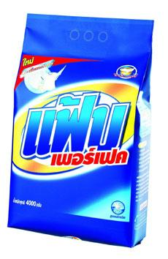
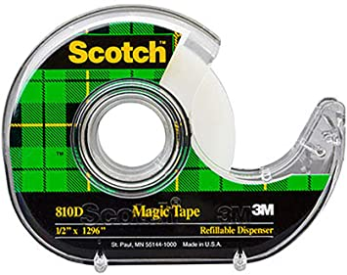
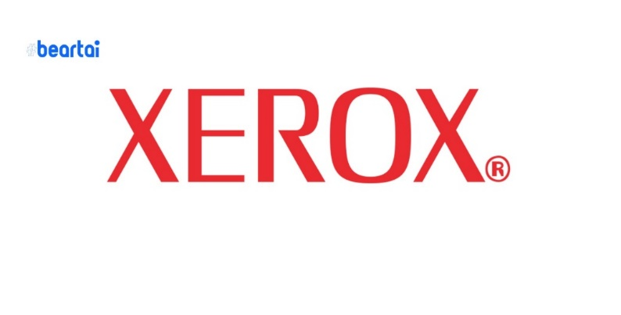
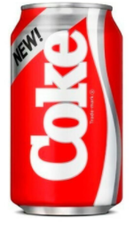
Trademark
generic product names cannot be trademarks. “camera”
Sometimes, however, a competitive product succeeds so far that its trademark becomes a generic name.
The trademark owner must protect the trademark by suing rivals who use the generic name to describe their products. Otherwise, the producer loses its property right in the generic name.

