Slide 1
Time Value of Money
Chapter 5
Future Value
Present Value
Annuities
Rates of Return
Amortization

Slide 2
Need Cash , Sir?
loan calculator
The Guardian Calculator

Slide 3
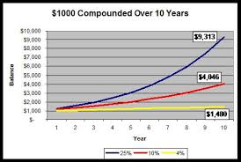

Slide 4
Time Lines
0
1
2
3
I%
CF₀
CF₁
CF₂
CF₃
Show the timing of cash flows.
Tick marks occur at the end of periods, so Time 0 is today; Time 1 is the end of the first period (year, month, etc.) or the beginning of the second period.

Slide 5
Drawing Time Lines
$100 lump sum due in 2 years
0
1
2
I%
100
3-year $100 ordinary annuity
0
1
2
3
I%
100
100
100

Slide 6
Drawing Time Lines
Uneven cash flow stream
0
1
2
3
I%
-50
100
75
50

Slide 7
Future Value

Slide 8
What is the future value (FV) of an initial $100 after 3 years, if I/YR = 10%?
Finding the FV of a cash flow or series of cash flows is called compounding.
FV can be solved by using the step-by-step, financial calculator, and spreadsheet methods.
0
1
2
3
10%
100
FV = ?

Slide 9
Solving for FV:
The Step-by-Step and Formula Methods
After 1 year:
  FV₁ = PV(1 + I) = $100(1.10) = $110.00
After 2 years:
  FV₂ = PV(1 + I)² = $100(1.10)² = $121.00
After 3 years:
  FV₃ = PV(1 + I)³ = $100(1.10)³ = $133.10
After N years (general case):
  FV_{N} = PV(1 + I)^{N}

Slide 10
Solving for FV:
Calculator and Excel Methods
Solves the general FV equation.
Requires 4 inputs into calculator, and will solve for the fifth. (Set to P/YR = 1 and END mode.)
Excel: =FV(rate,nper,pmt,pv,type)
INPUTS
3
10
-100
0
N
I/YR
PV
PMT
FV
OUTPUT
133.10

Slide 11
Example
If you deposit $10,000 in a bank account that pays 10% interest annually, how much will be in your account after 5 years?

Slide 12
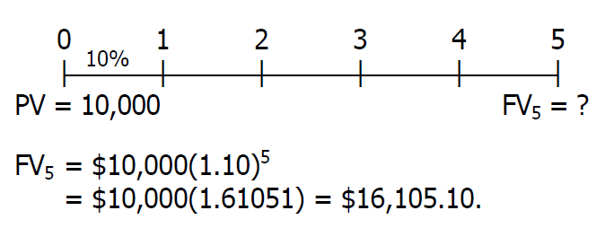
Solution
Alternatively, with a financial calculator enter the following: N= 5, I/YR= 10, PV= -10000, and PMT= 0. Solve for FV= $16,105.10

Slide 13
Present Value

Slide 14
What is the present value (PV) of $100 due in 3 years, if I/YR = 10%?
Finding the PV of a cash flow or series of cash flows is called discounting (the reverse of compounding).
The PV shows the value of cash flows in terms of today’s purchasing power.
0
1
2
3
10%
PV = ?
100

Slide 15
Solving for PV:
The Formula Method
Solve the general FV equation for PV:
  PV = FV_{N} /(1 + I)^{N}
  PV = FV₃ /(1 + I)³
  = $100/(1.10)³
  = $75.13

Slide 16
Solving for PV:
Calculator and Excel Methods
Solves the general FV equation for PV.
Exactly like solving for FV, except we have different input information and are solving for a different variable.
Excel: =PV(rate,nper,pmt,fv,type)
INPUTS
3
10
0
100
N
I/YR
PV
PMT
FV
OUTPUT
-75.13

Slide 17
Example
What is the present value of a security that will pay $5000 in 20 years if securities of equal risk pay 7% annually

Slide 18
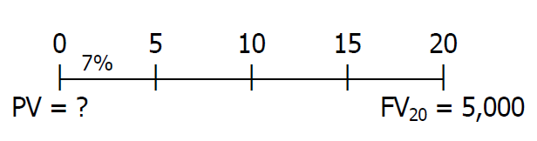
Solution
With a financial calculator enter the following: N = 20, I/YR = 7, PMT = 0, and
FV = 5000. Solve for PV = $1,292.10.

Slide 19
Future value
  FV_{N} = PV(1 + I)^{N}
Present value
PV = FV_{N} /(1 + I)^{N}

Slide 20
Solving for I: What annual interest rate would cause $100 to grow to $125.97 in 3 years?
Solves the general FV equation for I/YR.
Hard to solve without a financial calculator or spreadsheet.
Excel: =RATE(nper,pmt,pv,fv,type,guess)
INPUTS
3
-100
0
125.97
N
I/YR
PV
PMT
FV
OUTPUT
8

Slide 21
Example
Your parents will retire in 18 years. They currently have $250,000, and they think they will need $1,000,000 at retirement. What annual interest rate must they earn to reach their goal, assuming they don’t save any additional funds?

Slide 22
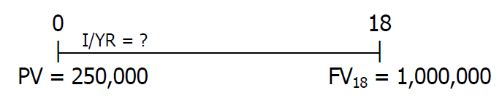
Solution
With a financial calculator enter the following: N = 18, PV = -250000, PMT = 0, and FV =1000000. Solve for I/YR = 8.01% ≈ 8%.

Slide 23
Solving for N: If sales grow at 20% per year, how long before sales double?
Solves the general FV equation for N.
Hard to solve without a financial calculator or spreadsheet.
EXCEL: =NPER(rate,pmt,pv,fv,type)
INPUTS
20
-1
0
2
N
I/YR
PV
PMT
FV
OUTPUT
3.8

Slide 24
Example
If you deposit money today in an account that pays 6.5% annual interest, how long will it take to double your money

Slide 25
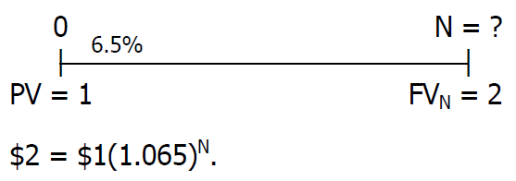
Solution
With a financial calculator enter the following: I/YR = 6.5, PV = -1, PMT = 0, and FV = 2. Solve for N = 11.01 ≈ 11 years.

Slide 26
Annuity

Slide 27
What is the difference between an ordinary annuity and an annuity due?
Ordinary Annuity
0
I%
1
2
3
PMT
PMT
PMT
Annuity Due
0
I%
1
2
3
PMT
PMT
PMT
NO NEED TO KNOW ANNUITY DUE

Slide 28
Solving for FV: 3-Year Ordinary Annuity of $100 at 10%
$100 payments occur at the end of each period, but there is no PV.
Excel: =FV(rate,nper,pmt,pv,type)
Here type = 0.
INPUTS
3
10
0
-100
N
I/YR
PV
PMT
FV
OUTPUT
331

Slide 29
Solving for PV: 3-year Ordinary Annuity of $100 at 10%
$100 payments still occur at the end of each period, but now there is no FV.
Excel: =PV(rate,nper,pmt,fv,type)
Here type = 0.
INPUTS
3
10
100
0
N
I/YR
PV
PMT
FV
OUTPUT
-248.69

Slide 30
What is the present value of a 5-year $100 ordinary annuity at 10%?
Be sure your financial calculator is set back to END mode and solve for PV:
  N = 5, I/YR = 10, PMT = -100, FV = 0.
  PV = $379.08.

Slide 31
What if it were a 10-year annuity? A 25-year annuity? A perpetuity?
10-year annuity
  N = 10, I/YR = 10, PMT = -100, FV = 0; solve for PV = $614.46.
25-year annuity
  N = 25, I/YR = 10, PMT = -100, FV = 0; solve for PV = $907.70.
Perpetuity
  PV = PMT/I = $100/0.1 = $1,000.

Slide 32
Example
Find the future values of these ordinary annuities. Compound occurs once a year.
  $400 per year for 10 years at 10%
  $400 per year for 5 years at 0%

Slide 33
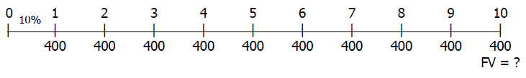
Solution
a. With a financial calculator, enter N = 10, I/YR = 10, PV = 0, and PMT = -400. Then press the FV key to find FV = $6,374.97.

Slide 34
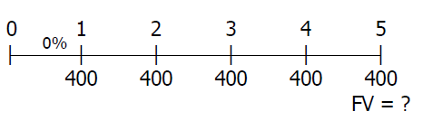
Solution (cont.)
b. Simply sum up all cash flows;
400+400+400+400+400= 400x5 = 2,000

Slide 35
The Power of Compound Interest

Slide 36
The Power of Compound Interest
A 20-year-old student wants to save $3 a day for her retirement. Every day she places $3 in a drawer. At the end of the year, she invests the accumulated savings ($1,095) in a brokerage account with an expected annual return of 12%.
How much money will she have when she is 65 years old?

Slide 37
Solving for FV: If she begins saving today, how much will she have when she is 65?
If she sticks to her plan, she will have $1,487,261.89 when she is 65.
Excel: =FV(.12,45,-1095,0,0)
INPUTS
45
12
0
-1095
N
I/YR
PV
PMT
FV
OUTPUT
1,487,262

Slide 38
Solving for FV: If you don’t start saving until you are 40 years old, how much will you have at 65?
If a 40-year-old investor begins saving today, and sticks to the plan, he or she will have $146,000.59 at age 65. This is $1.3 million less than if starting at age 20.
Lesson: It pays to start saving early.
Excel: =FV(.12,25,-1095,0,0)
INPUTS
25
12
0
-1095
N
I/YR
PV
PMT
FV
OUTPUT
146,001

Slide 39
Solving for PMT: How much must the 40-year old deposit annually to catch the 20-year old?
To find the required annual contribution, enter the number of years until retirement and the final goal of $1,487,261.89, and solve for PMT.
Excel: =PMT(rate,nper,pv,fv,type)
=PMT(.12,25,0,1487262,0)
INPUTS
25
12
0
1487262
N
I/YR
PV
PMT
FV
OUTPUT
-11,154.42

Slide 40
Uneven Cash Flow

Slide 41
What is the PV of this uneven cash flow stream?
0
1
2
3
4
10%
100
300
300
-50
90.91
247.93
225.39
-34.15
530.08 = PV

Slide 42
Solving for PV:
Uneven Cash Flow Stream
Input cash flows in the calculator’s “CFLO” register:
  CF₀ = 0
  CF₁ = 100
  CF₂ = 300
  CF₃ = 300
  CF₄ = -50
Enter I/YR = 10, press NPV button to get NPV = $530.087. (Here NPV = PV.)

Slide 43
Will the FV of a lump sum be larger or smaller if compounded more often, holding the stated I% constant?
LARGER, as the more frequently compounding occurs, interest is earned on interest more often.
0
1
2
3
10%
100
133.10
Annually: FV₃ = $100(1.10)³ = $133.10
0
1
2
3
0
1
2
3
4
5
6
5%
100
134.01
Semiannually: FV₆ = $100(1.05)⁶ = $134.01

Slide 44
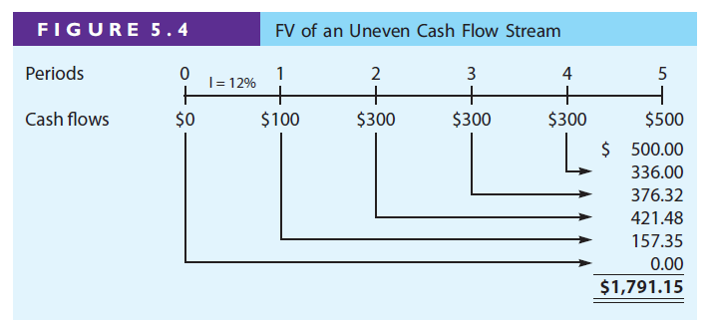
FV of an uneven cash flow stream

Slide 45
Example
Find the present values of the following cash flow streams at 8% compounded annually.
0
1
2
3
4
5
Stream A $0 $100 $400 $400 $400 $300
Stream B $0 $300 $400 $400 $400 $100

Slide 46
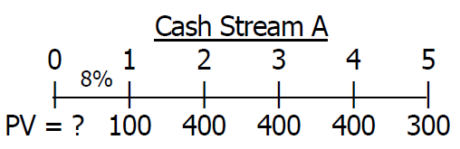
Solution
With a financial calculator, simply enter the cash flows (be sure to enter CF0 = 0), enter I/YR = 8, and press the NPV key to find NPV = PV = $1,251.25 for the first problem. Override I/YR = 8 with I/YR = 0 to find the next PV for Cash Stream A.

Slide 47
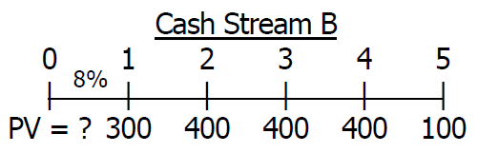
Solution (cont.)
Enter the cash flows for Cash Stream B, enter I/YR = 8, and press the NPV key to find NPV = PV = $1,300.32. Override I/YR = 8 with I/YR = 0 to find the next PV for Cash Stream B.

Slide 48
Classification of Interest Rates

Slide 49
Classification of Interest Rates
Nominal rate (I_{NOM}): also called the quoted or stated rate. An annual rate that ignores compounding effects.
  I_{NOM} is stated in contracts. Periods must also be given, e.g. 8% quarterly or 8% daily interest.
Periodic rate (I_{PER}): amount of interest charged each period, e.g. monthly or quarterly.
  I_{PER} = I_{NOM}/M, where M is the number of compounding periods per year. M = 4 for quarterly and M = 12 for monthly compounding.

Slide 50
Classification of Interest Rates
Effective (or equivalent) annual rate (EAR = EFF%): the annual rate of interest actually being earned, considering compounding.
  EFF% for 10% semiannual interest
  EFF% = (1 + I_{NOM}/M)^{M} – 1
  = (1 + 0.10/2)² – 1 = 10.25%
  Excel: =EFFECT(nominal_rate,npery)
    =EFFECT(.10,2)
  Should be indifferent between receiving 10.25% annual interest and receiving 10% interest, compounded semiannually.

Slide 51
Why is it important to consider effective rates of return?
Investments with different compounding intervals provide different effective returns.
To compare investments with different compounding intervals, you must look at their effective returns (EFF% or EAR).

Slide 52
Why is it important to consider effective rates of return?
See how the effective return varies between investments with the same nominal rate, but different compounding intervals.
EAR_{ANNUAL} 10.00%
EAR_{SEMIANNUALLY} 10.25%
EAR_{QUARTERLY} 10.38%
EAR_{MONTHLY} 10.47%
EAR_{DAILY (365)} 10.52%

Slide 53
When is each rate used?
I_{NOM}: Written into contracts, quoted by banks and brokers. Not used in calculations or shown on time lines.
I_{PER}: Used in calculations and shown on time lines. If M = 1, I_{NOM} = I_{PER} = EAR.
EAR: Used to compare returns on investments with different payments per year. Used in calculations when annuity payments don’t match compounding periods.

Slide 54
What is the FV of $100 after 3 years under 10% semiannual compounding? Quarterly compounding?

Slide 55
Can the effective rate ever be equal to the nominal rate?
Yes, but only if annual compounding is used, i.e., if M = 1.
If M > 1, EFF% will always be greater than the nominal rate.

Slide 56
What’s the FV of a 3-year $100 annuity, if the quoted interest rate is 10%, compounded semiannually?
Payments occur annually, but compounding occurs every 6 months.
Cannot use normal annuity valuation techniques.
0
1
2
3
4
5
6
5%
100
100
100

Slide 57
Method 1:
Compound Each Cash Flow
0
1
2
3
4
5
6
5%
100
100
100
110.25
121.55
331.80
FV₃ = $100(1.05)⁴ + $100(1.05)² + $100
FV₃ = $331.80

Slide 58
Method 2:
Financial Calculator or Excel
Find the EAR and treat as an annuity.
EAR = (1 + 0.10/2)² – 1 = 10.25%.
Excel: =FV(.1025,3,-100,0,0)
INPUTS
3
10.25
0
-100
N
I/YR
PV
PMT
FV
OUTPUT
331.80

Slide 59
Find the PV of This 3-Year Ordinary Annuity
Could solve by discounting each cash flow, or…
Use the EAR and treat as an annuity to solve for PV.
Excel: =PV(.1025,3,100,0,0)
INPUTS
3
10.25
100
0
N
I/YR
PV
PMT
FV
OUTPUT
-247.59

Slide 60
Example
Bank A pays 4% interest compounded annually on deposits, while Bank B pays 3.5% compounded daily.
  Based on the EAR (or EFF%), which bank should you use?

Slide 61
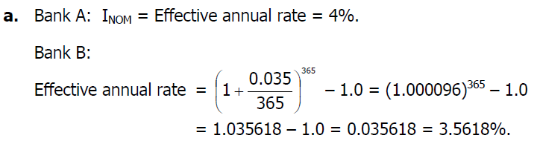
Solution
With a financial calculator, you can use the interest rate conversion feature to obtain the same
answer. You would choose Bank A because its EAR is higher.

Slide 62
Loans

Slide 63
Loan Amortization
Amortization tables are widely used for home mortgages, auto loans, business loans, retirement plans, etc.
Financial calculators and spreadsheets are great for setting up amortization tables.
EXAMPLE: Construct an amortization schedule for a $1,000, 10% annual rate loan with 3 equal payments.

Slide 64
Step 1:
Find the Required Annual Payment
All input information is already given, just remember that the FV = 0 because the reason for amortizing the loan and making payments is to retire the loan.
Excel: =PMT(.10,3,-1000,0,0)
INPUTS
3
10
-1000
0
N
I/YR
PV
PMT
FV
OUTPUT
402.11

Slide 65
Step 2:
Find the Interest Paid in Year 1
The borrower will owe interest upon the initial balance at the end of the first year. Interest to be paid in the first year can be found by multiplying the beginning balance by the interest rate.
INT_{t} = Beg bal_{t}(I)
INT₁ = $1,000(0.10) = $100

Slide 66
Step 3:
Find the Principal Repaid in Year 1
If a payment of $402.11 was made at the end of the first year and $100 was paid toward interest, the remaining value must represent the amount of principal repaid.
PRIN = PMT – INT
= $402.11 – $100 = $302.11

Slide 67
Step 4:
Find the Ending Balance after Year 1
To find the balance at the end of the period, subtract the amount paid toward principal from the beginning balance.
END BAL = BEG BAL – PRIN
= $1,000 – $302.11
= $697.89

Slide 68
Constructing an Amortization Table:
Repeat Steps 1-4 Until End of Loan
YEAR
BEG BAL
PMT
INT
PRIN
END BAL
1
$1,000
$
402
$100
$
302
$698
2
698
402
70
332
366
3
366
402
3
6
366
0
TOTAL
–
$1,206
$206
$1,000
–

Slide 69
Illustrating an Amortized Payment:
Where does the money go?
$
402.11
Interest
302.11
Principal Payments
0
1
2
3
Constant payments
Declining interest payments
Declining balance

Slide 70
Example
Set up an amortization schedule for a $25,000 loan to be repaid in equal installments at the end of each of the next 3 years. The interest rate is 10% compounded annually.
What percentage of the payment represents interest and what percentage represents principal for each of the 3 years? Why do these percentages change over time?

Slide 71
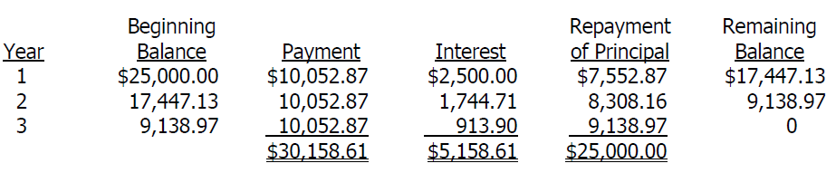
Solution
a. With a financial calculator, enter N = 3, I/YR = 10, PV = -25000, and FV = 0, and solve for PMT = $10,052.87. Then go through the amortization procedure as described in your calculator manual to get the entries for the amortization table.

Slide 72
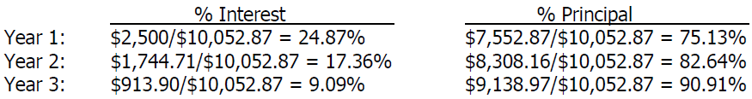
Solution (cont.)
b.
These percentages change over time because, even though the total payment is constant, the amount of interest paid each year is declining as the balance declines.

Slide 73
Lecture 7
Interest rates

Slide 74
Interest Rates
Chapter 7
Cost of Money and Interest Rate Levels
Determinants of Interest Rates
The Term Structure and Yield Curves
Using Yield Curves to Estimate Future Interest Rates

Slide 75
Cost of Money and
Interest Rate Levels
Notes:
Ajarn ka I think the slides for this part are missing?? Or it will require only explanation like introduction of the chapter?
But there is nothing to answering this objective
“List the various factors that influence the cost of money”

Slide 76
What four factors affect the level of interest rates?
Production opportunities
Time preferences for consumption
Risk
Expected inflation

Slide 77
Determinants of Interest Rates

Slide 78
“Nominal” vs. “Real” Rates
r = represents any nominal rate
r* = represents the “real” risk-free rate of interest. Like a T-bill rate, if there was no inflation. Typically ranges from 1% to 5% per year.
r_{RF} = represents the rate of interest on Treasury securities.

Slide 79
Determinants of Interest Rates
r = r* + IP + DRP + LP + MRP
r = required return on a debt security
r* = real risk-free rate of interest
IP = inflation premium
DRP = default risk premium (CREDIT)
LP = liquidity premium (RISK)
MRP = maturity risk premium

Slide 80
Premiums Added to r* for Different Types of Debt
 | IP | MRP | DRP | LP
S-T Treasury | ✓
L-T Treasury | ✓ | ✓
S-T Corporate | ✓ |  | ✓ | ✓
L-T Corporate | ✓ | ✓ | ✓ | ✓

Slide 81
TIPS
Interest Rate = real rate+ inflation rate
If the TIPS yield is 1% and inflation is 2%
Then TIPS will pay investors 1+2= 3%

Slide 82
Breakeven inflation
Treasury Bond gives you 3%
TIPS gives you 1%
Therefore the breakeven inflation rate is
= 2%

Slide 83
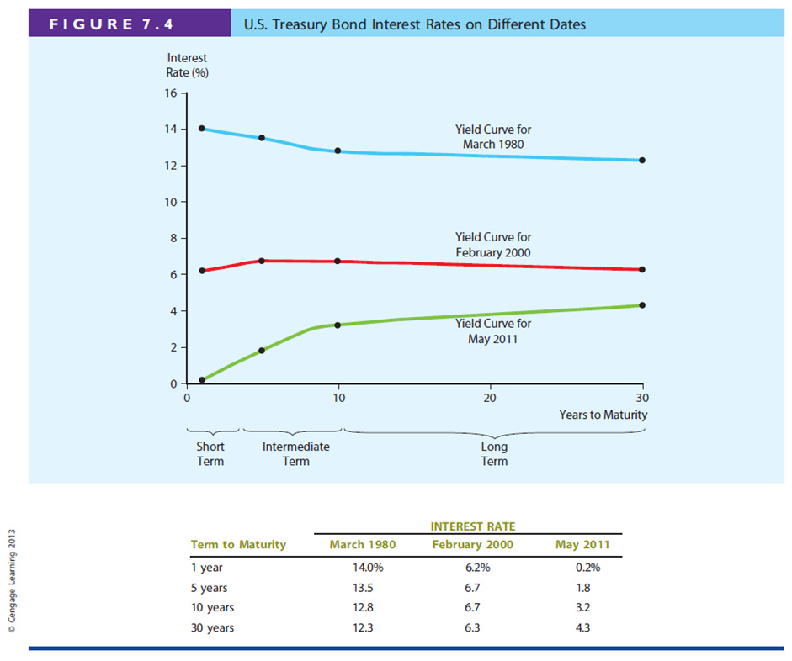

Slide 84
Yield Curve and the Term Structure of Interest Rates
Term structure: relationship between interest rates (or yields) and maturities.
The yield curve is a graph of the term structure.
The May 2011 Treasury yield curve is shown at the right.
Yield Curve for May 2011

Slide 85
Hypothetical Yield Curve
Interest
Rate (%)
An upward-sloping yield curve.
Upward slope due to an increase in expected inflation and increasing maturity risk premium.
15
Maturity risk premium
10
Inflation premium
5
Real risk-free rate
Years to
Maturity
0
1
10
20

Slide 86
Relationship Between Treasury Yield Curve and Yield Curves for Corporate Issues
Corporate yield curves are higher than that of Treasury securities, though not necessarily parallel to the Treasury curve.
The spread between corporate and Treasury yield curves widens as the corporate bond rating decreases.

Slide 87
Relationship Between Treasury Yield Curve and Yield Curves for Corporate Issues
Since corporate yields include a default risk premium (DRP) and a liquidity premium (LP), the corporate bond yield spread can be calculated as:

Slide 88
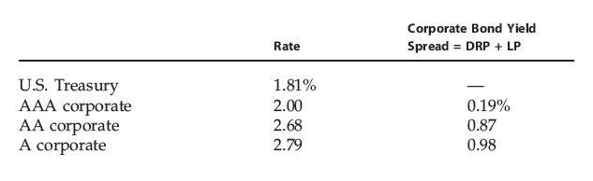
Representative Interest Rates on
5-Year Bonds in May 2011

Slide 89
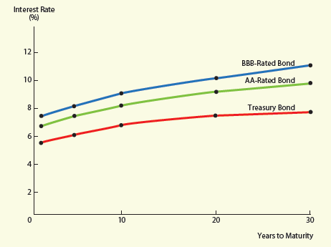

Illustrating the Relationship Between Corporate and Treasury Yield Curves

Slide 90
Using Yield Curves to Estimate Future Interest Rates

Slide 91
Pure Expectations Theory
The pure expectations theory contends that the shape of the yield curve depends on investors’ expectations about future interest rates.
If interest rates are expected to increase, L-T rates will be higher than S-T rates, and vice-versa. Thus, the yield curve can slope up, down, or even bow.

Slide 92
Assumptions of Pure Expectations
Assumes that the maturity risk premium for Treasury securities is zero.
Long-term rates are an average of current and future short-term rates.
If the pure expectations theory is correct, you can use the yield curve to “back out” expected future interest rates.

Slide 93
An Example: Observed Treasury Rates and Pure Expectations
Maturity | Yield
1 year | 6.0%
2 years | 6.2
3 years | 6.4
4 years | 6.5
5 years | 6.5
If the pure expectations theory holds, what does the market expect will be the interest rate on one-year securities, one year from now? Three-year securities, two years from now?

Slide 94
One-Year Forward Rate
6.0%
x%
0 1 2
6.2%
(1.062)² = (1.060) (1 + X)
1.12784/1.060 = (1 + X)
6.4004% = X
The pure expectations theory says that one-year securities will yield 6.4004%, one year from now.
Notice, if an arithmetic average is used, the answer is still very close. Solve: 6.2% = (6.0% + X)/2, and the result will be 6.4%.

Slide 95
Three-Year Security, Two Years from Now
6.2%
x%
0 1 2 3 4 5
6.5%
    (1.065)⁵ = (1.062)² (1 + X)³
1.37009/1.12784 = (1 + X)³
  6.7005% = X
    The pure expectations theory says that three-year securities will yield 6.7005%, two years from now.

Slide 96
Conclusions about Pure Expectations
Some would argue that the MRP ≠ 0, and hence the pure expectations theory is incorrect.
Most evidence supports the general view that lenders prefer S-T securities, and view L-T securities as riskier.
  Thus, investors demand a premium to persuade them to hold L-T securities (i.e., MRP > 0).

Slide 97
Macroeconomic Factors That Influence Interest Rate Levels
Federal reserve policy
Federal budget deficits or surpluses
International factors
Level of business activity

Slide 98
Example

Slide 99
Example 1
Suppose you believe that the economy is just entering a recession. Your firm must raise capital immediately, and debt will be used. Should you borrow on a long-term or a short-term basis? Why?

Slide 100
Solution 1
Interest rates will fall as the recession takes hold because (1) business borrowings will decrease and (2) the Fed will increase the money supply to stimulate the economy. Thus, it would be better to borrow short-term now, and then to convert to long-term when rates have reached a cyclical low.
Note, though, that this answer requires interest rate forecasting, which is extremely difficult to do with better than 50% accuracy.

Slide 101
Example 2
Suppose you have noticed that the slope of the corporate yield curve has become steeper over the past few months. What factors might explain the change in the slope

Slide 102
Solution 2
The yield on corporates is equal to:
r_{t} = r* + IP_{t} + MRP_{t} + DRP + LP.
Thus, a steeper corporate yield curve would indicate an increase in risk (as reflected by DRP and LP) and an increase in expected inflation (as reflected by IPt). MRPt is a premium that reflects interest rate risk and is higher on longer-term securities. Consequently, an increase in risk and expected inflation would impact MRPt as well.

Slide 103
Example 3
You read in the Wall Street Journal that 30-day T-bills are currently yielding 5.5%. Your brother-in-law, a broker at Safe and Sound Securities, has given you the following estimates of current interest rate premiums
  Inflation premium = 3.25%
  Liquidity premium = 0.6%
  Maturity risk premium = 1.8%
  Default risk premium = 2.15%

Slide 104
Solution 3
T-bill rate = r* + IP
5.5% = r* + 3.25%
r* = 2.25%.

Slide 105
Example 4
A Treasury bond that matures in 10 years has a yield of 6%. A 10-year corporate bond has a yield of 8%. Assume that the liquidity premium on the corporate bond is 0.5%. What is the default risk premium on the corporate bond?

Slide 106
Solution 4
rT10 = 6%; rC10 = 8%; LP = 0.5%; DRP = ?
r = r* + IP + DRP + LP + MRP.
rT10 = 6% = r* + IP10 + MRP10; DRP = LP = 0.
rC10 = 8% = r* + IP10 + DRP + 0.5% + MRP10.
Because both bonds are 10-year bonds the inflation premium and maturity risk premium on both bonds are equal. The only difference between them is the liquidity and default risk premiums.
rC10 = 8% = r* + IP10 + MRP10 + 0.5% + DRP. But we know from above that r* + IP10 + MRP10 = 6%; therefore,
rC10 = 8% = 6% + 0.5% + DRP
1.5% = DRP.

Slide 107
Example 5
Interest rate on 4-year Treasury securities are currently 7%, while 6-year Treasury securities yield 7.5%. If the pure expectations theory is correct, what does the market believe that 2-year securities will be yielding 4 years from now?

Slide 108
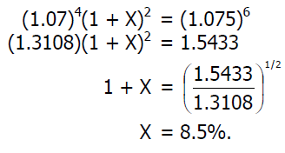
Solution 5
Let X equal the yield on 2-year securities 4 years from now:

Slide 109
Bonds and Their Valuation
Chapter 9
Key Features of Bonds
Bond Valuation
Measuring Yield
Assessing Risk

Slide 110
What is a bond?
A long-term debt instrument in which a borrower agrees to make payments of principal and interest, on specific dates, to the holders of the bond.

Slide 111
Bond Markets
Primarily traded in the over-the-counter (OTC) market.
Most bonds are owned by and traded among large financial institutions.
The Wall Street Journal reports key developments in the Treasury, corporate, and municipal markets. Online edition lists trading each day for the most actively-traded investment-grade, high-yield, and convertible bonds.

Slide 112
Key Features of a Bond
Par value: face amount of the bond, which
is paid at maturity (assume $1,000).
Coupon interest rate: stated interest rate (generally fixed) paid by the issuer. Multiply by par value to get dollar payment of interest.
Maturity date: years until the bond must be repaid.
Issue date: when the bond was issued.
Yield to maturity: rate of return earned on
a bond held until maturity (also called the “promised yield”).

Slide 113
Effect of a Call Provision
Allows issuer to refund the bond issue if rates decline (helps the issuer, but hurts the investor).
Borrowers are willing to pay more, and lenders require more, for callable bonds.
Most bonds have a deferred call and a declining call premium.

Slide 114
The Value of Financial Assets
0
1
2
N
r%
...
Value
CF₁
CF₂
CF_{N}

Slide 115
Other Types (Features) of Bonds
Convertible bond: may be exchanged for common stock of the firm, at the holder’s option.
Warrant: long-term option to buy a stated number of shares of common stock at a specified price.
Putable bond: allows holder to sell the bond back to the company prior to maturity.
Income bond: pays interest only when interest is earned by the firm.
Indexed bond: interest rate paid is based upon the rate of inflation.

Slide 116
What is the opportunity cost of debt capital?
The discount rate (r_{i}) is the opportunity cost of capital, and is the rate that could be earned on alternative investments of equal risk.
r_{i} = r* + IP + MRP + DRP + LP

Slide 117
What is the value of a 10-year, 10% annual coupon bond, if r_{d} = 10%?
0
1
2
N
10%
...
V_{B} = ?
100
100
100 + 1,000

Slide 118
Calculating the Value of a Bond
This bond has a $1,000 lump sum (the par value) due at maturity (t = 10), and annual $100 coupon payments beginning at t = 1 and continuing through t = 10, the price of the bond can be found by solving for the PV of these cash flows.
Excel: =PV(.10,10,100,1000)
INPUTS
10
10
100
1000
N
I/YR
PV
PMT
FV
OUTPUT
-1000

Slide 119
What’s the value of its 10-year bonds outstanding with the same risk but a 13% annual coupon rate?
The annual coupon payment is $130. Since the risk is the same it has the same yield to maturity as the previous bond (10%). This bond sells at a premium because the coupon rate > the yield to maturity.
Excel: =PV(.10,10,130,1000)
INPUTS
10
10
130
1000
N
I/YR
PV
PMT
FV
OUTPUT
-1184.34

Slide 120
What’s the value of its 10-year bonds outstanding with the same risk but a 7% annual coupon rate?
The annual coupon payment is $70. Since the risk is the same it has the same yield to maturity as the previous bonds (10%). This bond sells at a discount because the coupon rate < the yield to maturity.
Excel: =PV(.10,10,70,1000)
INPUTS
10
10
70
1000
N
I/YR
PV
PMT
FV
OUTPUT
-815.66

Slide 121
Changes in Bond Value over Time
What would happen to the value of these three bonds if the required rate of return remained at 10%?
V_{B}
1,184
1,000
816
13% coupon rate
10% coupon rate
7% coupon rate
Years
to Maturity
10
5
0

Slide 122
Bond Values over Time
At maturity, the value of any bond must equal its par value.
If r_{d} remains constant:
  The value of a premium bond would decrease over time, until it reached $1,000.
  The value of a discount bond would increase over time, until it reached $1,000.
  The value of a par bond stays at $1,000.

Slide 123
What is the YTM on a 10-year, 9% annual coupon, $1,000 par value bond, selling for $887?
Must find the r_{d} that solves this model.

Slide 124
Solving for the YTM
Solving for I/YR, the YTM of this bond is 10.91%. This bond sells at a discount, because YTM > coupon rate.
Excel: =RATE(10,90,-887,1000)
INPUTS
10
-887
90
1000
N
I/YR
PV
PMT
FV
OUTPUT
10.91

Slide 125
Find YTM If the Bond Price is $1,134.20
Solving for I/YR, the YTM of this bond is 7.08%. This bond sells at a premium, because YTM < coupon rate.
Excel: =RATE(10,90,-1134.20,1000)
INPUTS
10
-1134.20
90
1000
N
I/YR
PV
PMT
FV
OUTPUT
7.08

Slide 126
Definitions

Slide 127
An Example:
Current and Capital Gains Yields
Find the current yield and the capital gains yield for a 10-year, 9% annual coupon bond that sells for $887, and has a face value of $1,000.

Slide 128
Calculating Capital Gains Yield
YTM = Current yield + Capital gains yield
Could also find the expected price one year from now and divide the change in price by the beginning price, which gives the same answer.

Slide 129
What is price risk? Does a 1-year or 10-year bond have more price risk?
Price risk is the concern that rising r_{d} will cause the value of a bond to fall.
r_{d} 1-year Change 10-year Change
5% $1,048 $1,386
10% 1,000 1,000
15% 956 749
The 10-year bond is more sensitive to interest rate changes, and hence has more price risk.
+ 4.8%
– 4.4%
+38.6%
–25.1%

Slide 130
Illustrating Price Risk
Value ($)
10-Year Bond
1-Year Bond
YTM(%)

Slide 131
What is reinvestment risk?
Reinvestment risk is the concern that r_{d} will fall, and future CFs will have to be reinvested at lower rates, hence reducing income.
EXAMPLE: Suppose you just won $500,000 playing the lottery. You intend to invest the money and live off the interest.

Slide 132
Reinvestment Risk Example
You may invest in either a 10-year bond or a series of ten 1-year bonds. Both 10-year and 1-year bonds currently yield 10%.
If you choose the 1-year bond strategy:
  After Year 1, you receive $50,000 in income and have $500,000 to reinvest. But, if 1-year rates fall to 3%, your annual income would fall to $15,000.
If you choose the 10-year bond strategy:
  You can lock in a 10% interest rate, and $50,000 annual income for 10 years, assuming the bond is not callable.

Slide 133
Conclusions about Price Risk and Reinvestment Risk
Short
-
term
Long
-
term
AND/OR
AND/OR
High
-
coupon
Low
-
coupon
Bonds
Bonds
Price risk
Low
High
Reinvestment risk
High
Low
CONCLUSION: Nothing is riskless!

Slide 134
Semiannual Bonds
Multiply years by 2: Number of periods = 2N
Divide nominal rate by 2: Periodic rate (I/YR) = r_{d}/2
Divide annual coupon by 2: PMT = Annual coupon/2
INPUTS
2N
r_{d}/2
OK
cpn/2
OK
N
I/YR
PV
PMT
FV
OUTPUT

Slide 135
What is the value of a 10-year, 10% semiannual coupon bond, if r_{d} = 13%?
Multiply years by 2: N = 2 x 10 = 20
Divide nominal rate by 2: I/YR = 13/2 = 6.5
Divide annual coupon by 2: PMT = 100/2 = 50
Excel: =PV(.065,20,50,1000)
INPUTS
20
6.5
50
1000
N
I/YR
PV
PMT
FV
OUTPUT
-834.72

Slide 136
Would you prefer to buy a 10-year, 10% annual coupon bond or a 10-year, 10% semiannual coupon bond, all else equal?
The semiannual bond’s effective rate is:
Excel: =EFFECT(.10,2)
= 10.25%
10.25% > 10% (the annual bond’s effective rate), so you would prefer the semiannual bond.

Slide 137
If the proper price for this semiannual bond is $1,000, what would be the proper price for the annual coupon bond?
The semiannual bond has a 10.25% effective rate, so the annual bond should earn the same EAR. At these prices, the annual and semiannual bonds are in equilibrium.
Excel: =PV(.1025,10,100,1000)
INPUTS
10
10.25
100
1000
N
I/YR
PV
PMT
FV
OUTPUT
-984.80

Slide 138
A 10-year, 10% semiannual coupon bond selling for $1,135.90 can be called in 4 years for $1,050, what is its yield to call (YTC)?
The bond’s yield to maturity is 8%. Solving for the YTC is identical to solving for YTM, except the time to call is used for N and the call premium is FV.
Excel: =RATE(8,50,-1135.90,1050)
INPUTS
8
-1135.90
50
1050
N
I/YR
PV
PMT
FV
OUTPUT
3.568

Slide 139
Yield to Call
3.568% represents the periodic semiannual yield to call.
YTC_{NOM} = r_{NOM} = 3.568% x 2 = 7.137% is the rate that a broker would quote.
The effective yield to call can be calculated.
  YTC_{EFF} = (1.03568)² – 1 = 7.26%
  Excel: =EFFECT(.07137,2)
  = 7.26%

Slide 140
If you bought these callable bonds, would you be more likely to earn the YTM or YTC?
The coupon rate = 10% compared to YTC = 7.137%. The firm could raise money by selling new bonds which pay 7.137%.
Could replace bonds paying $100 per year with bonds paying only $71.37 per year.
Investors should expect a call, and to earn the YTC of 7.137%, rather than the YTM of 8%.

Slide 141
When is a call more likely to occur?
In general, if a bond sells at a premium, then (1) coupon > r_{d}, so (2) a call is more likely.
So, expect to earn:
  YTC on premium bonds.
  YTM on par and discount bonds.

Slide 142
Default Risk
If an issuer defaults, investors receive less than the promised return. Therefore, the expected return on corporate and municipal bonds is less than the promised return.
Influenced by the issuer’s financial strength and the terms of the bond contract.

Slide 143
Types of Bonds
Mortgage bonds
Debentures
Subordinated debentures
Investment-grade bonds
Junk bonds

Slide 144
Evaluating Default Risk:
Bond Ratings
 |  | Investment Grade |  | Junk Bonds
Moody’s |  | Aaa Aa A Baa |  | Ba B Caa C
S & P |  | AAA AA A BBB |  | BB B CCC C
Bond ratings are designed to reflect the probability of a bond issue going into default.

Slide 145
Example 1
Asiana Fashion’s bonds have 10 years remaining to maturity. Interest is paid annually, they have a $1,000 par value, the coupon interest rate is 8%, and the yield to maturity is 9%. What is the bond’s current market price?

Slide 146
Solution 1
With your financial calculator, enter the following:
  N = 10; I/YR = YTM = 9%; PMT = 0.08  1,000 = 80; FV = 1000; PV = VB = ?
  PV = $935.82.

Slide 147
Example 2
A bond has a $1,000 par value, 10 years to maturity, and a 7% annual coupon and sells for $985.
  What is its yield to maturity (YTM)?
  Assume that the yield to maturity remains constant for the next 3 years. What will the price be 3 years from today?

Slide 148
Solution 2
VB = $985; M = $1,000; Int = 0.07  $1,000 = $70.
a. N = 10; PV = -985; PMT = 70; FV = 1000; YTM = ?
Solve for I/YR = YTM = 7.2157% = 7.22%.
b. N = 7; I/YR = 7.2157; PMT = 70; FV = 1000; PV = ?
Solve for VB = PV = $988.46.

Slide 149
Example 3
Eastern Corporation bonds have 4 years left to maturity. Interest is paid annually, and the bonds have a $1,000 par value and a coupon rate of 9%.
  What is the yield to maturity at a current market price of (1) $829 and (2) $1,104?
  Would you pay $829 for each bond if you thought that a “fair” market interest rate for such bonds was 12%? Explain your answer.

Slide 150
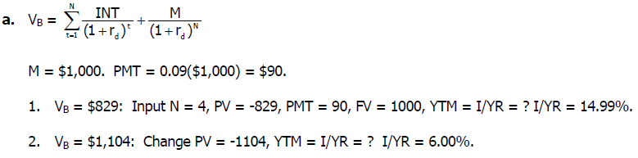
Solution 3
b. Yes. At a price of $829, the yield to maturity, 15%, is greater than your required rate of return of 12%. If your required rate of return were 12%, you should be willing to buy the bond at any price below $908.88.

Slide 151
Example 4
Shanghai Textile Pte. Ltd. Has bonds outstanding with 9 years left to maturity. The bonds have an 8% annual coupon rate and were issued 1 year ago at their par value of $1,000. However, due to changes in interest rates, the bond’s market price has fallen to $901.40. The capital gains yield last year was -9.86%.
  What is the yield to maturity?
  For the coming year, what are the expected current and capital gains yields?
  Will the actual realized yields be equal to the expected yields if interest rates change? If not, how will they differ?

Slide 152
Solution 4
Solving for YTM: N = 9, PV = -901.40, PMT = 80, FV = 1000 I/YR = YTM = 9.6911%.
b. The current yield is defined as the annual coupon payment divided by the current price.
CY = $80/$901.40 = 8.875%.
Expected capital gains yield can be found as the difference between YTM and the current yield.
CGY = YTM – CY = 9.691% – 8.875% = 0.816%.

Slide 153
Solution 4 (cont.)
Alternatively, you can solve for the capital gains yield by first finding the expected price next year. N = 8, I/YR = 9.6911, PMT = 80, FV = 1000
PV = -$908.76. VB = $908.76.
Hence, the capital gains yield is the percentage price appreciation over the next year.
CGY = (P1 – P0)/P0 = ($908.76 – $901.40)/$901.40 = 0.816%.
c. As rates change they will cause the end-of-year price to change and thus the realized capital gains yield to change. As a result, the realized return to investors will differ from the YTM.

Slide 154
Example 5
Bond x is noncallable and has 20 years to maturity, a 9% annual coupon, and a $1000 par value. Your required return on Bond X is 10%; and if you buy it, you plan to hold it for 5 years. You (and the market) have expectations that in 5 years, the yield to maturity on a 15-year bond with similar risk will be 8.5%. How much should you be willing to pay for Bond X today? (Hint: You will need to know how much the bond will be worth at the end of 5 years.)

Slide 155

Solution 5
First, we must find the amount of money we can expect to sell this bond for in 5 years. This is found using the fact that in five years, there will be 15 years remaining until the bond matures and that the expected YTM for this bond at that time will be 8.5%.
This is the value of the bond in 5 years. Therefore, we can solve for the maximum price we would be willing to pay for this bond today, subject to our required rate of return of 10%.

Slide 156

Solution 5 (cont.)
You would be willing to pay up to $987.87 for this bond today.

Slide 157
Stocks and Their Valuation
Chapter 10
Features of Common Stock
Determining Common Stock Values
Preferred Stock

Slide 158
Intrinsic Value and Stock Price
Outside investors, corporate insiders, and analysts use a variety of approaches to estimate a stock’s intrinsic value (P₀).
In equilibrium we assume that a stock’s price equals its intrinsic value.
  Outsiders estimate intrinsic value to help determine which stocks are attractive to buy and/or sell.
  Stocks with a price below (above) its intrinsic value are undervalued (overvalued).

Slide 159
Determinants of Intrinsic Value and Stock Prices
Managerial Actions, the Economic Environment, Taxes, and the Political Climate
“True” Investor Cash Flows
“True” Risk
“Perceived” Investor Cash Flows
“Perceived” Risk
Stock’s
Intrinsic Value
Stock’s
Market Price
Market Equilibrium:
Intrinsic Value = Stock Price

Slide 160
Different Approaches for Estimating the Intrinsic Value of a Common Stock
Discounted dividend model
Corporate valuation model
P/E multiple approach
EVA approach

Slide 161
1. Discounted Dividend Model
Value of a stock is the present value of the future dividends expected to be generated by the stock.

Slide 162
Constant Growth Stock
A stock whose dividends are expected to grow forever at a constant rate, g.
D₁ = D₀(1 + g)¹
D₂ = D₀(1 + g)²
D_{t} = D₀(1 + g)^{t}
If g is constant, the discounted dividend formula converges to:

Slide 163
Future Dividends and Their Present Values
$
0.25
0
Years (t)

Slide 164
What happens if g > r_{s}?
If g > r_{s}, the constant growth formula leads to a negative stock price, which does not make sense.
The constant growth model can only be used if:
  r_{s} > g.
  g is expected to be constant forever.

Slide 165
Use the SML to Calculate the Required
Rate of Return (r_{s})
If r_{RF} = 7%, r_{M} = 12%, and b = 1.2, what is the required rate of return on the firm’s stock?
r_{s} = r_{RF} + (r_{M} – r_{RF})b
= 7% + (12% – 7%)1.2
= 13%

Slide 166
Find the Expected Dividend Stream for the Next 3 Years and Their PVs
D₀ = $2 and g is a constant 6%.
0
1
2
3
g = 6%
2.12
2.247
2.382
1.8761
r_{s} = 13%
1.7599
1.6509

Slide 167
What is the stock’s intrinsic value?
Using the constant growth model:

Slide 168
What is the stock’s expected value, one year from now?
D₁ will have been paid out already. So, expected P₁ is the present value (as of Year 1) of D₂, D₃, D₄, etc.
Could also find expected P₁ as:

Slide 169
Find Expected Dividend Yield, Capital Gains Yield, and Total Return During First Year
Dividend yield
  = D₁/P₀ = $2.12/$30.29 = 7.0%
Capital gains yield
  = (P₁ – P₀)/P₀
  = ($32.10 – $30.29)/$30.29 = 6.0%
Total return (r_{s})
  = Dividend yield + Capital gains yield
  = 7.0% + 6.0% = 13.0%

Slide 170
What would the expected price today be, if g = 0?
The dividend stream would be a perpetuity.
0
r_{s} = 13%
1
2
3
2.00
2.00
2.00

Slide 171
Supernormal Growth: What if g = 30% for 3 years before achieving long-run growth of 6%?
Can no longer use just the constant growth model to find stock value.
However, the growth does become constant after 3 years.

Slide 172
Valuing Common Stock with Nonconstant Growth
D₀ = $2.00.
0
r_{s} = 13%
1
2
3
4
g = 30%
g = 30%
g = 30%
g = 6%
2.600 3.380 4.394
4.658
2.301
2.647
3.045
46.114
54.107 =

Slide 173
Find Expected Dividend and Capital Gains Yields During the First and Fourth Years
Dividend yield (first year)
  = $2.60/$54.11 = 4.81%
Capital gains yield (first year)
  = 13.00% – 4.81% = 8.19%
During nonconstant growth, dividend yield and capital gains yield are not constant, and capital gains yield ≠ g.
After t = 3, the stock has constant growth and dividend yield = 7%, while capital gains yield = 6%.

Slide 174
Nonconstant Growth: What if g = 0% for 3 years before long-run growth of 6%?
D₀ = $2.00.
0
r_{s} = 13%
1
2
3
4
g = 0%
g = 0%
g = 0%
g = 6%
2.00 2.00 2.00
2.12
1.77
1.57
1.39
20.99
25.72 =

Slide 175
If the stock was expected to have negative growth (g = -6%), would anyone buy the stock, and what is its value?
Yes. Even though the dividends are declining, the stock is still producing cash flows and therefore has positive value.

Slide 176
2. Corporate Valuation Model
Also called the free cash flow method. Suggests the value of the entire firm equals the present value of the firm’s free cash flows.
Remember, free cash flow is the firm’s after-tax operating income less the net capital investment.

Slide 177
Applying the Corporate Valuation Model
Find the market value (MV) of the firm, by finding the PV of the firm’s future FCFs.
Subtract MV of firm’s debt and preferred stock to get MV of common stock.
Divide MV of common stock by the number of shares outstanding to get intrinsic stock price (value).

Slide 178
Issues Regarding the Corporate Valuation Model
Often preferred to the discounted dividend model, especially when considering number of firms that don’t pay dividends or when dividends are hard to forecast.
Similar to discounted dividend model, assumes at some point free cash flow will grow at a constant rate.
Horizon value (HV_{N}) represents value of firm at the point that growth becomes constant.

Slide 179
Use the Corporate Valuation Model to Find the Firm’s Intrinsic Value
Given: Long-Run g_{FCF} = 6% and WACC = 10%
0
r = 10%
1
2
3
4
g = 6%
-5
10
20
21.20
-4.545
8.264
15.026
398.197
416.942

Slide 180
What is the firm’s intrinsic value per share?
The firm has $40 million total in debt and preferred stock and has 10 million shares of common stock.

Slide 181
3. Firm Multiples Method
Analysts often use the following multiples to value stocks.
  P/E
  P/CF
  P/Sales
EXAMPLE: Based on comparable firms, estimate the appropriate P/E. Multiply this by expected earnings to back out an estimate of the stock price.

Slide 182
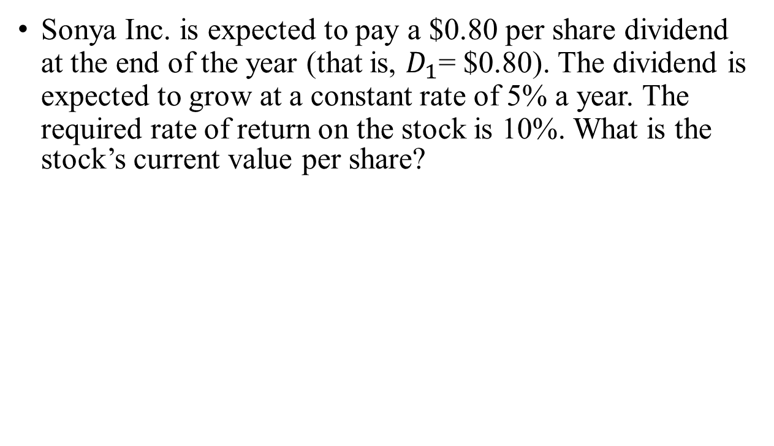
Example 1
Sonya Inc. is expected to pay a $0.80 per share dividend at the end of the year (that is, $D_{1}$= $0.80). The dividend is expected to grow at a constant rate of 5% a year. The required rate of return on the stock is 10%. What is the stock’s current value per share?

Slide 183
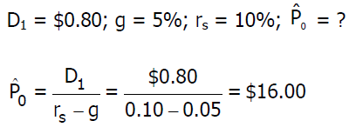
Solution 1

Slide 184
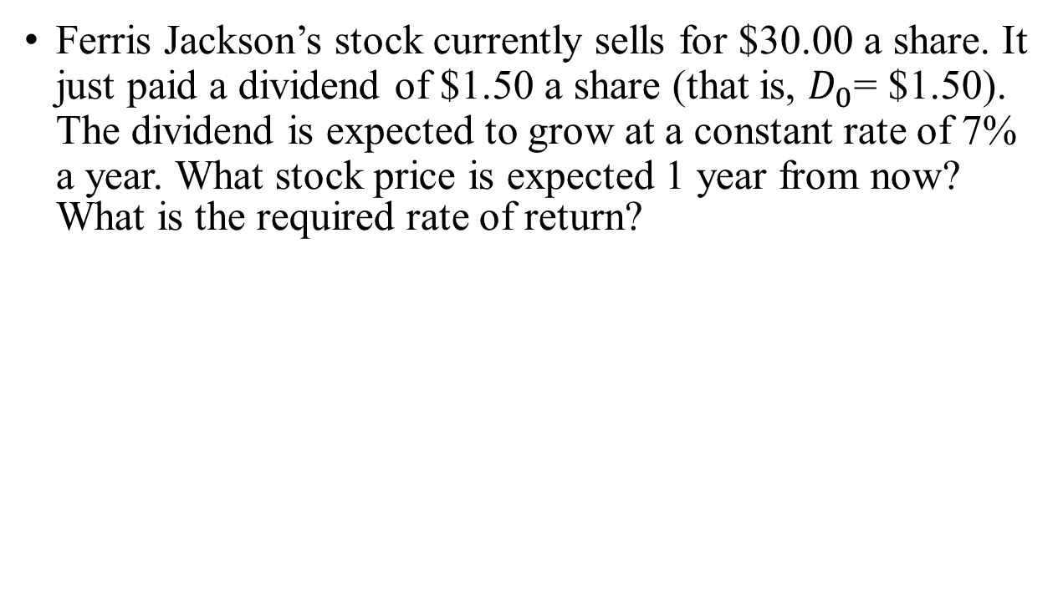
Example 2
Ferris Jackson’s stock currently sells for $30.00 a share. It just paid a dividend of $1.50 a share (that is, $D_{0}$= $1.50). The dividend is expected to grow at a constant rate of 7% a year. What stock price is expected 1 year from now? What is the required rate of return?

Slide 185
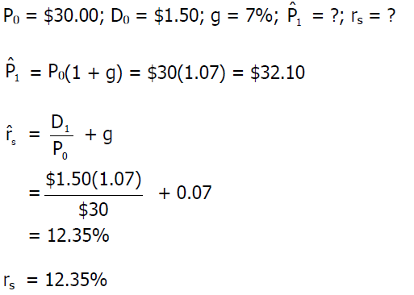
Solution 2

Slide 186
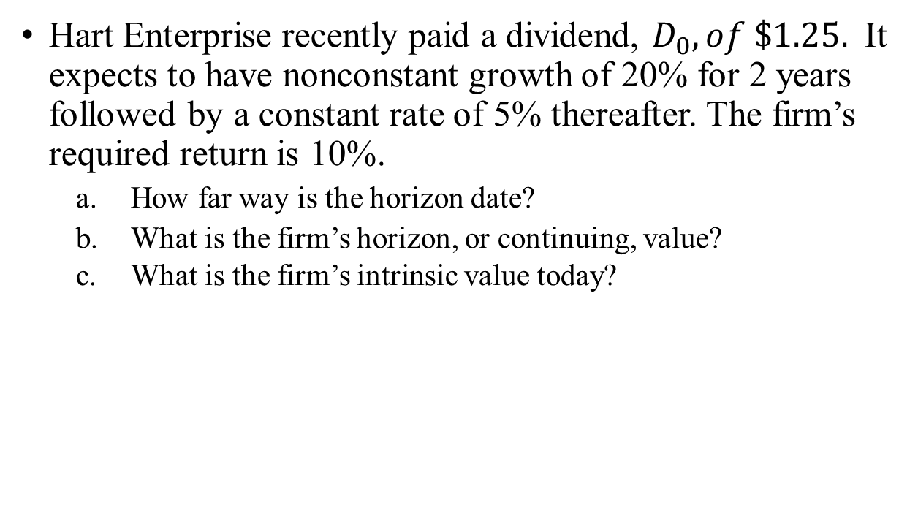
Example 3
Hart Enterprise recently paid a dividend, $D_{0}, of \$1.25.$ It expects to have nonconstant growth of 20% for 2 years followed by a constant rate of 5% thereafter. The firm’s required return is 10%.
  How far way is the horizon date?
  What is the firm’s horizon, or continuing, value?
  What is the firm’s intrinsic value today?

Slide 187
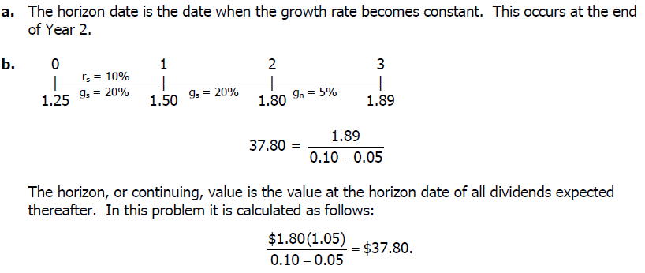
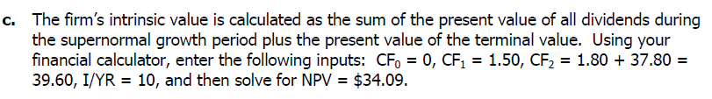
Solution 3

Slide 188
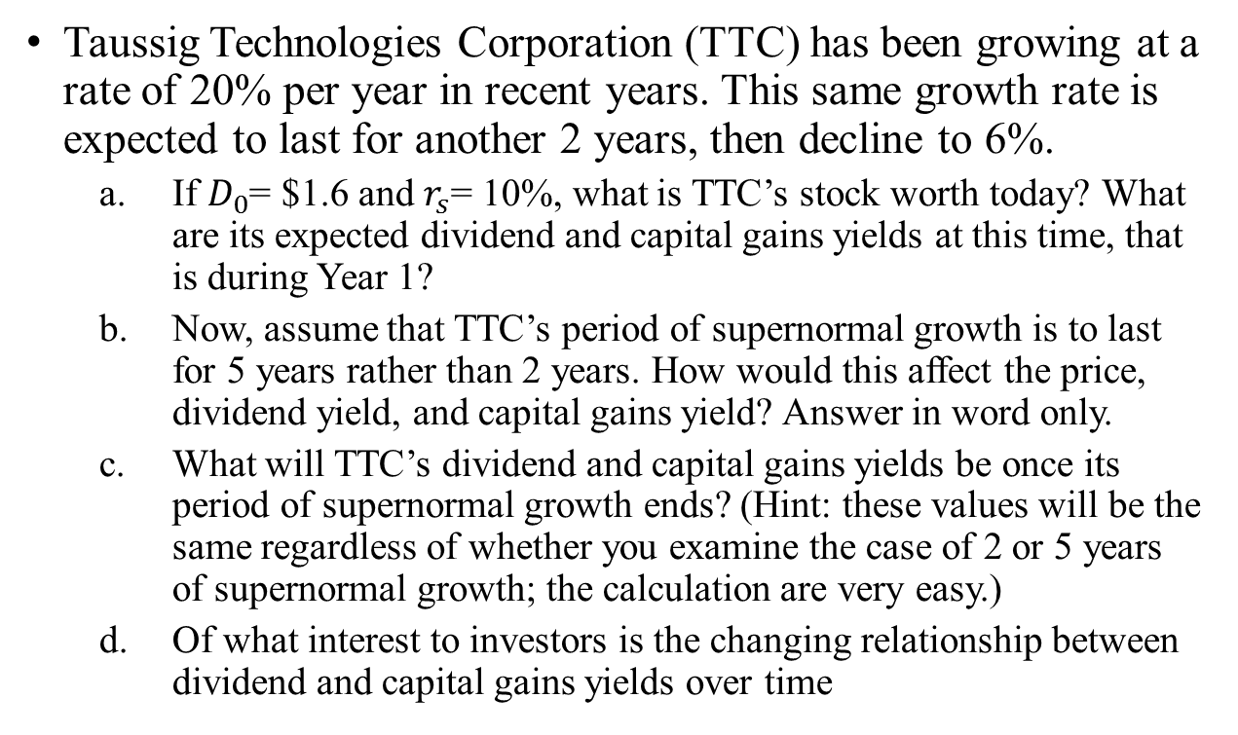
Example 4
Taussig Technologies Corporation (TTC) has been growing at a rate of 20% per year in recent years. This same growth rate is expected to last for another 2 years, then decline to 6%.
  If = $1.6 and = 10%, what is TTC’s stock worth today? What are its expected dividend and capital gains yields at this time, that is during Year 1?
  Now, assume that TTC’s period of supernormal growth is to last for 5 years rather than 2 years. How would this affect the price, dividend yield, and capital gains yield? Answer in word only.
  What will TTC’s dividend and capital gains yields be once its period of supernormal growth ends? (Hint: these values will be the same regardless of whether you examine the case of 2 or 5 years of supernormal growth; the calculation are very easy.)
  Of what interest to investors is the changing relationship between dividend and capital gains yields over time

Slide 189
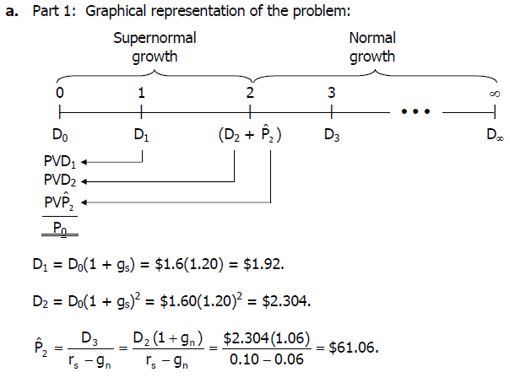
Solution 4

Slide 190
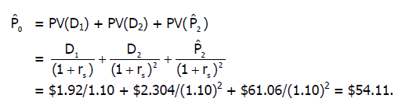
Solution 4 (cont.)

Slide 191
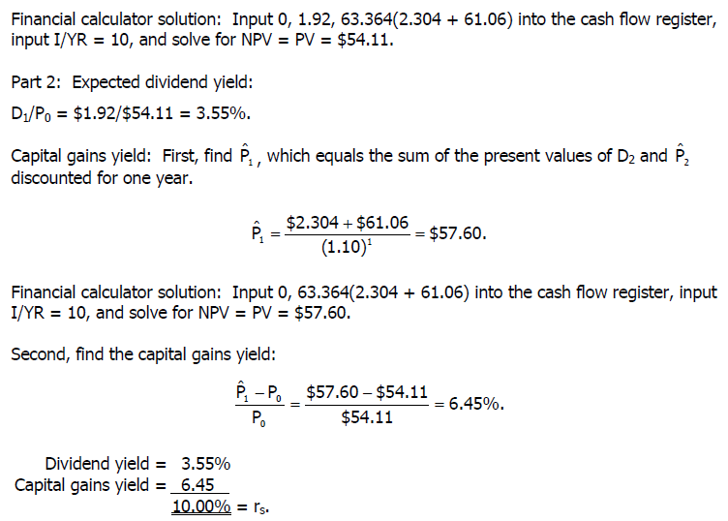
Solution 4 (cont.)

Slide 192
Corporate Value Model
Assume that today is Dec 31, 2012 and the following informaton applies to Vermeil Airlines;
  EBIT(1-T) for 2013 is expected to be $500 million
  The depreciation expense for 2013 is expected to be $100mil
  The capital expenditures for 2013 are expected to be $200 mil
  No Change is expected in net operating working capital
  The free cash flow is expected to grow at a constant rate of 6% per year
  The required return on equity is 14%
  The WACC is 10%
  The market value of the company s debt is $ 3bn
  200 million shares are outstanding
  WHAT SHOULD THE STOCK PRICE BE Today??

Slide 193
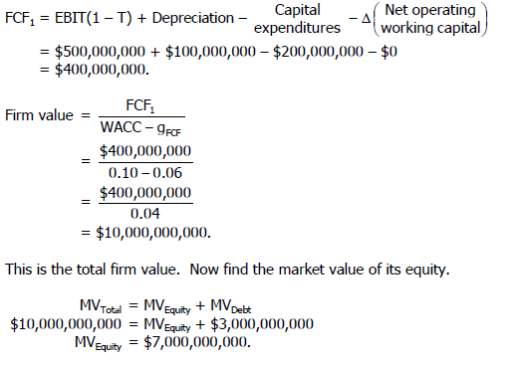

Slide 194
Risk and Rates of Return
Chapter 8
Stand-Alone Risk
Portfolio Risk
Risk and Return: CAPM/SML

Slide 195
What is investment risk?
Two types of investment risk
  Stand-alone risk
  Portfolio risk
Investment risk is related to the probability of earning a low or negative actual return.
The greater the chance of lower than expected, or negative returns, the riskier the investment.

Slide 196
Probability Distributions
A listing of all possible outcomes, and the probability of each occurrence.
Can be shown graphically.
Firm X
Firm Y
Rate of
Return (%)
-70
0
15
100
Expected Rate of Return

Slide 197
Selected Realized Returns, 1926-2010
Source: Based on Ibbotson Stocks, Bonds, Bills, and Inflation: 2011 Classic Yearbook (Chicago: Morningstar, Inc., 2011), p. 32.

Slide 198
Hypothetical Investment Alternatives
Economy | Prob. | T-Bills | Hi Tech | Coll | USRub | MP
Recession | 0.1 | 5.5% | -27.0% | 27.0% | 6.0% | -17.0%
Below avg | 0.2 | 5.5% | -7.0% | 13.0% | -14.0% | -3.0%
Average | 0.4 | 5.5% | 15.0% | 0.0% | 3.0% | 10.0%
Above avg | 0.2 | 5.5% | 30.0% | -11.0% | 41.0% | 25.0%
Boom | 0.1 | 5.5% | 45.0% | -21.0% | 26.0% | 38.0%

Slide 199
Why is the T-bill return independent of the economy? Do T-bills promise a completely risk-free return?
T-bills will return the promised 5.5%, regardless of the economy.
No, T-bills do not provide a completely risk-free return, as they are still exposed to inflation. Although, very little unexpected inflation is likely to occur over such a short period of time.
T-bills are also risky in terms of reinvestment risk.
T-bills are risk-free in the default sense of the word.

Slide 200
How do the returns of High Tech and Collections behave in relation to the market?
High Tech: Moves with the economy, and has a positive correlation. This is typical.
Collections: Is countercyclical with the economy, and has a negative correlation. This is unusual.

Slide 201
Calculating the Expected Return

Slide 202
Summary of Expected Returns
Expected Return
High Tech 12.4%
Market 10.5%
US Rubber 9.8%
T-bills 5.5%
Collections 1.0%
High Tech has the highest expected return, and appears to be the best investment alternative, but is it really? Have we failed to account for risk?

Slide 203
Calculating Standard Deviation

Slide 204
Standard Deviation for Each Investment
σ_{HT} = 20%
σ_{Coll} = 13.2%
σ_{M} = 15.2%
σ_{USR} = 18.8%

Slide 205
Comparing Standard Deviations
Prob.
T-bills
USR
HT
0 5.5 9.8 12.4 Rate of Return (%)

Slide 206
Comments on Standard Deviation as a Measure of Risk
Standard deviation (σ_{i}) measures total, or stand-alone, risk.
The larger σ_{i} is, the lower the probability that actual returns will be close to expected returns.
Larger σ_{i} is associated with a wider probability distribution of returns.

Slide 207
Comparing Risk and Return
Security
Expected Return,
Risk,
σ
T
-
bills
5
.5%
0.0%
High Tech
12.4
20.0
Collections*
1.0
13.2
US Rubber*
9.8
18.8
Market
10.5
1
5.2
*Seems out of place.

Slide 208
Coefficient of Variation (CV)
A standardized measure of dispersion about the expected value, that shows the risk per unit of return.

Slide 209
Illustrating the CV as a Measure of Relative Risk
Prob.
A
B
0
Rate of Return (%)
σ_{A} = σ_{B} , but A is riskier because of a larger probability of losses. In other words, the same amount of risk (as measured by σ) for smaller returns.

Slide 210
Risk Rankings by Coefficient of Variation
CV
T-bills 0.0
High Tech 1.6
Collections 13.2
US Rubber 1.9
Market 1.4
Collections has the highest degree of risk per unit of return.
High Tech, despite having the highest standard deviation of returns, has a relatively average CV.

Slide 211
Investor Attitude Towards Risk
Risk aversion: assumes investors dislike risk and require higher rates of return to encourage them to hold riskier securities.
Risk premium: the difference between the return on a risky asset and a riskless asset, which serves as compensation for investors to hold riskier securities.

Slide 212
Portfolio Construction: Risk and Return
Assume a two-stock portfolio is created with $50,000 invested in both High Tech and Collections.
A portfolio’s expected return is a weighted average of the returns of the portfolio’s component assets.
Standard deviation is a little more tricky and requires that a new probability distribution for the portfolio returns be constructed.

Slide 213
Calculating Portfolio Expected Return

Slide 214
An Alternative Method for Determining Portfolio Expected Return
Economy | Prob | HT | Coll | Port
Recession | 0.1 | -27.0% | 27.0% | 0.0%
Below avg | 0.2 | -7.0% | 13.0% | 3.0%
Average | 0.4 | 15.0% | 0.0% | 7.5%
Above avg | 0.2 | 30.0% | -11.0% | 9.5%
Boom | 0.1 | 45.0% | -21.0% | 12.0%

Slide 215
Calculating Portfolio Standard Deviation and CV

Slide 216
Comments on Portfolio Risk Measures
σ_{p} = 3.4% is much lower than the σ_{i} of either stock (σ_{HT} = 20.0%; σ_{Coll} = 13.2%).
σ_{p} = 3.4% is lower than the weighted average of High Tech and Collections’ σ (16.6%).
Therefore, the portfolio provides the average return of component stocks, but lower than the average risk.
Why? Negative correlation between stocks.

Slide 217
General Comments about Risk
σ ≈ 35% for an average stock.
Most stocks are positively (though not perfectly) correlated with the market (i.e., ρ between 0 and 1).
Combining stocks in a portfolio generally lowers risk.

Slide 218
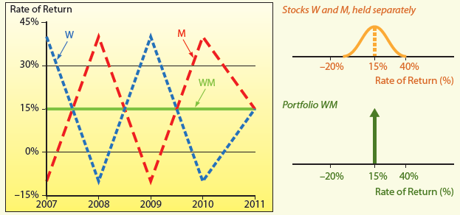
Returns Distribution for Two Perfectly Negatively Correlated Stocks (ρ = -1.0)

Slide 219
Returns Distribution for Two Perfectly Positively Correlated Stocks (ρ = 1.0)
Stock M
Stock M’
Portfolio MM’
25
25
25
15
15
15
0
0
0
-10
-10
-10

Slide 220
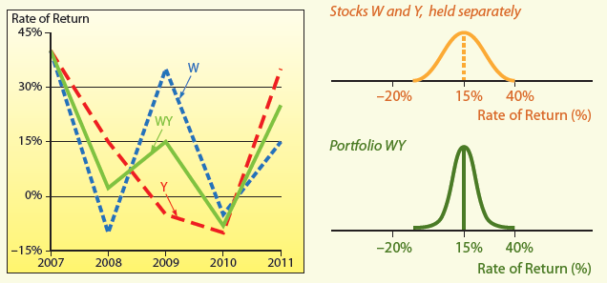
Partial Correlation, ρ = +0.35

Slide 221
Creating a Portfolio: Beginning with One Stock and Adding Randomly Selected Stocks to Portfolio
σ_{p} decreases as stocks are added, because they would not be perfectly correlated with the existing portfolio.
Expected return of the portfolio would remain relatively constant.
Eventually the diversification benefits of adding more stocks dissipates (after about 40 stocks), and for large stock portfolios, σ_{p} tends to converge to ≈ 20%.

Slide 222
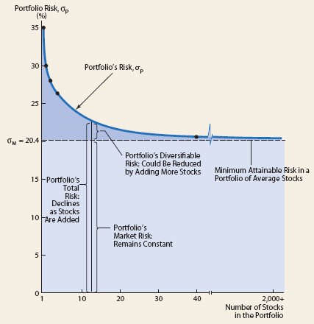
Illustrating Diversification Effects of a Stock Portfolio

Slide 223
Breaking Down Sources of Risk
Stand-alone risk = Market risk + Diversifiable risk
Market risk: portion of a security’s stand-alone risk that cannot be eliminated through diversification. Measured by beta.
Diversifiable risk: portion of a security’s stand-alone risk that can be eliminated through proper diversification.

