Slide 1

MK 333/326 Group Assignment 9:
Chapter 9-10-11
Topic: Exploring Trade in Brazil, China, Africa and the 4 Tigers
Each group is to prepare a one page power point slide presentation and analyze why your project country would want to trade with
Brazil
China
Africa
The 4 Tigers
Please design the one page by using graphs, charts, visuals to make one page interesting ka. Due next class on April 8, 2021
Notes:
1

Slide 2

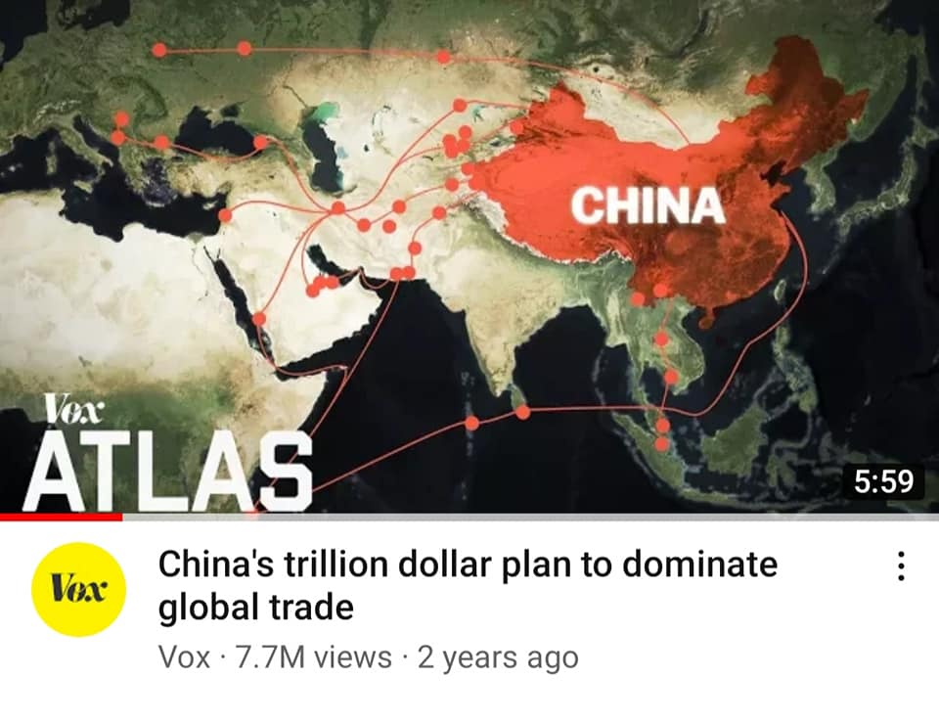




Slide 3
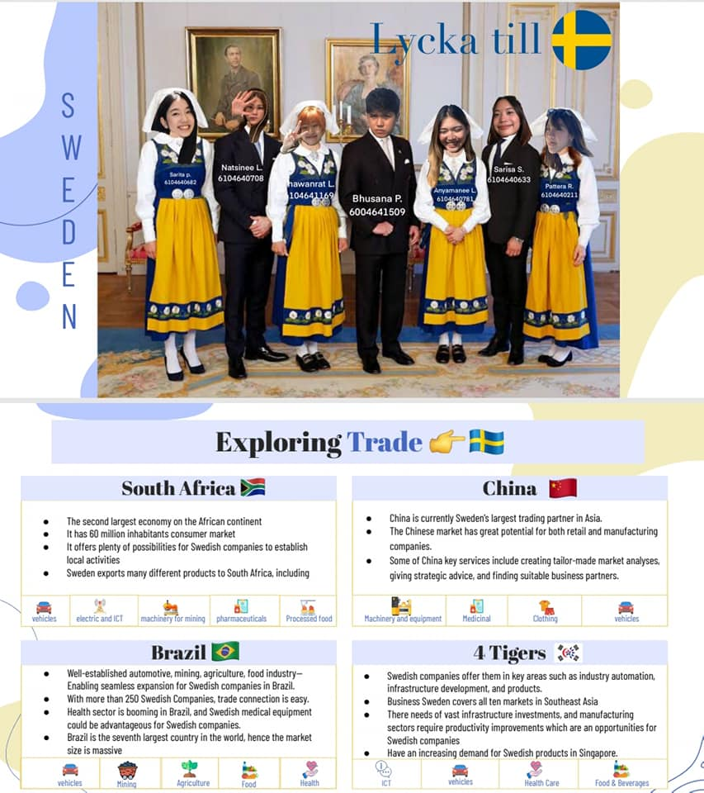

Slide 4


Slide 5
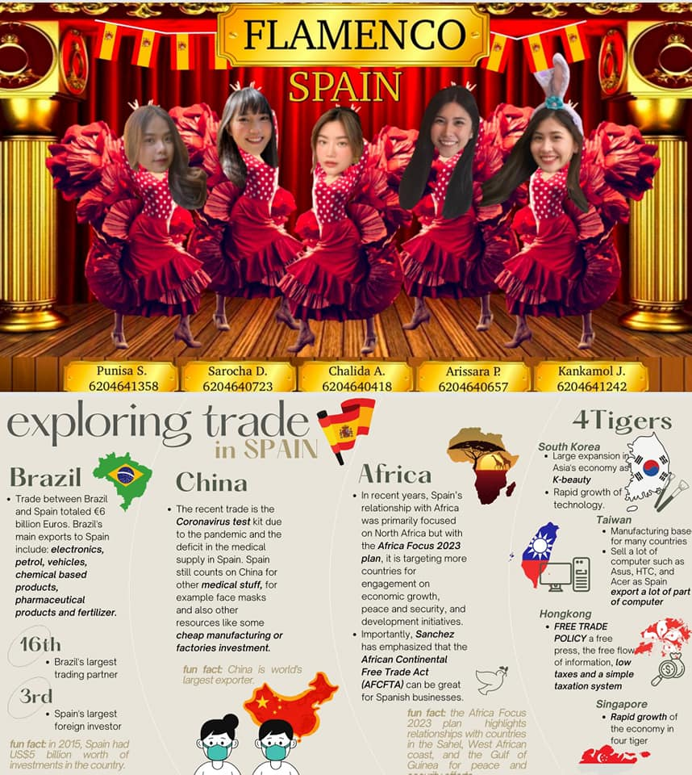

Slide 6


Slide 7


Slide 8


Slide 9
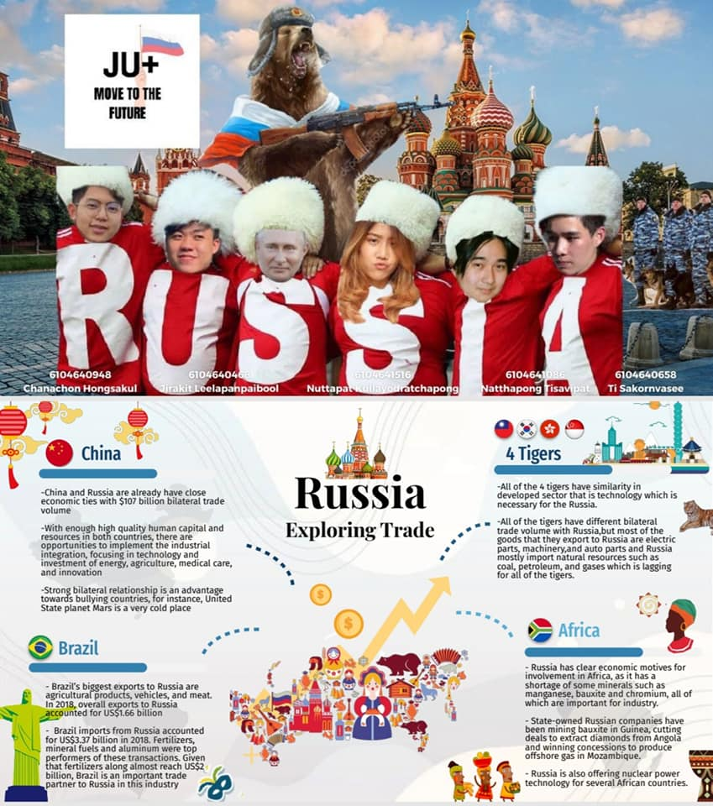

Slide 10


Slide 11
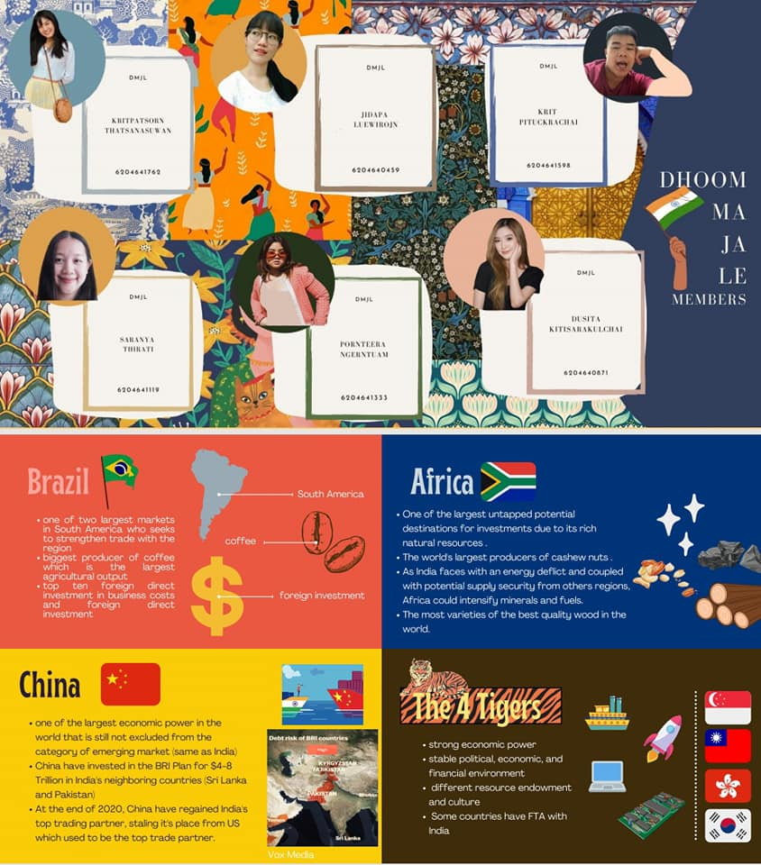

Slide 12
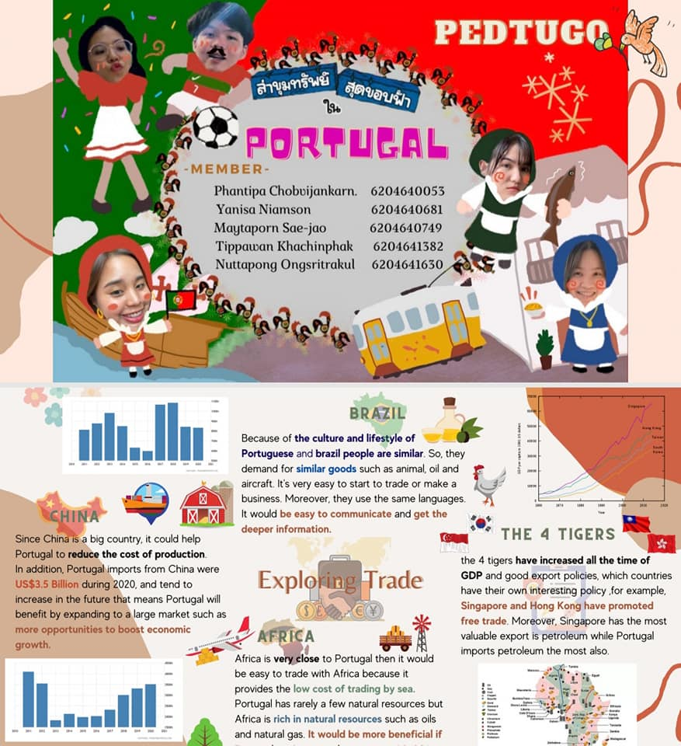

Slide 13
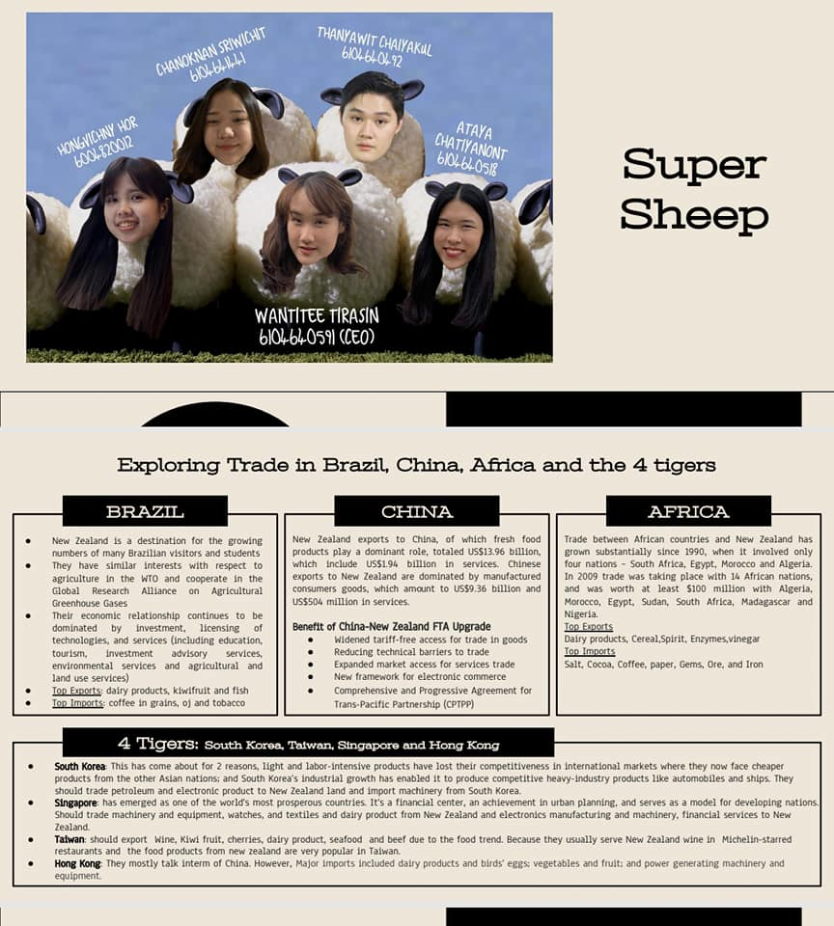


Slide 14


