Slide 1
FN 281: Personal Finance
Thanachote Rungsitivat, CFA, FRM

Slide 2
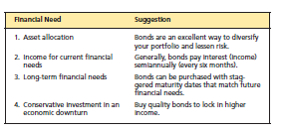
Why Consider Bonds?
Bonds reduce risk through diversification.
Bonds produce steady current income.
Bonds can be a safe investment if held to maturity.

Slide 3
Basic Bond Terminology and Features
Par value -- the amount returned to the holder at maturity
Coupon interest rate -- indicates the percentage of the face value that will be paid annually to the holder in the form of interest
Indenture -- a document that outlines the terms of the loan agreement

Slide 4
Basic Bond Terminology and Features (Cont’d)
Call provision -- allows the issuer to repurchase the bonds before the maturity date
  Deferred calls provide more protection.
Sinking fund -- money set aside annually to pay off the bonds at maturity

Slide 5
Different Types of Bonds
Corporate bonds
Treasury and agency bonds
Municipal bonds
Special situation bonds

Slide 6
Corporate Bonds
Secured corporate debts are secured by collateral or real property liens
  Secured bond
  Mortgage bond

Slide 7
Corporate Bonds (Cont’d)
Unsecured corporate debts are not secured by collateral, and pay a higher return
  Debenture -- long-term unsecured bond
  Can have a hierarchy of payment, with unsubordinated and subordinated debentures

Slide 8
Treasury and Agency Bonds
Treasury bonds
  Bills, notes, and bonds
  Treasury inflation-indexed bonds
Savings bonds
Agency bonds
  Pass-through certificates

Slide 9
Treasury Bills, Notes, and Bonds
Considered risk free – no default or call risk
Pay a lower rate of interest than other bonds
Most interest is exempt from state and local taxes
Treasury direct avoids brokerage fees

Slide 10
Treasury Bills, Notes, Bonds (Cont’d)
Bills mature in 3, 6, or 12 months
Notes mature in 2, 3, 5, or 10 years
Bonds mature in 10 to 30 years
All are sold in denominations of $1,000

Slide 11
Pass-through Certificates
Issued by government national mortgage association (GNMA)
Minimum $25,000 certificate for pool of mortgages
Principal and interest repaid monthly

Slide 12
Treasury Inflation-indexed Bonds
Maturities of 10 years and a minimum par value of $1,000
Inflation increases the face value of the bond, guaranteeing the investor a real return

Slide 13
Special Situation Bonds
Zero-coupon bonds
Junk bonds

Slide 14
Zero-coupon Bonds
Issued by corporations, municipalities, and the treasury (e.G., STRIPS)
Do not pay interest
Are sold at a discount from face value
Annual appreciation is taxed although it is not realized
Fluctuate more with interest rate changes than traditional bonds

Slide 15

Junk Bonds
Have very low ratings
Normally offer very high interest rates
Have a high default rate
Are almost always callable

Slide 16
Bond Yield
Is the total return on a bond investment
Is not the same as the interest rate
Is affected by the bond price which may be more or less than face value

Slide 17
Ways to Measure Bond Yield
Current yield
Yield to maturity
Equivalent taxable yield on muni’s

Slide 18
Current Yield
Ratio of annual interest payments to the bond’s market price
Current yield =
Annual interest payments
Market price of the bond

Slide 19
Yield to Maturity
True yield received if the bond is held to maturity
Approximate yield to maturity =
Annual interest + par value - current price payments years to maturity par value + current price
2

Slide 20
Equivalent Taxable Yield
Equivalent taxable yield =
Tax-free yield on the tax-free bond (1 - investor’s marginal tax bracket)

Slide 21
Bond Ratings –
A Measure of Riskiness
Generally ratings run from AAA or aaa for the safest to D for the extremely risky
Ratings categorize bonds by default risk
Rating companies
  Standard & Poor’s
  Moody’s

Slide 22
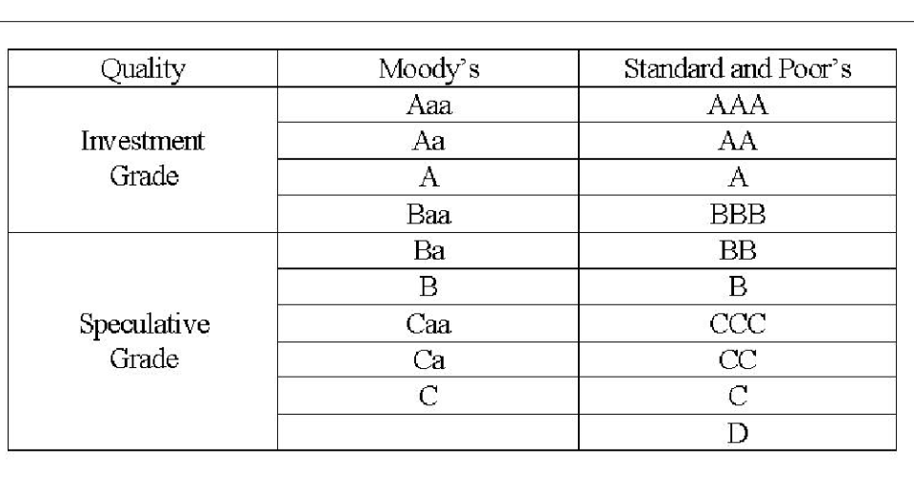
Bond Ratings
Jonathan learns that there are two companies that rate bonds as to their quality and default risk. Moody’s and Standard & Poor’s have slightly different ratings, but the ratings designation generally mean the same thing, the lower the rating, the greater the default risk. The first four rating categories are generally considered to be investment grade bonds, which means they are relatively sage and have a strong probability of making their payments. The rest of the categories are considered to be speculative grade bonds, which means there is some doubt as to whether interest and principal payments can be made. These ratings can help an investor understand the risks of the bond they are thinking about purchasing.

Slide 23
Bond Valuation Principles
Value of a bond =
Present value of + present value of repayment
All interest payments of par at maturity
Bonds fluctuate in value, and the longer the time to maturity the greater the fluctuation.

Slide 24
Valuation Principles (Cont’d)
Why would an investors required rate of return change?
  Change in the risk associated with the firm issuing the bond.
  Change in general interest rates in the market.

Slide 25
Valuation Principles (Continued)
As the available rate of return increases, the value of a lower rated bond decreases and an investor would pay a discount.
As the available rate of return drops, the value of a higher rated bond increases and an investor would pay a premium.

Slide 26
Valuation Principles (Cont’d)
Interest rates affect bond valuation by changing the demand, and price, for a bond.
Interest rates and bond values are inversely related in the secondary market. But the call price limits the upward price on a bond with a call provision.
As a bond approaches its maturity date, its market value approaches it par value.

Slide 27
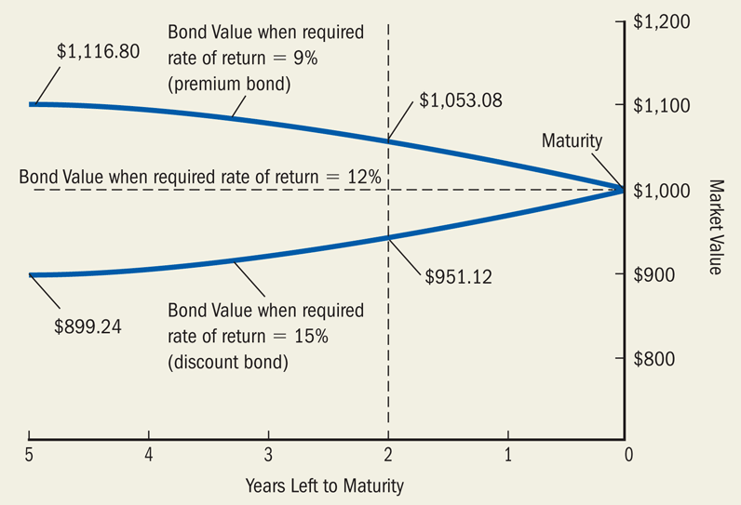
The Price Path of a 12 Percent Coupon Bond over Its Life

Slide 28
Bond Valuation Relationships and The Investor
If you expect interest rates to increase, buy short-term bonds.
If you expect interest rates to decrease, buy long-term non-callable bonds.

Slide 29
The Pros of Investing in Bonds
If interest rates drop, bond prices will rise.
Bonds reduce risk through diversification.
Bonds produce steady current income.
Bonds can be a safe investment if held to maturity.

Slide 30
The Cons of Investing in Bonds
If interest rates rise, bond prices will fall.
If the issuer experiences financial problems, the bondholder may lose.
If interest rates drop, rather than experiencing price appreciation, the bond may be called.

Slide 31
The Cons of Investing in Bonds (Cont’d)
If you need to sell your bonds early, you may have a problem selling them at a reasonable price.
Finding a good investment outlet for the interest you receive may be difficult.

Slide 32
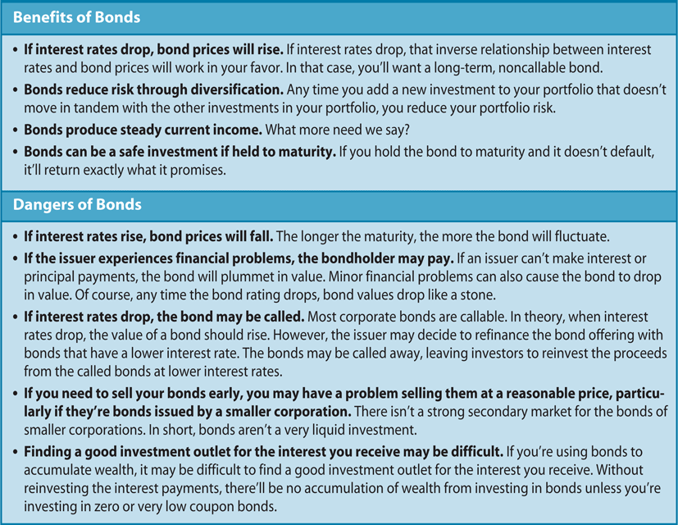
The Pros and Cons of Investing in Bonds

Slide 33
Analyzing Bond Choices
Think about taxes.
Keep the inverse relationship between interest rates and bond price in mind.
Avoid losers, and don’t worry about picking winners.
Consider only high quality bonds.
Buy a bond when it is first issued, rather than in the secondary market.

Slide 34
Analyzing Bond Choices (Cont’d)
Avoid bonds that might get called.
Match your bond’s maturity to your investment time horizon.
Stick to large issues.
When in doubt, go treasury!

Slide 35
The Situation
Jonathan Parks has been investing for about two years, and his broker has recommended that he add some bonds to his portfolio. He does not know much about bonds, so he wants to learn more about them before he makes any investment decisions.

Slide 36
Corporate Bonds
Jonathan learns that corporations sell bonds to obtain financing. One of the most common bonds that investors purchase is a corporate bond. Corporate bonds represents debt financing by the company. The face value is the specified amount that will be repaid at maturity. Interest payments are a percentage of the face value, and ½ of the interest is paid every six months.
For example, Jonathan finds a bond with a 6 percent interest rate (coupon rate). This bond would pay 6% of $1,000 or $60 for the year. Cash payments of $30 are made every six months.

Slide 37
Bond Indenture
A bond Indenture is a legal contract, which specified the face value, the interest payments, the maturity date of the bond and all of the unique features each particular bond has.
Jonathan is learning that there are many different bonds issued by hundreds of companies. Jonathan also learns that bond indentures are difficult for the average person to read and understand. Therefore, a corporation issuing bonds appoints an independent firm (trustee) to act as the bondholders’ representative. The trustee is usually a commercial bank or other financial institution and periodically reports information about the corporation’s ability to make interest payments to the bondholder. Jonathan realizes he needs to read the bond indenture carefully to truly understand each bond that he is thinking about purchasing.

Slide 38
Why Corporations Sell Corporate Bonds
After learning about all of the details of corporate bonds, Jonathan wonders why companies use bonds. He discovers that bonds can be a cheaper way for the corporation to borrow money and can lead to a higher rate of return for the corporation. He learns that bondholders are repaid at a future date and interest payments on the debt are required. He discovers that many corporations prefer selling bonds, because they retain control of the corporation since bondholders generally do not have a right to vote on corporate issues.

Slide 39
Types of Bonds
Jonathan learns that before issuing bonds, a corporation must decide what type of bond to issue and how the bond issued will be repaid. He also learns that most bonds are sold without any specific assets backing them up.
Debenture Bonds – unsecured bonds that are backed only by the reputation of the issuing corporation. These debenture bonds are basically as good as the reputation of the company that issues them.
Mortgage Bonds – secured bonds that can be backed by various assets such as real estate, stocks, bonds, and operating equipment owned by the company.
Jonathan realizes that if everything else is the same, then a mortgage bond would be safer but it will have a lower interest rate.
Subordinated Debenture Bonds – unsecured bonds that gives bondholders a secondary claim with respect to interest payments, repayment, and assets of the company after mortgage or debenture bonds have been repaid. Because subordinated debenture bonds would be paid after other bonds, they have a higher risk and would generally have higher interest rates that other bonds.

Slide 40
Types of Bonds (continued)
Jonathan learns that some bond can be converted into the common stock of the company. Jonathan realizes that this type of bond can be a real advantage for him. If the company does really well, and the stock price rises, normal bondholders gain nothing. However, convertible bondholders can trade their bonds for the stock of the company and share in the good returns enjoyed by the stockholders. If the company does not do well, bondholders still have the highest priority in the event of the failure of the company. In general, because of this advantage for bondholders, convertible bonds have lower interest rates than do regular debenture bonds.
Convertible bonds – bonds that can be converted or traded for a set number of shares of the common stock of the corporation at the discretion of the bondholder

Slide 41
Types of Bonds (continued)
Jonathan also learns that there are other bonds that can offer high interest rates. These bonds are called high – yield or junk bonds. They are sold by companies with a poor earnings history, a questionable credit record, or newer companies with unproven ability to increase sales and earn profits. While they do pay high interest, the risk is also high that the company will not be able to make interest payments or repay the bondholders at maturity.
High-yield bonds – bonds that pay higher interest, but also have a higher risk of default

Slide 42
Provisions for Repayment
Jonathan learns that callable bonds are often issued when interest rates are high. A company does not want to pay out any more cash than they have to. If market interest rates are high, then the interest payments that are paid on bonds would also be high. If theey issue callable bonds, then they can retire the high interest bonds and issue new bonds with lower interest payments after market interest rates fall. Callable bonds offer an advantage to the issuing company and not the investor. Therefore, callable bonds tend to have a higher interest rate than non-callable bonds.
A Call feature allows the corporation to buy back outstanding bonds from current investors before the maturity date. If the company buys back the bonds early, they often pay a premium on the bonds. They can pay slightly more than the face value on the bonds.

Slide 43
Provisions for Repayment (continued)
A sinking fund is a fund in which the company makes annual or semi-annual deposits over the life of the bond. The money is used to redeem the bonds at maturity.
Jonathan learns that a sinking fund is another way for the company to save up the money to repay the bonds. This makes the bond safer, and they generally have a lower interest rate than bonds without a sinking fund.

Slide 44
Why Investors Purchase Corporate Bonds
Jonathan did not realize that bonds could be an important part of his portfolio. He has made the mistake that many investors make of putting all of his “eggs in one basket.” If he adds bonds to his portfolio, it will allow him to diversify his risk. Jonathan realizes that bonds pay interest income and are repaid when the bond matures. Jonathan also realizes that bonds can preserve his investment funds during a downturn of the economy, and later when the economy, and later when the economy improves he can invest in the stock market should he desire to do so

Slide 45
Dollar Appreciation of Bond Value
Example:
An investor purchases a $1,000 bond paying 6% interest rate. The current market interest rate is 10%. If the market price of the bond is $800, determine if this is a good price for the bond.
Jonathan learns that one of the reasons why investors invest in bonds is to see the dollar appreciation in the value of the bonds. He needs to understand how an investor makes money by purchasing a bond. He learns that comparing interest rates in the market help an investor in determining what is a good purchase price for the bond.

Slide 46
Bond Calculations
The Price of a Bond
Current Yield
The Yield to Maturity on a Bond
If Jonathan is going to purchase bonds, he needs to know how to determine what is a good price to pay for a bond, and how to calculate the interest rate on a bond.

Slide 47
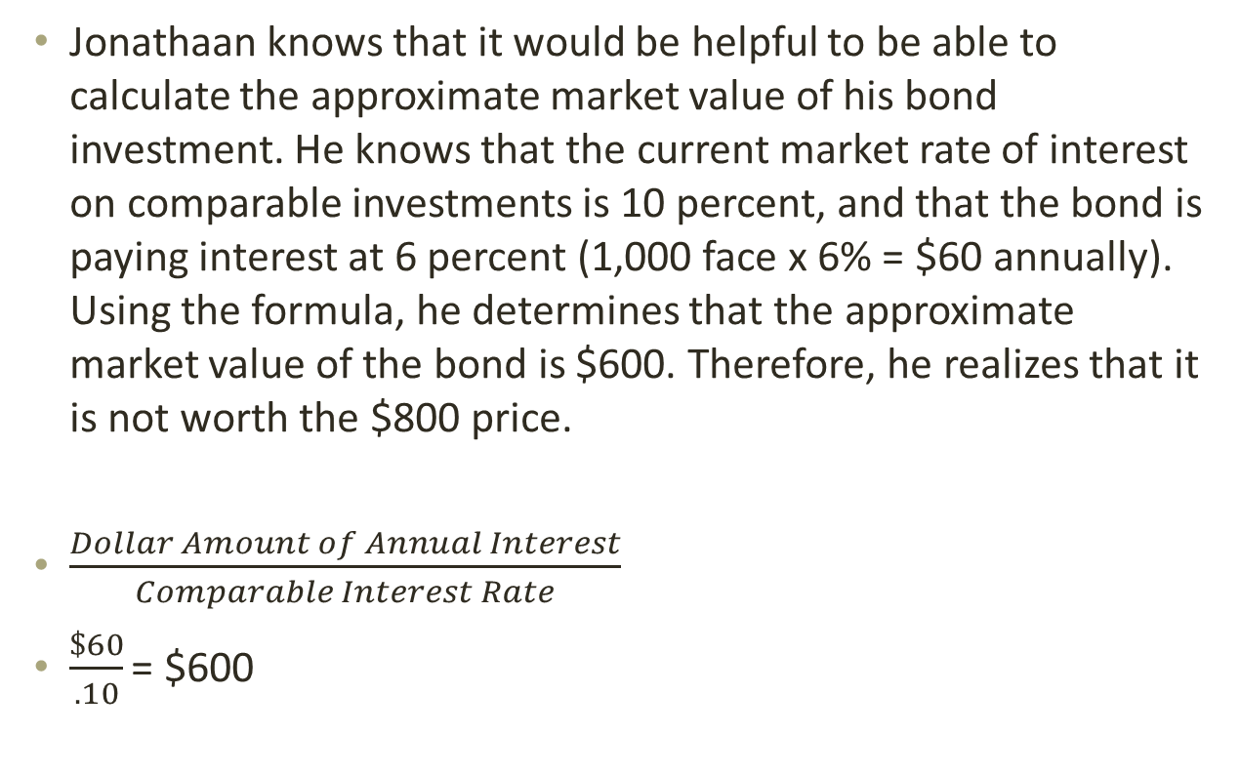
Calculating the Approximate Market Value of a Bond
Jonathaan knows that it would be helpful to be able to calculate the approximate market value of his bond investment. He knows that the current market rate of interest on comparable investments is 10 percent, and that the bond is paying interest at 6 percent (1,000 face x 6% = $60 annually). Using the formula, he determines that the approximate market value of the bond is $600. Therefore, he realizes that it is not worth the $800 price.
$\frac{Dollar Amount of Annual Interest}{Comparable Interest Rate}$
$\frac{\$60}{.10}$ = $600

Slide 48
The Price of a Bond
Bond Price:
  = Face value x bond quote
  = $1,000 x 84 percent
  = $1,000 x 0.84
  =$840
Jonathan learns that in bond quotations, prices are given as a percentage of the face value, which is usually $1,000. In order to find the actual price for a bond, he must multiply the face value by the bond quotation. Assume that a bond has a price quote of 84. Jonathan calculates that the actual price for the bond is $840.

Slide 49
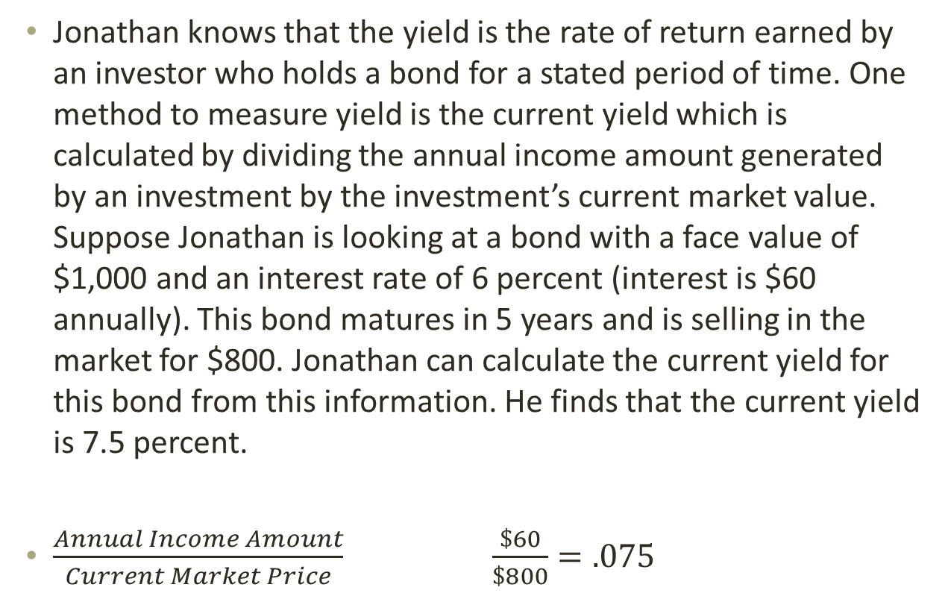
The Current Yield
Jonathan knows that the yield is the rate of return earned by an investor who holds a bond for a stated period of time. One method to measure yield is the current yield which is calculated by dividing the annual income amount generated by an investment by the investment’s current market value. Suppose Jonathan is looking at a bond with a face value of $1,000 and an interest rate of 6 percent (interest is $60 annually). This bond matures in 5 years and is selling in the market for $800. Jonathan can calculate the current yield for this bond from this information. He finds that the current yield is 7.5 percent.
$\frac{Annual Income Amount}{Current Market Price}$ $\frac{\$60}{\$800}=.075$

Slide 50
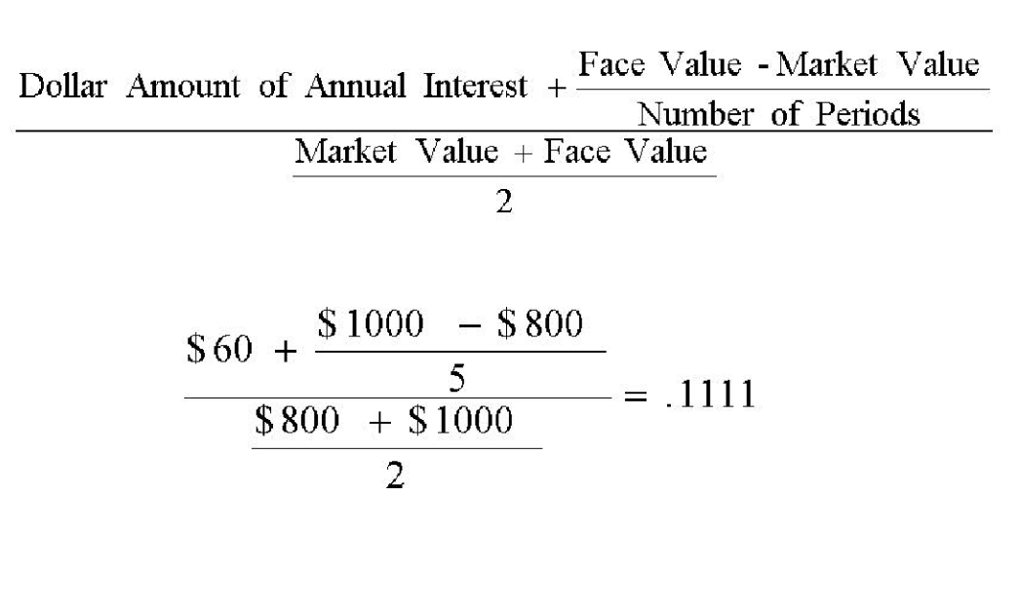
Calculating the Yield to Maturity
Another method to measure yield is the yield to maturity. This calculation gives Jonathan an indication of the interest rate he would earn over the life of the bond. Jonathan can calculate this for the bond mentioned previously. The yield to maturity on this bond is 11.11 percent.

Slide 51
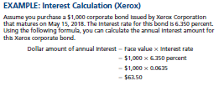
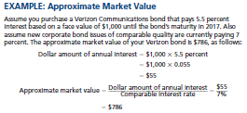
Appendix

Slide 52
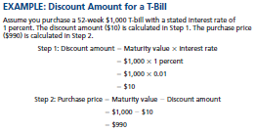

Appendix

Slide 53
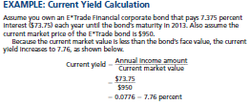
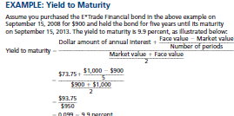
Appendix

Slide 54
Thank you

