Slide 1

INTEGRATED BRAND COMMUNICATION
Massimiliano La Franca
Lesson 2

Slide 2
Moodle enrollment key: 9329

Slide 3
Integrated Communication: what is it, how does it work and why?

Slide 4
What is it?
Communication* (kəˌmyo͞oniˈkāSHən): the activity of conveying information
When it comes to brand communication it is the act through which a brand shares info about itself or its products/services with the intention of influencing the behaviors of specific target groups (from stakeholders to shoppers)
In this course we will mainly talk about consumers behaviors and how to influence them through integrated brand communication
* from the Latin word "communis“ - to share

Slide 5
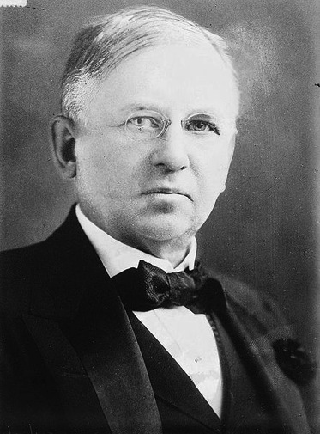
Half the money I spend on advertising is wasted; the trouble is I don't know which half.
John Wanamaker (July 11, 1838 – December 12, 1922) was a United States merchant, religious leader, civic and political figure, considered by some to be the father of modern advertising and a "pioneer in marketing.”

Slide 6

Integrated communication?
Integration of the brand communication channels in order to provide a more impactful, consistent and compelling message about the brand or its products

Slide 7
Why?

Slide 8

The world is changing…
fast.
From one way entertainment.

Slide 9
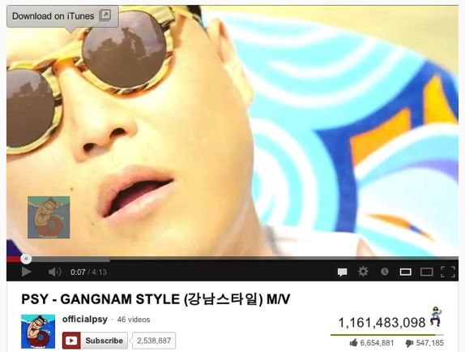
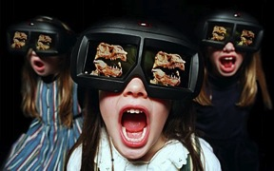
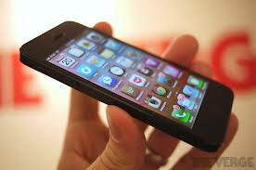
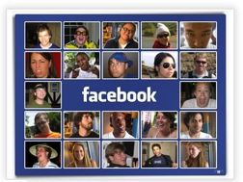
3 dynamics:
- Increasing number of channels
- More crowded channels
- More sophisticated consumers
3
Notes:
3 dynamics:
Increasing number of channels
More crowded channels
More sophisticated consumers

Slide 10
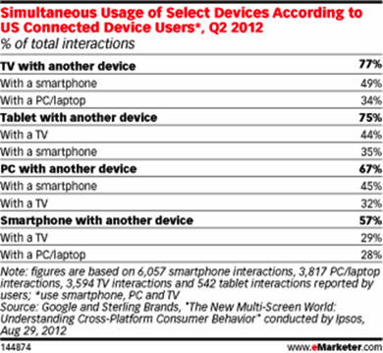

Slide 11
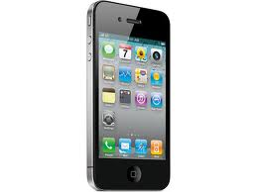
How did you buy your mobile?
Online opinions
Social networking
Feedback and Bloggers
Word of mouth
Brand experiences
Branded conversations
Notes:
How did I buy my car?
Blogs
Word of mouth
Expert Friends opinion
What I see in the streets
Corporate Website
A bit of TVC (!)

Slide 12
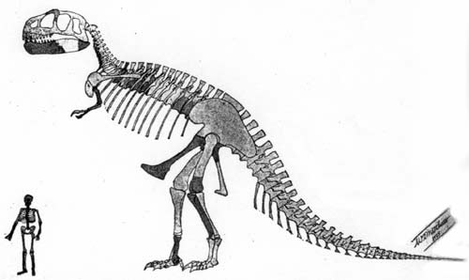
Brands need to change today or
face the consequence of being extinct.

Slide 13

Brands who will succeed are those who create believers, not consumers
Like a rock-band… not people who buy a record, but fans who live and breath the band, do what the band does, behave as the band ambassador…

Slide 14

To be able to do this brands need to establish ‘conversations’ with people in all relevant channels…
…different from bombarding target consumers with commercials

Slide 15
Advertiser vs. consumer

Slide 16
Summary
2 ways conversations
Multi-channels
Listen…

Slide 17
Stakeholders: who plays in this game

Slide 18
people
marketers
agencies

Slide 19
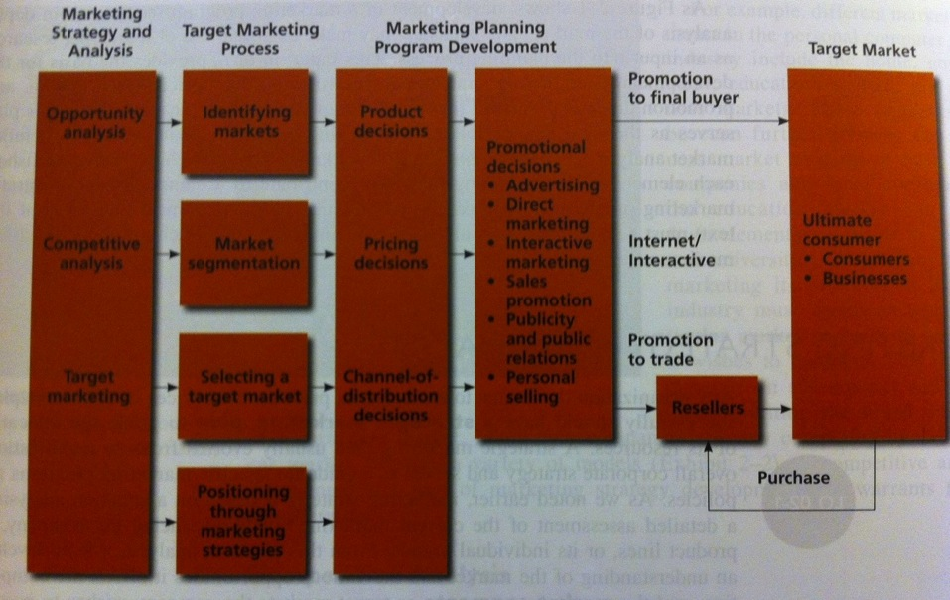
Marketing and promotions process model
Advantage
Page 43

Slide 20

1. MKTG strategy and analysis
To develop a strategic marketing plan
Opportunities analysis:
  existing products in current market, new products in current markets, existing products in new markets…
  Builds from trends and behaviors, unmet needs, innovation
Competitive analysis:
  Understand competition
  Define a competitive advantage (product, price, distribution, benefit?)
Identify a target market

Slide 21












Market is driven by functional benefits and respondent can clearly segment it
The anti-dandruff
Curative - Problem solution
Understand the benefit but don’t use
Hair functional benefit
Many variants and hair benefits, good for any type of women
EXAMPLE
The international brands
Specialized benefits (color hair, tangled hair)
More expensive
The basic cleaning
The cheap option
No innovation
For some SSK is part of this group

Slide 22
2. Target marketing process
To define the one or more target market to focus on
Market segmentation:
  Dividing up a market into distinct segments that have same needs and respond similarly to marketing activities
  Many kind of segmentation bases: geography, demographic, psychographic, product usage
  The more you segment the smaller the size of the market but the more focused the action
Select one or more segment to focus on
  Undifferentiated marketing
  Differentiated marketing
  Concentrated marketing
Determine the business potential of the segment and position your offer

Slide 23

3. Mktg planning program development
To define “positioning” through marketing activities
Positioning: the process by which marketers try to create an image or identity in the minds of their target market for its product, brand, or organization
Positioning by:
  Benefit
  Price
  Other categories (airlines vs. trains) or competitors
  Values and image
Repositioning: the strategy of changing brand positioning

Slide 24
3. Mktg planning program development (follow)
Defining the marketing mix
Product (branding, packaging, R&D, quality, innovation…)
Price
Distribution channels (place)
Promotion

Slide 25
people
marketers
agencies

Slide 26
The client’s side
MD
Production
Marketing
Sales
Finance
R&D
HR
Brand manager
Trade marketing
Brand manager (…)
Market Researches: Trends, Needs and Motivations, Market segmentation
Marketing mix development
Innovation
Communication
Pricing strategies
Positioning
Pack design
Agency management
Support to sales
Mktg services

Slide 27
people
marketers
agencies
Deliver specific services according to the nature of the agency:
Researches
Advertising
Media planning and buying
Web solutions
PR and influence plans
Packaging design

Slide 28
The ad agency side
President
Client services
Planning
Creative
Digital
Production
Finance
HR
Manage clients and supervise the projects
Define communication strategies and researches
Develop actual executions
Develop web solutions and integrate
Responsible for actual production (ex. shooting)
The boring thing Finance and HR do

Slide 29
Different type of advertising agencies
Big multinational groups (WPP, IPG, Omnicom, Publicis); full set of departments, highly integrated usually handling global accounts
Local strong players (in Thailand: Matchbox, Prakit, Bangkokshocase) born as spin-offs from bigger agencies or from local talents. Mid-small sizes focused on core services
“Creative boutiques” focused only in creative development. Known for out of the box thinking mainly work on ad hoc projects

Slide 30
WPP
Omnicom
Publicis
IPG

Slide 31
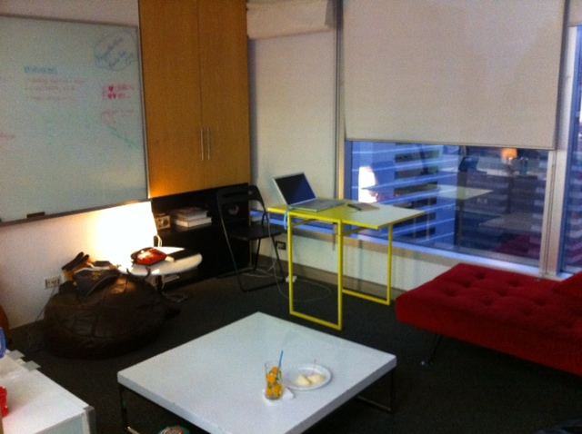
This is how it looks inside the agency

Slide 32
The typical flow
Brief from marketing to client services (C.S.)
Creative team to develop executions – Planners to work on strategy
Agency presents to client
Planners to understand the brief and develop creative brief
Planners and C.S. to brief creative team

