Slide 1
Demystifying Late Ayutthaya and Thonburi
Thorn Pitidol
Semester 1/2018

Slide 2
Topics
Late Ayutthaya period
  General conditions
  Trade and war
  The fall of Ayutthaya
The rise and fall of Thonburi

Slide 3
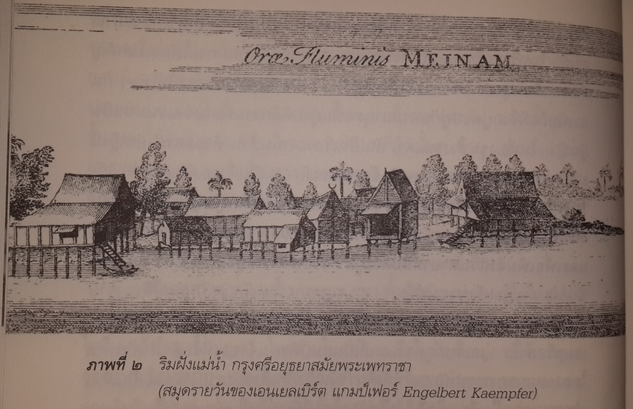
Late Ayutthaya
Geography

Slide 4
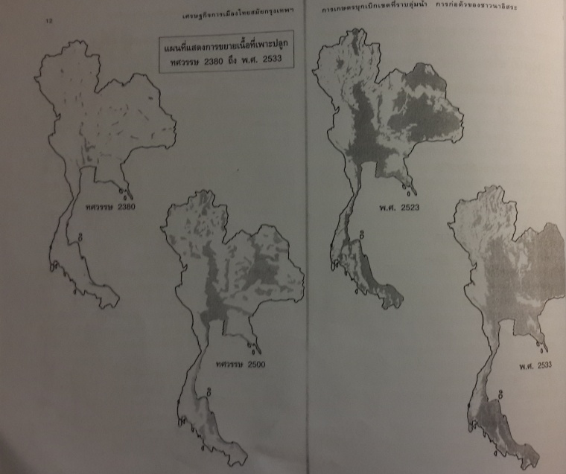
Late Ayutthaya
Geography

Slide 5
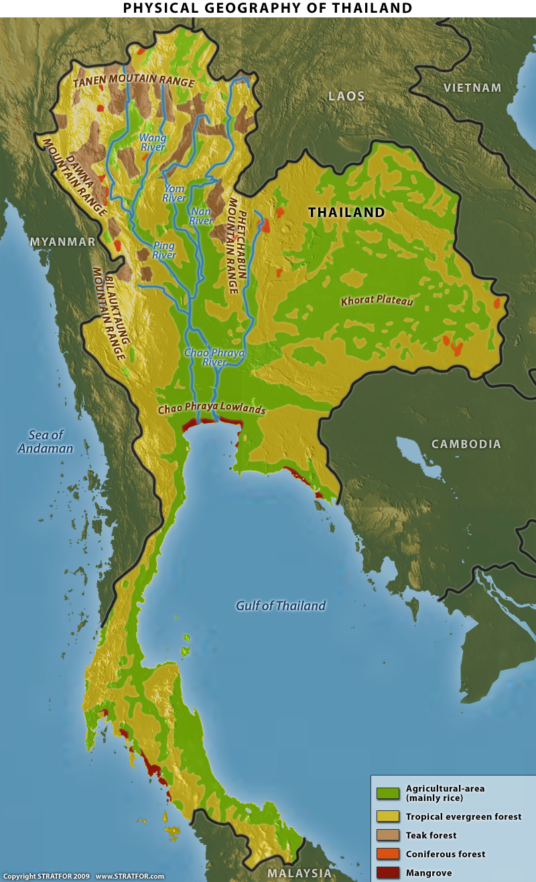
Late Ayutthaya
Geography: characterised by (1) low-land basin and (2) forest hinterland

Slide 6
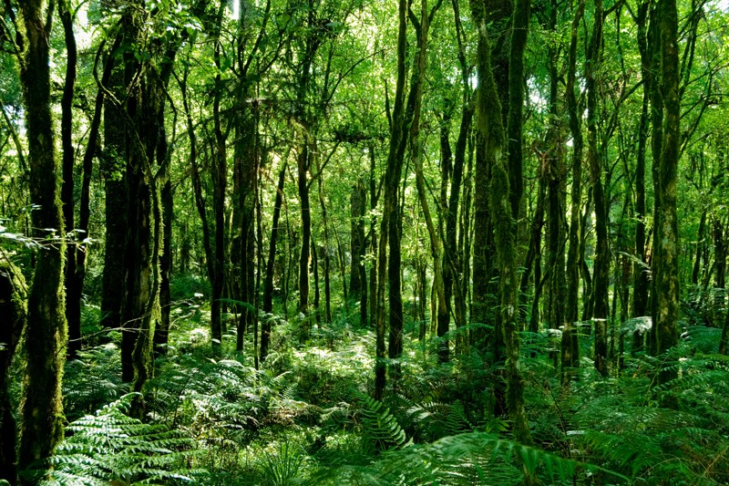
Late Ayutthaya
Two types of areas facilitated the Kingdom’s two crucial forms of production.
  Basin facilitated rice production
  Hinterland facilitated the collection of forest products

Slide 7
Ayutthaya Society
The basis for the wealth of Ayutthaya rulers
  Resources from rice-basins and forests
  Extractions of agricultural production and labour
Ruling system and the tasks of extraction coincided, and formed the type of Ayutthaya’s Feudalism.

Slide 8
Ayutthaya Society
What was the most crucial function of Ayutthaya’s Feudalism?

Slide 9
Ayutthaya’s trade and war
Trade of forest product was crucial to the wealth of rulers. Ayutthaya’s relationships with other cities were significantly influenced by trade.
  Seeking control of trade routes
  Building tributary relationship

Slide 10
Ayutthaya’s trade and war
Kings and nobles of Ayutthaya were traders, and the essential aspect of the Kingdom’s power was the ability to control and to facilitate trade.
  Foreigners in Ayutthaya
  Tributary relations with the Chinese emperor

Slide 11
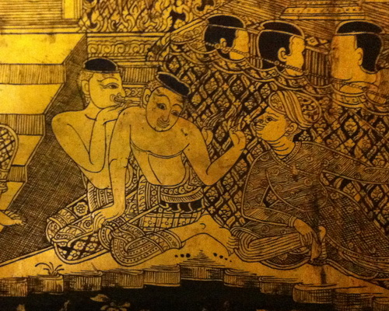
Ayutthaya’s trade and war
Foreigners in Ayutthaya

Slide 12
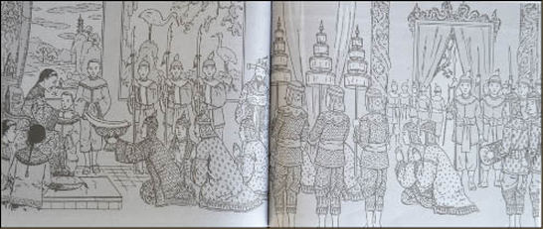
Ayutthaya’s relationship with China
Relationship with China much more important toward the end of Ayutthaya
  Rise in number of Chinese in Ayutthaya
  Trade with China increased, and became a major trade

Slide 13
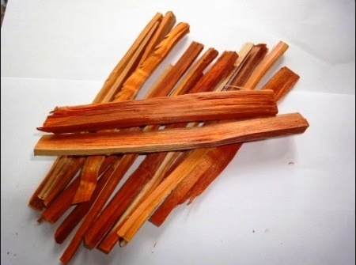
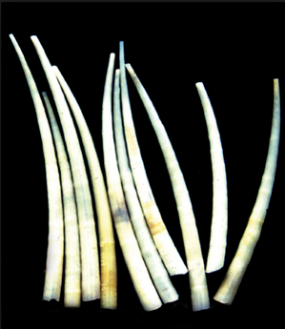
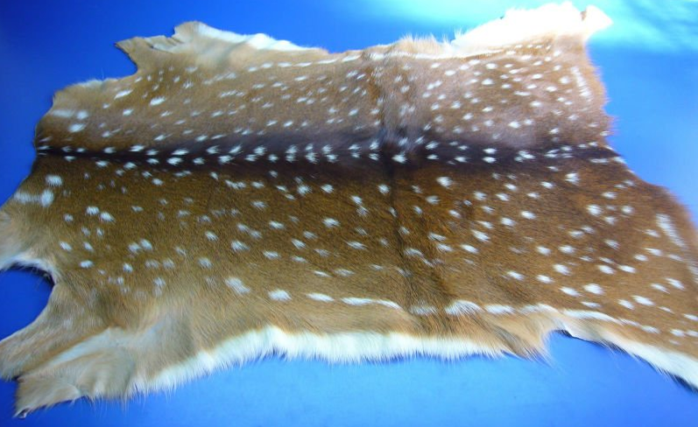
Ayutthaya’s trade and war
Trade products
Export: Rice, Hide, Jewelry, Spice, Fragrant Wood, Ivory, etc.
Import: Textile, Pottery, Porcelain, Weapons, Etc.

Slide 14
Ayutthaya’s trade and war
Wars
  Purpose of wars mostly relate to control over trade and to gain labour
  Constraints of wars: scarcity of population

Slide 15
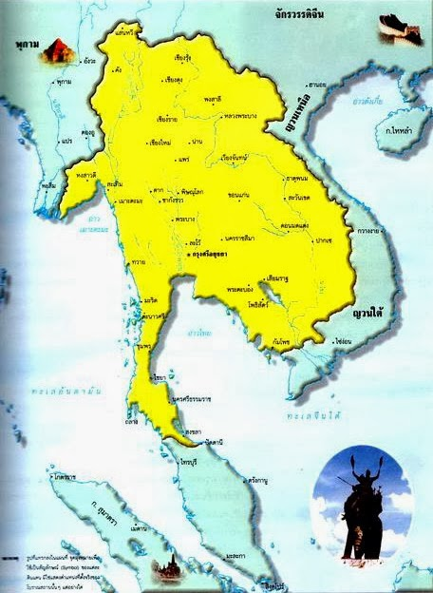
Ayutthaya’s trade and war
Misunderstandings of wars in Ayutthaya
  Not at all about territory
Ayutthaya and Mafia.

Slide 16
The fall of Ayutthaya
Factors in the downfall of Ayutthaya?
  The inability to meet the challenge emerging from transformations of Ayutthaya into commercial society (Baker and Phongpaichit, 2017)
    Rising power of nobles
    Losing centralizing power of King over provincial lords
    Struggle to control labour

Slide 17
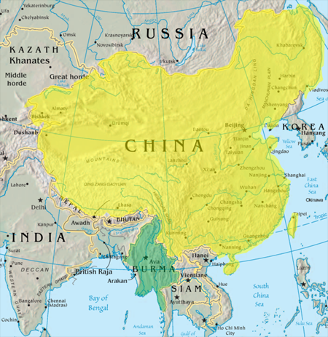
The fall of Ayutthaya
The Burmese Kingdom during late Ayutthaya
  Ayutthaya in fact made little resistance

Slide 18
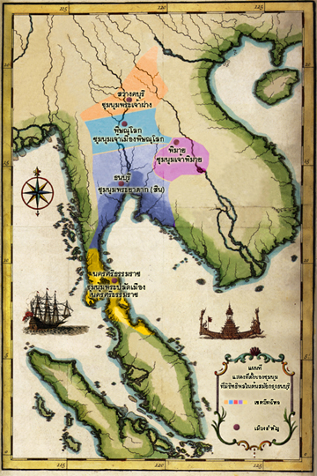
Thonburi period
Society after Ayutthaya downfall
  “Chum-num”.
  What set Taksin’s Chumnum apart from others?

Slide 19
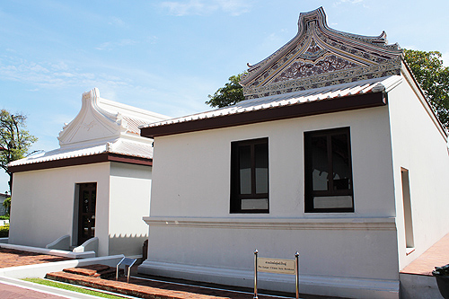
Taksin – the Chinese King
Taksin was a son of Teo-chew chinese merchant
He was likely to be born in Ayutthaya, but built himself as a merchant who travelled to trade in Tak.

Slide 20
The challenges of Thonburi
The strength of Taksin was in military skills. A fierce and ruthless leaders, he excelled at being a leader of a chumnum.
But he faced a totally different challenges as the King of a newly revived Siam.

Slide 21
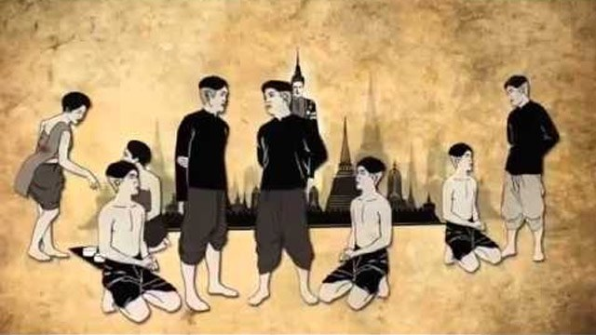
The challenges of Thonburi
Reviving the ruling system
Reviving the economy and re-establishing trade routes.

Slide 22
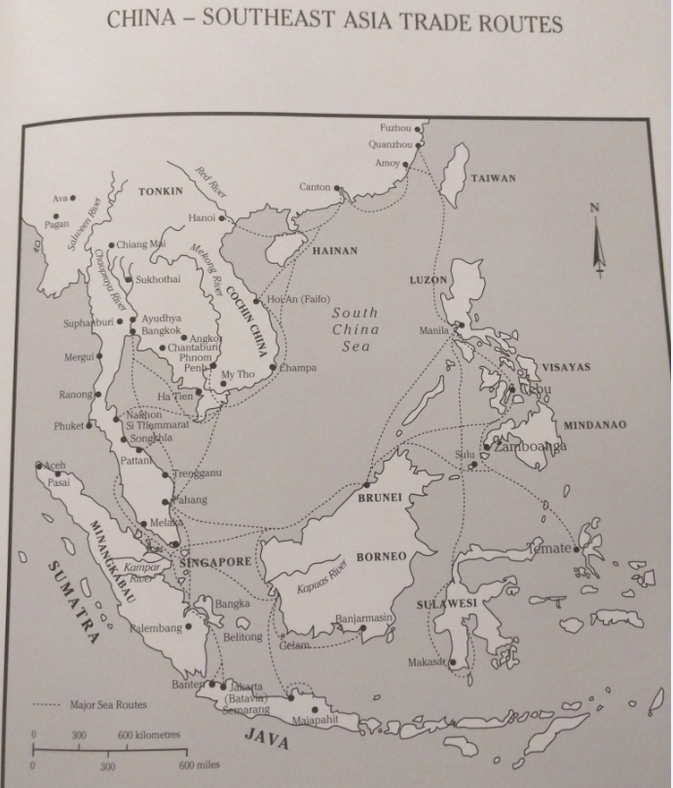
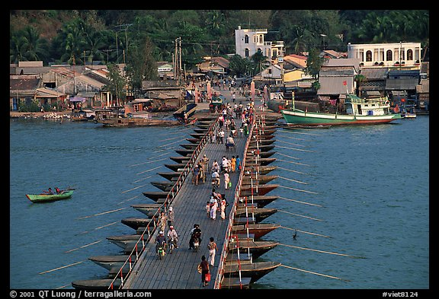
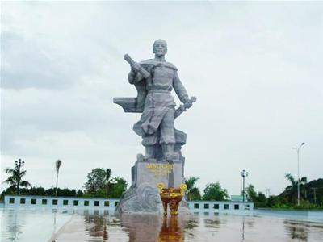
The challenges of Thonburi
Geo-politcs of trade with China
  Chantabun VS Ha-tien, Teochew VS Cantonese.

Slide 23
The fall of Thonburi
As the ruling system was rebuilt, Taksin’s position was destabilised by the system he tried to revived.
  The Chinese King VS Ayutthaya’s nobles?

Slide 24
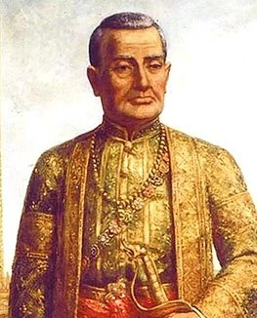
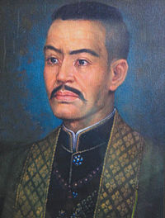
The fall of Thonburi
The center of power for Thonburi’s Ayutthaya nobles

Slide 25
Reflections from Thonburi Era
The rougher state of political economy
  A more natural form of politics (with no mafia state)
The basic challenges
  Scarcity of labour
  Expanding trade
  Rebuilding the society
  Reviving the royal court

Slide 26
Thailand | World
Rama I 1782-1809 (2325-2352 BE) | Industrial revolution started in 1760 Adam Smith died 1790 Napolean became the emperor of France 1804
Rama IV 1851-1868 (2394-2411 BE) | Britain imperial century started1815 First Anglo-Burmese War 1824
Rama V 1868-1910 (2411-2453 BE) | Beginning of Meiji Era 1868 First light bulb by Edison 1879 Titanic sank 1912 WWI 1914
Rama VII 1925-1933 (2468-2476 BE) | Great Depression started 1929 Adolf Hitler rose to power 1933
Rama IX 1946-present (2489-present) | Bombing of Hiroshima 1945 General Nevin coup in Burma 1962 Fall of Berlin Wall 1989

