Slide 1
TU 122 LAW IN EVERYDAY LIFE
NO # 2
Private Law Rights
Pananya Larbprasertporn

Slide 2
Terminology
Rights (สิทธิ) – something that you are legally allowed to do.
Freedom (เสรีภาพ) - the right to do what you want without being controlled or restricted by anyone.
Duty (หน้าที่) – something that you have to do because it is legally right. (See “obligation”)
Liability (ความรับผิด)– legal liability for something, especially for damage or injury
Privilege (เอกสิทธิ์) – An exemption from substantive law that is given only to one person or a group of people
Immunity (ความคุ้มกัน) – the rights of being protected from procedural laws.

Slide 3

Right and Duty, e.g., Section 194 TCCC
“By virtue of an obligation the creditor is entitled to claim performance from the debtor. The performance may consist in a forbearance.”

Slide 4
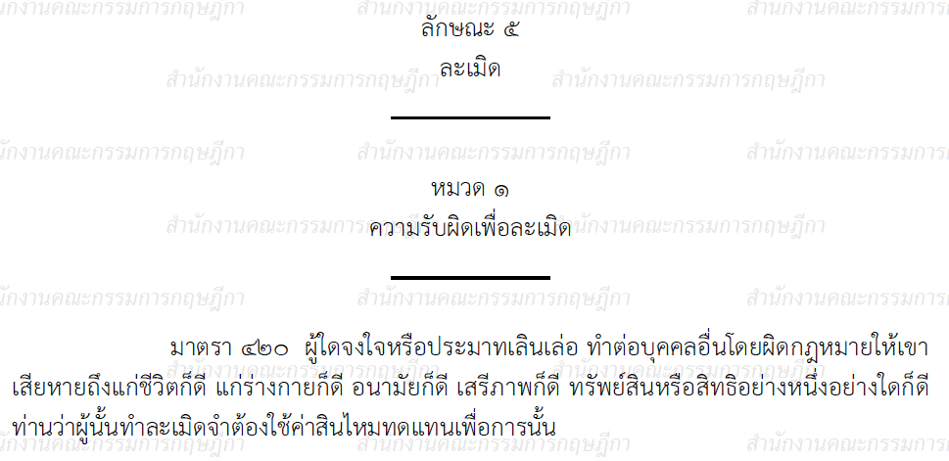
Liability, e.g., Section 420 TCCC
A person who, willfully or negligently, unlawfully injures the life, body, health, liberty, property or any right of another person, is said to commit a wrongful act and is bound to make compensation therefore.

Slide 5
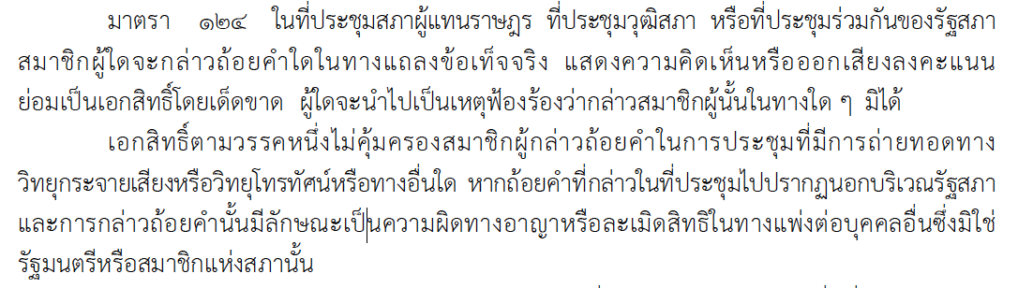
Privilege, e.g., Section 124 Constitution
…

Slide 6
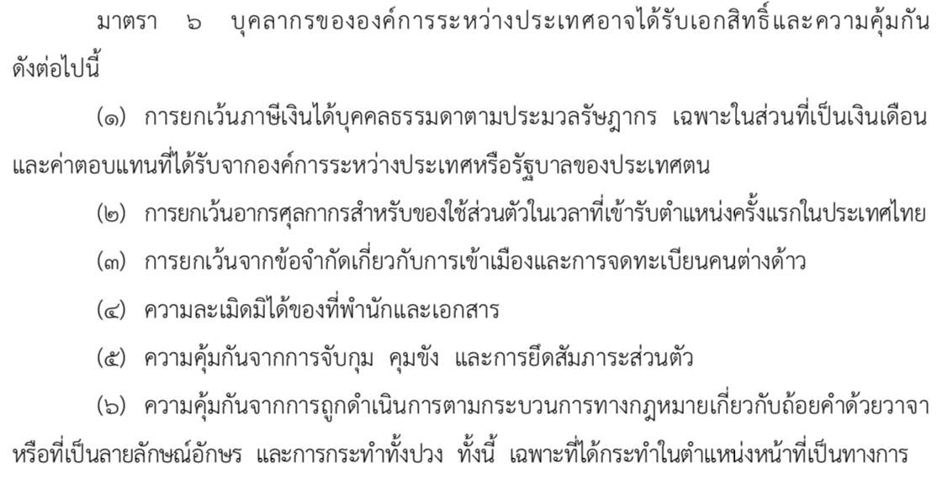
Immunities, e.g., The Act on Privileges and Immunities for International Organizations and International Conferences in Thailand 2018
....

Slide 7
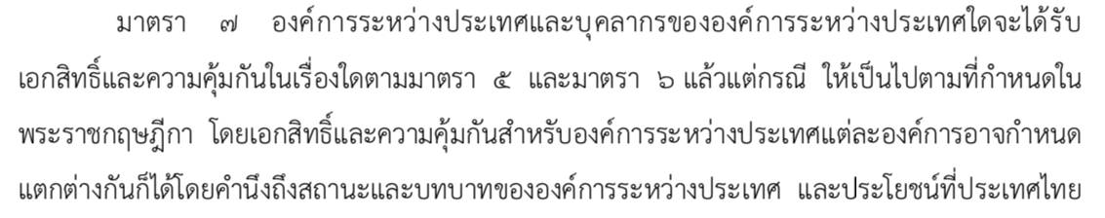
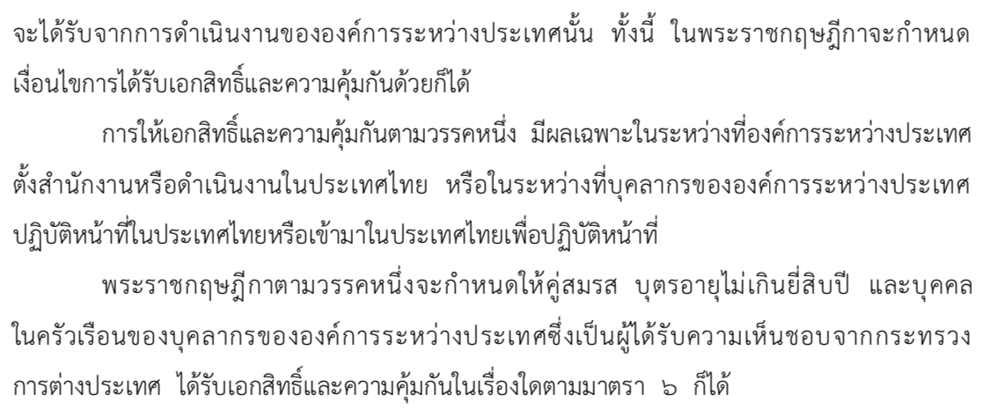
Royal Decree (secondary legislation)

Slide 8
Rights
Rights under public law
Rights under private law

Slide 9
Concepts of Rights in
Public Law
Rights in public law (especially constitution)
  Fundamental rights, e.g.,
    Right to liberty (สิทธิและเสรีภาพในชีวิตและร่างกาย)
    Right to due process of law (สิทธิในกระบวนการยุติธรรม)
    Right to freedom of movement (เสรีภาพในการเคลื่อนไหว ในการเคลื่อนย้ายและการเดินทาง)

Slide 10
Concepts of Rights in
Public Law
    Right to freedom of thought (เสรีภาพทางความคิด)
    Right to freedom of religion (เสรีภาพในการถือศาสนา)
    Right to freedom of expression (เสรีภาพในการแสดงความคิดเห็น)
    Right to peaceably assemble (เสรีภาพในการชุมนุมโดยสงบ)
    Right to ownership (สิทธิในทรัพย์สิน)

Slide 11
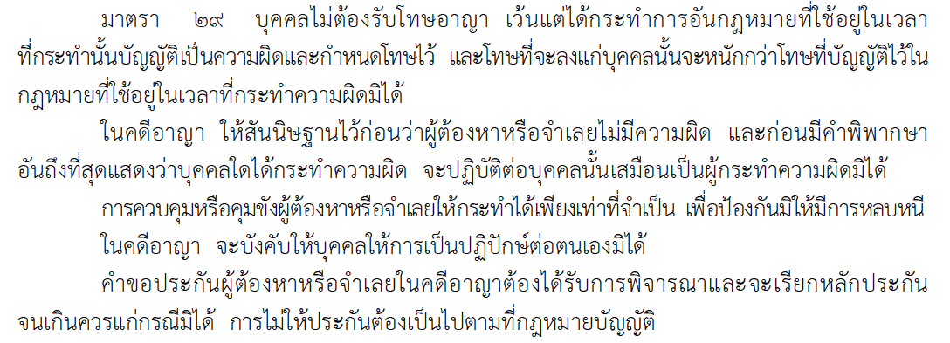
Constitution 2017

Slide 12
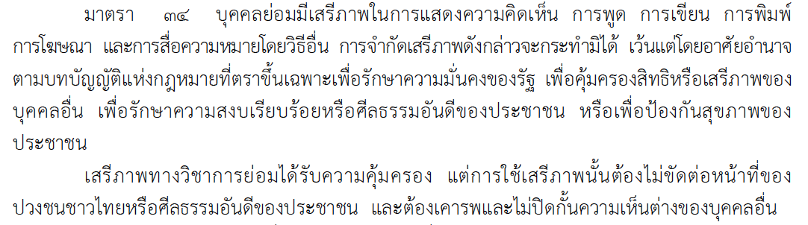
Constitution 2017

Slide 13
Rights under Private Law
Classification of Private Law Rights
The classification of private law rights varies depending on the criterion employed. Different criteria give different classifications.
Basic Classifications
  Classification by the subject matter protected by the rights
  Classification by the person who has a duty to respect the rights
  Classification by the enforcement of the rights

Slide 14
Classification by the Subject
Matter Protected by the Right
Rights related to things
  Real rights (rights in rem)
    Absolute real right – ownership
    Limited real right - habitation, superficies, servitude, usufruct, etc.
  Concession
  Intangible assets (especially IP rights)
  Obligatory rights (rights in personam)
Rights related to persons
  Rights to life
  Rights arising from status

Slide 15
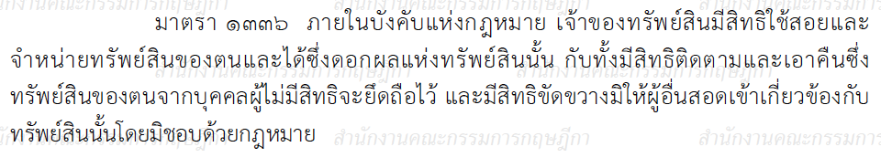
Ownership
Section 1336 TCCC. Within the limits of law, the owner of property has the right to use and dispose of it and acquires its fruits; he has the right to follow and recover it from any person not entitled to detain it, and has the right to prevent unlawful interference with it.

Slide 16
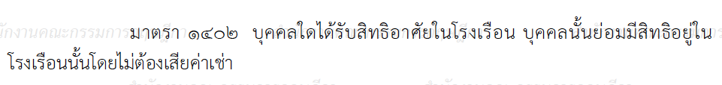
Habitation
Section 1402 TCCC. A person who has been granted a right of habitation (arsai) in a building is entitled to occupy such building as a dwelling place without paying rent.

Slide 17
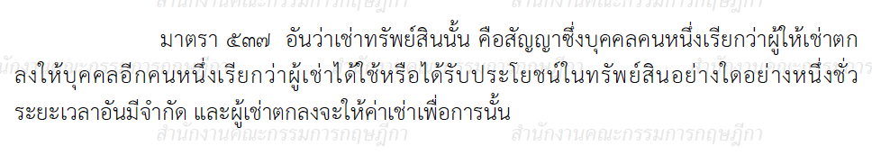
Obligatory Rights
Section 537 TCCC. A hire of property is a contract whereby a person, called the letter, agrees to let another person, called the hirer, have the use or benefit of a property for a limited period of time and the hirer agrees to pay rent therefore.

Slide 18
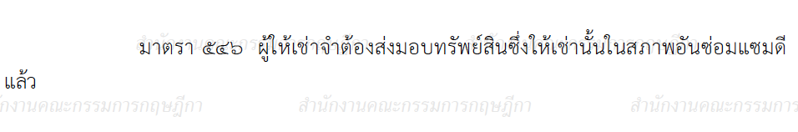
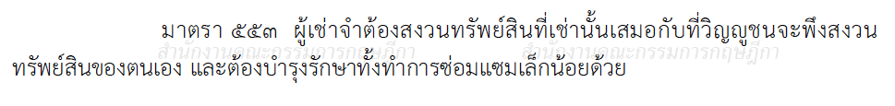
Obligatory Rights
Section 546 TCCC. The letter is bound to deliver the property hired in a good state of repair.
Section 553 TCCC. The hirer is bound to take as much care of the property hired as a person of ordinary prudence would take of his own property, and to do ordinary maintenance and petty repairs.

Slide 19
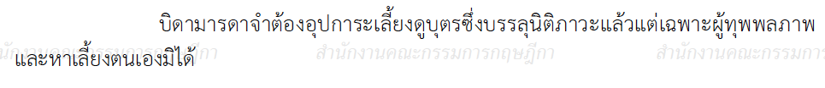
Rights arising from Status
Section 1564 TCCC. Parents are bound to maintain their children and to provide proper education for them during their minority.
When children are sui juris, parents are bound to maintain them only when they are infirm and unable to earn their living.
Sui juris means [Latin “of one’s own right”; independent] of full age and capacity
[Black’s Law Dictionary]

Slide 20
Classification by the Person
Who Has Duty to Respect the Right
Absolute right (can be invoked against everyone)
Relative right (can be invoked only against a specific person(s))
Are they absolute or relative right?
Real rights
Intangible rights
Obligatory rights
Right to life
Right arising from status

Slide 21
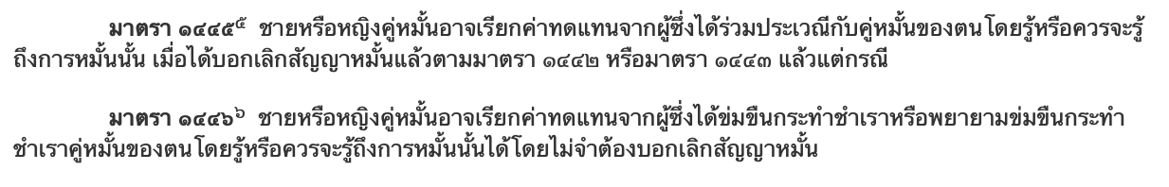
TCCC

Slide 22
Classification by the Enforcement
of the Right
Self-enforcing, including self-defense
Claim
Refusal
Nullification
Do the following rights constitute the right to self-enforcing?
Real rights
Concession
Intangible rights
Obligatory rights
Right to life
Right arising from status

Slide 23
Self-enforcing
Section 1336 TCCC. Within the limits of law, the owner of property has the right to use and dispose of it and acquires its fruits; he has the right to follow and recover it from any person not entitled to detain it, and has the right to prevent unlawful interference with it.
Question: Any limits?

Slide 24
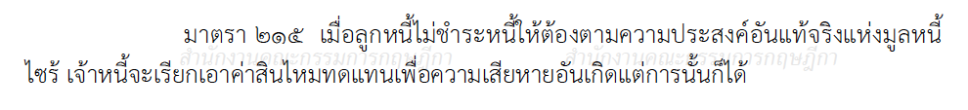
Claim
Section 215 TCCC. When the debtor does not perform the obligation
in accordance with the true intent and purpose of the same,
the creditor may claim compensation for any damages caused
thereby.
“Same” means the very thing just mentioned or described; it or them
[Black’s Law Dictionary]

Slide 25
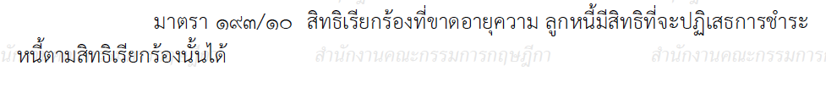
Refusal
Section 193/10 TCCC. After the lapse of the period of prescription for claims, the debtor is entitled to refuse performance.
E.g. Tax – 10 years; salary – 5 years, etc.

Slide 26
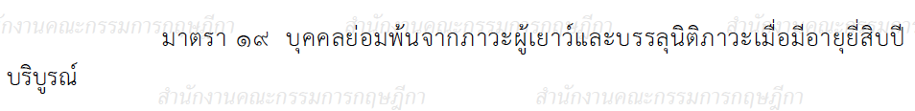
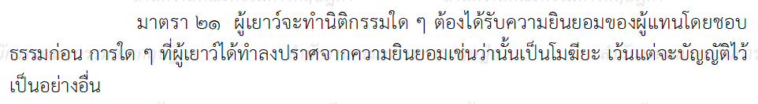
Nullification
Section 19 TCCC. A person, on completion of twenty years of age, ceases to be a minor and becomes sui juris.
Section 21 TCCC. For the doing of a juristic act, a minor must obtain the consent of his legal representative. All acts done by him without such consent are voidable unless otherwise provided.
“Voidable” means valid until annulled; esp., (of a contract) capable of being affirmed
or rejected at the option of one of the parties.
“Void” means of no legal effect; null. [Black’s Law Dictionary]

Slide 27
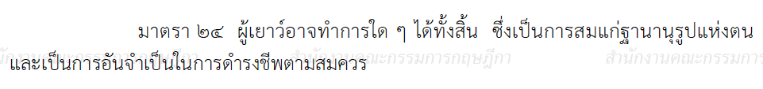
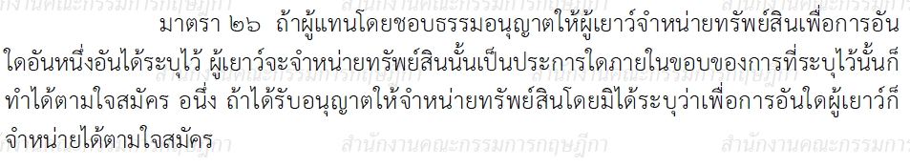
Nullification
Section 24 TCCC. A minor can do all acts which are suitable to his condition in life, and actually required for his reasonable needs.
Section 26 TCCC. When the legal representative permits a minor to dispose of property for a purpose specified by him, the minor may, within the limits of such purpose, dispose of it at his pleasure. He may do the same as to property which he has been permitted to dispose of without any purpose begin specified.
Question: Remember the Iwatch case?

Slide 28
Exercise
A driving negligently hit B, a minor, who was crossing a street. B’s parents had to pay 100,000 THB for this treatment. They would like to sue A to claim damages for such wrongful act. Please answer.
What rights of B were violated?
By suing A, what rights are the parents exercising?

Slide 29
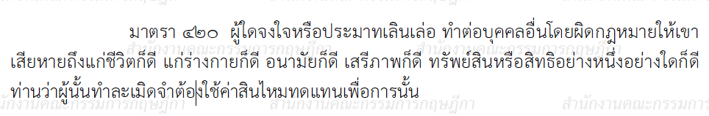
Tort
Section 420 TCCC. A person who, willfully or negligently, unlawfully injures the life, body, health, liberty, property or any right of another person, is said to commit a wrongful act and is bound to make compensation therefore.

Slide 30
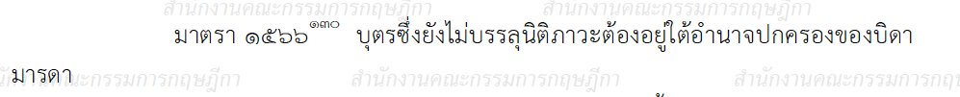
Parental power
Section 1566(1) TCCC. A child is subject to parental power as long as he is not sui juris.
…

