Slide 1

Trustee&
Custodian
By
Chotika Muktana-anant 5504640227
Natcha Choonhajinda 5504640714
Pinthip Srichart 5504641191
Pakaporn Tohwisessuk 5504640920
Patcharapon Suppiumlarp 5504640987
Ornpreeya Manovilas 5504640912
Sornsita Aimprasittichai 5504641670

Slide 2
Agenda
  Overview
1.
  Trustee
2.
  Custodian
3.
  Summary
4.
4.
Notes:
สีนี้โอเคมั้ยอ่า

Slide 3

Overview
Trust
Trustee
Other Clients
“MANAGE”
Custodian
“SECURE”
Overview
Trustee
Custodian
Summary
Notes:
รอบุ๊คส่ง diagram มา

Slide 4

TRUSTEE
Notes:
แต่งหรือหารูปให้โหน่ยย

Slide 5
The Securities and Exchange Commission
Regulate
Establishes the trust and transfers the ownership
Settlor
Trustee
Legal Ownership
Trust
Manages the assets in the trust
Beneficiaries
Equitable Ownership
Overview
Trustee
Custodian
Summary
Notes:
Legal Ownership (หลักกรรมสิทธิ์โดยกฎหมาย) หมายถึง
การเป็นผู้มีสิทธิตามกฎหมาย (Legal Title) เหนือทรัพย์สินในกองทรัสต์
ซึ่งสามารถจำหน่ายจ่ายโอนและจัดการทรัพย์สินดังกล่าวได้ภายใต้กรอบของสัญญาก่อตั้งทรัสต์แ
ละกฎหมายที่เกี่ยวข้อง
โดยทรัสตีจะเป็นผู้มีกรรมสิทธิ์โดยกฎหมายในทรัพย์สินของกองทรัสต์ภายใต้ชื่อของทรัสตีเองเพื่
อประโยชน์ของบุคคลอื่น อย่างไรก็ดี ทรัสตีไม่มีสิทธิที่จะได้รับประโยชน์จากทรัพย์สินนั้น
Equitable Ownership (หลักกรรมสิทธิ์โดยธรรม)หมายถึง
การเป็นผู้มีสิทธิที่จะได้รับประโยชน์อย่างแท้จริงจากทรัพย์สินในกองทรัสต์เท่านั้น
แต่ไม่สามารถบริหารจัดการทรัพย์สินเพื่อประโยชน์ของตนเองได้
โดยผู้รับประโยชน์เป็นผู้มีกรรมสิทธิ์โดยธรรมในทรัพย์สินของกองทรัสต์
ตลอดจนผลประโยชน์ใด ๆ ที่เกิดขึ้นจากทรัพย์สินนั้น

Slide 6
What is a Trustee?
An individual or organization manages assets for
the beneficiaries of a trust,
estate or other party
Overview
Trustee
Custodian
Summary

Slide 7
Type of Trustee
Type of Trustee
Public Trustee
A corporation that an officer appointed by Lord Chancellor and fulfil a number of public function
Ex. Administration of wills, small estates etc.
2. Bare Trustee
Holds property for the absolute benefits and disposal for beneficiary who is full of age and capacity
Overview
Trustee
Custodian
Summary
Notes:
สำนักงานที่จัดตั้งขึ้นตามพระราชบัญญัติแห่งชาติ

Slide 8
Type of Trustee
3. Judicial trustee
Person or corporation appointed by and under control of court
Worked in the case where the administration of estate by ordinary trustees had broken down
Overview
Trustee
Custodian
Summary
Notes:
a ​person or ​organization that ​holds ​money, ​property, or other ​assets for someone only until the ​time they have the ​right to own it themselves:You could ​buy the ​house for your grandson and ​hold it for him as a ​bare ​trustee until he is 18, when it becomes his absolutely.

Slide 9
Roles and Duties of a Trustee
1. Trust terms
Obligated to follow the terms as set out by the maker of the trust
2. Fiduciary duty
Must use utmost care when managing and investing the trust assets for beneficiaries
Overview
Trustee
Custodian
Summary

Slide 10
Roles and Duties of a Trustee
3. Duty to invest
Must act prudently in preserving the capital of the trust and in balancing the interests of different beneficiaries
4. Duty to beneficiaries
Communicate with all beneficiaries
Responsible for making all scheduled distributions from the trust to the beneficiaries
Overview
Trustee
Custodian
Summary

Slide 11
Roles and Duties of a Trustee
5. Accounting and taxes
Keep thorough records of all the trust businesses
Responsible for preparing, filling, and paying all tax debts of the trust
Overview
Trustee
Custodian
Summary

Slide 12
What happens if the trustee…
Fails to manage the trust in accordance with the trust instrument.
Fails to prepare an account of a trust property separately from any other accounts.
As stated in Trust for Transaction in
Capital Market Act 2007.
Overview
Trustee
Custodian
Summary

Slide 13

CUSTODIAN

Slide 14

What is a Custodian?
Overview
Trustee
Custodian
Summary

Slide 15
What is a Custodian?
  Financial term that describes an institution that holds customers’ assets/securities for safekeeping to prevent theft or loss.
Overview
Trustee
Custodian
Summary

Slide 16


What is a Custodian?
Can be both physical or book-entry securities
Overview
Trustee
Custodian
Summary

Slide 17
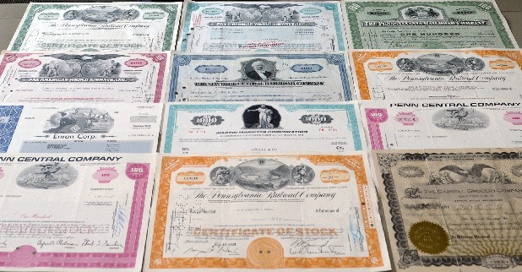
Why do we need a Custodian?
Take care these huge amount of assets
Overview
Trustee
Custodian
Summary

Slide 18

Clients
  Private Funds
  Provident Funds
  Institutional Investors
  International Financial Institutions
  Individual clients
Overview
Trustee
Custodian
Summary

Slide 19
Core services
1. Trade settlements
    - Monitoring and settling any purchases and sales
2. Income collection
    Track and record interest on bonds and
    equity security dividends.
    - Ensure that correct payment is posted to the right account.
Overview
Trustee
Custodian
Summary

Slide 20
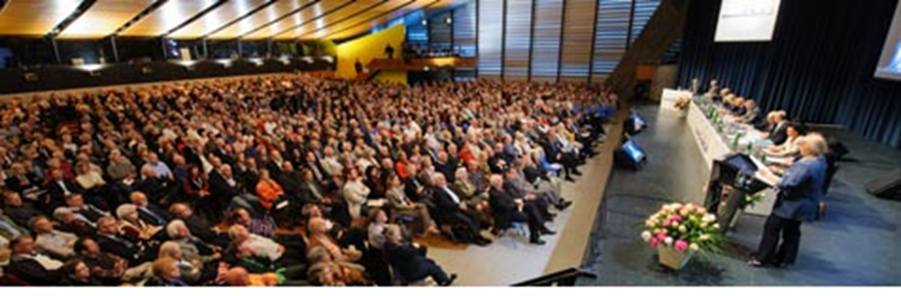
Core services
3. Information on the securities and their issuers
    - Annual general meeting and related proxies
Overview
Trustee
Custodian
Summary

Slide 21
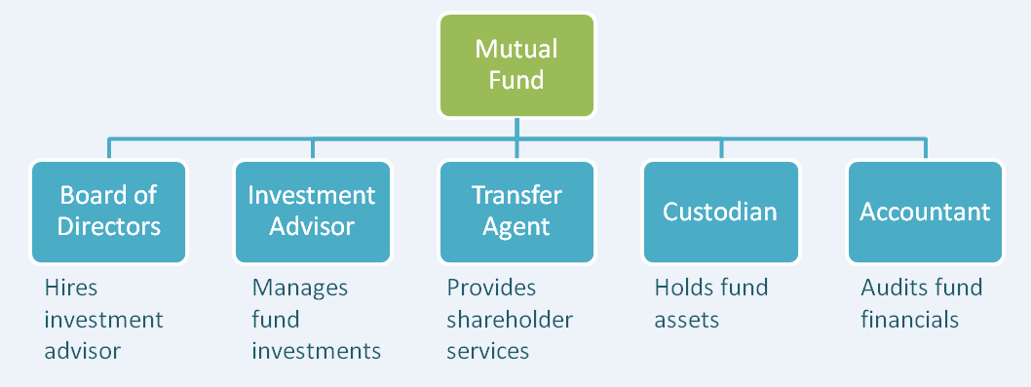
Example
Mutual Fund Custodian
http://blog.fundx.com/blog/2013/09/17/mutual-funds-complex-structure-checks-balances/
Records any transactions of mutual funds.
Calculate the NAV (Net Asset Value) of the fund on a daily basis.
Overview
Trustee
Custodian
Summary

Slide 22
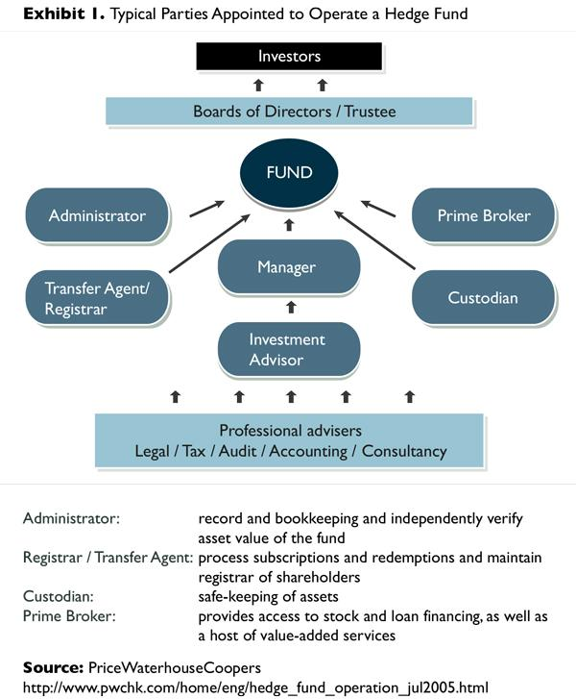
Example
Hedge
Fund
Overview
Trustee
Custodian
Summary

Slide 23

Global Custody Services
  Provides custody services for cross-border securities transactions.
  Executing foreign exchange transactions and processing tax reclaims.
Overview
Trustee
Custodian
Summary

Slide 24
Global Custody Services
  Typically has a sub-custodian, or agent bank, in each local market to help provide custody services in the foreign country.
Overview
Trustee
Custodian
Summary

Slide 25
List of Custodian
Approved by the office of SEC
(The Securities and Exchange Commission)
  The Hongkong and Shanghai Banking Corporation Limited
  Phillip Securities (Thailand) Public Company Limited
  CIMB Thai Bank Public Company Limited
  Deutsche Bank
  Standard Chartered Bank (Thai) Public Company Limited
  Thanachart Bank Public Company Limited
Citibank, N.A
TISCO Bank Public Company Limited
Siam Commercial Bank PCL.
Bangkok Bank Public Company Limited
Kasikorn Bank PCL
Bank of Ayudhya Public Company Limited
TMB Bank Public Company Limited
Overview
Trustee
Custodian
Summary

Slide 26
Summary
TRUSTEE | CUSTODIAN
Manage the assets in the trust | Physically hold the assets of the trust
Legal owner of the assets | Contractual relationship (usually a bank or stock brokerage)
Fiduciary Duty to the beneficiaries | NO fiduciary responsibilities
Can be sued by beneficiaries | Conduct financial transactions according to trustee’s decision
Overview
Trustee
Custodian
Summary
Notes:
ฝากแต่งโหน่ยย

Slide 27

Thank You

