Slide 1

MK 322 Retail Management
Chapter 15: Retail Communications Mix
Part I
By Ajarn Suwalya K.

Slide 2
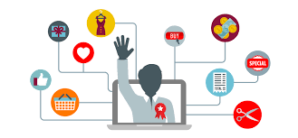
Integrated Marketing Communications

Slide 3
Integrated Marketing Communications (IMC) Program
IMC program: successful retailers utilize IMC program in which they integrate a variety of communication elements to deliver a comprehensive, consistent message to all customers over time, across all elements of their retail mix and across all delivery channels
Notes:
1

Slide 4
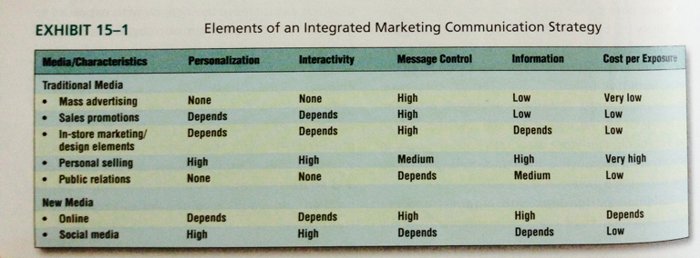
Integrated Marketing Communications (IMC) Program
Notes:
1

Slide 5

Traditional Media Elements

Slide 6
Mass Media Advertising
Advertising entails the placement of announcements and persuasive messages purchased by retailers and other organizations that seek to inform and/or persuade members of a particular target market or audience about their products, organizations or ideas
Mass advertisement is typically used to generate awareness in the need recognition stage of the buying process because of its low cost per exposure and control retailers have over content and timing of the communication
Notes:
1

Slide 7
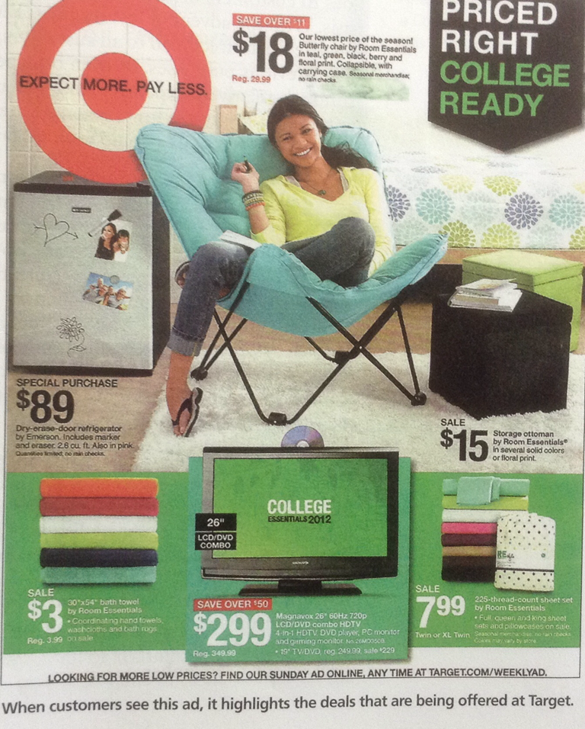
Newspapers
A freestanding insert (FSI) also called preprint is an advertisement printed at the retailer's expense and distributed as an insert in the newspaper
Notes:
1

Slide 8
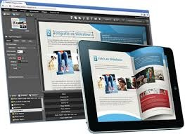
Magazines
Magazines offer both print and online adverstising or have transitioned to online only
This change in the business model for some magazines from print to online (or both) enables retailers to reach potential customers at a lower cost per exposure
Retailers tend to use it for image advertising, but due to lead time, difficult to coordinate with special events and sales
Notes:
1

Slide 9
Direct Mail
Direct mail includes brochure, catalog, advertisement, or other printed marketing material delivered directly to the consumer through the mail or a private delivery company
With the advent of loyalty and CRM programs, retailers are now able to personalize their direct mail to all customers, to a subset of customers according to their previous purchase or even personalized basis to individual customers
Notes:
1

Slide 10

Television
Retailers use TV for image advertising, to take advantage of the high production quality and the opportunity to communicate through both visual images and sound
TV can demonstrate product usage
Is an excellent medium for car, furniture, and consumer electronic dealers
Notes:
1

Slide 11
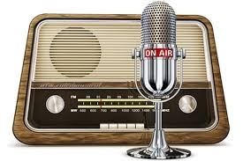
Radio
Many retailers use radio advertising because messages can be easily targeted to a specific segment of the market
Audiences can be loyal in a talk radio format
The cost in developing and broadcasting radio commercials is low
Notes:
1

Slide 12
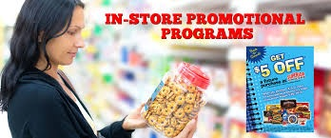
Sales Promotions

Slide 13
Sales Promotions
Sales promotions are special incentives or excitement-building programs that encourage consumers to purchase a particular product or service
Part of long term CRM programs
The ability to control the message is high and cost per exposure is low eventhough they provide relatively little information
Notes:
1

Slide 14
Coupons
Coupons offer a discount of price of specific items when they are purchased
Coupons are issued by manufacturers and retailers in newspapers, on products, on the shelf, at the cash register, over the internet, on mobile devices and through the mail
Some retailers link coupons to their loyalty programs
Notes:
1

Slide 15
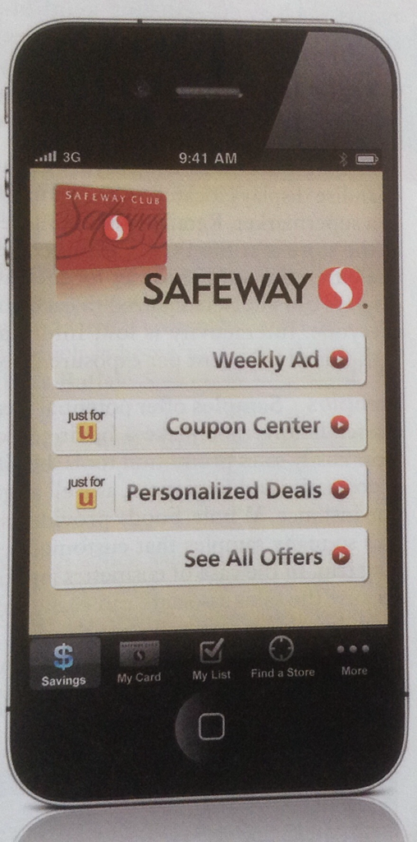
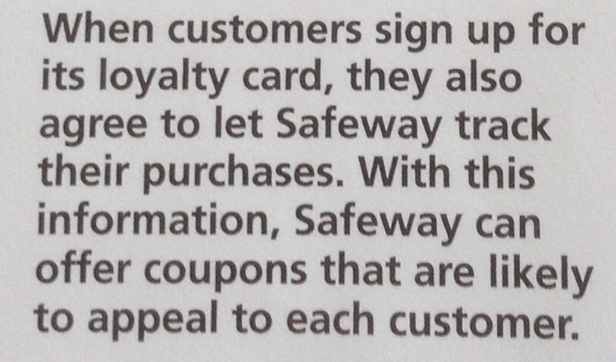
Coupons
Notes:
1

Slide 16
Rebates
Rebates provide another form of discounts for consumers
The manufacturer instead of the retailer, issues the refund portion of the purchase price returned to the buyer in form of cash
Some retailers offer "instant rebates" that can be redeemed at point-of-purchase
Notes:
1

Slide 17
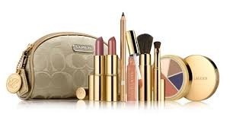
Premiums
A premium offers an item for free or at a bargain price to reward some type of behavior such as buying, sampling or testing
Such rewards build goodwill among consumers, who often perceive high value in them
A premium can be distributed in a variety of ways for ie. Toys in cereal boxes, free perfume offers that Victoria Secret mails to customers
Notes:
1

Slide 18
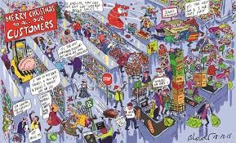
In-Store Marketing/Design Elements

Slide 19
Point-of-Purchase (POP) Displays
Point-of-purchase (POP) displays are merchandise displays located at the point of purchase, such as the checkout counter in a supermarket
Retailers have long recognized that the most valuable real estate in store is at the POP
Interactivity is low, cost per exposure is low
Notes:
1

Slide 20
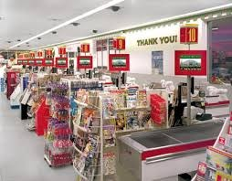
Point-of-Purchase (POP) Displays
Notes:
1

Slide 21
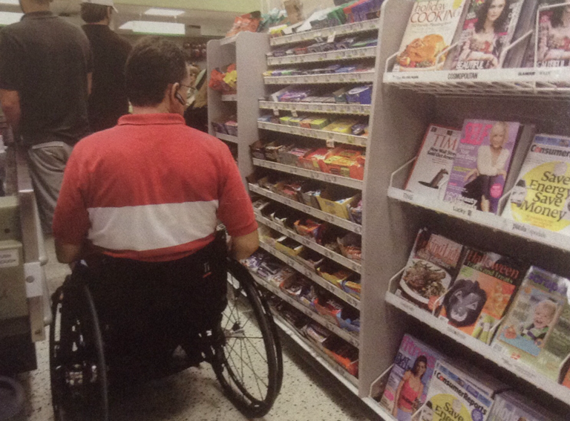
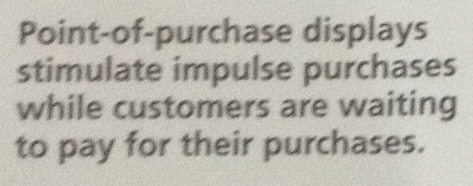
Point-of-Purchase (POP) Displays
Notes:
1

Slide 22
Samples
Samples offer potential customers the opportunity to try a product or service before they make a buying decision
Distribution samples is one of the most costly sales promotion tools, but it is also one if the most effective
Retailers of cosmetics and fragrances, as well as grocery stores, frequently employ sampling
Notes:
1

Slide 23
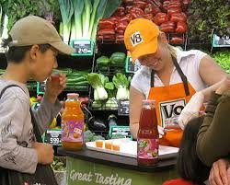
Samples
Notes:
1

Slide 24
Special Events
A special event is a sales promotion program comprising a number of sales techniques built around a seasonal, cultural, sporting musical or some other type of activity
Special events can generate excitement and traffic in the store
Event Sponsorship occurs when retailers support various activities (finally or otherwise), usually in the cultural or sports and entertainment center
Notes:
1

Slide 25
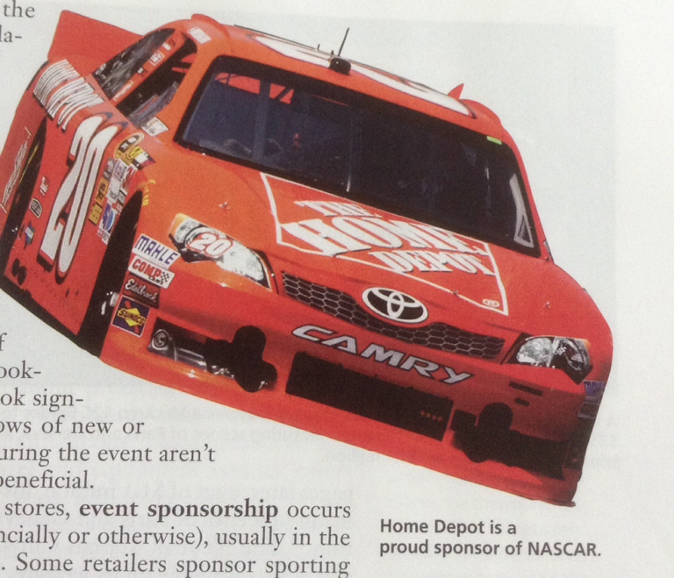
Special Events
Notes:
1

Slide 26

Personal Selling
Personal selling is a communication process in which sales associates help customers satisfy their needs through face-to-face exchanges of information
Sales people can personalize every message to fit the customers' needs and provide as much information as needed
Notes:
1

Slide 27
Public Relations
Public Relations (PR) involved managing communications and relationship to achieve various objectives, such as building and maintaining a positive image of the retailer, handling or heading off unfavorable stories or events
Notes:
1

Slide 28
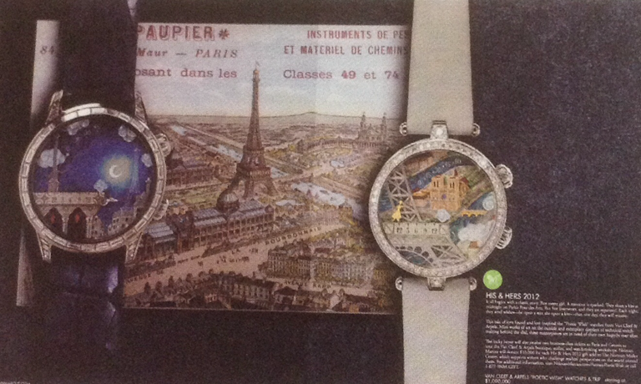

Public Relations
Neiman Marcus and Its Chritmas Catalog is the nation's best known retail catelog
Notes:
1

Slide 29
Public Relations
Macy's and Cause-Related Marketing
Starting in 2011, Macy's partnered with many charities in a successful campaign
In addition to providing a benefit for society, its Shop for a cause related campaign generates a lot of publicity
Notes:
1

Slide 30
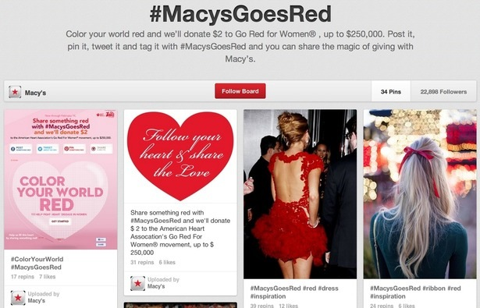
Public Relations
Macy's and Cause-Related Marketing
Notes:
1

Slide 31
Retailers and Product Placement
When retailers and vendors use product placement, they pay to have their product included in nontraditional situations, such as a scene in a movie or television program
Notes:
1

Slide 32
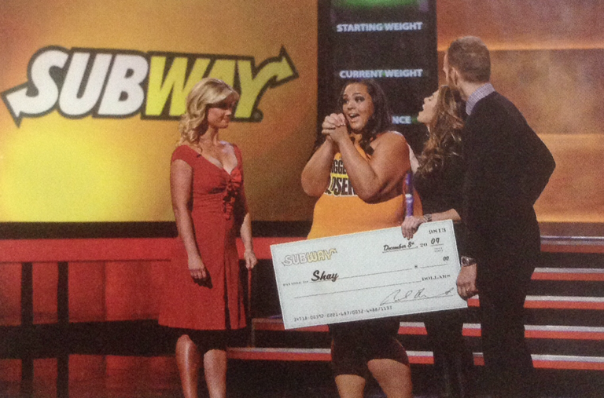
Retailers and Product Placement
Notes:
1

Slide 33


