Slide 1
Markets Failure
EE311
Chayun Tantivasadakarn
Faculty of Economics,
Thammasat University

Slide 2
Topics to be Discussed
Why markets fail
Asymmetric information
  Adverse selection problems
  Moral Hazard problems
Externalities
  Negative externalities
  Positive externalities
Public goods and free rider problems

Slide 3
Why Markets Fail
1. Market Power
  Those with market power choose the price and quantity
  Less output is sold than in competitive markets --> Inefficiency
Let X be a monopolized market, but Y be competitive
Firms in X produce until P_{X} > MR_{X} = MC_{X}. Firms in Y produce until P_{Y} = MR_{Y} = MC_{Y}. Hence,

Slide 4
Imperfect competition and market failure
If X and Y are competitive
|MRT| = P_{X}/P_{Y} = |MRS|
If X is monopoliszed Y is competitive
|MRT| < P/_{X}/P_{Y} = |MRS|
P_{X}/P_{Y}
CIC
Y
Y
Y_{M}
MRT
C
C
Y_{C}
Y_{C}
CIC/
|MRS| = P/_{X}/P_{Y}
X_{C}
X
X_{M}
X_{C}
X

Slide 5
Why Markets Fail
2. Incomplete Information
  Consumers must have accurate information about market prices or production quality for markets to operate efficiency
  Lack of information can change supply and demand
    Too much goods with low quality
    Consumers can’t find enough goods with sufficient quality
  Some markets may never develop

Slide 6
Why Markets Fail
3. Externalities
  Consumption or production has indirect effect on other consumption or production not reflected in market prices
  Market prices do not always reflect the activities of either producers or consumers
4. Public Goods
  Nonexclusive, nonrival good that, once available, is difficult to prevent others from consuming
  Example: Company thinking about researching a new technology if can’t get patent

Slide 7
Asymmetric Information
Asymmetric information: a buyer and a seller knows different information about a transaction
The one who knows more is the informed party and the one who knows less is the uninformed party. -> opportunistic behavior
Asymmetric information leads to
  Adverse selection: Unobserved characteristics
  Moral hazard: Unobserved actions

Slide 8
Adverse selection and the Market for Lemons
Adverse selection: Low quality goods drive high quality goods out of the market because unobserved characteristics
Examples
  The lack of complete information when purchasing a used car increases the risk of the purchase and lowers the value of the car.
  Markets for insurance, financial credit and employment are also characterized by asymmetric information about product quality

Slide 9

Used Cars and lemon problem
Assume: Two kinds of cars – low quality (lemons) and high quality (plums)
If buyers and sellers can distinguish between the cars ->There will be two markets – one for high quality and one for low quality
High quality market
  S_{H} is supply and D_{H} is demand for high quality
Low quality market
  S_{L} is supply and D_{L} is demand for low quality

Slide 10
The Lemons Problem
Market price for high quality cars is $10,000
Market price for low quality cars is $5000
50,000 of each type are sold
P_{H}
P_{L}
S_{H}
10,000
D_{H}
S_{L}
5,000
D_{L}
D_{L}
50,000
Q_{H}
50,000
Q_{L}

Slide 11
The Market for Used Cars
S_{H} is higher than S_{L} because owners of high quality cars need more money to sell them
D_{H} is higher than D_{L} because people are willing to pay more for higher quality
Sellers know more about the quality of the used car than the buyer
Initially buyers may think the odds are 50/50 that the car is high quality
  Buyers will view all cars as medium quality with demand D_{M}
However, fewer high quality cars (25,000) and more low quality cars (75,000) will now be sold
Perceived demand will now shift

Slide 12
The Lemons Problem
Medium quality cars sell for $7500 selling 25,000 high quality and 75,000 low quality
The increase in Q_{L} reduces expectations and demand to D_{LM}. The adjustment process continues until demand = D_{L}.
P_{H}
P_{L}
S_{H}
10,000
7,500
S_{L}
D_{H}
7,500
D_{M}
5,000
D_{M}
D_{LM}
D_{LM}
D_{L}
D_{L}
25,000
50,000
Q_{H}
50,000
75,000
Q_{L}

Slide 13
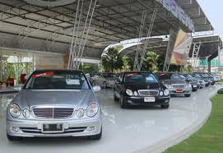
The Market for Used Cars
With unobserved characteristics:
  Low quality goods drive high quality goods out of the market- the lemons problem.
  The market has failed to produce mutually beneficial trade.
  Too many low and too few high quality cars are on the market.
  Adverse selection occurs; most cars on the market will be low quality cars.

Slide 14

Market for Insurance
Older individuals have difficulty purchasing health insurance at almost any price
They know more about their health than the insurance company
Because unhealthy people are more likely to want insurance, proportion of unhealthy people in the pool of insured people rises
Price of insurance rises so healthy people with low risk drop out – proportion of unhealthy people rises increasing price more

Slide 15


Market for Insurance
If auto insurance companies are targeting a certain population – males under 25
They know some of the males have low probability of getting in an accident and some have a high probability
If can’t distinguish among insured, it will base premium on the average experience
Some with low risk will choose not to insure and with raises the accident probability and rates

Slide 16

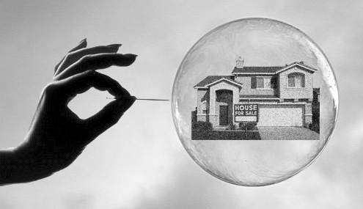
Market for Credit
The Market for Credit
  Asymmetric information creates the potential that only high risk borrowers will seek loans.
  Can end up with lemon problem again
  However, banks and credit agencies use credit histories to gauge risk of borrowers

Slide 17




Solutions to adverse selection problems
Control: force insurance
  pool risks
Reputation: credit history, “open since ..”
Standardization and Certification
  Chains that keep production the same everywhere – McDonalds

Slide 18

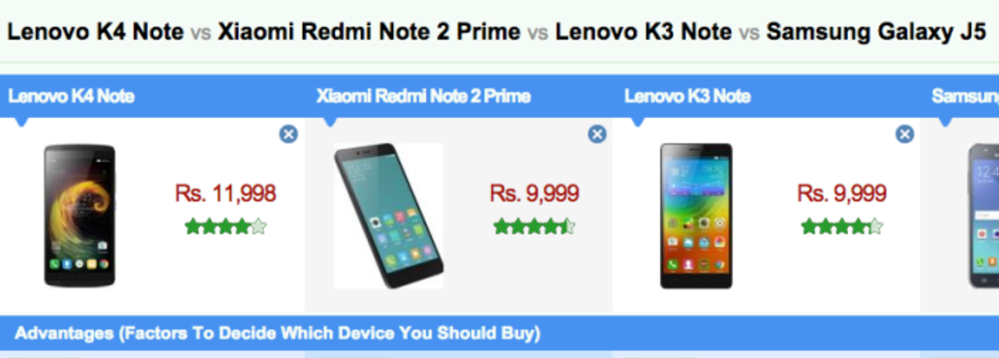

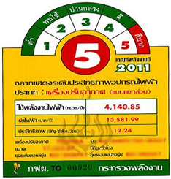
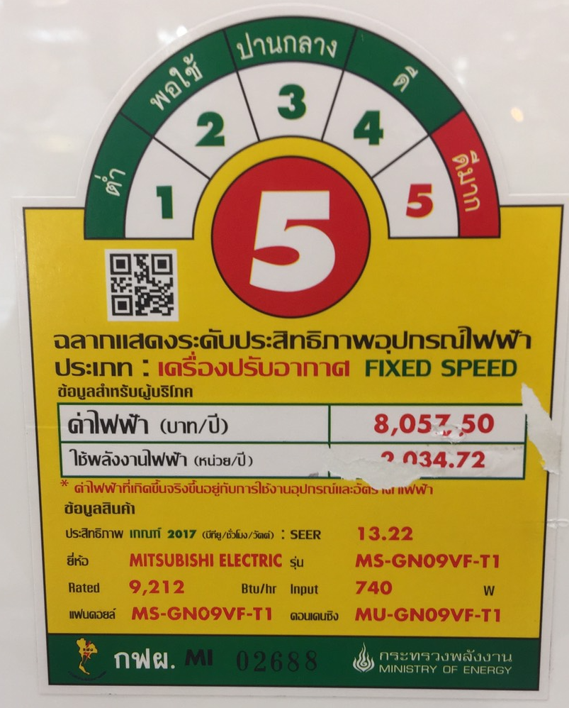
Solutions to adverse selection problems
Screening: testing the product
Third-party Comparisons
Market signaling:
  must be credible: warranties
  high quality producers must have low signaling cost
  not works if all sending the same signal

Slide 19
Market Signaling
The process of sellers using signals to convey information to buyers about the product’s quality.
For example, how do workers let employers know they are productive so they will be hired?
Weak signal could be dressing well
  Is weak because even unproductive employees can dress well
Strong Signal
  To be effective, a signal must be easier for high quality sellers to give than low quality sellers.
  Example: Highly productive workers signal with educational attainment level.

Slide 20
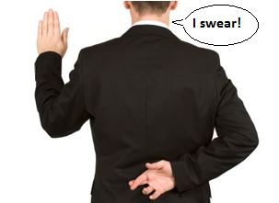
Moral Hazard
Moral hazard occurs when the informed parties exploit the uninformed parties due to unobserved action. Examples:
  If my home is insured, I might be less likely to lock my doors or install a security system
  Teachers can’t promise all students who attend classes to get at least B
  Financial institutions was less prudent because they know that central bank would help them. FED’s rescue of the investment banks encourages the banks to make risky loans again in the future

Slide 21
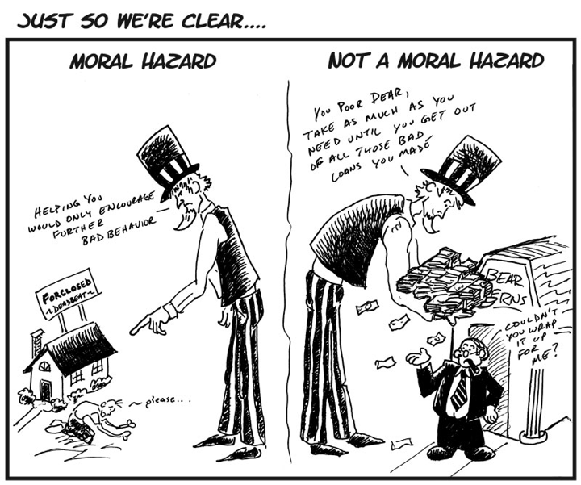

Slide 22
Moral Hazard
Determining the Premium for Fire Insurance
  Warehouse worth $100,000
  Probability of a fire:
    .005 with a $50 fire prevention program
    .01 without the program
  If the insurance company cannot monitor to see if he program was run, how do they determine premiums?

Slide 23
Moral Hazard
With the program the premium is:
  .005 x $100,000 = $500
Once insured owners purchase the insurance, the owners no longer have an incentive to run the program, therefore the probability of loss is .01
$500 premium will lead to a loss because the expected loss is now $1,000 (.01 x $100,000)

Slide 24
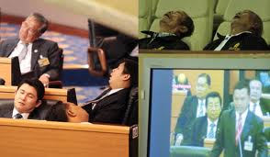
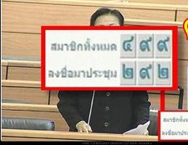

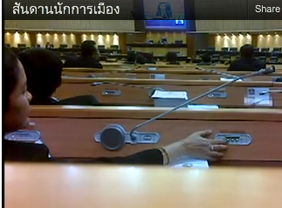
The Principal – Agent Problem
Principal-agent problem arises when welfare of the principal depends on the unobserved performance of the agent
  Owners cannot completely monitor their employees
  Share holders cannot completely monitor the effort of the manager
  Voters cannot easily remove politicians who do not keep their promises

Slide 25
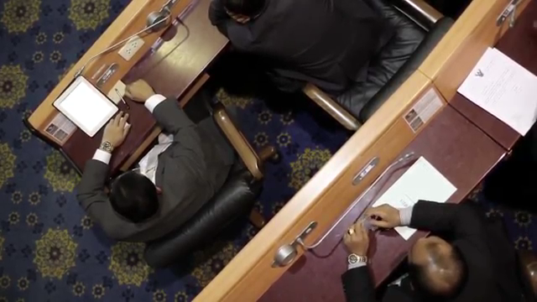
Principal-Agent problem

Slide 26


Exercise
Thai Tour operators often compete for Chinese tourists so much such that they offer “zero dollar tour package”.
Use the theory about asymmetric information to explain this situation.

Slide 27
Reducing Moral Hazard
Price discrimination by historical records
  Bad drivers pay higher premium
Partial liability
  deductible: auto-insurers take partial liability in case of their own carelessness
Profit sharing and piece rate contract
Efficiency wage contract

Slide 28
Efficiency Wage Theory
In a competitive labor market, all who wish to work will find jobs for a wage equal to their value of marginal product.
  However, most countries’ economies experience unemployment.
The efficiency wage theory can explain the presence of unemployment and wage discrimination. --> One way to solve Principal-agent problem.

Slide 29
Efficiency Wage Theory
The shirking model can be better used to explain unemployment and wage discrimination.
  Assumes perfectly competitive markets
  However, workers can work or shirk.
  Since performance information is limited, workers may not get fired.

Slide 30
Efficiency Wage Theory
If workers paid market clearing wage w*, they have incentive to shirk
If get caught and fired, they can immediately get a job elsewhere for same wage
Firms have to pay a higher wage to make loss higher from shirking
Wage at which no shirking occurs is the efficiency wage

Slide 31
Efficiency Wage Theory
Firms will offer more than market clearing wage, w*, say w_{e} (efficiency wage)
In this case workers fired for shirking face unemployment because demand for labor is less than market clearing quantity

Slide 32
Unemployment in a Shirking Model
Wage
Demand for
Labor
Without shirking, the market wage is w*, and full-employment exists at L*
No-Shirking
Constraint
S_{L}
The no-shirking
constraint gives
the wage necessary
to keep workers
from shirking.
At the equilibrium wage, W_{e} the firm hires L_{e} workers creating unemployment of L* - L_{e}.
w_{e}
w*
Quantity of
Labor
L_{e}
L*

Slide 33
Efficiency Wages at Ford Motor Company
Labor turnover at Ford
  1913: 380%
  1914: 1000%
    Average pay = $2 - $3
    Ford increased pay to $5
Results
  Productivity increased 51%
  Absenteeism had been halved
  Profitability rose from $30 million in 1914 to $60 million in 1916.

Slide 34
Externalities
Externalities arise between producers, between consumers or between producers and consumers
Externalities are the effects of production and consumption activities not directly reflected in the market
  They can be negative or positive

Slide 35
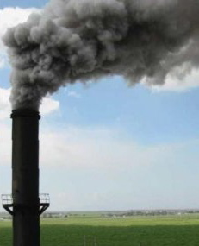
Externalities
Side effects which producers or consumers impose on the third parties
Negative externalities: Action by one party imposes costs on the third parties
  Plant dumps waste in a river affecting those downstream
  Car users release air pollution into the atmosphere
  Both have no incentive to account for the external costs that they impose on others

Slide 36
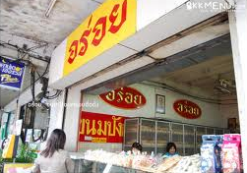
Externalities
Positive externalities: Action by one party benefits the third parties
  Large universities generate large customer base for shops located nearby
  A vaccinated tourist does not contract contagious disease and help preventing it to spread out
  Both did not take the external benefits into account when deciding to plant or vaccinate

Slide 37
Negative Externalities and Inefficiency
Scenario – paper plant dumping waste
  Marginal External Cost (MEC) is the increase in cost imposed on fishermen downstream for each level of production.
  Marginal Social Cost (MSC) is MC (Marginal private cost) plus MEC.
  We can show the competitive market firm decision and the market demand and supply curves

Slide 38
Negative Externalities and Inefficiency
Assume the firm has a fixed proportions production function and cannot alter its input combinations
  The only way to reduce waste is to reduce output
Price of paper and quantity of paper initially produced is at the intersection of supply and demand

Slide 39
Negative Externalities and Inefficiency
The MC curve for the firm is the marginal costs of production
Firm maximizes profit by producing where MC equals Price in a competitive firm
As firm output increase, external cost on fishermen increases measured by the marginal external cost curve
From a social point of view, negative externality cause over production

Slide 40
External Costs
The profit maximizing firm
produces at q₁ while the
efficient output level is q*.
Firm will produce q₁ at P₁.
There is MEC of production from the waste released. The MSC is true cost of production.
Price
MSC
Price
MC
MSC^{I}
S = MC^{I}
P*
P₁
P₁
MEC^{I}
MEC
D
q*
q₁
Firm output
Q*
Q₁
Industry output

Slide 41
External Costs
Price
The over production of the good that generates external costs, creates a social cost on society
MSC^{I}
S = MC^{I}
Aggregate social cost of negative externality
P*
P₁
MEC^{I}
D
Q*
Q₁
Industry output

Slide 42
Positive Externalities and Inefficiency
Positive externalities result in too little production, as can be shown in an example of vaccination.
Vaccination generates external benefits to the neighbors
  Show by the Marginal External Benefit curve (MEB)
  Marginal Social Benefit (MSB) curve adds MEB +D

Slide 43

External Benefits
Value
MSB
When there are positive
externalities (the benefits
of vaccination to neighbors),
marginal social benefits
MSB are higher than
marginal benefits D.
D
P₁
MC
P*
A self-interested person
vaccinates q₁ . The
efficient level of vaccination
q* is higher. The higher price
P₁ discourages vaccination.
MEB
q₁
q*
Vaccination Level

Slide 44
Question
Why do department stores often set some areas for rent to small shops and have their own food court?
[Hint: Compare the Central Department store at Wang Burapa and at Ladprao.]

Slide 45
When do externalities create problems?
Requires two conditions
Activities of on party reduces or increases welfare of the third parties
The third parties do not received compensation for their welfare reduction or
The party that increase others welfare does not receive compensation

Slide 46

When do externalities create problems?
Problems
  Polluted wastes from plants
  Massage parlors near schools
  Liquor or cigarettes advertisement
  Counterfeits of programs, songs, and movies
No problems
  Bee keepers and orchards
  Department stores and food courts

Slide 47
Ways of Correcting Market Failure due to externalities
Assumption: The market failure is pollution
  Output decision and emissions decision are independent
  Firm has chosen its profit-maximizing output level
  MEC is marginal external cost of emissions
    Equivalent to MEC from before
    Upward sloping because of substantially increasing harm as pollution increases

Slide 48
Ways of Correcting Market Failure
MAC is marginal abatement cost
  Additional cost to firm of controlling pollution
  Downward sloping because when emissions are high, little cost to controlling them
    Large reductions require costly changes in production process

Slide 49
The Efficient Level of Emissions
Dollars/ unit
of Emissions
MEC
7
At E_{o} the marginal
cost of abating emissions
is greater than the
marginal social cost.
4
At E₁ the marginal
social cost is greater
than the marginal benefit.
3
The efficient level of
emissions is where
MAC = MEC.
2
MAC
E₀
E*
E₁
Level of Emissions
0
2
4
6
8
10
12
14
16
18
20
22
24
26
Level of Abatements

Slide 50
Ways of Correcting Market Failure
If the firm does not consider abatement, their profit maximizing level is 26 units of emissions
  Level where MAC is zero
The socially efficient level of emissions is 12 where the MEC equals the MAC
Firms can be encouraged to reduce emissions to the efficient level in three ways
  Emissions standards
  Emissions fees
  Transferable emissions permits

Slide 51
Ways of Correcting Market Failure
Options for Reducing Emissions to E*
  Emission Standard
    Set a legal limit on emissions at E* (12)
    Enforced by monetary and criminal penalties
    Increases the cost of production and the threshold price to enter the industry
  Emissions Fee
    Charge levied on each unit of emission

Slide 52
Standards and Fees
Dollars/ unit
of Emissions
MEC
Standard
Fee
3
Total Fee
of emission
Total
Abatement Cost
MAC
E*
= 12
Level of Emissions
Level of abatement

Slide 53
The Case for Fees
Assume two firms
  Total emissions is 28 units
  Same marginal social cost curve
  Different marginal abatement cost curves
    MAC₁ and MAC₂
Emissions fees are preferable to standards in this case
  We want to reduce total emissions by 14 units
  The cheapest way to do that is for firm 1 to reduce by 6 and firm 2 by 8 units

Slide 54
The Case for Fees
If a fee of $3 was imposed, Firm 1 emissions would fall by 6 (14-8) to 8. Firm 2 emissions would fall by 8 (14-6) to 6. MAC₁ = MAC₂: efficient solution.
Fee per
Unit of
Emissions
MAC₁
MAC₂
6
The cost minimizing solution
would be an abatement of 6
for firm 1 and 8 for firm 2 and
MAC₁= MAC₂ = $3.
5
4
3
2
1
Level of
Emissions
0
1
2
3
4
5
6
7
8
9
10
11
12
13
14
Level of abatement

Slide 55
The Case for Fees
What if the regulatory agency forces each firm to cut emissions by 7 units
  MAC for firm 1 increases to $3.75
  MAC for firm 2 decreases to $2.50
This is not cost minimizing because one firm can reduce emissions at a lower cost than the other firm
Marginal cost of abatement must be equal between firms for reductions to occur at minimum cost

Slide 56
The Case for Fees
Fee per
Unit of
Emissions
MAC₁
The impact of a standard of
abatement of 7 for both firms
is illustrated.
Not efficient because
MAC₂ < MAC₁.
MAC₂
6
5
4
3.75
3
Firm 1’s Increased
Abatement Costs
2.50
2
Firm 2’s Reduced
Abatement
Costs
1
Level of
Emissions
0
1
2
3
4
5
6
7
8
9
10
11
12
13
14
Level of abatement

Slide 57
Ways of Correcting Market Failure
Advantages of Fees
  When equal standards must be used, fees achieve the same emission abatement at lower cost.
  Fees create an incentive to install equipment that would reduce emissions further.
  Fees generate income to used to subsidize cleaner technology

Slide 58
The Case for Standards
Assume we have
  Steep marginal external cost curve
  Flat marginal cost of abatement
  An emissions fee of $8 would be efficient but because of limited information, fee is set at $7
  Firms emissions increase and with steep MEC, this will lead to significant additional social costs

Slide 59
The Case for Standards
What if standard is used instead and has the same percentage mistake
  Standard set at 9 instead of 8
  Increase in social cost and decrease in abatement costs
  Net increase in social costs is smaller than with fees

Slide 60
The Case for Standards
Fee per
Unit of
Emissions
C
Based on incomplete information fee is $7 (12.5% decrease).
Emission increases to 11.
16
Marginal
External
Cost
14
ABC is the increase in social cost less the decrease in abatement cost.
12
E
10
A
Based on incomplete information standard is 9 (12.5% decrease).
ADE < ABC
D
8
B
6
4
MAC
2
0
2
4
6
8
10
12
14
16
Level of Emissions

Slide 61
Summary: Fees vs. Standards
Standards are preferred when MEC is steep and MAC is flat.
Standards (incomplete information) yield more certainty on emission levels and less certainty on the cost of abatement.

Slide 62
Property rights and Coase Theorem
Property Rights
  Legal rules describing what people or firms may do with their property
Bargaining and Economic Efficiency
  Economic efficiency can be achieved without government intervention when the externality affects relatively few parties and when property rights are well specified.

Slide 63
Property rights and Coase Theorem
Dollars/ unit
of Emissions
MEC
MAC
Benefits if emission is reduced from 26 to 20
Cost saving if emission is increased from 0 to 6
If the factory has the right to pollute
If the consumer has the right to clean water
3
Costs if emission is reduced from 26 to 20
E*
External costs if emission is increased from 0 to 6
0
6
12
20
26
Level of Emissions
Level of abatement

Slide 64
Property rights and Coase Theorem
The party that has no property rights can compensate the other party and moves toward the efficient outcome
Conclusion: Coase Theorem
  When parties can bargain without cost and to their mutual advantage, the resulting outcome will be efficient, regardless of how the property rights are specified.
But transaction cost can be prohibitively high when there are many parties.

Slide 65
Ways of Correcting Market Failure
Transferable Emissions Permits
  Permits help develop a competitive market for externalities.
    Agency determines the level of emissions and number of permits
    Permits are marketable
    High cost firm will purchase permits from low cost firms
    Need competitive market

Slide 66
Carbon market helps lowering abatement costs
Non-Market | Player | Emission | Abate | Cost | Total Cost
 | A | 5 | 5 | 10 | 50
 | B | 5 | 5 | 5 | 25
$75
Assumptions: MAC_{A} = 2, MAC_{B} = 1, E_{A} = E_{B} = 10/firm, Allowance = 5/firm, P = 7/credit
Market | Firm | Emis-sion | Abatement | Abatement costs | Credits supply | Cost of credits | Total costs
 | A | 8 | 2 | 20 | -3 | 21 | 41
 | B | 2 | 8 | 40 | 3 | -21 | 19
$60

Slide 67
5. Cap and Trade: carbon market
Price of carbon credits
Assuming that MAC_{A} > MAC_{B} and the allowance of permits is 5 Ton C. each
MAC_{A}
Permits
Supply of carbon credits
10
MAC_{B}
Demand for carbon credits
P
5
E (Ton C.)
0
5
10

Slide 68
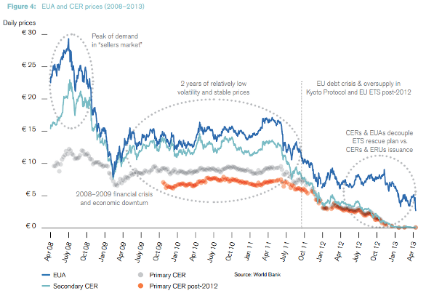
European Climate Exchange

Slide 69
Ways of Correcting Market Failure
Recycling
  Households can dispose of glass and other garbage at very low cost.
  The low cost of disposal creates a divergence between the private and the social cost of disposal.
Marginal private cost likely constant for fixed amount of garbage

Slide 70
The Efficient Amount of Recycling
MSC
Cost
MCR
MC + per unit refund
MC
m*
m1
12
Scrap

Slide 71
Recycling
Social cost of disposal includes the harm to environment from littering and injuries caused by litter
Without market intervention, the level of scrap will be at m and m₁ > m*
With refundable deposit, MC increases and MC = MSC = MCR

Slide 72


Alternative measures
โครงการผ้าป่าขยะ / ขยะแลกไข่
Reuse, Recycle, Reduce, Reject

Slide 73
Public Goods: Characteristics
Nonrival
  For any given level of production the marginal cost of providing it to an additional consumer is zero.
Nonexclusive
  People cannot be excluded from consuming the good, so that it is difficult or impossible to charge for their use
  Example – use of lighthouse by a ship, national defense, radio wave, fireworks

Slide 74

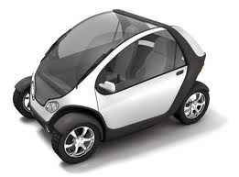


Public Goods
Exclusive Nonexclusive
Rival
Nonrival
Private goods:
car, cloth
Common property:
forest, fish stock
Public goods:
national defense,
radio wave
Semi-Public goods:
cable TV, sport club

Slide 75
Efficiency and Pubic Goods
Efficient level of private good is where marginal benefit equals marginal cost
For a public good, the value of each person must be considered
  Can add demand of all those who value good
Must equate the vertical sum of these marginal benefits to the marginal cost of production

Slide 76
Efficient Public Good Provision
Benefits
(dollars)
D₁ is demand for consumer 1
D₂ is demand for consumer 2
D is total demand for all consumers
$7.00
D₂
$5.50
MC
Efficient output occurs
where MC = total MB
2 units of output.
MB is $1.50 + $4.00 or $5.50.
$4.00
D = MB
$1.50
Market outcome, however, generate only 1 unit since consumer 1 will free ride on consumer 2
D₁
0
1
2
3
4
5
6
7
8
9
10
Output

Slide 77
Public Goods and Market Failure
Nonexclusive ->Free Riders
  There is no way to provide some goods and services without benefiting everyone.
  Households do not have the incentive to pay what the item is worth to them.
  Free riders understate the value of a good or service so that they can enjoy its benefit without paying for it.
Provision of public goods suffer from Prisoners’ Dilemma.

Slide 78
Private Preferences for Public Goods
Government production of a public good is advantageous because the government can assess taxes or fees to pay for it.
Determining how much of a public good to provide when free riders exist is difficult.

Slide 79
Private Preferences for Public Goods
Voting may generate non-transitive social preferences.
Rank 1 Rank 2 Rank 3
Voter 1 A B C
Voter 2 B C A
Voter 3 C A B
2 out of 3 prefer A to B, 2 out of 3 prefer B to C, 2 out of 3 prefer C to A --> non -transitive social preferences.
If voters have Single-Peaked preferences, the median voter wins regardless of the sequence of voting
But when voters have Multi-peaked preferences, the sequence of voting matters.

Slide 80
Private Preferences for Public Goods
From the previous preferences, the chosen allocation depends on the order in which the vote is taken.
A v.s. B then compare the winner to C
  1st round: A wins then 2nd round: C wins
C v.s. A then compare the winner to B
  1st round: C wins then 2nd round: B wins

Slide 81
Arrow’s Impossibility Theory
A socially welfare function should satisfy
  Complete and transitive
  If every one prefers A to B, A should be socially preferred to B
  Society’s ranking of A and B should depend only on individuals’ ranking of these two allocations, not on how they rank other alternatives
  Dictatorship is not allowed
Arrow proved that it is impossible to find a social welfare function that satisfies all this criteria.

Slide 82
Private Preferences for Public Goods
Example: democracy may not be fair
There are 5 people
Choice A: 4 people get 100 Baht from the last person.
Choice B: do nothing.
Majority rule would chose A over B.

Slide 83
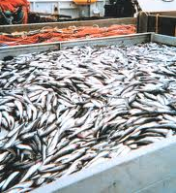
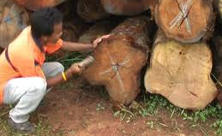
Common Property Resources
Characteristics
  Everyone has free access
  Likely to be over utilized
  Examples
    Air and water
    Fish, forest and animal populations
    Minerals

Slide 84
Common Property Resources
Consider a lake where people fish
Each fisherperson takes fish up to the point where the marginal benefit to them equals the marginal cost
There is no reason that any one fisherperson take into account how their taking fish affects others experience

Slide 85
Common Property Resources
Private cost underestimates the true cost to society
  More fishing reduces the stock of fish
  Less is available to others and too low of a stock will completely deplete the fish
  Too many fish are caught
This is the case that Hardin (1968) called “The Tragedy of The Commons”

Slide 86
Common Property Resources
Benefits,
Costs
($ per
fish)
Without control the number
of fish/month is F_{C} where
PC = MB.
Marginal Social Cost
However, private costs
underestimate true cost.
The efficient level of
fish/month is F* where
MSC = MB (D)
Private Cost
Demand (MB)
F*
F_{C}
Fish per Month

Slide 87
Common Property Resources
Solution
  Private ownership
  Owner will set fee for use of resource equal to the marginal cost of depleting the stock
  Fishermen will no longer find it profitable to catch more than the efficient amount of fish
  It is often the case that private ownership is not possible, the government steps in

