Slide 1

Change Management
MK 341: Special Topics in Marketing 1
Marketing Leadership Development and Cross-cultural Management
By Ajarn Suwalya K.

Slide 2
What we plan to achieve
Change Leadership
Activities
Change Management in Organizations
Who moved my Cheese?
Applying what you learned

Slide 3
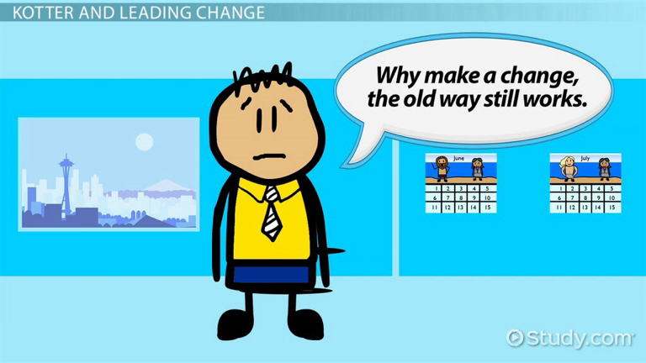

Slide 4
Change Management in Organizations
"Change management is the process, tools and techniques to manage the people side of change to achieve the required business outcome. Change management incorporates the organizational tools that can be utilized to help individuals make successful personal transitions resulting in the adoption and realization of change."

Slide 5
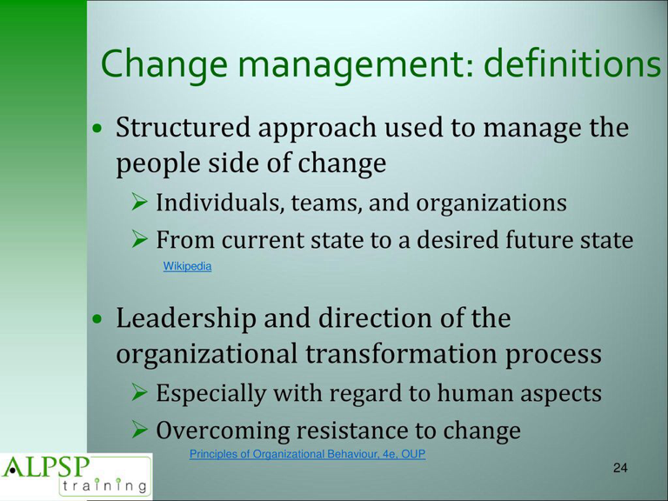
Change Management in Organizations

Slide 6
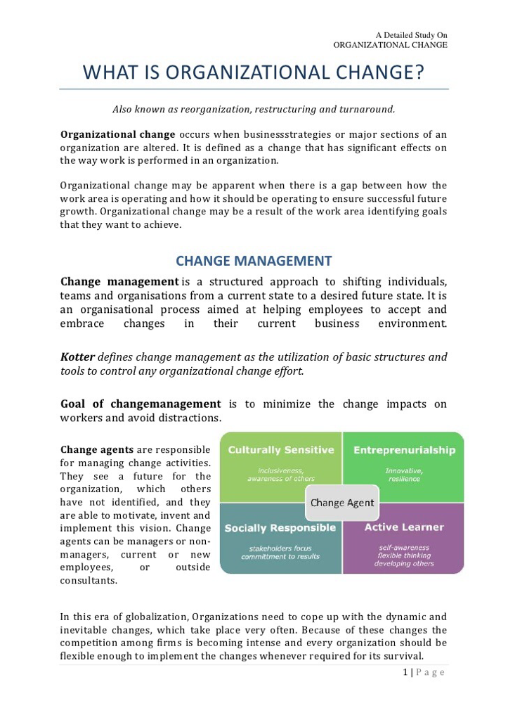

Slide 7


Slide 8


Slide 9
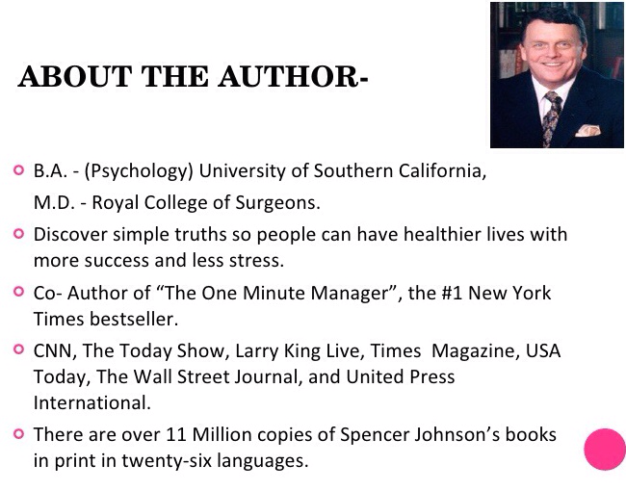

Slide 10


Slide 11
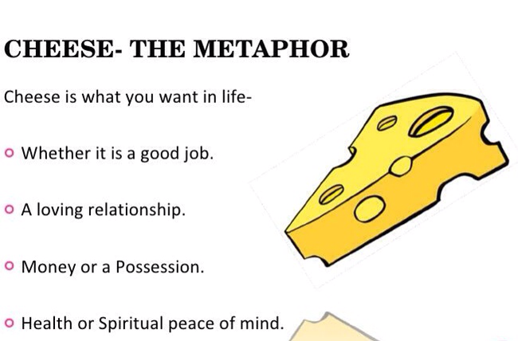

Slide 12
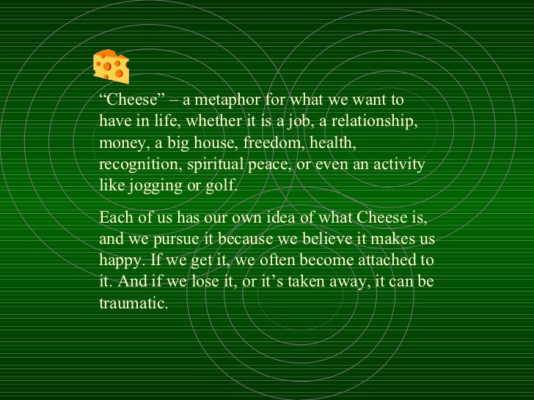

Slide 13


Slide 14
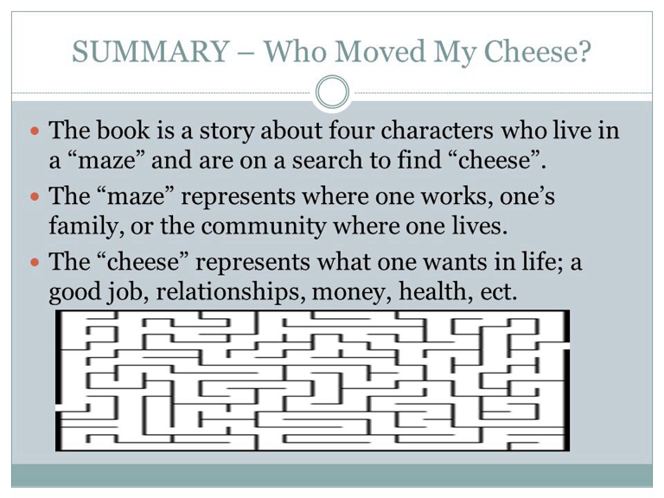

Slide 15
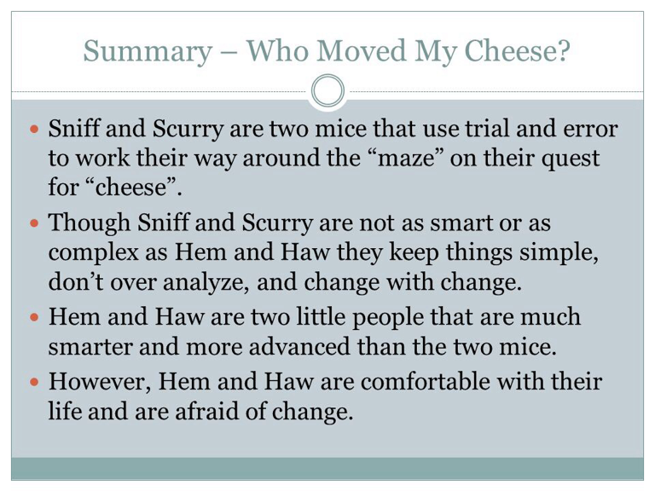

Slide 16
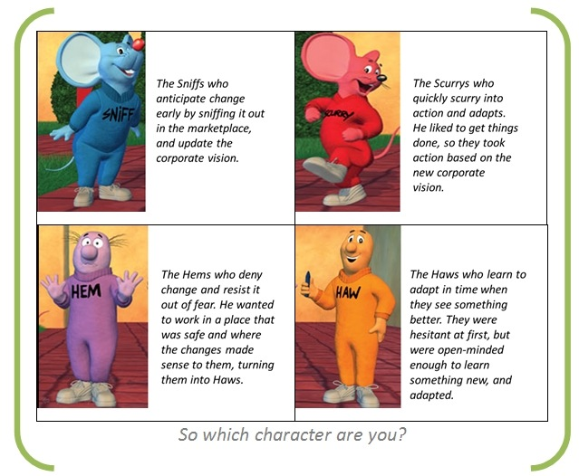

Slide 17
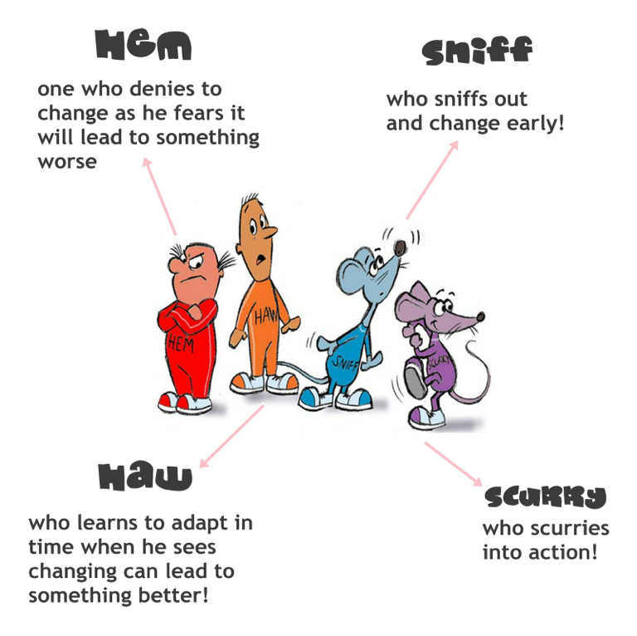

Slide 18



Slide 19


Slide 20
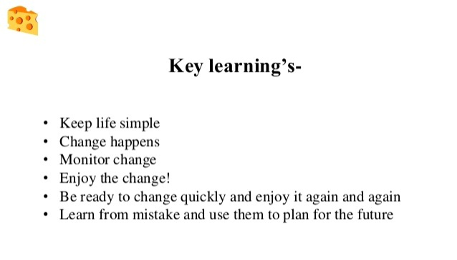
Who Moved my Cheese?

Slide 21
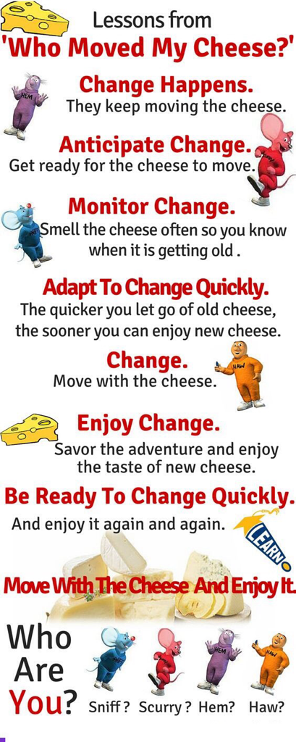

Slide 22
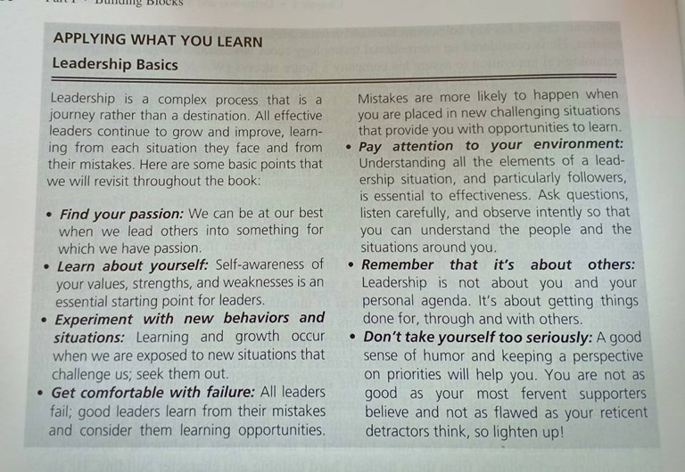
Apply what you learn
1e

Slide 23
What we accomplished
Change Leadership
Activities
Change Management in Organizations
Who moved my Cheese?
Applying what you learn

Slide 24


