Slide 1

Trade Finance
FN323 Semester1/2014

Slide 2
Members
1. Kittee Boonsongkroh 5504640466
2. Kornvasa Thanakarnjanasuth 5504640516
3. Napas warongrubporn 5504640672
4. Piyawat Jumphonjit 5504641258
5. Thanat Somboon 5504641910
6. Warit Jamkachornkiat 5504642066

Slide 3
Contents
What is trade finance?
Where did trade finance come from?
Trade finance in periods of crisis
Risks associated with trade finance
Trade finance activities
Import
Export
Real world example

Slide 4
What is Trade Finance?
Financing for trade
Concerns both domestic and international trade
Players : Sellers (or Exporter) & Buyers (or Importers)
Intermediaries : Banks & Financial Institutions
Key : Exporters or Importers may wish to reduce risk by providing various forms of support for payment.

Slide 5
Where did Trade Finance come from?
Great Depression
Goal : To stimulate both domestic and international trade

Slide 6
Trade Finance in periods of crisis
Global financial crisis in 2008-2009
Liquidity problem : firms being cut out from bank financing and cannot find a substitute of trade credit.
Scarcity of financing
Affects the whole supply chains

Slide 7
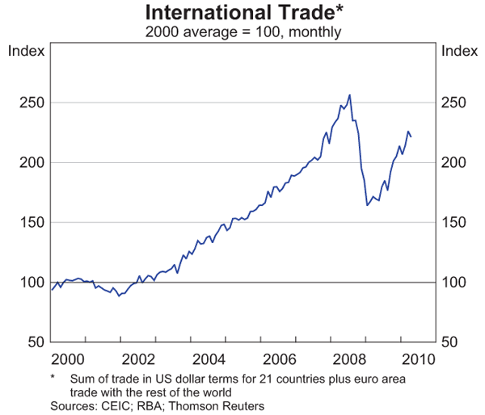
Trade Finance in periods of crisis

Slide 8
Risks Associated with Trade Financing
Economic Risk
Foreign Currency Risk
Transportation Risk
Other Risks

Slide 9
Trade Finance Activities
“Export”
“Import”
Pre-shipment Finance
Post-shipment Finance
- Letter of Credit (L/C) Sold at Discount
Trust Receipt (T/R)

Slide 10
Import

Slide 11
Trust Receipt (T/R)
Short–Term loan to provide the importers with financing to settle goods imported under letter of credit (L/C).

Slide 12
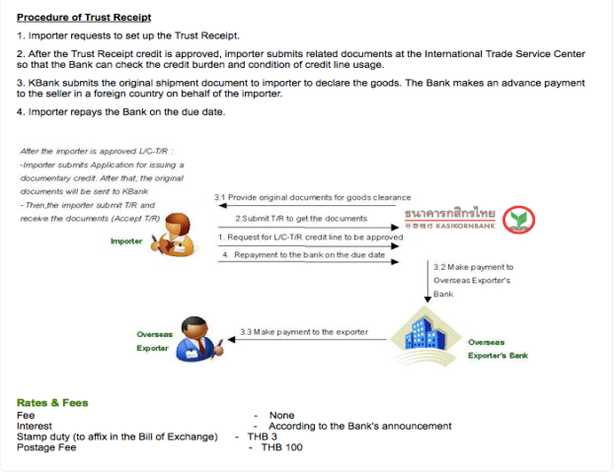
Trust Receipt (T/R)

Slide 13
Trust Receipt (T/R)
Required Document
1. Trust Receipt
2. Bill of Exchange
3. Invoice
4. Goods shipment document
5. Other documents refer from L/C

Slide 14
Export

Slide 15
Pre-shipment Finance
Provide money for pre-export cost
Risk
Collateral
- Letter of Credit (L/C)
- Invoice
- Inventory

Slide 16
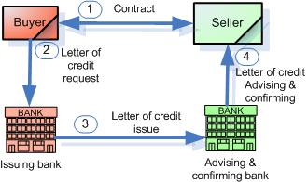
Packing Credit
Letter of Credit (L/C)

Slide 17
Inventory Finance
Inventory
Warehouse Receipt : Receipt that certifying quality and quantity of products
Company uses warehouse receipt as collateral.
Mostly used in developed countries.

Slide 18
Post-shipment Finance
Purchased/ Discounted under Export L/C
is that firm can sell the L/C to the bank to get money before the due date
Purpose : provide capital for firm to run business before due date of payment from buyer

Slide 19
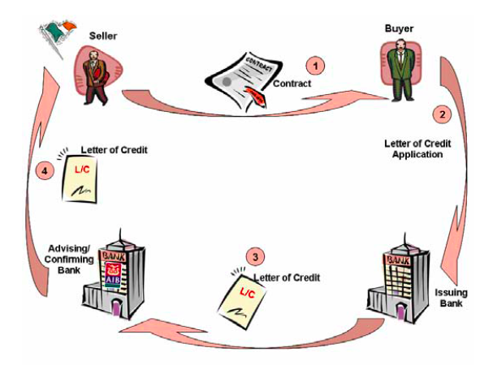
L/C Sold @ Discount
Issuance Process

Slide 20
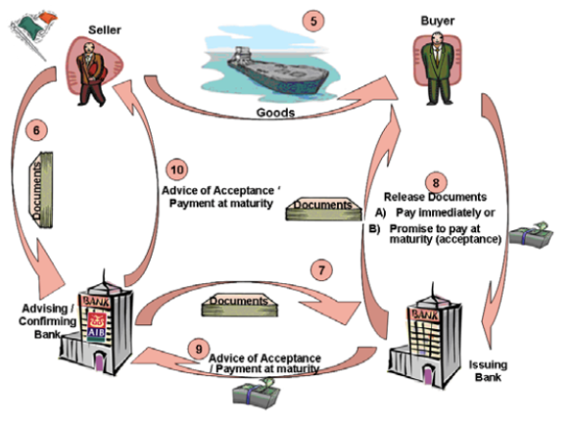
L/C Sold @ Discount
Negotiation Process

Slide 21
L/C Sold @ Discount
Example
Sell good to company A in US at the end of August
Due date of the payment at the end of October
2 month gap – need cash to cover some cost (Electricity Bill, Salary)
Sell L/C to the bank to get money first

Slide 22
L/C Sold @ Discount
Documents Needed
Original L/C
Commercial Invoice
Delivery Note ( Booking Note for ship, Shipping order )

Slide 23
Real World Examples

Slide 24
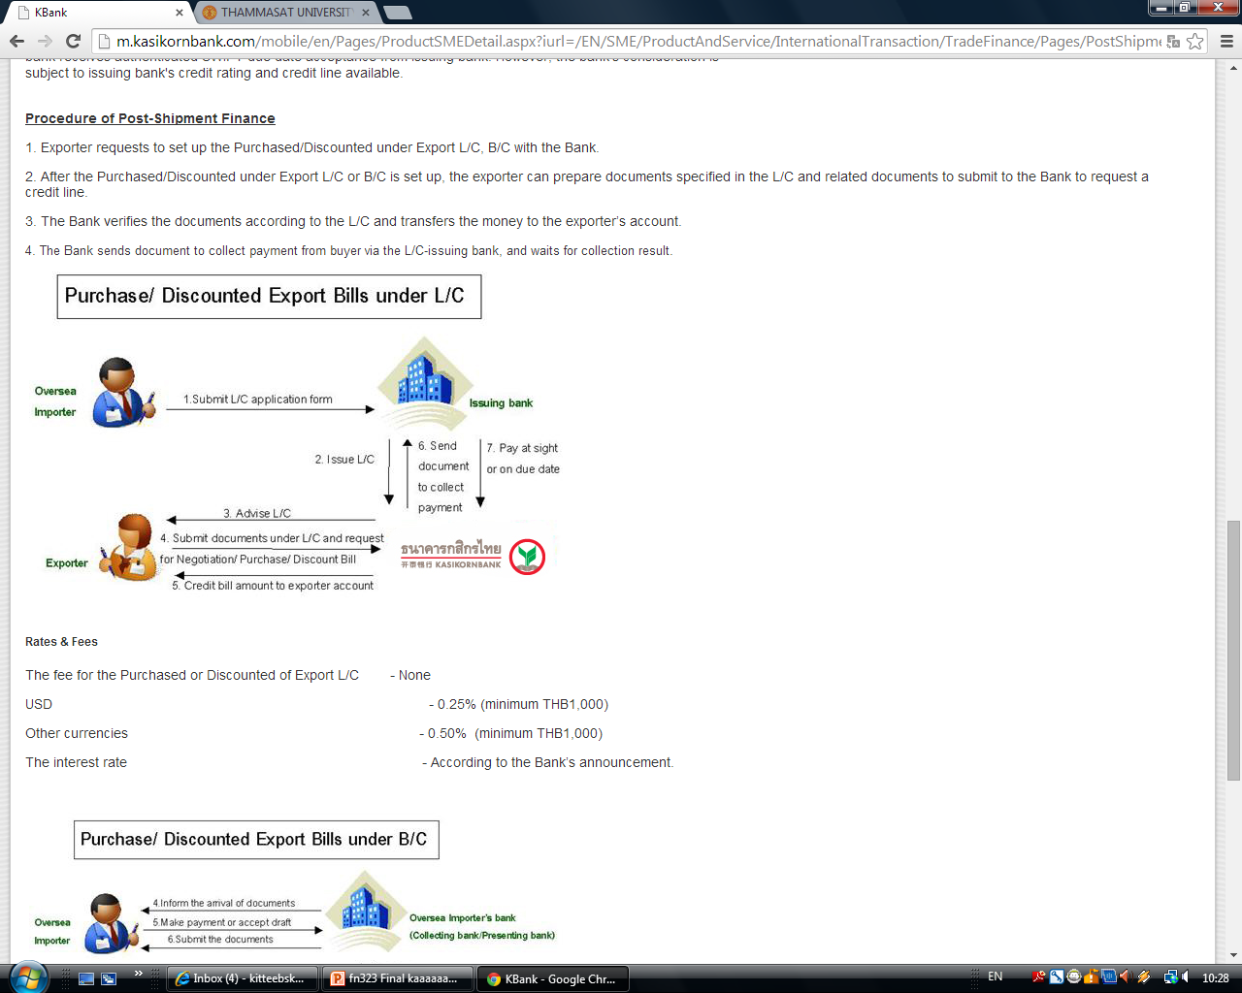

Slide 25
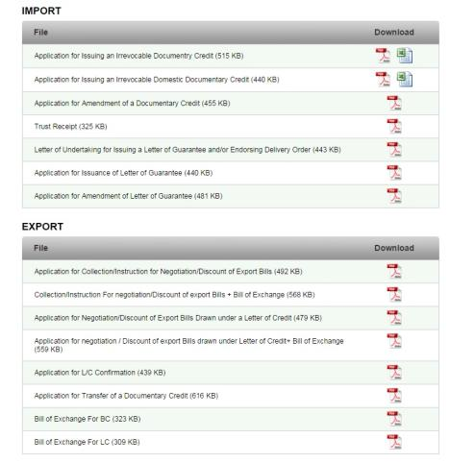

KBANK

Slide 26
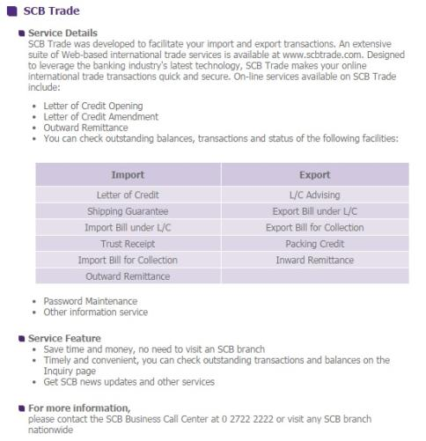

SCB

Slide 27
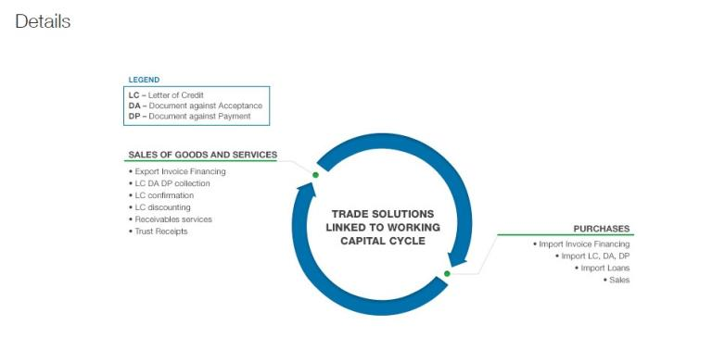

Standard Chartered

Slide 28

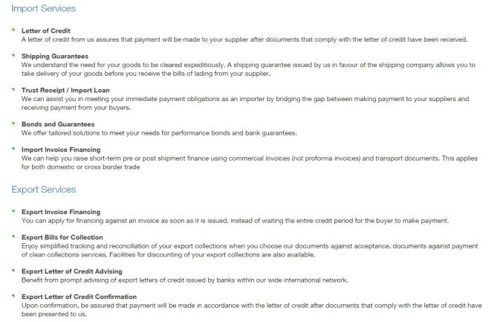
Standard Chartered

Slide 29
References
http://www.intracen.org/uploadedFiles/intracenorg/Content/Trade_Support_Institutions/Delivering_services_to_exporters/Evaluating_trade_credit_applications/How_to_Access_Trade_Finance.pdf
http://www.bbkonline.com/Corporate/TradeFinance/Pages/tradefinance.aspx
http://www.kasikornbank.com/en/sme/ProductAndService/InternationalTransaction/TradeFinance/Pages/TradeFinance.aspx
http://www.tradefinancemagazine.com/AboutUs/Stub/WhatIsTradeFinance.html
https://www.sc.com/sg/sme/trade-finance-working-capital.html

Slide 30
Q&A

