Slide 1
Linear Models and Matrix Algebra
Pawin Siriprapanukul
CW Ch.4

Slide 2
Outline
Matrices and Vectors
Matrix Operations
Notes on Vector Operations
Commutative, Associative, and Distributive Laws*
Identity Matrices and Null Matrices*
Transposes and Inverses*
Finite Markov Chains*

Slide 3
Matrices as Arrays
A matrix is defined as a rectangular array of numbers, parameters, or variables.
The members of the array, referred to as elements of the matrix, are usually enclosed in bracket, or sometimes in parentheses, or with double vertical lines: || ||.
Every matrix is an ordered set.

Slide 4
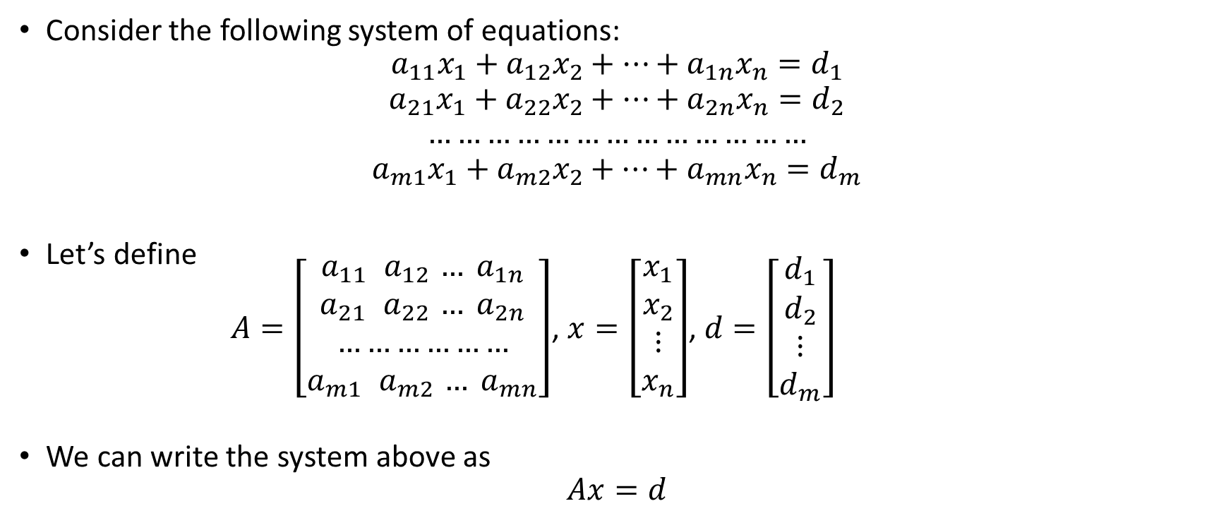
System of Equations in Matrix Form
Consider the following system of equations:
$$a_{11}x_{1}+a_{12}x_{2}+…+a_{1n}x_{n}=d_{1}$$
$$a_{21}x_{1}+a_{22}x_{2}+…+a_{2n}x_{n}=d_{2}$$
$$…………………………………$$
$$a_{m1}x_{1}+a_{m2}x_{2}+…+a_{mn}x_{n}=d_{m}$$
Let’s define
$A=\left[\begin{aligned}a_{11}{ a}_{12} … a_{1n} \\ a_{21}{ a}_{22} … a_{2n} \\ ……………… \\ a_{m1}{ a}_{m2} … a_{mn}\end{aligned}\right]$, $x=\left[\begin{aligned}x_{1} \\ x_{2} \\ ⋮ \\ x_{n}\end{aligned}\right]$, $d=\left[\begin{aligned}d_{1} \\ d_{2} \\ ⋮ \\ d_{m}\end{aligned}\right]$
We can write the system above as
$$Ax=d$$

Slide 5
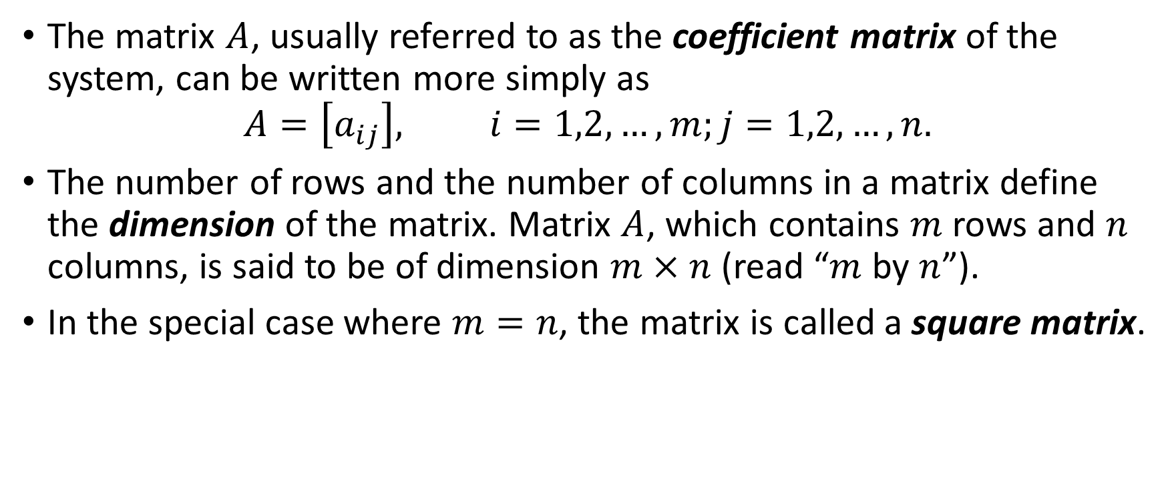
System of Equations in Matrix Form
The matrix $A$, usually referred to as the coefficient matrix of the system, can be written more simply as
$$A=\left[a_{ij}\right], i=1,2,…,m;j=1,2,…,n.$$
The number of rows and the number of columns in a matrix define the dimension of the matrix. Matrix $A$, which contains $m$ rows and $n$ columns, is said to be of dimension $m×n$ (read “$m$ by $n$”).
In the special case where $m=n$, the matrix is called a square matrix.

Slide 6
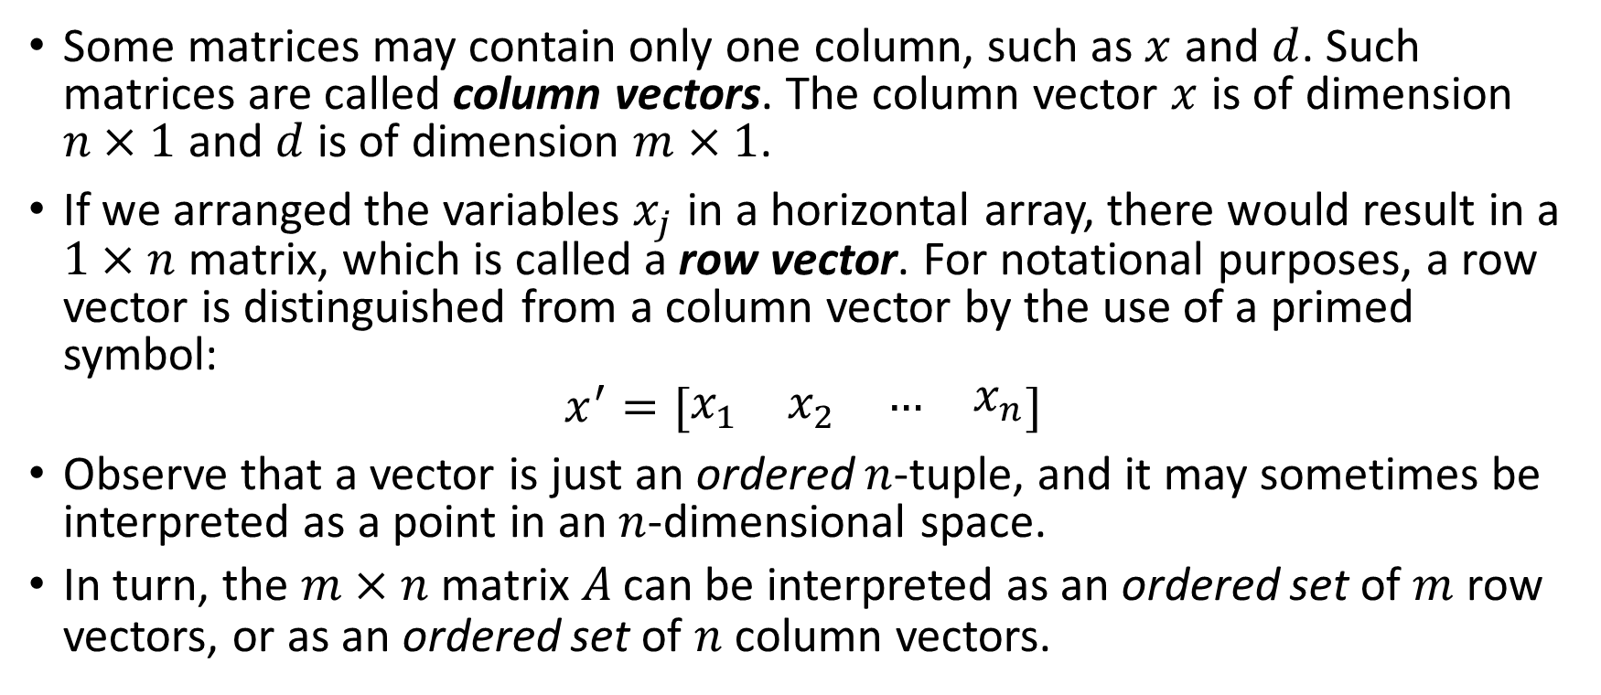
Vectors and Matrices
Some matrices may contain only one column, such as $x$ and $d$. Such matrices are called column vectors. The column vector $x$ is of dimension $n×1$ and $d$ is of dimension $m×1$.
If we arranged the variables $x_{j}$ in a horizontal array, there would result in a $1×n$ matrix, which is called a row vector. For notational purposes, a row vector is distinguished from a column vector by the use of a primed symbol:
$$x^{′}=[\begin{matrix}x_{1} & x_{2} & \begin{matrix}… & x_{n}\end{matrix}\end{matrix}]$$
Observe that a vector is just an ordered $n$-tuple, and it may sometimes be interpreted as a point in an $n$-dimensional space.
In turn, the $m×n$ matrix $A$ can be interpreted as an ordered set of $m$ row vectors, or as an ordered set of $n$ column vectors.

Slide 7
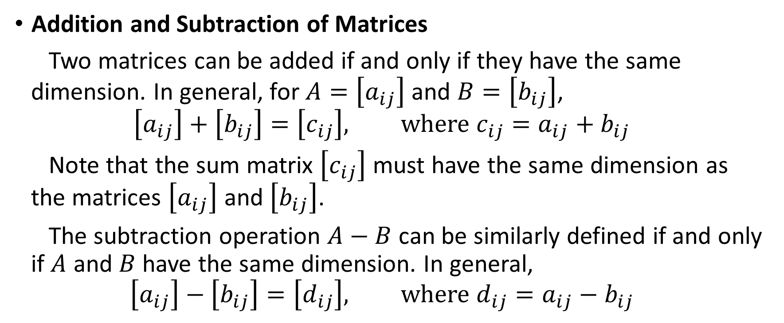
Matrix Operations
Addition and Subtraction of Matrices
Two matrices can be added if and only if they have the same dimension. In general, for $A=\left[a_{ij}\right]$ and $B=\left[b_{ij}\right]$,
$$\left[a_{ij}\right]+\left[b_{ij}\right]=\left[c_{ij}\right], where{ c}_{ij}=a_{ij}+b_{ij}$$
Note that the sum matrix $\left[c_{ij}\right]$ must have the same dimension as the matrices $\left[a_{ij}\right]$ and $\left[b_{ij}\right]$.
The subtraction operation $A−B$ can be similarly defined if and only if $A$ and $B$ have the same dimension. In general,
$$\left[a_{ij}\right]−\left[b_{ij}\right]=\left[d_{ij}\right], where{ d}_{ij}=a_{ij}−b_{ij}$$

Slide 8
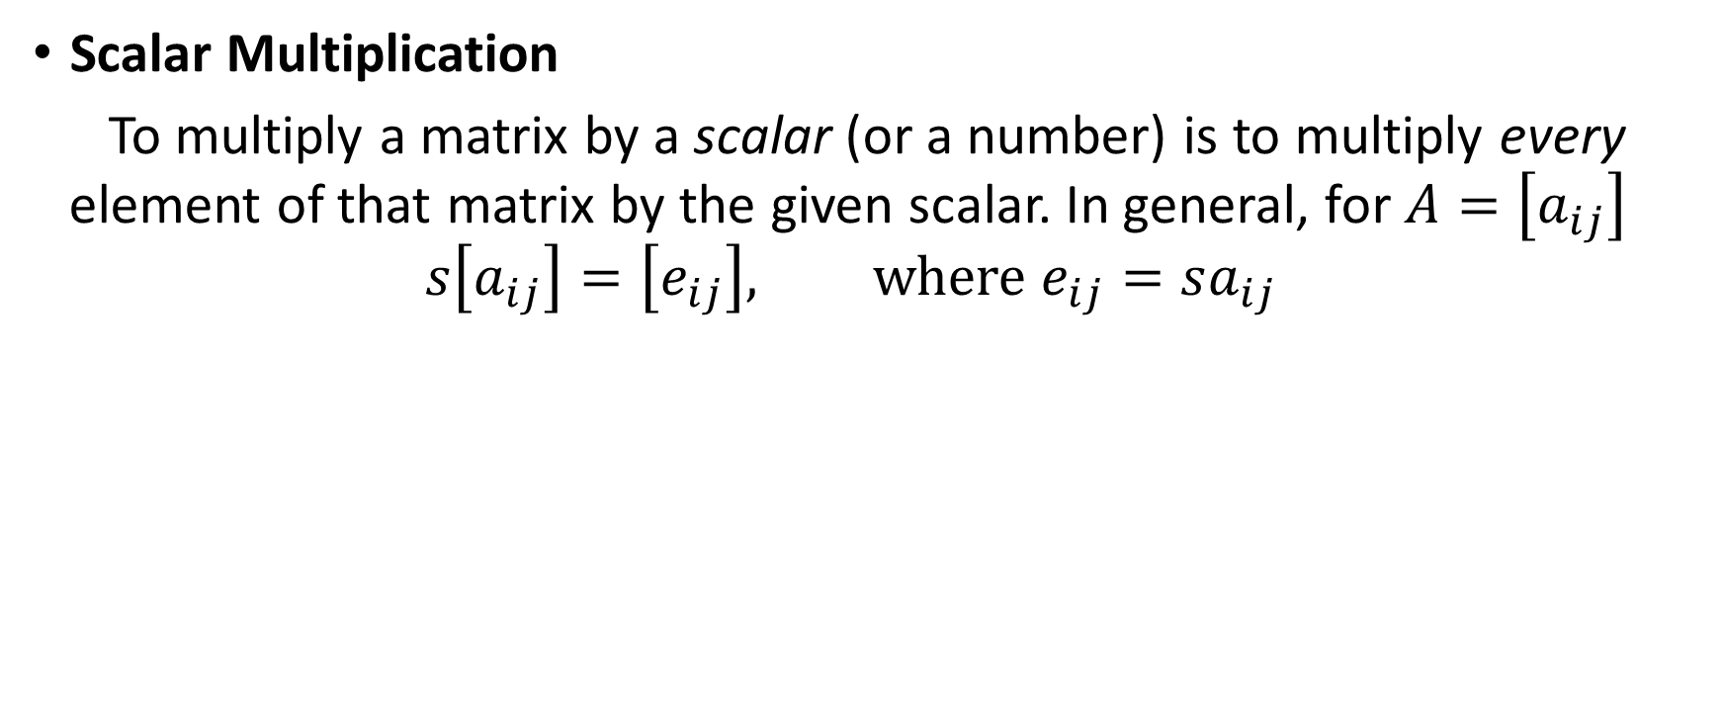
Matrix Operations
Scalar Multiplication
To multiply a matrix by a scalar (or a number) is to multiply every element of that matrix by the given scalar. In general, for $A=\left[a_{ij}\right]$
$$s\left[a_{ij}\right]=\left[e_{ij}\right], where{ e}_{ij}=sa_{ij}$$

Slide 9
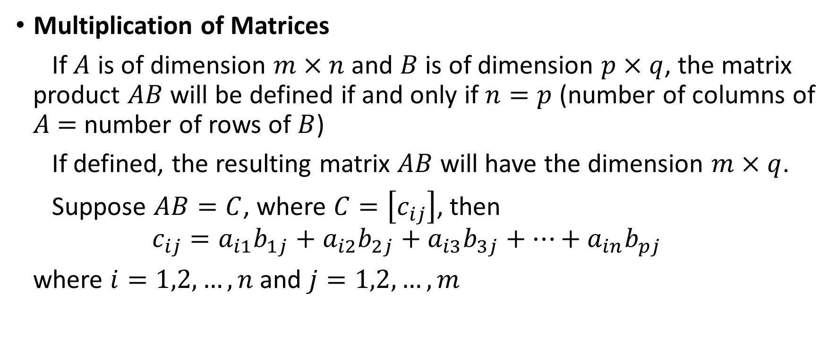
Matrix Operations
Multiplication of Matrices
If $A$ is of dimension $m×n$ and $B$ is of dimension $p×q$, the matrix product $AB$ will be defined if and only if $n=p$ (number of columns of $A$ $=$ number of rows of $B$)
If defined, the resulting matrix $AB$ will have the dimension $m×q$.
Suppose $AB=C$, where $C=\left[c_{ij}\right]$, then
$$c_{ij}=a_{i1}b_{1j}+a_{i2}b_{2j}+a_{i3}b_{3j}+…+a_{in}b_{pj}$$
where $i=1,2,…,n$ and $j=1,2,…,m$

Slide 10
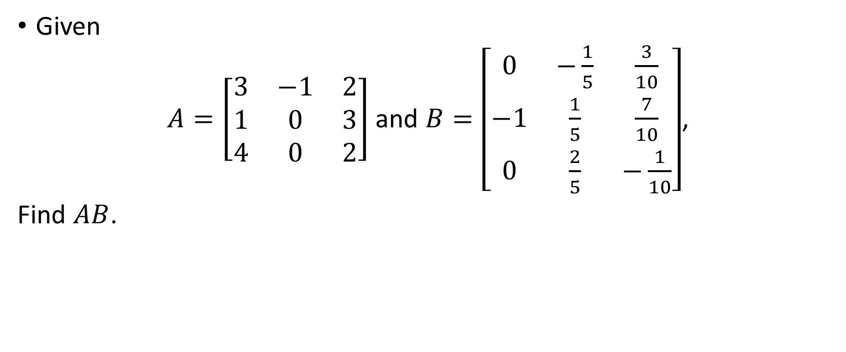
Example 1
Given
$A=\left[\begin{matrix}3 & −1 & 2 \\ 1 & 0 & 3 \\ 4 & 0 & 2\end{matrix}\right]$ and $B=\left[\begin{matrix}0 & −\frac{1}{5} & \frac{3}{10} \\ −1 & \frac{1}{5} & \frac{7}{10} \\ 0 & \frac{2}{5} & −\frac{1}{10}\end{matrix}\right]$,
Find $AB$.

Slide 11
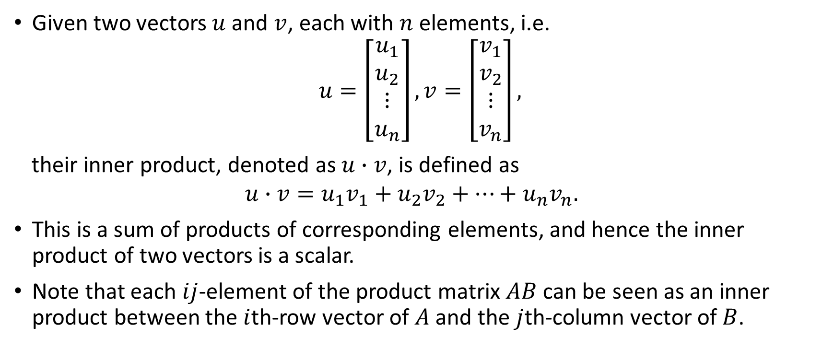
Inner Product
Given two vectors $u$ and $v$, each with $n$ elements, i.e.
$$u=\left[\begin{matrix}u_{1} \\ u_{2} \\ \begin{matrix}⋮ \\ u_{n}\end{matrix}\end{matrix}\right], v=\left[\begin{matrix}v_{1} \\ v_{2} \\ \begin{matrix}⋮ \\ v_{n}\end{matrix}\end{matrix}\right],$$
their inner product, denoted as $u∙v$, is defined as
$$u∙v=u_{1}v_{1}+u_{2}v_{2}+…+u_{n}v_{n}.$$
This is a sum of products of corresponding elements, and hence the inner product of two vectors is a scalar.
Note that each $ij$-element of the product matrix $AB$ can be seen as an inner product between the $i$th-row vector of $A$ and the $j$th-column vector of $B$.

Slide 12
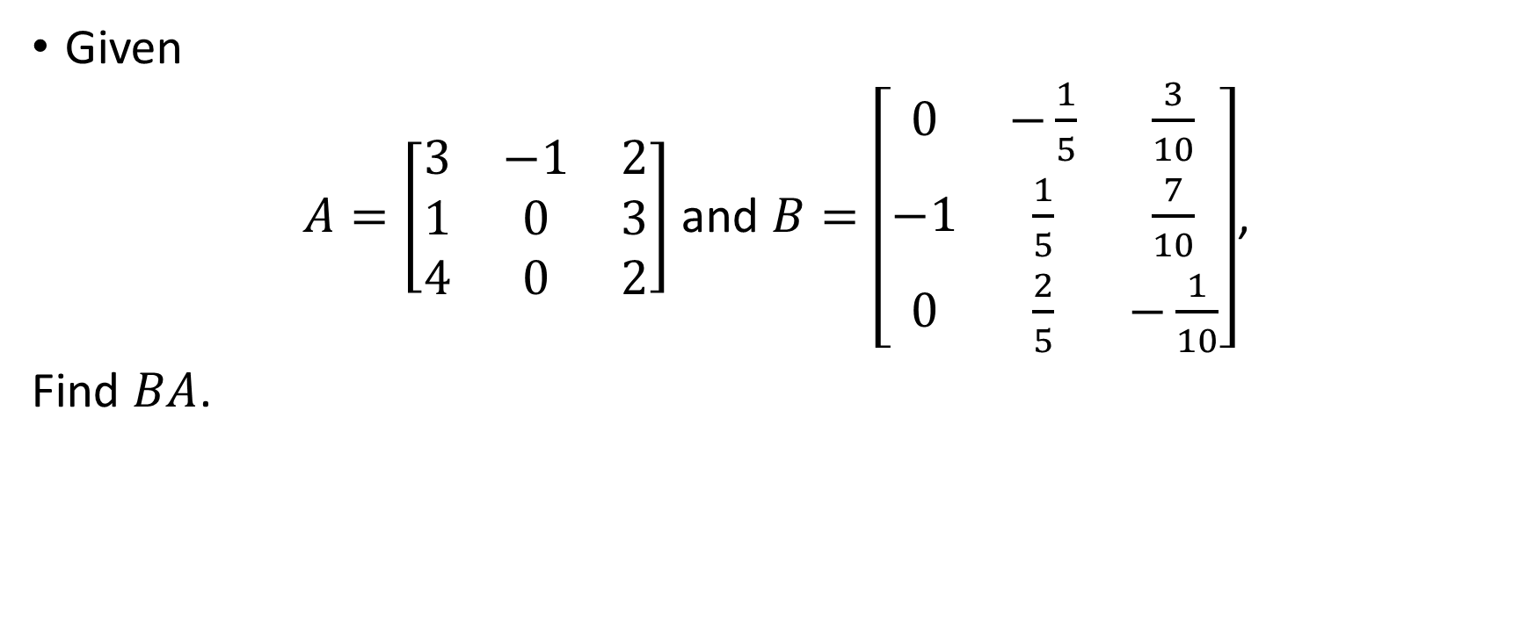
Example 2
Given
$A=\left[\begin{matrix}3 & −1 & 2 \\ 1 & 0 & 3 \\ 4 & 0 & 2\end{matrix}\right]$ and $B=\left[\begin{matrix}0 & −\frac{1}{5} & \frac{3}{10} \\ −1 & \frac{1}{5} & \frac{7}{10} \\ 0 & \frac{2}{5} & −\frac{1}{10}\end{matrix}\right]$,
Find $BA$.

Slide 13
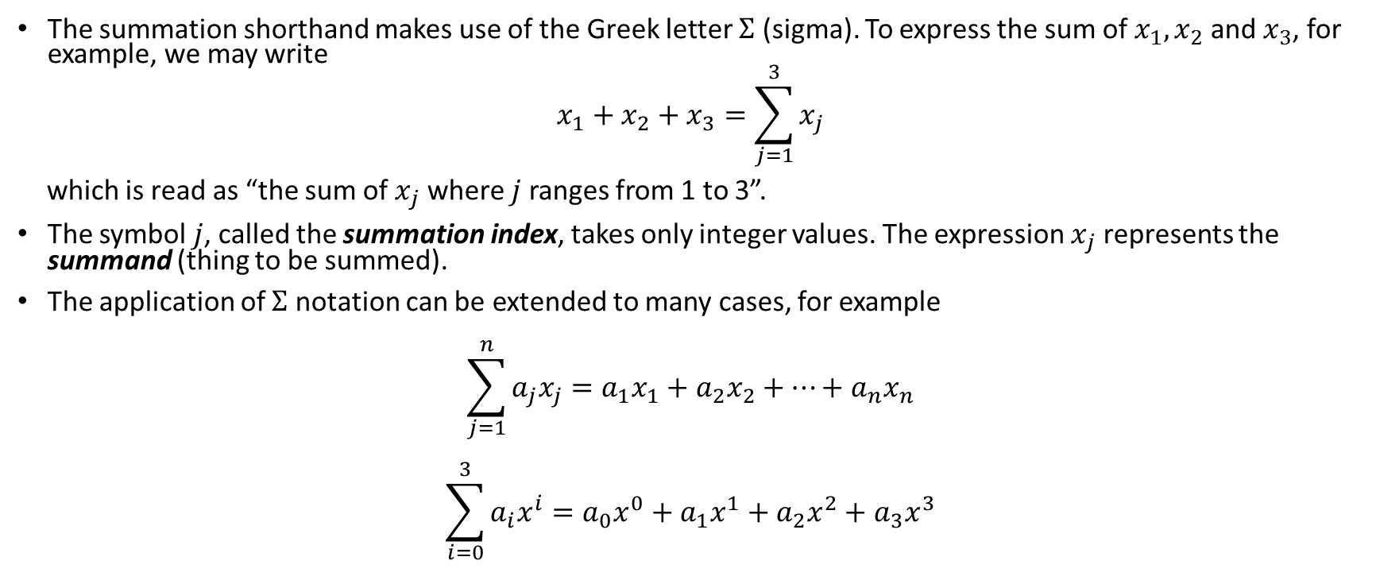

*The $Σ$ Notation
The summation shorthand makes use of the Greek letter $Σ$ (sigma). To express the sum of $x_{1},x_{2}$ and $x_{3}$, for example, we may write
$$x_{1}+x_{2}+x_{3}=\sum_{j=1}^{3}{x_{j}}$$
which is read as “the sum of $x_{j}$ where $j$ ranges from 1 to 3”.
The symbol $j$, called the summation index, takes only integer values. The expression $x_{j}$ represents the summand (thing to be summed).
The application of $Σ$ notation can be extended to many cases, for example
$$\sum_{j=1}^{n}{a_{j}x_{j}}=a_{1}x_{1}+a_{2}x_{2}+…+a_{n}x_{n}$$
$$\sum_{i=0}^{3}{a_{i}x^{i}}=a_{0}x^{0}+a_{1}x^{1}+a_{2}x^{2}+a_{3}x^{3}$$

Slide 14
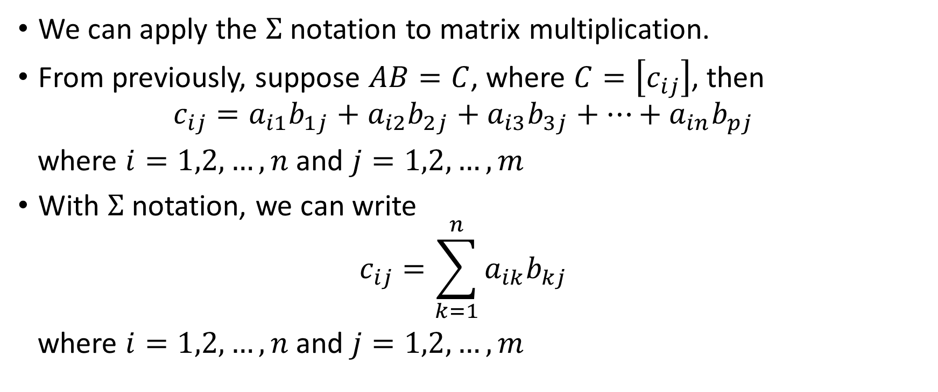
*The $Σ$ Notation
We can apply the $Σ$ notation to matrix multiplication.
From previously, suppose $AB=C$, where $C=\left[c_{ij}\right]$, then
$$c_{ij}=a_{i1}b_{1j}+a_{i2}b_{2j}+a_{i3}b_{3j}+…+a_{in}b_{pj}$$
where $i=1,2,…,n$ and $j=1,2,…,m$
With $Σ$ notation, we can write
$$c_{ij}=\sum_{k=1}^{n}{a_{ik}b_{kj}}$$
where $i=1,2,…,n$ and $j=1,2,…,m$

Slide 15
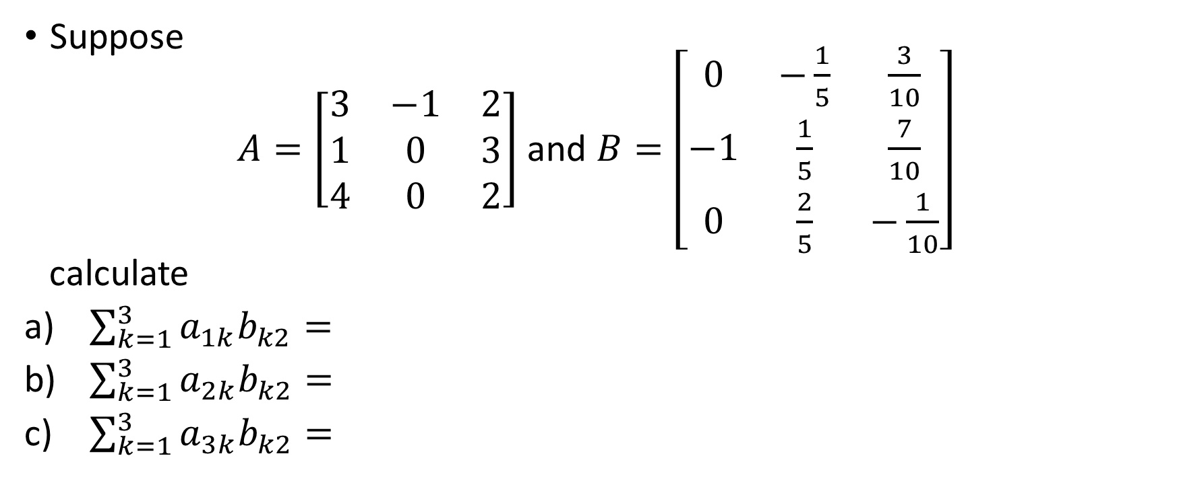
Example 3
Suppose
$A=\left[\begin{matrix}3 & −1 & 2 \\ 1 & 0 & 3 \\ 4 & 0 & 2\end{matrix}\right]$ and $B=\left[\begin{matrix}0 & −\frac{1}{5} & \frac{3}{10} \\ −1 & \frac{1}{5} & \frac{7}{10} \\ 0 & \frac{2}{5} & −\frac{1}{10}\end{matrix}\right]$
calculate
$\sum_{k=1}^{3}{a_{1k}b_{k2}}=$
$\sum_{k=1}^{3}{a_{2k}b_{k2}}=$
$\sum_{k=1}^{3}{a_{3k}b_{k2}}=$

Slide 16
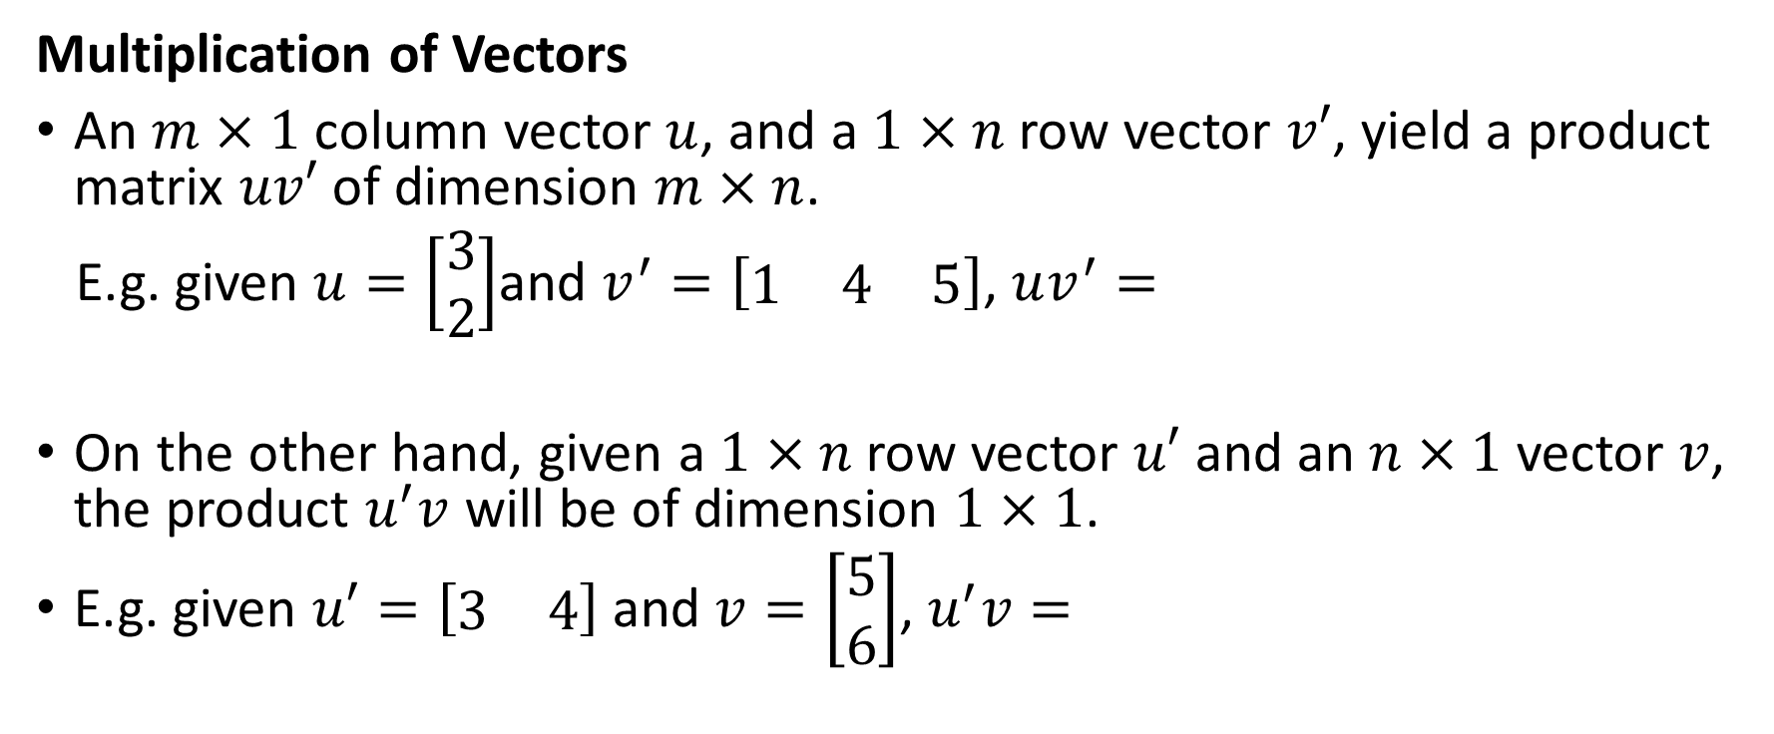
Notes on Vector Operations
Multiplication of Vectors
An $m×1$ column vector $u$, and a $1×n$ row vector $v′$, yield a product matrix $uv′$ of dimension $m×n$.
E.g. given $u=\left[\begin{matrix}3 \\ 2\end{matrix}\right]$and $v^{′}=\left[\begin{matrix}1 & 4 & 5\end{matrix}\right]$, $uv^{′}=$
On the other hand, given a $1×n$ row vector $u′$ and an $n×1$ vector $v$, the product $u^{′}v$ will be of dimension $1×1$.
E.g. given $u′=\left[\begin{matrix}3 & 4\end{matrix}\right]$ and $v=\left[\begin{matrix}5 \\ 6\end{matrix}\right]$, $u^{′}v=$

Slide 17
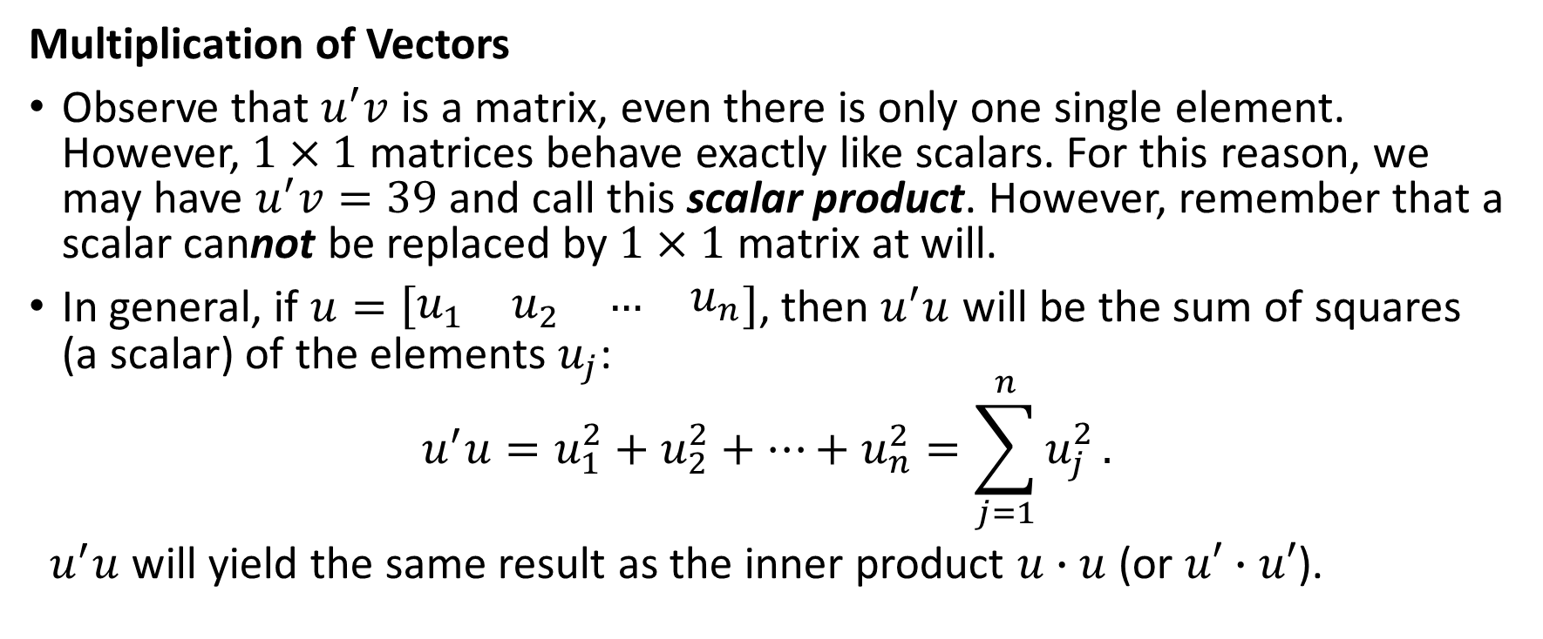
Notes on Vector Operations
Multiplication of Vectors
Observe that $u^{′}v$ is a matrix, even there is only one single element. However, $1×1$ matrices behave exactly like scalars. For this reason, we may have $u^{′}v=39$ and call this scalar product. However, remember that a scalar cannot be replaced by $1×1$ matrix at will.
In general, if $u=\left[\begin{matrix}u_{1} & u_{2} & \begin{matrix}… & u_{n}\end{matrix}\end{matrix}\right]$, then $u^{′}u$ will be the sum of squares (a scalar) of the elements $u_{j}$:
$$u^{′}u=u_{1}^{2}+u_{2}^{2}+…+u_{n}^{2}=\sum_{j=1}^{n}{u_{j}^{2}}.$$
$u^{′}u$ will yield the same result as the inner product $u∙u$ (or $u′∙u′$).

Slide 18
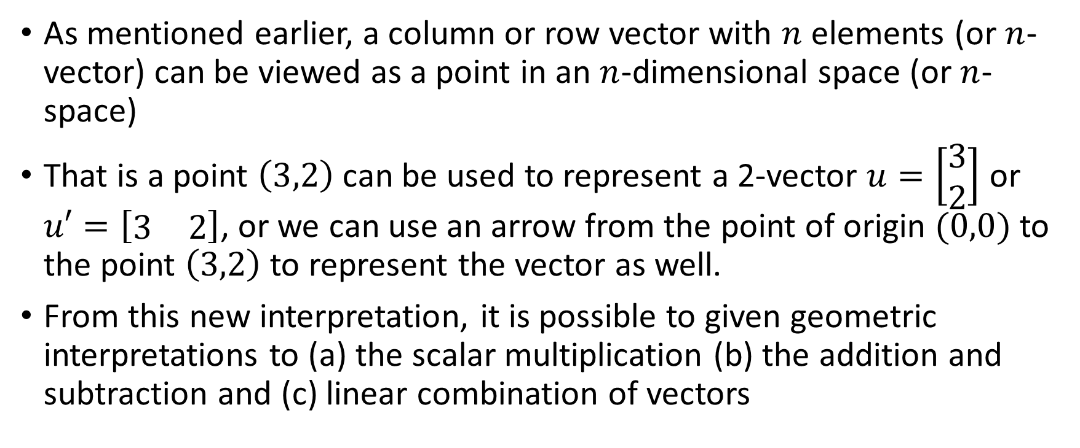
Geometric Interpretation of Vector Operations
As mentioned earlier, a column or row vector with $n$ elements (or $n$-vector) can be viewed as a point in an $n$-dimensional space (or $n$-space)
That is a point $\left(3,2\right)$ can be used to represent a 2-vector $u=\left[\begin{matrix}3 \\ 2\end{matrix}\right]$ or $u′=\left[\begin{matrix}3 & 2\end{matrix}\right]$, or we can use an arrow from the point of origin $(0,0)$ to the point $\left(3,2\right)$ to represent the vector as well.
From this new interpretation, it is possible to given geometric interpretations to (a) the scalar multiplication (b) the addition and subtraction and (c) linear combination of vectors

Slide 19
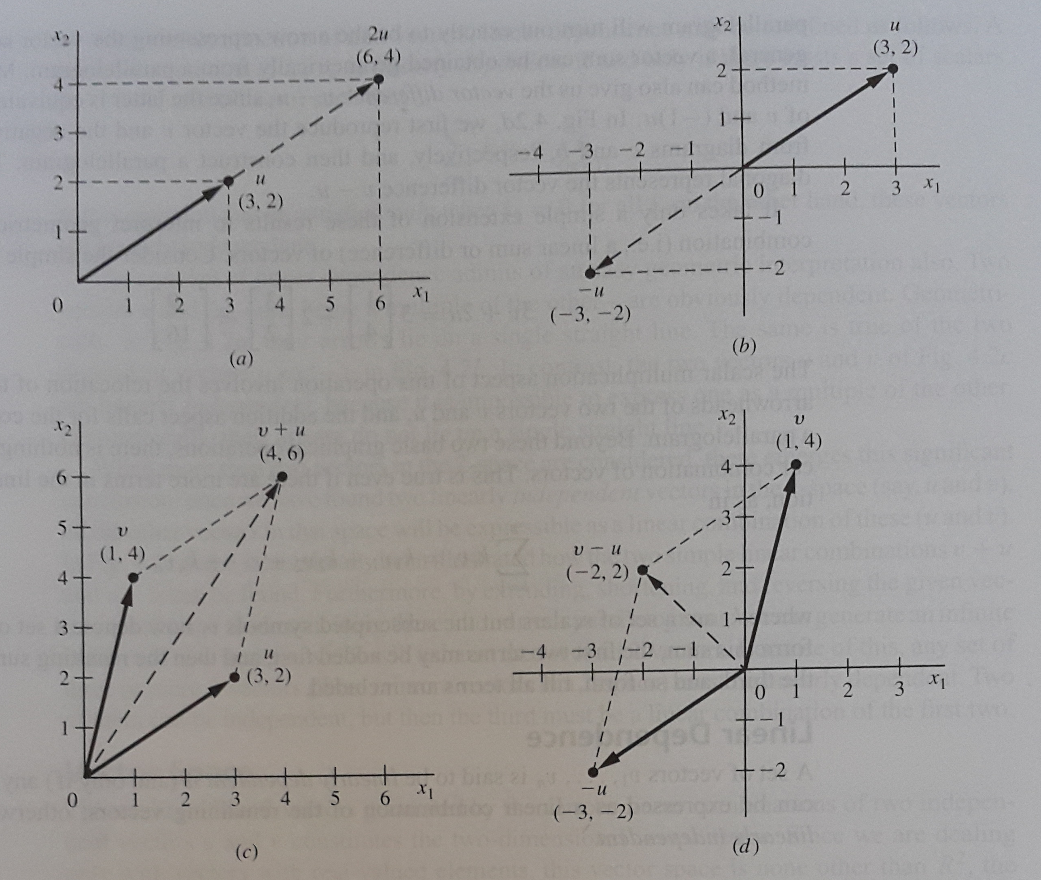

Slide 20
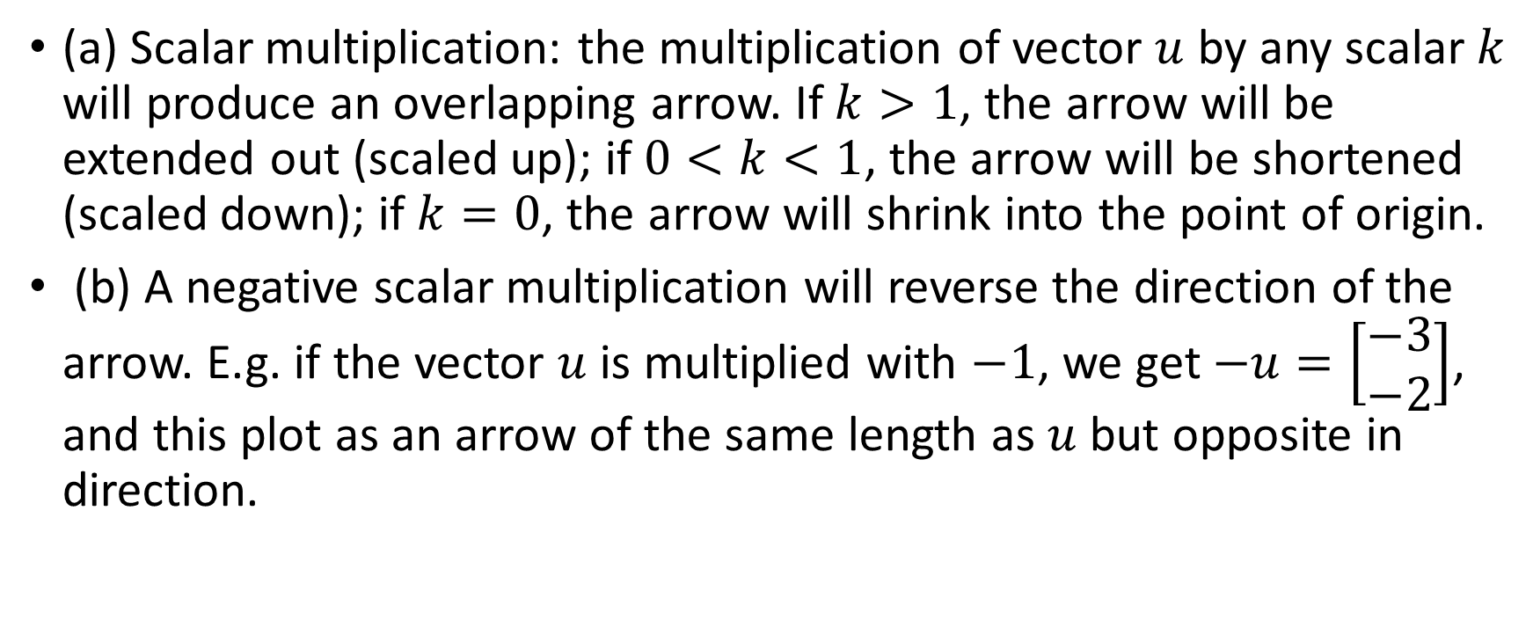
Geometric Interpretation of Vector Operations
(a) Scalar multiplication: the multiplication of vector $u$ by any scalar $k$ will produce an overlapping arrow. If $k>1$, the arrow will be extended out (scaled up); if $0<k<1$, the arrow will be shortened (scaled down); if $k=0$, the arrow will shrink into the point of origin.
(b) A negative scalar multiplication will reverse the direction of the arrow. E.g. if the vector $u$ is multiplied with $−1$, we get $−u=\left[\begin{matrix}−3 \\ −2\end{matrix}\right]$, and this plot as an arrow of the same length as $u$ but opposite in direction.

Slide 21
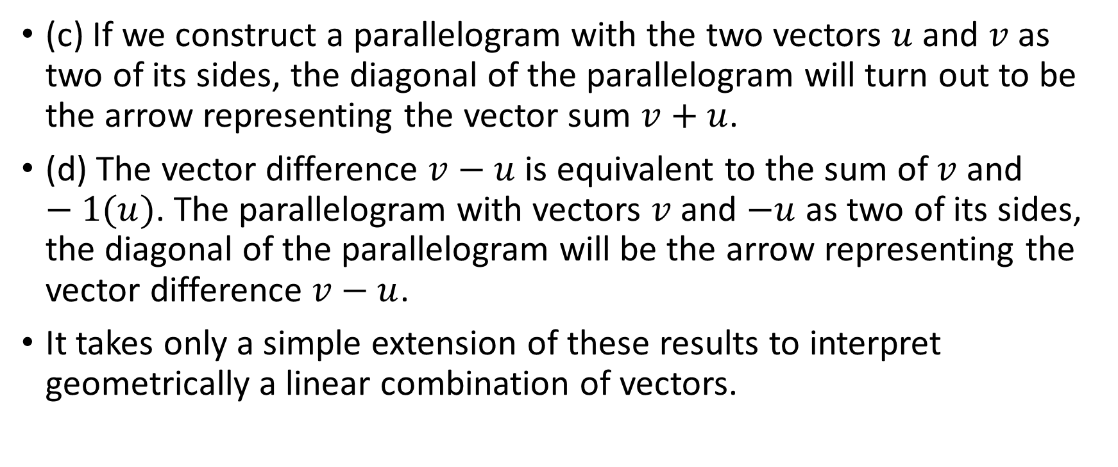
Geometric Interpretation of Vector Operations
(c) If we construct a parallelogram with the two vectors $u$ and $v$ as two of its sides, the diagonal of the parallelogram will turn out to be the arrow representing the vector sum $v+u$.
(d) The vector difference $v−u$ is equivalent to the sum of $v$ and $−1(u)$. The parallelogram with vectors $v$ and $−u$ as two of its sides, the diagonal of the parallelogram will be the arrow representing the vector difference $v−u$.
It takes only a simple extension of these results to interpret geometrically a linear combination of vectors.

Slide 22
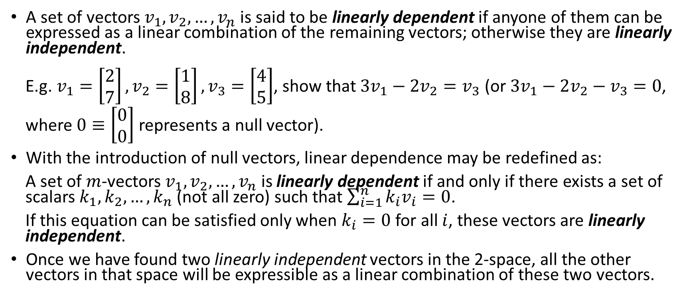
Linear Dependence
A set of vectors $v_{1},v_{2},…,v_{n}$ is said to be linearly dependent if anyone of them can be expressed as a linear combination of the remaining vectors; otherwise they are linearly independent.
E.g. $v_{1}=\left[\begin{matrix}2 \\ 7\end{matrix}\right],v_{2}=\left[\begin{matrix}1 \\ 8\end{matrix}\right],v_{3}=\left[\begin{matrix}4 \\ 5\end{matrix}\right]$, show that $3v_{1}−2v_{2}=v_{3}$ (or $3v_{1}−2v_{2}−v_{3}=0$, where $0≡\left[\begin{matrix}0 \\ 0\end{matrix}\right]$ represents a null vector).
With the introduction of null vectors, linear dependence may be redefined as:
A set of $m$-vectors $v_{1},v_{2},…,v_{n}$ is linearly dependent if and only if there exists a set of scalars $k_{1},k_{2},…,k_{n}$ (not all zero) such that $\sum_{i=1}^{n}{k_{i}v_{i}}=0$.
If this equation can be satisfied only when $k_{i}=0$ for all $i$, these vectors are linearly independent.
Once we have found two linearly independent vectors in the 2-space, all the other vectors in that space will be expressible as a linear combination of these two vectors.

Slide 23
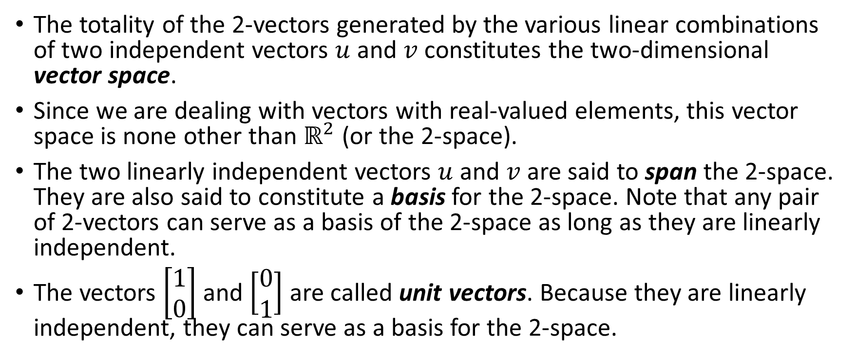
Vector Space
The totality of the 2-vectors generated by the various linear combinations of two independent vectors $u$ and $v$ constitutes the two-dimensional vector space.
Since we are dealing with vectors with real-valued elements, this vector space is none other than $ℝ^{2}$ (or the 2-space).
The two linearly independent vectors $u$ and $v$ are said to span the 2-space. They are also said to constitute a basis for the 2-space. Note that any pair of 2-vectors can serve as a basis of the 2-space as long as they are linearly independent.
The vectors $\left[\begin{matrix}1 \\ 0\end{matrix}\right]$ and $\left[\begin{matrix}0 \\ 1\end{matrix}\right]$ are called unit vectors. Because they are linearly independent, they can serve as a basis for the 2-space.

Slide 24
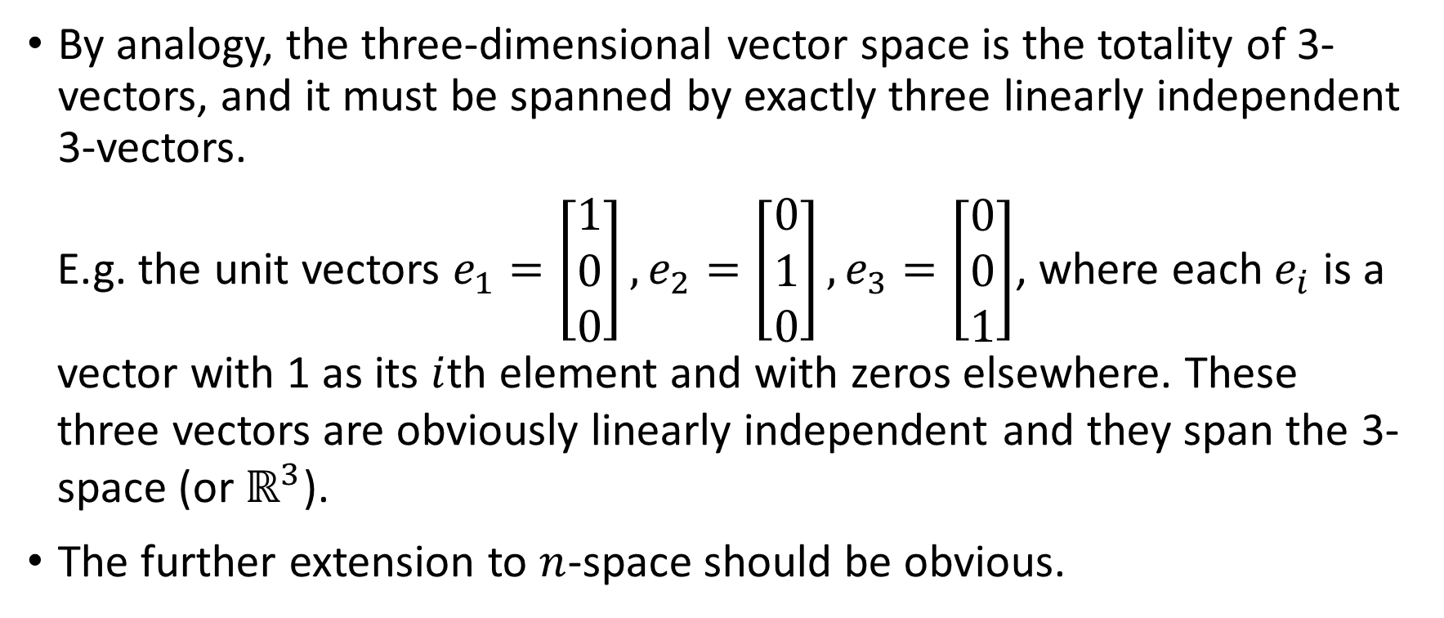
Vector Space
By analogy, the three-dimensional vector space is the totality of 3-vectors, and it must be spanned by exactly three linearly independent 3-vectors.
E.g. the unit vectors $e_{1}=\left[\begin{matrix}1 \\ 0 \\ 0\end{matrix}\right],e_{2}=\left[\begin{matrix}0 \\ 1 \\ 0\end{matrix}\right],e_{3}=\left[\begin{matrix}0 \\ 0 \\ 1\end{matrix}\right]$, where each $e_{i}$ is a vector with 1 as its $i$th element and with zeros elsewhere. These three vectors are obviously linearly independent and they span the 3-space (or $ℝ^{3}$).
The further extension to $n$-space should be obvious.

Slide 25
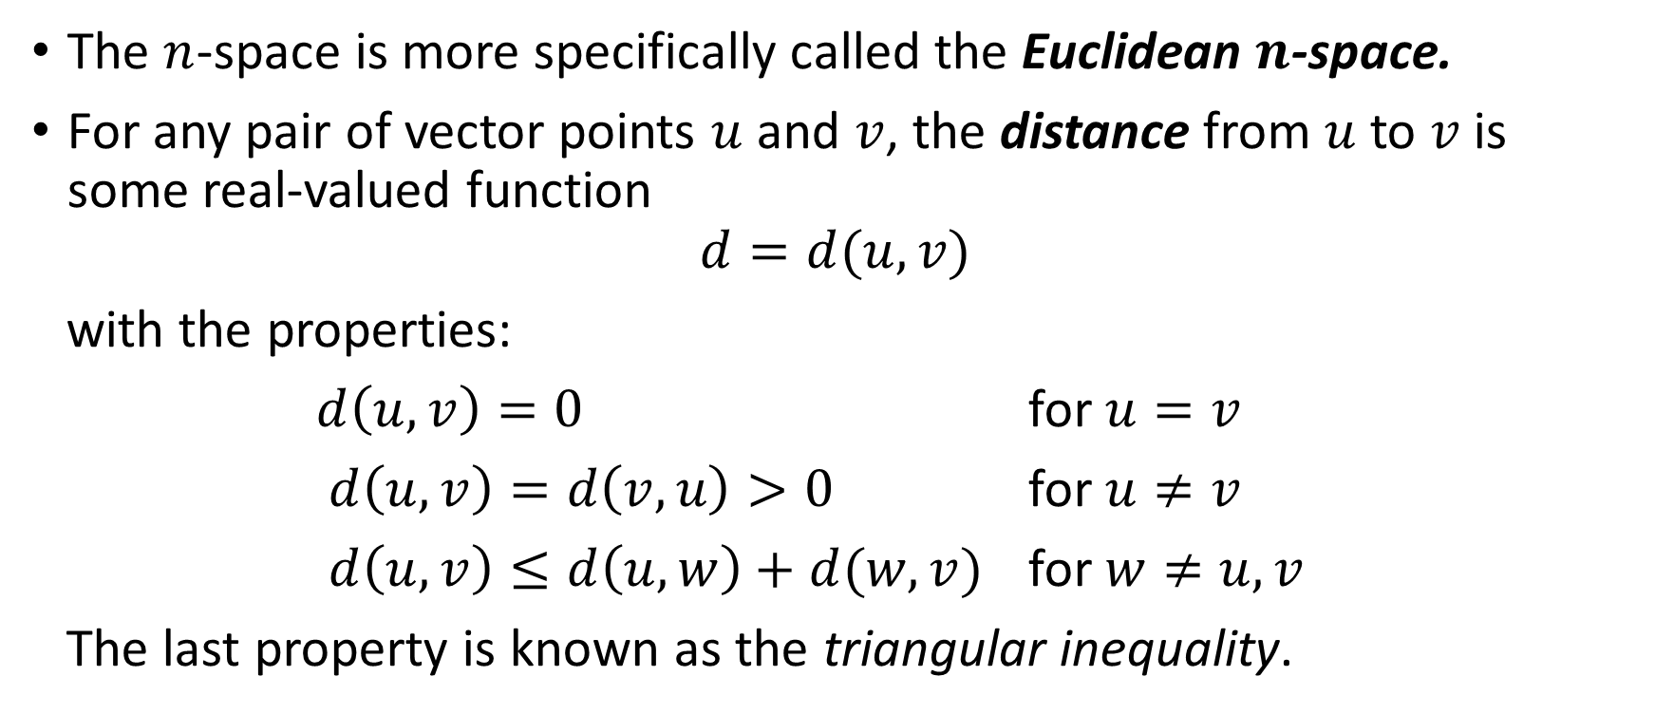
Euclidean Space
The $n$-space is more specifically called the Euclidean $n$-space.
For any pair of vector points $u$ and $v$, the distance from $u$ to $v$ is some real-valued function
$$d=d(u,v)$$
with the properties:
$d\left(u,v\right)=0$ for $u=v$
$d\left(u,v\right)=d\left(v,u\right)>0$ for $u≠v$
$d\left(u,v\right)≤d\left(u,w\right)+d(w,v)$ for $w≠u,v$
The last property is known as the triangular inequality.

Slide 26
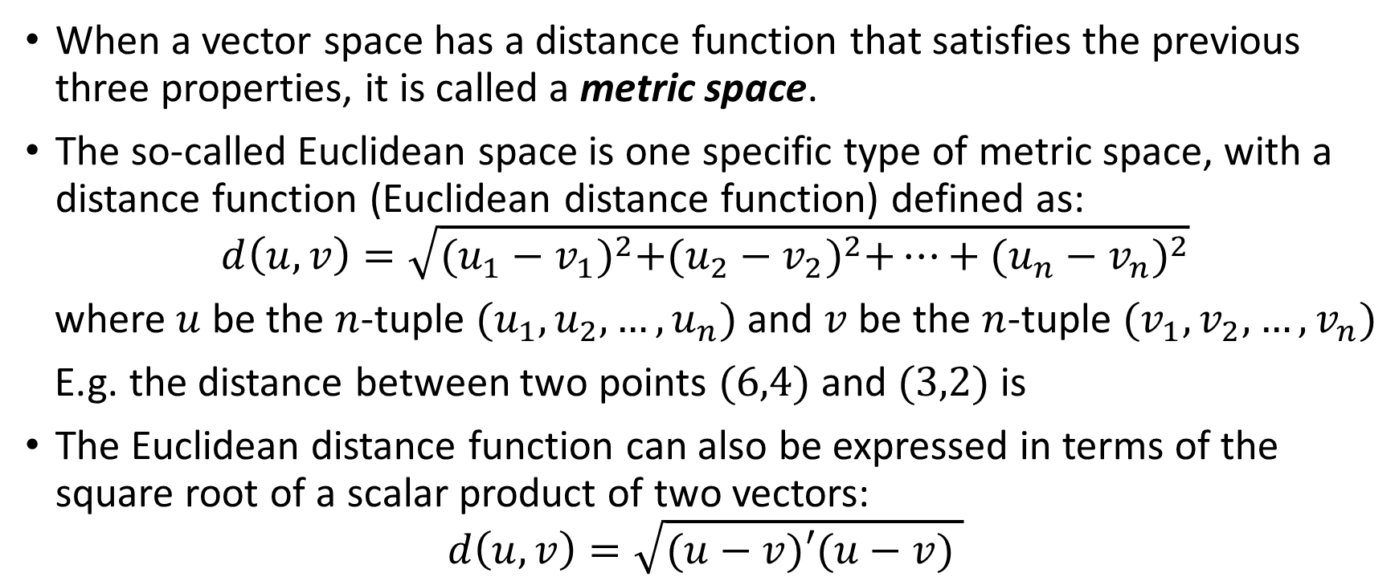
Euclidean Space
When a vector space has a distance function that satisfies the previous three properties, it is called a metric space.
The so-called Euclidean space is one specific type of metric space, with a distance function (Euclidean distance function) defined as:
$$d\left(u,v\right)=\sqrt{{(u_{1}−v_{1})}^{2}+{(u_{2}−v_{2})}^{2}+…+{(u_{n}−v_{n})}^{2}}$$
where $u$ be the $n$-tuple $(u_{1},u_{2},…,u_{n})$ and $v$ be the $n$-tuple $(v_{1},v_{2},…,v_{n})$
E.g. the distance between two points $(6,4)$ and $(3,2)$ is
The Euclidean distance function can also be expressed in terms of the square root of a scalar product of two vectors:
$$d\left(u,v\right)=\sqrt{(u−v)′(u−v) }$$

