Slide 1
4 New Concepts For Eggs

Slide 2
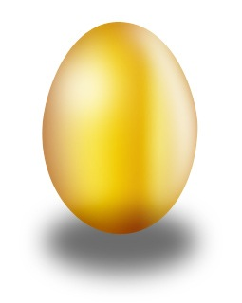
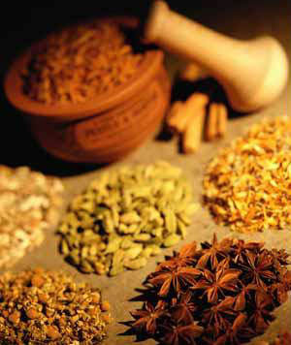
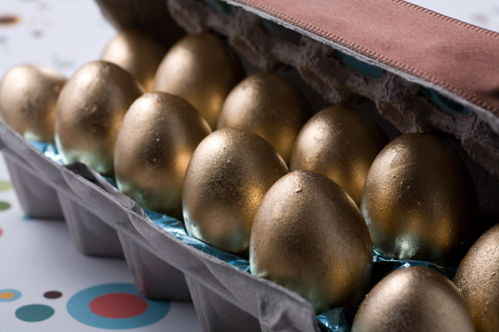
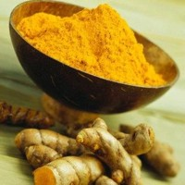

Concept 1: Beauty Egg
English Version:
You don’t have to eat salads every meal just to look and feel beautiful. Yes, we have a Beauty Egg just for your that will make your skin look so healthy and radiant, plus eating will be an extreme pleasure. The Beauty Egg which contains Tumeric known for centuries have always been an important part of Chinese herbal medicine and Ayurvedic medicine in India. Its main ingredient curcumin doesn’t only give a delicious golden shimmering coloring to the egg, but also is an antioxidant, lowers cholesterol levels and helps improve blood circulation. You’ll definitely have a delicious egg meal packed with natural proteins and antioxidants guaranteed to give your skin a healthy glow. You could choose to buy eggs that come both in raw form so you to cook according to your recipes and hard boiled to be readily eaten. The egg costs 29 Baht each.
Thai Version

Slide 3
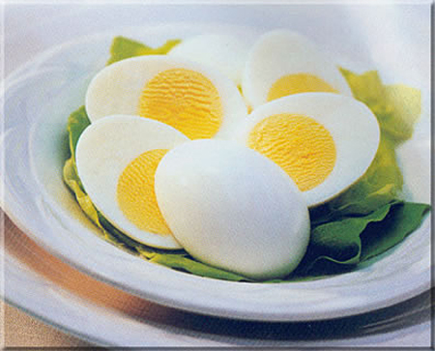

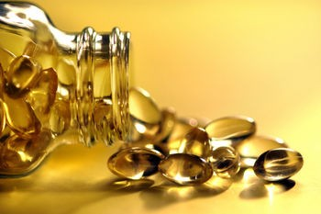

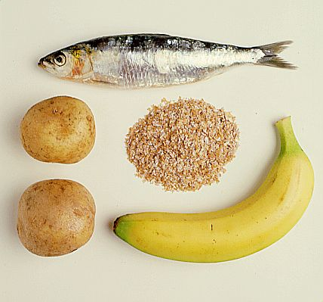
Concept 2:Brain Booster Egg
English Version:
Some people weren’t born smart or some just want to be smarter! But do you know that healthy eating makes the brain function better? Yes we have the Brain Booster Egg, with concentrated Vitamin B Complex essential for the healthy functioning of the nervous system and helps improve memory. So with just one egg, you could work smarter and feel less tired since the Brain Booster Egg will also provide essential proteins to recharge you with energy throughout the day. The savoring tastes of rich Vitamin B with proteins makes the yolk a natural delight! Why not eat smarter and live smarter? You could choose to buy eggs that come both in raw form so you to cook according to your recipes and hard boiled to be readily eaten. The egg costs 29 Baht each.
Thai Version:

Slide 4
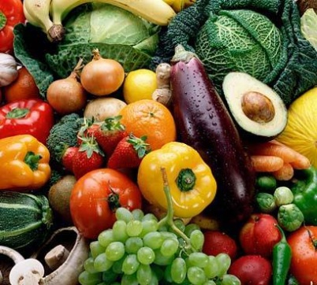

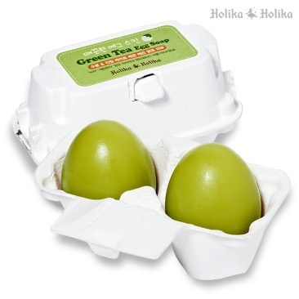
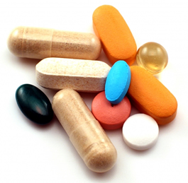

Concept 3: Nutritional Egg
English Version
Are you always on the go? No time to eat? What a pity, picking up junk food on the way work just to eat in 5 minutes.? Well, we have just the solution for you! Our Nutritional Egg with concentrated vegetables and multi-vitamins to give you a full meal in just one egg. Guaranteed to satisfy your hunger as the ingredients will also make you healthier, prevent deficiency, and relieve stress . Also for those of you who don’t like eating vegetables, this is a chance for you to eat as much veggies as you want in a single egg which comes in a appetizing green natural color and taste eaten any time of the day. Both delicious and full of nutrients ,you could choose to buy eggs that come both in raw form so you to cook according to your recipes and hard boiled to be readily eaten. The egg costs 29 Baht each.
Thai Version:

Slide 5
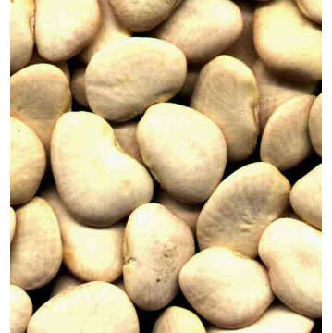

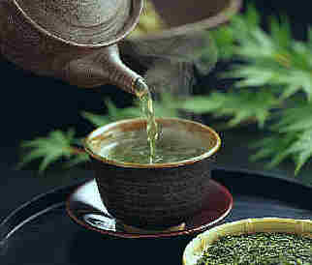
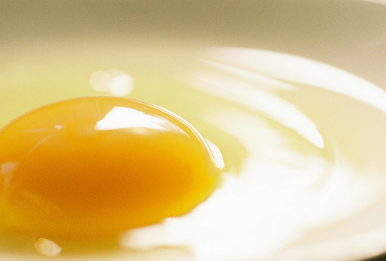

Concept 4:Diet Egg
English Version
Can’t seem to loose weight again? The challenge remains tough for women to both loose weight and maintain it. We have a Diet Egg that doesn’t only help you loose weight but also satisfies your appetite. Packed with White beans and Green tea. White beans are low in calories, high in fiber and the best part release fiber slowly into your blood stream, making you fuller longer….As for Green tea, it contains a powerful antioxidant known as epigallocatechin gallate (EGCG), which has been shown to elevate metabolic rate for increased lipolysis, or fat burning. So with a superb combination of White beans and Green tea both natural and safe you could loose weight faster and be beautifully fit! Why not loose weight with a deliciously natural tasting Diet Egg to satisfy your hunger pains as its protein and fiber enriched ingredients will become part of your life. You could choose to buy eggs that come both in raw form so you to cook according to your recipes and hard boiled to be readily eaten. The egg costs 29 Baht each.
Thai Version:

